Slide 1
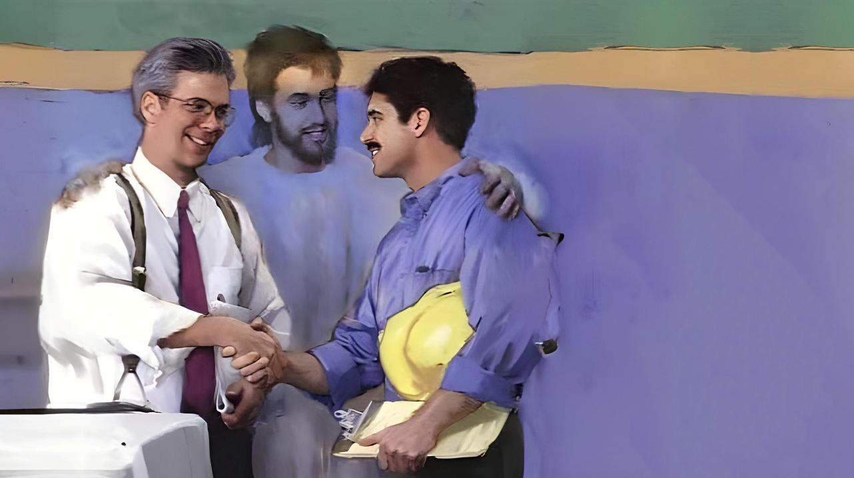
Icyigisho cya 12 cyo ku wa 21 Werurwe 2026
KUBANA N’ABANDI

Slide 2
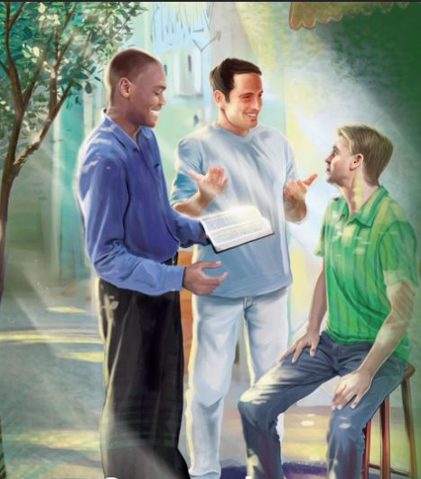
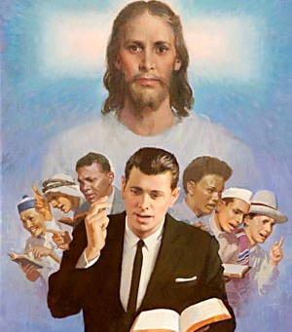
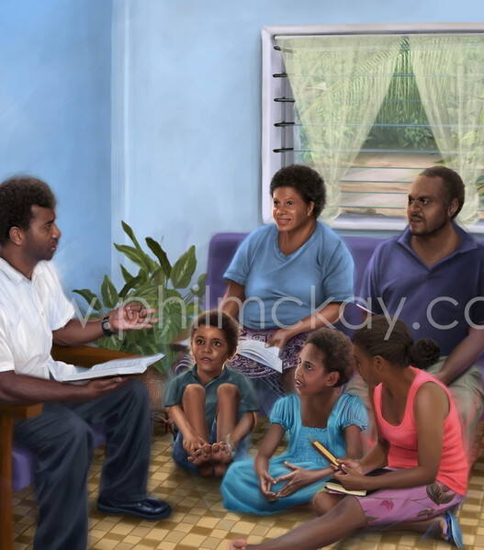
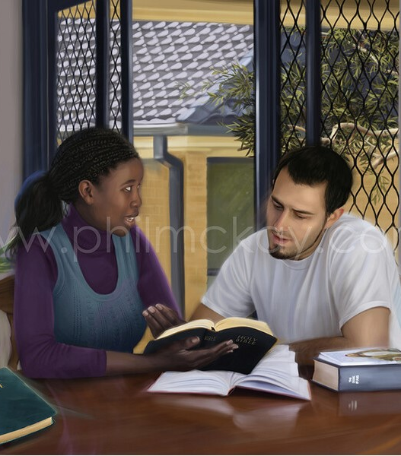
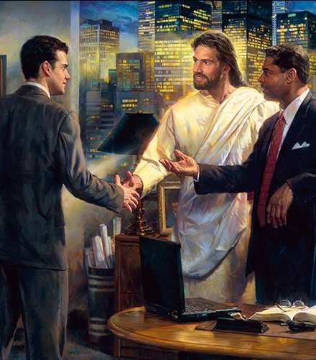
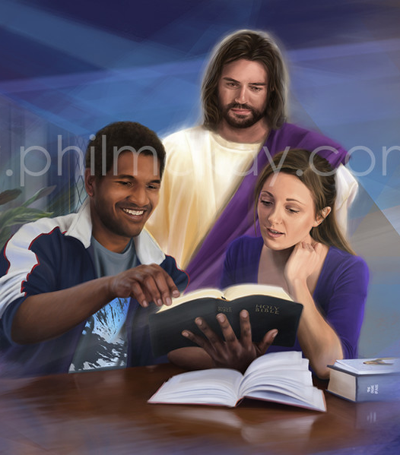
“Ijambo ryanyu rifatanye iteka n’ubuntu bw’Imana risize umunyu, kugira ngo mumenye uko mukwiriye gusubiza umuntu wese” Abakolosayi 4:6

Slide 3


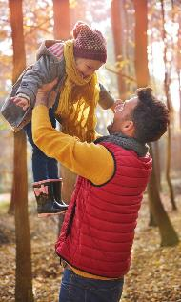

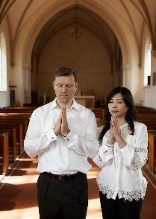

Mu mugabane w’urwandiko rw’Abakolosayi ugendereye inama-ngiro, Pawulo avuga ku ngingo y’imibanire y’abantu mu nzego zitari zimwe.
Imibanire itera amakimbirane n’impaka. Bityo rero, hakenewe ubwumvikane, amasezerano rusange ku micombonera, imigambi, n’intego.
Pawulo aduha amahame y’ingirakamaro yo kunoza imibanire hagati y’abashakanye, hagati y’ababyeyi n’abana, hagati y’imbata na ba shebuja, hagati y'abavandimwe mu itorero, ndetse no hagati y’abizera n’abatizera.
Imibanire hagati y’abashakanye (Abakolosayi 3:18–19)
Imibanire hagati y’ababyeyi n’abana (Abakolosayi 3:20–21)
Imibanire hagati y’abakoresha n’abakozi (Abakolosayi 3:22–25; 4:1)
Imibanire mu Itorero (Abakolosayi 4:2–4)
Imibanire n’abatizera (Abakolosayi 4:5–6)

Slide 4




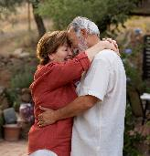


IMIBANIRE HAGATI Y’ABASHAKANYE
“Bagore, mugandukire abagabo banyu nk’uko bikwiriye abari mu Mwami wacu. Bagabo, namwe mukunde abagore banyu ntimubasharirire.” (Abakolosayi 3:18–19)
Inzandiko z’Abakolosayi n’Abefeso zanditswe mu gihe kimwe, zirimo inama zisa (kandi zuzuzanya) ku bijyanye n’abashakanye (Abakolosayi 3:18–19; Abefeso 5:21–33).
Abagore bagandukira abagabo babo (Abakolosayi 3:18; Abefeso 5:22–24)
Uku kuganduka kugomba kuba magirirane (Abefeso 5:21), kandi kugomba kuba “nk’uko bikwiriye mu Mwami.”
Abagabo bagomba gukunda abagore babo (Abakolosayi 3:19; Abefeso 5:28)
Kubakunda urukundo nk’urwo Kristo yadukunze (Abefeso 5:25)
Bagomba kwita ku kubaho neza kwabo (Abefeso 5:29)
Ntimukabasharirire (kutabarakaza, kwirinda gusharira cyangwa urugomo, igitugu)
Abashakanye bombi bagomba gukorera hamwe, bakajya inama, kandi bagafata ibyemezo ku bwumvikane, umugabo akaba ari we muyobozi ukwiriye w’umuryango. Buri wese agomba guhora ashakira mugenzi we imibereho myiza.

Slide 5

“Buri wese atange urukundo mu cyimbo cyo kurusaba. Mukuze muri mwe iby’igikundiro bihebuje byose, kandi mwihutire guhamya ibyiza mubona mu bandi. Kwiyumvamo gushimwa ni ikintu cyiza kandi kinezeza. Ineza no kubahwa bitera imbaraga zo guharanira ibyiza biruseho, kandi urukundo ubwarwo ruriyongera rukarushaho guharanira kugera ku rugero rusumbyeho. […]
Umugore agomba kubaha umugabo we. Umugabo agomba gukunda no kwita ku mugore we; kandi nk’uko indahiro yabo y’ugushyingiranwa ibahuza nk’umwe, ni ko no kwizera Kristo kwabo kugomba gutuma baba umwe muri We. Ni iki gishobora gushimisha Imana kuruta kubona abinjira mu mubano w’abashyingiranywe bashakira hamwe kwiga ibya Yesu no kurushaho kuzura Umwuka We?
E.G. White, The Adventist Home, pp. 107, 114

Slide 6




IMIBANIRE HAGATI Y’ABABYEYI N’ABANA
“Bana, mwumvire ababyeyi banyu muri byose, kuko ibyo ari byo Umwami ashima. Ba se, ntimukarakaze abana banyu batazinukwa. (Abakolosayi 3:20–21)
Mu muryango-mugari wa none, ijambo “ababyeyi” rikwiriye gukoreshwa haba ku bashakanye basanzwe ndetse no ku miryango ifite umubyeyi umwe. Nk’uko Pawulo abivuga, imibanire myiza si inshingano z’ababyeyi gusa, ahubwo ni n’iz’abana ubwabo.
Inshingano z’abana (abahungu n’abakobwa) (Abakolosayi 3:20; Abefeso 6:1–3)
Kumvira kw’abana si icyo bahitamo cyangwa ntibagihitemo
Uku kumvira gushingiye ku itegeko rya gatanu
Byongeye kandi, kumvira guherekezwa n’ingororano yako
Inshingano za kibyeyi (Abakolosayi 3:21; Abefeso 6:4)
Kubigisha utabatesheje agaciro cyangwa ngo ubarakaze, ukirinda kubaca intege
Kwirinda kubarakaza bitewe no kutihangana cyangwa umwaga
Kubigisha inzira z’Imana (Gutegeka 6:6–7; Imigani 22:6)
Gusenga mu muryango mu gitondo na nimugoroba ni ingenzi ku bana bacu kugira ngo bige iby’Imana kandi banzure ibizabageza ku bugingo buhoraho. Ntitwibagirwe ko urugero rwacu ari rwo mwarimu ukomeye w’abana bacu.

Slide 7

“Babyeyi, nimureke abana banyu babone ko mubakunda kandi ko mukora ibishoboka byose kugira ngo mubashimishe. Nimukora mutyo, ni bwo kugira ibyo mubabuza gukora bizagira uburemere bwinshi mu bwenge bwabo bukiri buto. Muyobore abana banyu mu bugwaneza n’impuhwe, mwibuka ko ‘abamarayika babo bo mu ijuru bahora bareba mu maso ha Data wo mu ijuru.’ Niba mwifuza ko abamarayika bakorera abana banyu umurimo Imana yabashinze, nimufatanye nabo mukora uruhare rwanyu.”
E.G. White, The Adventist Home, p. 193

Slide 8



IMIBANIRE HAGATI Y’ABAKORESHA N’ABAKOZI
“Mbata, mwumvire ba shobuja bo ku mubiri muri byose, ntimubakorere bakibareba gusa ngo muse n’abanezeza abantu, ahubwo mubakorere mutaryarya mu mitima yanyu mwubaha Imana.” (Abakolosayi 3:22)
Isano y’ububata yariho mu gihe cya Pawulo ntaho ihuriye n’ubwoko bw’ubucakara, ikibabaje, bukibaho na bugingo n’ubu. Kubw’ibyo, tugomba gusobanukirwa n’iyi nama mu rwego rw’imibanire y’umuyobozi n’uyoborwa.
Imyitwarire y’abayoborwa (Abakolosayi 3:22–25; Abefeso 6:5–8)
Iteka ryose, gukora ibyiza n’ubwo nta waba akureba
Haranira kuba indashyikirwa mu murimo wawe, nk’aho ukorera Imana
Emera gukeburwa, iyo bifite ishingiro
Umurimo mwiza ugira inyiturano
Kugira umuyobozi mubi ntibiduha urwaho rwo kutumvira (1Petero 2:18)
Imyitwarire y’abayobozi (Abakolosayi 4:1; Abefeso 6:9)
Kuyoborana ubutabera n’ugukiranuka
Ntugakoreshe ibikangisho cyangwa umwaga
Buri mukoresha afite Umukoresha we, uzamubaza ibyo yakoze
Twese, baba abakoresha cyangwa abayoborwa, turi abagaragu ba Kristo, kuko tumukorera.

Slide 9

“Ntabwo wari umurimo wa Pawulo guhita ahindura gahunda yari yarashyizweho mu bwami bw’Abaroma. Kugerageza gukora ibi byari ukudindiza umurimo wo kwamamaza ubutumwa bwiza. Ariko yigishije amahame yototeraga urufatiro rwo gukoresha abantu agahato, kandi iyo aya mahame akurikizwa yari gutuma iyo mikorere yose isenyuka buhoro buhoro. […]
Ubukristo ni umurunga ukomeye uhuza umugaragu na shebuja, umwami n’uwo ayobora, umuvugabutumwa bwiza n’umunyabyaha w’insuzugurwa wabonye guhanagurwaho icyaha muri Kristo. Bose buhagiwe mu maraso amwe, bayoborwa na Mwuka umwe; kandi bagizwe umwe muri Kristo Yesu.
E.G. White, Ibyakozwe n’Intumwa, p. 284

Slide 10


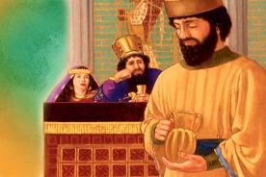
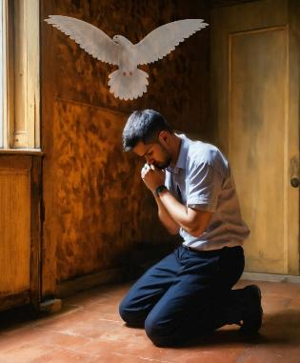
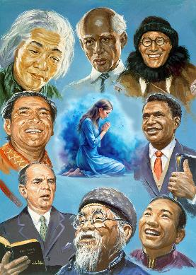
IMIBANIRE MU ITORERO
“Mukomeze gusenga muba maso, mushima” (Abakolosayi 4:2)
Dusabwa “gusengera abandi” kuko “gusenga k’umukiranutsi kugira umumaro mwinshi” (Yakobo 5:16).
Uretse gusenga mu gitondo na nimugoroba, Pawulo adusaba gusenga igihe cyose (Abakolosayi 4:2; Abefeso 6:18; 1 Abatesalonike 5:17). Nk’uko Nehemiya yasenze bucece imbere y’umwami (Nehemiya 2:4), dufite amahirwe yo gusengera ahantu hose cyangwa mu bihe ibyo ari byo byose.
Byongeye kandi, twizera ko Umwuka Wera azahindura isengesho ryacu ngo rigire umumaro (Abaroma 8:26).
Pawulo atanga icyifuzo cyihariye cyo gusengera abavuga ubutumwa bwiza (Abakolosayi 4:3–4; Abefeso 6:19). Ntacyo bivuze kuba umubwiriza afite ubunararibonye buke cyangwa bwinshi mu ivugabutumwa; nta muntu uhagije kuri uyu murimo. Pawulo ubwe ntiyasenze gusa, ahubwo yanasabye abavandimwe kumusengera kugira ngo amagambo ye abe akwiriye.

Slide 11

“Mu bikorwa byose ahantu hose ukuri kwamenyekanishijwe, hakenewe guhinduka mu bitekerezo, impano, imigambi ndetse n’uburyo bwo gushyira hamwe mu murimo. Bose bagomba guhūza inama, bagasengera hamwe. Kristo aravuga ati: ‘Kandi ndababwira yuko ababiri muri mwe nibahuza umutima mu isi wo kugira icyo basaba cyose, bazagikorerwa na Data wo mu ijuru.’ (Matayo 18:19)”
E.G. White, Selected Messages (Ubutumwa Bwatoranyijwe), vol. 3, p. 24

Slide 12

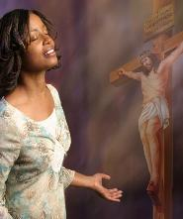
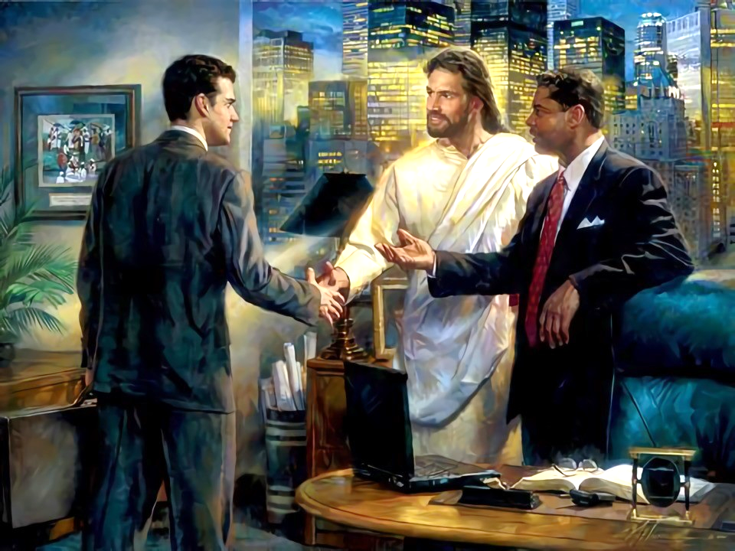
IMIBANIRE N’ABATIZERA
“Mugendere mu bwenge ku byo mugirira abo hanze, mucunguze uburyo umwete.” (Abakolosayi 4:5)
Dufite ihirwe rikomeye: twize ibyo Yesu yadukoreye, twarabyemeye, kandi dufite ubwishingizi bw’agakiza.
Ibi tubizi kuko hari uwabitubwiye. Mu buryo nk’ubwo, tugomba kubisangira n’abandi. Pawulo avuga ko twagombye kubana dute n’“abo hanze,” abataramenya Yesu (Abakolosayi 4:5–6)?
Tugendera mu bwenge
Dukeneye “ubwenge buva mu ijuru” (Yakobo 3:17) mu mibanire yacu n’abataramenya Yesu
Dukoresha amagambo y’ubuntu
Amagambo yacu agomba guhora ari meza kugira ngo abantu batwumve bishimye.
Amagambo “asize umunyu”
Ikiganiro kigomba kuba gikwiriye kandi gihujwe n’umuntu tubwira n’ahamukikije.
Dusubiza umuntu wese uko bikwiriye
Kubera ko buri muntu yihariye, Umwuka Wera azatuyobora ku cyo tugomba gusubiza muri buri mwanya.

Slide 13

“Ubupfura nyakuri bukubiranye n’ukuri n’ubutabera bituma imibereho itagira umumaro gusa, ahubwo inagira impumuro nziza kandi itāma hose. Amagambo meza, indoro nziza, mu maso huje ineza, bituma Umukristo agira igikundiro, bigatuma adashobora kwirengagizwa. Mu kwiyibagirwa, mu mucyo n’amahoro n’ibyishimo ahora aha abandi, aboneramo ibyishimo nyakuri.
Nimutyo tureke kwihugiraho, duhoze umutima ku gushimisha abandi, tubatura imitwaro yabo dukoresheje imirimo y’ubugwaneza n’ibikorwa by’urukundo ruzira inarijye.”
E.G. White, In Heavenly Places, June 22

