Slide 1
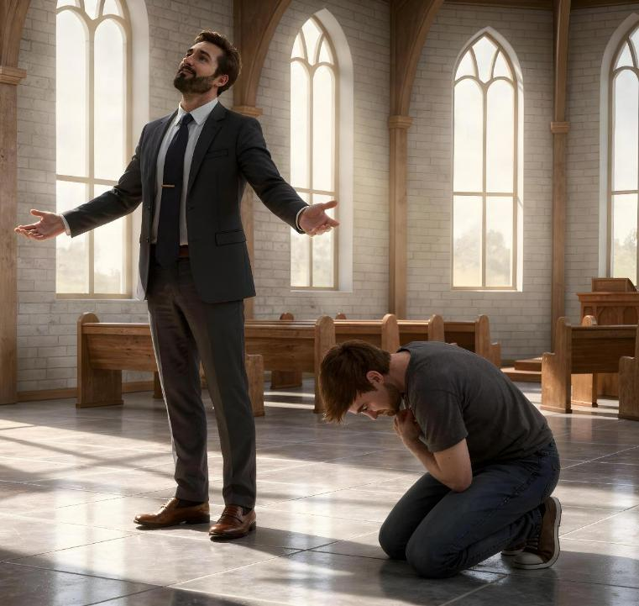
KWISHYIRA HEJURU UBIGERERANYIJE NO KWICISHA BUGUFI
Icyigisho cya 3 cyo ku wa 18 Mata 2026

Slide 2

“Kuko umuntu wese wishyira hejuru azacishwa bugufi, kandi uwicisha bugufi azashyirwa hejuru”
(Luka 14:11)

Slide 3

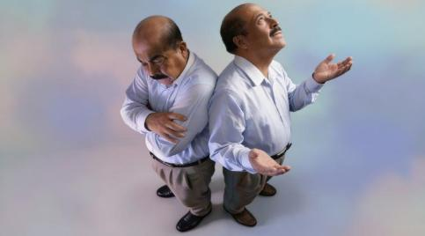
Kuri jye ni iki gifite agaciro? Icyo ni ikibazo kigoye gusubiza.
Iyo mvuze byinshi (mu buryo bw’ubwibone), mba nemera ko uwo ndi n’ibyo mfite byose nabyigejejeho ubwanjye.
Bite se, mvuze byinshi kuko Imana imbona nk’umwana wayo?
Iyo ntagize icyo mvuga (mu buryo bwo kwicisha bugufi), mba nemera ko uwo ndi n’ibyo mfite byose bituruka ku Mana.
Bite se, ntagize icyo mvuga kuko ntumva ko mfite agaciro?
Ingero zo kwishyira hejuru
Lusiferi
Abigishwa ba Yesu
Ingero zo kwicisha bugufi
Umukoresha w’ikoro
Mose
Yesu, We cyitegererezo

Slide 4

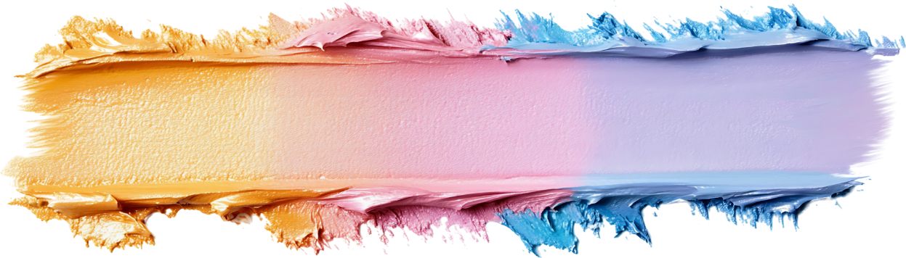
INGERO ZO KWISHYIRA HEJURU

Slide 5





LUSIFERI
“Kuko ikiri mu isi cyose ari irari ry’umubiri ari n’irari ry’amaso, cyangwa kwibona ku by’ubugingo bidaturuka kuri Data wa twese, ahubwo bituruka mu isi” (1 Yohana 2:16)
Niba tuvuga ubwibone, tugomba kuvuga uwo iki kintu cyagaragariyemo bwa mbere: Lusiferi. Yahisemo kutanyurwa n’umwanya we, ahubwo ashaka kujya ku wo hejuru. Nyuma y’igihe, yifuje gushyirwa hejuru cyane ku buryo yifuje kwicara ku ntebe y’ubwami y’Imana (Yesaya 14:12–14).
“Twarazwe” icyifuzo cyo gukora icyo ari cyo cyose kitunejeje, gutunga icyo dushaka cyose, no kubona imyanya iduhesha kuba ibyamamare cyangwa ubutunzi. Ibyo ni byo isi iduha! (1 Yohana 2:16).
Ariko ibyifuzo byose si ko biba ari ukwishyira hejuru. Kuba umwana yanyurwa n’ibyo agezeho, cyangwa kuba umuntu yagira intego ye bwite, si ngombwa ko byaba ari ishema ritari ryiza.
Ikintu cy’ingenzi tugomba kwibuka ni uko ubutunzi bwacu, ubuhanga bwacu, n’ibyo twagezeho atari byo bigena agaciro kacu. Ubwibone bukubiyemo no kudaha Imana icyubahiro ku byo idukorera mu mibereho yacu.

Slide 6



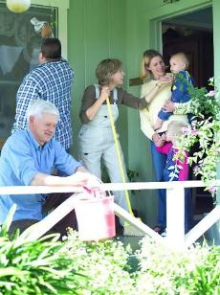

ABIGISHWA BA YESU
“Maze habyuka impaka muri bo, ngo ni nde muri bo ukwiriye gutekerezwa ko ari we mukuru” (Luka 22:24)
Bari bamaranye na Yesu imyaka irenga itatu. Yari amaze kubōza ibirenge no kubabwira iby’amaraso Ye yajyaga kumeneka ku bwa bose. Nyamara, ubwo basangiraga ifunguro, ikiganiro cyabo ntaho cyari gihuriye n’ibi byose: ni nde muri bo wari mukuru? (Luka 22:24).
Ubwibone bwabo bwabateye kumva ko bakwiriye umwanya wa mbere. Ntibasobanukiwe uburemere bw’ibyiyumvo byabo. Kwishyira hejuru kwabo kwarimo kwirukana Imana mu mitima yabo.
Yesu yavuze mu buryo butaziguye ati: “Ndi hagati yanyu meze nk’uhereza” (Luka 22:27). Mu yandi magambo: niba ushaka kuba mukuru nka Shobuja, korera abandi.
Ubwibone bwacu butubwira ko dukwiriye gukorerwa n’abandi (ko turi beza kubarusha). Dukeneye ubuntu bw’Imana kugira ngo tube abagaragu bicisha bugufi.

Slide 7

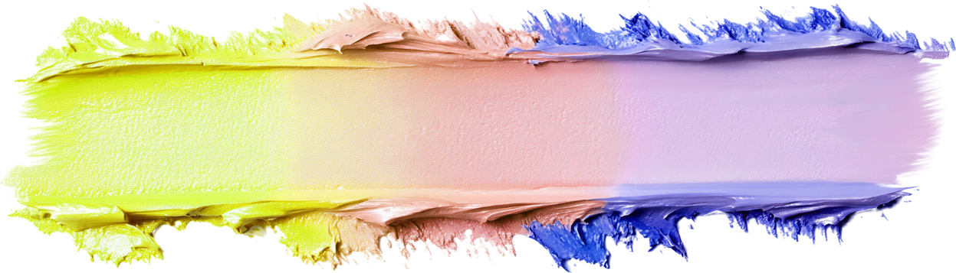
INGERO ZO KWICISHA BUGUFI

Slide 8





UMUKORESHA W’IKORO
“Naho uwo mukoresha w’ikoro ahagarara kure, ntiyahangara no kubura amaso ngo arebe mu ijuru, ahubwo yikubita mu gituza ati ‘Mana, mbabarira kuko ndi umunyabyaha!’ ” (Luka 18:13)
Umufarisayo yabwiraga Imana imirimo myiza yakoraga n’ibyiza yari afite imbere y’Ijuru. Ariko Yesu yavuze ko “yisengaga ubwe,” aho gusenga Imana (Luka 18:11–12). Ni urugero rwiza rw’ubwibone.
Umukoresha w’ikoro yasabaga Imana ubufasha, kuko yari umunyabyaha (Luka 18:13). Mu kuza imbere y’Imana yicishije bugufi, “yamanutse ajya iwe, ari we utsindishirijwe,” kuko “uwishyira hejuru azacishwa bugufi, ariko uwicisha bugufi azashyirwa hejuru” (Luka 18:14).
Kwicisha bugufi nyakuri gutangirira ku kwemera ibyaha byacu tugasaba gufashwa na Kristo. Hanyuma…
Ntituzabona abandi nk’abadafite agaciro (Abafilipi 2:3)
Ntituzashaka kuba ibirangirire mu bandi (Luka 14:7–11)
Tuzareka abandi babe ari bo baduha icyubahiro (Imigani 27:2)
Tuzakira ubuntu bw’Imana (Yakobo 4:6)
Tuzasangiza abandi ubwo buntu (1 Petero 4:10)

Slide 9

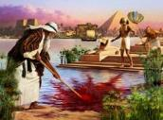






“Kwizera ni ko kwatumye Mose ubwo yari amaze gukura, yanga kwitwa umuhungu w’umukobwa wa Farawo, ahubwo agahitamo kurengananywa n’ubwoko bw’Imana, abirutisha kumara umwanya yishimira ibinezeza by’ibyaha.” (Abaheburayo 11:24—25)
MOSE
Mose yarezwe nk’uzaba Farawo wa Egiputa. Yari umuhanga mu by’ingamba akagira n’ubushobozi bw’ubwenge bukomeye (Ibyakozwe 7:22). Agize imyaka 40, yahisemo kureka ibyo byose maze yifatanya n’ubwoko bwe (Abaheburayo 11:24–25).
Yabaye umucunguzi! Ukuboko kwe gukomeye kwabohoye benewabo! Iryo ryari kuba ari ikosa rikomeye. Imana ntiyashoboraga kumukoresha mu gihe yari kuba afite ubwibone nk’ubwo.
Indi myaka 40 yamaze aganirira n’Imana mu butayu yatumye aba umuntu wicisha bugufi cyane (Kubara 12:3). Noneho yashoboraga gukoreshwa n’Imana mu kohereza ibyago, kwambuka inyanja, kwakira amategeko icumi, kuvugana n’Imana mu buryo butaziguye, gukubita urutare… Yashoboye no kwemera igihano cy’ubwibone bwe, ubwo yiyitiriraga ibyo yakoze (Kubara 20:10–12).
Urugero rwa Mose rutwereka ko kwicisha bugufi kudapfa kwizana muri twe, ahubwo tugomba gusaba Imana kuduha imbaraga buri munsi.

Slide 10




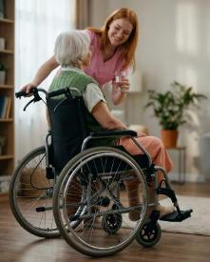
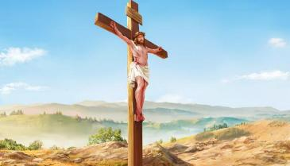
YESU, WE CYITEGEREREZO
“Yicisha bugufi, araganduka ntiyanga no gupfa ndetse urupfu rwo ku musaraba!” (Abafilipi 2:8)
Nta muntu n’umwe muri iyi si wigeze agira—kandi nta n’uzigera agira—ugukomera Yesu yari afite mbere yo kwigira umuntu. Nyamara yaretse byose kubera urukundo adukunda. Tugereranije n’uko kwicisha bugufi, ibyo dufite byose, ibyo turi byo byose, cyangwa ibyo dushobora kuzaba byo byose byagombye kuburiramo.
Yesu yasize ijuru kugira ngo apfire abantu yizeye ko twajyaga gusobanukirwa umurimo We w’ubuntu maze tukākīra irarika Rye ryo kugirana na We umubano mwiza (Abafilipi 2:5–8). Nta gushidikanya, ni We rugero rwiza rwo kwicisha bugufi.
“Mugire wa mutima wari muri Kristo Yesu” (Abafilipi 2:5).
Mu gukurikiza iki cyitegererezo, “ntimukagire icyo mukorera kwirema ibice cyangwa kwifata uko mutari, ahubwo mwicishe bugufi mu mitima, umuntu wese yibwire ko mugenzi we amuruta. Umuntu wese muri mwe areke kwizirikana ubwe gusa, ahubwo azirikane n’abandi” (Abafilipi 2:3–4).

Slide 11

“Ndagushimisha umutima wose,
Imbere y’ibigirwamana ndakuririmbira ishimwe.
Ndasenga nerekeye urusengero rwawe rwera
Nshimira izina ryawe imbabazi zawe n’umurava wawe,
Kuko washyirishije hejuru ijambo ryawe kurisohoza,
Ngo rirute ibyo izina ryawe ryose ryatwiringije.
Umunsi nagutakiyeho waransubije,
Umpumurisha guha umutima wanjye imbaraga.
Uwiteka, abami bo mu isi bose bazagushima,
Kuko bumvise amagambo yo mu kanwa kawe.
Ni koko bazaririmba inzira z’Uwiteka,
Kuko icyubahiro cy’Uwiteka ari cyinshi.
Kuko nubwo Uwiteka akomeye, Yita ku bicisha bugufi n’aboroheje;
Ariko abibone abamenyera kure.
Nubwo ngendera hagati y’amakuba n’ibyago uzanzura,
Uzaramburira ukuboko kwawe kurwanya umujinya w’abanzi banjye;
Ukuboko kwawe kw’iburyo kuzankiza.
Uwiteka azatunganya ibyanjye rwose;
Uwiteka, imbabazi zawe zihoraho iteka ryose—
Ntureke imirimo y’intoki zawe!”
Zaburi ya 138

Slide 12

“Mu kwikunda, kwishyira hejuru, n’ubwibone harimo ubugwari bwinshi; ariko mu kwicisha bugufi harimo imbaraga nyinshi. Icyubahiro cyacu nyakuri ntikiramba iyo twihugiraho, ahubwo kibaho iyo Imana iri mu bitekerezo byacu byose kandi imitima yacu yose ikagurumana urukundo dukunda Umucunguzi wacu n’urwo dukunda abandi bantu. Kwiyoroshya mu mico no kwicisha bugufi mu mutima bizatanga ibyishimo, mu gihe kwishyira hejuru bizazana kutanyurwa, kwicuza no guhora dutenguhwa. Ikizatuzanira imbaraga mvajuru ni ukwiga kwiyibagirwa ahubwo tugatera abandi kwishima.”
E.G. White, Testimonies for the Church, vol. 3, p. 476

