Slide 1
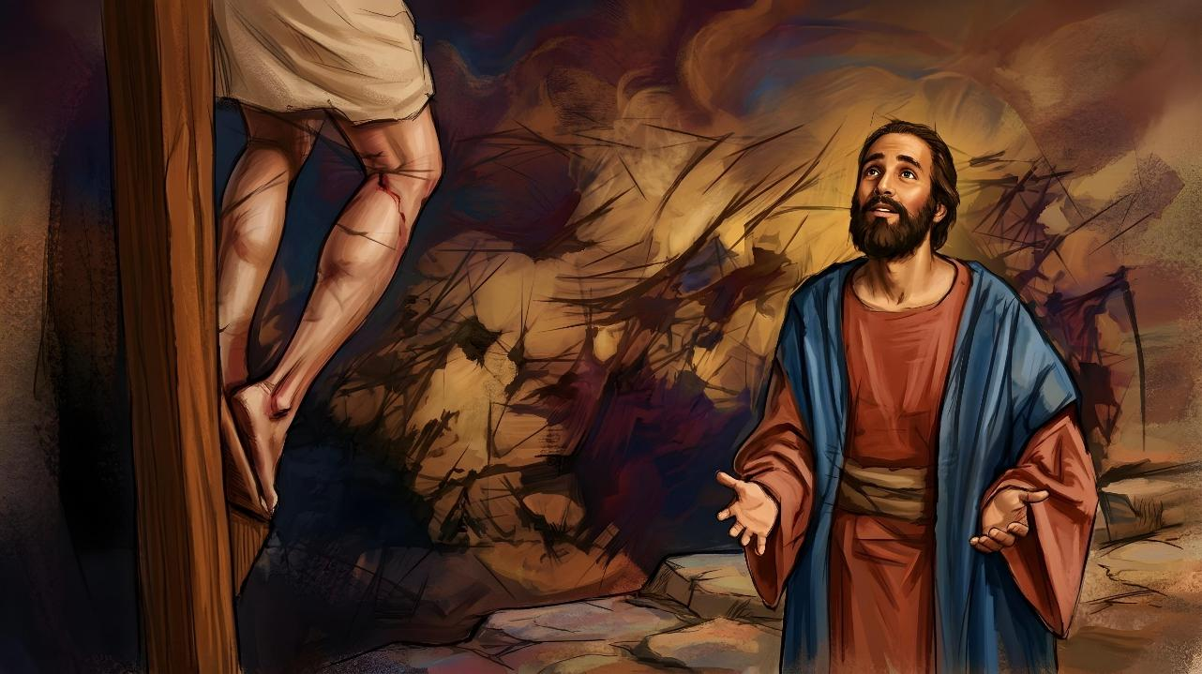
UBUTUMWA BW’UMUSARABA
Icyigisho cya 2 cyo ku wa 11 Nyakanga 2026

Slide 2
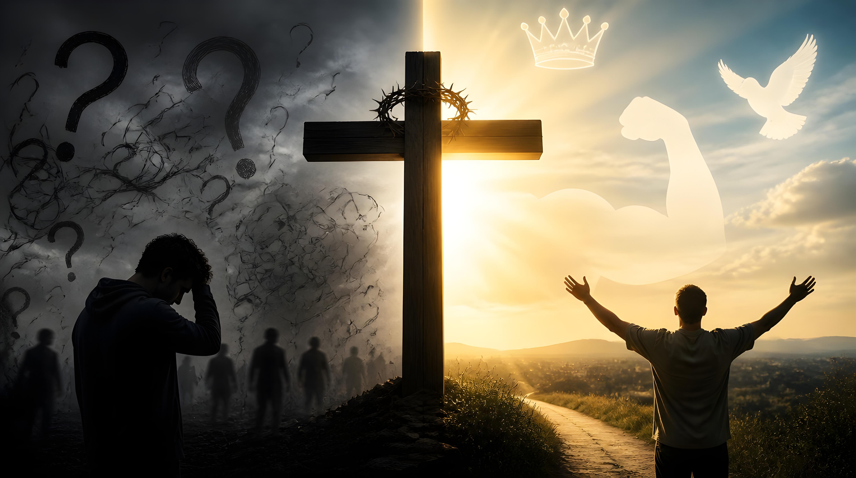
“Ijambo ry’umusaraba ku barimbuka ni ubupfu, ariko kuri twebwe abakizwa ni imbaraga z’Imana”
(1 Abakorinto 1:18)

Slide 3

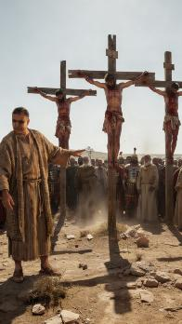
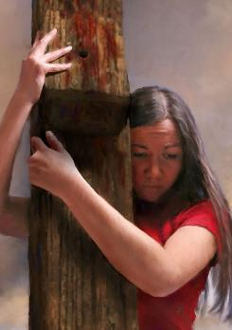
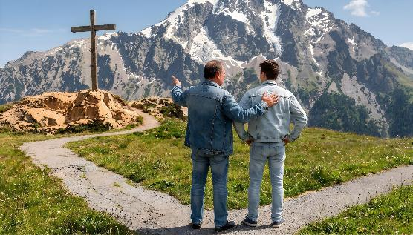
1 Abakorinto 1:17–31 havuga uburyo umusaraba ukora ku mibereho y’abantu.
Ku bizera, umusaraba ni ikimenyetso cy’agakiza. Ariko ku bantu babayeho mu kinyejana cya mbere, umusaraba wagereranyaga gusa urupfu rw’isoni rw’umugizi wa nabi ruharwa.
Gukizwa n’umuntu wapfiriye ku musaraba hanyuma akazuka? Ku bantu ni ubupfu, ubupfapfa, n’intege nke. Ariko kuri twe twafunguriye imitima yacu irarika ry’Umwuka Wera, umusaraba ni “imbaraga z’Imana, […] ubwenge, gukiranuka, kwezwa no gucungurwa” (1 Abakorinto 1:18, 30).
Ubwenge bw’Imana
Ubupfu bw’umusaraba
Imbaraga z’Imana
Ubutumwa bw’umusaraba
Ubupfu bw’Imana n’intege nke zayo

Slide 4

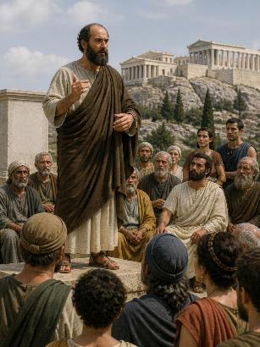
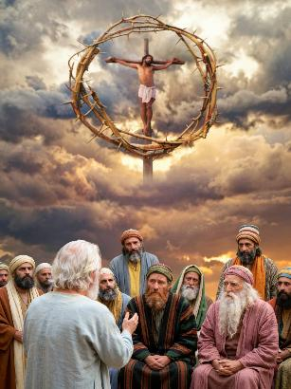
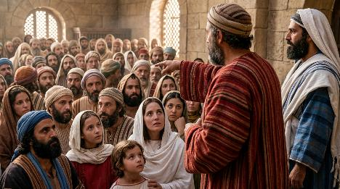
UBWENGE BW’IMANA
“Ariko ku bahamagawe b’Abayuda n’Abagiriki ni Kristo, ari we mbaraga z’Imana kandi ni ubwenge bwayo.” (1 Abakorinto 1:24)
Muri Atenayi, Pawulo yakoresheje ubwenge bwa muntu ngo agerageze kwemeza abanyabwenge. Kuva ubwo, yahisemo gukoresha ubwenge bw’Imana gusa.
Imana ubwayo ni Yo yari yamwohereje kwamamaza ubutumwa bwayo “ariko atavugisha ubwenge bw’amagambo, kugira ngo umusaraba wa Kristo udahinduka ubusa” (1 Abakorinto 1:17).
Ubwenge bw’Imana Pawulo yigishije ni ubuhe?
Ubwenge bw’Imana burimbura “ubwenge bw’abanyabwenge”; buhindura ubusa “ubwenge bw’abanyabwenge” (1 Abakorinto 1:19); kandi “bwahinduye ubupfu… ubwenge bw’isi” (1 Abakorinto 1:20).
Bitandukanye n’ubwenge bw’abantu, ubwenge bw’Imana ni “ugukirisha abayizera ubupfu bw’ibibwirizwa” (1 Abakorinto 1:21.

Slide 5

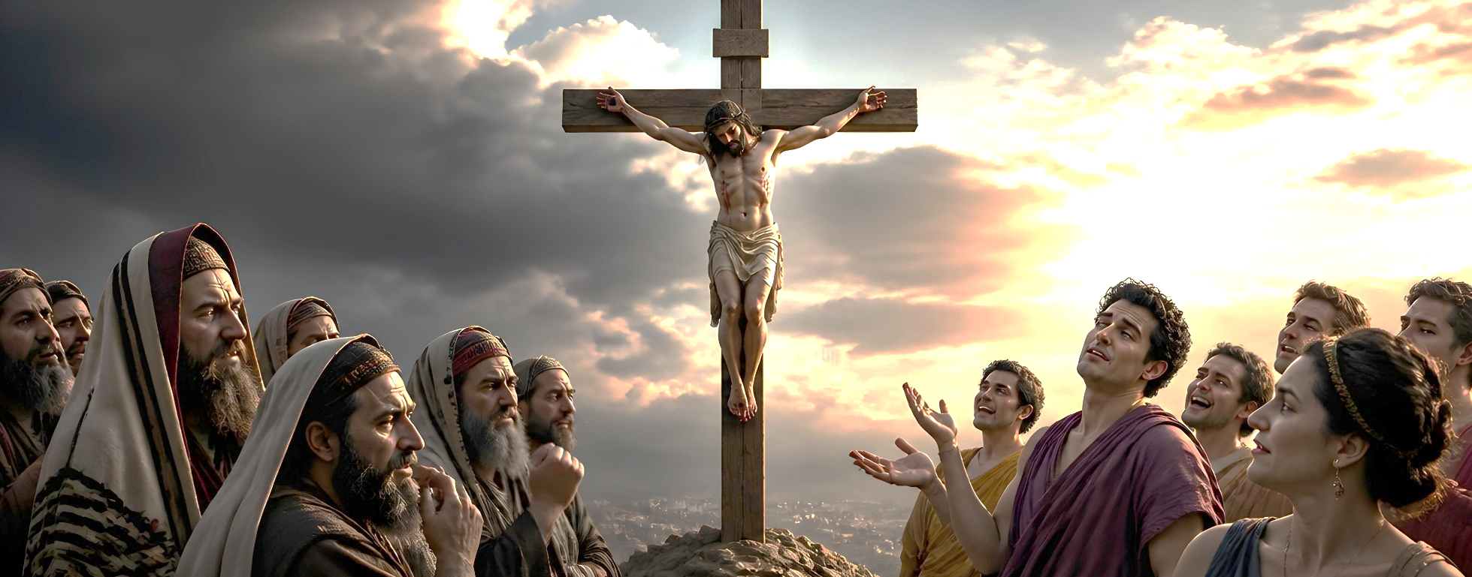

UBUPFU BW’UMUSARABA
“Ariko twebweho tubabwiriza ibya Kristo wabambwe. Uwo ku Bayuda ni ikigusha, ku banyamahanga ni ubupfu” (1 Abakorinto 1:23)
Ijambo ry'Ikigiriki mōria (ubusazi, ubupfapfa, ubupfu) ryakoreshejwe inshuro eshanu mu 1 Abakorinto :
“Ijambo ry’umusaraba ku barimbuka ni ubupfu” (1 Abakorinto 1:18)
“Imana yishimiye gukirisha abayizera ubupfu bw’ibibwirizwa” (1 Abakorinto 1:21)
“Kristo wabambwe, […] ku banyamahanga ni ubupfu” (1 Abakorinto 1:23)
“Ku muntu wa kamere […] iby’Umwuka w’Imana […] ni ubupfu kuri we” (1 Abakorinto 2:14)
“Ubwenge bw’iyi si ni ubupfu ku Mana” (1 Abakorinto 3:19)
Umusaraba ni ubupfu ku barimbuka, ku batazi Imana (Abanyamahanga), ku batekereza kuri iyi si gusa (umuntu wa kamere), ku bayoborwa n’ubwenge bwabo gusa.
Ariko umusaraba ni umugisha ku bakijijwe, ni ukuvuga ku bantu bafite ubushake bwo kubona umusaraba nk’uko Imana iwubona.

Slide 6

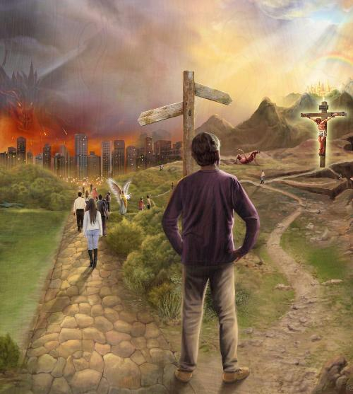
IMBARAGA Z’IMANA
“Ijambo ry’umusaraba ku barimbuka ni ubupfu, ariko kuri twebwe abakizwa ni imbaraga z’Imana.” (1 Abakorinto 1:18)
Umusaraba ufite ububasha bwo kwerekana ububi bw’umuntu n’ubwiza bw’Imana (1 Abakorinto 1:18).
Ububi bw’umuntu
Ubupfu
Kwirimbura
Ubwiza bw’Imana
Imbaraga
Imbabazi
Kurimbuka
Agakiza
Kwanga
Kwākīra
Abanga umusaraba basarura ingaruka z’imirimo yabo mibi, kandi amaherezo bazarimburwa n’Uwo banze.
Imbaraga z’Imana, zagaragarijwe ku musaraba, zishobora guhūza umuntu n’Imana, kubwo kumubabarira ibyaha bye byose, no kumuha ubugingo buhoraho (Abakolosayi 1:20; 1 Petero 2:24).

Slide 7

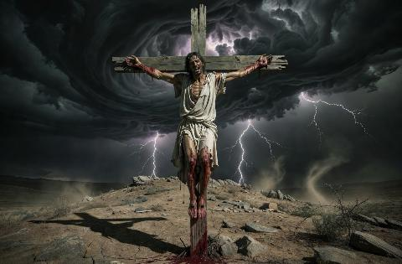
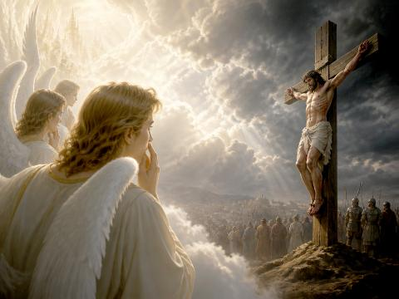
UBUTUMWA BW’UMUSARABA
“Kuko ubwo ubwenge bw’Imana bwategetse ko ab’isi badaheshwa kumenya Imana n’ubwenge bw’isi, Imana yishimiye gukirisha abayizera ubupfu bw’ibibwirizwa.” (1 Abakorinto 1:21)
Kuki kubwiriza ubutumwa bw’umusaraba ari ubupfu (1 Abakorinto 1:21–24)?
Abayuda bari biteze Mesiya ubakiza gukandamizwa n’Abaroma. Yesu amaze gutangaza ko agiye kubambwa, abigishwa Be bwite batewe n’ubwoba bwinshi. Byongeye kandi, ku Muyuda, umuntu umanitse ku giti yabaga ari umuntu wavumwe n’Imana (Gutegeka 21:23). Ku Munyamahanga, utarigeze ategereza Umucunguzi, umwanzuro wari umwe: umusaraba ni ubupfu.
Ariko, ku bamarayika, ubutumwa bw’umusaraba babubonaga ukundi rwose. Yesu, Uwo bari bazi mu Ijuru, yemeye gupfa kubera urukundo yakundaga ubwoko bwari bwaramwanze. Iyi ni yo mitekerereze Pawulo yashakaga kugaragaza binyuze mu kubwiriza kwe.
Ubutumwa bw’umusaraba bugaragaza uburyo Imana yiteguye kugera kure kugira ngo iduhe agakiza.

Slide 8

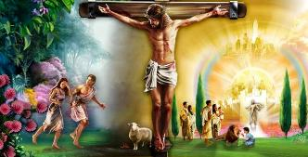
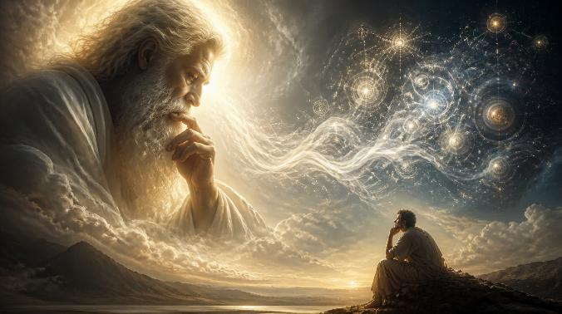
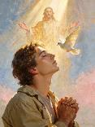
UBUPFU BW’IMANA N’INTEGE NKE ZAYO
“Kuko ubupfu bw’Imana burusha abantu ubwenge, kandi intege nke z’Imana zirusha abantu imbaraga.” (1 Abakorinto 1:25)
Ese Imana ni umupfapfa cyangwa inyantege nke (1 Abakorinto 1:25)?
Birumvikana ko atari byo, kuko Imana nta busembwa igira. Pawulo arimo agereranya gusa: Iyo Imana iba ifite ibitekerezo by’ubupfu, yari kuba irusha ubwenge, ubwenge bw’umuntu; cyangwa iyo Imana iza kugira intege nke mu ntekerezo, zari kuba zikomeye cyane kurusha intekerezo zikomeye z’abantu.
Ubwenge bwose buva mu bantu b’abanyabwenge cyane ntibushobora gutekereza inama y’agakiza k’abantu.
Imana yonyine ni Yo yashoboye gutanga ugucungurwa, binyuze mu mbaraga z’igitambo cya Yesu cyatangiwe ku musaraba, “ku bakizwa” (1 Abakorinto1:18); “ku bizera” (1 Abakorinto 1:21); “ku bahamagawe” (1 Abakorinto 1:24).
Menya neza ko abizera Yesu nk’igisubizo ku irarika rya Mwuka Wera ari bo bonyine bazakizwa.

Slide 9

“Ku bantu benshi bo muri iki gihe, umusaraba w’i Kaluvari ubibutsa ibintu byera. Mu ntekerezo zabo bumva ibyabereye ku musaraba ari ibintu byera. Ariko mu gihe cya Pawulo umusaraba wari ikintu abantu banga kandi giteye ubwoba. Kubwiriza ko Umukiza w’inyokomuntu ari umuntu wapfuye abambwe ku musaraba, byagombaga kumutera gusuzugurwa no kurwanywa. […]
Bashoboraga kumubona nk’umuntu ufite ubwenge buke kubwo kugeregeza kwerekana uburyo umusaraba ufitanye isano no kuzahurwa cyangwa agakiza k’inyokomuntu.
Nyamara kuri Pawulo umusaraba ni wo wari ikintu kimwe gifite agaciro kuruta ibindi. […] Yari azi mu byo yari yaragiye ahura na byo ko iyo umunyabyaha abonye urukundo rwa Data wo mu ijuru, nk’uko rwagaragaye mu gitambo cy’Umwana We, maze akiyegurira imbaraga y’Imana ngo imuyobore, habaho guhinduka k’umutima kandi kuva icyo gihe Kristo akamubera byose muri byose.”
E.G. White, Ibyakozwe n’Intumwa, p. 153

