Slide 1

ICYAHA MU ITORERO
Icyigisho cya 4 cyo ku wa 25 Nyakanga 2026

Slide 2
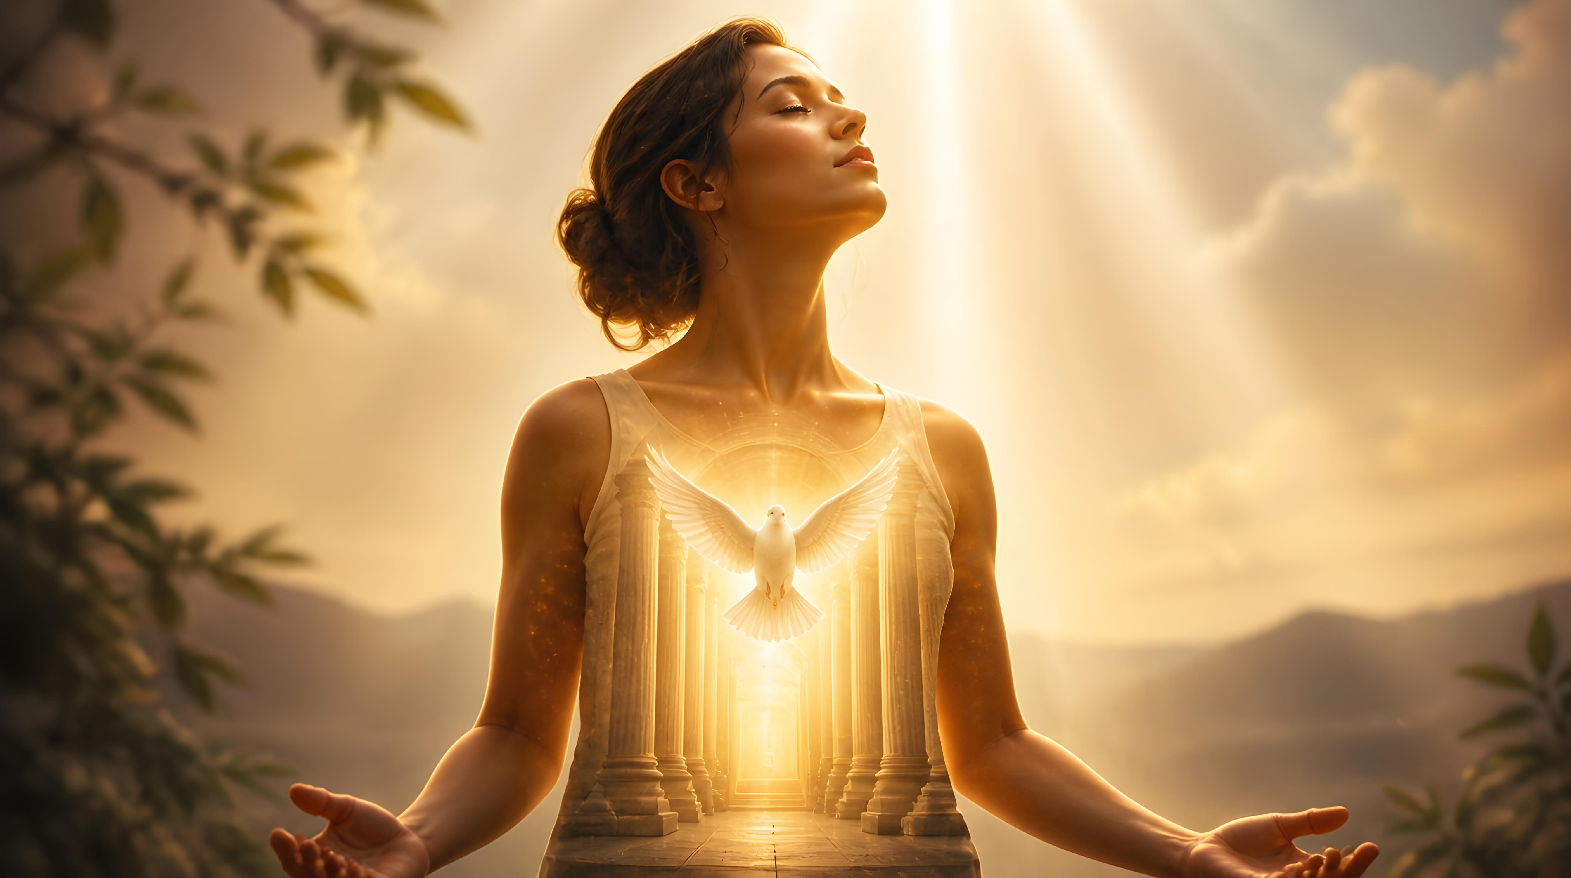
“Mbese ntimuzi yuko imibiri yanyu ari insengero z’Umwuka Wera uri muri mwe, uwo mufite wavuye ku Mana? Kandi ntimuri abanyu ngo mwigenge kuko mwaguzwe igiciro. Nuko rero mutume imibiri yanyu ihimbaza Imana”
(1 Abakorinto 6:19, 20)

Slide 3




Pawulo akoresha igice cya gatanu kugeza ku cya karindwi by’urwandiko rwa mbere rw’Abakorinto yibanda ku gukuraho icyaha cyari cyarashinze imizi mu itorero ry’i Korinto: ubusambanyi.
Iki cyaha ubwacyo cyari cyarongeweho ibindi nk’uburiganya hagati y’abavandimwe ubwabo, byabagezaga imbere y’inkiko mbonezamubano.
Pawulo, akoresheje imvugo isobanutse kandi itaziguye, ntabwo agaragaza icyaha gusa, ahubwo anatanga inama zo kugikemura, no kwirinda kongera kukigwamo.
Icyaha mu itorero
Iyo icyaha cyemewe
Kurandura icyaha
Gukemura ibibazo by’imbere
Uburyo bwo kwirinda icyaha mu itorero
Insengero z’Umwuka Wera
Imibonano mpuzabitsina yemewe

Slide 4
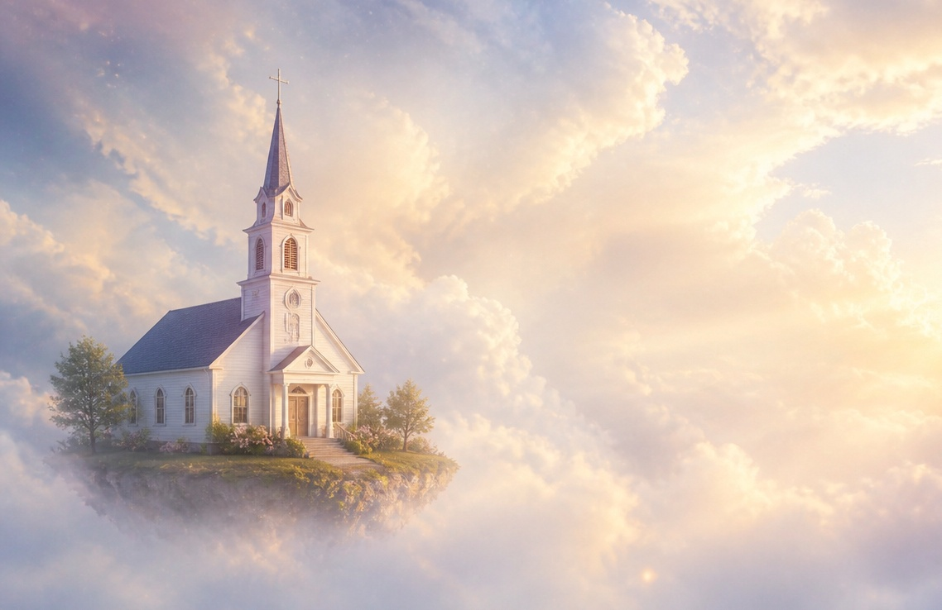
ICYAHA MU ITORERO

Slide 5



IYO ICYAHA CYEMEWE
“Namwe murihimbaza aho kubabara, kandi ari byo byari bibakwiriye ngo uwakoze icyo cyaha akurwe muri mwe?” (1 Abakorinto 5:2)
Mu itorero ry’i Korinto “habonetse ubusambanyi, ndetse bw’uburyo butaboneka no mu bapagani” (1 Abakorinto 5:1).
Kuba hari ubusambanyi mu itorero hagati y’abafitanye isano ya hafi, byari ikibazo gikomeye cyane. Ariko ibintu byarushijeho kuba bibi kuko aho kugira ngo bitere ishozi mu bizera, bari bafite ishema ryo kwemera icyo cyaha (1 Abakorinto 5:2).
Itorero ryari rigizwe ahanini n’Abanyamahanga. Umutimanama wabo wababwiraga ko gusambana kw’abafitanye isano bidakwiriye kwihanganirwa. Byongeye kandi, ibyo bari bazi mu Byanditswe Byera byashimangiye iki gitekerezo (Abalewi 18:8).
Niba bari basobanukiwe neza ko uyu mubano ari icyaha… kuki wabateraga ishema (1 Abakorinto 5:6)? Ese umuryango wabigizemo uruhare waravugaga rikijyana mu itorero? Ese birataga ko itorero ryihanganira abanyabyaha? …?

Slide 6





KURANDURA ICYAHA
“Ariko abo hanze Imana ni yo izabacira ho iteka. Mukure uwo munyabyaha muri mwe.” (1 Abakorinto 5:13)
Ikibazo cy’abaryamana bafitanye isano ya hafi cyari “ikimenyabose” (1 Abakorinto 5:1), bityo hari hakenewe ingamba zihutirwa mu kwirinda kwangiza izina ry’itorero. Ni izihe ngamba zagombaga gufatwa?
Gufata icyemezo cyerekana icyaha cy’uwo muntu , cyangwa icyemezo kimuhanaguraho icyaha (1 Abakorinto 5:3)
Kutifatanya n’umunyabyaha, ndetse no kudasangira na we, niba akomeje gushimangira ko yafatwa nk’umwe mu bagize itorero, kandi adashaka kureka icyaha cye (1 Abakorinto 5:11)
Guhēza umunyabyaha no kumuha “Satani,” kubera ko, mu kugundira iki cyaha, yahisemo kwishyira munsi y’umutwaro wa Satani ku bushake bwe (1 Abakorinto 5:2b, 5a, 13b)
Igihano cy’itorero (uko icyaha cyaba kingana kose) kigomba guhora gifite intego yo kugarura umuntu. Ikosa ry’umuntu rigomba kugaragazwa neza kugira ngo ashobore kurimenya, yihane, kandi “ku munsi w’Umwami Yesu, azakizwe” (1 Abakorinto 5:5).

Slide 7



GUKEMURA IBIBAZO BY’IMBERE
“Iyo umuntu wo muri mwe afite icyo apfa na mugenzi we, mbese ahangara kuburanira ku bakiranirwa ntaburanire ku bera?” (1 Abakorinto 6:1)
Pawulo, nyuma yo gusobanura uburyo bwo gukemura icyaha mu itorero, arabacyaha kubera kutubahiriza amabwiriza akwiriye no guharira inkiko zo mu isi ibyo gukemura amakimbirane hagati y’abizera (1 Abakorinto 6:1–6). Ariko Pawulo arīmbika, kandi akagera ku muzi w’ikibazo.
Icya mbere, nta kutumvikana gukwiriye kubaho hagati y’abizera bo mu itorero (1 Abakorinto 6:7a) kandi birumvikana ko abizera badakwiriye kurenganya cyangwa kugirira nabi abandi (1 Abakorinto 6:8).
Icya kabiri, abavandimwe bagomba kuba biteguye kubabarirana ikosa (1 Abakorinto 6:7b).
Icya gatatu, niba abizera batabashije kumvikana, itorero rigomba kubacira urubanza cyangwa kubahūza (1 Abakorinto 6:2).
Uretse ikibazo cy’ubugizi bwa nabi (Abaroma 13:1–5), ibibazo by’imbere mu itorero bigomba gukemurirwa imbere mu itorero.

Slide 8

“Ni akazi kacu kumenya amakosa yacu n’ibyaha byacu byihariye, bitera umwijima no gucika intege mu bya mwuka, kandi bigakonjesha urukundo rwacu rwa mbere. Ese ibyo ni ukwisanisha n’iby’isi? Ese ibyo ni inarijye? Ese ni ukwishyira imbere? Ese ni uguharanira kuba uw’imbere? Ese ni icyaha cyo kwishimisha kiba cyhawe akīto? Ese ni icyaha cy’Abanikolayiti, bahindura ubuntu bw’Imana ugushayisha mu irari? Ese ni ugukoresha nabi umucyo ukomeye n’amahirwe atangaje, tuvuga ko dufite ubwenge n’ubumenyi mu by’idini, mu gihe bitajyanye n’imibereho n’imico kandi ikaba ari mibi? Icyo ari cyo cyose cyaba cyarabibwe kandi kigakuzwa kugeza kimaze gukomera no kukugenga, gambirira kunesha, bitabaye ibyo uzarimbuka.”
E.G. White, Ye Shall Receive Power, December 18

Slide 9
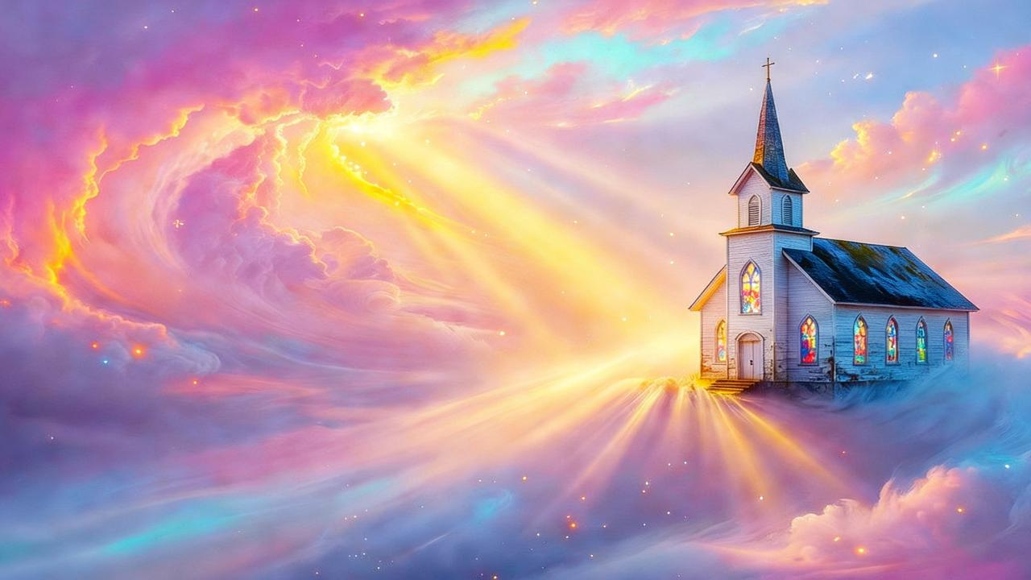
UBURYO BWO KWIRINDA ICYAHA MU ITORERO

Slide 10

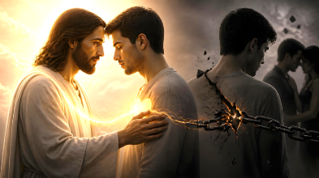

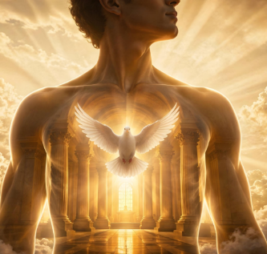
INSENGERO Z’UMWUKA WERA
“Mbese ntimuzi yuko imibiri yanyu ari insengero z’Umwuka Wera uri muri mwe, uwo mufite wavuye ku Mana? Kandi ntimuri abanyu ngo mwigenge”
(1 Abakorinto 6:19)
Pawulo amaze kuvuga ku kibazo cy’imanza, agaruka ku ngingo nyamukuru: ubusambanyi mu itorero. Kuki bwabayeho?
Abakristo bahamagariwe kuba abera (1 Abakorinto 6:11), kandi ibi bivuga gukuraho ibyaha byose. Ariko bamwe bavuga ko, kubera ko ibyaha byabo byababariwe, bashobora gukoresha imibiri yabo icyo bashakiye. Ni yo mpamvu Pawulo asobanura ko “umubiri si uwo gusambana” (1 Abakorinto 6:12–13).
Aho ahagaze: imibiri yacu ni ingingo za Kristo. Ntidushobora gufata ingingo za Kristo ngo tuzihuze n’indaya cyangwa umuhehesi (1 Abakorinto 6:15–18).
Amaherezo, bidutera kuzirikana ku kintu cy'ingenzi: imibiri yacu ni insengero z’Umwuka Wera, bityo si umutungo wacu, ahubwo ni uw’Imana (1 Abakorinto 6:19). Imana yatuguze amaraso y’igiciro y’Umwana wayo, bityo tugomba guhimbaza Imana mu mibiri yacu no mu mwuka wacu (1 Abakorinto 6:20).

Slide 11





IMIBONANO MPUZABITSINA YEMEWE
“Ariko ku bwo kwirinda gusambana, umugabo wese agire uwe mugore, n’umugore wese agire uwe mugabo.” (1 Abakorinto 7:2)
Pawulo asubiza ibibazo bimwe na bimwe byari byarabajijwe n’Itorero ry’i Korinto, adufasha gusobanukirwa uburyo dushobora kuzibukira ubusambanyi (1 Abakorinto 7:1).
Iby’ibanze: abashakanye bagomba kwishimira imibonano mpuzabitsina yemewe; abatarashaka ntibagomba kugirana imibonano mpuzabitsina n’uwo ari we wese.
Abashakanye ntibagomba kwīmana kugira ngo umwe yirinde gutera undi kujya mu busambanyi (1 Abakorinto 7:3–5).
Abatarashatse bafite impano yo kwifata bashobora gukoresha ayo mahirwe mu gukorera Imana nta mbogamizi ziturutse ku kwita ku muryango (1 Abakorinto 7:6–8, 32–34).
Abatarashaka badafite impano yo kwifata bagomba kugerageza gushaka kugira ngo birinde ibishuko (1 Abakorinto 7:9).

Slide 12

“Mu murimo ukorerwa abahabye, buri jisho rikwiriye kwerekezwa kuri Kristo. […] Nibabwire abararagiye iby’impuhwe zibabarira z’Umukiza. Nibashishikarize uwakoze icyaha kwihana no kwizera Ufite ububasha bwo kubabarira. […]
Itorero niryakirane umutima ushima kwihana k’umunyabyaha. Uwihannye nakurwe mu mwijima wo kutizera ashyirwe mu mucyo wo kwizera no gukiranuka. Ibiganza bye bihinda umushyitsi nibishyirwe mu biganza byuje urukundo bya Yesu. Mwene uko kubabarira kwemerwa n’ijuru.
E.G. White, Uwifuzwa Ibihe byose, p. 547

