Slide 1

MUKORERE BYOSE GUHIMBAZA IMANA
Icyigisho cya 5 cyo ku wa 1 Kanama 2026

Slide 2

(1 Abakorinto 10:31)
“Namwe iyo murya cyangwa munywa cyangwa mukora ikindi kintu cyose, mujye mukorera byose guhimbaza Imana”

Slide 3
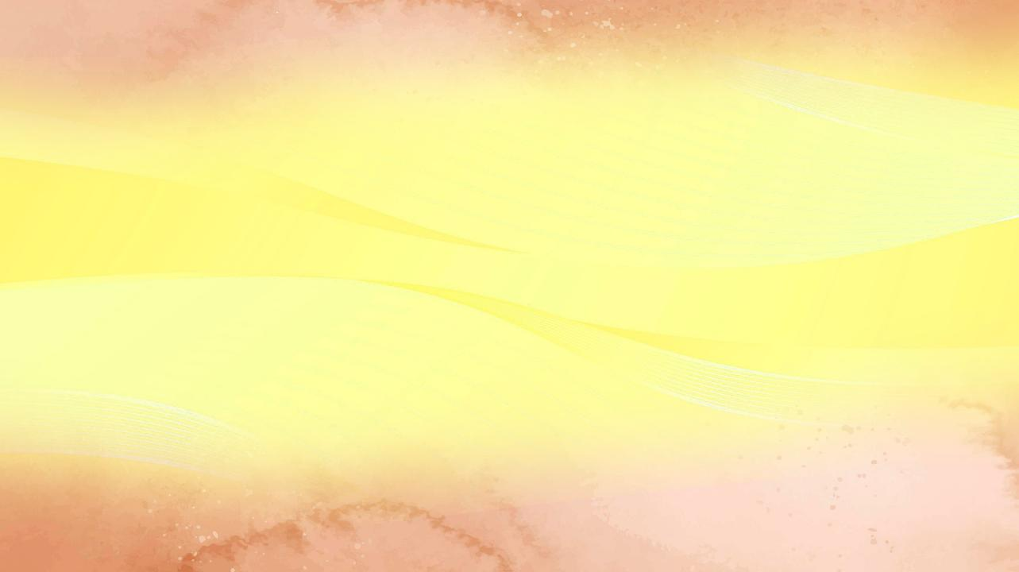

Pawulo yahereye ku 1 Abakorinto 7, yibanda ku gusubiza uruhūri rw’ibibazo Abakorinto bari baramwoherereje mu rwandiko (1 Abakorinto 7:1a).
1 Abakorinto 8
Ibyokurya byaterekerejwe ibigirwamana
(Ubwenge n’urukundo)
1 Abakorinto 9
Pawulo areka ibyo yemerewe
(Ibyo yemererwa n’ubutumwa bwiza)
1 Abakorinto 10:1–13
Umubūro ku kuramya ibigirwamana
(Ibyo twigira ku bihe byashize)
1 Abakorinto 10:14–22
Igikombe cy’Umwami n’igikombe cy’abadayimoni
(Kuzibukīra kuramya ibigirwamana)
1 Abakorinto 10:23–33
Mukorere byose guhimbaza Imana
(Ibyemewe n’ibikwiriye)
Kubera iyo mpamvu, nubwo igice cya 8 kugeza ku cya 10 havuga cyane cyane ku kuramya ibigirwamana, Pawulo avugira hamwe ingingo zimwe na zimwe zitagaragara nk’izifite aho zihuriye n’iki cyaha cyihariye.
Ariko, muri buri ngingo, agerageza gushyiramo injyana imwe: urukundo no kubahana, bigomba kugeza itorero ku bumwe.
Hamwe n’ibyo, Pawulo ashimangira ko ikintu cyose gikorerwa mu itorero, cyangwa mu buzima bwite, kigomba gukorwa ku bw’icyubahiro cy’Imana.

Slide 4





UBWENGE N’URUKUNDO
1 Abakorinto 8 (Ibyokurya byaterekerejwe ibigirwamana)
“Ubwenge butera kwihimbaza ariko urukundo rurakomeza.” (1 Abakorinto 8:1b)
Pawulo “agaba” itorero mu matsinda abiri: “abakomeye” n’ “abanyantege nke.
1 Abakorinto 8:4–7a
Abakomeye basobanukiwe ko ibigirwamana ntacyo bivuze, kuko hariho Imana imwe y’ukuri.
Abafite intege nke ntibarasobanukirwa iyi ngingo.
1 Abakorinto 8:7b
Abakomeye barya inyama zatambiwe ibigirwamana kuko bazi ko ibigirwamana bidashobora kwanduza ibiryo.
Abanyantege nke bizera ko iyo bariye izo nyama baba bakoze icyaha.
Ariko abakomeye, kubw’ubwenge bwabo n’urugero rwabo, bashobora gutera abanyantege nke kugwa (1 Abakorinto 8:10). Kubwo gukunda mwenese, ukomeye agomba kwifata (1 Abakorinto 8:11–13).
Abakristo bagomba gushyira urukundo imbere y’ubwenge mu gihe ubwenge bushobora kubera intaza umuvandimwe “udakomeye” (ukiri gukura).

Slide 5


IBYO YEMERERWA N’UBUTUMWA BWIZA
1 Abakorinto 9 (Pawulo areka ibyo yemerewe)
“N’Umwami wacu ni ko yategetse, ko abavuga ubutumwa bwiza batungwa n’ubutumwa.” (1 Abakorinto 9:14)
Pawulo yaretse ibyo yemerewe nibura bitatu kubera urukundo yakundaga abanyantege nke :
⁕ Uburenganzira bwo gutungwa n’itorero (1 Abakorinto 9:4)
⁕ Uburenganzira bwo kujyana n’umugore we (1 Abakorinto 9:5)
⁕ Uburenganzira bwo kudakora imirimo isanzwe yo kumutunga (1 Abakorinto 9:6)
Pawulo yaretse ibyo yemererwa nk’intumwa ari byo gufashwa n’amatorero yakoreraga, uko izindi ntumwa zagenzerezwaga.
Imigirire rusange mu ntumwa yari iyo kujyana n’abagore babo kugira ngo babafashe mu murimo wabo. Uyu mugore, kimwe n’umugabo we, yari afite uburenganzira bwo gushyigikirwa n’itorero.
Pawulo ashaka kwibeshaho kugira ngo yirinde abantu batekereza ko ashaka kugōndōza abamukurikira, ahubwo abahe urugero rwo kwitanga.
Nubwo Yesu yasobanuye neza ko ababwiriza ubutumwa bwiza bagomba kubeshwaho n’ubutumwa bwiza, Pawulo na Barinaba bombi babiretse ku bushake bwabo kugira ngo batabangamira abizera (1 Abakorinto 9:12–14; Luka 10:7).

Slide 6










IBYO TWIGIRA KU BIHE BYASHIZE
1 Abakorinto 10:1–13 (Umubūro ku kuramya ibigirwamana)
“Nuko rero ntimugasenge ibishushanyo nk’uko bamwe bo muri bo babisengaga, nk’uko byanditswe ngo ‘Abantu bicajwe no kurya no kunywa bahagurutswa no gukina.’ ” (1 Abakorinto 10:7)
Iyo ibyabaye mu gihe cyo Kuva (muri Egiputa) byumvikanye mu buryo bw’umwuka, bigirana isano n’ibitubaho. Kwambuka inyanja ni nk’isezerano ryacu ry’umubatizo (1 Abakorinto 10:1–2).
Ibyokurya n’ibinyobwa bafashe mu butayu ni nk’uko tujya ku Ifunguro Ryera, aho turya kandi tukanywa, mu buryo bw’umwuka, umubiri n’amaraso bya Yesu (1 Abakorinto 10:3–4).
Mwitonde! Nubwo byagenze gutyo, Abisirayeli baguye mu byaha bikomeye, harimo no kuramya ibigirwamana n’ubusambanyi. Ntibikatubeho! (1 Abakorinto 10:5–10).
Ni yo mpamvu intumwa Pawulo asoza uyu mugabane atanga inama ikomeye: “Nuko rero uwibwira ko ahagaze, yirinde atagwa” (1 Abakorinto 10:12).

Slide 7



KUZIBUKĪRA KURAMYA IBIGIRWAMANA
1 Abakorinto 10:14–22 (Igikombe cy’Umwami n’igikombe cy’abadayimoni)
“Nuko rero bakundwa, nimuzibukire kuramya ibishushanyo” (1 Abakorinto10:14)
Niba ibyokurya byaterekerejwe ibigirwamana bishobora kuribwa nta mpungenge, kuki mu 1 Abakorinto 10:20 Pawulo asa n’aho atugira inama yo kubirwanya?
Ni kimwe kurya inyama mu rugo nta gishinja, kandi ni ikindi kirenze ibyo kubikorera mu birori rusange aho baramya ibigirwamana. Mu kwitabira ibirori nk’ibyo, umwizera aba yihakanye ukwizera kwe maze akemera kuramya ibigirwamana.
Mu gusangira Ifunguro Ryera tuba bamwe mu bagize umubiri wa Kristo (itorero), mu gihe, iyo twitabiriye imihango yo kuramya ibigirwamana, tuba bamwe mu bagize abadayimoni (1 Abakorinto 10:16–20).
Ntidushobora kunywera ku gikombe cy’Ifunguro Ryera, aho duhimbaza Yesu, maze ngo—icyarimwe—tunywere no ku gikombe gisingiza abadayimoni (1 Abakorinto 10:21).

Slide 8



IBYEMEWE N’IBIKWIRIYE
1 Abakorinto 10:23–33 (Mukorere byose guhimbaza Imana)
“Namwe iyo murya cyangwa munywa cyangwa mukora ikindi kintu cyose, mujye mukorera byose guhimbaza Imana.” (1 Abakorinto 10:31)
“Byose turabyemererwa koko, ariko ibitwungura si byose” (1 Abakorinto 10:23).
Ingero ebyiri zifatika :
Ibagiro ry’inyama ryagurishaga inyama zaterekerejwe ibigirwamana n’inyama zitaterekerejwe. Umwizera ntiyagombaga kubaza inkomoko yazo kugira ngo adatanga igitekerezo cy’uko yumva ko bitemewe kurya ubwo bwoko bw’inyama
(1 Abakorinto 10:25).
Umuntu utizera yatumiye umwizera ngo basangire. Umwizera yarariye nta kubaza (kuri we byose biremewe). Ariko umusangwa yavuze ko inyama zari zaterekerejwe ikigirwamana. Kubw’ibyo, kubwo kutāngīza umutimanama w’umusangwa, byafashwe nk’ibidakwiriye ko umwizera yarya izo nyama
(1 Abakorinto 10:27–29).
Amahame shingiro aya mabwiriza ashingiyeho na yo ni abiri: guhimbaza Imana muri byose (1 Abakorinto 10:31), no gushakira abandi ibyiza (1 Abakorinto 10:24, 32).
Ibyo bivuze gukunda Imana kuruta byose no gukunda mugenzi wawe nk’uko wikunda (nk’uko Yesu yabisabye umusore w’umutunzi).

Slide 9

“Intumwa Pawulo yabwiye Abakorinto ati: ‘nuko rero uwibwira ko ahagaze, yirinde atagwa.’ Iyo birata kandi bakiyiringira, bakirengagiza kuba maso no gusenga, bari kugwa mu cyaha gikomeye bakihamagarira kugibwaho n’uburakari bw’Imana. […]
Pawulo yingingiye abavandimwe be mu kwizera kwibaza icyo amagambo n’ibikorwa byabo bishobora gukora ku bandi no kutagira icyo bakora, kabone nubwo cyaba ari cyiza, cyasa n’aho gishyigikira kuramya ibigirwamana cyangwa kigakomeretsa ugushidikanya kw’abashobora kuba ari abanyantege nke mu kwizera. Yaravuze ati: ‘Namwe iyo murya cyangwa munywa cyangwa mukora ikindi kintu cyose, mujye mukorera byose guhimbaza Imana. Ntimukabere abayuda ikigusha, cyangwa Abagiriki cyangwa itorero ry’Imana .’ ”
E.G. White, Ibyakozwe n’Intumwa, p. 194–195

