Slide 1

UMURIMO UKOMOTSE KU RUKUNDO
Icyigisho cya 9 cyo ku wa 29 Kanama 2026

Slide 2

“Nabandikiye mfite agahinda kenshi n’umubabaro mwinshi wo mu mutima, ndira amarira menshi. Icyakora si ukugira ngo mbatere agahinda, ahubwo ni ukugira ngo mumenye uburyo urukundo mbakunda ruhebuje”
(2 Abakorinto 2:4)

Slide 3









Mu gihe twiga mu buryo bwimbitse urwandiko rwa kabiri Pawulo yandikiye Abakorinto, tubona ko intumwa ishishikajwe cyane n’imibereho myiza y’itorero.
Nubwo muri iyi si yuzuye ibyaha, gukurikiza inzira z’Imana bitigeze byoroha, mu kinyejana cya mbere ho kwiyita Umukristo byashoboraga gutera ingorane zikomeye.
Pawulo yateguriye itorero guhangana n’izo ngorane, zaba iz’imbere n’iziva hanze, kandi abigisha kuba itsinda ryuje ubumwe mu rukundo ruzira inarijye. Muri iyi nama, uyu munsi dushobora kwigiramo kuba “impumuro y’ubugingo itanga ubugingo” (2 Abakorinto 2:16).
Ihumure ry’Imana mu makuba
Ukwera n’ubunyangamugayo mu murimo
Kugendera mu bwenge
Kubabarirwa no gukomorerwa
Impumuro ya Kristo

Slide 4


IHUMURE RY’IMANA MU MAKUBA
“Iduhumuriza mu makuba yacu yose kugira ngo natwe tubone uko duhumuriza abari mu makuba yose, tubahumurisha ihumure twahawe n’Imana.” (2 Abakorinto 1:4)
Urwandiko rwa Kabiri rw’Abakorinto ni rwo Pawulo avugamo byinshi ku ihumure. Itorero ryari riri mu bihe bigoye, kandi urwandiko rwa mbere Pawulo yabandikiye rwari rwarabashyize mu kababaro.
Ihumure ry’Imana
Ritubohora ku bwoba
Ritwibutsa ibihe Imana yadufashijemo
Ridufasha kwihanganira imibabaro
Ritugeza ku gukura mu bya mwuka
Ridutera umwete wo gusabira abandi
Turahumurizanya kubw’uko twahumurijwe n’Imana
Ariko ako gahinda kari “ako mu buryo bw’Imana,” kabatera kwihana (2 Abakorinto 7:10). Bityo, Pawulo ntashaka ko ako gahinda kabaganza, ahubwo yashakaga ko bahumurizwa.
Na we ubwe yari yarahuye n’ibihe aho ubuzima bwe bwari mu kaga maze acika intege (2 Abakorinto 1:8–10). Ariko Imana iramuhumuriza, na we ni ko guha itorero iryo humure (2 Abakorinto 1:6).

Slide 5




UKWERA N’UBUNYANGAMUGAYO MU MURIMO
“Kwishima kwacu ni uku: ni ibyo umutima wacu uhana uhamya yuko ingeso twagiraga mu isi, kandi cyane cyane kuri mwe, ari ukwera no kutaryarya kuva ku Mana no kudakurikiza ubwenge bwa kavukire, ahubwo gukurikiza ubuntu bw’Imana” (2 Abakorinto 1:12)
Hari abantu bamwe basuzuguraga Pawulo, bamushinja ko ari umunyantege nke kandi adashikama ku byemezo (2 Abakorinto 10:10). Kubw’iyo mpamvu, kandi kugira ngo inama ze zakirwe kandi zemerwe, byari ngombwa ko intumwa yiregura kuri ibyo birego.
Nk’umuntu, yiyumvaga nk’utagira umumaro (Abefeso 3:8). Ariko, ku bw’ubuntu bw’Imana, yashoboraga kwirata ko afite umutimanama utamucira urubanza (2 Abakorinto 1:12).
We n’abo bari kumwe bavugaga nta kwihenda ko imyitwarire ye yari iyera kandi itariho umugayo [itunganye], haba mu itorero ndetse no hanze yaryo.
Kubw’ibyo, inyandiko za Pawulo ntizari zifite imigambi ya rwihishwa. Yari yizeye ko izi nzandiko zizasomwa kandi zigasobanuka muri ubwo buryo bw’ukwera n’ubunyangamugayo—bivuga ko zanditswe kubera urukundo abafitiye no kubashakira ineza gusa (2 Abakorinto 1:13–14).

Slide 6



KUGENDERA MU BWENGE
“Ariko Imana ni yo ntanze ho umugabo ku bugingo bwanjye, yuko icyatumye ntongera kuza i Korinto ari ukubababarira” (2 Abakorinto 1:23)
Mu rwandiko rwa Pwulo rwa mbere, yabwiye Abakorinto inzira yateganyaga kunyuramo (1 Abakorinto 16:5–11):
Efeso
Makedoniya
Korinto
Yudeya
Mu rwandiko yanditse nyuma (rwatakaye, 2 Abakorinto 7:8) yababwiye kuzabasura kabiri (2 Abakorinto 1:15–16):
Efeso
Makedoniya
Korinto
Yudeya
Korinto
Ariko, yaje guhindura gahunda ze maze yanzura kutabasura kuri iriya nshuro ya mbere (2 Abakorinto 1:23). Izi mpinduka zatumye bamwe bamunenga kuba umuntu uhindagurika kandi utaguma hamwe. Kuki yahinduye igitekerezo cye?
Kuba i Korinto kwa Pawulo byasaga n’aho ari ngombwa kubera ibibazo byari bihari. Ariko kubera urukundo rwinshi yari abafitiye, yashatse kwirinda kurwanywa yashoboraga kuhabonera (2 Abakorinto 2:1–4).

Slide 7

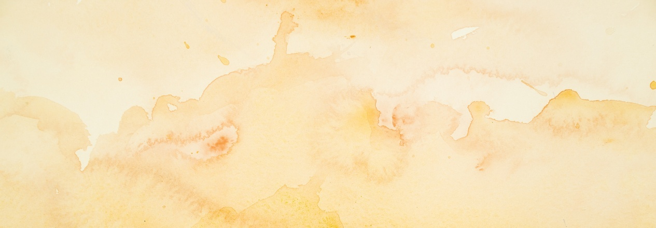



KUBABARIRWA NO GUKOMORERWA
“Ariko uwo mugira icyo mubabarira nanjye mba nkimubabariye, kuko nanjye ubwanjye iyo hari uwo ngize icyo mbabarira, nkimubabarira ku bwanyu imbere ya Kristo” (2 Abakorinto 2:10)
Ubwo Pawulo yari mu nzira ajya i Tirowa, Tito yagiye i Korinto. Pawulo avuye i Tirowa, yagiye i Makedoniya. Ariko yari afite agahinda kenshi kuko atari yahuriye na Tito i Tirowa ngo amubwire amakuru y’itorero ry’i Korinto (2 Abakorinto 2:12–13).
Nyuma gato, Tito yaje guhurira na Pawulo i Makedoniya. Yamubwiye uburyo itorero ryakiriye neza inama z’intumwa (2 Abakorinto 7:5–9, 13–16).
Kimwe mu bibazo bari bakeneye ko abakemurira ni ikibazo cyari kijyanye n’igihano cy’itorero. Mu kumvira intumwa, abari barakosheje bari baramaze gucyahwa, kandi abo bari baremeye uko gucyaha. Ubu noneho, Pawulo abasaba gutera intambwe irenzeho: kubababarira no kubakomorera (2 Abakorinto 2:5–11).

Slide 8





IMPUMURO YA KRISTO
“kuko turi impumuro nziza ya Kristo ku Mana hagati y’abakira n’abarimbuka” (2 Abakorinto 2:15)
Pawulo avuga ku kuntu Imana “yakinguye urugi” kugira ngo ubutumwa bwiza bubwirizwe i Tirowa, arangurura ijwi ry’ishimwe no kunesha ati: “Ariko Imana ishimwe kuko ihora iturangaje imbere, ikaduha kuneshereza muri Kristo no gukwiza hose impumuro nziza yo kuyimenya” (2 Abakorinto 2:14).
Nk’impumuro itāma hose, kumenya Kristo kugera kuri buri muntu. Ku Bakorinto, nk’uko bimeze kuri twe, iyi mpumuro ni iy’ubugingo buhoraho. Ariko, ku banze irarika, ni impumuro y’urupfu (2 Abakorinto 2:15–16).
Pawulo yibanda ku nshingano ibi bitanga, asobanura ko ubutumwa bugomba gutangwa mu buryo buvuye ku mutima, nta gushaka inyungu bwite, ahubwo kubwo gushaka agakiza k’ababwumva (2 Abakorinto 2:17).

Slide 9

“Iyi ntumwa y’indahemuka yazanye inkuru inejeje ko hari uguhinduka gutangaje kwari kwarabaye mu bizera b’i Korinto. Benshi bari baremeye inama zari mu rwandiko rwa Pawulo kandi bari barihanye ibyaha byabo. Imibereho yabo ntiyari ikiri igisebo ku Bukristo, ahubwo yari yaragize uruhare runini mu gutuma habaho kubaha Imana. […]
Uko kwihana kuzanwa mu mutima n’ubuntu mvajuru, kuzatuma habaho kwicuza icyaha no kukireka. Izo ni zo mbuto intumwa yavuze ko zari zarabonetse mu mibereho y’abizera b’i Korinto.
E.G. White, Ibyakozwe n’Intumwa, pp. 199–200

