Slide 1

GUHANGANA N’ABIGISHA B’IBINYOMA
Icyigisho cya 12 cyo ku wa 19 Nzeri 2026

Slide 2

“Kuko intwaro z’intambara yacu atari iz’abantu, ahubwo imbere y’Imana zigira imbaraga zo gusenya ibihome no kubikubita hasi” (2 Abakorinto 10:4)

Slide 3





Pawulo yagize intego yo guhora amenya amakuru y’amatorero yose. Kubera iki? Kumenya niba bakeneye ubufasha, gusurwa, guhumurizwa, cyangwa ijambo ryo kubatera umwete (2 Abakorinto 11:28).
Hari ubwo yabwiwe iby’abigisha b’ibinyoma bagushaga abizera. Ubwo ibyo byabaga, intumwa yazabiranijwe n’umubabaro (2 Abakorinto 11:29).
Mu gusoza urwandiko rwe rwa kabiri yandikiye Abakorinto, Pawulo avuga ku kibazo cy’abo bigisha b’ibinyoma. Twabamenya dute? Twabarwanya dute muri iyi ntambara yo mu buryo bw’umwuka? Twabanesha dute?
Intambara yo mu buryo bw’umwuka:
  Intwaro zo kurwanisha (2 Abakorinto 10:1–11)
  Uburyo bukwiriye bwo kurengera ukuri (2 Abakorinto 10:12–18)
Guhangana n’abigisha b’ibinyoma:
  Abashukanyi bigira intumwa (2 Abakorinto 11:1–15)
  Pawulo n’abigisha b’ibinyoma (2 Abakorinto 11:16–31)
  Kwisuzuma no kunesha (2 Abakorinto 12:14–13:10)

Slide 4


INTAMBARA YO MU BURYO BW’UMWUKA

Slide 5





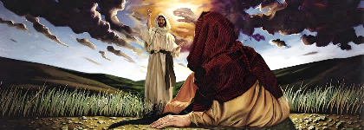
INTWARO ZO KURWANISHA
“kuko intwaro z’intambara yacu atari iz’abantu, ahubwo imbere y’Imana zigira imbaraga zo gusenya ibihome no kubikubita hasi” (2 Abakorinto 10:4)
Pawulo yashinjwe kuba umunyabwoba ugwa ikinya iyo ari mu bantu, nubwo mu nzandiko ze yakoreshaga imvugo ikarishye (2 Abakorinto 10:10).
Mu gusubiza iyi mitekerereze, Pawulo yagaragaje neza ko yumvaga ashoboye kuba umuntu ukarishye imbonankubone nk’uko byari biri mu nzandiko ze, ariko ko atashoboraga gukoresha “intwaro z’umubiri” (nk’igitugu, ibihano by’umubiri, cyangwa kwirata), ahubwo agakoresha gusa intwaro “zigira imbaraga imbere y’Imana” (2 Abakorinto 10:2–4).
Izi “ntwaro” zirimo gukorana kwicisha bugufi no gutuza nk’uko Kristo yabigenzaga (Matayo 11:29). Ariko kandi, nk’uko Yesu yabikoze, zisaba no guhagarara dushikamye turwanya ibibi (Matayo 21:12–13), cyangwa mu gihe gikwiriye tukavuga tweruye (Matayo 23:23–27).
Ububasha bwa Pawulo yabukomoraga kuri Kristo, kandi buri gihe akabukoresha yubaka, aho gusenya (2 Abakorinto 10:8).
Notes:
2 Corinthians 10:1-11

Slide 6






UBURYO BUKWIRIYE BWO KURENGERA UKURI
“Kuko uwiyogeza atari we ushimwa, keretse uwo Umwami wacu yogeza, ni we ushimwa.” (2 Abakorinto 10:18)
Abacurabwenge b’Abagiriki bashyuzaga umurengera abanyeshuri bashakaga kubigiraho. Kugira ngo bireherezeho abo banyeshuri, birataga ubumenyi bwabo, urwego rwabo mu mibereho, cyangwa abantu bakomeye babazi kandi babubaha. Ibi ni na byo byari imigenzo y’abigisha b’ibinyoma bacengeye i Korinto (2 Abakorinto 10:12; 11:19–20).
Ntimukihi-mbaze
Mureke Imana abe ari Yo ibogeza
Ariko Pawulo ntiyishyuzaga ukwigisha kwe, ntiyarataga ibyo kwemerwa n’abantu, cyangwa ngo yirate ubwe. Ibyo byatumye bamufata nk’usuzuguritse! Ese ni gute yashoboraga kwiregura?
Bisa nkaho yari akeneye gushimwa imbere y’Abakorinto kugira ngo yemerwe na bo. Ariko si we wagombaga kwishima ubwe (Imigani 27:2). Pawulo yarekeye Imana kuba ari Yo imushima (2 Abakorinto 10:18).
Niba hari ikintu dushobora kwirata cyangwa kwishimira ubwacu, ni ukumenya Imana no kuyumvira (Yeremiya 9:24; 2 Abakorinto 10:17).
Notes:
2 Corinthians 10:12-18

Slide 7


GUHANGANA N’ABIGISHA B’IBINYOMA

Slide 8





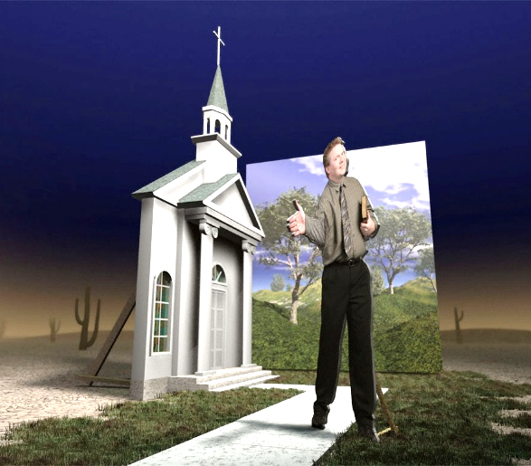
ABASHUKANYI BIGIRA INTUMWA
“Bene abo ni intumwa z’ibinyoma, ni abakozi bariganya bigira nk’intumwa za Kristo” (2 Abakorinto 11:13)
Pawulo yifuzaga gushyīra Kristo itorero riboneye (2 Abakorinto 11:2). Nyamara nka Eva, itorero ryari mu kaga ko gushukwa, no kureka kuba umugeni wa Yesu (2 Abakorinto 11:3).
Akaga nyirizina barimo kari akahe? Abayuda biyemeraga ko ari “intumwa zikomeye” za Yesu bari baje i Korinto bigisha “undi Yesu,” “umwuka wundi,” n’“ubutumwa bwiza bundi” (2 Abakorinto 11:4–5; Abagalatiya 1:8).
Kuba umuntu abwiriza ibya Yesu ntibivuze ko atwereka Yesu nyakuri, nk’uko Bibiliya imuduhishurira. Amagambo yabo ashobora kuba meza cyane, ariko Satani ubwe azi no kuvuga ibitangaza no kwigaragaza “nka marayika w’umucyo” (2 Abakorinto 11:14).
Mu byo abigisha nyakuri bakora n’ibyo bavuga, bigisha “ukuri kwa Kristo” (2 Abakorinto 11:9–10). Ariko abigisha b’ibinyoma, bicurira ugukiranuka, ni abakozi b’uburiganya biyoberanyije bakigira intumwa (2 Abakorinto 11:13–15).
Notes:
2 Corinthians 11:1-15

Slide 9




PAWULO N’ABIGISHA B’IBINYOMA
“Mbese abo si Abaheburayo? Nanjye ni uko. Si Abisirayeli? Nanjye ni uko. Si urubyaro rwa Aburahamu? Nanjye ni uko” (2 Abakorinto 11:22)
Ni ibihe bintu Pawulo n’abigisha b’ibinyoma bari bahuriyeho? Bose bari Abayuda bahindukiriye Ubukristo (2 Abakorinto 11:22).
Ni iki bari batandukaniyeho? Aha ni ho Pawulo abahagurukana akavuga ati: “Si abakozi ba Kristo bagabura ibye? (Noneho ndavuga nk’umusazi), ndabarusha” (2 Abakorinto 11:23). Niba abo bandi barirataga ko bababajwe kubwa Kristo, Pawulo yari kubarusha: yarakubiswe; yashyizwe mu nzu z’imbohe; yasimbutse urupfu kenshi; yatewe amabuye; yarohamye mu nyanja; yahuye n’ibyago by’uburyo bwose; yarashonje, yicwa n’inyota, imbeho no kwambara ubusa; yahoranaga impungenge ku bw’amatorero (2 Abakorinto 11:23b–29).
Aha ni ho “ubusazi” bwa Pawulo bugarukira. Ntiyashakaga gutanga igitekerezo cy’uko yifuza kwirata ibyo yakoreye Kristo. Ahubwo, ishema rye nyakuri (cyangwa icyo yishimiraga cyane) ni ibyo Kristo yamukoreye.
Imbaraga ze nyakuri zari mu ntege nke ze, zamuteye kwishingikiriza kuri Yesu byuzuye (2 Abakorinto 11:30–31; 12:6–10).
Notes:
2 Corinthians 11:16-31

Slide 10



KWISUZUMA NO KUNESHA
“Ngaho nimwisuzume ubwanyu, mumenye yuko mukiri mu byo twizera kandi mwigerageze. Mbese ntimwimenya kandi ntimuzi yuko Yesu Kristo ari muri mwe? Keretse ahari mubaye abagawa” (2 Abakorinto 13:5)
Igihe cyari cyegereje ubwo Pawulo yagombaga gusura i Korinto. Ni iki yari yiteze kubona kandi yari kubyitwaramo ate? (2 Abakorinto 13:1–2).
Pawulo yari yiteguye gukoresha ububasha nk’umushumba, agacyahana imbaraga: kugira ngo agarure abihannye, anahane abananiranye.
Ubwoba bwe bwari uko nahagera, yabasanga mu makimbirane n’ibyaha by’amahara-kwinshi. Yatinyaga kuririra abanyabyaha batihannye (2 Abakorinto 12:20–21).
Bityo rero, mbere y’uko icyo gihe kigera, Abakorinto bagombaga kwīnīra no kwisuzuma (2 Abakorinto 13:5).
Pawulo, ku ruhande rwe, yabasengeraga kugira ngo bareke gukora ibibi, ahubwo bakore ibyiza, kandi batunganywe (2 Abakorinto 13:7–9).
Notes:
2 Corinthians 11:16-31

Slide 11

“Abantu b’Imana bayoborwa ku Byanditswe Byera kugira ngo bibarinde abigisha b’ibinyoma n’imbaraga z’imyuka y’umwijima iyobya. Satani akoresha ubucakura bwose kugira ngo abuze abantu gusobanukirwa na Bibiliya; kuko ishyira ku mugaragaro ubuhendanyi bwe. Mu ihembura iryo ari ryo ryose ry’umurimo w’Imana, umutware w’ikibi arahaguruka agakorana umwete umurimo we; n’ubu arakoresha imbaraga zirenze urugero mu ntambara iheruka arwanya Kristo n’abayoboke Be. […] Azakoresha ubuhendanyi bukomeye busa n’ukuri ku buryo kubutahura bitazaba byoroshye uretse kuba warasomye Ibyanditswe Byera. Mu buhamya bw’abo biyitirira Kristo, ijambo ryose n’igitangaza cyose bigomba gusuzumanwa ubushishozi.”
E.G. White, Intambara Ikomeye, igice cya 37, p. 576

