Slide 1

UMUREMYI ARAVUGA
Icyigisho cya 1 cyo ku wa 3 Ukwakira 2026

Slide 2
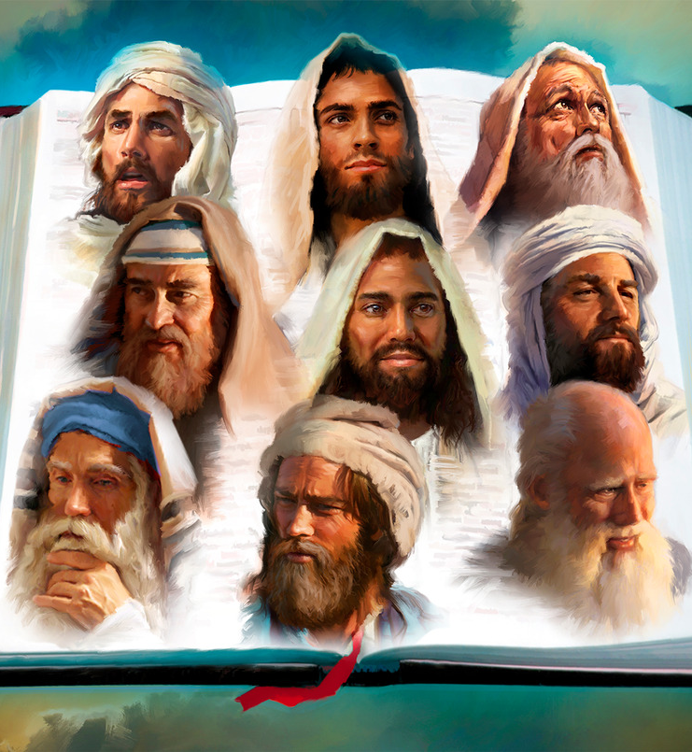
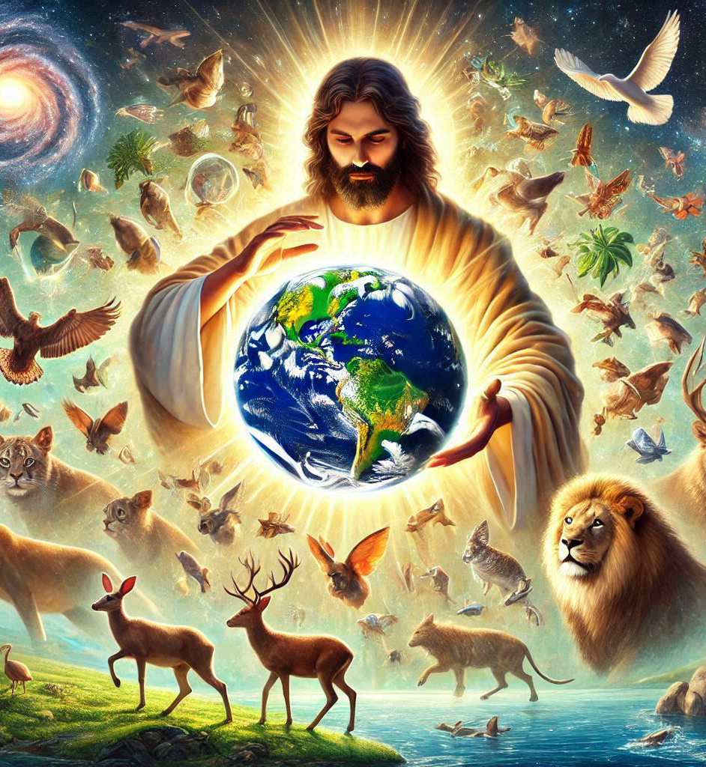
“Kera Imana yavuganiye na ba sogokuruza mu kanwa k’abahanuzi mu bihe byinshi no mu buryo bwinshi, naho muri iyi minsi y’imperuka yavuganiye natwe mu kanwa k’Umwana wayo, uwo yashyiriyeho kuba umuragwa wa byose ari we yaremesheje isi”
(Abaheburayo 1:1–2)

Slide 3



Ese wigeze uvugana n’Imana mu buryo butaziguye? Ese wigeze wumva amagambo yayo? Igisubizo, birumvikana, ni: “Oya.”
Dushobora kuvugana n’Imana gusa binyuze mu buryo butaziguye (gusenga, Bibiliya, abahanuzi, …)
Ni iyihe mpamvu ituma tudashobora kuvugana n’Imana mu buryo butaziguye? Ese byahoze bimeze gutya? Ese tuzigera tuvugana nayo amaso ku maso?
Ni gute Imana yavuganaga n’abantu mu ntangiriro?
1
Ni gute abantu bahagaritse kuvugana n’Imana?
2
Ni gute Imana yagerageje kugarura umushyikirano n’abantu?
3
Kuki ubu tudashobora kuvugana n’Imana amaso ku maso?
4
Ni gute twavugana n’Imana muri iki gihe?
5

Slide 4






NI GUTE IMANA YAVUGANAGA N’ABANTU MU NTANGIRIRO?
“Uwiteka Imana iramutegeka iti ‘Ku giti cyose cyo muri iyo ngobyi ujye urya imbuto zacyo uko ushaka’ ” (Itangiriro 2:16)
Mu ntangiriro, Imana yaremye isi kugira ngo abantu bayituremo (Yesaya 45:18).
Ibintu byose bimaze gutegurwa, yaremye Adamu mu mukungugu wo hasi (Itangiriro 2: 4–7).
Kuri uwo munsi, yaremye Eva mu rubavu rumwe rwa Adamu (Itangiriro 2:18, 21–22).
Inyokomuntu yari yuzuye kandi yiteguye gutura mu isi yari yaremwe ari nshya (Itangiriro 1:27).

Slide 5




NI GUTE IMANA YAVUGANAGA N’ABANTU MU NTANGIRIRO?
“Uwiteka Imana iramutegeka iti ‘Ku giti cyose cyo muri iyo ngobyi ujye urya imbuto zacyo uko ushaka’ ” (Itangiriro 2:16)
Muri ibyo bihe, habayeho umushyikirano ukomeye hagati y’Imana na Adamu :
Yamuhaye amabwiriza yerekeye umurimo yagombaga gukora muri Edeni (Itangiriro 2:15).
Yamweretse ingabano z’aho kutarenga (Itangiriro 2:16–17).
Yamusabye kwita amazina inyamaswa (Itangiriro 2:19).
Yamweretse Eva, maze abagira umwe mu gushyingiranwa (Itangiriro 2:22–24).

Slide 6




NI GUTE IMANA YAVUGANAGA N’ABANTU MU NTANGIRIRO?
“Uwiteka Imana iramutegeka iti ‘Ku giti cyose cyo muri iyo ngobyi ujye urya imbuto zacyo uko ushaka’ ” (Itangiriro 2:16)
Imana yabwiye Adamu na Eva uko bagombaga kwitwara n’ibyo bagombaga kurya (Itangiriro 1:2–29).
Yabaremye nk’abagomba kubana n’abandi, bafite ubushobozi bwo kuvugana, atari hagati yabo gusa, ahubwo n’ibindi biremwa (urugero: abamarayika).
Hanyuma yaremye umunsi wa karindwi kugira ngo bashobore kwishimana muri uwo munsi wose.
Kuva icyo gihe, yahuraga nabo buri munsi mu gihe cy’amafu (Itangiriro 3:8).

Slide 7

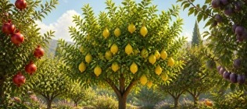
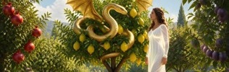



NI GUTE ABANTU BAHAGARITSE KUVUGANA N’IMANA?
“Arayisubiza ati “Numvise imirindi yawe muri iyi ngobyi, ntinyishwa n’uko nambaye ubusa, ndihisha” (Itangiriro 3:10)
Adamu na Eva baremwe bafite ubushobozi bwo guhitamo uko bashaka. Kugira ngo bakoreshe uwo mudendezo, Imana yabahaye byose, ariko yikubitira igiti (Itangiriro 2:16–17).
Kuri icyo giti, ni ho umushukanyi, wihinduye nk’inzoka kandi yigira nk’ushakira Adamu na Eva imibereho myiza, yabashukishije urukurikirane rw’ibinyoma (ibyo Eva yagejeje kuri Adamu): ntimushobora gupfa (“ntimuzapfa”); muzaba imana (“muzaba nk’Imana”); Imana ibahisha ukuri (“Imana izi ko…”) (Itangiriro 3:1–5).
Eva yashimishijwe n’ibitangaje by’imbuto bari barabujijwe, aryaho maze ashukashuka Adamu, na we ararya (Itangiriro 3:6).
Muri ako kanya, umwambaro w’ubwiza wari ubatwikiriye wabavuyeho; bamenya ko bambaye ubusa; maze bishakira ibisubizo byo guhisha ikosa ryabo (Itangiriro 3:7).
Icyakurikiyeho ni uko bumvaga bafite ikidodo cyo kutumvira kwabo ku buryo batashakaga kongera kuvugana n’Imana (Itangiriro 3:8).

Slide 8





NI GUTE IMANA YAGERAGEJE KUGARURA UMUSHYIKIRANO?
“Uwiteka Imana ihamagara uwo mugabo, iramubaza iti ‘Uri he?’ ” (Itangiriro 3:9)
Imana yari izi ko Adamu na Eva bakoze icyaha; ariko nk’uko byari bisanzwe, yarabegereye kugira ngo iganire nabo. Bwa mbere, aho gusohoka ngo bayisanganire bishimye, byabaye ngombwa ko ibahamagara ngo bayisanganire (Itangiriro 3:8–9).
Nubwo batashakaga kuvugana n’Imana, Imana yashakaga kuvugana nabo. Ntiyigeze yirinda kubana n’umunyabyaha, ahubwo yamusanze ari mu cyaha cye, imuhendahendera kwihana (Itangiriro 3:10–11).
Nyuma y’ibinyejana byinshi, Imana yarebanye undi munyabyaha ijisho rimuhendahendera kwihana: Petero (Luka 22:61–62).
Bitandukanye na Petero, wemeye icyaha cye, Adamu na Eva batangiye kwigira intungane imbere y’Imana no guherereza ahandi icyaha cyabo (Itangiriro 3:12–13).
Muri iki gihe, dukurikiza inzira nk’izo. Twizirika ku cyaha kandi tukagerageza kwitsindishiriza. Nubwo icyaha “kitwiziringaho”, Imana iracyashaka kutugarura, kandi iraturarika iti: “Nimuze aho ndi” (Yesaya 55:3).

Slide 9




KUKI UBU TUDASHOBORA KUVUGANA N’IMANA AMASO KU MASO?
“Nuko yirukana uwo muntu, kandi mu ruhande rw’iyo ngobyi yo muri Edeni rwerekeye iburasirazuba, ishyiraho Abakerubi n’inkota yaka umuriro, izenguruka impande zose, ngo ibuze inzira ijya kuri cya giti cy’ubugingo” (Itangiriro 3:24)
Ingaruka kuri :
Ababyeyi bacu ba mbere bamaze gucumura, bagaragarijwe n’Imana ingaruka z’icyaha cyabo, zirimo no kudashobora kongera kuvugana n’Imana nyuma yo kwirukanwa muri Edeni (Itangiriro 3:16–24).
Eva
Kubabara mu gihe cyo kubyara
Gutakaza uburinganire bwe na Adamu
Adamu
Gukora agatutubikana
Kuruhira kubona ibyokurya
Bose
Urupfu
Gutandukana n’Imana
Mbere yo gutangaza ingaruka z’icyaha, Imana yabahaye igisubizo: urubyaro rwa Eva ruzakuraho imbaraga za Satani kandi rugakomorera abantu (Itangiriro 3:15).
Imana ibinyujije mu bahanuzi, yavuze uburyo gucungurwa kwagombaga gusohozwa: Imana ubwayo yigize umuntu, ipfa kubera ibyaha byacu, irazuka, kandi iduha ubugingo buhoraho (Yesaya 9:6; 53:6, 10–11).
Icyaha kikimara kubaho, isezerano ry’Umukiza naryo ryahise ritangwa.

Slide 10


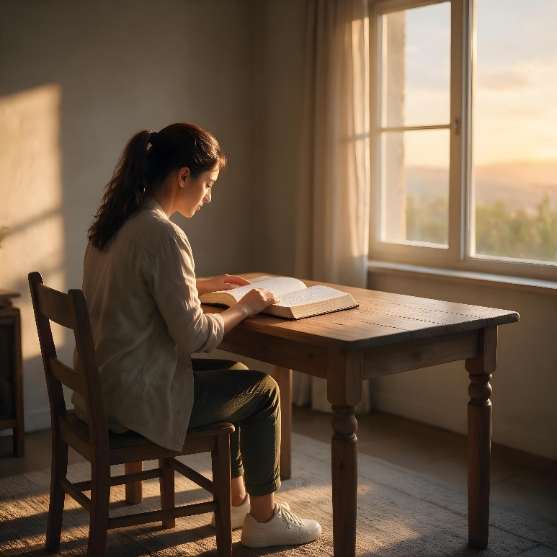


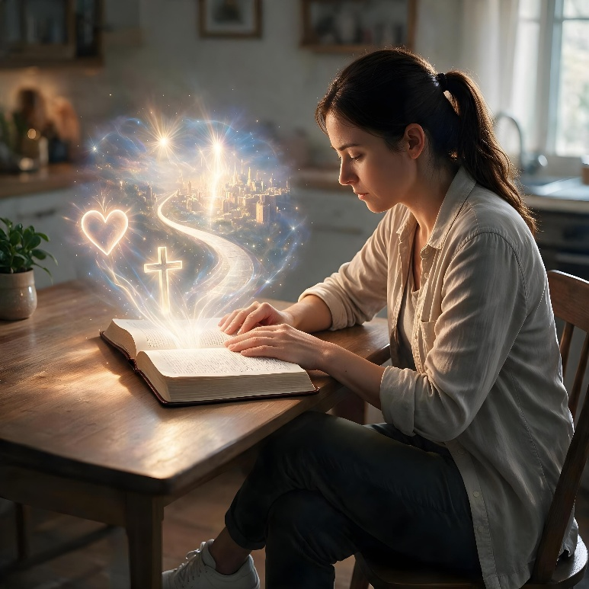

NI GUTE TWAVUGANA N’IMANA MURI IKI GIHE?
“Nuko rero mwana w’umuntu, nagushyiriyeho kuba umurinzi w’umuryango wa Isirayeli, nuko wumve ijambo riva ku kanwa kanjye, ubanyihanangirize.”
(Ezekiyeli 33:7)
Kugira ngo Imana ivugane natwe none, yanditse “ibitabo bibiri ngenderwaho”: Ibyaremwe, na Bibiliya (Abaroma 1:20; 2 Timoteyo 3:15).
Nubwo Ibyaremwe bitubwira iby’Umuremyi, byahindanijwe cyane n’icyaha. Ariko, Bibiliya irimo amabwiriza asobanutse neza kandi ataziguye, yatanzwe n’abahanuzi bahawe ubutumwa buturutse ku Mana. Muri Bibiliya, tunasangamo uburyo Imana yigaragaza neza cyane mu mibereho ya Yesu no mu murimo We (Abaheburayo 1:1–2).
Muri yo, tumenya abo turi bo, aho tuva n’aho tujya. Aho ni ho tubonera umugambi w’Imana ku buzima bwacu.
Byongeye kandi, Imana ivugana natwe binyuze mu gusenga (Zaburi 5:2), abamarayika (Ibyakozwe 8:26), abahanuzi (Yoweli 2:28), ndetse mu buryo bwihariye, binyuze muri Mwuka Wera (Yohana 14:26).

Slide 11

“Hagombaga kubaho ugukorana hagati y’umuntu n’Imana. Ariko iyi gahunda yahungabanyijwe cyane no kugwa kwa Adamu. Satani yamuyoboye ku gucumura, kandi nyuma yaho ntabwo Uwiteka yashoboraga gukomeza kuvuganaga na we nk’uko byahoze mbere yo kugwa.
Nyuma yo kugwa kwa Adamu, Kristo yamubereye umwigisha. Yakoze mu mwanya w’Imana yita ku nyokomuntu, abakiza urupfu rw’ako kanya. Yafashe umwanya w’umuhuza. Adamu na Eva bahawe igihe cy’imbabazi kugira ngo basubire ku budahemuka bwabo, kandi urubyaro rwabo rwose rwari rukubiye muri iyi gahunda.
Iyo hatabaho impongano y’Umwana w’Imana, nta buryo Imana yajyaga kugeza ku muntu umugisha cyangwa agakiza. Imana yafuhiraga icyubahiro cy’amategeko yayo. Gucumura kuri ayo mategeko byateje umworera uteye ubwoba hagati y’Imana n’umuntu. Adamu mu butungane bwe yari yarahawe kugirana n’Umuremyi we umushyikirano, utaziguye, mu bwisanzure, ndetse n’umunezero. Nyuma y’uko umuntu arenze ku mategeko y’Imana, Imana yavuganaga n’umuntu binyuze kuri Kristo n’abamarayika gusa.”
E.G. White, Conflict and Courage, January 14

Slide 12




UMUGEREKA: IMIBEREHO YA ELINA G. WHITE
Elina Gulude na Elizabeti Harumoni, abahererezi (impanga) mu bana umunani ba Yunisi na Roberi Harumoni, bavutse ku ya 26 Ugushyingo 1827 i Goruhamu, muri Meyine, muri Leta Zunze Ubumwe za Amerika.
Nyuma gato umuryango wimukiye i Potilande, umujyi ukomeye muri Meyine, kugira ngo bāgūre ubucuruzi bwabo bwo gukora ingofero.
Ubwo Elina yari afite imyaka icyenda, umunyeshuri biganaga yamuteye ibuye, rimutera igikomere gikomeye mu maso. Icyo gikomere cyamuteye ingaruka zirambye zatumye areka ishuri kandi zigabanya ibyo gusabana n’abandi mu buzima bwe.
Umuryango wakiriye inyigisho za Wiliyamu Mileri, maze Elina abatizwa mu itorero rya Metodisiti mu 1842.
Ariko Elina yiyumvaga nk’uwazimiye, kandi yibwira ko adakwiriye agakiza, kugeza ubwo Pasiteri Levi Sitokimani yamufashije gusobanukirwa urukundo nyakuri rw’Imana.
Kuva ubwo, yakunze Yesu cyane maze amukorera ubuzima bwe bwose.

