Slide 1

Icyigisho cya 4 cyo ku wa 24 Ukwakira 2026
ABAHANUZI BO MU ISEZERANO RISHYA

Slide 2
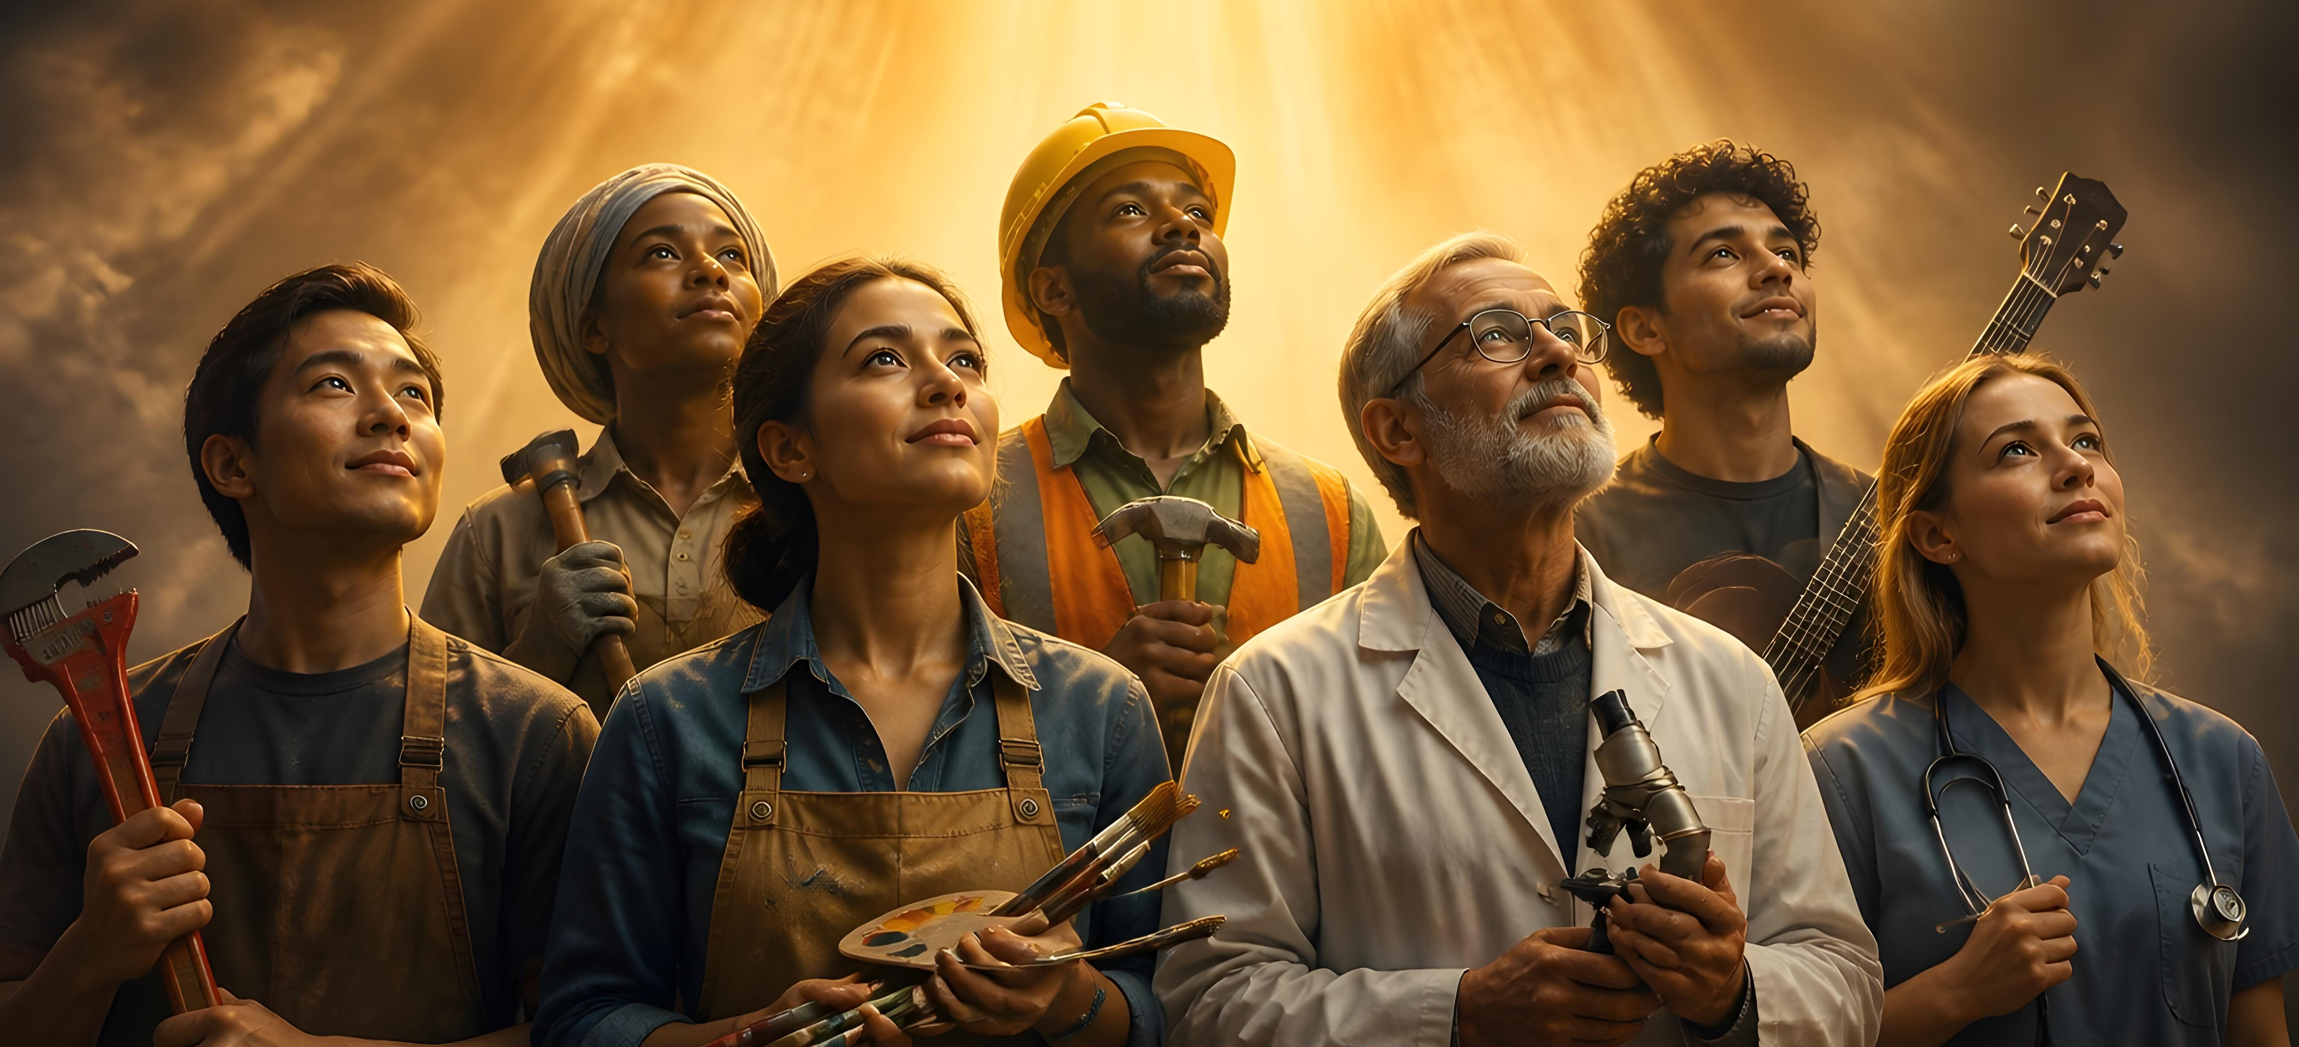
“Icyakora hariho impano z’uburyo bwinshi, ariko Umwuka ni umwe. Kandi hariho uburyo bwinshi bwo kugabura iby’Imana, ariko Umwami ni umwe. Hariho n’uburyo bwinshi bwo gukora, ariko Imana ikorera byose muri bose ni imwe” (1 Abakorinto 12:4–6)

Slide 3










Kuva kuri Malaki, imyaka 400 yarashize nta jwi ry’umuhanuzi n’umwe ryumvikana mu bwoko bw’Imana. Kubera uko guceceka, Abisirayeli babonaga ko urutonde rw’Ibyanditswe Byera (ni ukuvuga ibitabo bigize Isezerano rya Kera) rusojwe.
Ariko, Imana ntiyakomeje guceceka igihe kirekire. Igihe gikwiriye gisohoye, yohereje umuhanuzi mushya: Yohana Umubatiza (Matayo 11:7–9). Kuva icyo gihe, abahanuzi bongeye kugaragara. Mu nshingano nyinshi bari bafite, banashinzwe kwandika Isezerano Rishya.
Ni izihe nshingano aba bahanuzi n’abahanuzikazi bashya bari bafite? Bari bande? Ese hanabayeho abahanuzi b’ibinyoma, nk’uko byagenze mu gihe cy’Isezerano rya Kera?
Uruhare rw’abahanuzi mu Isezerano Rishya
Abahanuzi bo mu Isezerano Rishya:
  Yesu, umuhanuzi wahanuwe
  Intumwa n’abahanuzi
  Abahanuzikazi
  Abakoranye na Pawulo
  Abahanuzi b’ibinyoma

Slide 4




URUHARE RW’ABAHANUZI MU ISEZERANO RISHYA
“Ariko uhanura we abwira abantu ibyo kubungura n’ibyo kubahugura, n’ibyo kubahumuriza” (1 Abakarinto 14:3)
Mu Isezerano Rishya, ubuhanuzi bugaragazwa nk’impano y’Umwuka Wera, yasutswe cyane (Abaroma 12:6). Mu itorero rimwe hashoboraga kubaho abahanuzi benshi ku buryo bagombaga gusimburana kuvuga (1 Abakorinto 14:29–31).
Ni uruhe ruhare abo bahanuzi bagize? (Ibyahishuwe 19:10; 1:1; Abefeso 4:11–12; 1 Abakorinto 14:3; Ibyakozwe 15:32).
Guhamya Yesu
Inshingano nyamukuru kwari ukuyobora abantu kuri Yesu
Gutangaza iby’ejo hazaza
Bahishuye ibintu byakomeje kubaho kugeza n’ubu
Kubaka
Kubaka itorero rikomeye rishobora kwihanganira ibitero by’umwanzi
Guhugura
Kuvuga icyaha mu izina ryacyo, kugira ngo abantu bihane
Guhumuriza
Yuda na Sila boherejwe mu matorero kubera iyi mpamvu yihariye

Slide 5




ABAHANUZI BO MU ISEZERANO RISHYA

Slide 6






YESU, UMUHANUZI WAHANUWE
“Uwiteka Imana yawe izabahagurukiriza umuhanuzi umeze nkanjye ukomotse hagati muri mwe, muri bene wanyu, azabe ari we mwumvira.” (Gutegeka kwa Kabiri 18:15)
Abo mu gihe cya Yesu bamufataga nk’umuhanuzi (Matayo 21:11; Mariko 6:15; Luka 7:16; Yohana 6:14).
We ubwe yiyise atyo (Mariko 6:4; Luka 13:33).
Petero yavuze ko Yesu yari Umuhanuzi/Mesiya wahanuwe na Mose n’abandi bahanuzi (Gutegeka 18:15; Ibyakozwe 3:18–26).
Nyamara Yesu ntabwo yanditse Ijambo ry’Imana, ahubwo ni IJAMBO (Yohana 1:1).
Si “itabaza rimurikira ahacuze umwijima” gusa, nk’uko byari ku bandi bahanuzi, ahubwo ni UMUCYO (2 Petero 1:19; Yohana 1:9; 8:12).
Umurimo We urenze uw’umuhanuzi uwo ari we wese. Yesu ni We wenyine ushobora kuduha twese ubugingo buhoraho binyuze mu mibereho Ye, urupfu Rwe, no kuzuka Kwe.

Slide 7





INTUMWA N’ABAHANUZI
“Ubwo ntibwamenyeshejwe abana b’abantu mu bindi bihe, nk’uko muri iki gihe intumwa ze zera n’abahanuzi babuhishuriwe n’Umwuka” (Abefeso 3:5)
Intumwa n’abahanuzi bo mu Isezerano Rishya bafite ibintu bahuriyeho:
Ni abantu batumwe n’Imana (Luka 11:49)
Bahawe impano zo kuyobora itorero (1 Abakorinto 12:28–29; Abefeso 4:11–12)
Babaye imfatiro z’itorero (Abefeso 2:20)
Bahawe amahishurwa (Abefeso 3:5)
Bishimira ubutabera (Ibyahishuwe 18:20)
Iyo bavugiwe hamwe, intumwa zibanziriza abahanuzi (usibye muri Luka 11:49). Petero agereranya intumwa n’abahanuzi ba kera (2 Petero 3:2).
Intumwa zahawe umwihariko wihariye wo kuba abahamya bo kuzuka kwa Yesu ubwe (Ibyakozwe 10:40–41).
Isezerano Rishya rivuga abahanuzi benshi, bamwe mu mazina yabo: Barinaba (intumwa), Simoni, Lukiyosi, Manayeni, Sawuli (intumwa), Yuda, Sila, na Agabo (Ibyakozwe 11:27; 13:1; 15:32; 19:6–7; 21:10).

Slide 8






ABAHANUZIKAZI
“Uwo yari afite abakobwa bane b’abari bahanuraga” (Ibyakozwe n’Intumwa 21:9)
Umuhanuzikazi rukumbi uvugwa mu izina rye mu Isezerano Rishya ni Ana, “avuga ibya Yesu abibwira bose bari bategereje gucungurwa kw’i Yerusalemu” (Luka 2:36–38).
Abakobwa bane b’umuvugabutumwa Filipo nabo bahawe impano yo guhanura (Ibyakozwe 21:8–9).
Byongeye kandi, ubuhanuzi buvugwa nk’impano rusange, haba ku bagore no ku bagabo (1 Abakorinto 11:4–5).
Yoweli yavuze mbere y’igihe ko Umwuka Wera azakorera mu bantu ku buryo abahungu, abakobwa, abasaza, abasore, abagaragu n’abaja bazahanura (Yoweli 2:28–29).

Slide 9



ABAKORANYE NA PAWULO
“Mwana wanjye Timoteyo, ndakwihanangiriza nkurikije ubuhanuzi bwa kera bwahanuye ibyawe, kugira ngo buduheshe kurwana intambara nziza.” (1 Timoteyo 1:18)
Uretse intumwa, abahanuzi n’abahanuzikazi, hari bamwe mu bafashaga Pawulo aho, kimwe na Sila na Barinaba, nabo bari bafite impano yo guhanura :
TIMOTEYO
Umuhamagaro we wo gukorera Imana wari warahanuwe (1 Timoteyo 1:18). Yafatanyije na Pawulo kwandika inzandiko: 2 Abakorinto (2 Abakorinto 1:1), Abafilipi (Abafilipi 1:1), Abakolosayi (Abakolosayi 1:1), 1 Abatesalonike (1 Abatesalonike 1:1), 2 Abatesalonike (2 Abatesalonike 1:1), na Filemoni (Abafilipi 1:1).
TITO
Yakoze imirimo myinshi ya gihanuzi, nko kwigisha (2 Abakorinto 8:6), guhugura (Tito 2:6, 9, 15), no guhumuriza (2 Abakorinto 7:13)

Slide 10





ABAHANUZI B’IBINYOMA
“Bakundwa, ntimwizere imyuka yose ahubwo mugerageze imyuka ko yavuye ku Mana, kuko abahanuzi b’ibinyoma benshi badutse bakaza mu isi.” (1 Yohana 4:1)
Yesu yatanze umuburo ko hazabaho abahanuzi b’ibinyoma, abo yise “amasega aryana” (Matayo 24:24; 7:15). Abo bahanuzi b’ibinyoma batangiye kugaragara no mu itorero rya mbere (1 Yohana 4:1).
Pawulo yaburiye abakuru b’i Efeso ko “amasega aryana” yajyaga kuvuka muri bo (Ibyakozwe 20:29). Yaburiye Abakorinto ko hariho “intumwa z’ibinyoma” (2 Abakorinto 11:13).
Ubuhanuzi bw’ukuri buhuza n’Ijambo ry’Imana, bwerekeza abantu kuri Kristo, kandi bukubaka itorero, mu gihe abahanuzi b’ibinyoma bashyigikira inyigisho zishingiye ku macakubiri n’indamu zabo bwite.
Twebwe abizera duhamagariwe gusuzuma abahanuzi no kwemeza ko ubutumwa bwabo bwose buhuye n’Ibyanditswe Byera kandi bushingiye kuri Kristo.
Ingabo rukumbi yadukingira abahanuzi b’ibinyoma (n’imbaraga mbi zibakoresha) ni ukwambara intwaro Imana yaduhaye (Abefeso 6:10–18).

Slide 11

“Abakurambere, abahanuzi n’intumwa bavuze bayobowe n’Umwuka Wera, kandi bavuze neza ko batavugaga ku bubasha bwabo cyangwa mu izina ryabo. Bifuzaga ko batagomba guhabwa ishimwe, ko hatagira ubabona nk’aho ari bo batangije ikintu cyose cyaba icyo kwiratana. Bari bafite ifuhe ryo guharira icyubahiro Uwiteka, We ukwiriye ishimwe ryose. Bavuze ko ubushobozi bwabo ndetse n’ubutumwa bazanye babihawe nk’intumwa z’imbaraga z’Imana. Imana ni Yo yari ububasha bwabo no kunyurwa bwabo.”
E.G. White, To Be Like Jesus, July 30

Slide 12





UMUGEREKA: AMAHAME Y’INGENZI Y’UMURIMO WA ELINA G. WHITE
Umurimo wa Elina G. White wari ufite intego ebyiri z’ingenzi: kuzana abantu kuri Yesu; no kwerekeza intekerezo zabo kuri Bibiliya.
INKINGI YA MBERE: YESU
Nyuma y’inama ya 1888, ubwo yari abajijwe ku ngingo zaganiriweho, yarasubije ati: “Namaze imyaka 45 mbibagezaho—imico ntagereranywa ya Kristo” (Sermons and Talks, vol. 1, p. 116) .
INKINGI YA KABIRI: BIBILIYA
Elina ntiyigeze avuga ko inyandiko ze ziruta Bibiliya ahubwo yahoraga asaba ko zigeragereshwa Bibiliya. Nk’intumwa y’Umwami, yabonaga we ari nk’“umucyo muto” uyobora abantu ku “mucyo munini”, ari wo Bibiliya (Ubutumwa Bwatoranyijwe, igitabo cya 3, p. 29).

