Slide 1
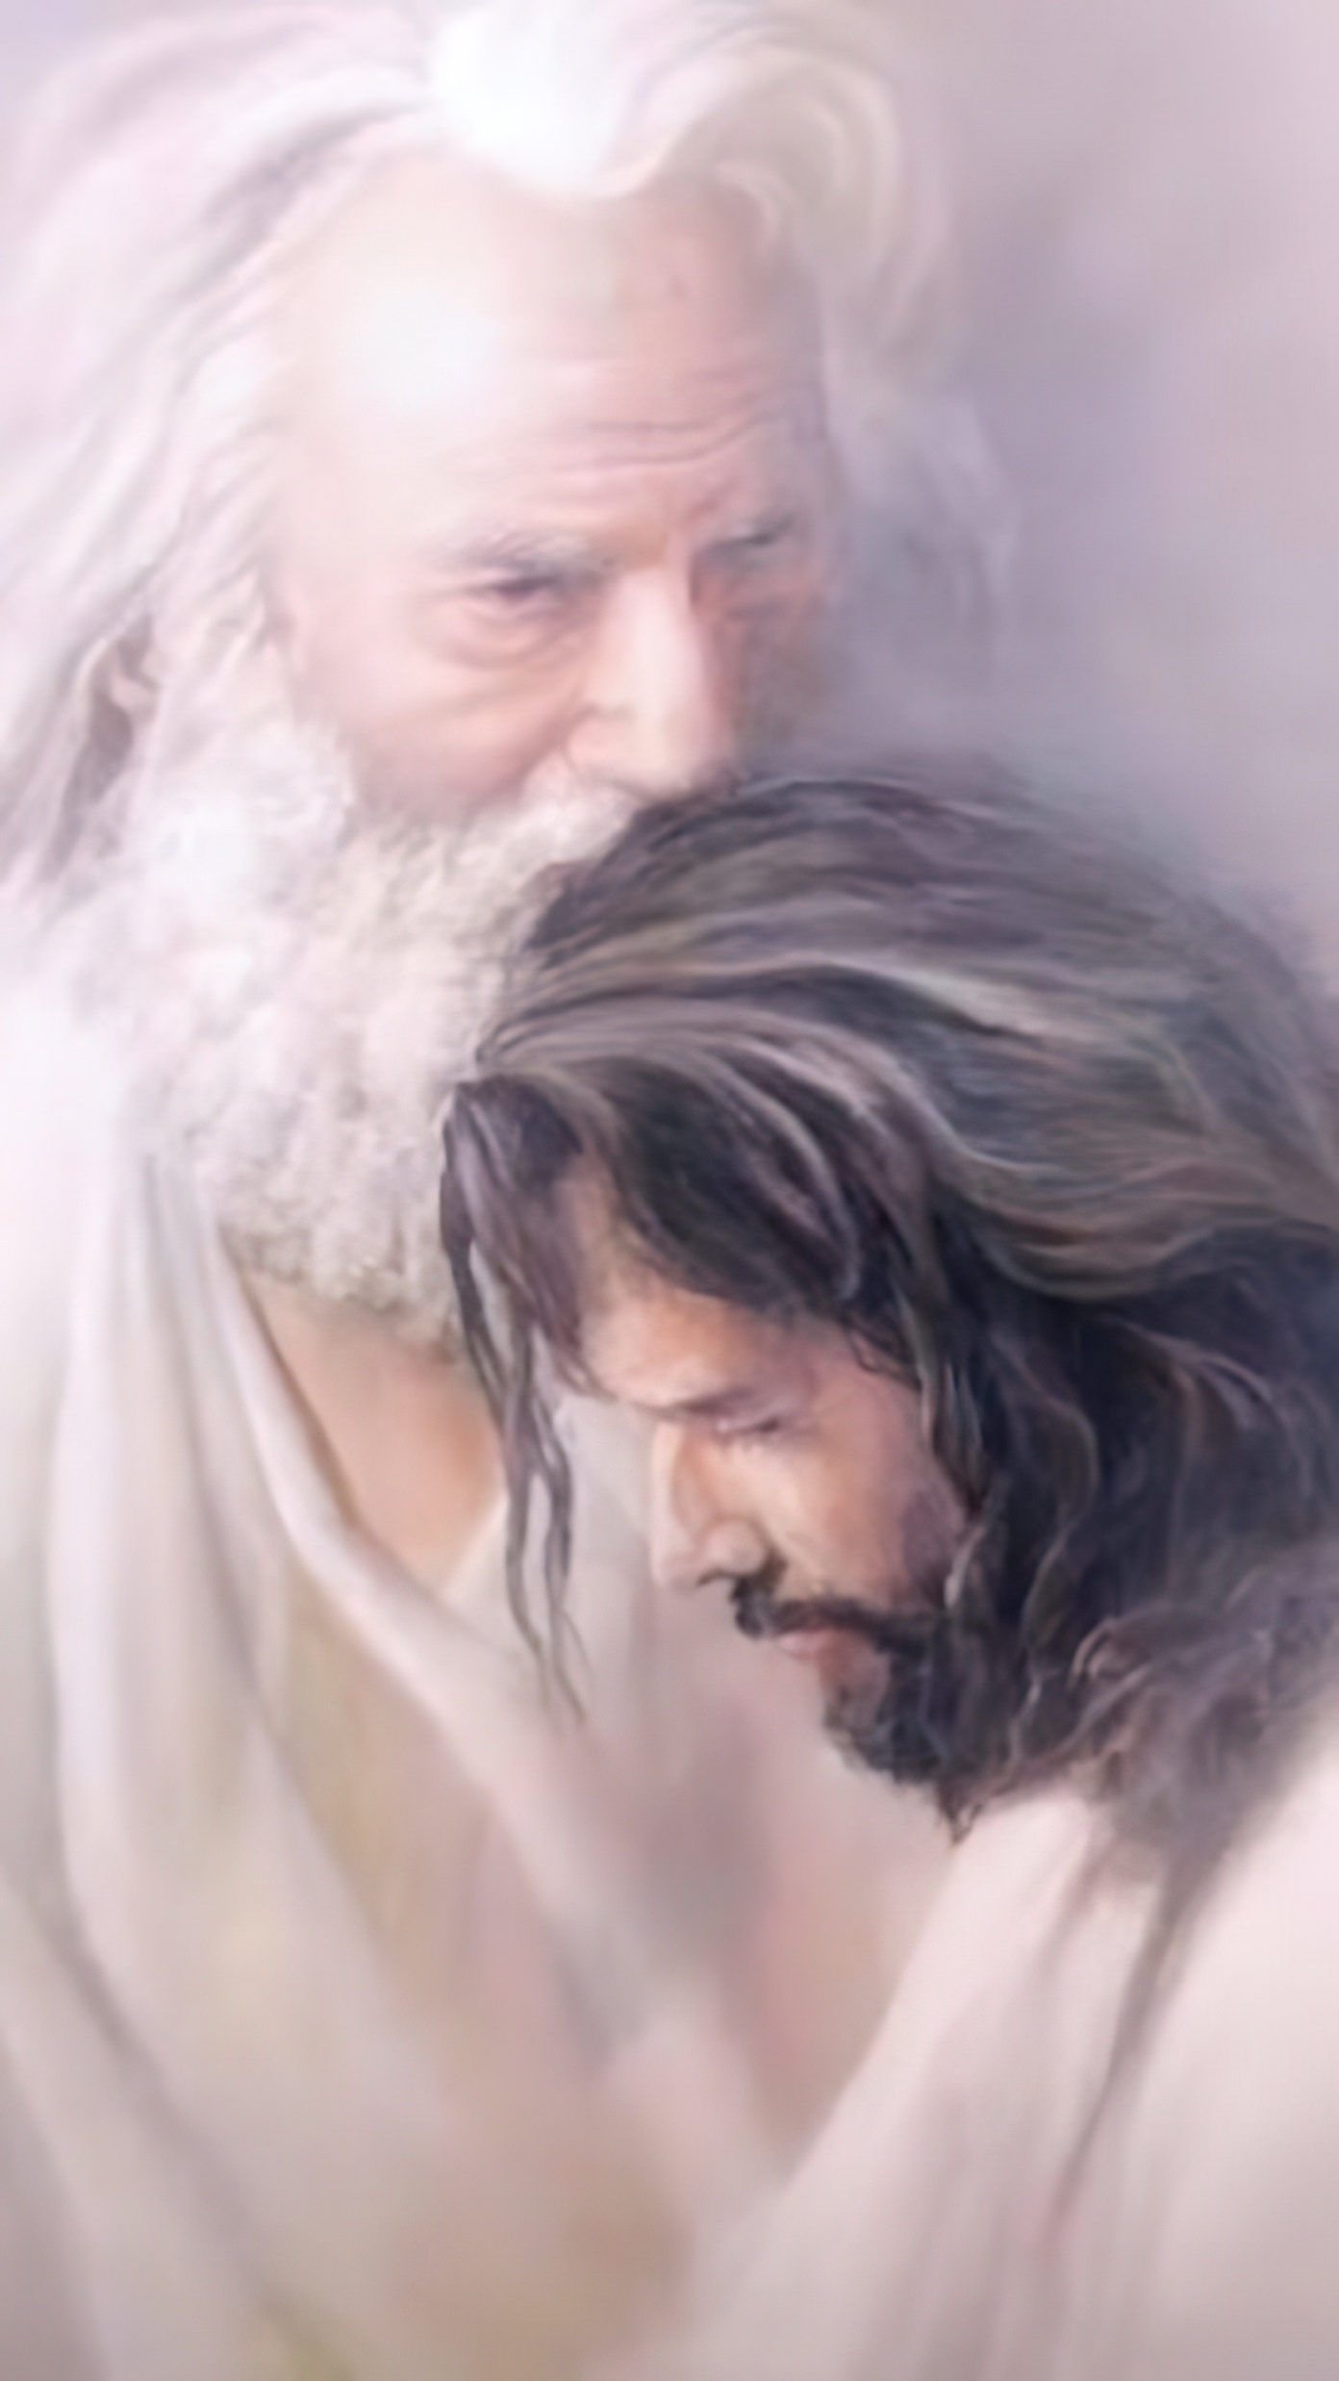
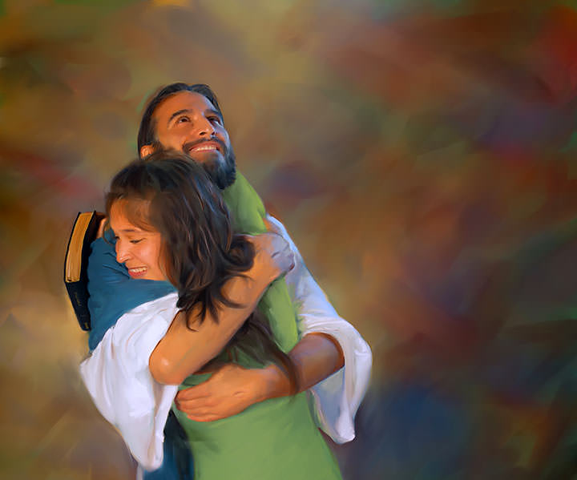
“Uko Data yankunze ni ko nanjye nabakunze. Nuko rero mugume mu rukundo rwanjye”
(Yohana 15:9)

Slide 2
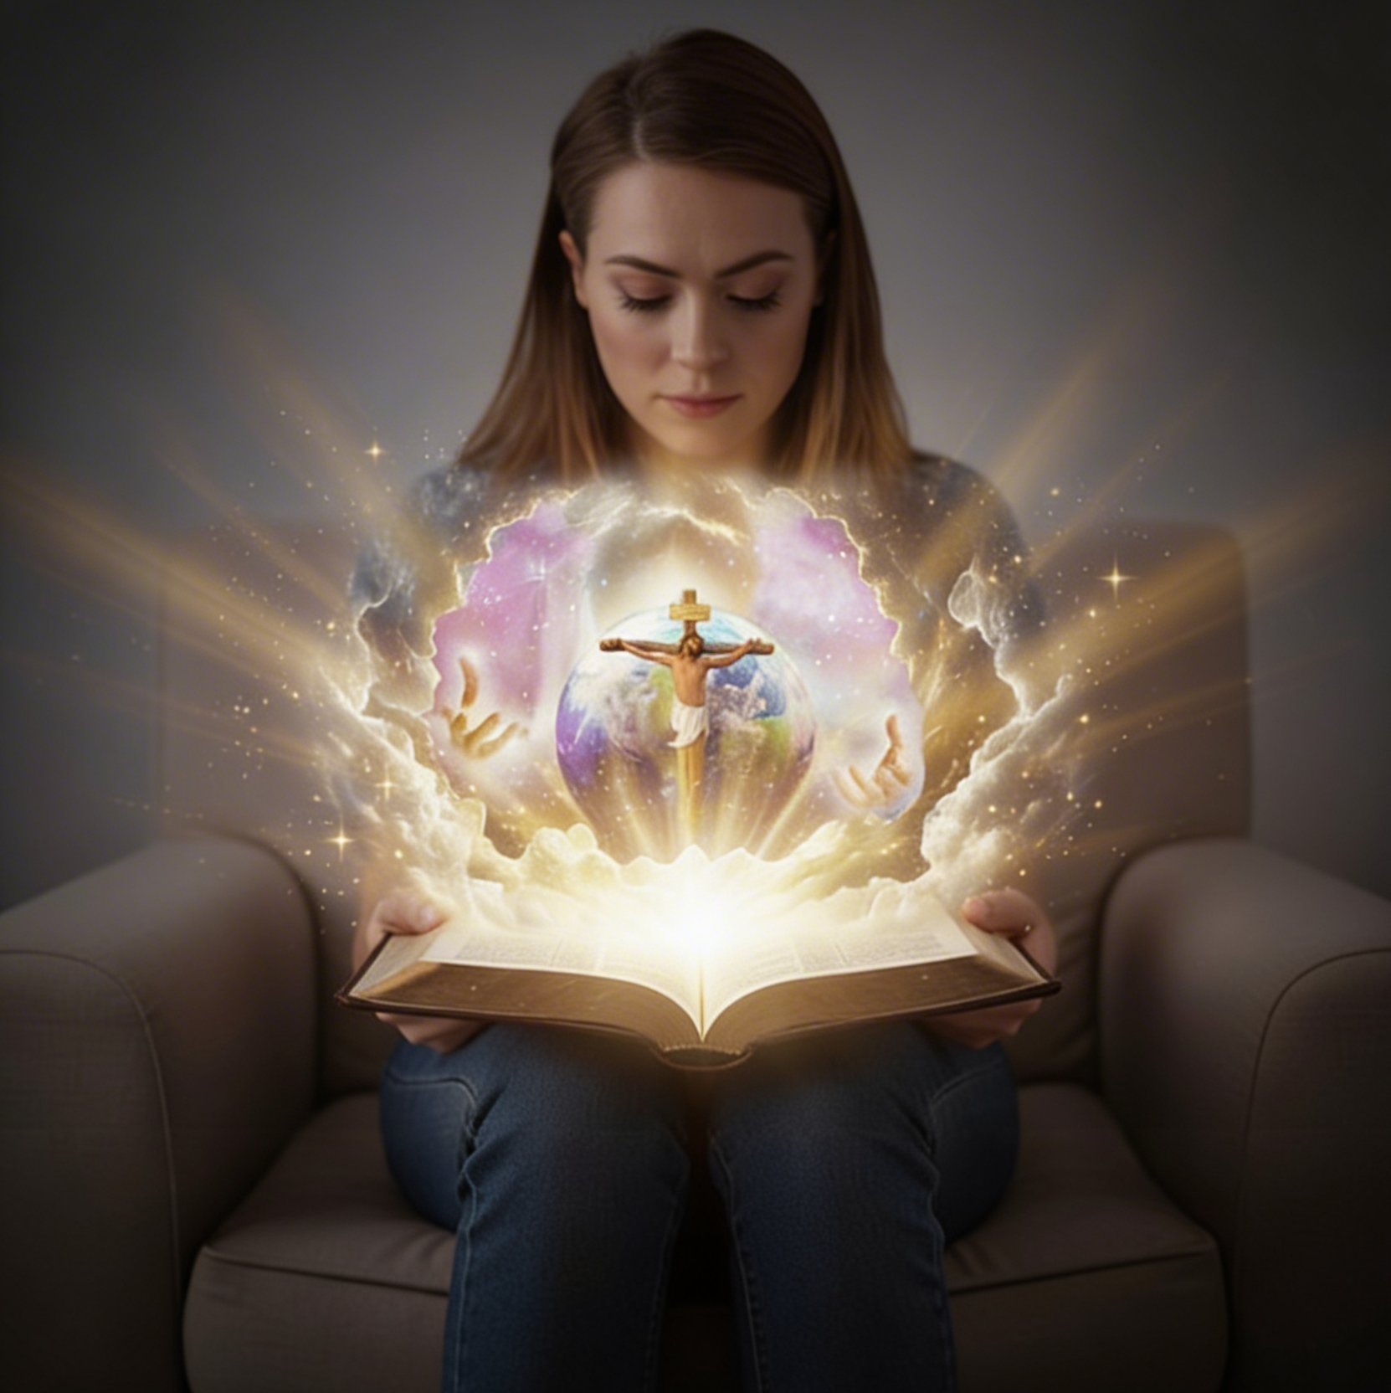
“Ubu ni bwo bugingo buhoraho, ko bakumenya ko ari wowe Mana y’ukuri yonyine, bakamenya n’uwo watumye ari we Yesu Kristo”
(Yohana 17:3)

Slide 3

“Kuko umuntu wese wishyira hejuru azacishwa bugufi, kandi uwicisha bugufi azashyirwa hejuru”
(Luka 14:11)

Slide 4

“Kuko ijambo ry’Imana ari rizima, rifite imbaraga kandi rikagira ubugi buruta ubw’inkota zose, rigahinguranya ndetse kugeza ubwo rigabanya ubugingo n’umwuka, rikagabanya ingingo n’umusokōro kandi rikabangukira kugenzura ibyo umutima wibwira ukagambirira” (Abaheburayo 4:12)
Notes:
Buscar en biblia-espada

Slide 5

“Ni ko ijambo ryanjye riva mu kanwa kanjye rizamera. Ntirizagaruka ubusa ahubwo rizasohoza ibyo nshaka, rizashobora gukora icyo naritumye” (Yesaya 55:11)

Slide 6

“Nkundira Uwiteka, Kuko yumvise ijwi ryanjye no kwinginga kwanjye. Kuko yantegeye ugutwi, Ni cyo gituma nzajya mwambaza nkiriho”
(Zaburi ya 116:1, 2)

Slide 7
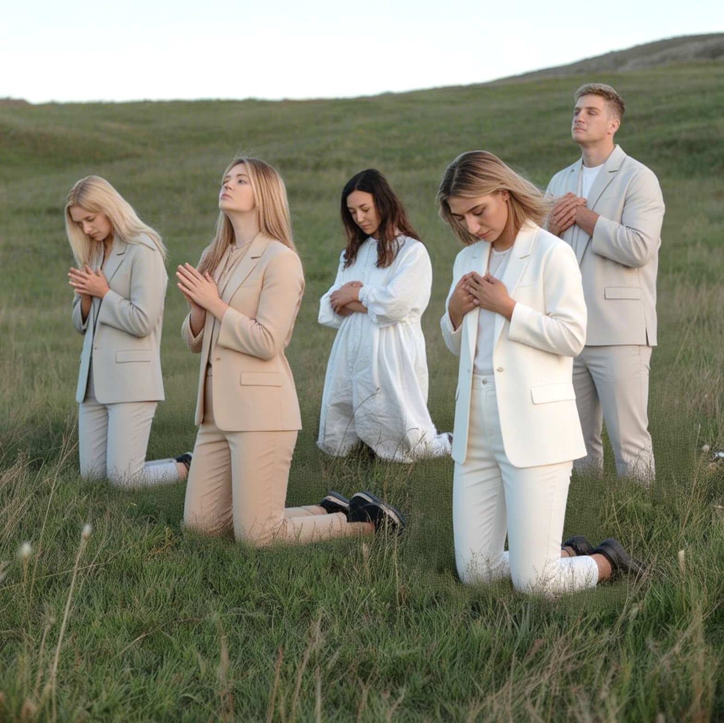
“Mwa bantu mwe, mujye muyiringira, Ibyo mu mitima yanyu mubisuke imbere yayo, Imana ni yo buhungiro bwacu”
(Zaburi ya 62:8)

Slide 8

“Kwizera ni ukumenya rwose ibyiringirwa udashidikanya ko bitazaba, kandi ni ko kuduhamiriza ibyo tutareba ko ari iby’ukuri”
(Abaheburayo 11:1)

Slide 9
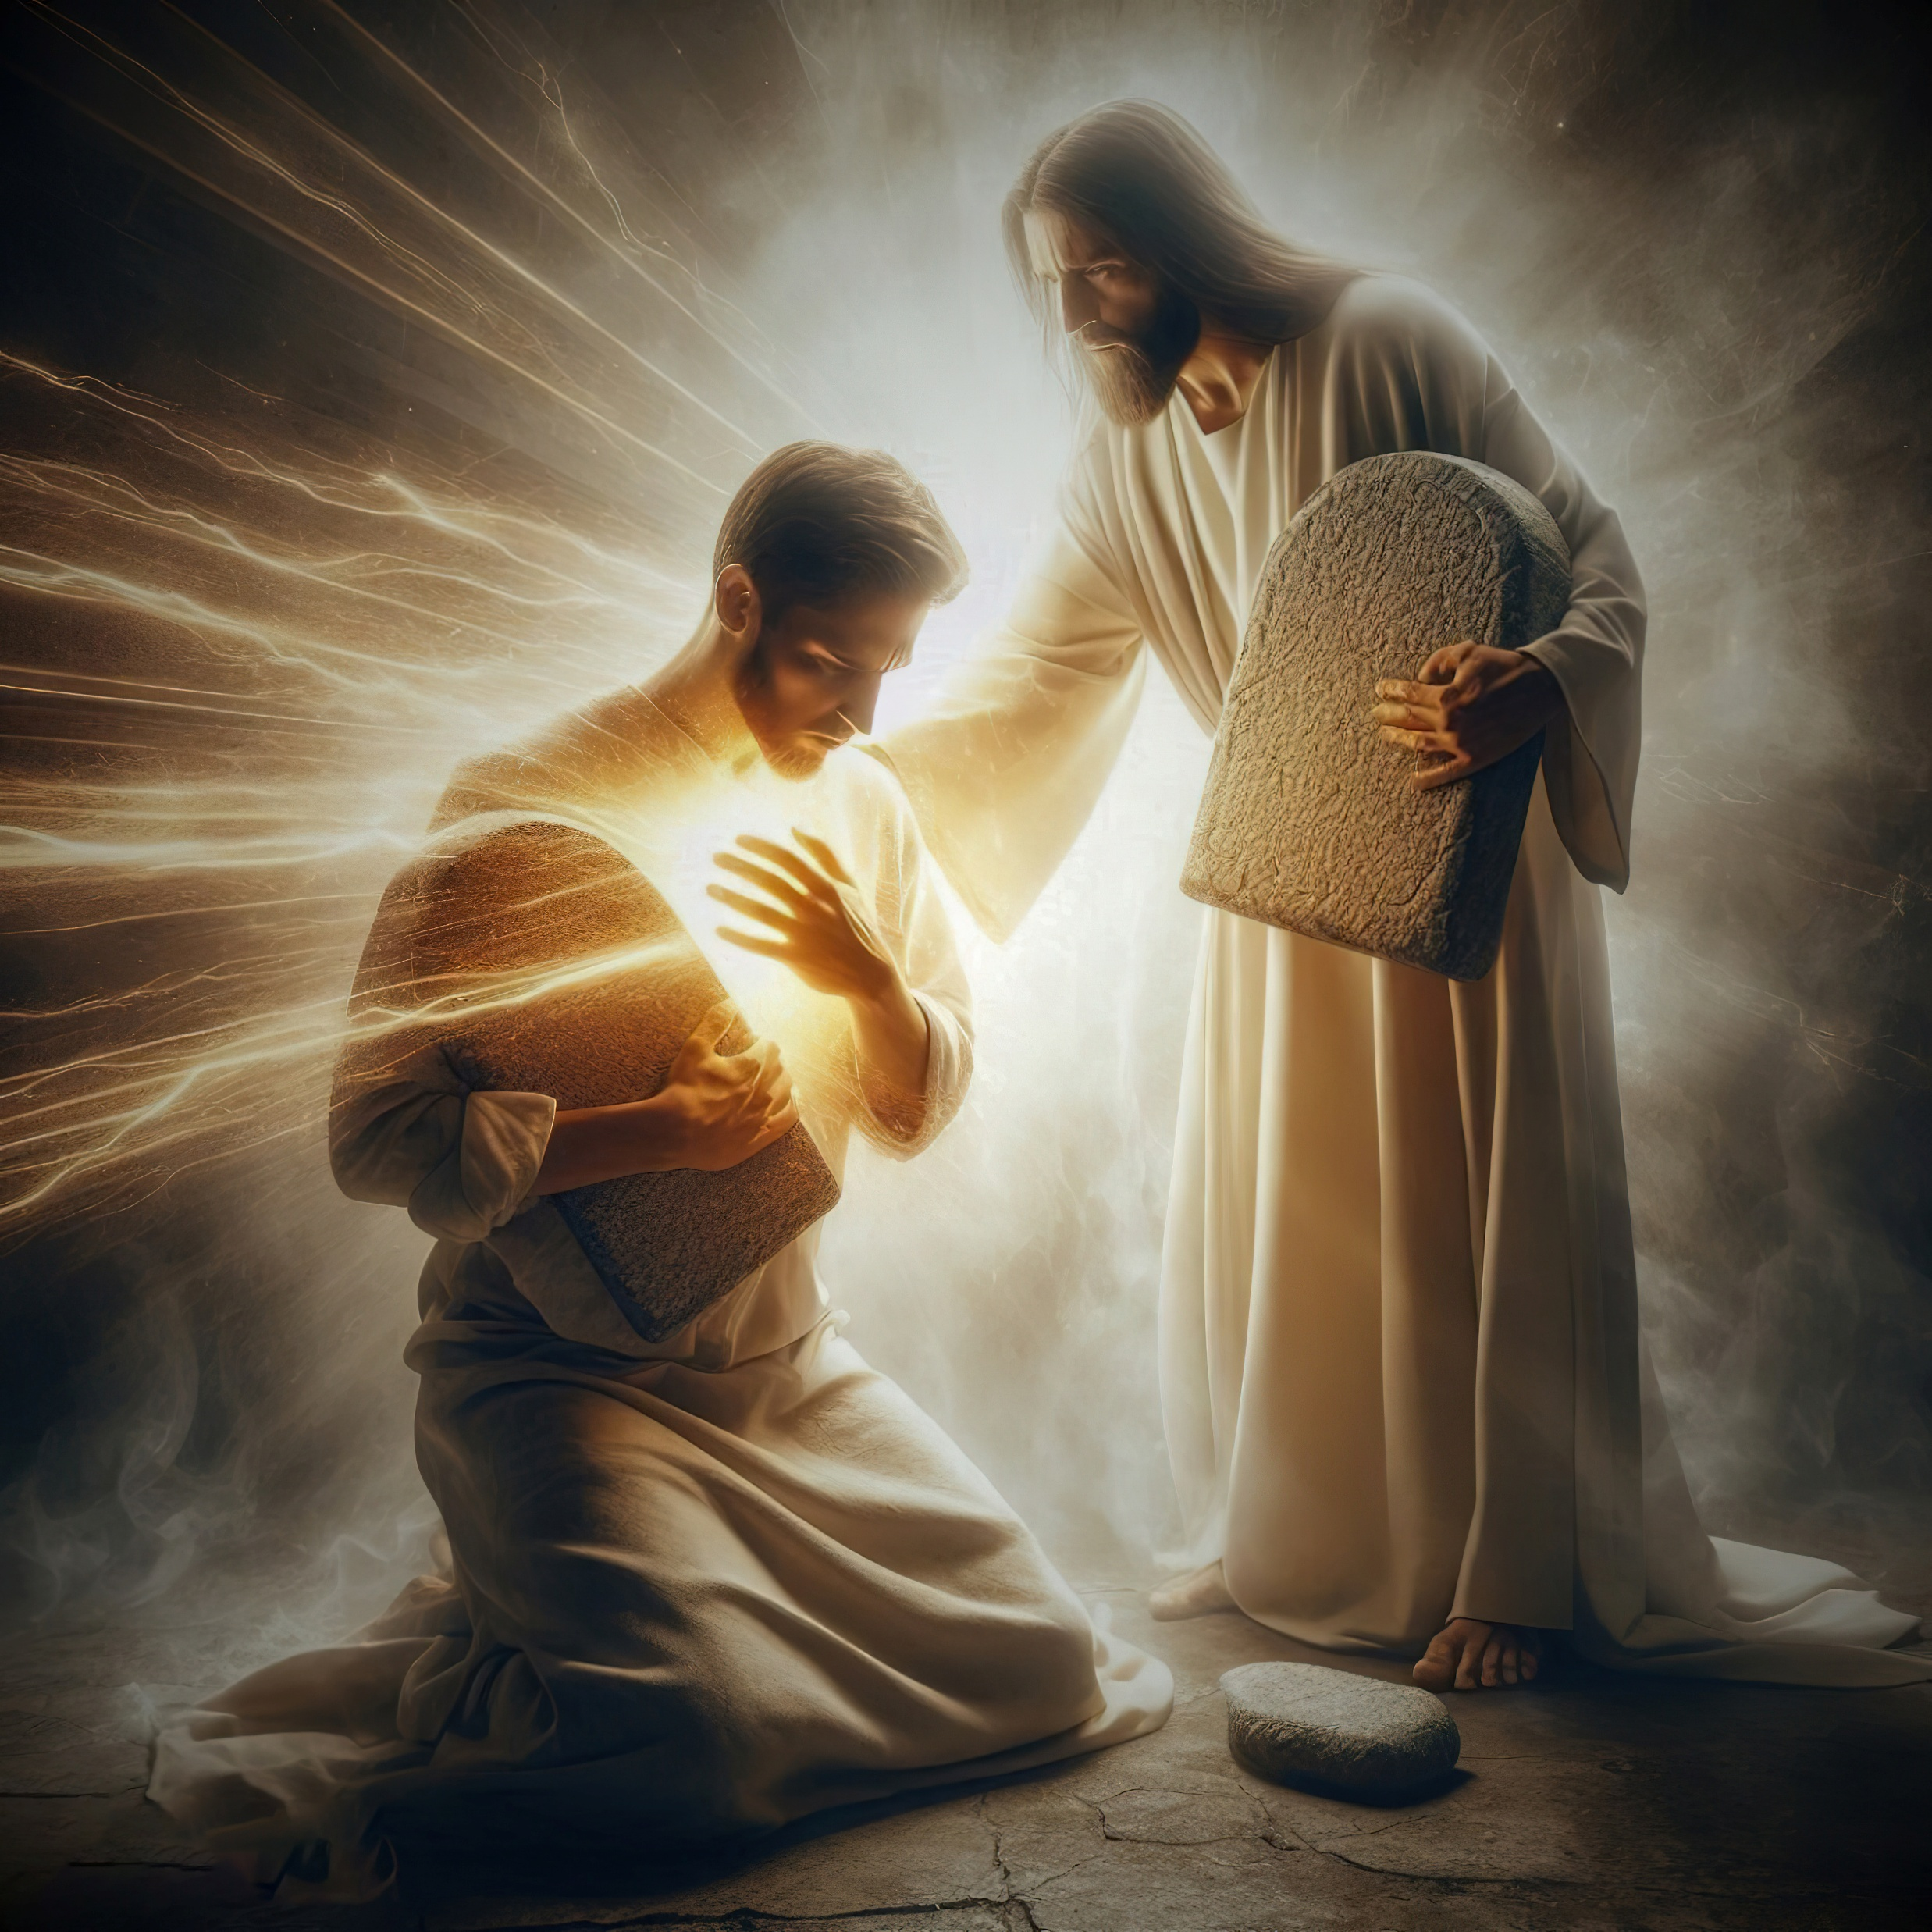
“Ntabwo nzibagirwa amategeko wigishije, Kuko ari yo wanzurishije. Ndi uwawe nkiza, Kuko ndondora amategeko wigishije”
(Zaburi ya 119:93, 94)

Slide 10
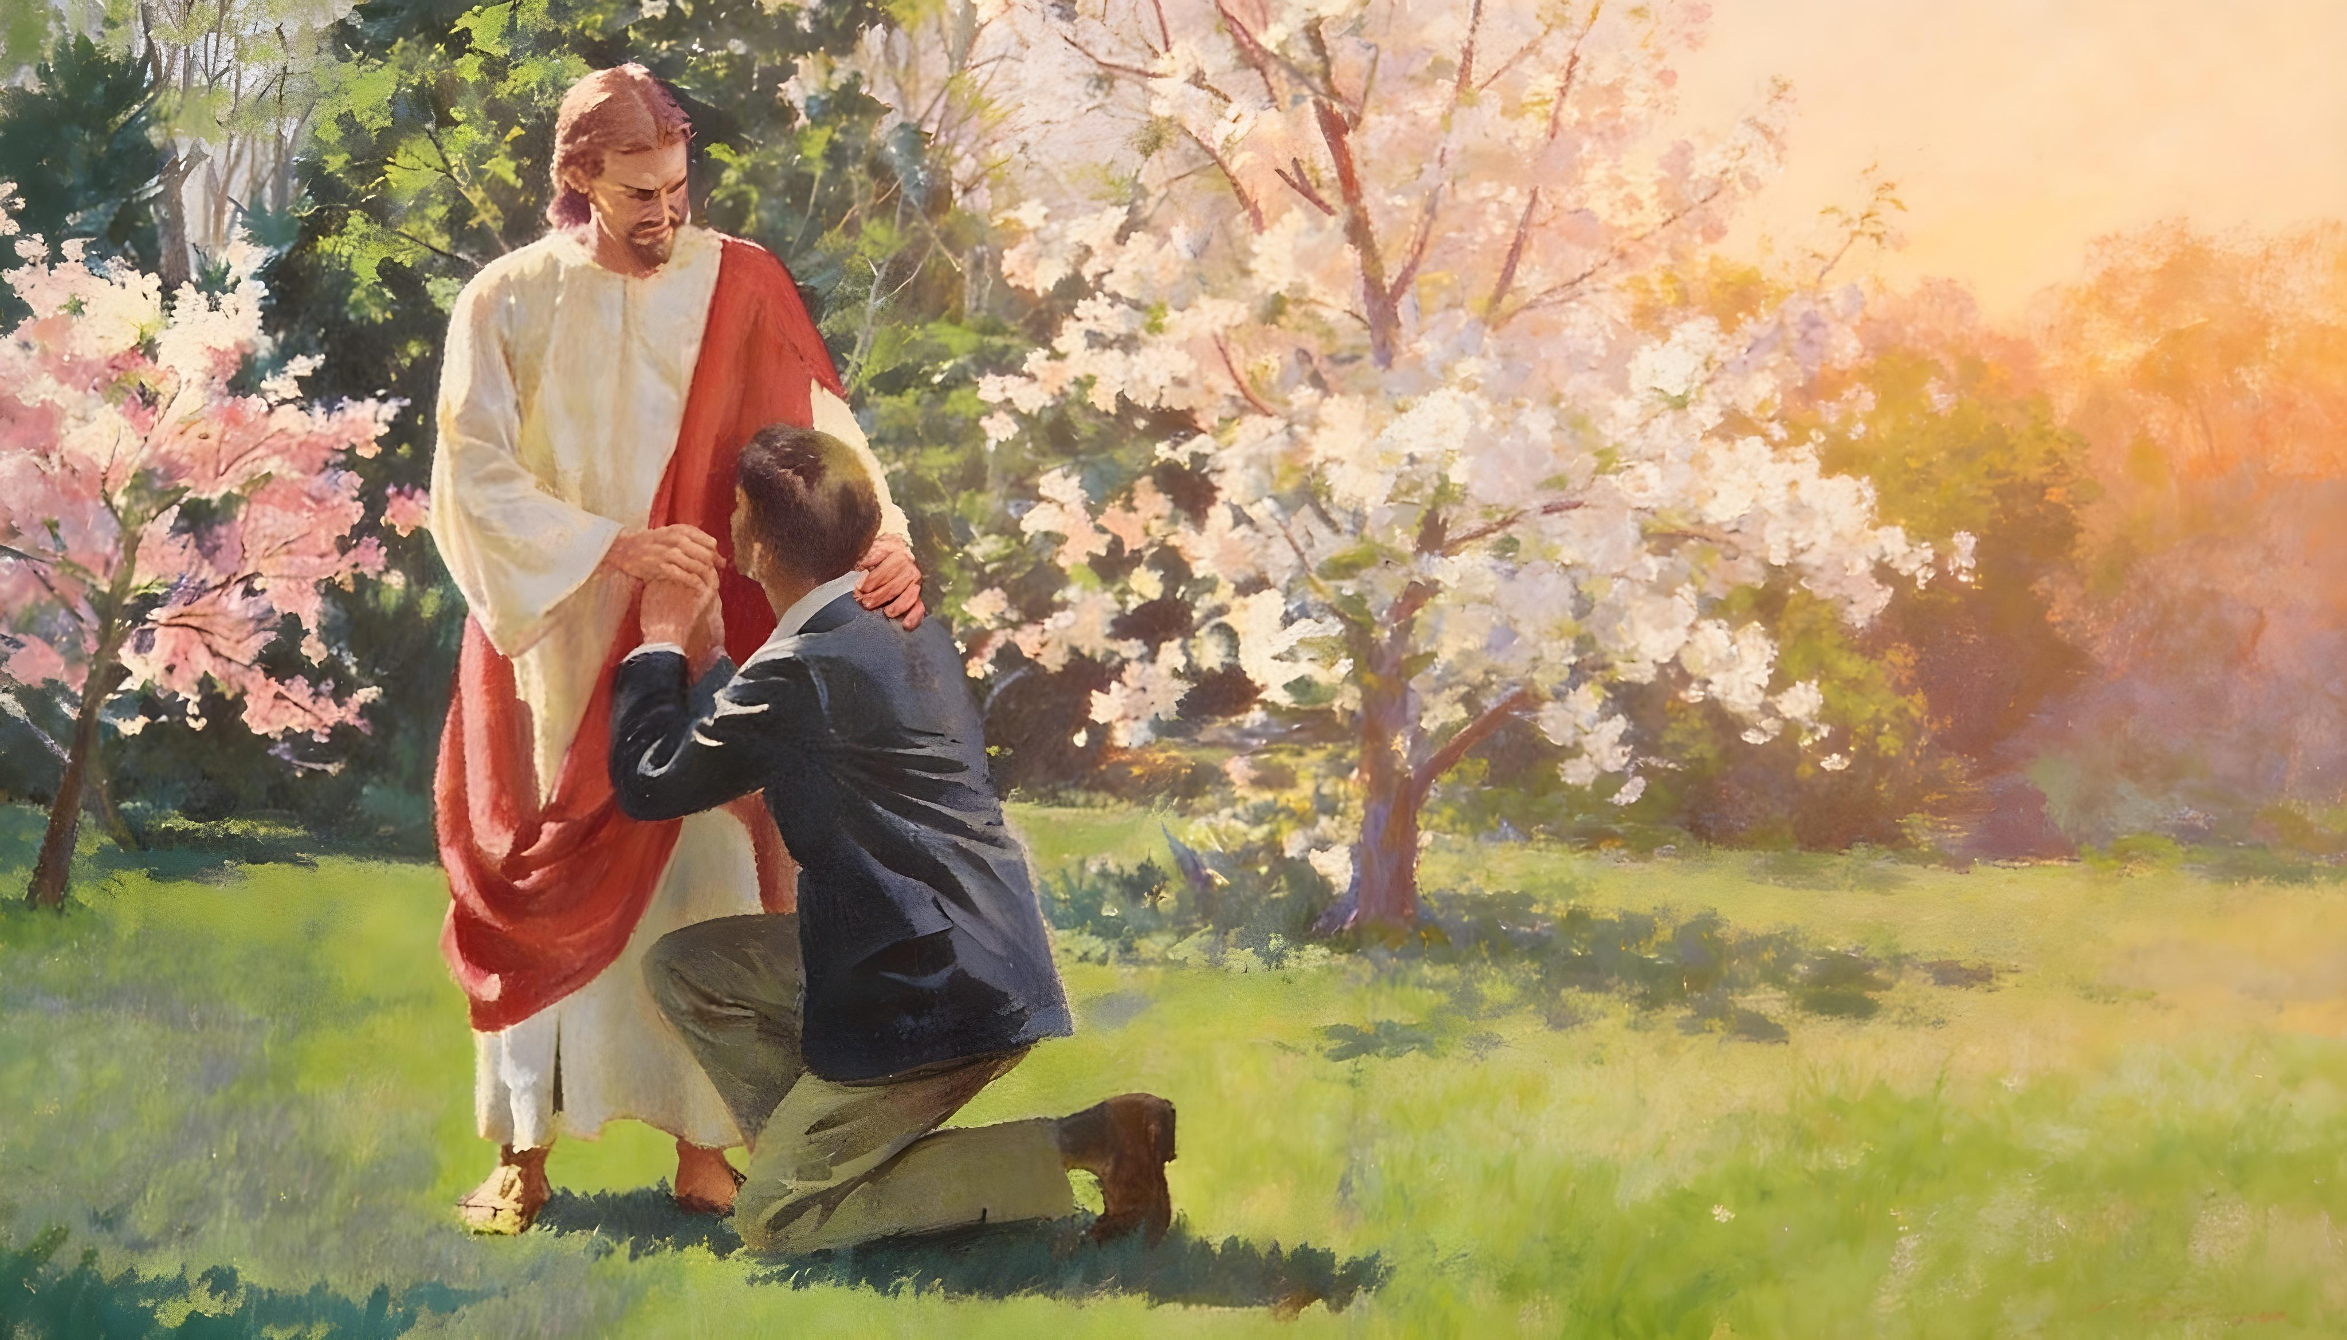
“Ariko nitwatura ibyaha byacu, ni yo yo kwizerwa kandi ikiranukira kutubabarira ibyaha byacu no kutwezaho gukiranirwa kose”
(1 Yohana 1:9)

Slide 11
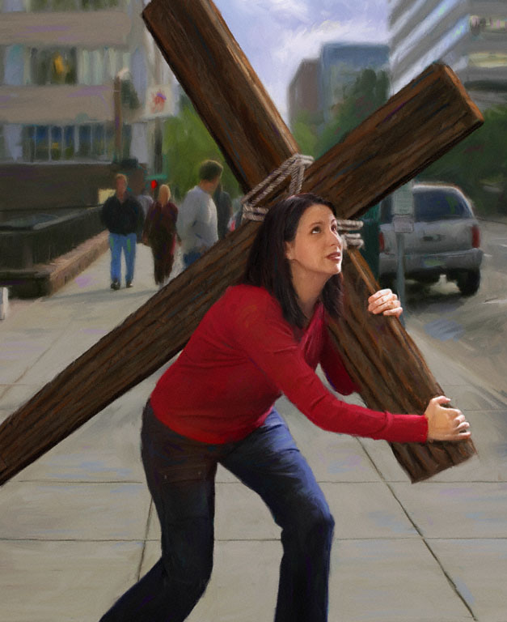

“Ariko si ibyo byonyine, ahubwo twishimira no mu makuba yacu, kuko tuzi yuko amakuba atera kwihangana, kandi kwihangana kugatera kunesha ibitugerageza, uko kunesha kugatera ibyiringiro. Bene ibyo byiringiro ntibikoza isoni, kuko urukundo rw’Imana rwasabye mu mitima yacu ku bw’Umwuka Wera twahawe”
(Abaroma 5:3–5)

Slide 12
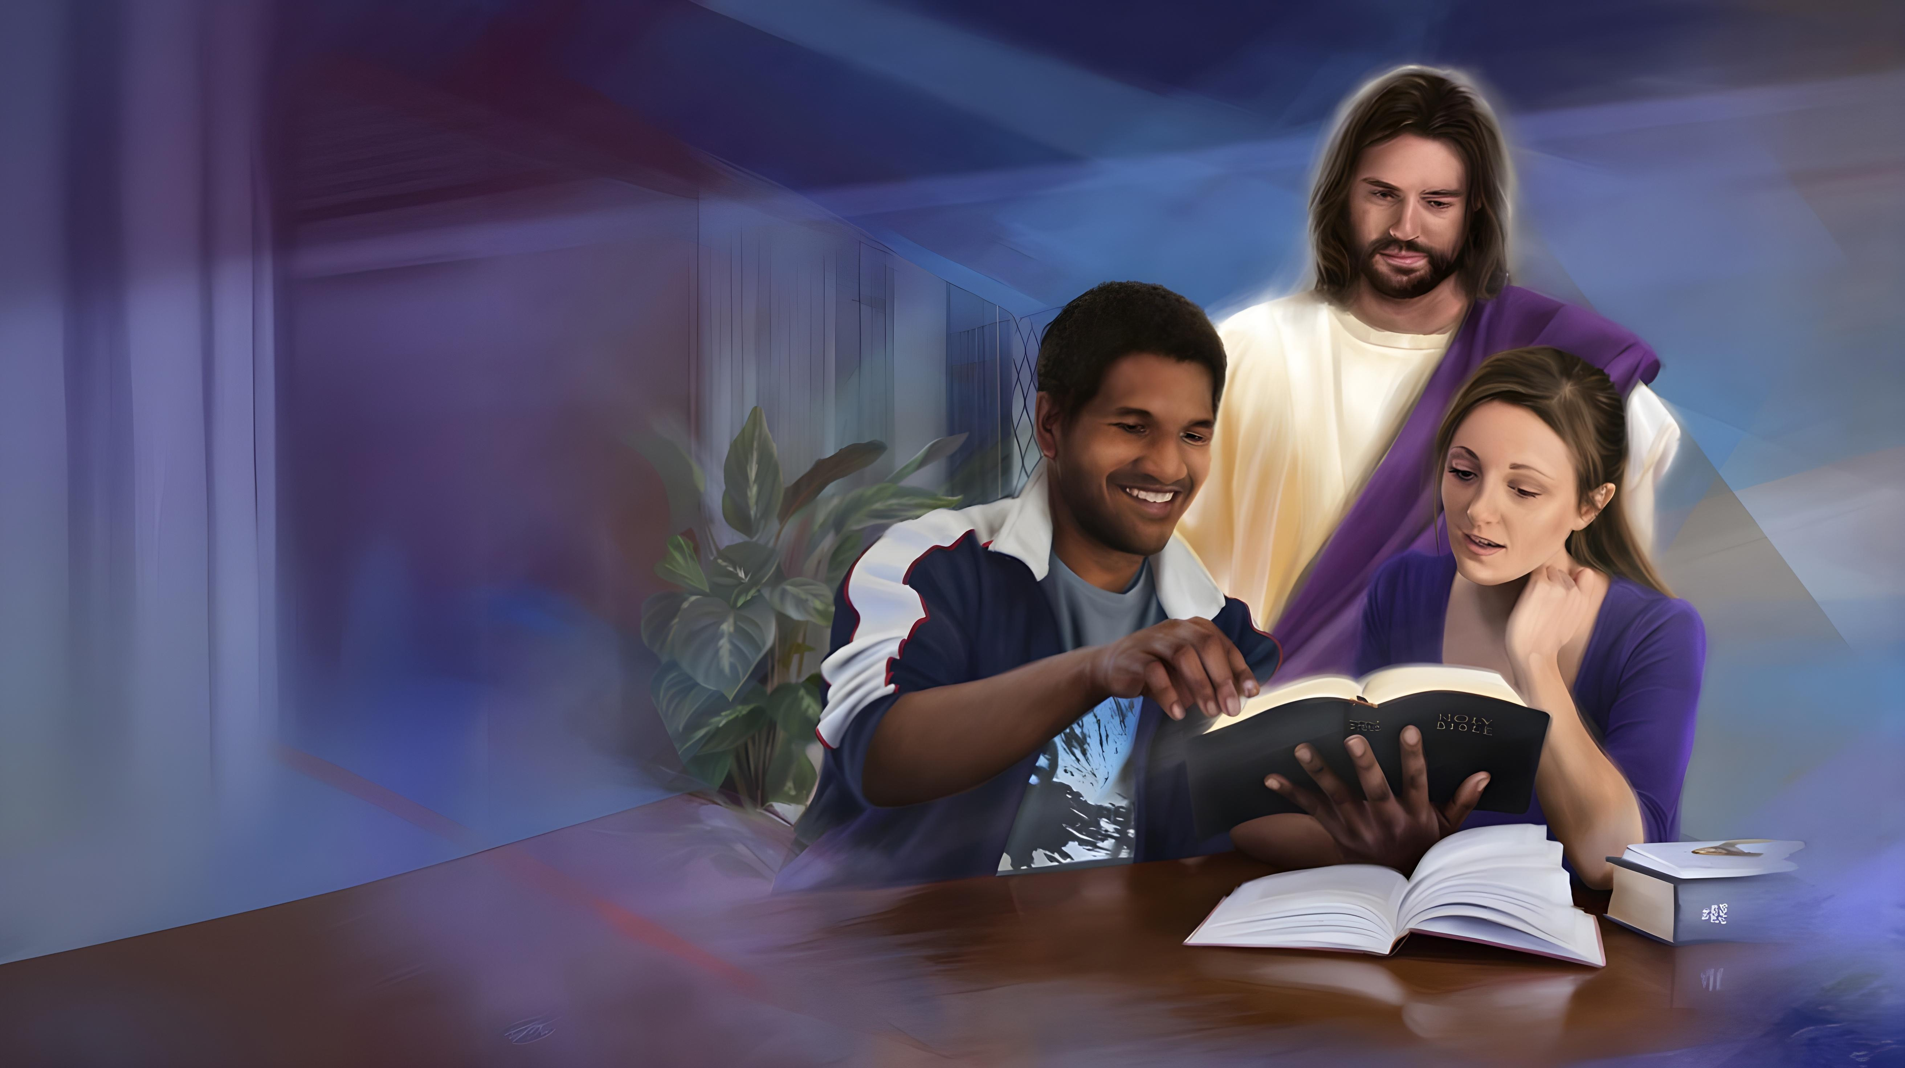
“Umwami Imana impaye ururimi rw’abigishijwe kugira ngo menye gukomeresha urushye amagambo, inkangura uko bukeye, ikangurira ugutwi kwanjye kumva nk’abantu bigishijwe”
(Yesaya 50:4)

Slide 13
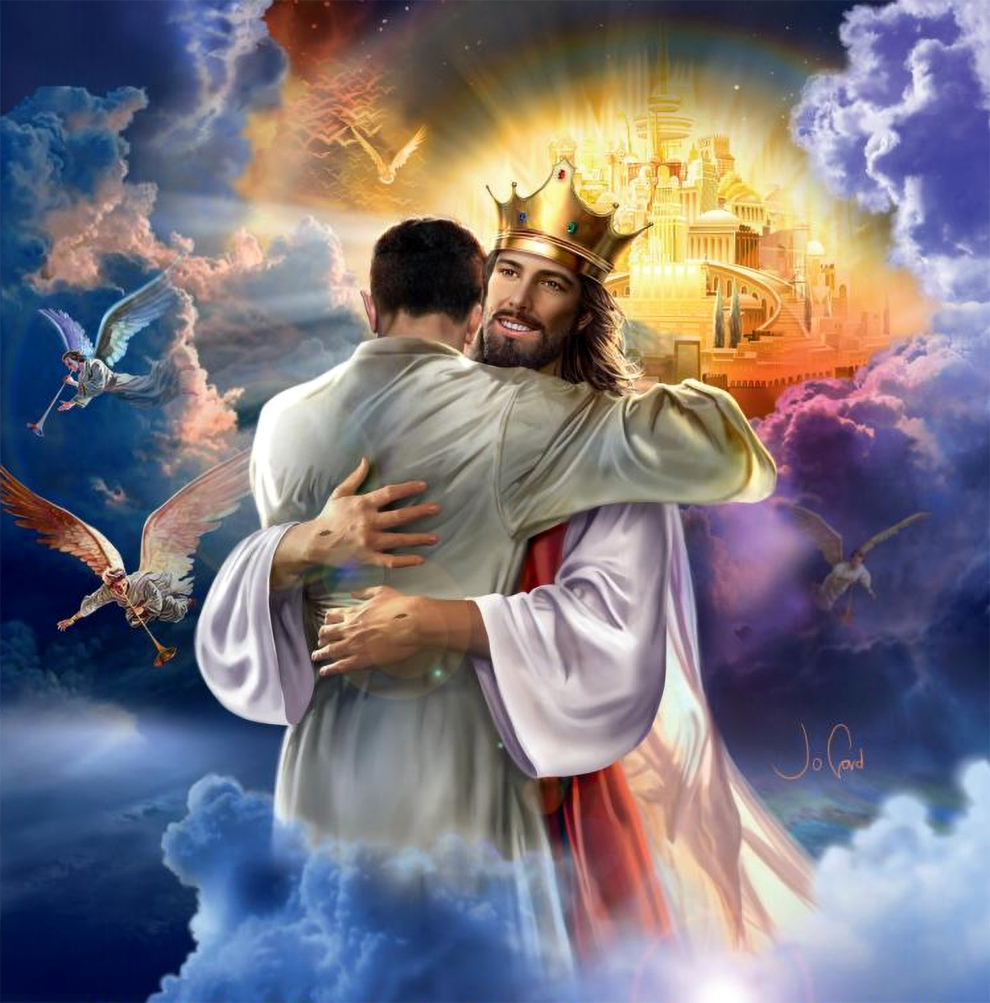

“Bakundwa, ubu turi abana b’Imana ariko uko tuzamera ntikurerekanwa. Icyakora icyo tuzi ni uko Yesu niyerekanwa, tuzasa na we kuko tuzamureba uko ari”
(1 Yohana 3:2)

