Slide 1
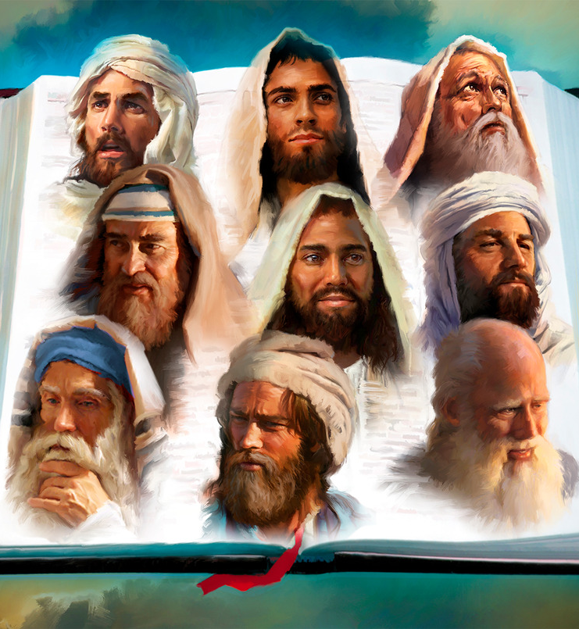
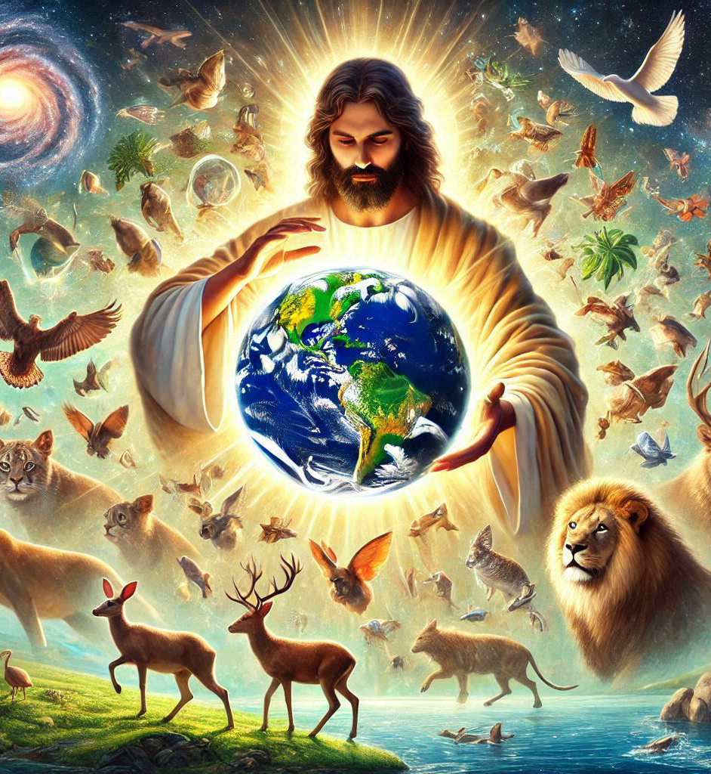
“Kera Imana yavuganiye na ba sogokuruza mu kanwa k’abahanuzi mu bihe byinshi no mu buryo bwinshi, naho muri iyi minsi y’imperuka yavuganiye natwe mu kanwa k’Umwana wayo, uwo yashyiriyeho kuba umuragwa wa byose ari we yaremesheje isi”
(Abaheburayo 1:1–2)

Slide 2

«Numva ijwi ry’Umwami Imana riti “Ndatuma nde, ni nde watugendera?” Maze ndavuga nti “Ni jye. Ba ari jye utuma.”»
(Yesaya 6:8)

Slide 3

«Yehoshafati arahagarara aravuga ati “Nimunyumve yemwe Bayuda namwe abatuye i Yerusalemu, mwizere Uwiteka Imana yanyu mubone gukomezwa, mwizere n’abahanuzi bayo mubone kugubwa neza.”»
(2 Ngoma 20:20)

Slide 4
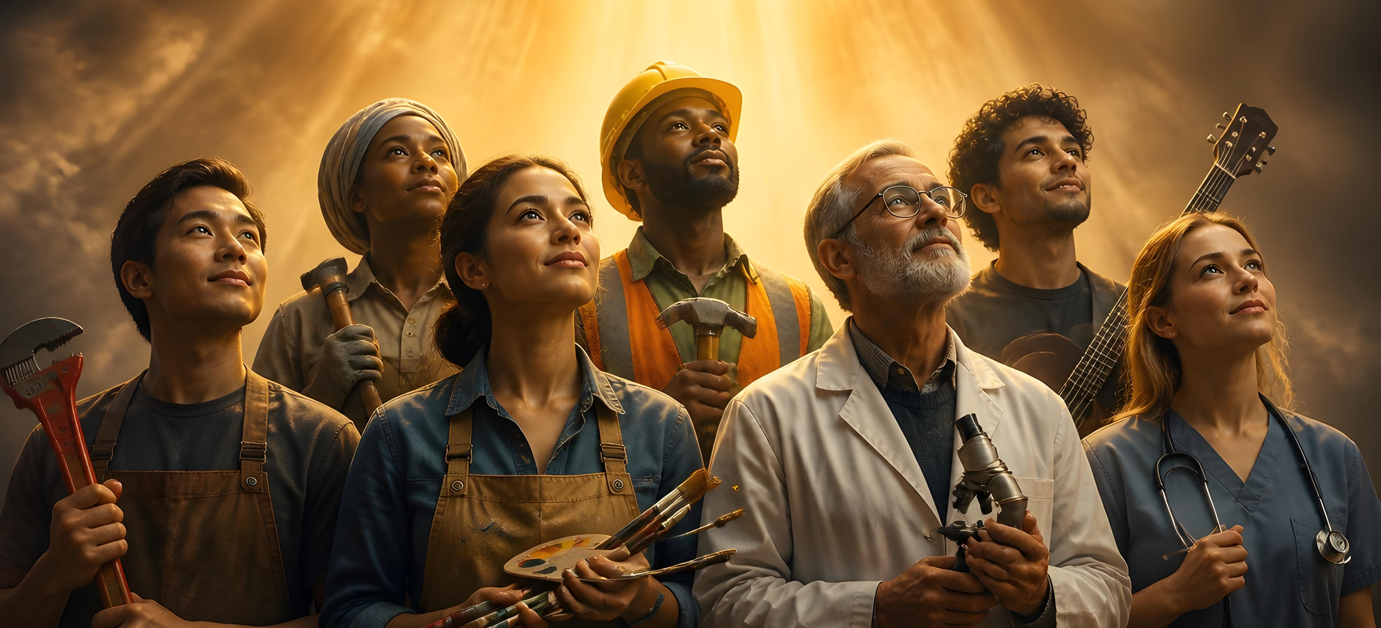
“Icyakora hariho impano z’uburyo bwinshi, ariko Umwuka ni umwe. Kandi hariho uburyo bwinshi bwo kugabura iby’Imana, ariko Umwami ni umwe. Hariho n’uburyo bwinshi bwo gukora, ariko Imana ikorera byose muri bose ni imwe” (1 Abakorinto 12:4–6)

Slide 5

“Ibyahishuwe na Yesu Kristo, ibyo Imana yamuhereye kugira ngo yereke imbata ze ibikwiriye kuzabaho vuba, agatuma marayika we na we akabimenyesha imbata ye Yohana, uhamya ibyo yabonye byose, ari ijambo ry’Imana no guhamya kwa Yesu Kristo” (Ibyahishuwe 1:1–2)

Slide 6


“Ibyanditswe kera byose byandikiwe kutwigisha, kugira ngo kwihangana no guhumurizwa bitangwa na byo biduheshe ibyiringiro” (Abaroma 15:4)

Slide 7







“Ibyo byababereyeho kutubera akabarore, kandi byandikiwe kuduhugura twebwe abasohoreweho n’imperuka y’ibihe” (1 Abakorinto 10:11)

Slide 8

“Atangirira kuri Mose no ku bahanuzi bose, abasobanurira mu byanditswe byose ibyanditswe kuri we”
(Luka 24:27)

Slide 9
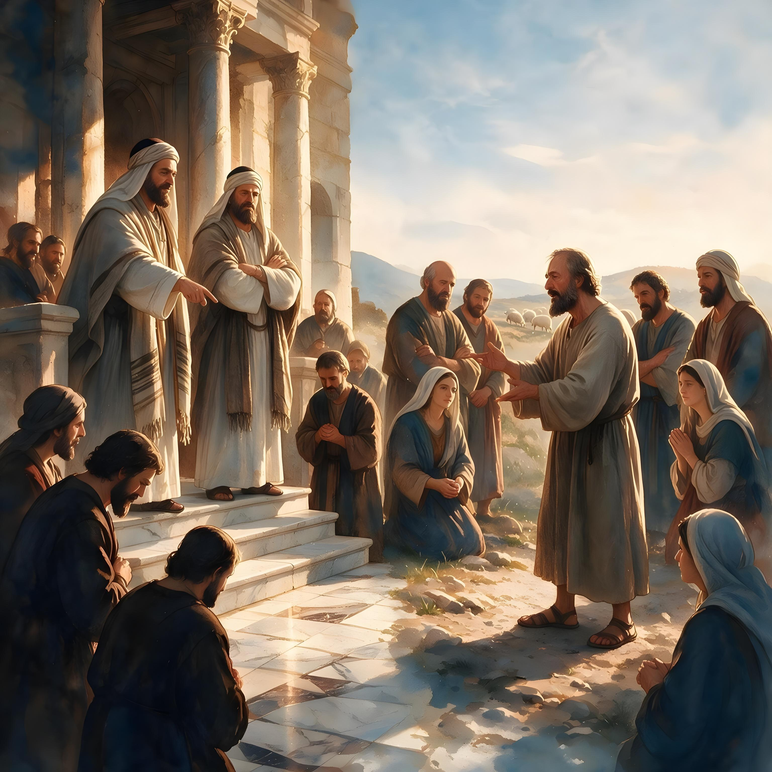

“Bakundwa, ntimwizere imyuka yose ahubwo mugerageze imyuka ko yavuye ku Mana, kuko abahanuzi b’ibinyoma benshi badutse bakaza mu isi”
(1 Yohana 4:1)

Slide 10
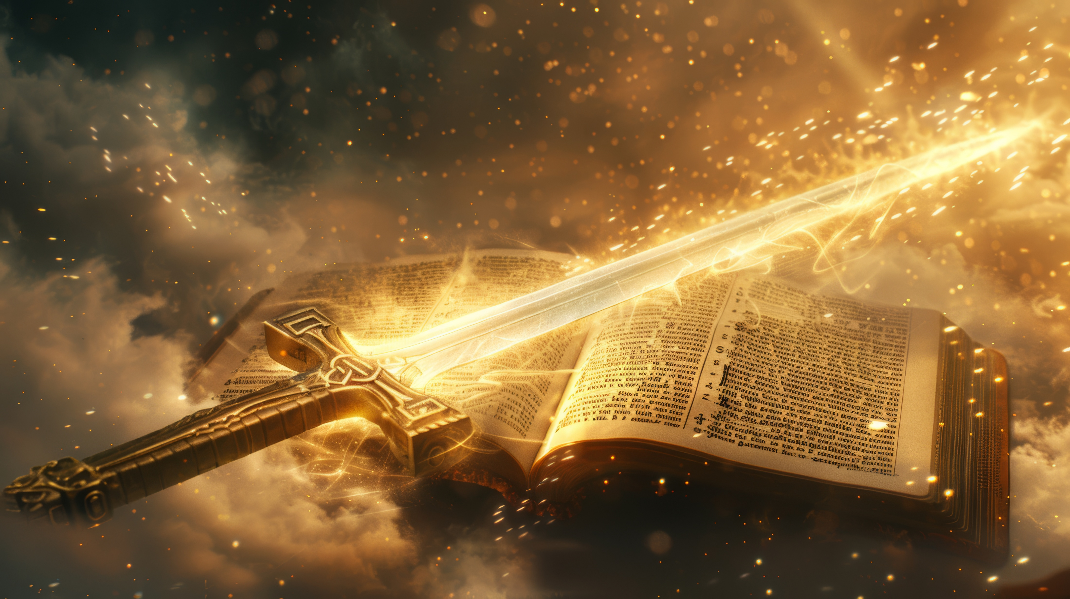
“Kuko ijambo ry’Imana ari rizima, rifite imbaraga kandi rikagira ubugi buruta ubw’inkota zose, rigahinguranya ndetse kugeza ubwo rigabanya ubugingo n’umwuka, rikagabanya ingingo n’umusokōro kandi rikabangukira kugenzura ibyo umutima wibwira ukagambirira” (Abaheburayo 4:12)

Slide 11

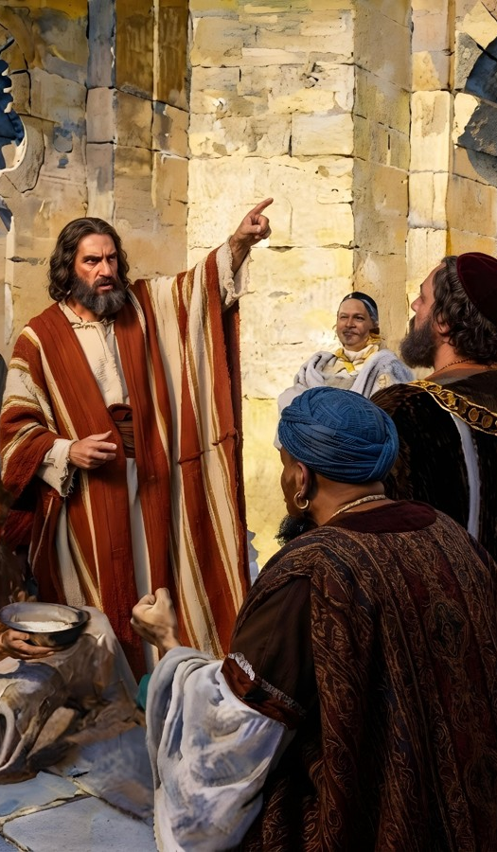
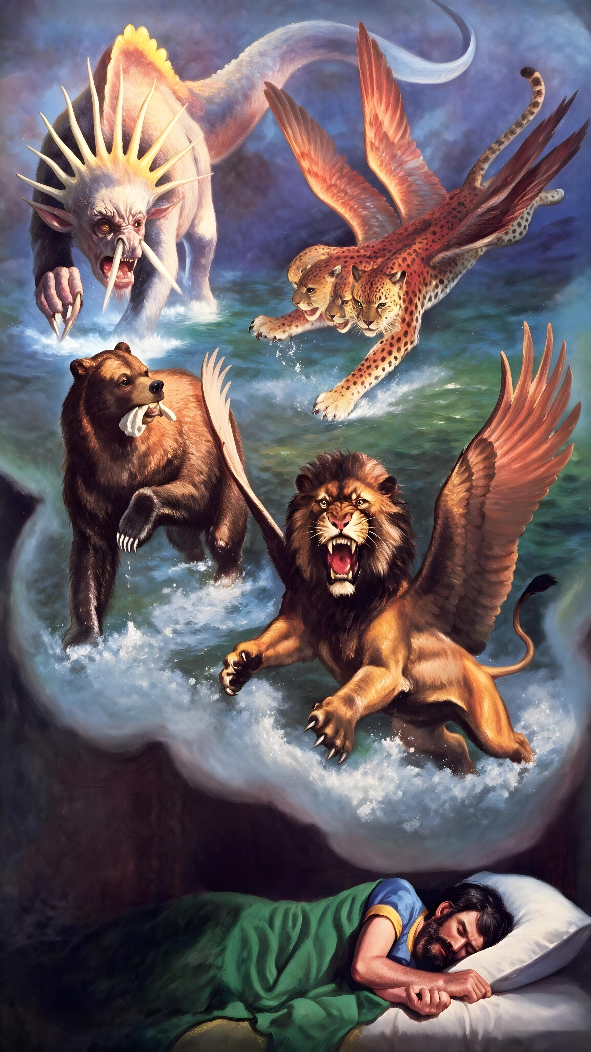
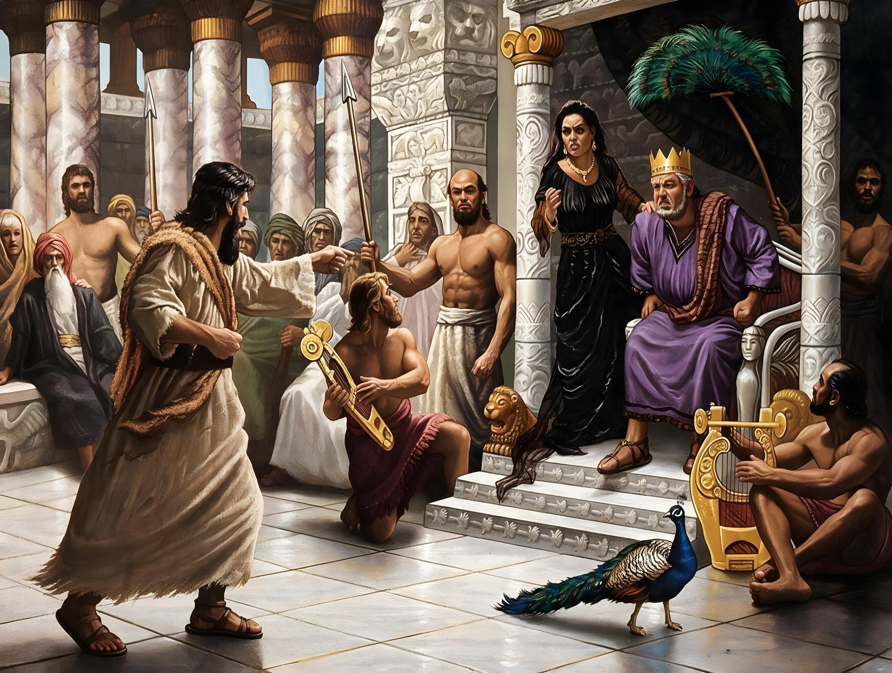
“Ni ukuri Uwiteka Imana ntizagira icyo ikora itabanje guhishurira abagaragu bayo b’abahanuzi ibihishwe byayo”
(Amosi 3:7)

Slide 12
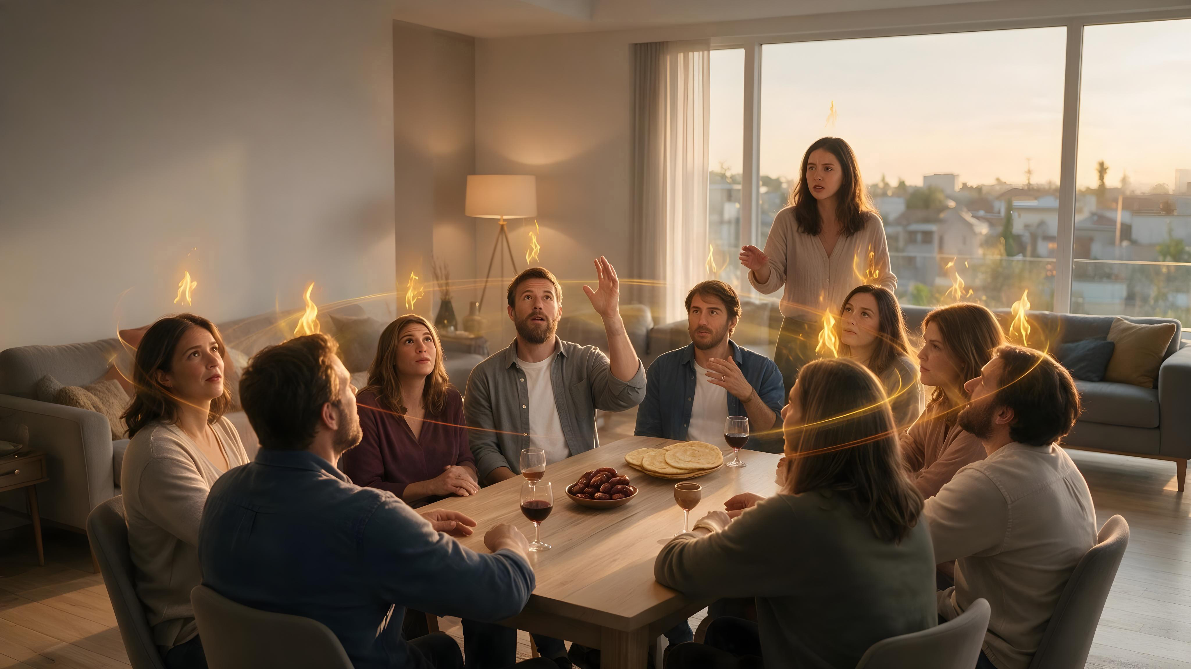
“Hanyuma y’ibyo, nzasuka Umwuka wanjye ku bantu bose, abahungu banyu n’abakobwa banyu bazahanura, abakambwe banyu bazarota, n’abasore banyu bazerekwa. Ndetse n’abagaragu banjye n’abaja banjye nzabasukira ku Mwuka wanjye muri iyo minsi”
(Yoweli 2:28–29)

Slide 13
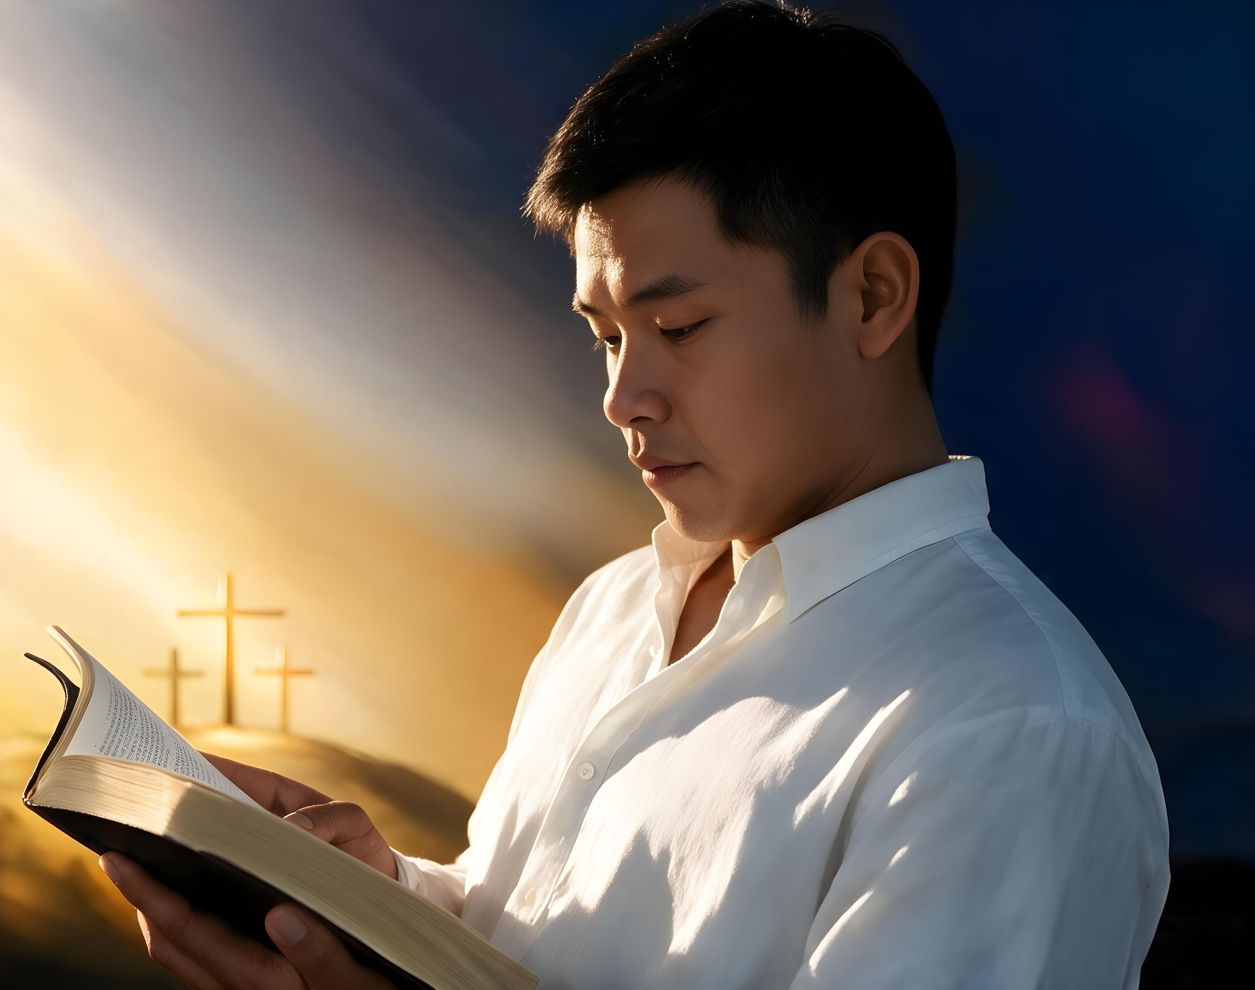
“Ibyanditswe byera byose byahumetswe n’Imana kandi bigira umumaro wo kwigisha umuntu, no kumwemeza ibyaha bye no kumutunganya, no kumuhanira gukiranuka, kugira ngo umuntu w’Imana abe ashyitse, afite ibimukwiriye byose ngo akore imirimo myiza yose”
(2 Timoteyo 3:16–17)

