Slide 1
HONDO INOITISA HONDO DZESE
Chidzidzo 1 cha Kubvumbi 6, 2024

Slide 2
“Ɀino kurwa kwakaʋa’po kuɗeŋga; Mikaeri naʋatumŋa ʋake ʋakarwa neshato, shato ikarwa inaʋatumŋa ʋayo;ʋakasakunda, nenɀimbo yaʋo hainakuzowanikwa kuɗeŋga” (Zvakazarurwa 12:7, 8)

Slide 3
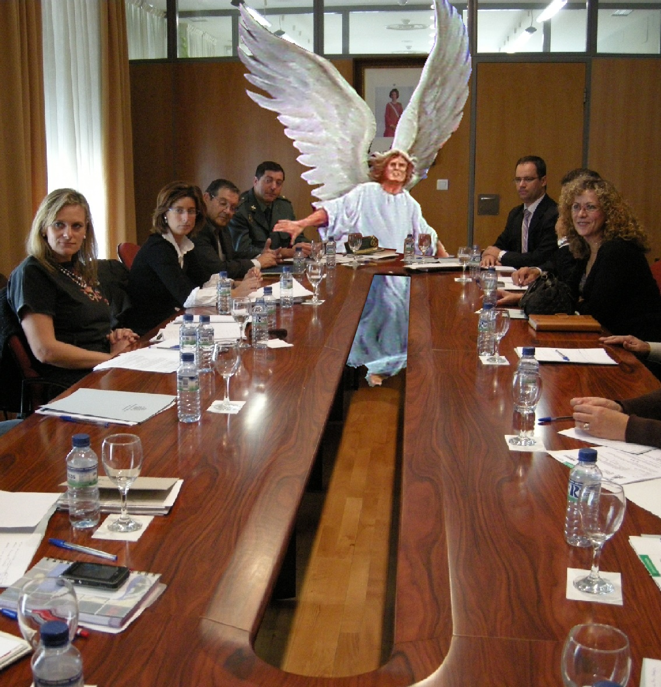
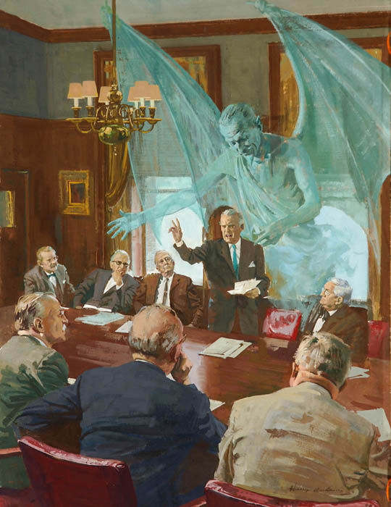
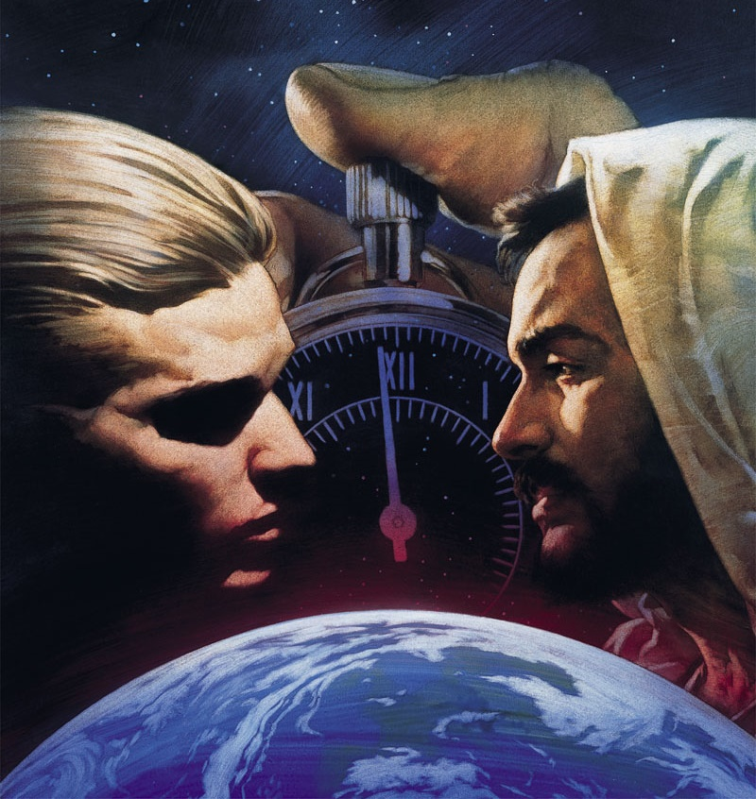
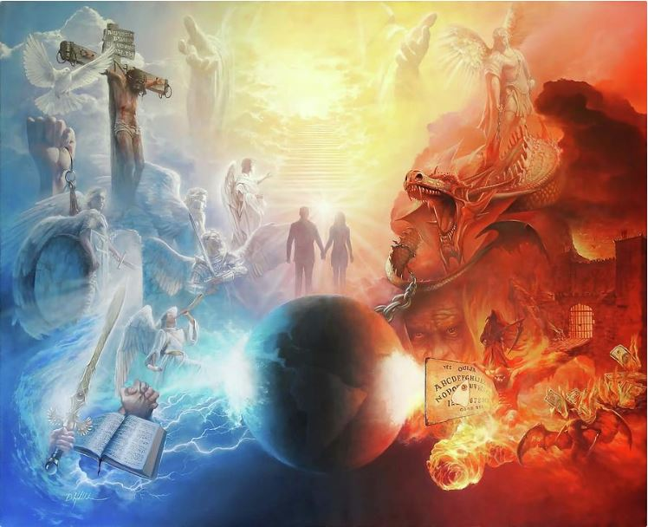
Tinorarama takanyura mukukonana kukuru kwazvo. Kunyange kana isu tisingazivi, kana kuti tisingatendi kuti izvi zvinogoneka, kukonana uku ndekwechokwadi
.
Masimba anorwisana ndeomweya, asingaoneki kwatiri (VaEfe. 6:12). Zvisinei, tinogona kunzwa migumisiro yehondo. njodzi, unzenza, rufu…
Hurumende imene yaMwari yaiva munjodzi, kuvimbika kwengirozi nenyika dzisina kutadza. Nhasi kutendeka kwenyu neni kuri mungozi.
Mavambo ekukonana
Kumukira Kudenga
Kumukira paNyika
Rudo rwunodzorera
Kukonana zvino

Slide 4
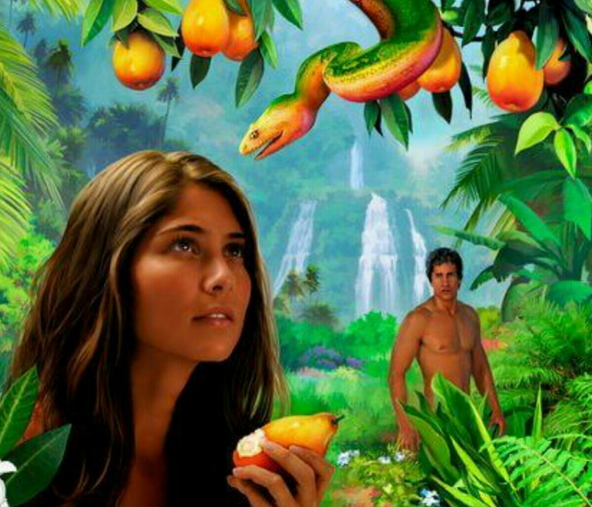
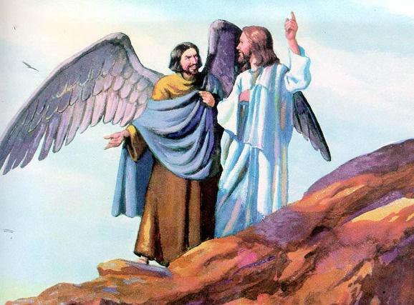
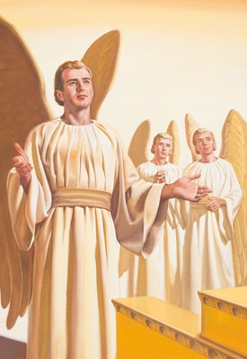
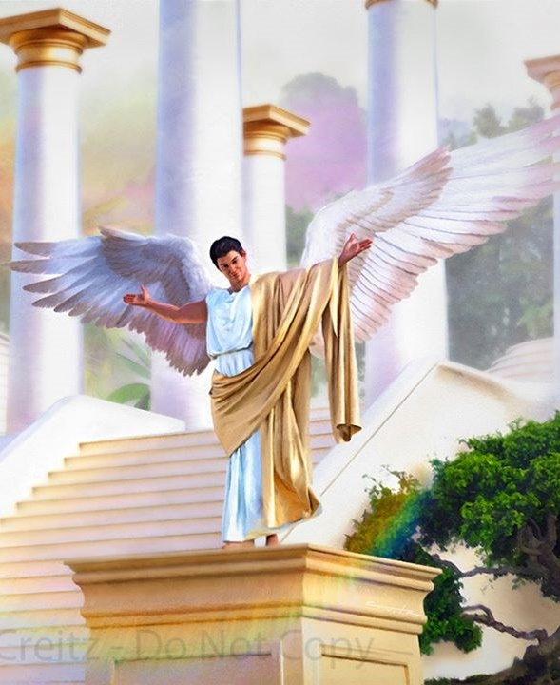
MAVAMBO EKUKONANA
“Wakaŋga wakakwana panzira dzako kubva pazuʋa rokusikwa kwako, kuȿikira kusarurama kwakawanikwa mukati mako” (Izikiyeri 28:15)
Idi rokuti, muIdheni, makanga mune chisikwa chakafurira Evha kusavimba naMwari, rinoratidzira kupandukira Mwari kwakavako vanhu vasati vavapo.(Gen. 3:1).
Jesu akadana munhu uyu anokonzera kusavimbana naMwari nezvisikwa zvake kuti “muvengi,” waakazivisa sadhiyabhorosi(Mt. 13:39).
Mubvunzo wekutanga watinofanira kuzvibvunza ndewekuti: Mwari akasika dhiyabhorosi here, kureva kuti Mwari akasika munhu akaipa here?
Bhaibheri rinotiudza kuti dhiabhorosi ingirozi inonzi Rusifa (Isaya 14:12). Ngirozi iyi yakasikwa yakakwana uye yakanaka (Izi. 28:12 ). Iye akakwidziridzwa kunzvimbo yakakwirira zvikuru iyo ngirozi yaigona kushuva: kerubhi rinodzivirira(Izi. 28:13-14).
Kana Rusifa aive akakwana, akazova dhiyabhorosi sei? Ko hondo pakati paMwari naye yakatanga sei? Mwari akamupa, sezvisikwa zvake zvose, rusununguko rwokusarudza uye, nenzira isingatsananguriki, Rusifa akasarudza kupandukira, uye akashuva kugara pachigaro choumambo chaMwari(Izi. 28:15; Is. 14:13-14).

Slide 5
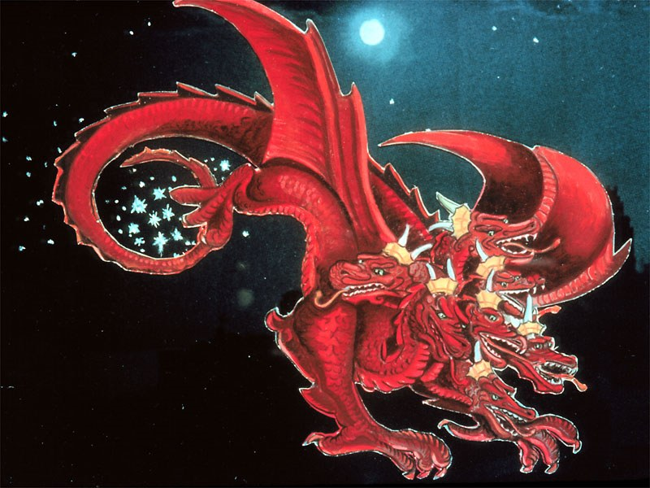
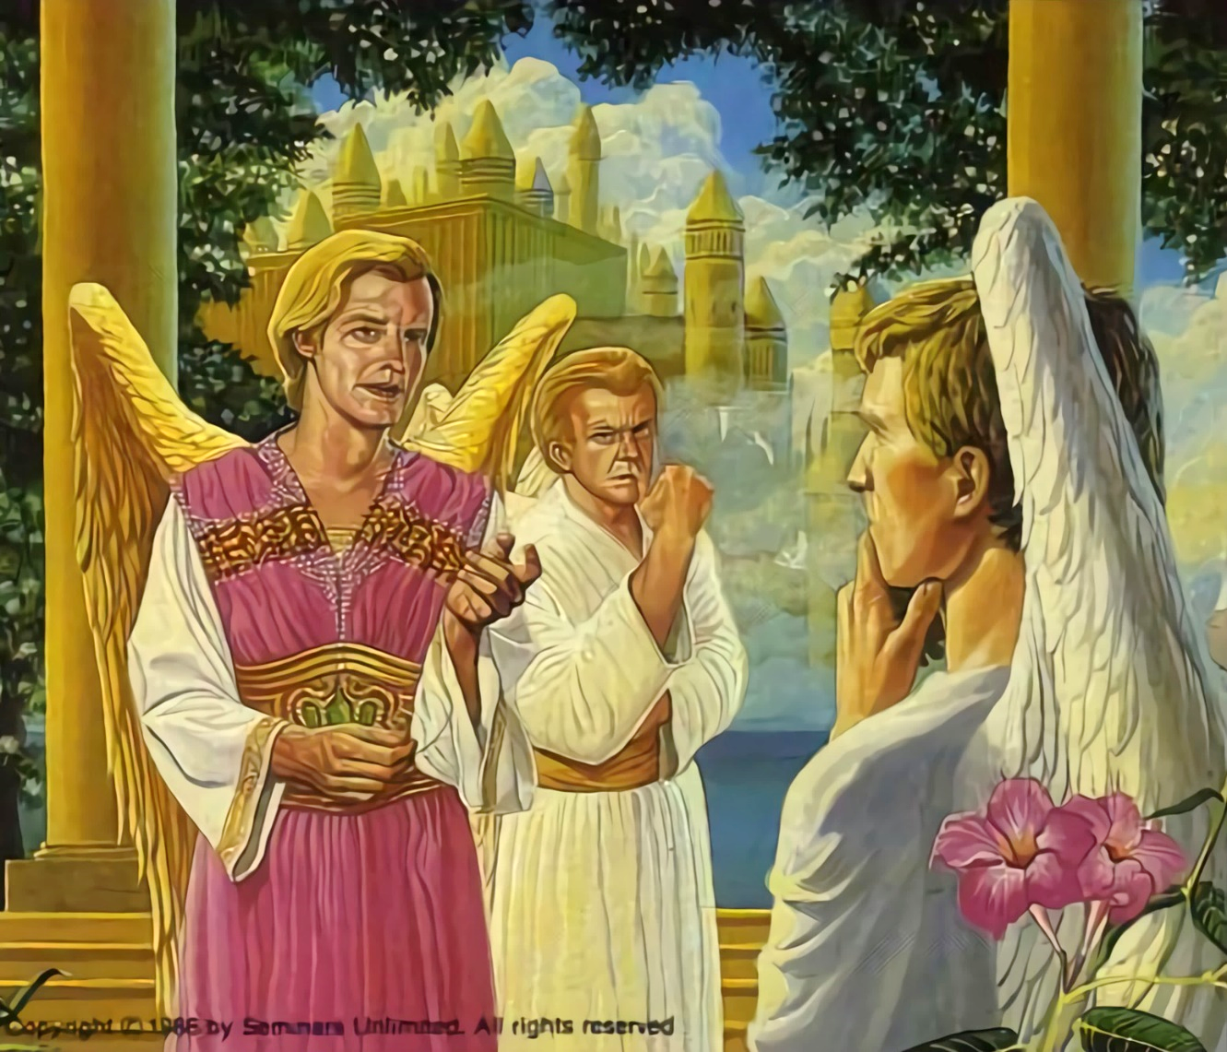
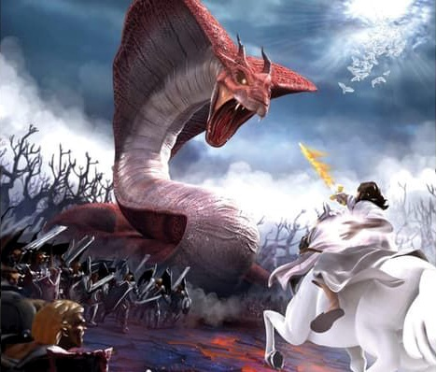
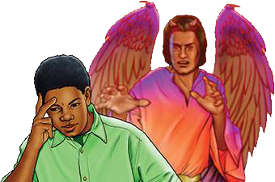
KUMUKIRA KUDENGA
“Rumhinda rwayo rukakweʋa cetatu cenyeredzi dzokuɗeŋga, ndokudzikandira pasi panyika…” (Zvakazarurwa 12:4a)
Muchishuvo chake chokubvuta chigaro cheKudenga, Rusifa akamutsa kusava nechokwadi mungirozi pamusoro peruramisiro yehurumende youmwari. Handiti vaive vakasununguka vese here? Sei kuzviisa pasi pemitemo yakaoma uye, pamwe, isina kururama?
Rusifa akava Satani, mupomeri ( Zva. 12:10; Jobho 1:6, 9-10 ). Akaramba kudanwa kwose kworudo rwaMwari kuti ashandure mafungiro ake.
Kumukira uku kwakazova kurwisana kuri pachena, hondo apo ngirozi imwe neimwe yaifanira kuita sarudzo yayo. 1/3 yengirozi yakatevera Satani, dzmwe dzose dzikaramba dzakatendeka kuna Mwari (Zva. 12:4a).
Iko zvino hondo iyi iri kuenderera mberi. Satani achiri kushanda. Anoedza kukwevera munhu wese kuti apandukire Mwari. Kune mativi maviri chete. Vaya vanoda kuteerera Mutemo waMwari, kana kuti vaya vanouramba. Sarudzo ndeyedu(Deut. 30:11, 16, 19; Josh. 24:15).

Slide 6
“Mwari mukuru angadai akakanda munyengeri mukuru uyu pakarepo kubva kudenga; asi ichi chakanga chisiri chinangwa Chake. Aizopa vapanduki mukana wakaenzana wokuyera simba nesimba roMwanakomana Wake amene nengirozi Dzake dzakavimbika. Muhondo iyi ngirozi imwe neimwe yaizosarudza divi rayo uye zvichiratidzwa kune vese. […] Kudai Mwari akanga ashandisa simba Rake kuranga mupanduki mukuru uyu, ngirozi dzisina kukanganiswa dzingadai dzisina kuratidzwa; nokudaro, Mwari akatora imwe nzira, nokuti Iye aizoratidzira nomutoo wakajeka kuuto rose rokudenga ruramisiro Yake nokutonga Kwake.” -Non Official Translation by Gift Mawoyo
EGW (The Story of Redemption, pg. 17)

Slide 7
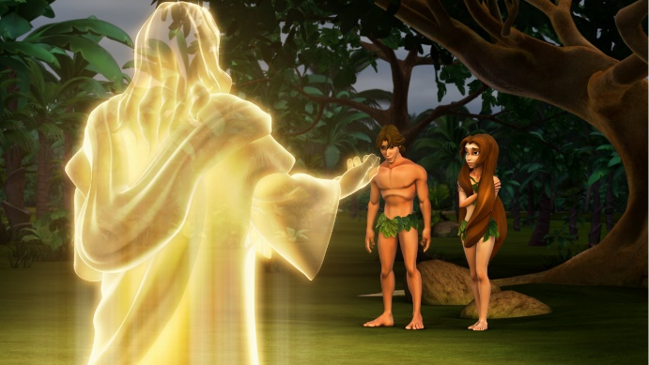
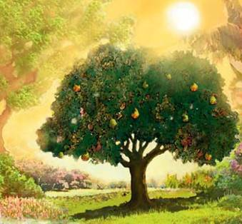
KUMUKIRA PANYIKA
“Iye akati, ‘Ndianiko wakakuʋudza kuti hauna‐kusimira — Wadya kanhi muti wandakakuraira kuti urege kuudya?’ ” (Genesisi 3:11)
Mwari akasika ngirozi munzvimbo isina chivi, yakakwana. Saizvozvowo, Mwari akasika vanhu vari mumhoteredzo yakakwana, isina chivi(Gen.1:31).
Sezvakaitika kungirozi, Mwari akatisikawo tiine simba rekusarudza takasununguka. Saka, Adhamu naEvha vaigona kushandisa rusununguko irworwo, akavapa murayiro wakapfava: “asi muti wokuziʋa ɀakanaka neɀakaipa usaudya” (Gen. 2:17).
Ndiyo chete nzvimbo yaigona kuita kuti Satani aite kuti vapokane. Nokunyengera, akazadzisa chinangwa chake. Adhamu naEvha vakasava nechokwadi naMwari, vakasamuteerera, uye vakabva patsime roupenyu (Gen.3:6, 9-13, 19). Adhamu akazarura musuo wokuti chivi chipinde, uye nokudaro rufu rwakapfuurira kuvanhu vose (VaRoma 5:12).
Kubva ipapo, tiri kurarama munyika ine marwadzo, zvirwere uye rufu. Tose tiri kubhadharira chivi chaAdhamu here?
Mumwe nomumwe wedu anoripira zvivi zvake: “nokuti ʋose ʋakatadza, ʋakasaȿika pakubginya kwaMŋari” (VaRoma 3:23).

Slide 8
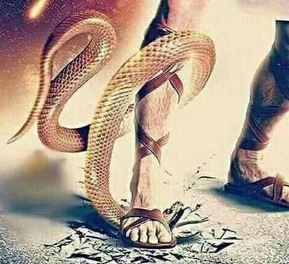
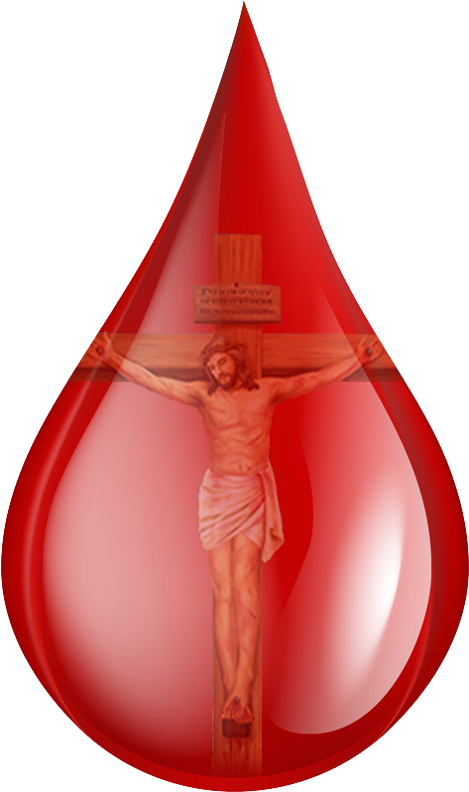
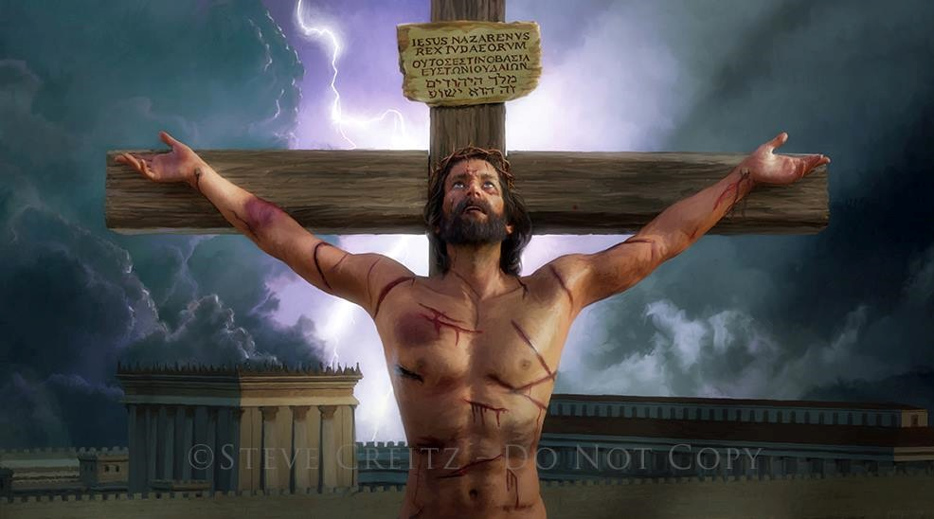
RUDO RWUNDZORERA
“Ruɗo ruri pacinhu ici, kuti hatizisu takaɗa Mŋari, asi kuti ndiye wakatiɗa, akatuma Mŋanakomana wake kuti aʋe rudzikinuro rweɀiʋi ɀeɗu” (1Johani 4:10)
Kunyange asati azivisa migumisiro yokusateerera, Mwari akaudza Adhamu naEvha kuti kwakanga kuine zano rokudzikinurwa kwavo.(Gen.3:15).
Vanhu vakanga vazviparadzanisa pachavo kubva kuMusiki. Asi panzvimbo pokusiya vana vake vasingaongi, Mwari akaratidzira chimiro chake chechokwadi kubudikidza nokuvada zvisingadaviriki(Johani 3:16).
Rufu rwaisafanira kuva mugumo usingagumi womutadzi. Jesu akaratidza rudo rwake nekubhadhara mutengo wechivi neupenyu hwake (VaRo. 5:8).
Hapana chiri matiri chinoita kuti tikodzere kudiwa naMwari. Zvisinei, nedonhwe rose reropa rakadeurwa naJesu paKarivhari, Mwari anotiudza, kuti: “Ndinokuda.”

Slide 9
RUDO RWUNDZORERA
“Ruɗo ruri pacinhu ici, kuti hatizisu takaɗa Mŋari, asi kuti ndiye wakatiɗa, akatuma Mŋanakomana wake kuti aʋe rudzikinuro rweɀiʋi ɀeɗu” (1Johani 4:10)
Jesu akatiratidza sei rudo Rwake?
Jesu akasika zvinhu zvose zviripo(Jn. 1:3)
Akava chisikwa (Johani 1:14)
Akapfuura nemumatambudziko, kutambura, nzara nemarwadzo, sesu(Is. 53:3; Marko 11:12)
Akaedzwa sesu(VaHeb. 4:15)
Zvaakanga akarurama, akatambura nokuzvidira nokuda kwezvivi zvedu(1 Pet. 3:18; Johani 10:17-18)
Nokufa uye kutimutsa, akativimbisa nezvoupenyu husingaperi tiri pamwe chete naye(VaRoma 6:3-4)
Uye zvese izvi zvaive zverudo(1Jn. 4:10)

Slide 10
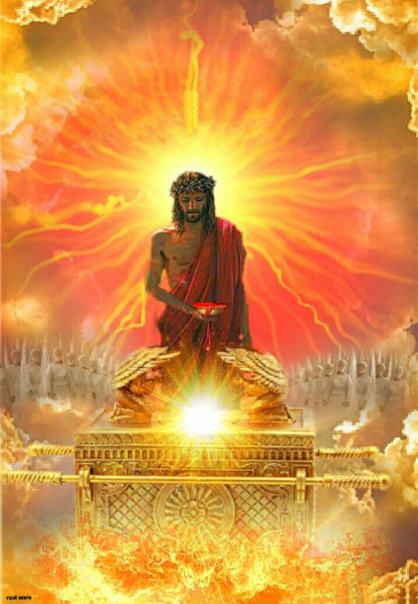
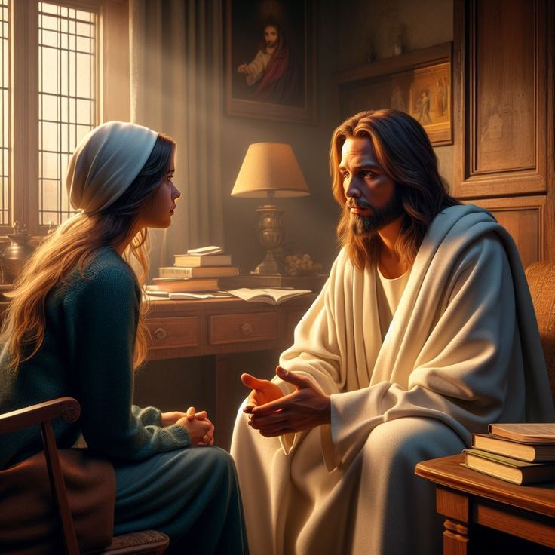
KUKONANA ZVINO
“Naiɀoɀo unesimba rokuponesa kwaɀo‐kwaɀo aʋo ʋanosweɗera kunaMŋari naye, ɀaanorarama nokusiŋgaperi kuti aʋareʋerere.” (VaHebhuru 7:25)
Iko zvino, Jesu ari kutireverera muSenjuwari yeKudenga(VaHeb. 9:24; 7:25).
Nekuda kweropa rake rakadeurwa pamuchinjikwa, Jesu anotiisa pamberi paBaba - uye pamberi pevagari vese veKudenga neNyika - sevanhu vakarurama, vakakwana, vanokodzera kugara munzvimbo Kudenga.
Naizvozvo, tinokokwa kuti tisvike kuna Mwari nechivimbo kuburikidza naJesu(VaHeb. 4:15-16).
Jesu anoda kuti tivimbe naye pane zvose zvatinoda muupenyu hwedu (Joh. 14:13-14). Pane kutya, anouyisa rugare; pane mhosva, anokanganwira; pane utera, ndipo paanopa simba.
Chishuvo chikuru chaJesu ndechekugara nesu nokusingaperi (Joh. 17:24). Chishuwo chako chikuru here ichi?

Slide 11
“Kana miyedzo ichikurova, kana hanya, kuvhiringika, uye rima zvichiita kunge zvakakomberedza mweya wako, tarisa kunzvimbo yawakapedzisira kuona chiedza. Zorora murudo rwaKristu uye pasi pekuchengetedza kwake. Kana chivi chichirwira kutonga mukati memoyo, apo mhosva inodzvanyirira mweya ichiremedza hana, apo kusatenda kwafukidzira pfungwa, rangarira kuti nyasha dzaKristu dzakakwana kukurira chivi nekudzinga rima. Tichipinda mukuyanana neMuponesi, tinopinda munharaunda yerunyararo."-Non Official Translation by Gift Mawoyo
EGW (The Ministry of Healing, pg. 193)

