Slide 1
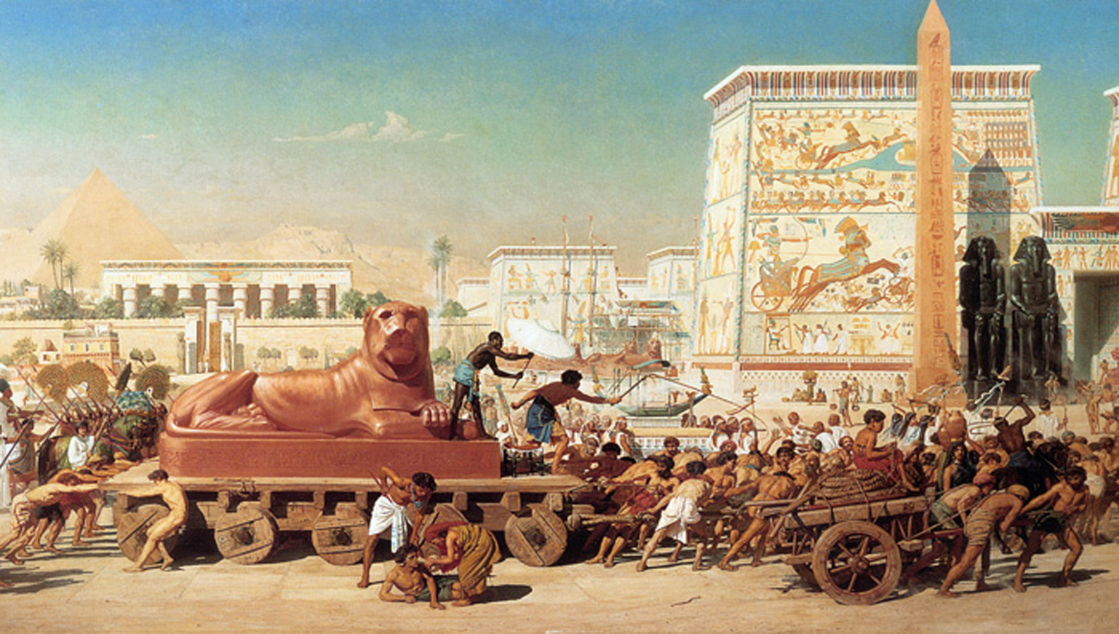
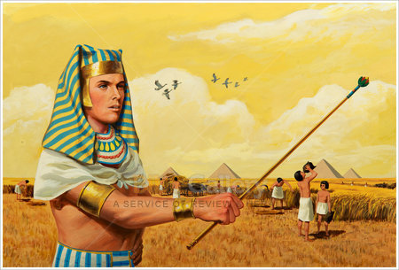
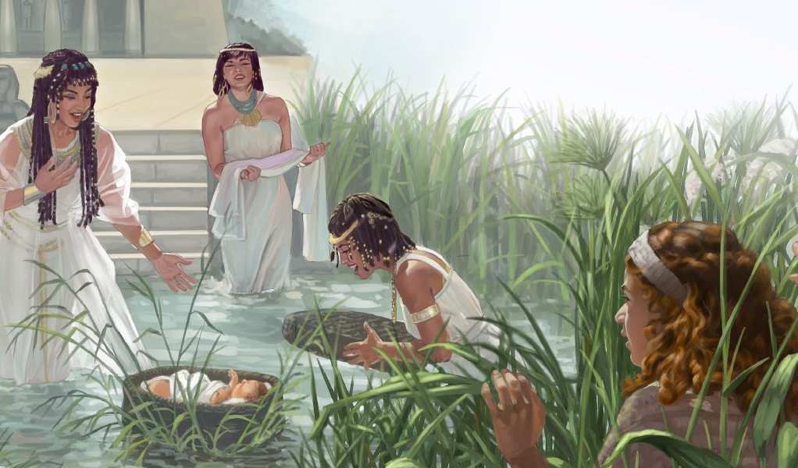
Lesson 1 for July 5, 2025
KUDZVANYIRIRWA: MATANGIRO UYE KUBEREKWA KWAMOZISI

Slide 2
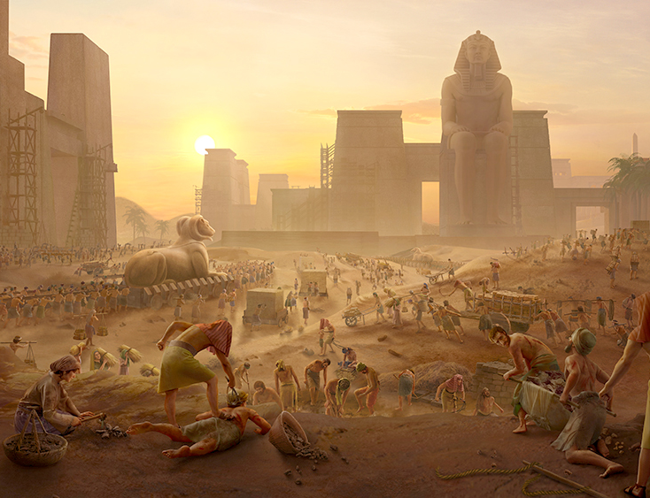
“Ɀino mazuʋa mazhinji akati apfuʋura, mambo weEgipita akafa; ʋana ʋaIsraeri ʋakagomera nokuɗa kwoʋuranda bgaʋo, ʋakaɗanidzira, kuɗanidzira kwaʋo kukaȿika kunaMŋari nokuɗa kwoʋuranda. Mŋari akanzwa kugomba kwaʋo, Mŋari akaraŋgarira suŋgano yake naAbrahama, naIsaka, naJakobo. Mŋari akaʋona ʋana ʋaIsraeri, Mŋari akaʋaraŋgarira”
Ekisodho 2:23–25

Slide 3

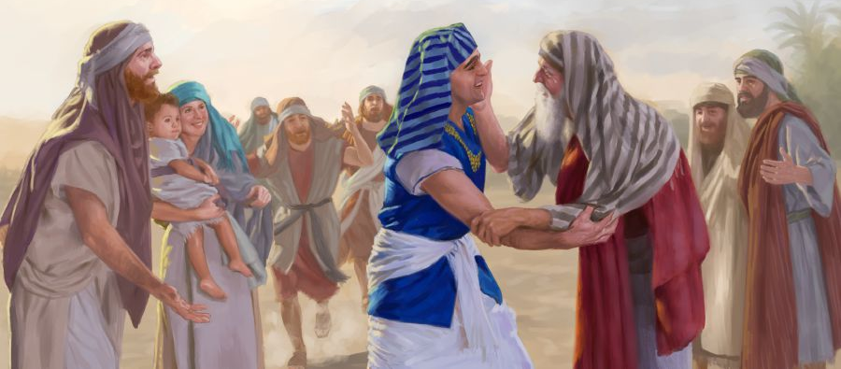
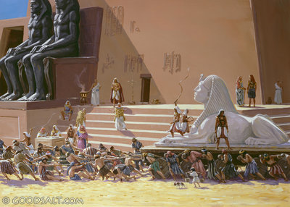
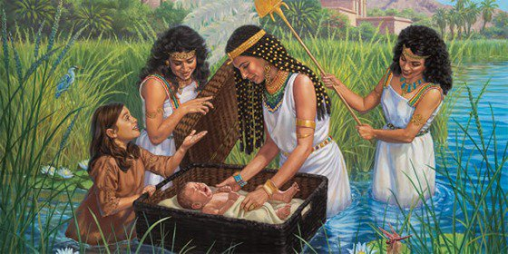





Eksodho inotanga nyaya yayo nemhuri duku inogara muEgipita netendero yaFarao.
Chiriporipotyo, mamiriro acho ezvinhu anochinja, vachiva varanda vanomanikidzwa kushandira “vatenzi vavo veEgipita.”
Mamiriro ezvinhu ari kuramba achiwedzera kuipa. Pakati pokutambura, kutendeka kwevakadzi vaviri, Shifra naPua, kunopenya, sezvinoita mwaranzi wetariro uyo Mwari anokwazisa nawo vanhu Vake: mwana akaisvonaka akanunurwa muNairi, Mozisi.
Vanhu vaMwari muEgipita(Ekisodho 1:1-14)
Kubva kuna Abhurahama kusvika kuna Mozisi(Genesisi 15:13; Ekisodho 1:8)
Kukunda Kwekutendeka(Ekisodho 1:15-22)
Mwanakomana weNairi(Ekisodho 2:1-10)
Musununguri akakundikana(Ekisodho 2:11-25)

Slide 4

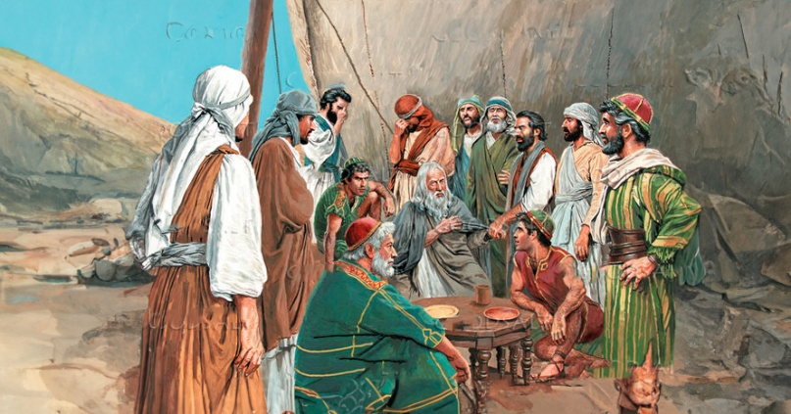
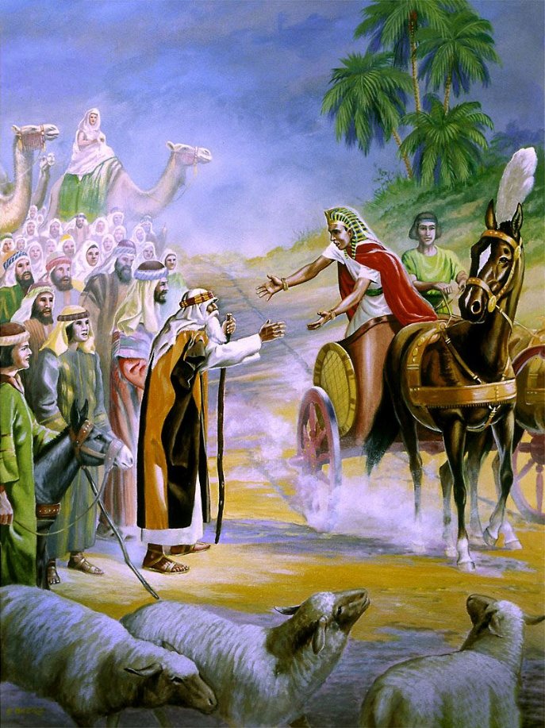
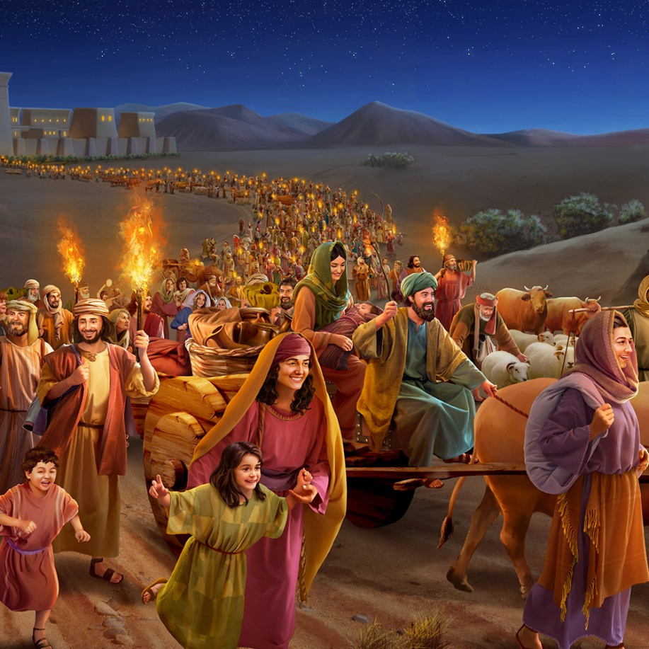
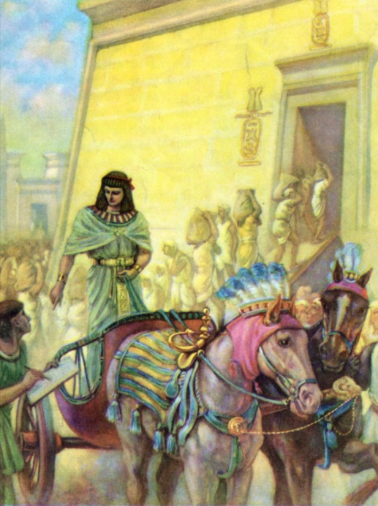
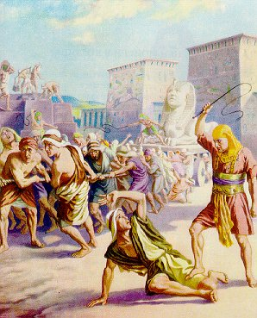
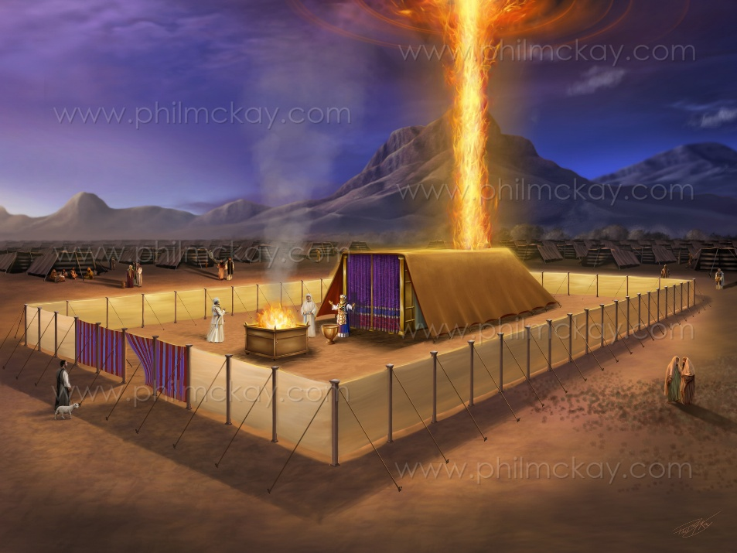
VANHU VAMWARI MUEGIPITA
“Ndiwo mazita aʋana ʋaIsraeri ʋakaŋga ʋaenda Egipita: mumŋe nomumŋe wakaenda naJakobo anaʋeimba yake” (Ekisodho 1:1)
Bhuku rechipiri raMozisi rainzi“Exodus” muchiLatin nekuda kwechinyorwa chayo. Asi muchiHebheru rinozivikanwa se“Shemot ” (Mazita), nokuda kwemazwi aro okutanga (Ekisodho 1:1).
“Mazita” aya ndeaya aJakobho nevanakomana vake.Boka duku revanhu 70( Gen. 46:26-27; Ekis. 1:5 ). Nokufamba kwenguva, vakakura kuva vanhu vane uto revarwi vanenge 600 000(Eki. 12:37).
Mwanakomana waJakobo, Joseph, aive gurukota kuna Farao wedzinza rechi 17th weHyksos, kwete Egipt, mavambo. Pakakundwa maHyksos, dzinza idzva rakatanga muEgipita,“wakaŋga asina‐kuziʋa Josefa” (Ekisodho1:7-8).
Izvi zvakaunza Israeri kumamiriro ezvinhu akaoma ( Ekisodho 1: 9-14 ). Zvisinei, pamagumo ebhuku raEkisodho, mamiriro ezvinhu anoshanduka zvachose: Isiraeri anonamata akasununguka, pamberi pohuvepo hwaMwari chaihwo ( Ekisodho 40:38 ). Dzidziso yebhuku racho yakajeka: Mwari ndiye ari kutonga; Achatiponesa, kunyange kana mamiriro ezvinhu akaita kuti zviratidzike sezvisingabviri.

Slide 5

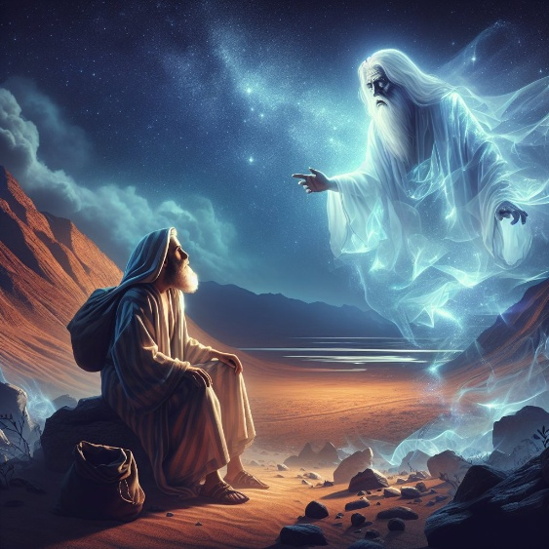
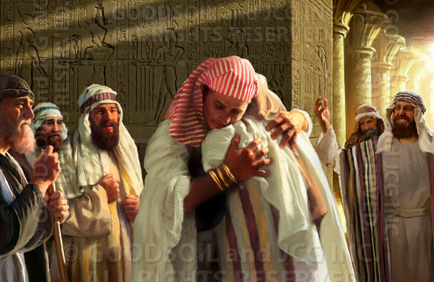
KUBVA KUNA ABHURAHAMA KUSVIKA KUNA MOZISI
“Akati kunaAbrama, ‘Uziʋe kwaɀo kuti ʋana ʋako ʋacaʋa ʋatorwa munyika isati iri yaʋo: ʋacaʋa ʋaranda ʋaʋo; ʋacatambudzwa makore anamazana manna.’” (Genesisi 15:13)
Mwari akanga apikira kupa Abrahama nyika yeKenani, asi akamunyevera pamusoro pokunonoka kwamakore 400 mukuzadzika zano iri(Gen. 15:13-16).
Mozisi naPauro vanowedzera makore 30 kunhambo iyi, vachiidzorera kukudanwa kwapaHarani(Eki. 12:40; VaGa. 3:17):
Kubva pakudanwa kwaAbrama paHarani kusvikira Jakobho asvika muEgipita: makore 215
Kubva pakusvika kwaJakobho muEgipita kusvikira paKubuda: makore 215
Uye Jakobho akasvika sei kuEgipita? Nenzira inoshamisa chose. Pasinei nekuedza kuuraya Josefa, akava mutungamiriri weEgipita. Nemhaka yechinzvimbo chake, akakwanisa kuunza mhuri yake yose.
Zvose izvi zvakaitika rini? Hatizive mazuva chaiwo, asi isu tinoziva zvakakwana kuti tizvikwanise munhoroondo inozivikanwa (iyo ine zvakare mazuva asina kurongeka).

Slide 6

KUBVA KUNA ABHURAHAMA KUSVIKA KUNA MOZISI
“Ɀino pagore ramazana manna namakumi masere shure kwokuɓuɗa kwaʋana ʋaIsraeri panyika yeEgipita, pagore recinna rokuɓata ʋushe kwaSoromoni pakati paIsraeri, nomŋedzi weZifi, ndiwo mŋedzi wecipiri, wakataŋga kuʋaka imba yaJehova” (1 Madzimambo 6:1)
1 Madzimambo 6:1 inoti Kubuda kwakaitika makore 480 gore rechipiri raSoromoni risati rasvika. Kana zuva iri rakarurama uye richisanganisira, rinotiisa ku1445 BC. Kana tikafunga iyi "nhamba yakatenderera," uye tichifunga nezverufu rwaFarao, kubuda kwakaitika muna 1450 BC. Neizvi,tinogona kuona nguva dzinoverengeka muhupenyu hwaMozisi.
Ahmose I (1575/1550). Anokurira vaHyksos. Ndiye Farao “wakaŋga asina‐kuziʋa Josefa” akaisa vaIsiraeri muhuranda(Eki. 1:8-12)
Amenophis I (1550/1530). Akaenderera mberi nekudzvanyirira vaIsiraeri (Eki. 1:13-14)
Thutmose I (1530/1517). Akarayira kuti vana vechiHebhuru vaurayiwe(Eki. 1:15-22)
Mozisi (1530/1410). Akatorwa kuita mwana nemwanasikana wa Thutmose I, Hatshepsut
Thutmose II (1517/?). Panguva yokutonga kwake, Mozisi akatiza Egipita(1490)
Hatshepsut (?/1479). Akafa “mwanakomana” wake asati adzokera kuEgipita
Thutmose III (1479/1450). Farao weKubuda. Mwanakomana wake wedangwe ai“tarisira zvipfuwo” asi haana kumbotonga, sezvo akafa mudambudziko rechigumi.
Amenophis II (1450/1424). Mwanakomana waThutmose III, asi asiri dangwe rake

Slide 7

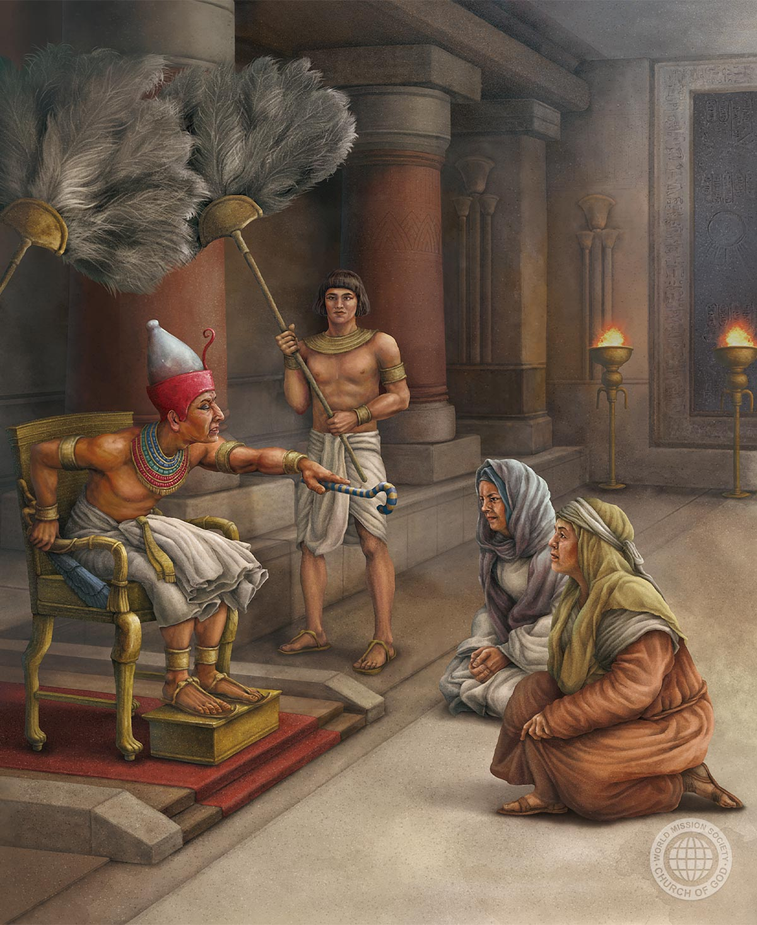
KUKUNDA KWEKUTENDEKA
“Ɀino madzimbuya ɀaakaŋga acitya Mŋari, iye akaʋapa mhuri” (Ekisodho 1:21)
Dzinza rechi18 reEgipita pakutonga,raivenga vatorwa. Uyezve, vaIsiraeri vakanga vawanda zvokukwanisa kupanduka ( Ekis. 1:9-10 ). Saka vakavakurira zvishoma nezvishoma:
1
Vakagadza vatariri ekuvamanikidza kuvaka zvivako(Eki. 1:11)
Vakasimbisa zvavaida, vachivashandura kuva vashandi/varanda(Eki. 1:13-14)
Vakaraira kuti varume vafe, vachishandisa vananyamukuta(Eki. 1:15-16)
Pakupedzisira, vakamanikidza rufu rwevana vechirume nechisimba(Eki. 1:22)
2
3
4
Pakati pekutambudzika uku, kutendeka kwevananyamukuta, Shifra naPua, kunooneka ( Eki. 1:15-19 ). Mozisi anosiya zita raFarao, asi anotipa mazita avo.
Panonyorawo, kuti tidzidze, kuti Mwari akavakomborera sei nokuda kwokutendeka kwavo(Eki. 1:20-21).

Slide 8

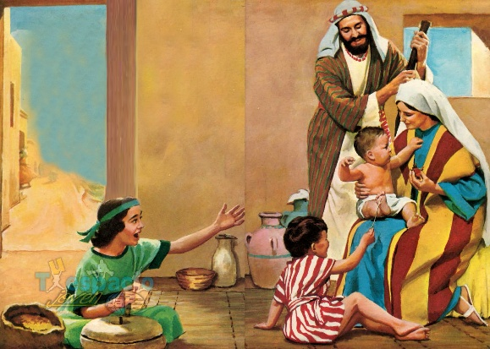
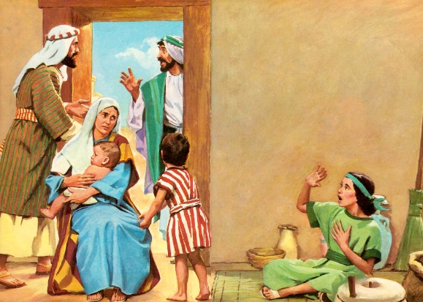
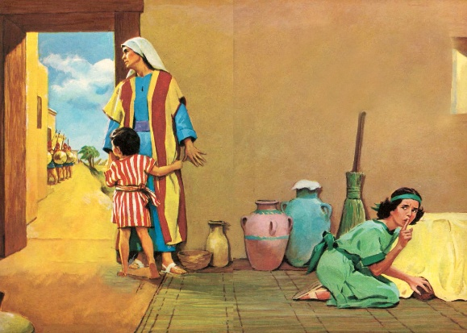
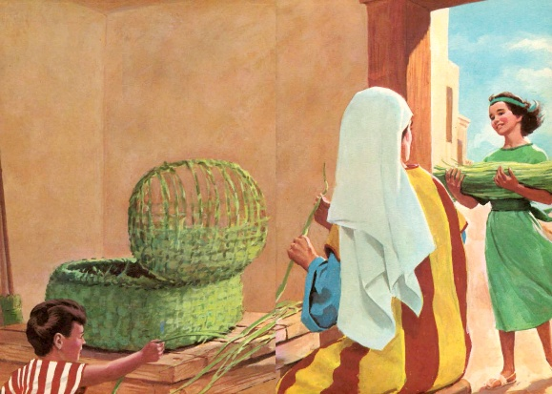
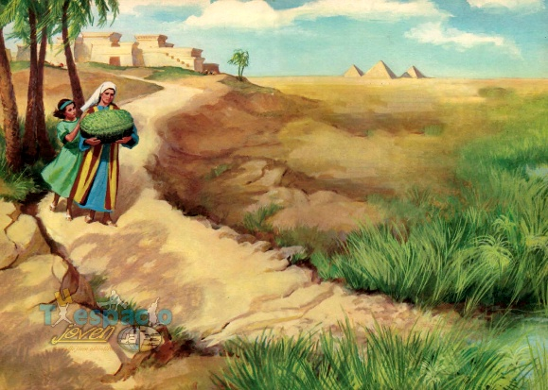
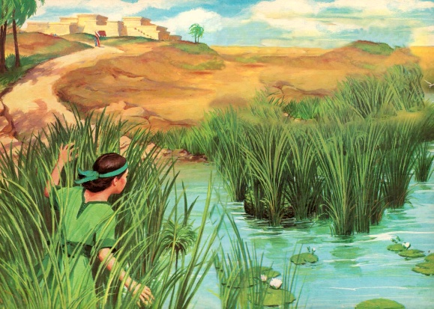
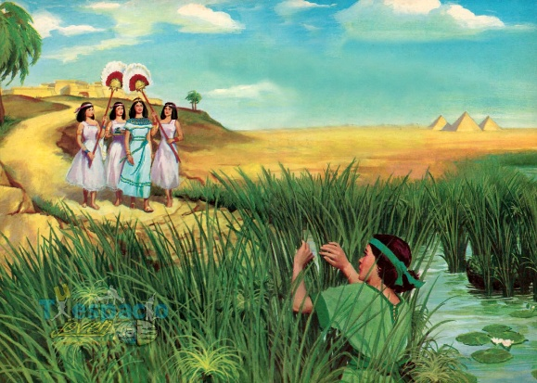
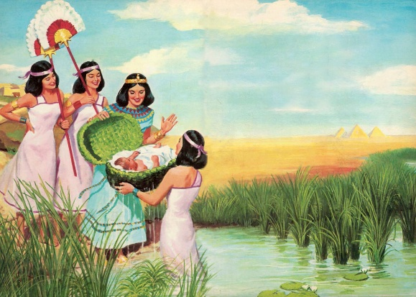
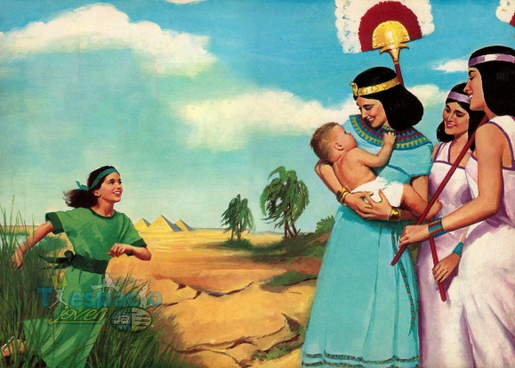
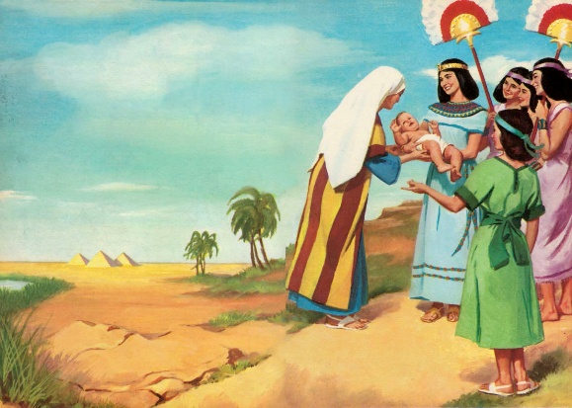
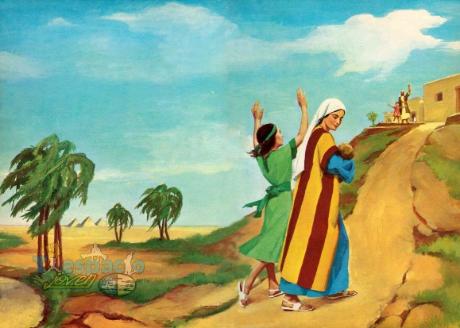
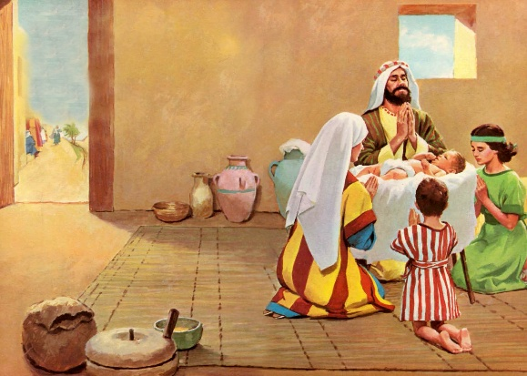
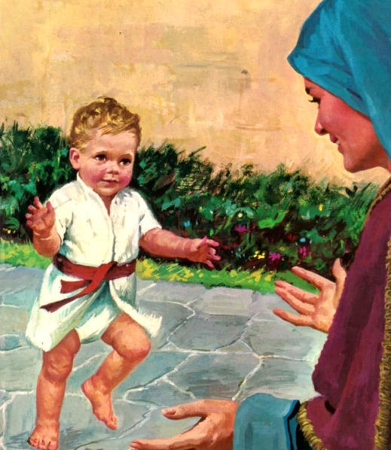
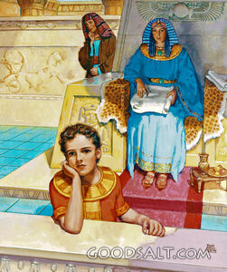
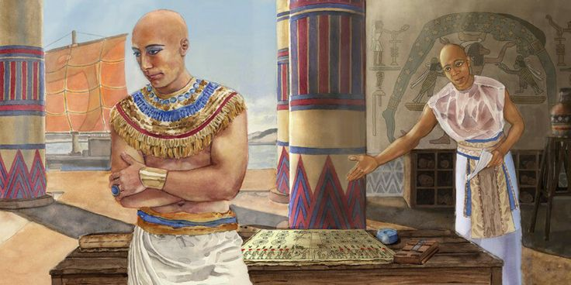
MWANAKOMANA WENAIRI
“Mukadzi akaʋa nemimba, akaɓereka mŋanakomana; ɀino wakati aciʋona kuti mŋana wakanaka, akamuʋanza mŋedzi mitatu” (Ekisodho 2:2)
“Akanaka” anoperevedza pakurondedzera mwanakomana waJokebhedhi ( Eki. 2:2 ) Shoko rechiHebheru“tob ” (akanaka, akakwana) ndiro rimwe chete rinoshandiswa naMwari kutsanangura kukwana kwezvisikwa zvake (Gen. 1:31).
Mwari aive nemarongero akakosha kwaari. Amai vakazviisa pangozi; mukadzi wechidiki akabatwa moyo; mwana akataura nohuchenjeri… uye mudzikinuri wenguva yemberi akaponeswa parufu(Eki. 2:3-7).
Hatizivi zita raakapiwa nevabereki vake, asi tinoziva zita raakapiwa naamai vake vatsva, mwanasikana waFarao: Hapimosis (mwanakomana wamwari waNairi). Asi aingozviti “mwanakomana,” “mosis ,” Mozisi (Eki. 2:10).
Amai vake vakashandisa zvakanaka makore mashomanana avakanga vamuchengeta ( Eki. 2:8-9 ). Vakamudzidzisa kuva mwana waMwari wechokwadi. Ibasa rinokosha zvakadini rinoitwa naamai mukurera vana vavo mukutya Mwari!

Slide 9
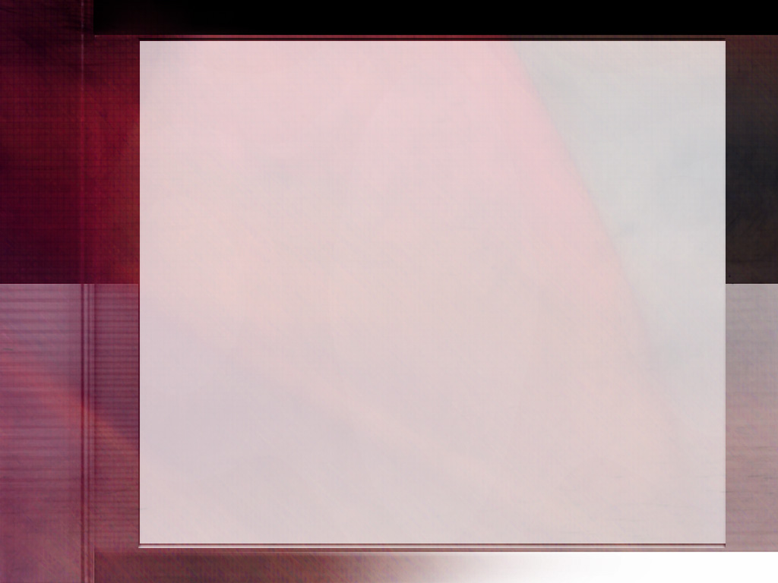
“Mwari akanga anzwa minamato yaamai; kutenda kwake kwakanga kwatuswa. Kwakanga kuri nekutenda kukuru kuti akapinda pabasa rake rakachengeteka uye rinofadza. Nokutendeka akavandudza mukana wake wokudzidzisa mwana wake zvaMwari. Akanzwa aine chivimbo chokuti akanga achengeterwa rimwe basa guru, uye aiziva kuti nokukurumidza aifanira kupiwa kuna amai vake vohumambo, kuti ave akapoteredzwa nezvinhu zvaizoita kuti abve pana Mwari. Zvose izvi zvakaita kuti ashingaire uye angwarire murayiridzo wake kupfuura wevamwe vana vake. Akaedza kuzadza pfungwa dzake nokutya Mwari uye kuda chokwadi nokururamisira, uye akanyengetera nomwoyo wose[p. 244] kuti adzivirirwe kubva pakufurira kwose kunoodza. Iye akamuratidza upenzi nechivi chokunamata zvidhori, uye pakuvamba-vamba akamudzidzisa kupfugama ndokunyengetera kuna Mwari mupenyu, uyo oga aigona kumunzwa ndokumubetsera munjodzi iri yose.” -Non Official Translation by Gift Mawoyo
EGW (Patriarchs and Prophets, p. 243)

Slide 10


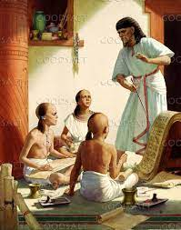
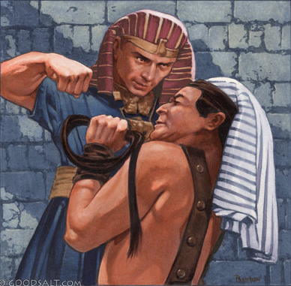
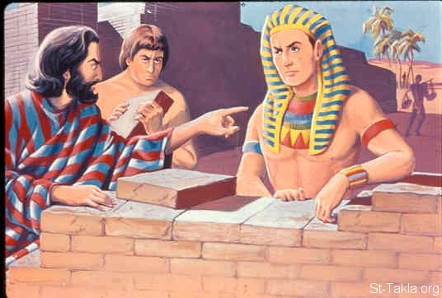
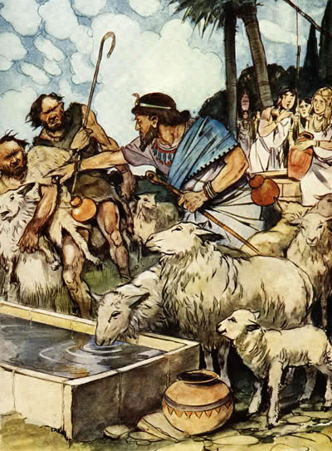
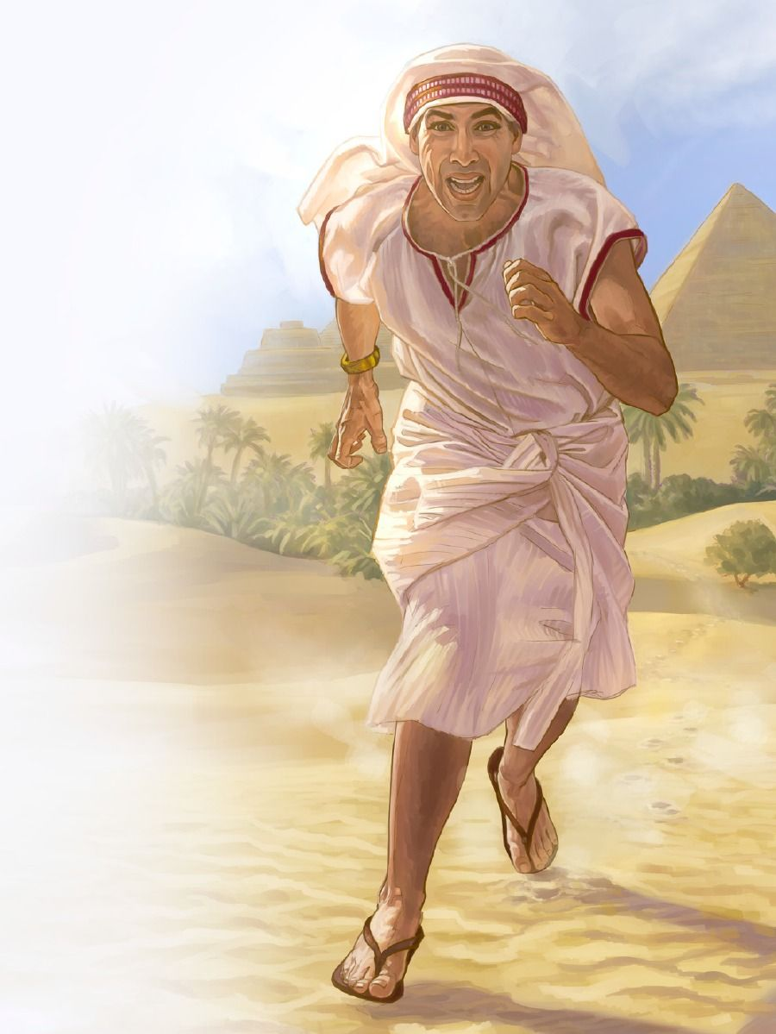
MUSUNUNGURI AKAKUNDIKANA
“Ɀino Farao wakati anzwa cinhu ico, akatȿaka kuʋuraya Mosesi. Asi Mosesi wakatiza pamberi paFarao, akandogara kunyika yeMidiani, akagara pasi patsime” (Ekisodho 2:15)
Tinoziva zvishoma nezvehuduku hwaMozisi. Semunhu aizogona kuva mugari wenhaka kuchigaro choumambo, angadai akawana dzidzo nokuda kwahwo, kubatanidza unyanzvi hwehondo nedzezvamatongerwe enyika(EGW , “Patriarchs and Prophets,” p. 245) . -Non Official Translation by Gift Mawoyo
Tinoziva kuti nguva pfupi Mozisi asati asvitsa makore 40, Thutmose II akanzi farao pamusana pezvamatongerwe enyika.Mozisi akabva atenda kuti nguva yakanga yasvika yokuti asunungure vanhu vake vaIsiraeri. Asi akatanga kusunungurwa kwake nekuuraya muEgipita. Uku kwaive kukanganisa kukuru (Ekisodho. 2:11-12). Kunyange vanhu vake vakanga vasingamuoni semusununguri wavo ( Ekis. 2:13-14 ; Mab 7:25 ).
Mumazuva mashomanana chete, akabva pakuva nhengo yairemekedzwa mudare raFarao achiva mufudzi mupoteri ( Ekis. 2:15-22 ). Zvisinei, Mwari haana kuramba Mozisi; panzvimbo pezvo, akaramba achivimba naye, pasinei zvapo nechikanganiso chake.

Slide 11

“Muzinda wakaisvonaka waFarao nechigaro chohumambo chakaitwa sechikuchidziro kuna Mozisi; asi aiziva kuti mafaro ezvivi anoita kuti vanhu vakanganwe Mwari akanga ari muvazhe dzake dzohumambo. Akatarira mberi kweimba yamambo yakaisvonaka, kupfuura korona yamambo, nokukudzwa kwakakwirira kuchapiwa vatsvene voWokumusoro-soro muhumambo husina kusvibiswa nechivi. Akaona nekutenda korona isingaori yaizoiswa naMambo wekudenga pahuma yemukundi. Kutenda uku kwakamuita kuti abve pavana ishe vepanyika ndokubatana nerudzi runozvininipisa, rwakaderera, rwakazvidzwa rwakanga rwasarudza kuteerera Mwari pane kushumira chivi.” -Non Official Translation by Gift Mawoyo
EGW (Patriarchs and Prophets, p. 246)

