Slide 1
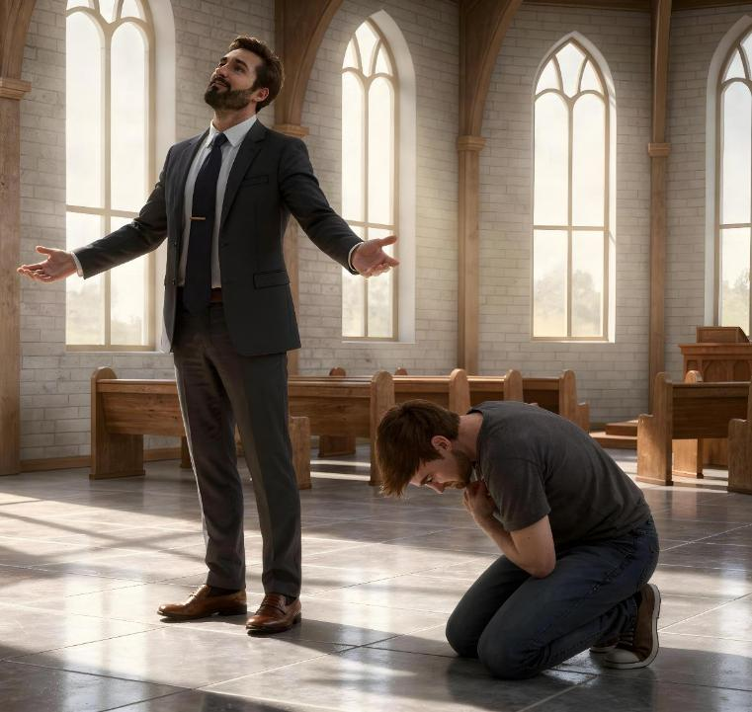
CHINDINI VS KUZVININIPISA
Chidzidzo 3 cha Kubvumbi 18, 2026

Slide 2

“Nokuti mumŋe nomumŋe unoɀikudza, ucaninipiswa; ʋuye mumŋe nomumŋe unoɀininipisa, ucakudzwa”
(Ruka 14:11)

Slide 3

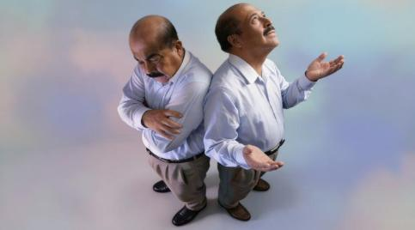
Chii chakakosha pandiri? Uyu mubvunzo wakaoma kupindura.
Kana ndikataura zvakawanda (ndichibuditsa dundundu kunze), ndinobvuma kuti zvese zvandiri uye zvandinazvo ndakazviwana ndega.
Ko kana ndikataura zvakawanda nekuti Mwari anonditora semwanakomana Wake?
Kana ndisingatauri chinhu (kuzvininipisa), ndinobvuma kuti zvose zvandiri nezvandinazvo zvinobva kuna Mwari.
Ko kana ndikasataura chinhu nekuti ndinoshaya kuzviremekedza?
Mienzaniso yechindini
Rusifa
Vadzidzi vaJesu
Mienzaniso yekuzvininipisa
Muteresi
Mozisi
Jesu, muenzaniso wakakwana

Slide 4

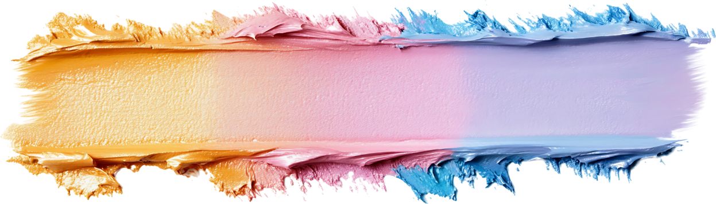
MIENZANISO YECHINDINI

Slide 5





RUSIFA
“Nokuti ɀose ɀiri munyika, ɀinoti, kuciʋa kwenyama, nokuciʋa kwameso, nokuɀikudza kwoʋupenyu, haɀibvi kunaƂaɓa, asi panyika” (1 Johani 2:16)
Kana tichitaura pamusoro pekuzvikudza, tinofanira kutaura nezveuyo akatanga kuita manzwiro aya: Rusifa. Akasarudza kusagutsikana nechinzvimbo chake, asi aida kukwira kune chimwe chepamusoro. Pashure penguva yakati, akashuva kukwidziridzwa zvokuti akashuva kugara pachigaro chimene chohumambo chaMwari ( Isaya 14:12-14 ).
“Takagara nhaka” yechido chokuita chero chinotifadza, kuva nechero chatinoda, uye kuwana zvinzvimbo zvinoita kuti tive nomukurumbira kana pfuma. Ndizvo zvatinopiwa nenyika! ( 1 Johani 2:16).
Asi hakusi shuviro yose kuzvikudza. Kugutsikana kunobva mukubudirira kwomwana, kana kuti vavariro yomunhu oga, hakusati kuri hako kuzvikudza kusina kunaka
Chinhu chinokosha chokuyeuka ndechokuti zvinhu zvedu, unyanzvi hwedu, uye zvatinokwanisa kuita hazviratidzi kukosha kwedu. Kuzvikudza kunosanganisira kusapa Mwari mbiri pane zvaanoita muhupenyu hwedu

Slide 6



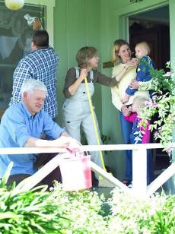

VADZIDZI VAJESU
“Ɀino nharo dzakamuka pakati paʋo kuti ndiani kwaʋari ucanzi mukuru.” (Ruka 22:24)
Vakanga vapedza makore anopfuura matatu vaina Jesu. Akanga achangobva kushambidza tsoka dzavo uye akavaudza nezveropa rake rakadeurwa nokuda kwavose. Zvino vakati vachidya kudya kwemanheru, nhaurirano yavo ikasava nechokuita neizvi zvose; ndiani kwaʋari ucanzi mukuru? ( Ruka 22:24)
Kuzvikudza kwavo kwakavaita kuti vatende kuti vakakodzera nzvimbo yepamusoro. Vakatadza kunzwisisa kukomba kwemanzwiro avo. Vakanga vachibvisa Mwari kubva pamwoyo yavo nokuda kwekuzvikudza kwavo.
Jesu akananga papfungwa yacho: “Asi ini ndiri pakati penyu sounoshumira.” (Ruka 22:27). Nemamwe manzwi: kana uchida kuva mukuru saTenzi wako, shandira vamwe.
Kuzvikudza kwedu kunotitaurira kuti tinofanirwa kushumirwa nevamwe (tiri nani kupfuura ivo). Tinoda nyasha dzaMwari kuti tive varanda vanozvininipisa.

Slide 7

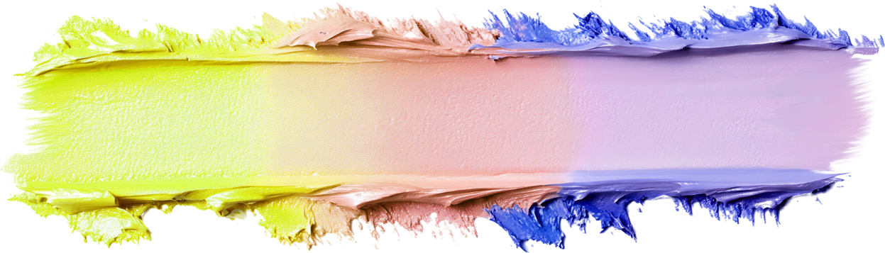
MIENZANISO YEKUZVININIPISA

Slide 8





MUTERESI
“Asi muteresi wakamira kure, asiŋgaɗi kunyaŋge nokutarira kuɗeŋga, akaɀiroʋa cifuʋa, akati, ‘Mŋari, ndinzwirei tsitsi, ini mutadzi!’ ” (Ruka 18:13)
Mumwe muFarise aiudza Mwari nezvemabasa akanaka aaiita uye nezvakanaka zvaaiva nazvo pamberi peDenga. Asi Jesu akati “akanyengetera mumwoyo make,” kwete kuna Mwari ( Ruka 18:11-12 ). Muenzaniso wakakwana wekuzvikudza.
Muteresi aikumbira kubatsirwa naMwari, nokuti akanga ari mutadzi (Ruka 18:13). Nokuzviisa pamberi paMwari achizvininipisa,“uyu wakaɓurukira kumba kwake aruramiswa,” “Nokuti mumŋe nomumŋe, unoɀikudza, ucaninipiswa, nomumŋe nomumŋe, unoɀininipisa ucakudzwa” (Ruka 18:14).
Kuzvininipisa kwechokwadi kunotanga patinobvuma chivi chedu uye tichikumbira rubatsiro rwaKristu.
Zvadaro…
Hatizotarisi vamwe sevakaderera (VaFi. 2:3)
Hatizotsvage kuzivikanwa neruzhinji (Ruka. 14:7-11)
Ticharega vamwe vachitipa kuzivikanwa (Zvi. 27:2)
Tichagamuchira nyasha dzaMwari (Jakobho 4:6)
Tinozopa vamwe nyasha idzodzo (1 Petro 4:10)

Slide 9

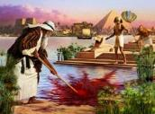






“Nokutenda Mosesi, akura, wakaramba kunzi mŋanakomana womukunda waFarao,akati ɀirinani kuitirwa ɀakaipa pamŋe cete naʋanhu ʋaMŋari pakufarira ɀiʋi ŋguʋa ɗuku.” (VaHebhuru 11:24-25)
MOZISI
Mozisi akadzidziswa kuva Farao aitevera weEgipita. Akanga ari nyanzvi huru uye ane unyanzvi hukuru hwenjere (Mabasa 7:22). Pazera remakore 40, akasarudza kuisa zvose izvi parutivi ndokubatana nevanhu vake (VaHebhuru 11:24-25).
Akanga ari mudzikinuri! Ruoko rwake rune simba rwaizosunungura hama dzake! Kukanganisa kukuru. Mwari aisagona kumushandisa iye aine kuzvikudza kwakadaro.
Mamwe makore 40 ekuyanana naMwari murenje akamuita munhu anozvininipisa zvikuru ( Num. 12:3 ). Zvino aigona kushandiswa naMwari kutumira madambudziko; kuyambuka gungwa; kugamuchira mirairo ine gumi; kutaura naMwari; kurova dombo… Akatokwanisa kugamuchira nokuzvininipisa chirango nokuda kwechiito chake chorudado, achitora mbiri nokuda kwezvaakaita.(Num. 20:10-12).
Muenzaniso waMozisi unotiratidza kuti kuzvininipisa hakungoerekani kwamuka matiri, asi tinofanira kukumbira Mwari kuti atizadze nako mazuva ose

Slide 10




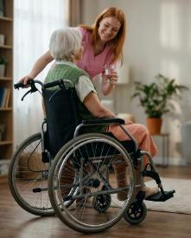
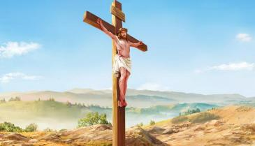
JESU, MUENZANISO WAKAKWANA
“akati awanikwa nomufananidzo womunhu, akaɀininipisa, akaterera kuȿikira parufu, irwo rufu rwomucinjikwa!” (VaFiripi 2:8)
Hapana munhu munyika ino ati ambova—kana kuti achazombova—neukuru hwaiva naJesu asati ava munhu. Asi iye akarasa zvinhu zvose nokuda kwedu. Takatarisana nokunyadziswa kwakadaro, zvose zvatinazvo, zvose zvatiri, kana kuti zvose zvatingagona hazvisi kana chiro kana zvichienzaniswa.
Jesu akarasa Denga kuti afire vanhu netariro yokuti tichanzwisisa chiito chake chenyasha uye tigopindura kukoka kwake kuhukama naye ( VaFi. 2:5-8 ). Iye, pasina mubvunzo, muenzaniso wakakwana wokuzvininipisa.
“Iʋai nomŋoyo uyo, wakaŋga uri munaKristu Jesu ʋo” (VaFi. 2:5).
Kuteera muenzaniso Wake, “musiŋgaiti cinhu nenharo, kana nokuɀikudza, asi mumŋe nomumŋe ŋgaati nomŋoyo unoɀininipisa, ʋamŋe ʋanomupfuʋura iye pakunaka; 4mumŋe nomumŋe ŋgaarege kutarira ɀake, asi ŋgaatarire ɀaʋamŋe ʋo” (VaFi. 2:3-4).

Slide 11

“1Ndicakuʋoŋgai nomŋoyo waŋgu wose;
Ndicakuimbirai nziyo dzokurumbidza pamberi paʋamŋari.
2Ndicanamata ndakatarira kutembere yenyu tȿene,
Nokuʋoŋga zita renyu nokuɗa kwoʋunyoro bgenyu nokutendeka kwenyu;
Nokuti makakurisa shoko renyu kupfuʋura zita renyu rose.
3Pazuʋa randakaɗana makandipindura,
Makandisimbisa nesimba pamŋeya waŋgu.
4Madzimambo ose enyika acakuʋoŋgai, Jehova,
Nokuti ʋakanzwa mashoko omuromo wenyu.
5Ɀirokwaɀo, ʋacaimba ʋacireʋa nzira dzaJehova;
Nokuti kubginya kwaJehova kukuru.
6Nokuti Jehova uri kumsoro, kunyaŋge ɀakaɗaro unehanya nounoɀininipisa;
Asi unamanyawi Jehova unomuziʋa ari kure.
7Kana ndicifamba pakati penhamo, imi mucandiponesa;
Mucatambanudza ruʋoko rwenyu kudziʋisa kutsamŋa kwaʋaʋeŋgi ʋaŋgu,
Ruʋoko rwenyu rworudyi rucandiponesa.
8Jehova ucandikwanisira ɀinhu ɀaŋgu;
Ŋgoni dzenyu, Jehova, dzinogara nokusiŋgaperi;
Musarega maɓasa amaʋoko enyu.!”
MAPISAREMA 138

Slide 12
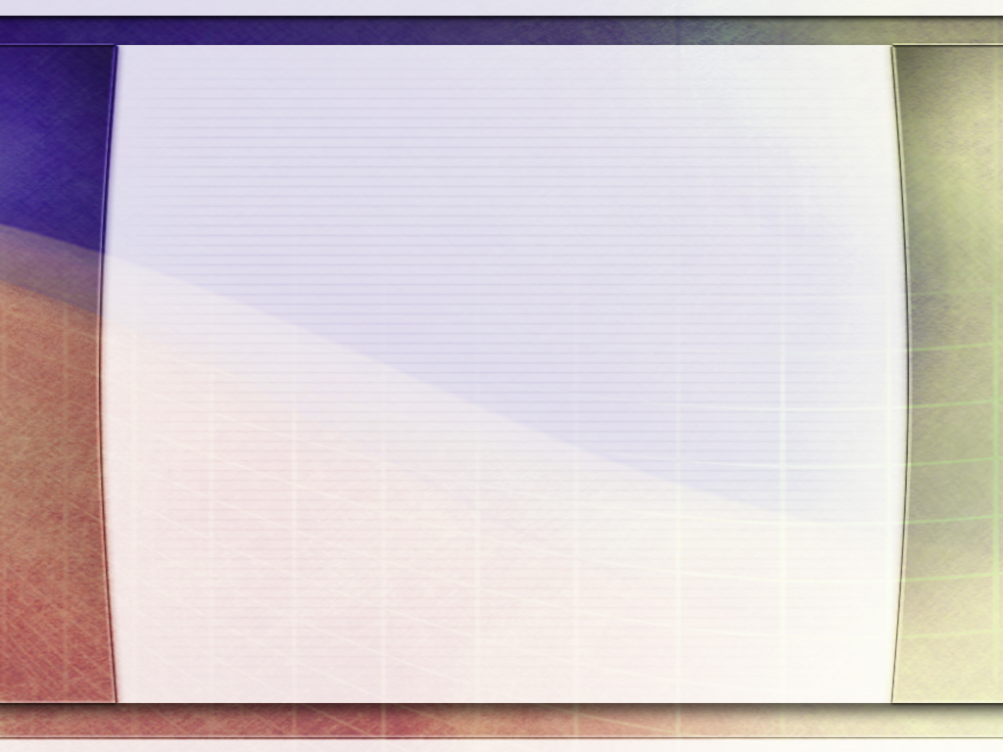
“Mukuzvida, kuzvikwidziridza, nekuzvikudza mune hutera hukuru; asi mukuzvininipisa mune simba guru. Chiremerera chedu chechokwadi hachichengetwe patinozvifunga zvikuru pachedu, asi kana Mwari ari mundangariro dzedu dzose uye nemoyo yedu yose ichipfuta nerudo kuMudzikinuri wedu uye rudo kune vamwe vedu. Kupfava kwehunhu uye kuzvininipisa kwemwoyo zvinopa mufaro, nepo kuzvitutumadza kuchiunza kusagutsikana, kutsamwa, uye kuodzwa mwoyo kunongoramba kuchiitika. Kudzidza kuzvifunga zvishoma uye kuwedzera kufadza vamwe izvo zvichaunza kwatiri simba rohuMwari.” -Non-Official translation by Gift Mawoyo
EGW (Testimonies for the Church, vol. 3, p. 476)

