Slide 1

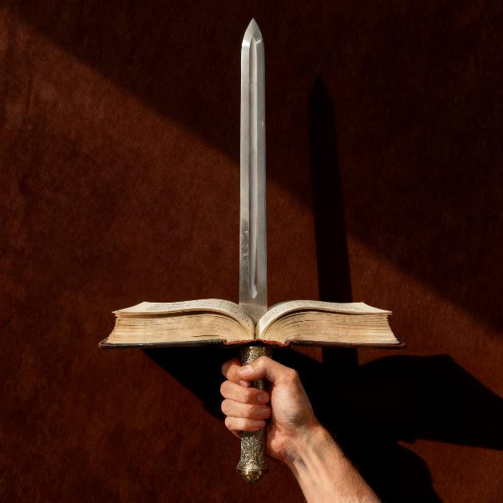

BASA REBHAIBHERI
Chidzidzo 4 cha Kubvumbi 25, 2026

Slide 2

“Nokuti shoko raMŋari iɓenyu, rinesimba, rinopinza kukunda munondo unoceka kumatiʋi maʋiri, rinoɓaya kuȿikira panoparadzana mŋoyo nomŋeya, namafundo nomŋoŋgo; rinotoŋga mifuŋgo nendaŋgariro dzomŋoyo.” (VaHebhuru 4:12)
Notes:
Buscar en biblia-espada

Slide 3


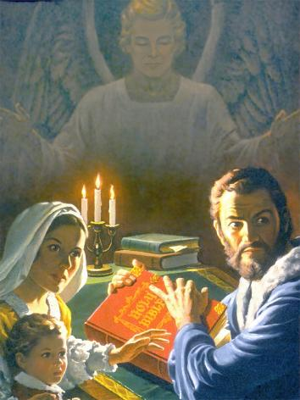
Bhaibheri ndiro bhuku rinotengwa zvikuru pasi rose, kupfuura bhuku riri pachinhanho chechipiri kashanu. Asi izvi zvakanga zvisiri izvo nguva dzose dzapfuura.
Paiva nenguva apo kuva neBhaibheri, kuriverenga, kana kuti kunyange kutaura nezvaro kwaigona kuva chikonzero chokuiswa mujeri, kutambudzwa, uye kunyange rufu.
Kudai yakanga isiri dziviriro yaMwari, Bhaibheri ringadai rakanyangarika kare kare. Sei? Chii chakakosha pamusoro pebhuku iri chinoita kuti rive rinodiwa uye kuvengwa zvakadaro?
Muvengi weBhaibheri
Nzira dzakarurama uye dzisina kururama dzokuverenga Bhaibheri
Bhaibheri chii?
Zvakanakira kuverenga Bhaibheri
Shamwari dzeBhaibheri

Slide 4


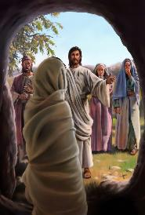
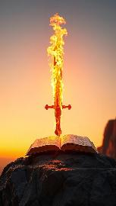

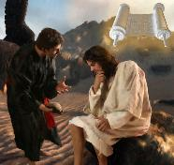
MUVENGI WEBHAIBHERI
“Torai […] munondo woMŋeya, iro Shoko raMŋari.” (VaEfeso 6:17)
Funga nezvinokwaniswa kuitwa neshoko raMwari raanenge ataura: kusika uye kupa hupenyu (Mapisarema 33:6 ), kana kuti kumutsa vakafa.(Johani 5:28-29).
Chinyi icho Bhaibheri, shoko raMwari rakanyorwa, rinokwanisa kuita? Rine simba rekutidzivirira(VaEfe. 6:17b) nekutishandura (VaHeb. 4:12). Jesu akashandisa Bhaibheri kuzvidzivirira pamuedzo (Mat. 4:4, 7, 10).
Satani anoziva kuti haana simba rokupikisa simba reBhaibheri. Naizvozvo, akaedza kuriparadza. Akakundikana, sezvo sosaiti dzeBhaibheri dzakavamba kuparadzira zviuru zvamaBhaibheri. Ipapo akaedza kurizvidza nokutsoropodza kwakakwirira. Iye zvino ava kuda kutitadzisa kuriverenga nokuita nguva yedu nezvimwe zvinhu
.
Ndomusiya akadaro here? Handikwanisi here kuwana imwe nguva mupurogiramu yangu yokuverenga Bhaibheri? Kuriverenga kunotishandura uye kunoita kuti tive vakasimba pakurwisa muvengi wedu mukuru: dhiyabhorosi.

Slide 5

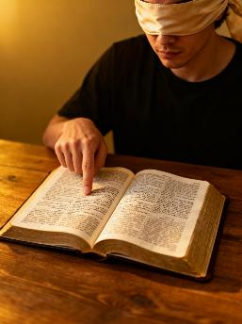



NZIRA DZAKARURAMA UYE DZISINA KURURAMA DZOKUVERENGA BHAIBHERI
“Shiŋgaira kuti uɀiratidze pamberi paMŋari uri munhu wakatendeka, muɓati usiŋgafaniri hake kunyadziswa, unonatsa kururamisa shoko raɀokwaɗi.” (2 Timotio 2:15)
Dzisina kururama
Kutsvaga chimwe chinhu chinoenderana nemaonero edu
Kusarudza zvinyorwa zvisina tsarukano, pasina chinangwa
Dzakarurama
Kutsvaka kudzidza kuda kwaMwari
Ita chidzidzo chakarongeka
Kusarudza zvikamu zvatinoda, uye ramba zvikamu zvatisingadi
Usarambe chero chinyorwa, asi ongorora zvose.
Kudzidza kwedu Bhaibheri kunofanira kuva nemusoro, asi pfungwa dzedu dzinofanira kuzviisa pasi pesimba raMweya Mutsvene kuti tive nekunzwisisa zvakanaka shoko rebhaibheri
Ngenyi? Nokuti kufunga kwedu kune pakunoguma uye hakuvimbiki nguva dzose. Ndicho chikonzero nei, pakudzidza Bhaibheri, tinofanira kutsvaka huchenjeri hwoMunyori waro

Slide 6
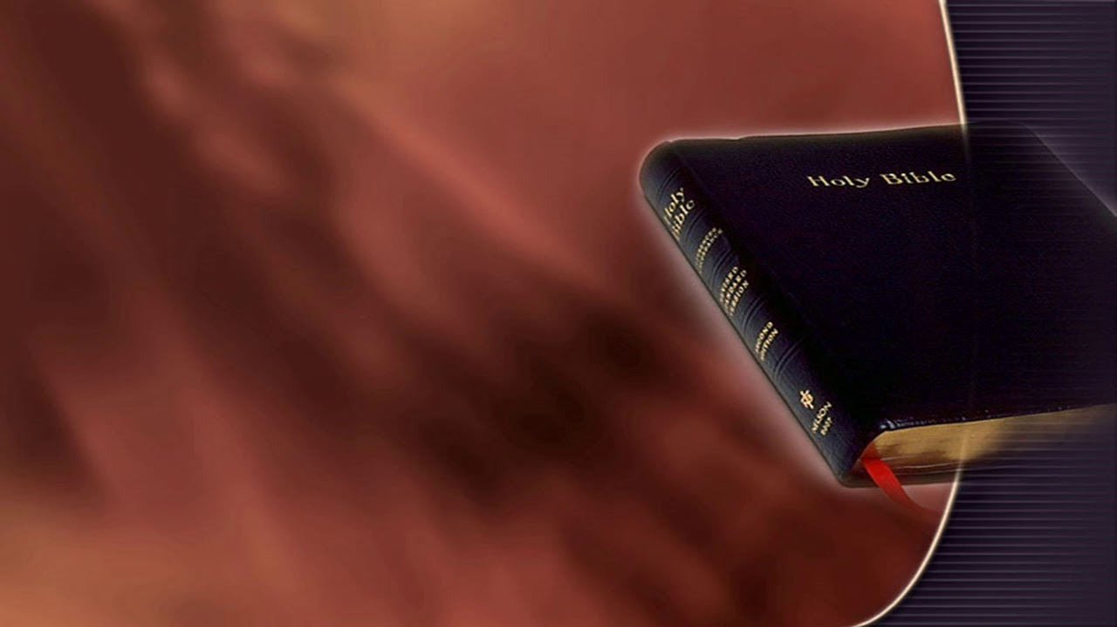

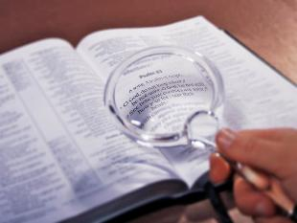
BHAIBHERI CHII?
Munharaunda yedu, uye kunyange pakati pemasangano echiKristu, pane kutenda kuti chokwadi chinoenderana, kuti hapana chokwadi chinoramba chiripo uye chisingashanduki nekufamba kwenguva.
“Ʋuŋganidzo yeshoko renyu iɀokwaɗi;
Ɀose ɀamakatoŋga, ɀakarurama, ɀinogara nokusiŋgaperi.” (Mapisarema 119:160)
Zvisinei, Bhaibheri—seshoko raMwari—rinoti rine chokwadi chakakwana (Mapisarema 119:160; Johani 17:17; Jakobho 1:18). Rinozviti rakachena uye inhovo inodzivirira pazvinopesana nohungwaru hwevanhu ( Zvirevo 30:5 ). Kana tikawedzera chero “chokwadi” chedu pachedu kwairi, tinganzi tiri varevi venhema pamberi paMwari ( Zvirevo 30:6 ).
Chokwadi chipi nechipi, chinofanira kuedzwa neBhaibheri. Kana pane kupesana pakati pezvatinoona sechokwadi nezvinotaurwa neBhaibheri, pane zvinhu zviviri zvinobvira: tingave takanganisa, kana kuti tiri kutsanangura Bhaibheri zvisiri izvo

Slide 7


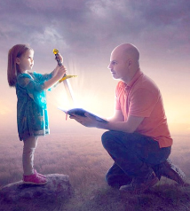


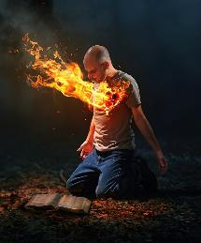
ZVAKANAKIRA KUVERENGA BHAIBHERI
“Shoko renyu ndakariʋiga mumŋoyo waŋgu,
Kuti ndirege kukutadzirai” (Mapisarema 119:11)
Chimwe chinhu chisingarambiki kunyange nevavengi chaivo veBhaibheri isimba raro rokushandura vanhu. Pauro anorienzanisa nebakatwa rine simba guru.
Rinoita kuti tione zvatiri chaizvo (VaHeb. 4:12)
Rinotidzivirira kubva kuchivi
(Mapisarema 119:11)
Chikafu chemweya
(soul) wedu (Jer. 15:16)
Rinoita kuti tikure pamweya (1 Petro 2:2)
Rinotipa hupenyu(Johani 6:63)
Hapana rimwe bhuku rinogona kutibatsira nekutishandura seBhaibheri. Kana isu tichida kuisa dzidziso dzaro muhupenyu hwedu, tinoshanduka kuita zvirinani.
Kana tikariverenga nemoyo wakazaruka uye tikakumbira Mwari kuvhenekera kwaMweya Mutsvene, hupenyu hwedu hunoshandurwa

Slide 8

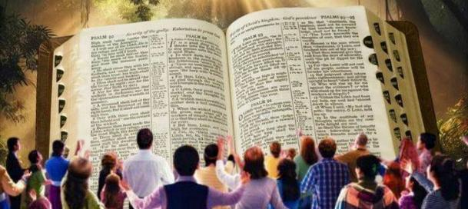
“Saka isu ʋo tinoramba ticiʋoŋga Mŋari, kuti paŋguʋa yamakagamucira shoko, iro shoko raMŋari, ramakanzwa kwatiri, hamuna‐kurigamucira seshoko raʋanhu, asi seshoko raMŋari,rinoɓata ʋo mukati menyu, imi munotenda.” (1 VaTesaromika 2:13)
SHAMWARI DZEBHAIBHERI
Patinogamuchira Bhaibheri nenzira iyi…
Rinotiratidza mamiriro ehukama hwedu naMwari
Rinotiudza kuti tingasimbisa sei ukama ihwohwo
Tiri kusangana neshanduko zvishoma nezvishoma
Tinoswedera pedyo naJesu
Rinotipa ʋucenjeri bgunoisa kukuponeswa
Tiri kukura mukuziva chokwadi
Kutenda kwedu kunokura nokusimbisa
Tine tariro
Tinoziva kuti upenyu huri nani, husingaperi, hunoshamisa hwakatimirira
Shamwari dzeBhaibheri dzinosvika kwariri dzichiziva kuti iShoko Benyu raMwari (1 VaTesaronika 2:13). Asi ndingasvika sei pakutenda ikoko?
Pauro anotiudza kuti, nokuda kwaizvozvi, tinoda nzwisiso yomweya, ndiko kuti, mano okunzwisisa zvinhu zvomweya ( 1 VaKorinte 2:14 ). Naizvozvo, kuziva shoko rehumwari riri muBhaibheri ibasa raMweya Mutsvene anoshanda matiri.

Slide 9

“Bhaibheri rinofumura zvokwadi nokupfava uye kushandukira zvakakwana kuzvinodikanwa nezvishuvo zvomwoyo womunhu, izvo zvashamisa nokukwezva ndangariro dzakasakurirwa zvikurusa, nepo richigonesa vanozvininipisa kuti vaone nzira yoruponeso. Asi zvokwadi idzi dzakataurwa zviri nyore dzinobata nyaya dzakakwirira, dzinosvika kure, dzinopfuura simba rokunzwisisa kwomunhu, zvokuti tinogona kuzvigamuchira bedzi nokuti Mwari akazvizivisa. […] Kunyanya kunzvera Bhaibheri, kunobva kwawedzera kutenda kwake kuti ishoko raMwari mupenyu, uye pfungwa dzevanhu dzinokotama pamberi pehukuru hwezvakazarurwa zvehumwari.” -Non-Official translation by Gift Mawoyo
EGW (Steps to Christ, p. 107)

