Slide 1
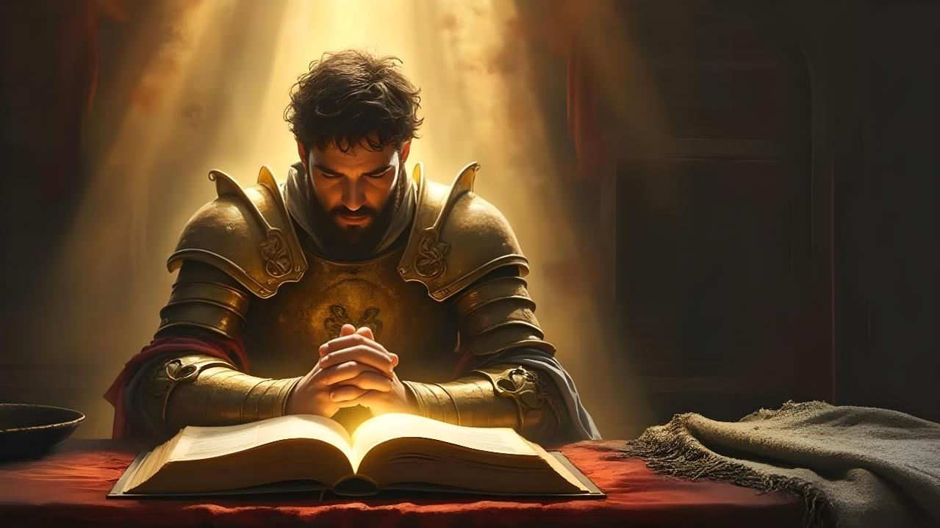
VANORWIRA MUMUNAMATO
Chidzidzo 6 cha Chivabvu 9, 2026

Slide 2

“Ndinoɗa Jehova, nokuti unonzwa
Inzwi raŋgu nokukumbira kwaŋgu.
Ɀaakarereka nzeʋe yake kwandiri,
Ndicaɗana kwaari mazuʋa aŋgu ose” (Mapisarema 116:1, 2)

Slide 3


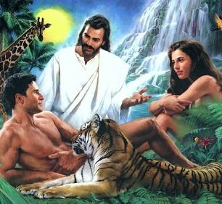

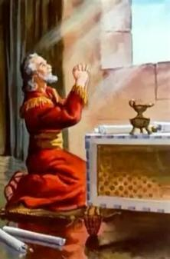
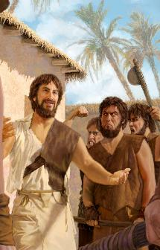
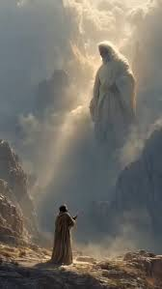


Zvisikwa zvose, kusanganisira vanhu, vakasikwa naMwari vachikwanisa kutaurirana, uye naYe.
Zvinosuruvarisa, vanhu vakarasikirwa nekukwanisa kutaura vakatarisana naMwari apo Adhamu naEvha vakatadza.
Asi Mwari akatisiira chipo. “Foni” inotitendera kuti tirambe tichitaurirana Naye: munamato.
Danieri, Enoki, uye Mozisi mienzaniso yokushandisa kwatinoita chipo ichi chine simba.
Danieri:
  Kunamata munguva dzine njodzi
  Namata uri pachimiro chakakodzera.
Enoki:
  Hupenyu hwemunamato
Mozisi:
  Kutaura naMwari
  Kunamatira vamwe

Slide 4

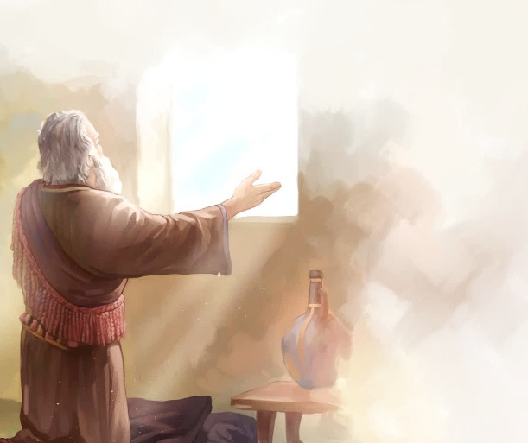
DANIERI

Slide 5

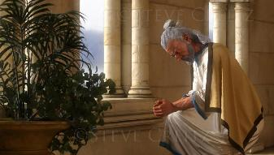
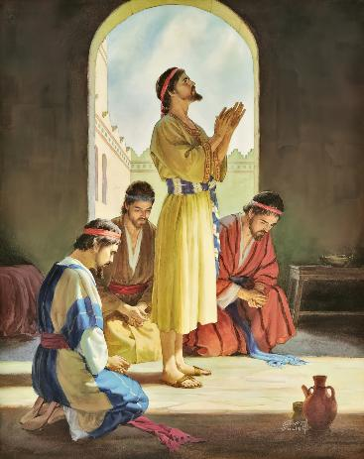














KUNAMATA MUNGUVA DZINE NJODZI
“Ndikarinzira ciso caŋgu kunaShe Mŋari, ndikamutȿaka nokunyeŋgetera nokukumbira, nokuɀinyima ɀokudya, namasaga namaɗota.” (Danieri 9:3)
Nemhaka yokuvimba kwake naMwari, Danieri akagamuchira ungwaru, mano okududzira zviroto, nouchenjeri ( Dan. 1:8, 17, 20 ). Apo upenyu hwake nehweshamwari dzake hwakanga huri mungozi, akanyengetera kuna Mwari (Dan. 2:17-23).
Pashure poupenyu hwokunyengetera, Danieri akanga ava nounhu hupi (Dan. 6:3-5)?
MUTUNGAMIRI
AKANAKA
KUTENDEKA
HANYA NEKUZVIPIRA
KUSATSVIKA
KUVIMBIKA
KUKUDZWA
KUSAVA NETSIKA
DZAKAIPA

Slide 6

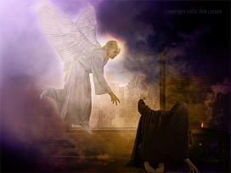
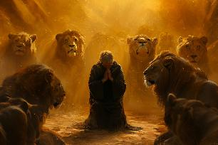
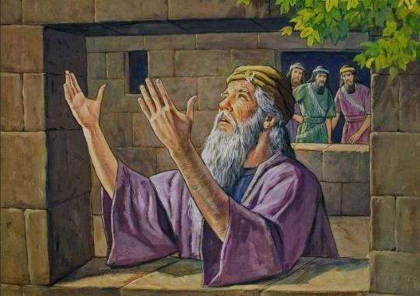
KUNAMATA MUNGUVA DZINE NJODZI
“Ndikarinzira ciso caŋgu kunaShe Mŋari, ndikamutȿaka nokunyeŋgetera nokukumbira, nokuɀinyima ɀokudya, namasaga namaɗota.” (Danieri 9:3)
Denga rakanga rakateerera munyengetero waDanieri ( Dan. 9:20-23; 10:12 ). Kungotyora chisungo ichi chete vavengi vake vaigona kumukuvadza(Dan. 6:5-7).
Atarisana neiyi tyisidziro itsva yorufu, Dhanieri akaramba ata miitiro yake yokunyengetera (Dan. 6:10):
Akanga asingashanduki, achinyengetera katatu pazuva
Yaiva garoziva, aivhura hwindo rakatarira kuJerusarema
Aiva netsika yake; ainamata akapfugama
Waainangidzira pakuonga nokuteterera

Slide 7

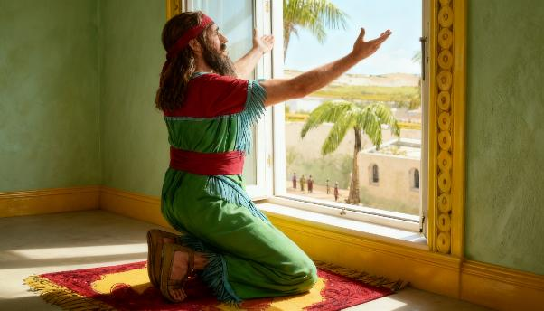

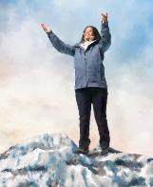
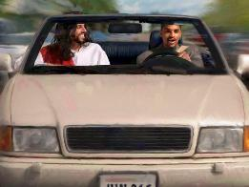
NAMATA URI PACHIMIRO CHAKAKODZERA
“Ɀino Danieri wakati anzwa kuti runyoro rwaiswa zita ramambo, akapinda mumba make (ɀino mawindi ekamuri yake akaŋga akazarurwa acitarira kurutiʋi rweJerusarema); akafugama namabvi ake katatu nezuʋa, akanyeŋgetera nokuʋoŋga pamberi paMŋari wake, seɀaaisiita.” (Danieri 6:10)
Patinonyengetera, tinotaura kuna Mwari sokunge tiri kutaura neshamwari. Zvisinei, Mwari haana kufanana nesu. Ndiye Mambo weZvisikwa zvose.
Nokuda kwechikonzero ichi, tsika yaDhanieri yakanga iri yokupfugama pamberi Pake kuti anyengetere, achimubvuma saChangamire wake.
Sezvo tichigona kunyengetera kuna Mwari mumamiriro ezvinhu api naapi uye panguva ipi neipi, hakusi nguva dzose kunobvira kana kuti kuri madikanwa kuita kudaro nenzira iyi.
Kuvhara maziso edu kunotibvumira kuisa pfungwa dzedu pamunyengetero, asi mune mamwe mamiriro ezvinhu hazvibviri (kufamba, kutyaira, nezvimwewo).
Chinokosha ndechokuti minyengetero yedu inoitwa noruremekedzo rwakafanira kuna Mwari.

Slide 8

NAMATA URI PACHIMIRO CHAKAKODZERA
“Ɀino Danieri wakati anzwa kuti runyoro rwaiswa zita ramambo, akapinda mumba make (ɀino mawindi ekamuri yake akaŋga akazarurwa acitarira kurutiʋi rweJerusarema); akafugama namabvi ake katatu nezuʋa, akanyeŋgetera nokuʋoŋga pamberi paMŋari wake, seɀaaisiita.” (Danieri6:10)
MuBhaibheri tinowana mienzaniso yevanhu vakanyengetera nenzira dzakasiyana-siyana, maererano nemamiriro avo ezvinhu.
Jehoshafati akanyengetera amire pamberi pavanhu (2Makoronike. 20:5)
Dhavhidhi akagara pamberi paMwari achivonga
(2S. 7:18)
Soromoni akanyengetera akapfugama, maoko ake akasimudzwa
(1Madzi. 8:54)
Vanhu vakakotamisa misoro kuti vanamate
(Neh. 8:6)
Dhavhidha akanamata akakotama panhovo yake
(1Madzi. 1:47)
Nehemia akamira ndokunyengetera chinyararire pamberi pamambo
(Neh. 2:1-4)
Pasinei nemaonero edu, Bhaibheri rinotikurudzira kuti tirambe tichinyengetera (1 VaTes. 5:17), tichitsungirira ( Vakorose. 4:2 ) uye nguva dzose.(VaRoma. 12:12).

Slide 9

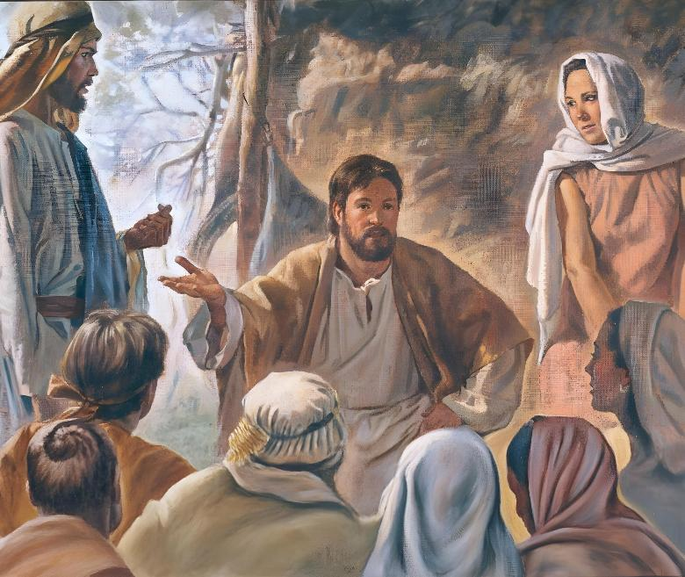
ENOKI

Slide 10

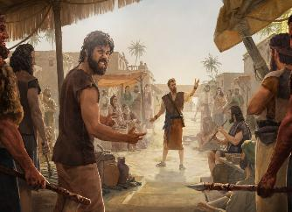
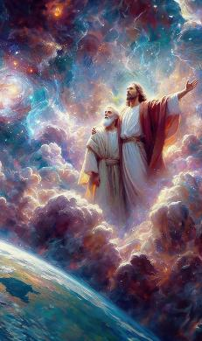
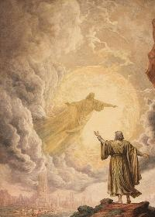
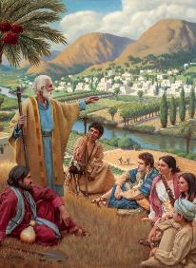
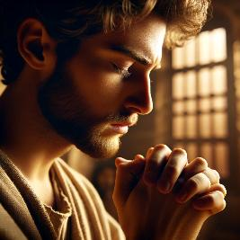
HUPENYU HWEMUNAMATO
“Enoki akafamba naMŋari, akasazoʋa’po, nokuti Mŋari wakamutora.” (Genesisi 5:24)
Enoki akararama munguva dzakaoma, apo uipi hwapanguva yeMafashamo asati auya hwakanga huchiwedzera. Nokuzvarwa kwomwanakomana wake, kunzwisisa kwake Mwari kwakawedzera, uye ruwadzano rwake Naye rwakawedzera (Gen. 5:21-24).
Munyengetero wakanga uri chinhu chinokosha muhukama ihwohwo. Basa rake parakaramba richiwedzera uye richiwedzera hukoshi, minamato yake yairamba ichiwedzera uye yakasimba. Dzimwe nguva, aienda kunzvimbo dzakahwanda kuti ave nohukama naMwari. Zvisinei, aigara achidzokera kuvanhu kuti avaudze zivo yake yaMwari.
Mwari anotinzwa mubishi nekutatarika kwehupenyu hwemazuva ese uye mukunyarara kwekudzokera shure. Hapana nzvimbo paNyika yaasingakwanise kutiona nekutinzwa. Tinogona kutaura munyengetero wedu nemashoko (anotibatsira kuisa pfungwa dzedu pamwoyo), kana kuti tingazviita chinyararire (zvinotibatsira kutaura zvatinofunga). Chinokosha ndechokuti usamborega kutaura naMwari mumunyengetero.

Slide 11

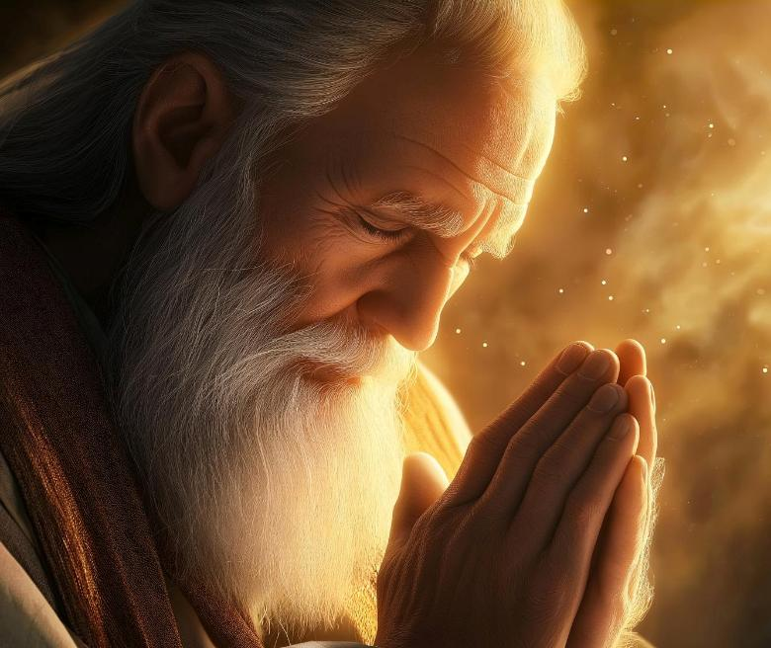
MOZISI

Slide 12


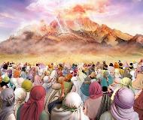
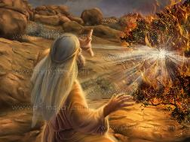
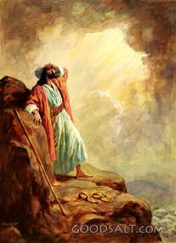
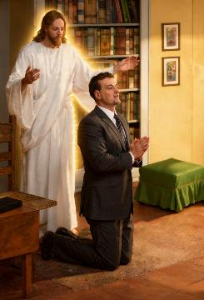
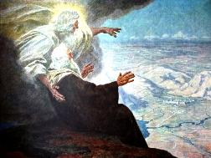
KUTAURA NAMWARI
“Hakuna‐kuzomuka ɀe muprofita pakati paIsraeri wakafanana naMosesi, wakaŋga acizikanwa naJehova, ɀiso ɀakatarisana” (Deuteronomio 34:10)
Pakunzwa inzwi raMwari richitaura kubva paSinai, vanhu vaIsraeri vakakumbira kuti Iye asataura navo zvakananga zvakare, nokuti vaitya kufa nokuda kwenzwi Rake(Eki. 20:18-19).
Izvi handizvo zvakaitika kuna Mozisi, uyo akataura naMwari vakatarisana (Deutronomio 34:10). Kwamakore 40 (kubva pagwenzi raipfuta kusvikira parufu rwake), Mozisi naMwari vaiva nekurukurirano pachavo dzenguva dzose(Eki. 33:9-11).
Bhaibheri rinotaura nezvemazuva anoverengeka emazuva makumi mana umo Mwari akapa Mozisi mirayiridzo chaiyo yokuvaka tabhenakeri uye akamuudza mitemo yakasiyana-siyana. Mukati mekurukurirano idzi, Mozisi akarevererawo vanhu.
Hatina ropafadzo yokutaura naMwari takatarisana, asi munyengetero unozadza mukaha iwoyo nokutibvumira kutaura zvakananga Naye

Slide 13
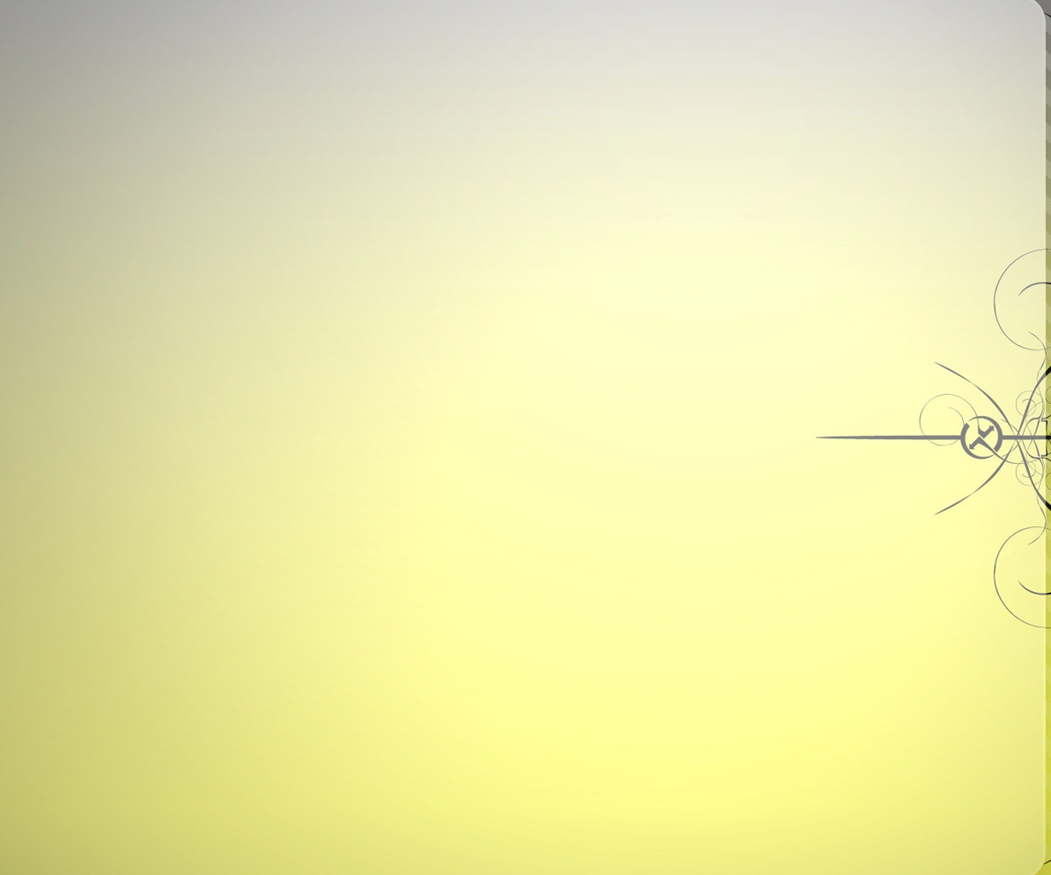
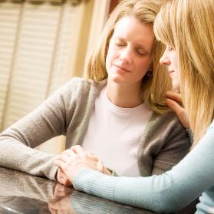

KUNAMATIRA VAMWE
“Jehova wakaŋga aneshuŋgu ʋo kwaɀo naAroni, akaɗa kumuparadza, ndikanyeŋgeterera Aroni ʋo neŋguʋa iyo.” (Deuteronomio 9:20)
Patinonamatira vamwe tinee tichimiririra vamwe vanhu (Jakobho 5:16; Mateo 5:44; 1 Timotio 2:1-4).
Mozisi akamiririra vamwe kuna Mwari pazviitiko zvakasiyana-siyana uye nezvikonzero zvakasiyana-siyana:
NHENGO DZEMHURI YAKE
⁕ Nokuda kwechivi chaAroni
(Deut. 9:20)
⁕ Nokuda kwokunyunyuta kwaMiriyemu
(Nm. 12:10-13)
VANHU
⁕ Pavakanga vave nenyota
(Eki. 15:24-25)
⁕ Pavakanga vave nenzara (Nm. 11:11-13)
⁕ Pavakaita chivi
(Eki. 32:30-32)
Chii chakaita kuti Mozisi anyengeterere vamwe?
Chinhu chimwe chetecho chinofanira kutikurudzira: kuda avo vatinonyengeterera.

Slide 14

“Tinofanira kunamata mumhuri, uye pamusoro pezvose hatifanire kuregeredza munamato wepachivande, nekuti uhwu ndihwo hupenyu hwemweya. Hazvibviri kuti mweya ukure asi munamato uchiregeredzwa. Munamato wemhuri kana paruzhinji chete hauna kukwana. Pakuva wega mweya ngauzarurwe kuziso rinoongorora raMwari. Munamato wepachivande unofanira kunzwiwa chete naMwari anonzwa munamato. Hapana nzeve inoda kuziva inogamuchira mutoro wezvikumbiro zvakadaro. Mumunamato wepachivande mweya wakasununguka kubva kupesvedzero dzakaukomberedza, hauna manyawi. Ichasvasvavirira Mwari zvakadzikama, asi nesimba. Simba rinobva kuna Iye anoona pakavanda richatapira, ane nzeve yakazaruka kuti anzwe munamato unobva mumwoyo.” -Non-Official translation by Gift Mawoyo
EGW (Steps to Christ, p. 98)

