Slide 1

KUTENDEUKA UYE KUREGERERWA
Chidzidzo 10 cha Chikumi 6, 2026

Slide 2

“Kana ticiɀireʋurura ɀiʋi ɀeɗu, iye wakatendeka wakarurama, nokuɗaro kuti unotikaŋganwira ɀiʋi ɀeɗu, nokutinatsa pakusakarurama kwose”
(1 Johani 1:9)

Slide 3










The Bible declares that “ʋose ʋakatadza, ʋakasaȿika pakubginya kwaMŋari.” (VaRom. 3:23).
Rinotaurawo kuti hatikwanisi kudzivisa kana kubvisa chivi chedu (Jer. 13:23; 2:22).
Asi Mwari anoda kutiregerera zvivi zvedu. Hakuna chivi chikuru kana chinotyisa zvekuti Mwari haadi kuchiregerera(Isaya 1:18).
Pane chimwe chete chinodiwa: kutendeuka.
Kutendeuka:
  Kuverengera kutendeuka
  Kutendeuka kwechokwadi
  Rukoko kukutendeuka
Kuregererwa:
  Nyasha dzekuregererwa
  Nguo dzekuregerera

Slide 4



KUTENDEUKA

Slide 5







KUVERENGERA KUTENDEUKA
“Ishe akapindura, akati kwaari: Marta! Marta! unofuŋganya, nokuɀitambudza neɀinhu ɀizhinji.” (Luke 10:41)
At Lazarus's house, Jesus spoke about important matters, vital for salvation. But Martha didn't listen. She didn't have time. There were so many things to do! (Lk. 10:40-41).
This also happens to us. When we have sinned, and the Holy Spirit calls us to repentance, Satan fills us with activity, worries, or any other distraction that prevents us from reflecting on our sinful situation and seeking forgiveness.
But God does not give up. He persists in his call (Ezek. 33:11). He compares our sins to filthy garments (Isa. 64:6). He offers an exchange: our filthy garments for his clean garments (Zech. 3:4), garments washed in the blood of Jesus (Rev. 7:14).

Slide 6



KUTENDEUKA KWECHOKWADI
“Ʋuyai, tidzokere kunaJehova; nokuti wakabvambura, asi ucatipodza ɀe; wakaroʋa, asi ucatisuŋga ɀe patakakuʋara.” (Hosea 6:1)
Kutendeuka chii? Ndeupi musiyano uripo pakati pekutendeuka kwechokwadi nekutendeuka kwekunyepedzera? (2 VaKo. 7:10)
Kana chivi chikaunza migumisiro yekukurumidza uye isingadikanwi, kuzvidemba kunovapo. Zvinonyadzisa nekuti zvatakaita hazvina kumira mushe. Dai pasina migumisiro yakaipa, tingadai tisina kunzwa kusuwa nokuda kwezviito zvedu. Uku hakusi kutendeuka kwechokwadi.
Kana idi chairo rokutadza riri iro rinotikonzeresa kusuwa, uye chishuvo chikuru chokukanganwirwa (kana kwave nemigumisiro yakaipa kana kuti kwete), tinotarisana nokutendeuka kwechokwadi.
Kana tikatadza, Mweya Mutsvene “anotibvambura-bvambura” uye “anotikuvadza” nepfungwa huru yekusuwa. Kana tikapindura nokutendeuka kwechokwadi, Mwari anotiporesa, achikanganwira zvivi zvedu(Hos. 6:1).

Slide 7





RUKOKO KUKUTENDEUKA
“Naiɀoɀo tendeʋukai, mudzoke, kuti ɀiʋi ɀenyu ɀidzimŋe, kuti ŋguʋa dzokusimbiswa dzinobva kunaShe, dziȿike.” (Mabasa 3:19)
Johani Mubhapatidzi naJesu vakatanga hushumiri hwavo neshoko rimwe chetero: “Tendeukai” (Mt. 3:1-2; 4:17).
Sei kutendeuka kuchikosha? Nokuti kunze kwako hakuna kuregererwa kwezvivi ( Mabasa 2:38; 3:19 ). Nzira iyi inoitika sei?
Nekuda kwekunaka kwake, Mwari anotidanira kukutendeuka (VaRom. 2:4)
Tinopindura kudana Kwake
Nekusuwa kwechokwadi pamusoro pezvakaipa zvakaitwa
Nesarudzo yechokwadi yekusiya chivi
Mwari vanoregerera zvivi zvedu kuburikidza neropa rakadeurwa naJesu pamuchinjikwa (VaKorose. 1:13-14)
Cherechedza kuti kutendeuka nekuregererwa zvinofanira kugara zvichititungamirira kukuvandudzwa; kushanduko yemafungiro ayo anotitungamirira kuti tirege kutadza(Jn. 5:14).

Slide 8



KUREGERERWA

Slide 9





NYASHA DZEKUREGERERWA
“Nokuɗa kwezita renyu, Jehova,
Kaŋganwirai ɀakaipa ɀaŋgu, nokuti ɀikuru” (Mapisarema 25:11)
Hapana chinomanikidza Mwari kutiregerera. Hapana chatingaita kuti tiwane kuregererwa ikoko. Mwari anotipa ruregerero nenyasha; norudo Rwake rusingaperi. Anoregerera nekuti “akanaka, anofarira kukaŋganwira,Aneŋgoni zhinji kunaʋose ʋanoɗana kwaari” (Mapisarema 86:5; ona Eki 34:6-7).
Rudo rwake rwakamuita kuti azvipire pamuchinjikwa, uye kubhadhara chikwereti chechivi chatisingakwanisi kuripa (VaEfe. 2:4-5).
Kana tikaunza zvitadzo zvedu patsoka yemuchinjikwa, Jesu anotisunungura kubva pamutoro unotiremera
(VaHeb. 12:1-2)

Slide 10


NYASHA DZEKUREGERERWA
“Nokuɗa kwezita renyu, Jehova,
Kaŋganwirai ɀakaipa ɀaŋgu, nokuti ɀikuru” (Mapisarema 25:11)
Hukama rudzii huri pakati pechivi nenyasha?
HUKAMA PAKATI PACHIVI NENYASHA
VaRoma 5:8
VaRoma 5:20
VaRoma 5:21
VaRoma 6:23
“ticiri ʋatadzi”
“Kristu wakatifira”
“ɀiʋi paɀakawanda”
“nyasha dzakawanda nokupfuʋurisa”
“ɀiʋi seɀaɀakaɓata ʋushe parufu”
“nyasha dziɓate ʋushe… kuʋupenyu bgusiŋgaperi”
“Nokuti muɓairo weɀiʋi ndirwo rufu”
“cipo cokuŋgopiwa caMŋari ndibgo ʋupenyu bgusiŋgaperi”

Slide 11





NGUO DZEKUREGERERA
“akati kwaari, ‘Shamŋari, wapinda pano seiko, usineŋguʋo yomutambo wokuwana?’ Akanyarara.” (Mateo 22:12)
Sangano raMwari—uye naizvozvo imwe neimwe yenhengo dzayo—yakapfeka“muceka wakanaka, unopenya, usinetȿina” and “isinegwapa, kana kuwonyana, kana cinhu cakaɗai” (Zva. 19:8; VaEfe. 5:27).
Mucheka wakanaka uyu chiratidzo che“ɀakarurama ɀaʋatȿene” (Zva. 19:8b). Asi kururama uku hakusi kwavo; kwakapiwa kwavari naKristu (Zva. 7:14).
Adhamu naEvha pavakatadza, vakafukidza kusasimira kwavo nemabasa avo. Asi vaizviona sevasina kusimira pamberi paMwari (Gen. 3:7-10). Zvipfeko zvaMwari zvaimiririra “nguo yomuchato” yatinopiwa naKristu: kururama kwake kwakakwana kunodzima zvivi zvedu ( Gen. 3:21; Mapis. 51:7-10).
Hapana achaenda Kudenga asina nguo iyoyo(Mt. 22:1-14).

Slide 12
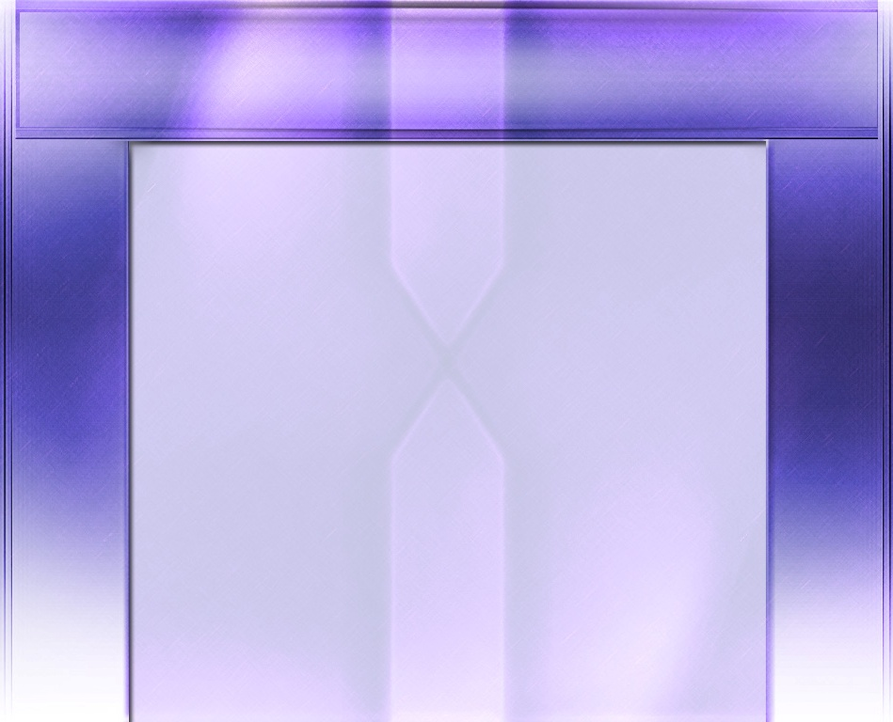
“Uyo anozova mwana waMwari anofanira kugashira chokwadi chokuti kutendeuka nekuregererwa hazvifaniri kuwanikwa kumwe kunze kwekuyananisa kwaKristu. Avimbiswa neizvi mutadzi anofanira kuita nhamburiko inowirirana nebasa raaitirwa, uye nokukumbira asinganeti anofanira kukumbira kuchigaro chovushe chenyasha, kuti simba rokuvandudza raMwari riuye mumweya wake. Kristu haaregereri mumwe kunze kwevakatendeuka, asi uyo waanoregerera anotanga kuita kuti atendeuke. Hurongwa hwakaitwa hwakakwana, uye kururama kusingaperi kwaKristu kunoiswa pamweya wose unotenda. Nguo inodhura, isina ruvara, yakarukwa mumupendero wedenga, yakagoverwa kumutadzi anotendeuka, anotenda.” -Non-Official translation by Gift Mawoyo
EGW (Selected Messages, vol. 1, p. 393)

