Slide 1





Chidzidzo 11 cha Chikumi 13, 2026
ZVIPINGAIDZO

Slide 2


“Ɀisati ɀiri iɀo ɓedzi, asi ŋgatifare ʋo mumaɗambudziko, ticiziʋa kuti kutambudzika kunoʋuyisa kutsuŋgirira; kutsuŋgirira kunoʋuyisa kuidzwa; kuidzwa kunoʋuyisa tariro; tariro hainyadzisi; nokuti ruɗo rwaMŋari rwakaɗirwa mumŋoyo yeɗu noMŋeya Mutȿene watakapiwa”
(VaRoma 5:3–5)

Slide 3
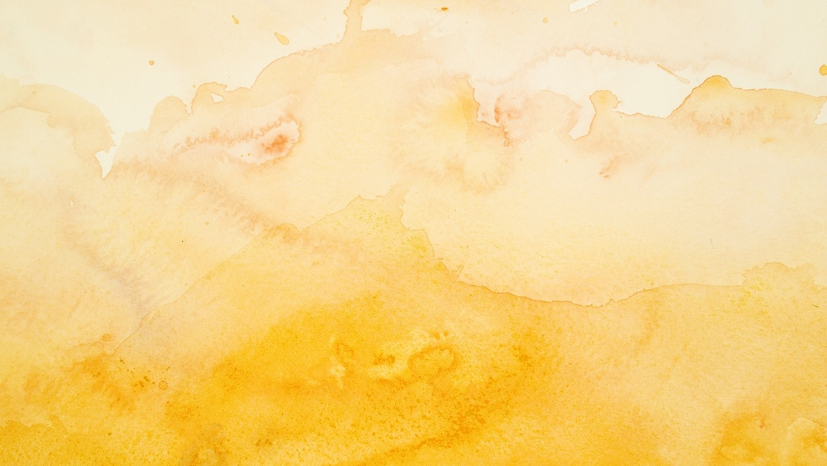

Tiri kurarama munyika yakazara nechivi uye kutambura. Tose tinombosangana nematambudziko anogona kutiita kuti tisava nechokwadi nezverudo rwaMwari.
Tinozvitambira sei zvipingaidzo izvi?
Tichadzidza kuti vamwe vanhu vemuBhaibheri vakaita sei mumamiriro ezvinhu akaipa akasiyana-siyana, uye kuti muenzaniso wavo ungatibatsira sei kutarisana nematambudziko akafanana neiwawo.
Madutu ehupenyu
Zvirwere
Njodzi
Kuodzwa mwoyo
Ona Jesu

Slide 4




MADUTU EHUPENYU
“Ɀino ɗutu guru remhepo rakamuka, mafuŋgu emvura akaroʋa mugwa, rikaŋga roɗo‐kuzara” (Marko 4:37)
Kuyambuka Gungwa reGarireya pakati pohusiku, kunyange pakati pedutu, kwakanga kusiri chinhu chitsva kuna Petro, Andreya, Jakobho naJohani, varedzi vehove vane unyanzvi..
Zvisinei, dutu racho rakavakurira. Mhepo yakavhuvhuta mafungu, mvura ikafashamira igwa uye ichiisa hupenyu hwavo mungozi. Vakabva vati… Jesu aripi? Akarara here? Sei asiri kutibatsira? Haana basa nezvinoitika kwatiri? (Marko 4:35-38).
Muhupenyu hwedu tinosangana nemadutu. Tinokumbira kubatsirwa naJesu, asi zvinoita sokuti akarara. Hatinzwi huvepo hwaKe. Asi Aripo.
Mirira nguva yekutsiura dutu redu: "Rugare, nyarara" (Mako 4:39). Iye ane hanya nesu ( 1 Petro 5:7 ). Anogona kunyaradza madutu edu. Usakanganwa kumurumbidza paAnoanyaradza(Marko 4:40-41).

Slide 5





ZVIRWERE
“Nokuti wakati, ‘Kana ndikaɓata ŋguʋo yake ɓedzi, ndicaponeswa’ ”
(Marko 5:28)
Kutambura nekubuda ropa kwemakore gumi nemaviri pasina kuwana chiremba angamuporesa kwakasiya mukadzi ari murombo uye asina tariro (Marko 5: 25-26). Nhasi, kune dzinyika umo kusina kurapwa kwemahara, uye nyaya iyi inogona kunge ichiri yechokwadi.
Chero zvazvingava, tose tinogona kutarisana nechirwere chinotisunga mbiradzakondo uye chinotitsimbirira, pasina kuwana zororo.
Mukadzi akaona muna Jesu mhinduro yacho, uye kutenda kwake kwakamuponesa (Marko 5:27-29).
Tinofanira kuvimba kuti Jesu anogona kushandisa vanachiremba vane unyanzvi kutirapa, kana kuita chishamiso matiri.
Chero zvazvingava, Jesu anotikoka kuti tisiye mitoro yedu yese nezvinonetsa paari (Mt. 11:28-30).

Slide 6





NJODZI
“Kunyaŋge ganda raŋgu riciŋge raparadzwa saiɀoɀo,
Kunyaŋge ɀakaɗaro ndicaʋona Mŋari ndisinenyama yaŋgu.” (Jobo 19:26)
Hondo, chisimba, uye njodzi dzinongoitika dzoga zvakashandura hupenyu hwaJobho zvikuru ( Jobo 1:13-19 ). Tose tinowirwa nenjodzi, dzingava dzomusikirwo kana kuti dzinokonzerwa nohuipi huri munyika ino.
Tichaita sei? Jobo akaita sei?
Haana kupa Mwari mhosva kana kumuramba
Akanamatira kwaAri nesimba rake rose
Aivimba kunyange munguva dzizere rima guru
Akaisa pfungwa dzake pane ramangwana rine mbiri (Jobo 19:25-27)
Kana tikasaora mwoyo, tichaona kuti kunyange mumiedzo yedu yakaoma zvikuru, Mwari anogara aripo. Anotida uye anotisimbisa kuti tiwane simba kubva mukusava nesimba, ushingi kubva mukuora mwoyo, uye tariro kubva munjodzi (Joere 3:10; VaRoma. 5:3-5).
Kana uri kutarisana nenguva dzakaoma, rangarira pamusoro peidi rokuti rudo rwaMwari nehanya newe ndicho chinhu chakachengeteka uye chakatsiga zvikuru muhupenyu hwako.

Slide 7






KUODZWA MWOYO
“Takaŋga ticiti ndiye waizodzikinura ʋaIsraeri…” (Ruka 24:21a)
Maonero: Jesu ndiye Mesiasi achadzikinura Isiraeri. Chokwadi ndechokuti: Afa (Rk 24:18-21).
Kuodzwa mwoyo kwavo kwakanga kuri kukuru kwazvo zvokuti hakuna kuvabvumira kubvuma kunyange humbowo hwakajeka hwokumuka kwaJesu(Rk 24:22-24).
Nemwoyo murefu, Jesu akavabatsira kuti vavezve netariro. Pakupedzisira, “Ipapo meso aʋo akaȿinudzwa” ( Ruka 24:31 ) , uye vakamhanya kundokurudzira avo vakanga vachiri vakaodzwa mwoyo ( Ruka 24:32–35; 2 VaKorinte 1:4 ). Tingadzidzei pane zvakaitika kwavari?
Hatifaniri kurega kusava nechokwadi kuchidzika midzi mupfungwa dzedu
Jesu anofamba padivi pedu kunyangwe mukuodzwa mwoyo kwedu
Achagadzirisa zvinotinetsa kana tikamubvumira
Jesu anoziva zviri nani kupfuura zvatinoita izvo chokwadi chedu chiri
Notes:
Jesus died and was resurrected

Slide 8


ONA JESU
“Nokuti ndinoti maɗambudziko eŋguʋa ino haana‐kufanira kuenzaniswa nokubginya kucazoratidzwa kwatiri.” (VaRoma 8:18)
Apo Ellen G. White akanga ari mukupererwa nezano rose, akava nechiono umo akaona Jesu.
Ainzwisisa kuti Ainzwisisa zvese zvaaisangana nazvo. Pane imwe nguva, akaisa ruoko rwake pamusoro wake, Jesu akati kwaari: “Usatya.”
Akaona zviono zvinobwinya, uye zvaiita sekuti akanga awana chengeteko nerunyararo rwekudenga.
Hope idzi dzakamupa tariro nokutenda, uye chokwadi chokuti aigona kuvimba naMwari.

Slide 9


“Tinoziʋa kuti ɀinhu ɀose ɀinoɓatirana kuti ɀiitire ɀakanaka aʋo ʋanoɗa Mŋari, aʋo ʋakaɗanwa seɀaakafuŋga.” (VaRoma 8:28)
“Musafuŋganya pamsoro pecinhu cimŋe; asi paɀinhu ɀose, mikumbiro yenyu ŋgaiziʋiswe Mŋari nokunyeŋgetera nokukumbira, pamŋe cete nokuʋoŋga. 7Ɀino rugare rwaMŋari runopfuʋura kunzwisisa kwose, rucarinda mŋoyo yenyu nemifuŋgo yenyu munaKristu Jesu.” (VaFiripi 4:6-7)
“Hama dzaŋgu, muti mufaro ɓedzi kana muciwira mumiidzo mizhinji; 3muciziʋa kuti kuidzwa kwokutenda kwenyu kunoɓereka kutsuŋgirira.Asi kutsuŋgirira ŋgakuʋe neɓasa rakakwaniswa, kuti mukwane, mururame kwaɀo, musiŋgashaiwi cinhu. […] Wakaropafadzwa munhu uyo unotsuŋga mŋoyo pakuidzwa; nokuti kana atendwa, ucapiwa korona yoʋupenyu yakapikirwa aʋo ʋanomuɗa.” (Jakobho 1:2-4, 12)
“Iye akati kwandiri, “Nyasha dzaŋgu dzinokuriŋgana; nokuti simba raŋgu rinozadziswa paʋutera bgako.” Naiɀoɀo ɀirinani kuti ndiɀirumbidze nomufaro mukuru noʋutera bgaŋgu, kuti simba raKristu rigare pamsoro paŋgu.” (2 VaKorinte 12:9)

Slide 10

“Mune zvinosanga navose, munouya nguva dzekuodzwa mwoyo kukuru—mazuva apo kusuwa kuri mugove, uye zvakaoma kutenda kuti Mwari achiri mubatsiri ane mutsa wevana Vake vakaberekwa pasi; mazuva apo matambudziko anotambudza mweya, kusvikira rufu rwaita serwakanaka pane hupenyu. Ipapo ndipo apo vazhinji vanorasikirwa nekubata kwavo pana Mwari uye vanopinzwa muhuranda hwekupokana, hunhapwa hwekusatenda. Tingagona here panguva dzakadai kunzwisisa nenzwisiso yemweya zvinoreva kurongeka kwaMwari, tinofanira kuona ngirozi dzichitsvaka kutiponesa kubva kwatiri, dzichivavarira kusima tsoka dzedu panheyo dzakasimba kupfuura zvikomo zvinogara nokusingaperi, uye kutenda kutsva, hupenyu hutsva, zvaizobuda.” -Non-Official translation by Gift Mawoyo
EGW (Prophets and Kings, pg. 163)

