Slide 1

MUGOVANE
Chidzidzo 12 cha Chikumi 20, 2026
Notes:
C

Slide 2

“‘Ishe Jehova wakandipa rurimi rwaʋakadzidziswa, kuti ndiziʋe kusimbisa ʋakaneta namashoko; unondimutsa maŋgwanani ose, unomutsa nzeʋe dzaŋgu kuti ndinzwe saʋanodzidziswa’”
(Isaya 50:4)

Slide 3
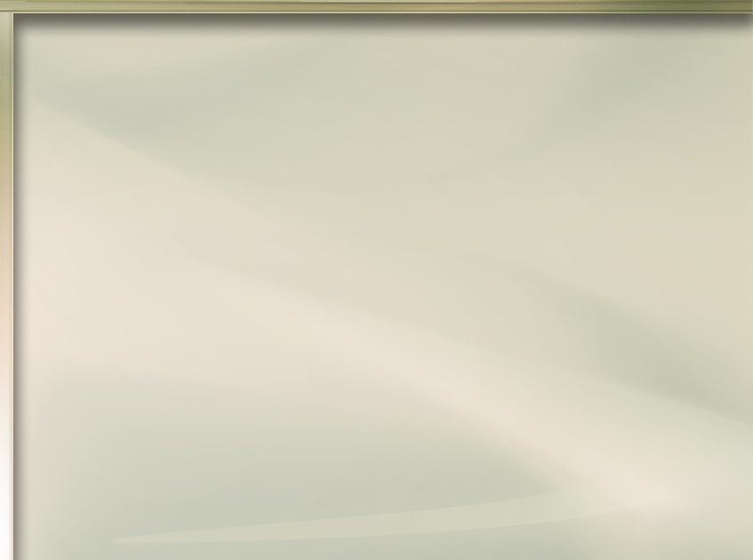






Zviuru hazvizivi Jesu zvechokwadi. Tinovadaidza kuti “makwai akarasika,” asi havatombozivi kuti vakarasika. Uye vachaziva sei kuti vanoda Jesu kana pasina anovatsanangurira?
Mwari ane hanya nemunhu wese ari panyika ino uye “unoɗa kuti ʋanhu ʋose ʋaponeswe, ʋaȿike pakuziʋa ɀokwaɗi.” (1 Tim. 2:4). Izvi zvinosanganisira vose vasingamuzivi uye vaya vakatsauka panzira dzake, kunyange vakamuziva.
Mwari akasarudza sei kusvika vanhu vose ivavo? Kuburikidza nesu. Iri ndiro “basa redu guru”
Chii chatinofanira kugovana?
  Kutumwa Kukuru
Tingagovera sei?
  Kutevedzera Jesu
  Kukudziridza hushamwari
Nzira yekudzosa avo vakasiya
  Mwari anotsvaka vana vake
  Tiri kutsvaga akaenda

Slide 4

CHII CHATINOFANIRA KUGOVANA?

Slide 5







KUTUMWA KUKURU
“Endai naiɀoɀo, mudzidzise marudzi ose, muʋabapatidze muzita raƂaɓa, neroMŋanakomana, neroMŋeya Mutȿene” (Mateo 28:19)
“Endai… [ku] marudzi ose” wakanga uri murayiro wakapihwa naJesu kuvanhu vakanga vakaungana kuzomuona pashure pokumutswa kwake(Mt. 28:18-19a).
Vaifanira kuitei? Vaifanira kuenda kunoita vadzidzi. Kureva, kutaura nevanhu, kuvabhabhatidza, uye kuvadzidzisa kuva vadzidzi vaJesu(Mt. 28:19-20).
Vadzidzi ivavo, vakadzidzisawo vamwe vadzidzi… uye zvichingodaro kwemakore zviuru zviviri… kusvika kuzuva redu. Zvino, isu tisu tinogashira murairo waJesu.
Sa Petro na Johani, “Nokuti hatigoni isu kurega kutaura ɀatakaʋona, neɀatakanzwa” (Mabasa 4:20). Tinogona kutaura tiri papurupiti, kuchema mumigwagwa, kugovera uchapupu hwedu pasocial media, kana kungohugovera nemumwe munhu. Tose tinobatanidzwa.

Slide 6

TINGAGOVERA SEI?

Slide 7





KUTEVEDZERA JESU
“Nokuti ruɗo rwaKristu runotimanikidza; ɀatinoziʋa cinhu ici kuti mumŋe wakafira ʋose” (2 VaKorinte 5:14a)
Chii chakaita kuti Jesu atsvake “makwai akarasika” (Mt. 15:24)?
Pasina kupokana, rwaiva rudo rwake kwatiri ( Mat. 9:36; VaEf. 5:2 ). Akaisawo rudo Rwake matiri, kuti tigovane naavo vasati vaziva Jesu. Dzimwe nguva, vanhu vanoedza kumanikidza vamwe kugamuchira Jesu kuti zvivanakire ivo. Asi handiyo nzira yakasarudzwa naMwari.
Mwari haana kumanikidza Adhamu naEvha kuti vasatadza. Haana kumanikidza vakararama pamberi pemvura zhinji kuti vapinde muareka. Haana kumanikidza vaNinivhi kuti vamugamuchire. Akataura navo norudo uye akavanyevera nezvemigumisiro yokutevera nzira dzavo vamene.
Nokutevedzera Jesu, tinoratidza rudo Rwake kune vamwe, uye tinovakoka kuti vamutevere.

Slide 8



KUKUDZIRIDZA HUSHAMWARI
Ziva mumwe munhu uye kuvaka hushamwari nekufamba kwenguva
Namata kuti Mweya Mutsvene ashande pamwoyo wemunhu. Nyengeterera mikana yakanaka yekutaurirana naye
Tsvaka nzira dzekutaura pamusoro pezviitiko zvekutenda kwako pachako kana kumunamatira
Tsvaga nzira dzekubatanidza shamwari yako itsva nevamwe vekusangano kwako
Namata nezvezvido kana mibvunzo ingangove neshamwari yako itsva
Tsvaka mukana wokuvaratidza kuti Bhaibheri rinopa sei nyaradzo, mazano, uye nhungamiro muhupenyu hwedu
Ichasvika nguva yauchazoda kubvunza kana shamwari yako ingada kudzidza newe Bhaibheri. Gare gare, shamwari yako ingada kubhabhatidzwa
“…mugare makaɀigadzira kupindura mumŋe nomumŋe unokubvunzai pamsoro petariro iri mukati menyu, asi muciita noʋunyoro nokutya.” (1 Petro 3:15)
Tose tiri vaparidzi vaJesu uye tinorayirwa kuti tigadzirire izvi (1 Petro 3:15). Asi hatisi tose tinoziva kuparidza. Zvisinei, tine vimbiso yokuti Mwari pachake achatipa mashoko anodiwa (Isaya 50:4).
Heano mamwe mazano akareruka ekuchengeta mupfungwa paunenge uchifunga nzira yekuva nechinangwa chekugovana Jesu nevamwe:

Slide 9

NZIRA YEKUDZOSA AVO VAKASIYA

Slide 10
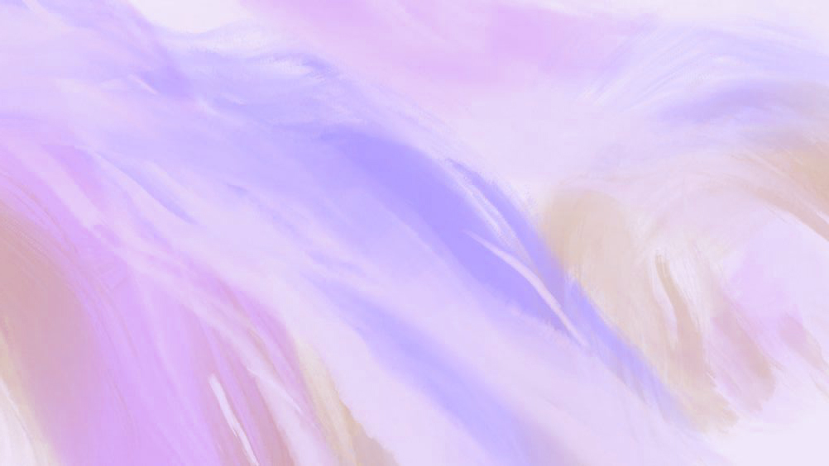




MWARI ANOTSVAKA VANA VAKE
“Ko Efraimi ndiye mŋanakomana waŋgu unoɗikanwa here? Ndiye mŋana unondifadza here? Nokuti ŋguʋa dzose kana ndicimutuka, ndinoramba ndicimuraŋgarira kwaɀo; naiɀoɀo mŋoyo waŋgu unomucemera; ɀirokwaɀo, ndicamunzwira nyasha — ndiɀo ɀinotaura Jehova.” (Jeremiya 31:20)
Pane imwe nguva, vanhu vaMwari vakaparadzana: Efremu (humambo hwokuchamhembe) vakasiya Mwari; Judha (humambo hwezasi) akaramba akatendeka.
Pasinei nokuraswa kwake, Mwari akaramba achiona Efraimi semwanakomana wake anodiwa ( Jer. 31:20 ). Akatofananidza ambuya vake, Rakeri, vachichema vanakomana vavo, vakanga vafira muzvivi zvavo (Jer. 31:15).
Avo vakashumira Mwari ndokubva vamusiya, Mwari anoramba achidana kwavari norudo. Vana Vake, uye Anovada uye anoramba achivakurudzira kuti vadzoke kwaAri.
Zvichida vamwe vevana vedu chaivo, vaichimboziva kutenda, vakakurasa. Pane kuvafuratira, tinofanira kuramba tichivada uye tichitaura navo nomutsa. Mwari anotiyeuchidza kuti ndivo vanoitirwa tsitsi dzake huru, uye anoshuvira nemoyo wese kuti vadzokere kwaAri.

Slide 11



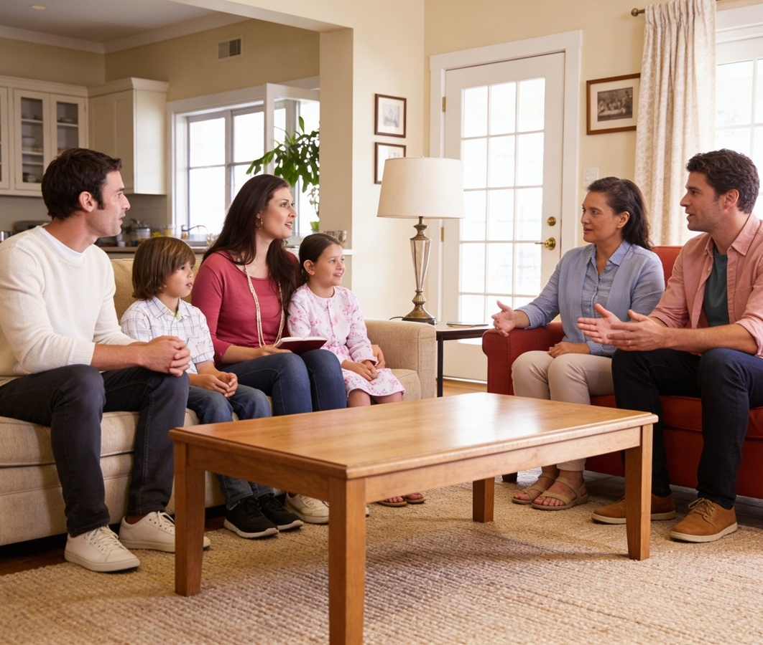

TIRI KUTSVAGA AKAENDA
“Ndicaʋakusha pakati pendudzi dzaʋanhu; ʋacandiraŋgarira kunyika dziri kure; ʋacararama pamŋe cete naʋana ʋaʋo, ʋakadzoka” (Zekariya 10:9)
Mudzimai/murume wedu; mwanakomana wedu; mwanasikana wedu; shamwari yedu; muvakidzani wedu; hama iya kana hanzvadzi yaigara pachigaro ichi… Rimwe zuva vainamata nesu, asi iko zvino varipi?
Pane zvikonzero zvakawanda zvinoita kuti vanhu vasiye sangano. Hatina kudanwa kutonga zvikonzero zvavo, kushoropodza vavariro dzavo, kana kungokanganwa nezvavo.
Basa redu nderekuenda kunovatsvaga tovadzosa mudanga. Tinozviita sei izvi? Kutanga, nokunyengetera. Chechipiri, nokuva muenzaniso worudo nomutsa kwavari.
Huchapupu hwehupenyu hwako, zviito zvako, mazwi, neminamato yemumwe munhu akarasika kubva kuna Mwari zvinokwanisa kushandura hupenyu hwavo neramangwana ravo.

Slide 12

“Mwari anogona kunge akapa shoko revhangeri, nebasa rose rehushumiri hwerudo, kungirozi dzekudenga. Angangodaro akashandisa dzimwe nzira kuti azadzise chinangwa Chake. Asi murudo Rwake rusingaperi akasarudza kutiita vashandi pamwe naye pachake, naKristu nengirozi, kuti tigovane chikomborero, mufaro, kusimudzirwa kwemweya, kunobva muhushumiri uhwu husina udyire. […]
Kana ukaenda kunoshanda semarongero aKristu kuti vadzidzi Vake vachamuitira, uye nokumuwanira mweya, unozonzwa kuda kweruzivo rwakadzama neruzivo rwakakura muzvinhu zvitsvene, uye unova nenzara nenyota yekururama. Uchanyengerera Mwari, uye kutenda kwako kuchasimbiswa, uye mweya wako uchanwa zvakadzika patsime reruponeso. Kusangana nekupikiswa nemiedzo kuchakutuma kuBhaibheri nemunamato. Unozokura munyasha neruzivo rwaKristu, uye unozova neruzivo rwakapfuma”. -Non-Official translation by Gift Mawoyo.
EGW (The Way to Christ, pp. 79-80)

