Slide 1
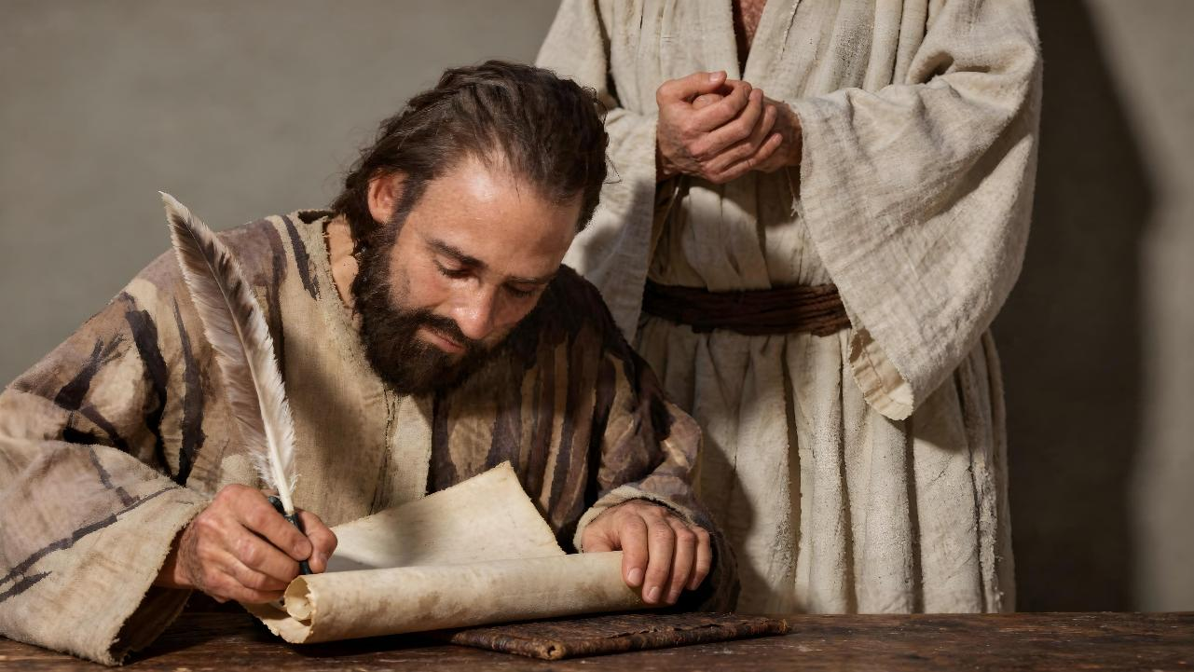
HUSHUMIRI HUNOFAMBISWA NERUDO
Chidzidzo 9 cha Nyamavhuvhu 29, 2026

Slide 2
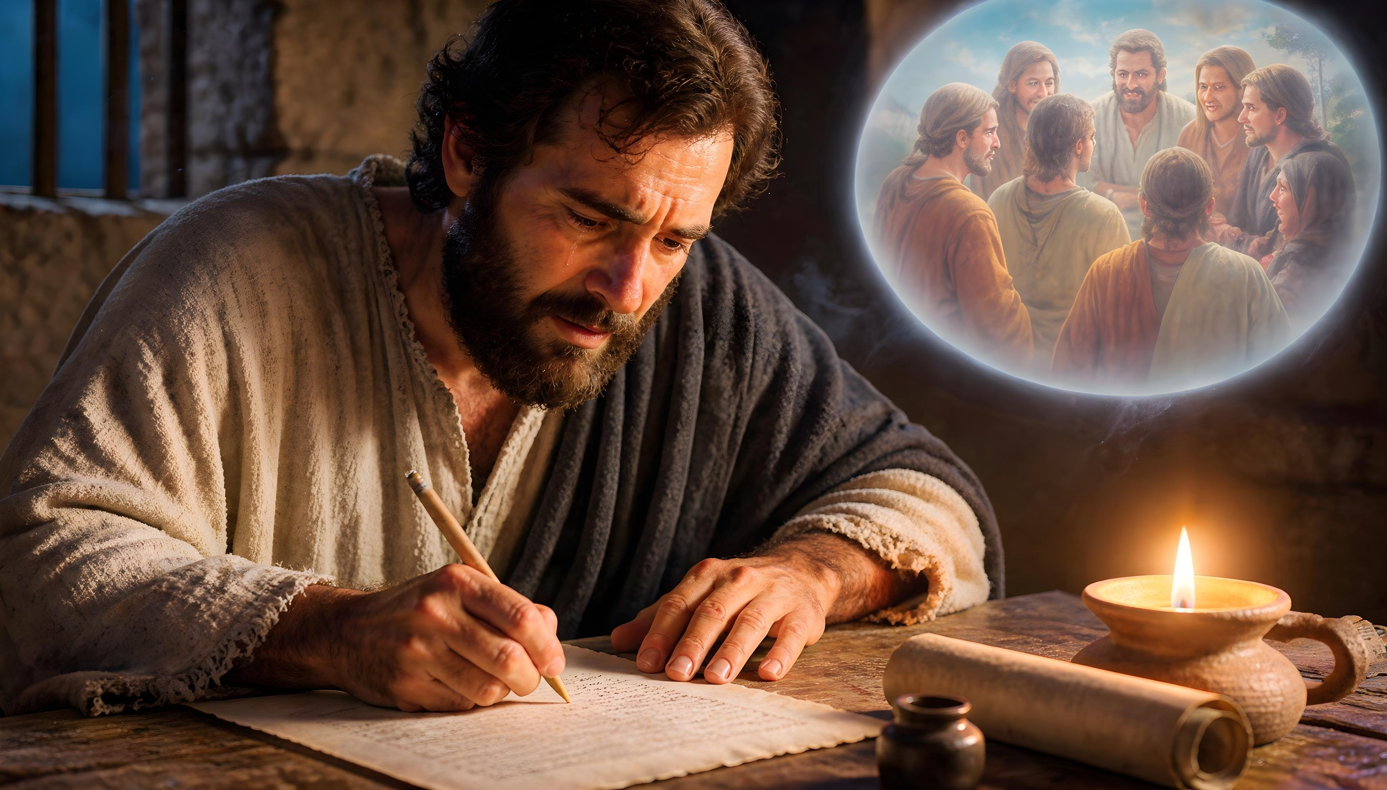
“Nokuti ndakakunyorerai nemisodzi mizhinji pakutambudzika kukuru nenhamo yomŋoyo; ndisiŋgati mucemedzwe, asi kuti muziʋe ruɗo rukuru rwandinokuɗai narwo”
(2 VaKorinte 2:4)

Slide 3

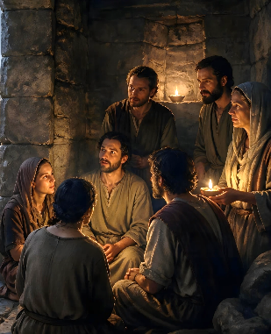
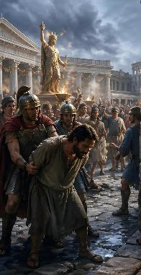
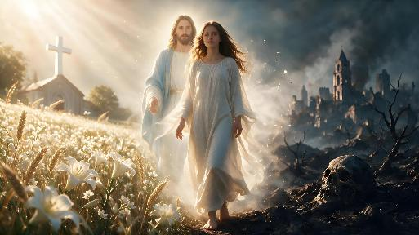





Patinonyatsoongorora tsamba yechipiri yaPauro kuvaKorinte, tinoona kuti muapostora uyu ane hanya zvikuru nekugara zvakanaka kwesangano.
Kunyange zvazvo zvisina kumbombova nyore kutevera nzira dzaMwari munyika ino izere nechivi, muzana remakore rekutanga, kuzvizivisa kuti uri muKristu kwaigona kuunza matambudziko makuru.
Pauro anogadzirira sangano kutarisana nematambudziko aya, emukati neekunze, uye anovadzidzisa kuumba muviri wakabatana murudo rusina udyire. Kubva pazano iri tinogona kudzidza nhasi kuva“bgema bgoʋupenyu bgunoisa kuʋupenyu”(2 VaKo. 2:16).
Kunyaradza kwaMwari pakutambudzika
Hutsvene nezvokwadi muhushumiri
Kuzvibata nehuchenjeri
Kuregerera nekudzorerera
Bgema bgaKristu

Slide 4

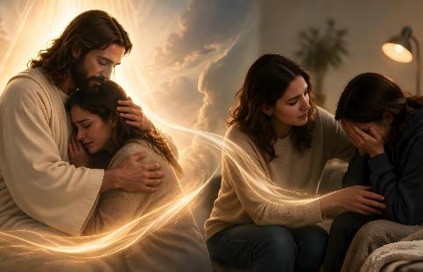
KUNYARADZA KWAMWARI PAKUTAMBUDZIKA
“iye unotinyaradza pakutambudzika kweɗu kwose, kuti isu tiʋe nesimba rokunyaradza ʋari mukutambudzika kupi nokupi, nokunyaradzwa kwatinonyaradzwa nako naMŋari.” (2 VaKorinte 1:4)
Tsamba yechipiri yevaKorinte ndiyo tsamba umo Pauro anonyanya kutaura nezvenyaradzo. Sangano iri rakanga richisangana nenguva yakaoma, uye tsamba yaPauro yapfuura yakanga yavasiya vakasuwa zvikuru..
Kunyaradza kwaMwari
Kunotisunungura kubva pakutya
Kunotiyeuchidza nezvenguva dzaakatibatsira
Kunotisimbisa kutsungirira pamatambudziko
Kunotitungamirira kukukura mumweya
Kunotikurudzira kunyengeterera vamwe
Tinonyaradzana sezvatakanyaradzwa naMwari
Asi kusuwa uku kwaiva “kweumwari,” kunotungamirira kukutendeuka (2 VaKo. 7:10). Saka Pauro haadi kuti kusuruvara ikoko kuvakurire, asi anoda kuti vanyaradzwe.
Iye pachake akambosangana nenguva dzaive nenjodzi kuhupenyu hwake, uye akanga asvika pakushaya tariro(2 VaKo. 1:8-10). Asi Mwari akamunyaradza, uye iye zvino ava kupa kunyaradzwa ikoko kusangano(2 VaKo. 1:6).

Slide 5

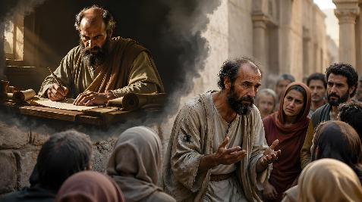
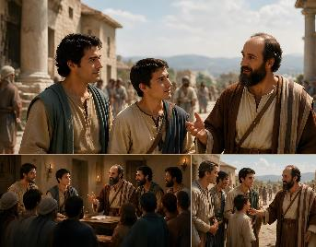
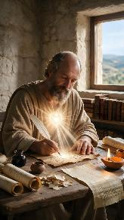
HUTSVENE NEZVOKWADI MUHUSHUMIRI
“Nokuti kuɀirumbidza kweɗu ndikoku: Kupupura kwehana yeɗu, kuti takafamba panyika, ɀikuru kwamuri, noʋutȿene neɀokwaɗi yaMŋari, tisiŋgafambi noʋucenjeri bgenyama, asi nenyasha dzaMŋari” (2 VaKorinte 1:12)
Vamwe vanhu vaizvidza Pauro, vachimupomera mhosva yekuti aiva munhu asina simba uye asingakwanisi kuita sarudzo (2 VaKo. 10:10). Nemhaka yeizvi, uye kuitira kuti mazano ake agamuchirwe, zvakanga zvakakodzera kuti muapostora azvidzivirire kubva pakupomerwa kwakadaro.
Semunhu, aizviona seasingakoshi (VaEfe. 3:8). Asi, nenyasha dzaMwari, aikwanisa kuzvirumbidza nekuva nehana yakachena(2 VaKo. 1:12).
Iye nevamwe vake vaigona kutaura nechivimbo kuti maitiro ake aiva matsvene uye akachena, kungava mukati mesangano kana kuti kunze kwaro.
Nemhaka yeizvi, zvakanyorwa naPauro zvakanga zvisina zvinangwa zvakavanzika. Aitarisira kuti tsamba idzi dzaizoverengwa nekunzwisiswa zvichienderana nehutsvene uye chokwadi—kureva kuti, dzakanyorwa nekuda kwavo uye dzichitsvaga kuvabatsira chete(2 VaKo. 1:13-14).

Slide 6

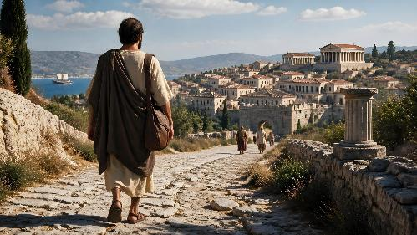
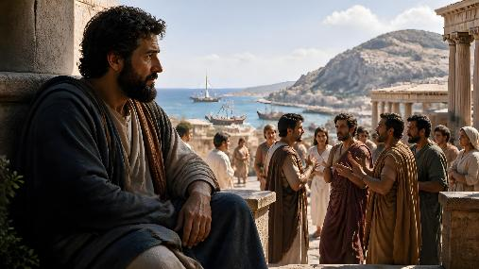
KUZVIBATA NEHUCHENJERI
“Asi ndinoɗana Mŋari, aʋe capupu pamŋoyo waŋgu, kuti handina‐kuzoʋuya Korinte, nokuti ndakakunzwirai tsitsi.” (2 VaKorinte 1:23)
Mutsamba yake yekutanga, Pauro akazivisa vaKorinte nezve nzira yaakaronga kutevera(1 VaKo. 16:5-11):
Efeso
Makedonia
Korinte
Judea
Mutsamba yakazotevera(2 VaKo. 7:8) Akavazivisa kuti aizovashanyira kaviri(2 VaKo. 1:15-16):
Efeso
Makedonia
Korinte
Judea
Korinte
Zvisinei, akanga ashandura hurongwa zvake uye akasarudza kusaita rwendo irworwo rwekutanga (2 VaKo. 1:23). Shanduko idzi dzakaita kuti vamwe vamutsoropodze vachiti haana kugadzikana uye anoshanduka-shanduka pfungwa. Ngenyi akanga ashandura pfungwa?
Kuva kwaPauro muKorinte kwaioneka kwakakosha nekuda kwematambudziko aivapo. Asi kupikiswa kwaaisangana nako kwaireva kusangana nekukakavadzana kwaaida kudzivisa, nekuda kwerudo rukuru rwaaiva narwo kwavari(2 VaKo. 2:1-4).

Slide 7

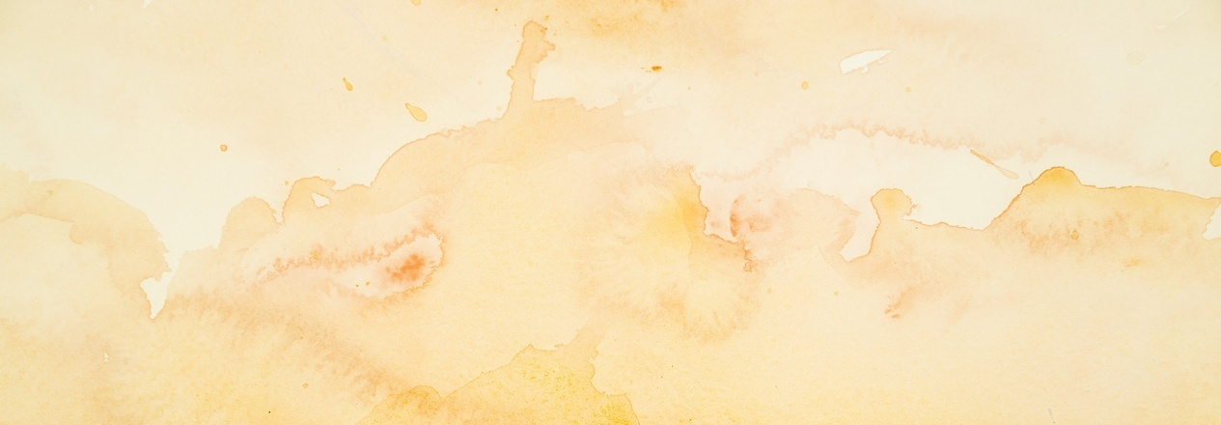
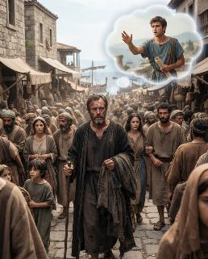
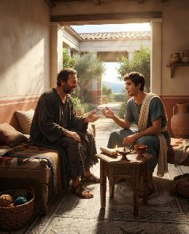
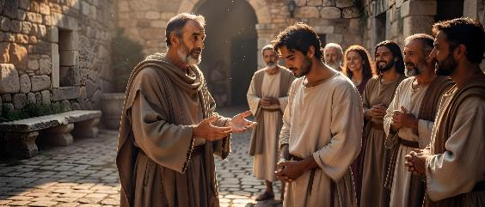
KUREGERERA NEKUDZORERERA
“Ɀino iye wamunokaŋganwira, neni ndinomukaŋganwira ʋo; nokuti iɀo ɀandakaŋganwira ini, kana ndineŋge ndakakaŋganwira cinhu, ndakaɀiita nokuɗa kwenyu pamberi paKristu.” (2 VaKorinte 2:10)
Panguva iyo Pauro aiva munzira achienda kuTroasi, Tito akaenda kuKorinte. Kubva kuTroasi, Pauro akaenda kuMakedonia. Asi akanetseka zvikuru nekuti Tito akanga asina kusangana naye kuTroasi kuti amupe mashoko pamusoro pechechi yekuKorinte(2 VaKo. 2:12-13).
Pasina nguva yakareba, Tito akazopedzisira asangana naPauro kuMakedonia. Akamuudza nezvekugamuchirwa zvakanaka zvikuru kwakaitwa neungano mazano nemirayiro zvaakanga apa semuapostora(2 VaKo. 7:5-9, 13-16).
Imwe yenyaya dzaifanira kugadziriswa yaiva ine chekuita nekuranga kwemusangano. Vachitevedzera mirairo yemuapostora, munhu akanga akanganisa akanga atsiurwa, uye akanga agamuchira kutsiurwa kwacho. Iye zvino, Pauro ari kuvakumbira kuti vatore danho rinotevera: kuregerera nekudzoreredza munhu wacho panzvimbo yake(2 VaKo. 2:5-11).

Slide 8


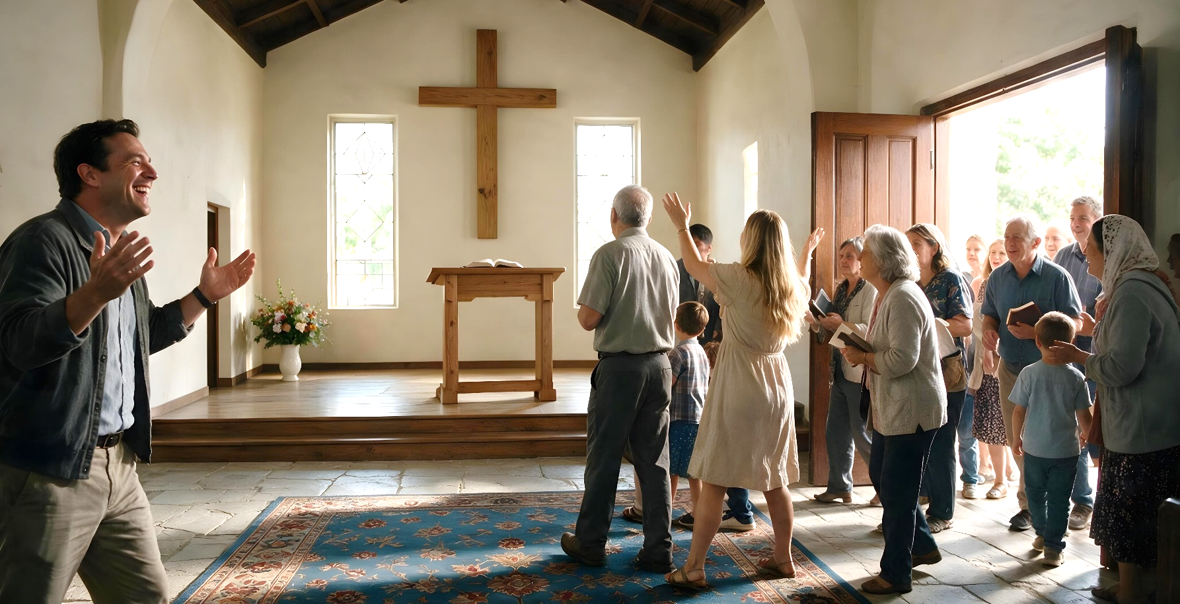
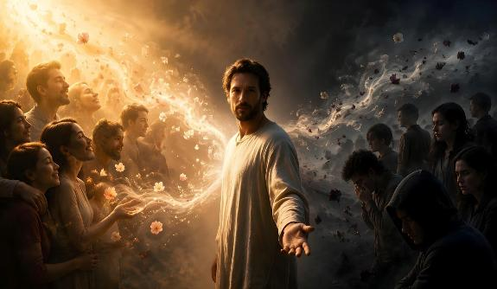
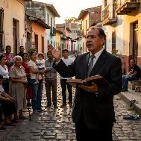
BGEMA BGAKRISTU
“Nokuti isu tiri bgema bgakanaka bgaKristu kunaMŋari, pakati paiʋo ʋanoponeswa naʋanoparara” (2 VaKorinte 2:15)
Achitaura nezvekuti Mwari aka “zarura mukoʋa” sei kuti vhangeri riparidzwe zvinobudirira muTroas, Pauro anoputika nemashoko ekurumbidza nekupemberera kukunda: “Asi Mŋari ŋgaaʋoŋgwe, unotikundisa ŋguʋa dzose munaKristu, unoratidza nesu kwose‐kwose bgema bgokuziʋa kwake” (2 VaKo. 2:14).
Kufanana nehwema hunopararira kwese-kwese, ruzivo rwaKristu runosvika kumweya wese. KuvaKorinte, sezvazviri kwatiriwo, hwema uhwu hwema hwehupenyu husingaperi. Zvisinei, kune avo vanoramba kudaidzwa uku, hwema hwerufu
(2 VaKo. 2:15-16).
Achitarisa nezvemutoro unouya nebasa iri, Pauro anotsanangura kuti shoko racho rinofanira kupiwa nemwoyo wese, pasina kutsvaga zvibereko zvinobatsira mumwe munhu, asi kutsvaga kuponeswa kweavo vari kuteerera
(2 VaKo. 2:17).

Slide 9

“Nhume iyi yakatendeka yakauya nenhau dzinofadza dzekuti pakanga paitika shanduko inoshamisa pakati pevatendi vekuKorinte. Vazhinji vakanga vagamuchira mirayiro yaiva mutsamba yaPauro uye vakanga vatendeuka pazvivi zvavo. Hupenyu hwavo hwakanga husisiri chinhu chinonyadzisa chiKristu, asi hwakanga hwave nesimba guru mukukurudzira kurarama hupenyu hwehumwari hunooneka muzviito. […]
Kutendeuka kunokonzerwa nesimba renyasha dzaMwari mumoyo kunotungamirira pakureurura nekusiya zvivi. Iyi ndiyo yaiva michero iyo muapostora akataura kuti yakaonekwa muhupenyu hwevatendi vekuKorinde. -Non-Official translation by Gift Mawoyo
EGW (The Acts of the Apostles, pp. 324)

