Slide 1

MUSIKI ANOTAURA
Chidzidzo 1 cha Gumiguru 3, 2026

Slide 2


"Mŋari wakataura kare kunamadziɓaɓa muʋaprofita nemigoʋe mizhinji, ʋuye nemitoʋo mizhinji,ɀino pakupedzisira kwamazuʋa ano wakataura kwatiri muMŋanakomana wake, waakaita mudyi wenhaka yeɀinhu ɀose, waakaita ʋo naye nyika.“ (VaHebhuru 1:1-2)

Slide 3



Wakambotaura naMwari zvakananga here? Wakambokwanisa kunzwa mashoko ake here? Mhinduro, zviri pachena, ndeyekuti: “Kwete.”
Tinogona chete kutaura kuna Mwari nenzira dzisina kunanga (munamato, Bhaibheri, vaporofita, …)
Chii chiri chikonzero chekuti titadze kutaura naMwari zvakananga? Zvagara zvakadai here? Tichazombokwanisa kuita izvi here?
Mwari aitaurirana sei nevanhu pakutanga?
1
Vanhu vakamira sei kutaura naMwari?
2
Mwari akaedza sei kudzorera kutaurirana?
3
Sei tisingakwanise kutaura naMwari zvakananga iye zvino?
4
Tingataura sei naMwari zvino?
5

Slide 4






MWARI AITAURIRANA SEI NEVANHU PAKUTANGA?
“Jehova Mŋari akaraira munhu, aciti, ‘Uŋgadya hako miti yose yomunda’ ” (Genesisi 2:16)
Pakutanga, Mwari akasika nyika kuti igarwe nevanhu(Isaya 45:18).
Pakange pave nezvose zvakagadzirira, akasika Adhamu kubva muguruva revhu(Gen. 2:4-7).
Pazuva iroro, akasika Evha kubva pane rimwe remapfupa emadivi aAdhamu(Gen. 2:18, 21-22).
Vanhu vakanga vava vakakwana uye vakagadzirira kugara munyika yakanga ichangobva kusikwa(Gen. 1:27).

Slide 5




MWARI AITAURIRANA SEI NEVANHU PAKUTANGA?
“Jehova Mŋari akaraira munhu, aciti, ‘Uŋgadya hako miti yose yomunda’ ” (Genesisi 2:16)
Panguva yegadziriro iyi, pakanga paine kutaurirana kukuru pakati paMwari naAdhamu:
Akamupa mirayiridzo pamusoro pebasa raaifanira kuita muEdheni(Gen. 2:15).
Akataura nezvemiganhu yake (Gen. 2:16-17).
Akamukumbira kuti ape mazita kumhuka
(Gen. 2:19).
Akamuunzira Evha, akabva avabatanidza muwanano
(Gen. 2:22-24).

Slide 6




MWARI AITAURIRANA SEI NEVANHU PAKUTANGA?
“Jehova Mŋari akaraira munhu, aciti, ‘Uŋgadya hako miti yose yomunda’ ” (Genesisi 2:16)
Mwari akaraira Adhamu naEvha kuti vaifanira kuzvibata sei uye kuti vaifanira kudya chii(Gen. 1:28-29).
Akavasika sevanhu vanogarisana, vanokwanisa kutaurirana, kwete pakati pavo chete, asi nezvimwe zvisikwa (zvakadai, semuenzaniso, ngirozi).
Ndokubva asika zuva rechinomwe kuitira kuti vafare kuva pamwe chete zuva iroro rose.
Kubva panguva iyoyo zvichienda mberi, aisangana navo zuva nezuva panguva yekutonhora kwezuva(Gen. 3:8).

Slide 7






VANHU VAKAMIRA SEI KUTAURA NAMWARI?
“Iye akati, “Ndakanzwa inzwi renyu mumunda, ndikatya, nokuti ndakaŋga ndisina‐kusimira; ndikaʋanda” (Genesisi 3:10)
Adhamu naEvha vakasikwa vaine kugona kusarudza zvakasununguka. Kuti vakwanise kushandisa rusununguko irworwo, Mwari akavapa zvinhu zvose, asi akazvichengetera muti mumwe chete(Gen. 2:16-17).
Pamuti iwoyo, muedzi—uyo akanga azvishandura kuita nyoka uye achinyepedzera kuva nehanya nekugara zvakanaka kwaAdhamu naEvha—akavaudza nhema dzakatevedzana (idzo Evha akazoudza Adhamu): hamuzofi(“Hamuŋgafi ɀirokwaɀo”); muchava vanamwari(“mukaʋa saMŋari”); Mwari anokuvanzirai chokwadi (“Mŋari unoziʋa kuti…”) (Gen. 3:1-5).
Achikwezvwa nezvinoshamisa zvemuchero wairambidzwa, Evha akadya kubva mauri akakwezva Adhamu, uyo akadyawo(Gen. 3:6).
Panguva iyoyo, nguo yekubwinya yaivafukidza yakanyangarika; vakaziva kuti vaiva vasina kupfeka; vakatsvaga nzira dzekuvanza kukanganisa kwavo(Gen. 3:7).
Chimwe chinhu chisina kunaka chakatevera ndechekuti vainzwa mhosva huru nekusateerera kwavo, zvekuti vaisada kuzotaura naMwari zvakare(Gen. 3:8).

Slide 8





MWARI AKAEDZA SEI KUDZORERA KUTAURIRANA?
“Jehova Mŋari akaɗana munhu, akati kwaari, ‘Uripiko?’ ” (Genesisi 3:9)
Achiziva kuti Adhamu naEvha vakanga vatadza, Mwari—setsika yake—akasvika kwavari kuti ataure navo. Kekutanga, panzvimbo pokubuda kunomuchingamidza nomufaro, Mwari aitofanira kuvadana kuti vasangane naye (Gen. 3:8-9).
Kunyange zvazvo vaisada kutaura naMwari, Mwari Iye aida kutaura navo. Haana kutiza kuva pakati pevatadzi, asi akatarisana nemutadzi pamusoro pechivi chake, achitsvaka kuti atendeuke (Gen. 3:10-11).
Mushure memazana remakore, Mwari vakatungamirira meso avo kune mumwe mutadzi kuti vawane kutendeuka kwake: Petro(Rk 22:61-62).
Kusiyana naPetro, uyo akabvuma chivi chake, Adhamu naEvha vakatanga kuzvidzivirira pamberi paMwari vachipa vamwe mhosva yekudarika kwavo(Gen. 3:12-13).
Nhasi uno, isu vanhu tinotevera maitiro akafanana. Tinonamatira kuchivi uye kuedza kuzviruramisira. Kunyange zvazvo chivi chichinamatira kwatiri, Mwari achiri kuda kutidzorera, uye ari kutidaidza: “muʋuye kwandiri” (Isaya 55:3).

Slide 9




SEI TISINGAKWANISE KUTAURA NAMWARI ZVAKANANGA IYE ZVINO?
“Naiɀoɀo akadziŋga munhu, akaisa makerubi kurutiʋi rwamabvazuʋa rwomunda weEdeni, nomuraɀo womunondo waimonereka kumatiʋi ose, kurindira nzira yomuti woʋupenyu” (Genesisi 3:24)
Mwari akaratidza vaviri vakanga vaita chivi migumisiro yechivi chavo, iyo yaisanganisira kusakwanisika kwekutaura naMwari zvakananga zvakare mushure mekudzingwa kwavo muEdheni (Gen. 3:16-24).
Migumisiro:
yaEvha
Kurwadziwa panguva yekusununguka
Kurasikirwa nekuenzana naAdhamu
yaAdam
Shanda nesimba
Kukudza zvekudya
yavose
Rufu
Kupatsaniswa naMwari
Asati avazivisa nezvemigumisiro yechivi, Mwari akavapa mhinduro yacho: mumwe wevazukuru vaEvha aizopedza simba raDhiyabhorosi uye kudzoredzera vanhu (Gen. 3:15).
Kuburikidza nevaprofita, Mwari vakazivisa nzira iyo rudzikunuro yaizoitwa nayo: Mwari pachake akava munhu, akatambura nekufira zvivi zvedu, akamuka kubva kuvakafa, uye anotipa hupenyu husingaperi (Is. 9:6; 53:6, 10-11).
Pakangomuka chivi, pakabva pamukawo vimbiso yoMuponesi.

Slide 10


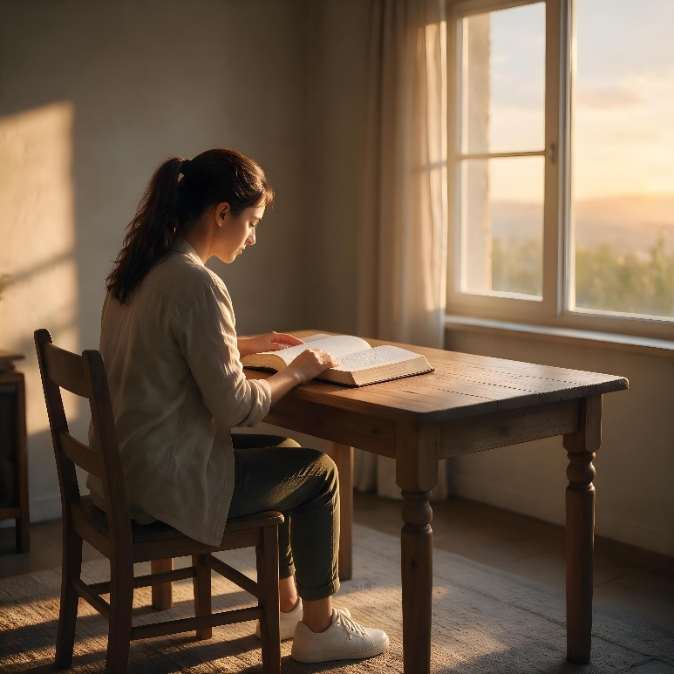




TINGATAURA SEI NAMWARI ZVINO?
“Saiɀoɀo ʋo iwe mŋanakomana womunhu, ndakakuita nharirire paimba yaIsraeri; naiɀoɀo cinzwa shoko rinoɓuɗa mumuromo maŋgu, uʋanyeʋere panɀimbo yaŋgu.” (Ezekieri 33:7)
Kuti ataure nesu nhasi, Mwari akanyora mabhuku maviri ekutitungamirira: Zvisikwa neBhaibheri(VaRoma 1:20; 2 Tim. 3:15).
Kunyange zvazvo zvisikwa zvichitiudza nezveMusiki, zvakasvibiswa zvikuru nechivi. Zvisinei, Bhaibheri rine mirayiridzo yakajeka uye yakananga, yakapihwa nevaporofita vakagamuchira mashoko kubva kuna Mwari. MuBhaibheri, tinowanawo kuratidzwa kwakakwana kwaMwari muhupenyu nehushumiri hwaJesu(VaHeb. 1:1-2).
Mariri, tinoona kuti tiri vanaani, tinobva kupi, uye tiri kuenda kupi. Imomoo tinowana chinangwa chaMwari chehupenyu hwedu.
Pamusoro pezvo, Mwari anotaurirana nesu kuburikidza nemunamato (Mapisarema 5:2); ngirozi (Mabasa 8:26); vaporofita (Joere 2:28); uye, zvikuru-kuru, kuburikidza naMweya Mutsvene (Johani 14:26).

Slide 11

“Paifanira kuva nekushanda pamwe chete pakati pemunhu naMwari. Asi hurongwa uhwu hwakakanganiswa zvikuru nekudarika kwaAdhamu. Satani akamukwezvera kuti aite chivi, uye Ishe haana kuzotaura naye mushure mekunge aita chivi sezvavaiita paakanga asina chivi.
Mushure mekudonha kwevanhu, Kristu akava mudzidzisi waAdhamu. Akamiririra Mwari pamberi pevanhu, achivaponesa kubva parufu rwekukurumidza. Akatora basa rekuva murevereri. Adhamu naEvha vakapihwa mukana wekudzokera mukuteerera Mwari, uye hurongwa uhwu hwaisanganisira vana vavo vose vaizotevera.
Dai pasina rudzikunuro rweMwanakomana waMwari, zvaisagona kuva nekutaurirana kana kugamuchirwa kwezvikomborero neruponeso kubva kuna Mwari kuenda kuvanhu. Mwari aikoshesa zvikuru rukudzo rwemutemo wake. Kutyora mutemo uyu kwakakonzera kupatsanurana kunotyisa pakati paMwari nevanhu. Adhamu, panguva yaakanga asina chivi, akapihwa mukana wekukurukura zvakananga, zvakasununguka, uye nemufaro neMusiki wake. Mushure mekunge atyora mutemo, Mwari vakatanga kukurukura nevanhu kuburikidza naKristu nengirozi chete.” -Non-Official translation by Gift Mawoyo
EGW (Conflict and Courage, January 14)

Slide 12




APPENDIX: BIOGRAPHY OF ELLEN G. WHITE
Ellen Gould and Elizabeth Harmon, the youngest of Eunice and Robert Harmon's eight children, were born on November 26, 1827 in Gorham, Maine, USA.
Shortly afterwards the family moved to Portland, a major city in Maine, to expand their hat-making business.
When Ellen was nine years old, a classmate threw a stone at her, causing a severe facial injury. The injury left her with lasting effects that forced her to drop out of school and limited her social life.
The family accepted William Miller's teachings, and Ellen was baptized into the Methodist church in 1842.
But Ellen felt lost, and believed herself unworthy of salvation, until Pastor Levi Stockman helped her understand God's true love.
From that moment on, she fell deeply in love with Jesus and served him for the rest of her life.

