Slide 1

ZVAKAZARURWA NEKUFEMERA
Chidzidzo 5 cha Gumiguru 31, 2026

Slide 2

“Ɀakazarurwa ɀaJesu Kristu, ɀaakapiwa naMŋari, kuti aratidze ʋaranda ʋake ɀinhu iɀo ɀinofanira kukurumidza kuitwa; akaɀituma nomutumŋa wake, ndokuziʋisa muranda wake Johane; wakapupurira shoko raMŋari, neɀokupupura kwaJesu Kristu, acireʋa ɀose ɀaakaʋona” (Zvakazarurwa 1:1-2)

Slide 3










Zvakazarurwa 1:1-2 ine muenzaniso wekuti Mwari anozivisa sei shoko rake kwatiri kuburikidza nemuporofita:
Mwari anozivisa shoko rake kuna Jesu
Jesu anorazarurira shoko kungirozi
Ngirozi inozarurira shoko kuna Johani, muporofita
Johani anonyora pasi mashoko aakagamuchira
Asi iyi haisi iyo nzira yoga iyo Mwari akazvizarurira nayo kuvaporofita, uyewo haisi iyo nzira yoga iyo shoko raMwari rakaparadzirwa naro kuburikidza navo. Tichadzidza nzira dzakasiyana-siyana idzo Mwari akazviratidza nadzo kuvaporofita, nekuvafemera.
Zvakazarurwa nekufemera:
  Zvimwe zvakazarurwa nezvakazarurwa zvakakosha
  Zvinoitika pakufemerwa
Mhando dzekutaurirana kwechiporofita:
  Mashoko anotaurwa
  Mashoko anonyorwa
  Mitambo, zviratidzo, mufananidzo

Slide 4


ZVAKAZARURWA NEKUFEMERA

Slide 5

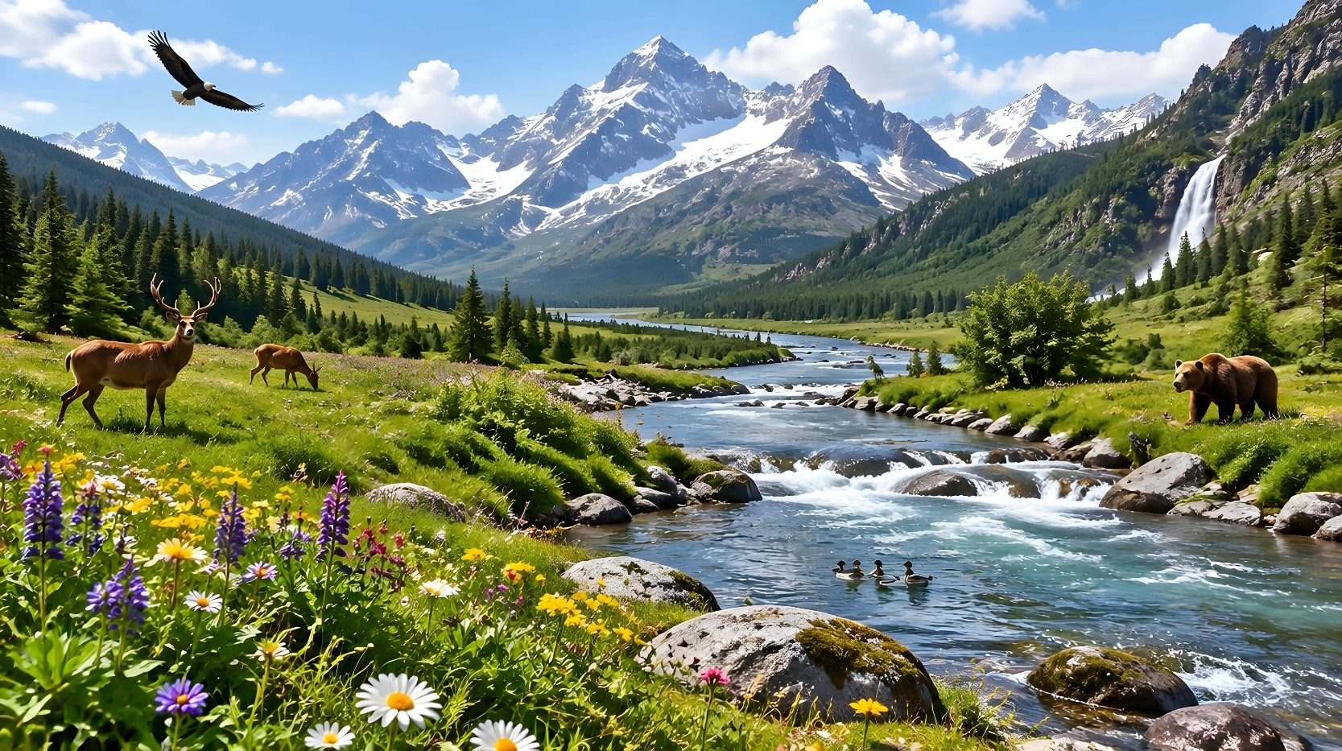


ZVIMWE ZVAKAZARURWA NE ZAKAZARURWA ZVAKAKOSHA
“Kuɗeŋga‐ɗeŋga kunoparidzira kubginya kwaMŋari;
Ʋuye ɗeŋga rinoratidza ɓasa ramaʋoko ake”
(Mapisarema 19:1 )
“Kana kunomuprofita pakati penyu, ini Jehova ndicaɀiziʋisa kwaari neciratidzo, ndicataura naye nokurota hope” (Numeri 12:6)
Pauro anoti vaya vanoramba kuvapo kwaMwari “ʋarege kuʋa nepembedzo,” nekuti zvisikwa zvinoratidza “iɀo ɀake ɀisiŋgaʋonekwi, iro simba rake risiŋgaperi noʋuMŋari bgake, ɀinoʋonekwa kwaɀo”(VaRoma 1:20; Mapis. 19:1).
Tinogona kuona kuti Mwari akaona mberi kupinda kwechivi, kuburikidza nesimba rekugadzirisa patsva raakaisa muzvisikwa zvipenyu. Kana tikakuvara, panotanga kushanda maitiro anovhara ronda uye anogadzirisa nyama yakakuvadzwa kuti idzokere sezvayakanga yakaita. Uye maitiro iwayo aive atovepo kare, kunyange tisati takuvadzwa!
Asi zvisikwa, kubva pakudonha kwaAdamu naEvha, naizvowo zvine mhedzisiro yechivi (kupambwa, kudengenyeka kwenyika, …)
Nokuda kwechikonzero ichi, Mwari akashandisa nzira dzakananga zvikuru kuzvizivisa: kuzarura kwakakosha kuburikidza nevaporofita naJesu Kristu, sezvakanyorwa muBhaibheri, iro Shoko raMwari(VaHeb. 1:1-2).

Slide 6



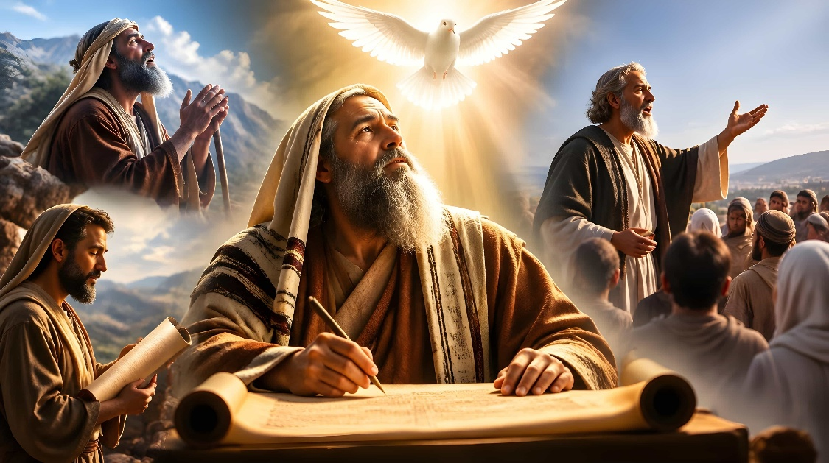
ZVINOITIKA PAKUFEMERWA
“Rugwaro rwose rwakafuridzirwa naMŋari, runoɓatsira pakudzidzisa, nokuraira, nokururamisa, nokuraŋga kuri mukururama” (2 Timotio 3:16)
Kwemazana emakore, mabasa nemashoko aMwari zvaipfuudzwa nemuromo, kusvika Mwari paakafemera Mozisi kuti anyore pasi mabasa nemashoko aya.
Kubva panguva iyoyo zvichienda mberi, mashoko aida kuchengetedzwa naMwari akanyorwa nevanhu “vakafemerwa,” kureva kuti, vaitungamirirwa naMweya Mutsvene (2 Petro 1:21). Izvi zvinoita kuti Bhaibheri rive bhuku rakasiyana nemamwe ose, rine mukati maro zvakazarurwa zvose zvinobva kuna Mwari.
Zvii zvaiitika pakufemerwa?
Kuburikidza nezviratidzo nezviroto(Numeri 12:6)
Kuburikidza nezvakaitika muupenyu hwemunhu(1 Johani 1:3)
Kuburikidza netsvakurudzo yenhoroondo(Rk . 1:3)
Kuburikidza nekuratidzwa kwehumwari(2P. 1:21)

Slide 7



MHANDO DZEKUTAURIRANA KWECHIPOROFITA

Slide 8




MASHOKO ANOTAURWA
“Akaisa ʋaRevi mumba maJehova, ʋanamakandira, nemiteŋgeranwa, nembira, seɀaʋakarairwa naDavidi, ʋuye nomuʋoni wamambo Gad, ʋuye nomuprofita Natania; nokuti wakaŋga ari Jehova wakaraira naʋaprofita ʋake. ƲaRevi ʋakamira neɀokuridza ɀaDavidi, naʋaprista ʋanehwamanda”
(2 Makoronike 29:25-26)
Mwari akataura zvakananga nevanhu pazviitiko zvina:
Kuna Adhamu naEvha
(Gen. 2:16-17)
Paaipa mitemo ine gumi (Deut . 4:12)
Pakubhabhatidzwa kwaJesu (Mt. 3:17)
Pakushanduka kwechitarisiko (Marko 9:7)
Kana vari ivo, vaprofita vacho vakazivisa mashoko aitaurwa naMwari nomuromo, vachinyatsoti: “Ɀanzi naJehova” (Vatongi 6:8). Mashoko aya—sezvakaitika kuna Noa aisanyorwa pasi nguva dzese.
Mashoko evaprofita vakawanda tinoaziva chete kuburikidza nezvakanyorwa nevamwe, kunyange zvazvo vaiva nesimba rakafanana nerevaya vakasiya mharidzo dzavo dzakanyorwa. Pakati pavo pane Natani, Eria, Erisha, naJohani Mubhabhatidzi.

Slide 9


MASHOKO ANONYORWA
“Ɀino Jehova akati kunaMosesi, ‘Nyora iɀi mubuku, ʋaɀiraŋgarire’ ” (Ekisodho 17:14a)
Ndezvipi zvimwe zvezvikonzero zvakaita kuti Mwari asarudze kusiya shoko rake rakanyorwa?
Kuzorangarira zvakaitika (Ex. 17:14)
Kutipa mirayiridzo(Mupa. 12:10)
Kutikoka kuti titendeuke (Jer. 36:2-3)
Kutipa mienzaniso yekutevedzera kana yekuramba(1 VaKo. 10:11)
Kuti tigone kuziva ramangwana(Zva. 1:19)
MuBhaibheri, vaporofita vakaratidza manzwiro avo sevanhu, pamwe chete neevamwe vanhu. Rine nhetembo, nhoroondo dzezvakaitika, uye mharidzo dzakanyorwa. Dzimwe nguva rinosanganisira mashoko akatorwa kubva kuvanyori vasiri vemuBhaibheri, kana kuti mirairo yakabva kumadzimambo evanhu vasina kutenda muna Mwari.
Zvisinei, muBhaibheri hamuna matanho akasiyana-siyana ekufemerwa. Kungave kuti rine mharidzo, zviitiko, kana huporofita, zvese zvakafemerwa naMwari, uye zvinosvitsa mashoko ake kwatiri nenzira yakatendeka kuburikidza nenguva dzose(2 Tim. 3:16-17).

Slide 10







MITAMBO, ZVIRATIDZO, MIFANANIDZO
“Ndakataura ʋo naʋaprofita, ndikawanza ɀandakaʋaratidza; ndakaʋataurira ɀifananidzo nemiromo yaʋaprofita” (Hosea 12:10)
Pamusoro penyaya dzenhoroondo, zvirevo, nhetembo, kana hurukuro, Bhaibheri rine mashoko akawanda anoratidzwa kuburikidza nemitambo, zviratidzo, nemifananidzo.
Ezekieri 4:1-8. Mwari akakumbira Ezekieri kuti agadzire mufananidzo weJerusarema, unoratidza kukombwa nekudonha kweguta racho.
DRAMA
Hosea 1:2-9. Mwari vakaraira Hosea kuti aroore chifeve, senzira yekuratidza kusatendeka kweIsiraeri.
1 Madzimambo 20:37-42. Muporofita anokumbira mumwe kuti amurove, ndokuzviita seakakuvara muhondo, kuitira kutsiura chivi chaAhabhu.
Jeremiya 13:1-11. Pakuraira kwaMwari, Jeremiya akatenga bhandi akarivanza. Gare gare, Mwari akamuudza kuti adzokere kunoritora, kuitira kuratidza mamiriro ehunhu hweJerusarema.

Slide 11


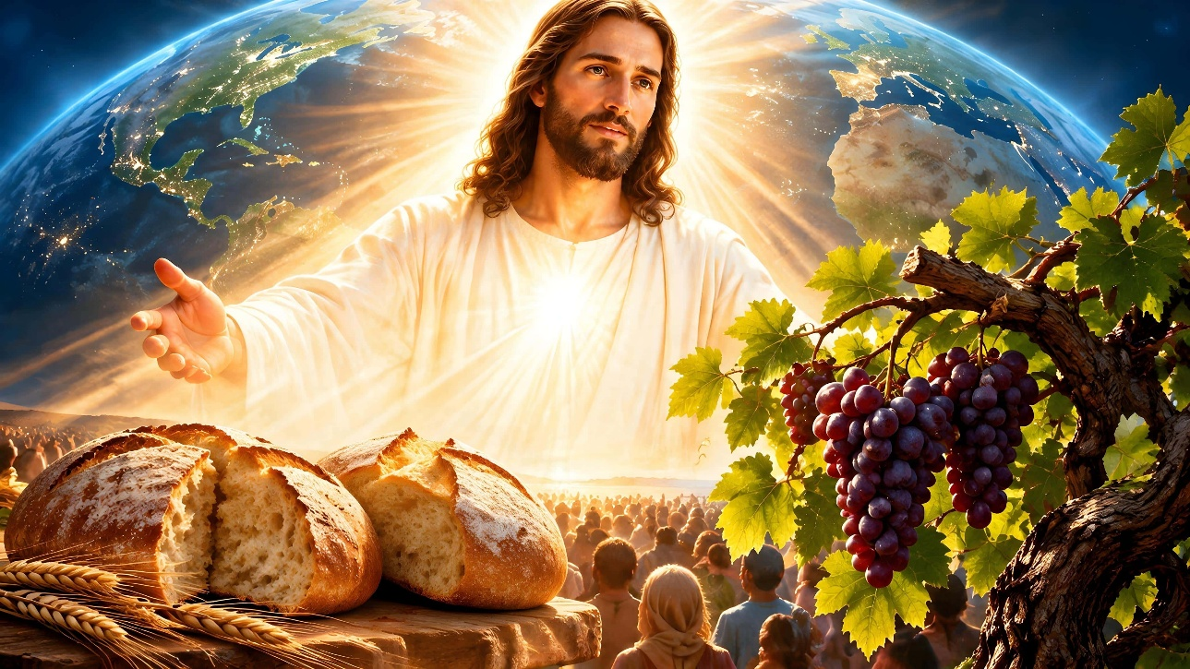


MITAMBO, ZVIRATIDZO, MIFANANIDZO
ZVIRATIDZO
Ekisodho 25:8. Mapirisiti, senjuwari, nebasa rinoitwamo, zviratidzo zvinotsanangura zvakadzama Zano Reruponeso.
Zvakazarurwa 13:2. Mabhuku aDhanieri naZvakazarurwa anoshandisa zviratidzo (zvakaita semhuka, nyanga, …) kuratidza zvinhu zvakaitika munhoroondo.
Johani 15:1. Jesu akashandisa zviratidzo kutsanangura basa rake, zvakaita sechiedza, muzambiringa, uye mufudzi akanaka…
MIFANANIDZO
Isaya 5:1-7. Vaporofita vaishandisa mifananidzo kudaidza vanhu kuti vafungisise nezvemamiriro avo epamweya.
Mateo 13:5. Jesu akashandisa mifananidzo yakawanda kudzidzisa chokwadi chepamweya.

Slide 12

“Bhaibheri rinoratidza chokwadi nenzira iri nyore uye yakakodzera chaizvo zvinodiwa nezvinoshuviwa nemoyo wemunhu; izvi zvakashamisa nekukwezva kunyange pfungwa dzakadzidziswa zvikuru, ukuwo zvichigonesa kunyange vanhu vakaderera kana vasina dzidzo yepamusoro kuti vanzwisise nzira yeruponeso. […] Nokudaro, zano reruponeso rinoratidzwa kwatiri, kuitira kuti munhu mumwe nemumwe aone matanho aanofanira kutora mukutendeuka achidzokera kuna Mwari, uye mukutenda muna Ishe wedu Jesu Kristu, kuitira kuti aponeswe nenzira yakatarwa naMwari. […] Kana munhu achinyanya kuongorora Bhaibheri, ndipo paanowedzera kuva nechokwadi chokuti ishoko raMwari mupenyu, uye njere dzevanhu dzinokotama pamberi peukuru hwezvakazarurwa naMwari.” -Non-Official translation by Gift Mawoyo
EGW (Steps to Christ, p. 107)

Slide 13

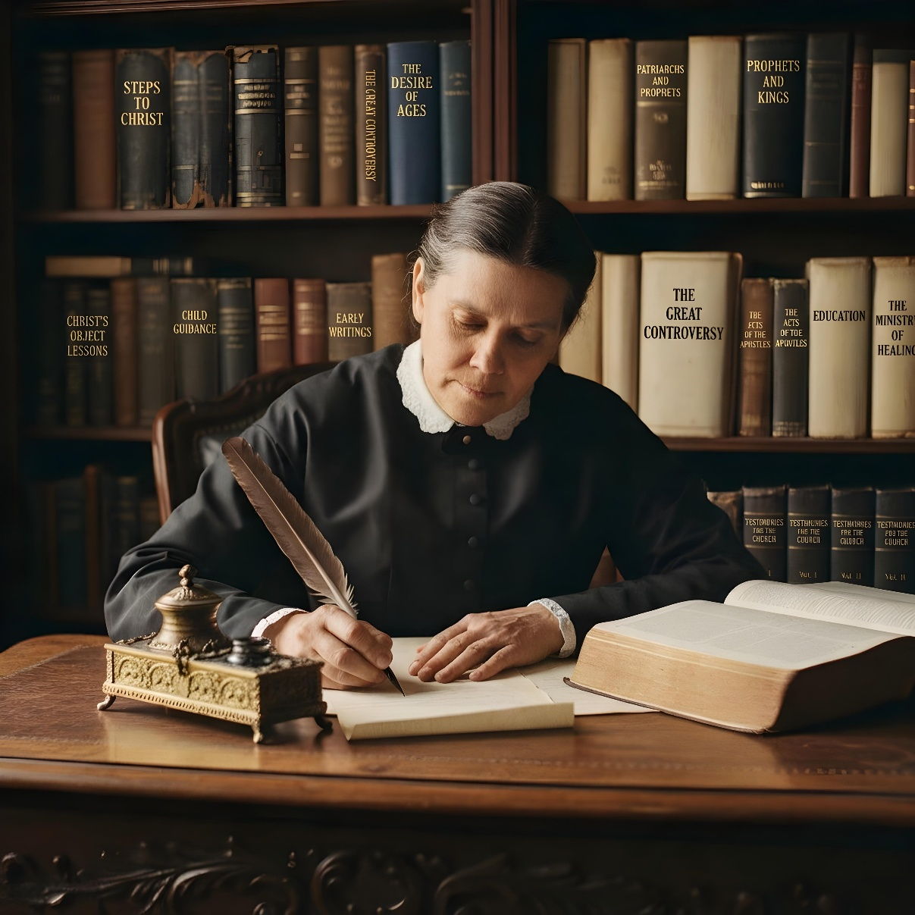



APPENDIX: REVELATION AND INSPIRATION IN ELLEN G. WHITE
Ellen White was divinely inspired. Her writings, her life, and her ministry are those of a true prophet. She possessed the same inspiration as the prophets of the Bible, although she never considered her writings to be equal to those of Scripture. She always regarded the Bible as the authoritative and infallible revelation of God.
She recognized that the process of inspiration involved an interaction between the divine and the human. God communicated his messages, but then the prophet conveyed the divine instruction using his own words. She understood the divine inspiration of human thoughts as a union between divine revelation and human experience.
She pointed out that not all of the human experiences and communications she conveyed were inspired. It is important to keep this distinction in mind when reading and engaging with her writings and experiences, especially her correspondence and diaries.

