Slide 1
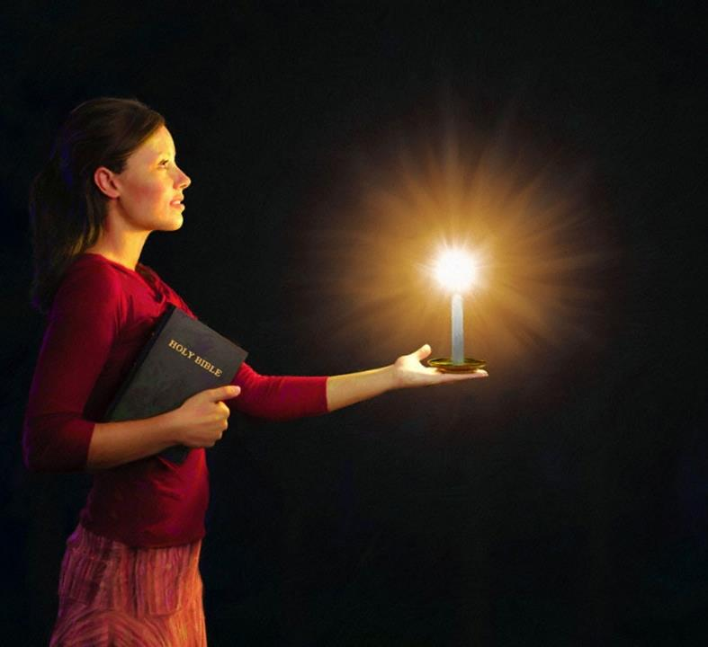


Simmun 5: January 31, 2024
JAAN LAI A THAOMEI VAH BANG A VAH

Slide 2

“Ima jouse phunchel lou hiel le kinel baotam lou hiel in bol un; chuti a chu hiche khang lamvai le vahkoiho lah a hi nuolnabei le thiemmona neilou, thiemmona bei Pathien chate nahi uva, vannuoi a nisa bang a navah theina diuvin”
Philippi 2:14, 15

Slide 3

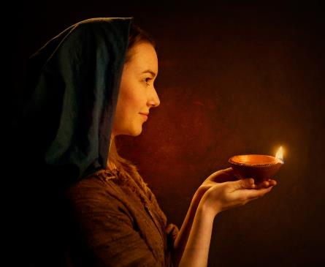



“Hitobang chun navah u miho masang ah kilang hen, chuti leh mi’n natohphatna u mu’n tin, van a um na Pa u avahchoi diu ahi.” (Mt. 5:16).
Hiche thupieh chu Paul in Philippi 2:12-18 a jong aseikit e.
Pathien Dan kengto chutpha a kikoina vannuoi a cheng ihi uvin, ahin hichu jui ding kigellha Christian ho vang chu muthim lah a thaomei kide bang ahiuve.
Vannuoi vah ho:
  Pathien mel kilahna (Philippi 2:12-13)
  Vannuoi vah hi ding (Philippi 2:14-16)
  Damlai luonglhen kipe (Philippi 2:17-18)
Vah kiti ho:
  Timothy (Philippi 2:19-24)
  Epaphroditus (Philippi 2:25-30)

Slide 4

VANNUOI VAH HO

Slide 5




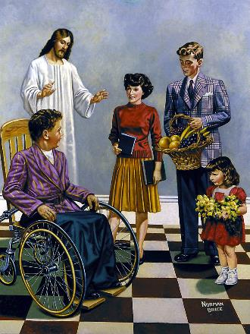
PATHIEN MEL KILAHNA
“Ijieh in em itile alungnachim ding deichatna le tohnuomna ding a nasung uva natong chu Pathen ma ma ahibouve.” (Philippi 2:13)
Jesu jumna leh thokit umdol asei jou in, Paul in Jesu kineosah tah a aum jieh a loupi tah dinmun alhun thei asei e. Hijieh chun “lei jouse’n Pa Pathien loupina ding a Jesu Christa chu 'Pakai’ ti a aphuondoh chieh diu ahi” ati (Phil. 2:11). Atahsan Philippi mite leh eihon jong iphuondoh diu dol ahi.
Ibol diu masa chu huhhing chantheina dia “kicha le kithing” pum a ana itoh diu ahi (Phil. 2:12). Mijouse huhhing a chu Pathien ahi mong leh (Titus 2:11), ibol a ilungkham diu ham?
“Kicha le kithing pum a” ati hi Pathien lunglam bolna dia kipumpih ding atina ahi (Psalm 2:11). Hiche ding a lungsung tohnuomna leh muolso theina thahat pe a jong Pathien ahi ati (Philippi 2:13).

Slide 6




VANNUOI VAH HI DING
“…chuti a chu hiche khang lamvai le vahkoiho lah a hi nuolnabei le thiemmona neilou, thiemmona bei Pathien chate nahi uva, vannuoi a nisa bang a navah theina diuvin.” (Philippi 2:15)
Paul in tahsan chate vannuoi vah hitheina ding lampi 3 aseipih e:
Kilungkhat ding (Phil. 2:14)
Tohkhompi ho lah a phunchel, kidem, kiniel, guhthim a kithukop tiho tam
jong leh bol lou ding.
Chonchan nuolna bei hi ding (Phil. 2:15)
Pa Pathien deilam bolna hinkho tudet jing chu chonsete lampi toh kikhenna ahi.
Pathien Thu nit ding (Phil. 2:16)
Lunggel leh thilbol jouse Pathien Thu toh kilhonsah jing ding ahi.
Muthimna pen a chun vah akilang hoi pen e. Pathien kinungsunna vannuoi a hin vah bang a Christiante ivah hoi joh ding u ahi.

Slide 7




DAMLAI LUONGLHEN KIPE
“Natahsan jal uva Pathien a thilpieh le natohna a hin kahinna thisan hi kisunglha hiel jong le ka kipah in, naboncha uva chung a ka kitaipi uve.” (Philippi 2:17)
Paul akilhadoh ding akinep vang in thiemmo chansah ahiding jong bailam tah ahi nalai e. Apet adinmun chu “hinna thisan kisunglha hiel” toh abahsah e (Phil. 2:17).
Kilhaina lengpitui maicham phung a kisunglha ji ahi (Ex. 29:39-40). Hitobang chun Philippi mite din Paul kisunglha din aum tai.
Philippi miten jong “tahsan jal a natoh” atoh jom jing diu ahin, amaho dia hichu damlai luonglhen apieh uva kisimpih chu ahi
(Rom. 12:1).
Paul in thi ding alung-olmopi poi, ajieh chu ama hettuohsah jal a tahsanna mite tampi’n Gospel dinpi jouna tha aneithei ding u ahi; hijieh chun hangsan tah leh Pathien cha khat hina lom tah in thu asei jing e.

Slide 8

VAH
KITI
HO

Slide 9

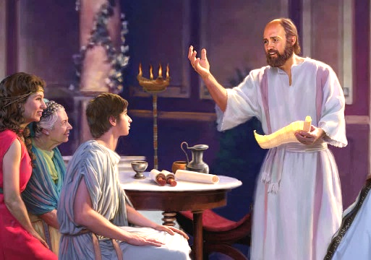


TIMOTHY
“Timothy vang aphatchuom je nahe uve, ajieh chu chapa’n apa akithopi bang a Kipana Thupha thu a hi suoh natong bang a keima ei tohhu ahi e”. (Philippi 2:22)
Timothy hi Paul natoh kithopi phatah chu ahin, lekhathot 6 jen asuthu e (2 Corinth, Philippi , Colossa, 1 Thessalonica, 2 Thessaloniaca, Philemon). Paul amatah in evangelist natoh atohpat sah ahi (Acts 16:1-3). I ati leh achung a Paul kinepna sangpi umthei ah hin tem?
Timothy hi mitin “seiphat chang” ahi; achungchang gaothu a kisei masah toh ahung kilhon diel e (1 Tim. 1:18). Khangdong cha ahin, Paul in acha bang in angaito’i (1 Tim. 1:2; 4:12). Timothy’n jong pa khat chan ding lom jana leh ngailutna chu Paul achan e (Phil. 2:22).
Paul bang a Timothy jong natoh kisonpi thei tah khat hi’n agel e (1 Cor. 6:10). Corinth (1 Cor. 4:17), Philippi (Phil. 2:19) (1 Thess. 3:2) mite vekol din jong angleh Thessalonica houbung anse’i. Paul bang in jong suongkul ana taang e (Heb. 13:23).

Slide 10

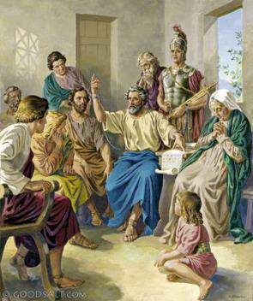


“Ka ngailutna kinbol dia na solchah u, ka sipai chanpi le tohkhompi, sopi Epaphroditus hi naheng uva hinsol loi ding khoh kasa tai” (Philippi 2:25)
EPAPHRODITUS
Philippi miten Paul Rome suongkul ataan ajah jah un angaichat ho (inluoman, neh, sil le chen, etc) bolpih ding agel pai tauve. Solchahpu kom gadel lut a, gabolpih din Epaphroditus ahin sol ta uve (Phil. 4:18; 2:25).
Epaphroditus in thilpieh bou ahinchoipih pon, aphaat seh in Paul akilhonpi le’n, angaichat ho avetpih in, Thupha jong alhangsap hu’i.
Gospel ding a guttah ahi jal in ahinna jieng jong itchalou in, dammona khohtah ahin tuoh tan ahi (Phil. 2:27, 30). Hichu Philippi miten ajah phaat un Paul in amaho ding lekhathot asut chu Ephaphroditus agalhutpih sah tai (Phil . 2:26, 28).
Paul in Philippi mite kom ah “hitobang mi hi anasang un lang, jabol un” (Phil. 2:29) tin asun e. Tahbeh in Epaphroditus chu Christian kitah tah mong anahi.

Slide 11

“Eiho Palai Jesu’n van a ei thuumpih jing lai u hin Lhagao Thieng in “alungnachim ding deichatna le toh nuomna ding a” eiho sung a na atoh jing ahi. Van a um jouse’n huhhing ihi tei diu eilunggot pih u ahi. Ibol a Pathien in ei bolpih diu leh eibolpih jing u ahi iginchatlel nahlai diu ham?
Midang hil a pang eihon Pathien toh kiguijopna dihtah inei masah u ngai ahi. Eiho sung a Christa hinna tuinah luong jing ahi jieh jal a chu Lhagao leh Thu a mite dia tuonsot hinna luondohna tuinah ibah ding u ahi.
Kana le natthuohlelna’n tahsan hin patep ji na’nte; ahin Mutheilou Umpina chun ei salvah jing un, Jesu kiselna inei jing ding u ahi.”
EGW (You Shall Receive Power, December 8)

