Slide 1
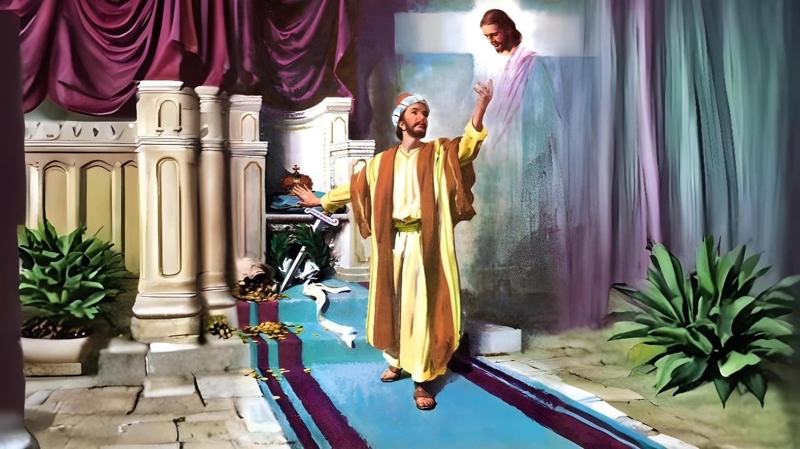
Simmun 6: February 7, 2026
CHRISTA JIENG BOUVA KISUONNA

Slide 2


“Ama leh athokit thahatna kahet a athuohgimna chu kathuohkhompi a,
athina bang a chu kathi nuom ahin,
kajo pou le thina a kuon a jong kathodoh ding ahi”
Philippi 3:10, 11

Slide 3










Philippi mite’n sochatna lampi itobang ahi phatah in aheta uve; Paul le Silas in hiche khopi dia tahsanna kisaan masa- suongkul ngahpa- kom anaseipihsa lhon bang chun (Acts 16:30-31).
Tun vang houbung akiphut det tai; ahin sochatna lampi lhokhielna thei tampi aum nalai e
Hiche tah jieh chun Paul in tahsanna khompi ho ahailou diuvin agahchah e.
Sochatna lhasolouna dia thumop:
Kidalsena ding ho (Philippi 3:1-3)
Dalhah ding ho (Philippi 3:4-6)
Poimo pen tah chu (Philippi 3:7-8)
Sochatna nei jing dia thumop:
Christa tahsanna (Philippi 3:9)
Christa hetna (Philippi 3:10-16)

Slide 4

SOCHATNA LHASOLOUNA DIA THUMOP

Slide 5

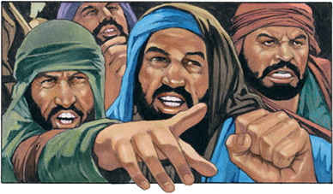

KIDALSENA DING HO
“Uichate chu kivet phat un, thilse bol ho chu kivet phat un lang cheptan lou khohsah ho chu kivet phat uvin.” (Philippi 3:2)
Tahsanna suhmangpih theiho asei masang in Paul in thumop phabep ape’i: “Pakai chung ah kipah jing un” (Phil. 3:1a).
Hitin jong aseibe’i: “Nangho dia aphatchuom jieh in kasutsa velsut kit ding kachim poi” (Phil. 3:1b).
Pathien lungsiet longlou chan (Psalm 31:7)
Ama a tahsanna ngaplhah (Psalm 5:11)
Sochatna ga phattheina chan (Psalm 9:14)
Pathien Dan nit (Psalm 119:14; Isaiah 58:13, 14)
Athu tahsan (Psalm 119:162)
Pathien tahsan chate puikhang (Prov. 23:24, 25)
Pakai a iti ikipa thanop jing ding u ham?
Hiche pet dia houbung manthahna lhut thei melma lien pen thudol Paul in asei e: chondan khaotah a jui dia seile mihil lhem ho (Phil. 3:2). Koudan 3 in aminphah e: uichate (Ps. 22:16; 2 Pet. 2:21-22); thilse bolho; chuleh cheptan lou khohsah ho.

Slide 6

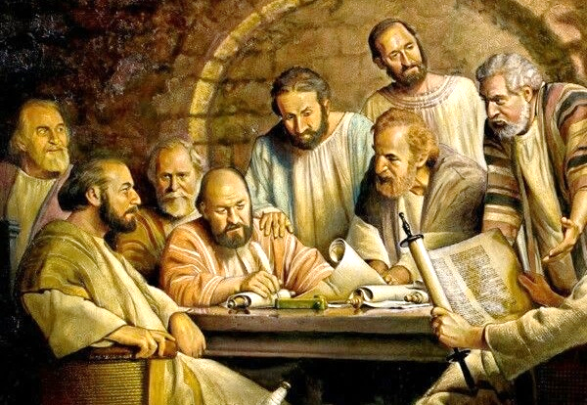
DALHAH DING HO
“Niget ni a chep kitan, Israel chilhah, Benjamin phung, Hebrew chilhah Hebrew mi, Danthu dungjui a Pharisai kahin” (Philippi 3:5)
Jerusalem Khoppi a chun Judate chondan Gentile te chung a chesah tei ding gotlou ding ahi akiti uve (Acts 15:19-21). Hinlah, cheptan ding ngaisah mihil phabep Philippi ahung lut ta uve (Phil. 3:2-3).
Phaat chesa a Paul cheptan le Juda chondan jui bukim le gut tah ahi dan aseipih e (Phil. 3:4-6):
Niget ni a chep kitan, hou guttah insung a hung seilien ahi
Hebrew lah a jong Hebrew mi; Benjami phung mi ahi
Danthu jui bukim, Pharisai hougut tah ahi
Tompan jieh a houbung bolse a pang ahi
Danthu lamdol a nuolna bei ahi
Jesu ahet masang chun ahina kiletsahpi tah anahi. Tun vang Dan hethiem lou ahi ahin kihetdoh tai (Mt. 5:21-22).
Christa bouva sochatna aum ahin he tai (Phil. 3:7).

Slide 7

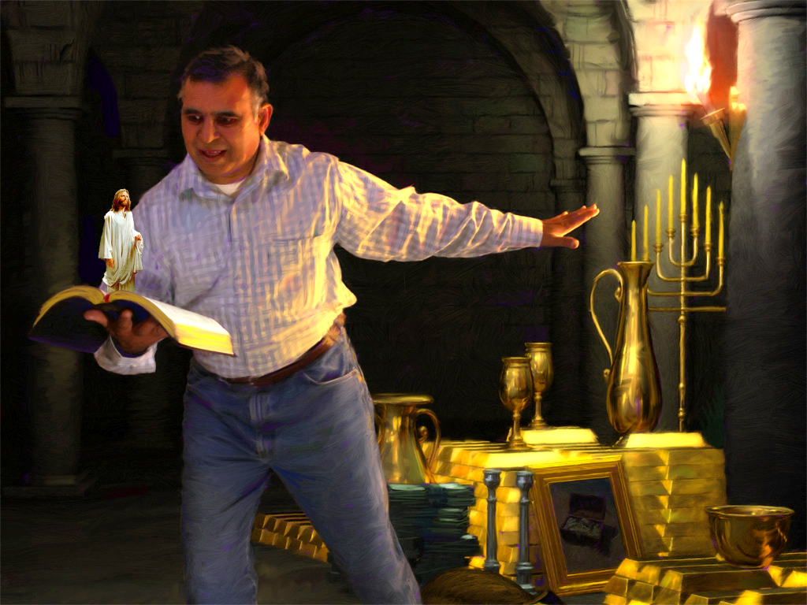



POIMO PEN TAH CHU
“Ahinla hitobang phatchuomna kanei hi aboncha Christa jal a pannabei thil a kagel ahitai.” (Philippi 3:7)
Paul in ahinkho lui leh thah alepkah in ahi. Langkhat a chun hetna gilna anei ho, Gamaliel thalheng thei le akineppi tah ahina, Pharisai lah a jong boltheina sangpi nei ahina; aphatchuompi thei ngen ahi.
Alangkhat a chun Christa anei apat ahinko akoi in, aphatchuompi thei jouse eh bang in agel tai; ajieh chu Christa ngailutna tepi thei umlou amudoh tai (Phil. 3:7-8).
Van le lei thah a tuonsot hinna nei ding sang a lu jo chanvou ipi um in tem? Ahin vannuoi in hichu hetphah in anei poi.
Hilai a vannuoi in thupi tah agelho leh Vangam a thupi kiti ding ho kah a lhenkahna aum jing e; Christa bang chonchan leh lhagao sochatna chu vannuoi thilho toh lepkah in aum jing e.

Slide 8

SOCHATNA NEI JING DIA THUMOP

Slide 9



CHRISTA TAHSANNA
“Ama sunggil a keima ka kimudoh a, thiemchanna chu Danthu vang a kanei hilouva, tahsan jal a Pathien a hung kuon thiemchanna… Christa tahsan vang a kanei thei a” (Philippi 3:9)
Paul chondih tah a kigel pum in Damascus lampi achephei e; tahsan dihlou jop ho “Lampi” dih a lepui lut ding ati ahi (Acts 9:1-2). Ahin Damascus alut lut chun chondihna thahat jo, “Christa tahsan vang a kinei thei” chondihna, chun aluonkhum tan ahi” (Philippi 3:9).
Hiche nikho a pat ama chondihna a kisonna him him anei tapon ahi. Eima tohdoh jal a sochatna kineppi thei ahi poi ti ahin hechien tai (Gal. 2:16).
“(Christa) a thiemchanna anei ding” akilhen joh tai (Phil. 3:9). Ipi jieh hin tem?
1 Corinth 1:30 chun “Christa a um chu” sochatna thu, lhagao mitvah kipatna (chihna), tahsan vang a thiemchanna (chondihna), van thahat sopthieng sah dia kigotna (thienthouna), Christa hung kit nikho a loupi channa (huhhingna), abon a, anei suoh ding ahi tai ati.

Slide 10







CHRISTA HETNA
“Ama le athokit thahatna kahet a, athuohgimna chu kathuohkhompi a, athina bang a chu kathi nuom ahin” (Philippi 3:10).
Christa hetna iti inei thei diu ham (Phil. 3:10-16)?
Athu ikhuol tieng u leh
Lhagao Thieng ikipuisah tieng u leh
Athuohgimna ithuohpi tieng u leh
Malam bidoi hatah a idel tieng u leh
Christian hinkho hi guolsieh lhai kitet tobang ahi. Malam bidoi kichieh tah a ikihet masah u ngai ahi. Hiche leisiet hinkho a umden le nopsah den ding igel u ahi poi. Christa thokitna ichan diu kinem joh ihi uve (Phil. 3:11).
Hiche nikho lhun kahse a “Christa’n keima ei matkhah bang a keiman jong matkhah katup ahi” iti thei ding u ahi jo’i (Phil. 3:12). Jesu’n kei din khopi hoi tah, kipa man, Ama toh tuonsot a lhatkhom ding ei koipih tai (Heb. 11:10; Phil. 3:14; 1Thess. 4:17).

Slide 11

“Hahsatna le buoina meipi sa tah in jiing hen lang hijong leh Paul in malam bidoi adel jing bang a tahsan chate jouse’n jong Pathien kinbol ding a ikilhanthieng ding u ahi.
Huhhingpu kuon a kaimang ding tupna’n vannuoi thil dei um tah tah hon hin nailut inte, ahin ama chun abidoi atoudel jing ding, vannuoi mite leh vantilte masang a Pathien mel mu ding chu thuohgimna jouse leh kihambolna jouse gei a imalou bang a asim ahi ti aphuondoh joh ding ahi. Ajieh chu hiche kinepna kipaman chan ding chu gimbolna jouse kalpeh a akoi ahi tai.
Christa seijui lah a nuoinung pen jong vanmun nop tah a chu lha ding ahin, chultih neilou Pathien gou lo ding a guotsa ahi tai.”
EGW (Conflict and Courage, December 13)

