Slide 1

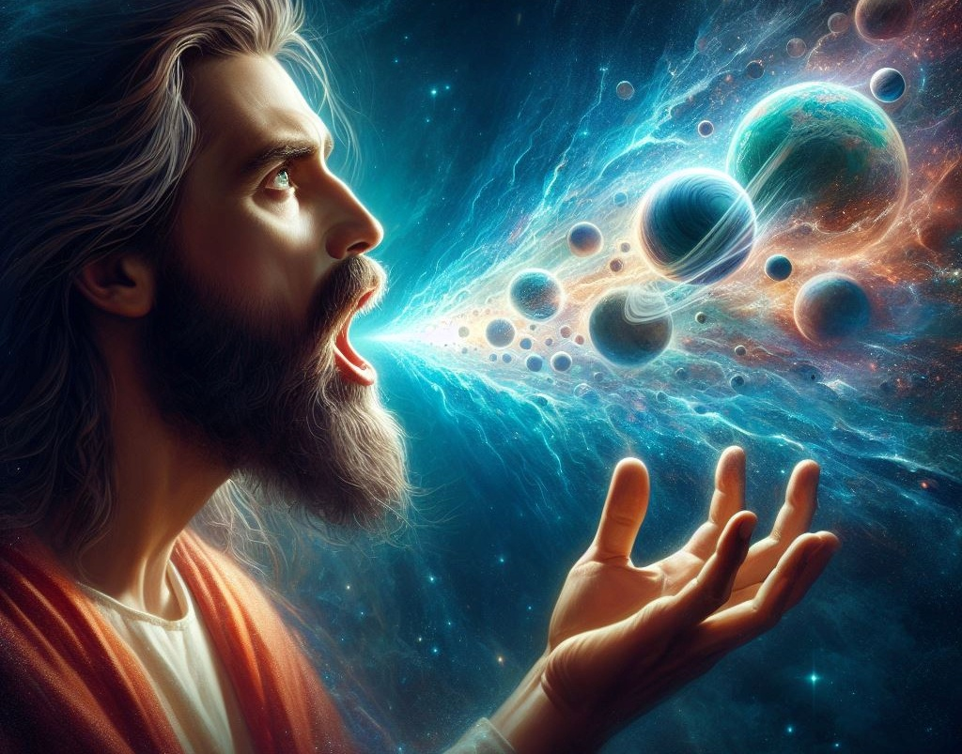
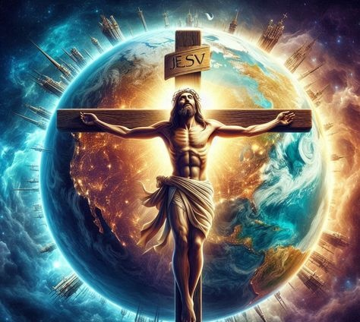
Simmun 8: February 21, 2026
CHRISTA CHUNGNUNNA

Slide 2
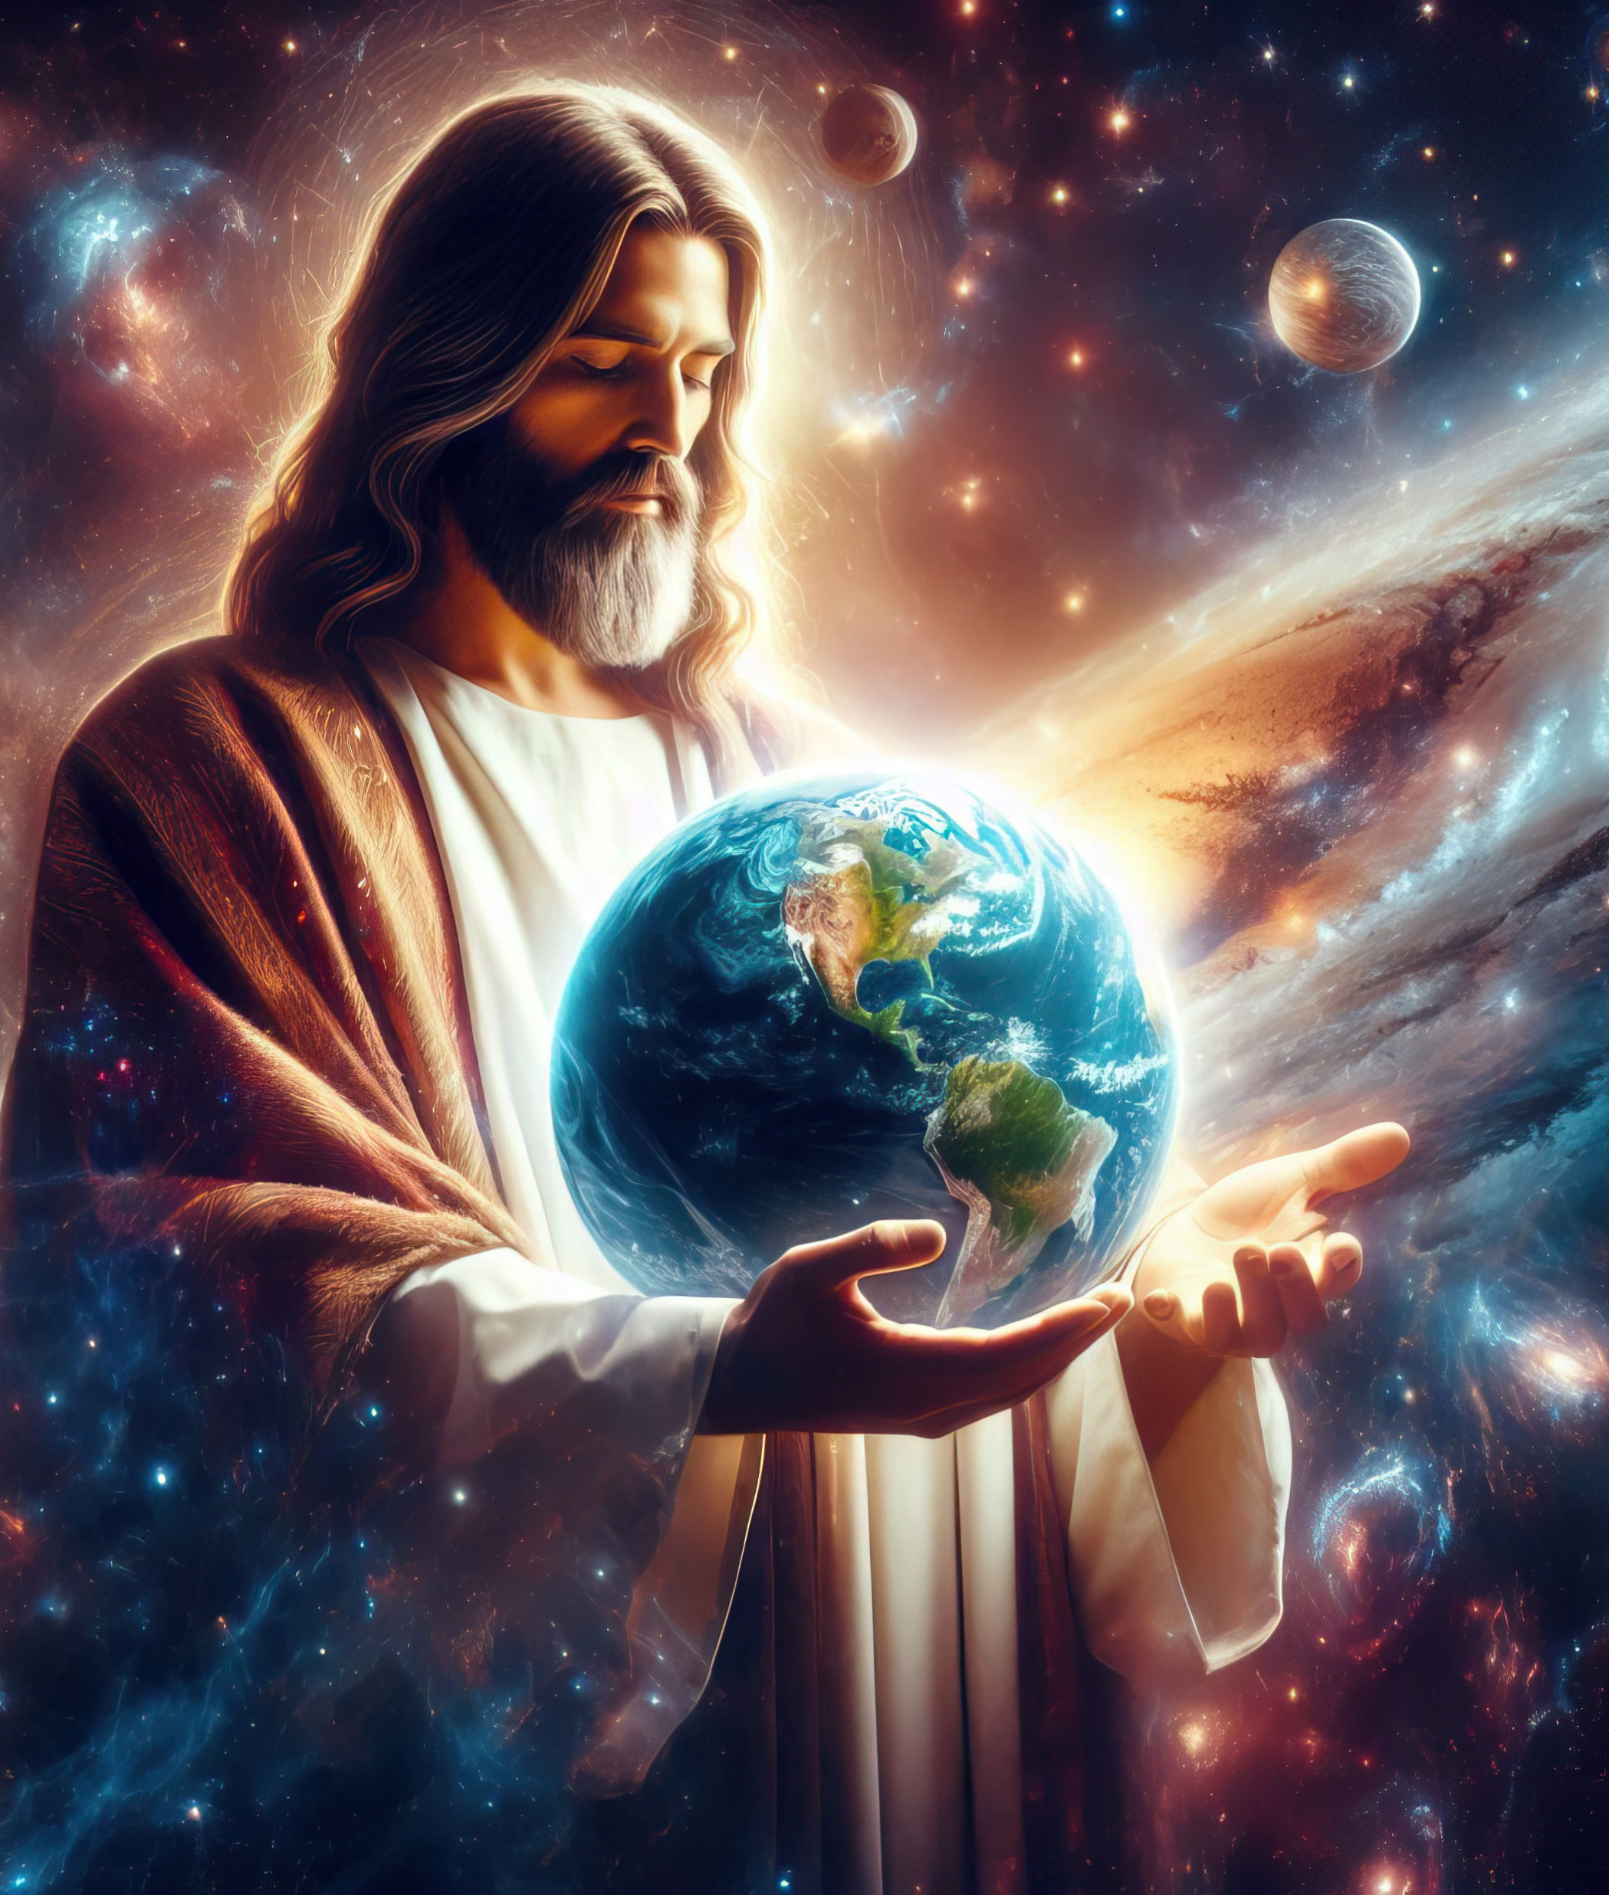
“Chapa chu mu theilou Pathien limpu ahin, thilsiem jouse sang a masa jo ahi; ijeh in em itile ama jal a thil ijakai, van a hi hen leisiet chung a hijongle,
muthei le mumo ho, laltouna ho le loinehna gam ho gei, vaihom thu neina ahin, thil ijakai hi Ama jal le Ama ding a kisem ahi;
chule Ama chu thil jouse masanga ana um jing ahin, thil ijakai hi Amato akijopmat tieng ding det ahi uve.” Colossa 1:15–17

Slide 3


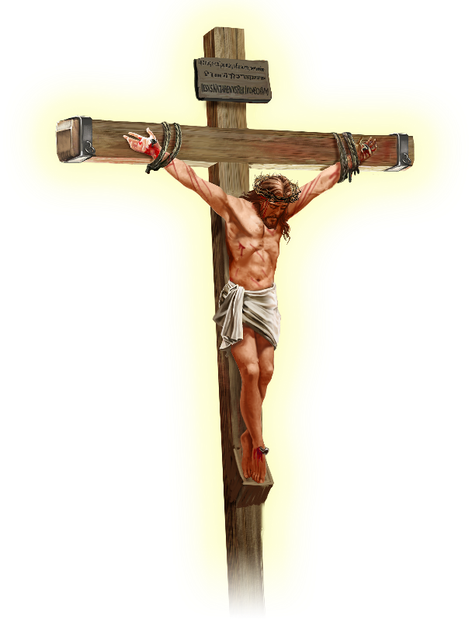






Jesu’n “leisiet chung a um jouse le vanlaijol a um jouse kah a chamna asiem ahi tai” tin Paul in aphuongdoh e (Col. 1:20).
Hiche thugol asei masang in Jesu koi mong ahi Paul in ahilchien masa’i. Mihil minthang, miching minthang, houhil minthang, thiemgao minthang, thupha phuong minthang ati poi…
Jesu Christa chu…
Pathien limpu ahi (Colossa 1:15a)
Thil jouse masang a umsa ahi (Colossa 1:15b-17)
Houbung luchang ahi (Colossa 1:18a)
Abul ahi (Colossa 1:18b)
Chamna siem ah ahi (Colossa 1:19-20)

Slide 4





PATHIEN LIMPU AHI
“Chapa chu mu theilou Pathen limpu ahi”(Colossa 1:15)
Limpu chu atahpa tobang hiji ahi (photo, hologram, jihtho leh suong lim kikhen tiho bang a). Ahin Bible sei limpu chun hiche ho khelpeh in jong kibahpina anei in ahi.
Pathien in Adam le Eve ama lim in asiem e (Gen. 1:27), Adam in ama limpu cha khat anei e (Gen. 5:3). Atahpa lim kilopi mai mai ahipon, umchan leh lungput kilopi mai mai jong ahipoi. Tahsa limso, khohei dan leh thilsiem dangho lhangaina nei tah ahina uva Siempa limpu ahi uve.
Paul in danthu chu “thilpha hung um ding ho” lim tahbeh ahipoi ati (Heb. 10:1), lim=atahpa, kibang ahi lhon avetsah e.”
Khuti ahi leh: Jesu chu Pathien toh kikot hin tem, kibang hin tem? Pathien ahina min “KEIMA” amanji bang in, “Kei leh Pa thakhat kahi lhon e” (John 10:30); “Keima eimu a chun Pa amu ahi tai” (John 14:9) ati akimui.

Slide 5




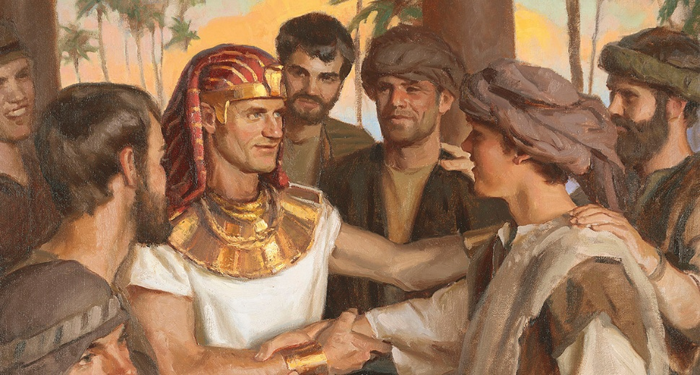
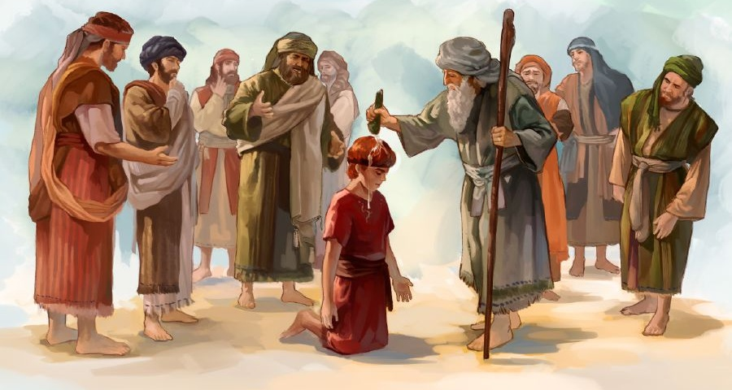


THIL JOUSE MASANG A UMSA AHI
“Ama chu thil jouse masang a ana um jing ahin,
thil ijakai hi Ama toh akijopmat tieng dingdet ahi uve.” (Colossa 1:17)
“Um masa” chu cha masa tina ahi. Hijieh chun kimkhat in Jesu chu Pathien thilsiem lah a masa pen ahi tin ahilji uve (Col. 1:15). Hinla, “limpu” thucheng kiman bang hin “um masa” thucheng jong hi Bible mandan eiho mandan khelpeh gei ahi.
Ishmael hilouvin Isaac joh cha masa ahi; Reuben hilouvin Joseph joh cha masa ahi; Eliab hilouvin David joh cha masa ahikit e (Psalm 89:27). Asopite lah a dinmun chungnung jo kipe ahi jieh un cha masa a kisim ahi ta uve, apien masah jal u ahipoi.
Paul in Jesu cha masa ahina chu Colossa mite alekhathot a chun aminphah e. Koiman ahetkhiel louna din Pathien ahina thil ni toh aseitha’i: thil jouse Ama jal le Ama ding a kisiem ahi (Col. 1:16; Isa. 45:18); Ama jal a bou dettah a umthei u ahi ati (Col. 1:17; Ps. 119:91).

Slide 6



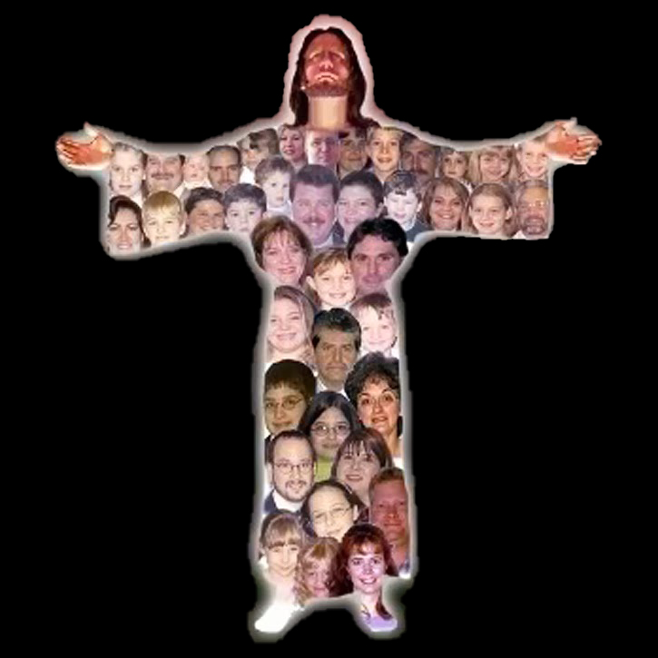
HOUBUNG LUCHANG AHI
“Ama chu atahsa houbung luchang… ahi.” (Colossa 1:18)
Pao kimkhat (English pao, Catalan pao tiho tobang) a hin “luchang” thucheng hi “lamkai”, “alienpen” tin jong akiledoh thei e; ajieh chu hitobang ho chu luchang dinmun a kikoi ahi uve. Hebrew pao a jong chutima chu ahi. Vetsahna’n, “…achung uvah lamkai khat seh akilhen un…” (Hos. 1:11) kiti hi “lubuh khat akilhen un” jong tithei ahi.
Eiho louva bukim theilou ahi (1 Cor. 12:15)
Khat in panmun poimo anei chieh e (1 Cor. 12:17)
Isahlouva koithei koima aum poi (1 Cor. 12:21)
Tahsan chate lah a “hatmo” “hoimo” jo kiti thei aum poi (1 Cor. 12:22-24)
Khat le khat kigelkhohtuo chieh hiding ahi uve (1 Cor. 12:25-26)
Hitobang tah chun Christa jong houbung luchang ahi tin Paul in anasei e (Col. 1:18a).
Chukit leh Paul in tahsa limput dol jong aseibe’i. Christa chu luchang ahitah leh eiho- houbung mite- chu atahsa ihi ta uve. Hichun hetdoh be thei tampi eipe kit uve.

Slide 7


“Ama houbung luchang, abul ahin, ima lam jouse a amasat jingna din athiho lah a jong athoudoh masa pen e.” (Colossa 1:18)
ABUL AHI
“Abul” ti a kiledoh thucheng chu Greek thucheng archē (ἀρχή) ahi. Thugol kisut dan puoh in hiche thucheng hin lamdoh chuom chuom anei thei e: abul, kuondohna, kipatdohna, thupatna, dinna ti a jong ledoh thei, thunei, vaihom, thahat, kivaihomna ti a jong ledoh thei kit ahi.
Christa kiseina akiman tieng, hiche thucheng koudoh thei jouse hi manthei ahisuohkei e (Col. 1:18). Jesu thil jouse kipatna ahi [Pathiem limpu ahi], thil jouse kisiemlona jieh ahi [a um masa pen ahi], thunei chungnung [luchang ahi]. Hiche ho jieh hin ima jouse chung a Christa chungnunna chang ah ahi.
(Mousi athi lah a thoudoh masa pen ahi vang in) Paul in Jesu chu “athiho lah a athoudoh masa pen” ahi jong ati. Thina chung a agaljona chun chonsiet chung a agaljo a, ama limpu a eisiem thei u atahlah e.

Slide 8

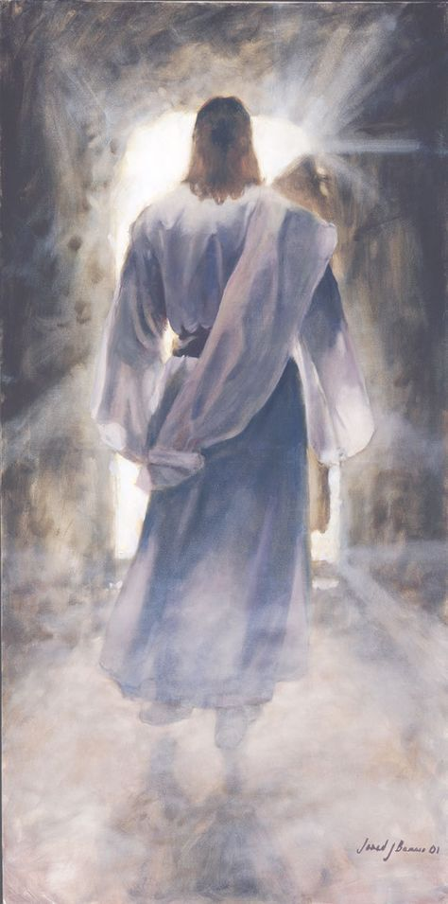



CHAMNA SIEM AH AHI
“…ajieh chu Ama jal a thil ijakai aboncha aheng a suhchamsuoh a, Ama vangle athingpel thisan jal a leisiet chung a um jouse le vanlaijol a um jouse kah a chamna asiem ahi tai.” (Colossa 1:20)
Jesu anatoh jal in ijakai ah panmun chungnung achang e. Paul in Christa seiphat jouse chang ding lom ahi ati; “ijeh in em itile Chapa sung a hi Pathien in chamkim kei a chenpha adei ahi” (Col 1:19). Ajieh chu Jesu chu Pathien lhingset leh mihiem lhingset ahi gel e. “Chapa chang khatseh loupina lungsiet le thutah lhingset in kamu ta uve” (John 1:14).
Thingpel a athi a, chujouva athodoh kit chun mihiem le Pathien kichamtuosahna natoh chu amuolsuo ahi tai (Col. 1:20).
Pathien toh “leisiet thil ho” kah a chamna aumsah tai ti ihe uve. Ahin, van thil ho toh kikah jong asuhcham ahitah dan iti ihetthei um?
Vanmun leimun thilsiem jouse’n Satan hina dihtah amu ta uve. Hijieh chun Pathien chu lei le vanmun jouse ah thiem achang tai.

Slide 9

“Jesu vanmun a loupi le ja um chungnung anahi, vantil jouse’n alhangai lamkai pipui anahi, alungdei bol ding a kigosadiem ahi uve. Pathien toh khat ahin, “Pa op a beh jingpa” ahi (John 1:18), hinla chonsiet le gentheina’n mihiem asuhgam jing lai hin Pathien toh kibah a umden ding agel pon, alallukhuh leh aleng tenggol adalha’n, Pathien ahina chu mihiem mel in ahin kivon in ahung kumsuh tai.
Alaltouna a mihiemte toukhompi thei ahikitna din, amaho dopsangna din thingpel thina gei kisaan din ahung kineosah tai. Pa mel phuongdoh din ngailutna’n ahung kilah in, mihiem toh Pathien kah chamna ahung siem tai.”
EGW (Selected Messages, Volume 1, p. 321)

