Slide 1
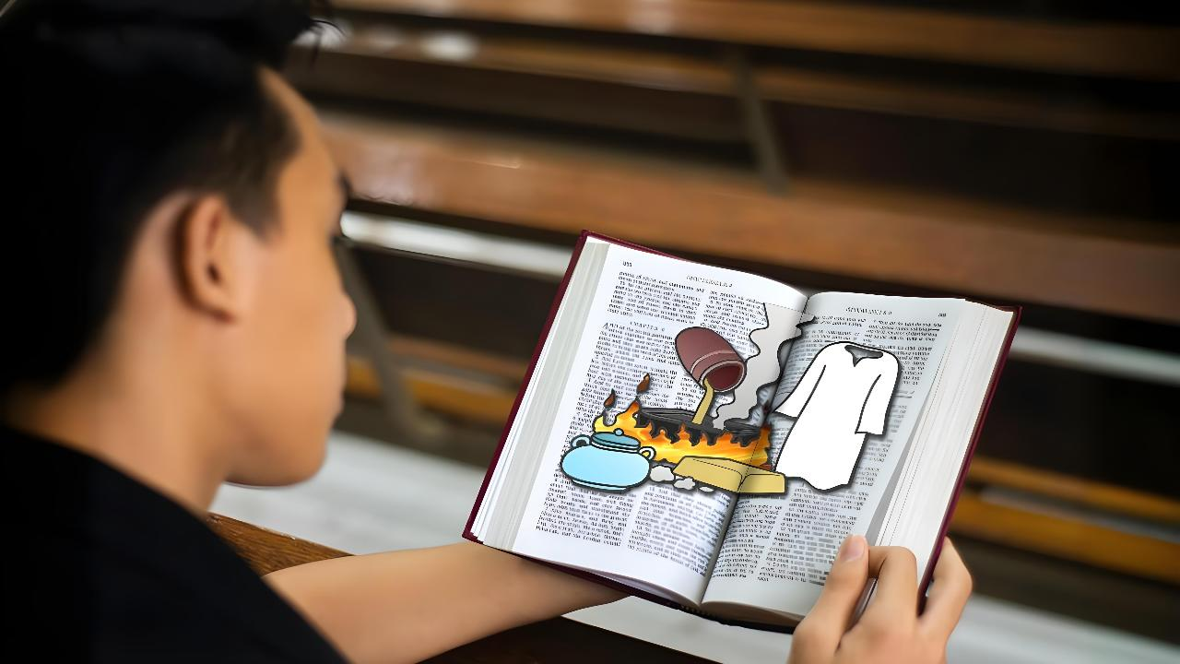
ATAH HINAM PATEP DING
Simmun 1: April 4, 2026

Slide 2
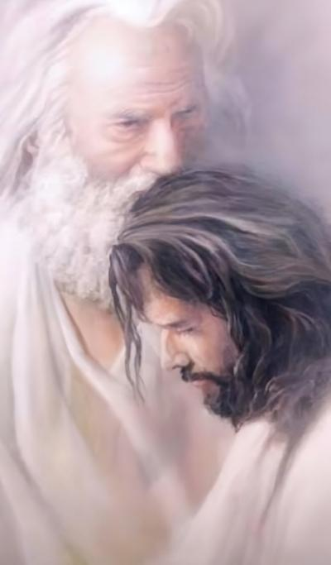

“Ka Pa’n ei ngailut bang a ken jong ka ngailut nahi uve; ka-ngailut sung a cheng jing un.”
John 15:9

Slide 3

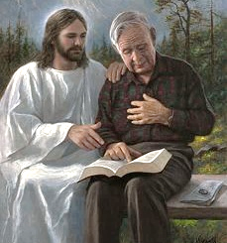



Eima toh Pathien kikah dinmun khat nei chieh ihi uve. Hiche dinmun chu tu sang a siemhoi a, khantousah ding inop tei diu tahsan ahi.
Pathien toh ikah dinmun khantousahna dia kalse masah ding chu eima lhagao dinmun kikhuol ding chu ahi.
Pathien in nikho kichaina houbung mite lhagao dinmun hettheina eipe un, hiche mite dinmun ding kiseiho eima dinmun kituopi hoi chu ham ti kivetdoh a, Pathien toh ikah hatsah leh suhdet ding lampi ikiholdoh diu ahi.
Pathien a kuon thuthot (Thuphuon 3:14-22):
  Kikhuol ding (vv. 14-17)
  Adamna ding (v. 18)
  Bol ding (vv. 19-20)
  Kipaman mu ding (vv. 21-22)
Atah hinam patep ding (John 15:1-11):
  Lengpigui leh abah
  Lengpigui tui

Slide 4

PATHIEN A KUON THUTHOT
(Thuphuon 3:14-22)

Slide 5




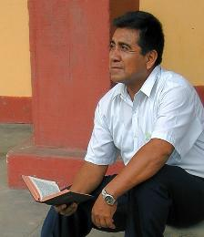
KIKHUOL DING
“Ijieh in em itile nang in, 'Kahaove, sum kanei e, imacha ngaichat kaneipoi,' nati’n; nang tah chu adapen le khotuo um pen, vaicha tah le mitcho chule sagohkeo nahi lam nakihet poi.” (Rev. 3:17)
Houbung 7 ho thuthot chu solchahte khang a pat tukhang gei houbung dinmun kiseina ahi (Rev. 2-3). Tukhang mite (Laodicea) ding thuthot aseina chun Jesu’n "Amen (Thutah), Hettohsahpa, Tahsan um…” hi in akisei e (Rev. 3:14).
Eima kigelna a thutah chu, “Kahaove, sum kanei e, imacha ngaichat kanei poi…” ti ahi ji’n ahi (Rev. 3:17a).
Hinlah Jesu’n thutah chu ahe’n, “nangma khotuo um tah, vaicha, mitcho le sagohkeo nahi…” ei ti e (Rev. 3:17b).
Tu hi kikhuol phaat mong chu ahi. Inei leh ikivat ipi pi hintem, khuoldoh ding phaat tah chu ahi. Christa toh kakah ichan khangtou hitam? Khantouna malam no kahi hinam?

Slide 6


ADAMNA DING
“Nahaona dia kakom a akilha thiengsel sana kichoh ding le nakisil a najamo kimudohlouna dia nakhujol ding puon bangleh kichoh a, kho namu theina dia mitlou kichoh ding a kathumop nahi.” (Rev. 3:18)
Noptah a umthim hin thasietna (sa la salou, vot la votlou) alhut ji ahin, hi jieh chun Jesu’n thil 3 bol din ei thumop ui:
Sana thiengsel kichoh ding
Thudih bukiplou kisaanlou ding ahi, chuleh Bible vet phuilap nganse lou ding ahi. Mihiem chihgut pampai ding, Bible thugil hetthiemlou umlouna dia khuolgil cheh ji ding ahi.
Puon bangleh kichoh ding
Sochatna lampi umsun chu Jesu chondihna kisaan chu ahi. Pathien ma-ang a eima chondihna tahlah ding nei a kigel hi sagohkeova i um kitahlahna tobang bep ahibouve.
Mitlou kichoh ding
Lhagao Thieng kisaan in. Amabou in lhagao mitvahna napieh thei a, na dinmun dihtah naki hetdoh sah thei ahi (John 16:8).

Slide 7

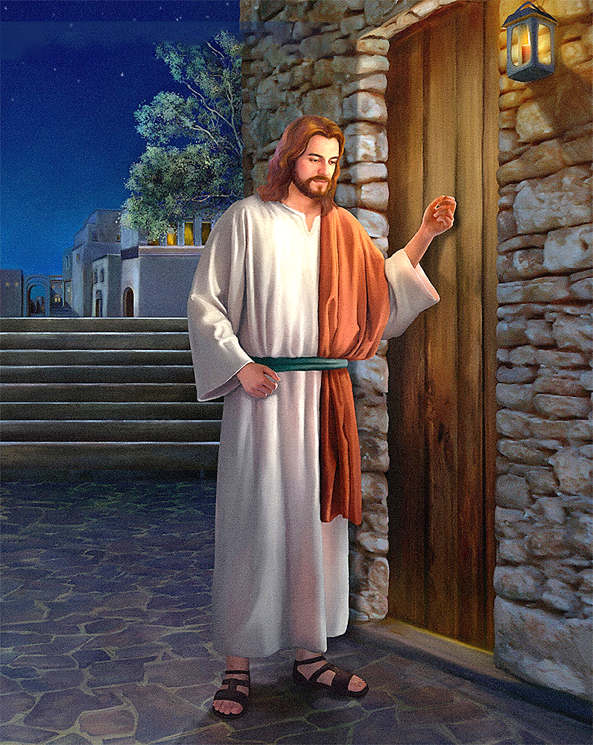
BOL DING
“Ven, kotkhah bul ah kading in kakiu jing e, khattouvin ka ogin ajah a kot eihon leh, ahieng a kahung sunglhah a ama chu an ka nehkhompi a, aman jong ei nehkhompi ding ahi.” (Rev. 3:20)
Ahimo khat aum e. Lhagao dinmun hoisel in ka kigel e, ahin Jesu’n khangtoube din ei dei e. Kikhelna ngaicha kahina ima kaki mudoh poi. Ipi kikhelna ding ngaikhoh um ham kati. Kaneisa ahin, kichoh ding akivat aumpoi kati.
Asuhdihna din Jesu’n lampi khat akoi e: “Keiman kalungsiet chan kaphosal a kabolgimji ahi, hijieh chun tompan in” chuleh “lung hei in” atibe’i (Rev. 3:19).
Jesu phosal leh bolgimna chan hi aphalou lam jieng hiji ahipoi. Ama toh itoukhom uva, ikihou diu adei ahi…“Ven, kotkhah bul a ka ding in kakiu jing e, khattouvin ka ogin ajah a kot ei hon leh, ahieng a kahung sunglhah a ama chu an ka nehkhompi a, aman jong ei nehkhompi ding ahi” ati (Rev. 3:20).
Jesu’n lungthim kot akiu jing in, lungnieng tah in ei ngah uve. Ama toh toukhom din vang ei mohno jieng po uve. Hichu eima thulhuhna in akoi tai.

Slide 8


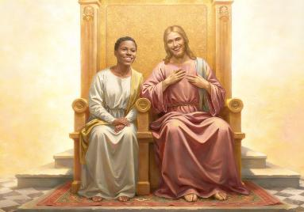
KIPAMAN MU DING
“Galjouva chu ken jong kajo a ka Pa toh alaltouna ka toukhom bang a hi kei toh ka laltouna toukhomna thei thu kapieh ding ahi.” (Rev. 3:21)
Jesu’n lampi hahsa ahi ei hetpih uve. Sana, puon bangleh, chuleh mitlou kichoh ding kihambol ihi u jong ei hetpih uve. Vot la votlou, sa la salou dinmun ideilouvu jong ahe’n, ama kot honpih a, toukhompi ding igot u jong ahe’i. Hijieh chun “ka galjo bang a nanghon jong na galjo diu ahi” ati (Rev. 3:21).
Eiho kipatdoh masa jieng thei ihilouvu jong ahe’n, hijieh chun ama ei lampat masah jing uve.
Eiho ei siem uve
(Gen. 2:7)
Chonse ei holdoh kit uve (Gen. 3:8-9)
Eiho din ama akipedoh e (John 3:16)
Kipaman eipe nuom un, ama toh tuonsot a lhakhom din ei dei ui (Rev. 3:21)
Hiche Pathien thilbol umje (eiho chan ding lom hilou) chu ngailut vang ahi: “Kalungsiet longlouvin kakan jing uve” (Jeremiah 31:3).
Amatoh pumkhat ihi ding u adei ahi; ihi ngel u hinam? Kalung kot kahonpih a, ei ngailut bang a ka ngailut hinam?

Slide 9

ATAH HINAM PATEP DING
(John 15:1-11)

Slide 10

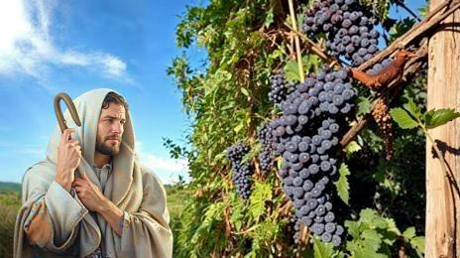
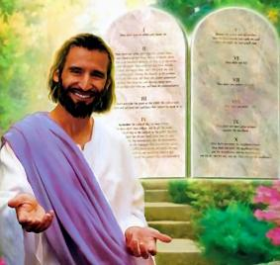

LENGPIGUI LEH ABAH
“Keima lengpigui kahi’n, nangho abah nahi uve. Ama sung a kachen bang a kei sung a cheng mi chu apung lheh ji e; ajieh chu keilouvin nang hon ima na bolthei po uve.” (John 15:5)
Jesu’n athi kuon chun “lengpigui” kahi ati’n, aseijuiho “abah” ahi uve ati. Ipi aseina hin tem?
Abah chu aguipi panglouvin chomcha bou ahingthei in, agop pai ji tai. Tuonsot hinna ineithei nading un Jesu’n “Keisung ah cheng un” (John 15:4) ti’n ei kou kou uve. Hiche thulem aseina chang 11 sung a hin “Kasung ah cheng un” 10 vei jen asei e. Iti lom a ngaikhoh ahi ta dem!
Laodicea houbung hatdohkitna ding damdoi Jesu sung a chen chu ahi. Hichu kipa kuonna jong ahi (John 5:11). Chuti ahi leh Jesu sung a iti igachen ding u hin tem?
Ama lungdei ibol uva kuon hi ding ahi- athupieh init ding u ahi (John 15:10). Hiche hi ama ngailutna chu ngailutna ma a ilethuh theina u lampi umsun chu ahi (1 John 4:19).

Slide 11


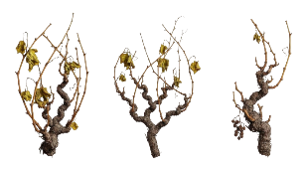

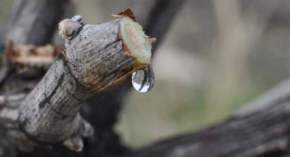

LENGPIGUI TUI
“Kasung ah cheng jing un, keijong nasung uva cheng jing ing e. Lengpibah achang a aga theilou bang a, kei sung a nachen louvu leh nangho jong napun theilou diu ahi. (John 15:4)
Phalbi ahi tieng lengpibah ho agui ah akikhai den un, ga vang agaji po uve. Ipi jieh hin tem? Ajieh chu ajung a tui chelhung lou ahi tai.
Gojuh lha ahung lhun tieng le bou ajung a kuon tui ahung kaitou thei in, amit thah ahin khodoh thei ji tan ahi. Greek thucheng “abah” ti a kiledoh hi abah ajung toh kikhensa, athah beh a kisoubeh kit tina’n jong akimang thei e.
Lengpibah mit thah ham, kisoubeh thah ham ihi maithei u ahi, hinla agui a hung kai doh tui louvin hinna inei thei po uve. Hichu itoh itekah diu tam?
Jesu’n John 14-17 sung ma a hin hilchetna ape’i: Lhagao Thieng jal a hiche hinna tui chu ineithei diu ahi, ithuum tieng u leh.
Lhamuonsah tu ahi (John 14:16-17)
Jesu hetna ei neisah uve (John 15:26)
Chonsiet kisihna ei neisah uve (John 16:8)
Thudih jouse ah ei puilut uve (John 16:13)

Slide 12

“Hiva mei a kihal thiengsel sana kiti hi tahsan le ngailutna chu ahi. Hichun lungsung haosatna ape’i; ajieh chun athien ma se a kisop sop jieng ahin, aki patep chan in avah a em cheh cheh in ahi.
Puon bangleh kiti khu chonchan thiengthou tah chu ahin, Christa chondihna chonsepa kichansah chu ahi. Hiche puon chu van a kikhong ahin, Christa bouvin achohpih thei, thunung lhungkeipa apieh thei chu ahi.
Mitlou kiti chu se le pha hetkhenthei sah a pang, chonsiet kiselgu jouse mudoh sah a pang chihna le panpina chu ahi. Pathien in ahoubung chu kichieh sel a amutheina din, chuleh chihna kipe chu amantheina din, mitvahna ape’n ahi. Ahin mi tampi’n hiche mitlou chu adeipo uve; ajieh chu achonsietna u khovah a phuondoh ahi ding anompo uve, phosal ahi tei diu akihet uve. Van a kuon kipe mitlou chun datkhentheina phatah apieh ding u ahi. Christa hiche panpina jouse kuonna chu ahin, hijieh chun kei a kuon “kichoh un” ati ahi (Rev. 3:18).
EGW (Testimonies for the Church, vol. 4, p. 88)

