Slide 1

PATHIEN HET DING
Simmun 2: April 11, 2026

Slide 2
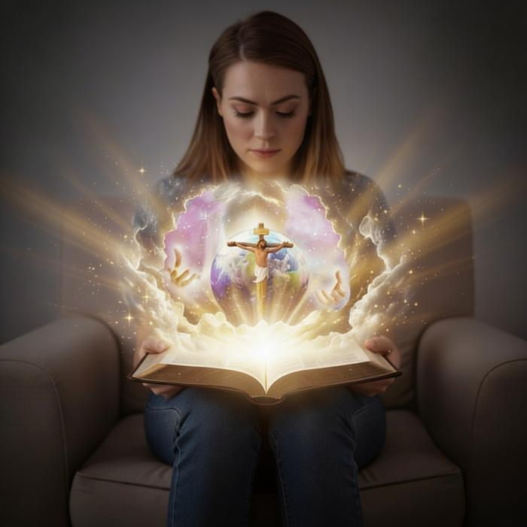
“Pathien tah khat seh Nang le nahin sol Jesu Christa ahet diu hi tuonsot hinna ahi.”
(John 17:3)

Slide 3

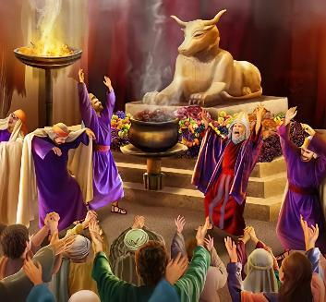

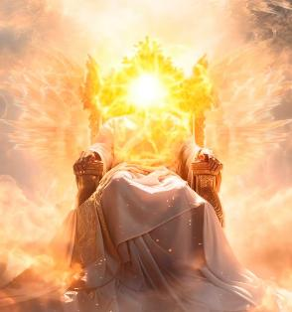

Chonsiet jal hin Pathien ahina bang tah in ihedoh thei tapo uve. Pathien hetnopna jal hin tampi’n mihiem le gamsa lim asiem un pathien ahi akiti uve. Kichat um le lunggel kikhel loi loi ahisah un, Pathien chu mihiem limpu in akisiem doh ta uve.
Hinlah Pathien chu itobang mong ahi dem? Thupi behseh jieng a mihiem te hetjoujai hilouva hin tem? Iti’n ti jong leu hen, tahbeh in vang, Pathien chu mihiem te hetthiem joujai ahipoi. Ko’n ei hetthiem sah jou diu hitan tem?
Hetthiem sah a chu ana umsa ahibouve, Pathien itobang ahi nahet mong leh! Bible a hin Pathien hina dihtah akimu’i.
Pathien hina ho.
Pathien chonchan dol:
  Pathien thiengthou tah ahi
  Pathien ngailut ahi
Pathien hetdoh theina:
  Thilsiem a kuon Pathien kimuthei
  Jesu a Pathien kimuthei (Emmanuel)

Slide 4


PATHIEN HINA HO

Slide 5


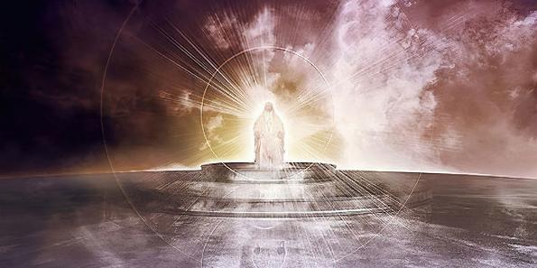

“Pakai thanei pen Pathien, nahat kibahpi aumpon; ijakai a kitah pen nahi Pakai!” (Psalm 89:8)
PATHIEN HINA HO
Bible a hin Pathien amel lom tah le ahina hetdoh theina bulhing pen akimu’i. Pathien ahina ho a kuon itobang tah ahi ding hettheina ei nei sah uve.
PATHIEN HINA PHABEP
Chondih tah (Psalm 11:7)
Hepina dim (Deuteronomy 4:31)
Thuohhat le tiilkhou kuonna (Rome 15:5)
Lungsiet kuonna (Rome 3:24)
Ngaidam jing (Psalm 86:5)
Laltouna a tou jing (Psalm 47:8)
Tuonsot a um (Genesis 21:33)
Hat chungnung (Genesis 17:1)
Muntin a um (1 John 3:20)
Khonung ding hejou kei (Isaiah 46:10)
Satan vang chun atiil abul a kuon Pathien hina dihlou tah in atahlah in, ama ding bou kigel leh chang kingailu ahi ati. (Gen. 3:4-5)

Slide 6

PATHIEN CHONCHAN DOL

Slide 7

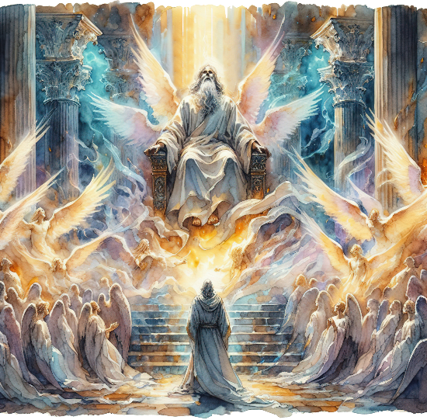
PATHIEN THIENGTHOU TAH AHI
“Ganhing ho hi akihouvun: "Athieng, athieng, athieng, kiti chu Pakai Hatchungnung pen ahin, Aloupina’n vannuoi aluo suoh tai," ati uve.” (Isa. 6:3)
Pathien kom a vantil dingle ho chun “Athieng, athieng, athieng” ti’n avahchoi uve (Isa. 6:3; Rev. 4:8). Hiche ahina hi achonchan toh kilhekhen theilou khop ahi jieh in Isaiah’n Pathien min chu “Athiengpa” ti’n asun tai (Isa. 40:25; 57:15).
Thiengthou tah chu ipi tina hin tem? Kithiensuo, kichuom koi, thiengsel tina ahi. Sietna ikikhenpi uva Pathien thusah ibol tieng u leh eiho jong thiengthou tah ihi diu ahi (Num. 15:40; Lev. 11:44; 1 Pet. 2:9).
Pathien vang chu sietna jouse toh kikhen del jieng leh chonsietna toh kiguijopna neocha jong neilou ahi.
Pathien thiengthou tah ahi jieh chun angailutna jong thiengthou tah le chang ding kigelna behlou beh ahi. Hatchungnung ahina jong thiengthou tah le chang ding kigelna behlou beh ahi. Ahina thiengthou tah ngen ahi.

Slide 8


PATHIEN NGAILUT AHI
“Chule Pathien in eiho sung a ngailutna anei hi eihon ihe uvin itahsan uve. Pathien chu ngailut ahin, ngailut sung a um mi chu Pathien sung a um ahin, chule ama sung a Pathien um a ahi.” (1 John 4:16)
Ngailutna anei leh ahopjal goh hilouvin, “Pathien CHU ngailut ahi” (1 John 4:8, 16). Thiengthou tah ahibang chun ngailutna jong Pathien ahina sunggil tah chu ahi.
Ngailutna vang a bou mihiem numei le pasal in asiem in, akingailut tuo lhon din “athupieh e” (Gen. 2:24)
Adam le Eve chonsietna alhah lhon chun ngailutna vang in aholdoh in, kinepna ape e.
(Gen. 3:9, 15)
Ngailutna vang in Abraham toh kitepna asiem in, nam tin phattheina ateppih e. (Gen. 26:4)
Ngailutna vang in achapa, Jesu Christa, eiho chonsiet jal a thi din ape e. (John 3:16)
Angailutna iti ka lethuh thei ding ham?
“Aman ei ngailut masah jieh a ei hon ingailut u ahibouve.” (1 John 4:19)
Notes:
SmartArt with large images (the four “for love”)

Slide 9

PATHIEN HETDOH THEINA

Slide 10



THILSIEM A KUON PATHIEN KIMUTHEI
“Vanmun jouse’n Pathien loupina aphuong in, Vanthamjol in jong akhutsuoh aseidoh e!” (Psalm 19:1)
Bible akipatna chun Pathien chu אֱלֹהִ֑ים (Elohim) ahi ti’n asei ngal e. Hiche thucheng chu “pathien ho” ti a ledoh thei ahivang in, Pathien khat bou seina’n akimang e. “Siemtil in Pathien hon lei le van ana siem e” tithei tobang ahi” (Gen. 1:1).
Siempa Pathien chun Thu [Jesu Christa] vang a, chuleh Lhagao panlahna jal a thilsiem jouse ahin umsah a, thanei tah a aboldoh ahi (Gen.1:1-3; Jn. 1:1-3).
Genesis bung 2 a hin Pathien ama kisah min akimu’i: יְהוָ֥ה (Yahweh). Pathien in “hung um hen” ti bou sei in akichai sah poi; mihiem chu akhut ah ala’n, asiemjol sel e. Kinaipi thei tah le kihoupi thei tah Pathien ahina atahlah e.
Akhut in ei tuh uvin, ei houpi un, ei hilthiem un, toh ding ei pe un…ei ngailu mama jieng uve.

Slide 11


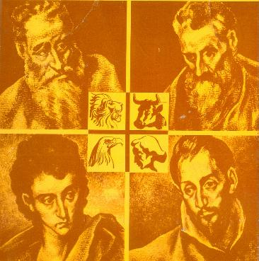
JESU A PATHIEN KIMUTHEI (EMMANUEL)
“Koiman Pathien amukha poi, Pathien hing jing khat seh chu Pa op’a beh jing pa’n bou aphuondoh ahi.” (John 1:18)
Pathien ahina hetdoh tei itup u leh Jesu ihet masah u ngai ahi. Pathien ama tah eiho lah a hung lha ahi (John 1:14). Eihon imu uva, asei ijah theina diuva mihiem hina jouse hin kivon a, mihiem mel a hung ahi (John 1:18; 14:9; 1 John 5:20).
Gaothu kisei in amin asahsa, atoh ding phuondohna min chu aneisa ahi: Emmanuel, Pathien in ei umpi uve (Isaiah 7:14; Matthew 1:23). Evangelist 4 ho hin seidan chuom chieh in ama chu ei tahlah pih uve:
Matthew
Juda mi 1 akuon Juda mite ding
Mark
Juda mi 1 akuon Gentile mite ding
Luke
Gentile mi 1 akuon Gentile mite ding
John
Juda mi 1 akuon Juda le Gentile mite ding
Athutep muolsuo Messiah chu ahi
Midang ho dia kimansa le tong jing chu ahi
Khotuona le hepina a dimset ahi
Tahsa le lhagao hinna Pepa chu ahi

Slide 12

“Sang tampi’n Pathien leh ahina hetdan dihlou tah anei un ahi… Pathien chu thudih Pathien ahi. Dihtah a thutan leh lungsietna chu Alaltouna khombul ahi. Ngailut, hepina chuleh khotuona dimset Pathien ahi.
Ahina jouse chu Achapa, ei huhhingpu’n, bulhing set in ahin tahlah tai. Lungnieng leh thuohhat tah Pathien ahi. Hitobang Pathien chu ideipenpa u ahi a, ahina joppih dia kigo jing ihi u leh, Pathien dihtah hou ihi ding u ahi.”
EGW (God Cares for Us, August 8)

