Slide 1
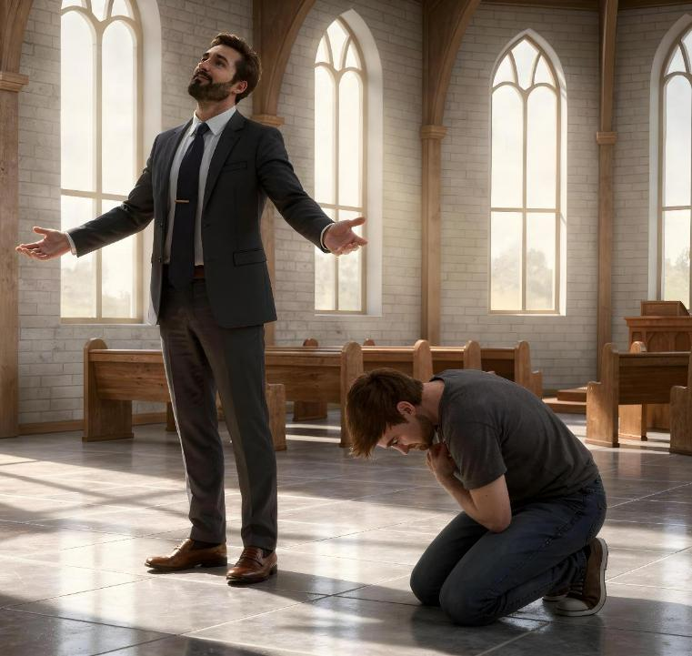
KINEOSAHNA LE KILETSAHNA
Simmun 3: April 18, 2026

Slide 2

“Ijeh in em itile mi ama le ama kichoisang chan kisuniem a, ama le ama kisuniem chan chu choisang a um ding ahi" ati.
(Luke 14:11)

Slide 3

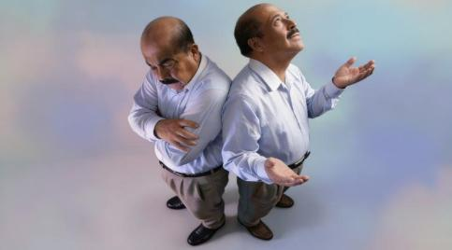
Kei a manlu pen ipi hin tem? Donbutna pieh jieng hahsa tah ahi.
Tampi sei leng (kiletsah tah in) katoh le kamuolsuo cheng keima kilamdoh kabahsah ding ahi.
Pathien in acha a ei sim kipa jal in tampi sei leng iti’n tem?
Ima seida leng (kineosah tah in) kanei le kaboldoh jouse Pathien a hung kuon ahi kapomna hiding ahi.
Janelou behseh jieh in ima seilouvin um leng iti’n tem?
Kiletsah miho
Lucifer
Jesu seijui ho
Kineosah miho
Kaidongpa
Mose
Vettondia chamkim Jesu

Slide 4


KILETSAH MIHO

Slide 5





LUCIFER
“Ijieh in em itile vannuoi leisiet a um chengse tahsaphe lung ngaichat le mit teni’n jon lunggul a amu, chule hinkho a kimoh vahchoi- hiti ho hi Pa a hung kuon ahipon, vannuoi leisiet a kuon joh ahibouve.” (1 John 2:16)
Kiletsah thudol isei tieng, kiletsahna hin nei masa le hung kuondohnapa- Lucifer- minphah tei angai e. Achan chung a lung lhailouva, achanlou ding khat deichatna’n ana dimlha tai. Choisang a aum ding adei behseh jieh in Pathien laltouna jieng jong ahin deicha tai (Isaiah 14:12-14).
Inop tah a hinkho man a, idei chan nei a, haosatna le mithanna neitheina chanvoute nei ding mihiem jouse lungdei ahi. Hichu vannuoi leisiet a kuon ahi! (1 John 2:16).
Tupsang jouse kiletsah man ahi dieh poi. Chapang khat boldoh thah khat anei jal a akitaina, mimal khat kihambol jal a lolhinna anei akipa chu kiletsah man hilou ahi.
Inei igou, thepna, boldoh le lamdoh ti ho hin manlu tah eiso jieng ahi poi. Pathien in ei boldoh pih ho gelphalouva, ama loupina petheilouva ium chu kiletsahna inei jal ahi.

Slide 6



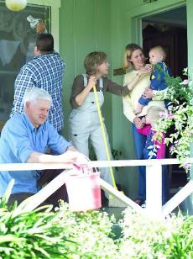

JESU SEIJUI HO
“Seijuite lah a koi alien pen a kisei ding thu a kinielna asuoh doh tai” (Luke 22:24)
Jesu toh kum 3 val ana lhakhom uve. Akeng u asil pih in, mitin dia athisan kisuo thudol asei pih chai chet ahi. Hinama jong leh, ankuong a u’m jing lai un, idang sei ding neilou bang in alien pen ding kichuna’n phaat anamang ta uve (Luke 22:24).
Lungsung kiletsahna anei jal un alien pen hi tei din akigel chieh uve. Lungput dihlou tah aken u akihetdoh thei tapo uvin, Pathien din mun akoithei tapo uve.
Jesu’n changmel in aseipih tai: “Ahile, Kei la nalah uva lhacha’n kapang in ahi” (Luke 22:27). Hichu, napupa bang a naliet nuom leh nang jong midang lhacha’n pang in atina ahi.
Kiletsahna chun midang keima lhacha a pang ding ahi (alienjo kahi jieh a) ati. Pathien lungsiet man thilpieh chun bou kineosahna lungput ei pieh thei u ahi.

Slide 7


KINEOSAH MIHO

Slide 8





KAIDONGPA
“"Kaidongpa vang chu gamla thim tah a adding in, dah a van lam jong ve ngamlouvin, adip alai akidop in, 'Pathien nei lungsiet in, keima michonse kahi bouve!' ati.” (Luke 18:13)
Pharisaipa chun Pathien hieng ah atohphat le van mitmu a athiemchanna jieng asei e. Hinla Jesu’n “ama le ama kom a tao” ahin, Pathien kom a tao ahipoi atipih e (Luke 18:11-12). Kiletsah dihtah umchan ahi.
Kaidongpa chun chonse ahi akihet in, Pathien panpina athuum e (Luke 18:13). Pathien ang a kinesah tah a akun jal in “thiem chang in inlam achesuh tai”, ajieh chu koi hi leh ama kichoi sang chu kisuniem ding, ama kisuniem chu kichoi sang ding ahi (Luke 18:14).
Kineosahna dihtah chu chonse ihi kihetdoh a, Christa panpina ingaichat tieng le bou hung umdoh thei ahi. Chutieng leh…
Midang imusit tahlou diu ahi (Phil. 2:3)
Mite pachat hi ding ingaisah tahlou diu ahi (Luke. 14:7-11)
Chang kivahchoi ibol tahlou diu ahi (Pr. 27:2)
Pathien lungsietna ikilhen joh diu ahi (James 4:6)
Pathien lungsietna ihopjal thei diu ahi (1 Peter 4:10)

Slide 9

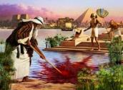






“Tahsanna jieh a Mose’n akhanlhit phat a Pharoah chanu chapa kiti ding da ahi. Chonsiet a chomkhat nopsah sang in Pathien mite toh gim hesuoh thohkhom ding akilhenjo’i.” (Hebrew 11:24-25)
MOSE
Mose chu Egypt leng Pharaoh hung hi dia jilna kipe ahi. Thusei le natohna jouse a chihgilna nei a ahi (Acts 7:22). Kum 40 alhin chun hiche loupina jouse chuomkoi a, amite joh toh thakhat a kisimtha ding akilhen jo tan ahi (Hebrew 11:24-25).
Mose chu jalenna hin lhutpa ahi! Aban thahat chun asopite achamlhat sah e! Hinla, hitobang kiletsah lungput chu anakeng hita leh Pathien in amanchah theilou hiel ding anahi.
Nelgam a kum 40 Pathien toh kinaitah a amankhom chun kineosah tah mihiem ahin suo tai (Minbu 12:3). Tuhin Pathien manchah phatah ahung hithei tan, ama khut a gamna hise asolsah in, tuipi apalkai sah in, thupieh som alahsah in, Pathien toh kimaituo a kihoupa ahung hitai…kiletsahna aneikhah jal in kineosah tah in thiemmo le gotna akisaan thei tan ahi (Minbu 20:10-12).
Kineosahna hi hung umphut thei ahipon, Pathien kom a ithuum uva, ama a kuon ineidoh thei diu ahibouve ti Mose hinkho a kuon akimu thei e.

Slide 10




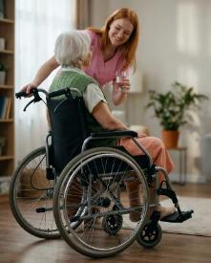

VETTON DIA CHAMKIM JESU
“Thina chan gei in achamtah in akineosah in, thingpel a thina chan gei in thu’n anung e!” (Philippi 2:8)
Vannuoi mite koiman Jesu lei a ahung masang loupina anei chu anei doh thei ngei ngei lou diu ahi. Hinla aman eiho ngailut vang in hiche loupi chu anungsun tai. Nuoinung le musit umtah ahung hi chu eiho hina, boltheina chuleh loupina chan ding chutoh tekot huoi ahipoi.
Jesu’n van loupina akikhenpi a thina akilhen joh chu ama lungsietna hethiem a, angailutna kisaan a, ama toh pumkhat hinkho ikilhen diu akinep jal ahi (Phil. 2:5-8). Tahbeh in ama eiho vetton dia kineosah chamkim tah chu ahi.
“Jesu Christa sung a cheng lungput chu nang ho sunggil a jong cheng ding ahi” (Phil. 2:5).
Jesu khonung chon utin, “moh hamhoitho le kiletsah man a imacha bollouvin, lung nem hieu cha’n khat in khat chu ama sang a phajo a gel chieh hi uvin. Koiman ama chang seh ding mai gellouvin, midang ding jong gelkhoh chieh hi uvin.” (Phil. 2:3-4).

Slide 11

1. O Pakai kalungthim pumpi’n kathangvah in, siemthu pathiente mai a navahchoi la kasai!
2. Na hou in thieng lam nga’n bohkhup ing, nalungsiet longlou le nakitahna jal, na thupieh gilje leh na thaneije na musah jal in, na min kavahchoi e!
3. Kakou ni’n nei houvin, katha na kiduosah tai!
4. Vo Pakai leisiet lengte’n nathutep ho aja ta uve, nangma vahchoi ta uvinte!
5. Nabol chengse le naloupi kidanje la asah diu ahi!
6. Lal loupe tah nahi vang in lhasamte kho natuo’n, kiletsahte na kom a akisel theipoi!
7. Gim hesuohna ka dimset vang in, nei huoidam jing in; Ka melmate lunghan na doudal in, naban thahat in nei huhhing tai!
8. Na tepsa aboncha na bolsoh ding ahi O Pakai tuonsot in na lungsiet e, Na patdohsa tohban chu suchamkim suoh tei in!
Labu 138

Slide 12

“Chang kingailut, chang kichoisang, chuleh kiletsahna a hin lhinlelna sang tah aum e; kineosahna a hin vang thahatna lien tah aum e. Chang ding bou khohsah jal in koima jana achang ji poi; hinla alungsung Pathien luodim sah a, Huhhingpu ngailutna dimset nei a, mite ngailutna nei jing a chu jana chang ji ahi.
Chonchan lhaisel leh lung a kineosah tah mi chu kipana’n abom in, chang jieng bou kisahlelpi a chu lungkimlouna, deichat thil lhangaina, chuleh lung oilouna’n alhunkhum ji e. Eima ding kigel lhom a, midang kipana ding hagel pih joh chun lhagao thahatna alhutpih ding ahi.”
EGW (Testimonies for the Church, vol. 3, p. 476)

