Slide 1

NGAILUT VANG A NATOH
Simmun 9: August 29, 2026

Slide 2

“Chule nalung phatmona ding uva hilouvin,
keiman nangho ka ngailut je u hi nahetdohna ding uva,
lung hesuoh, lungkham, chule mitlhi tamtah pum a hiche thu mama chu Kahin sut ahi”
(2 Corinth 2:4)

Slide 3









Corinth mite hieng a Paul lekhathot nina isutgil chan un Paul in houbung damthei ding akhohsah dan akimudoh be jing e.
Chonsiet dimna leisiet a Pathien nungjui dihtah hi ding hahsa tah ahi; kum jabi khat lai chun Christian kahi ti mai mai ding jong hinna chaanna thei anahi.
Paul in houbung sung le po a melma kidintepi ding je mite ahilthiem in, midang dia kipumpieh le kilungkhat ding je ahil e. Hichun “gimnam tui” hi je ei hil ui (2 Cor. 2:16).
Thuohgimna a Pathien lhamuonna
Thienthouna le natoh a kitahna
Chingthei tah a chonna
Ngaidamna le dinthah kitna
Christa gimnam tui

Slide 4


THUOHGIMNA A PATHIEN LHAMUONNA
“Aman genthei hesuoh kathuohna chan uva ei lhamuon uvin, keihon jong Pathien a kamu u hiche lungmuonna chun genthei hesuoh tuohkha jouse ka lhamuonsah thei ui.” (2 Corinth 1:4)
Corinth thot 2na hi Paul in lhamuonna thu atam seina pen ahi. Houbung phaat hahsa atuo lai ahin, alekhathot masa jal chun lungkham a aum lai tah u ahi.
Pathien Lhamuonna
Kichat asumang suoh e
Ei panpina u ei geldoh sah uve
Nat thuohlel thuohjouna tha eipe uve
Lhagao pilhinna lampi ei puilut uve
Midang huhhingna natoh ei bolsah uve
Pathien lhamuonna chun midang ei lhamuonsah uve
Ahin hiche lungkhamna chu tahsa lam dol hilouvin, lhagao mite kisihna kuon chu ahi jo’i (2 Cor. 7:10). Paul in hiche lungkhamna chun achupgam diu adei pon, lhamuonna anei teina diu joh agel ahi.
Paul ama tah jong phaat hahsa atuo a, hinna chaan thei dia aumna jong atam in, chutieng lhadah tah anahi ji e (2 Cor. 1:8-10). Ahin Pathien in lhamuonna ape ji’n, tun hiche lhamuonna chu houbung mite piehson ding ati ahi (2 Cor. 1:6).

Slide 5




THIENTHOUNA LE NATOH A KITAHNA
“Ka kisuonna u chu hiche hi ahi: vannuoi a kachon namlhah u le nangho kabolna u hi tahsaphe chihna a kabol u ahipon, lung thiengsel le lung navah pel a Pathien lungsiet jal a bol kahi u ka hetthiemna u lunggil hi hettuohsah a pang ahi.” (2 Corinth 1:12)
Kimkhat in Paul lunggel lhasam le taimo um tah ahi ati uve (2 Cor. 10:10). Hijieh hin, chuleh athusei le ahilchahna akisaan kimtheina diuvin, solchahpu hin midehho oimona chu limlomlou ahi ahilchet ngai ahi tai.
Mite lah a ima’n akigel poi (Eph. 3:8). Ahin, Pathien lungsietna achan jal chun lunggel kisuh le kichieh tah nei in akigel e (2 Cor. 1:12).
Ama le atohkhompi cheng in kisuong tah in achonchan hi thiengthou le kitah tah ahin, houbung le polang a muthei ahi ati uve.
Hijieh hin Paul thilsut jouse selguh bei le lung thiengsel jieng ahi. Athilsut jouse thienthouna le kitahna pum a asim uva, ahetthiem tei diu akineppi e. Ngailut le aphatna diu jieng gelna a kisun ahi akimudoh diu akinem e (2 Cor. 1:13-14).

Slide 6



CHINGTHEI TA A CHONNA
“Nangho ka khohsah jieh a tugei a Corinth a kahung lou hi kahinkho a ahetuoh Pathien pan a kakou ahi.” (2 Corinth 1:23)
Alekhathot masa chun Paul in Corinth mite akhuoljin lampi hopa ding mun ahetsah e (1 Cor. 16:5-11):
Ephesus
Macedonia
Corinth
Judea
Khonung alekhathot chun ( 2 Cor. 7:8) nivei jen avil ding asei pih e (2 Cor. 1:15-16):
Ephesus
Macedonia
Corinth
Judea
Corinth
Hinla alunggel akhel in, khatveina chu avohai in, niveina pa bouva avil din asei tai (2 Cor. 1:23). Hijieh hin kimkhat in lunggel detlou le taimo um tin asei ta uve. Ibol a lunggel akhel hin tem?
Corinth houbung buoina suhlhappih dia Paul ache tei angai vang in, hiche houbung mite lah a hilna pha ngainuomlouva, thudeh tinten tampi aum ding jieh chun ache ding avohai tan ahi; hichu angailutna jal ahin, kinahpi ding anoplou jieh ahi (2 Cor. 2:1-4).

Slide 7

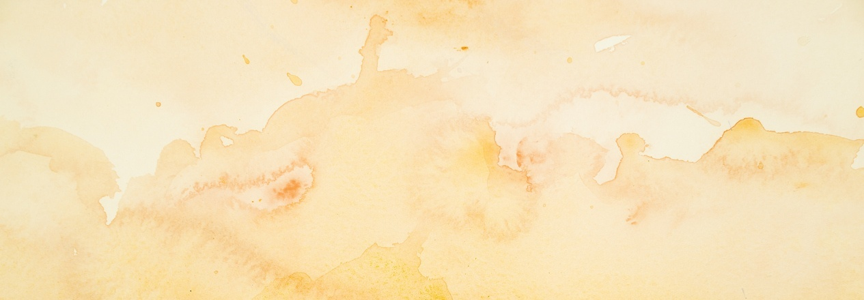



NGAIDAMNA LE DINTHAH KITNA
“Nang hon mi khattou na ngaidam u le ken jong ama chu ka ngaidam thouve, hiti a chu khattou ka ngaidam le Christa angsung a nangho jal a kabol ahi” (2 Corinth 2:10)
Paul Troas lam ajot chun Titus in Corinth lam ajon tai. Troas a kuon Paul in Macedonia lam ajon kit tai. Titus in Corinth mun a Paul akimupi tahlou phat chun Corinth houbung thudol Paul in ima het anei tapon, phamo asa lheh jieng e (2 Cor. 2:12-13).
Chomkhat jouvin Titus in Paul Macedonia ah akimupi’n, Corinth houbung in solchahpu hilchahna ginngai tah a ajui aseipih tai (2 Cor. 7:5-9, 13-16).
Corinth houbung bol ding poimo tah chu kipuigahna (discipline) lampang ahi. Solchahpu hilchahna akisaan un, amimo thiemmo chan ahitan, thiemmona akisaan ta uve. Tun aban chal ta din aseipih tai: ngaidamna le dinthah kitna ding phaat ahi tai (2 Cor. 2:5-11).

Slide 8





CHRISTA GIMNAM TUI
“Pathien kom a keiho hi Christa ding a huhhing a umsate hieng le amangthah ding ho hieng gei a jong gimnam tui kahi uvin” (2 Corinth 2:15)
Troas mun a gospel loupi tah a akiphuon theina dia Pathien in “kot ahon pih” thudol asei chun Paul apengjah jieng in: “Christa hinkho a galjona a ei kijotkhompi jing uva, keiho mangcha a Christa hetdohna le phuondohna chu muntin a gimnam tui bang a eithe chansuoh uva Pathien chu thangvah in um jing hen” ati tai (2 Cor. 2:14).
Muntin chansuoh gimnam tui bang in Christa thupha hetna jong mitin lungsung achang tai. Corinth mite din hiche gimnam tui hi tuonsot hinna’n apang tai. Kouna nungsun ho din vang thina gimnam in apang tai (2 Cor. 2:15-16).
Hiche gimnam tui nei jouse’n mopuohna sang pen achal u Paul in asei in, chang ding gellouva, kitah tah a huhhingna thu aseiphuong diu je asei e (2 Cor. 2:17).

Slide 9

“Thupole a pang kitah tah chun Corinth houbung a kikhelna loupi tah alhun aseipih tan, hichu ngainop um tah thulhut chu ahi tai. Mi tampi’n Corinth houbung lekhathot a kisun Paul phosalna chu akisaan un, akhielna u akisihpi ta uvin ahi. Hite hinkho chu Christiante jumna’n apang ta pon, thiennna hinkho man ding kisinsahna a kihilna phatah in apang jo tan ahi. […]
Pathien lungsietna’n lungsung alodim tieng chonsiet kisihna le chonsiet nungsunna aum ji’n ahi. Hitobang tah chun Corinth mite chung a ga pha lhung muthei a aum solchahpu’n asei e.
EGW (The Acts of the Apostles, pp. 324)

