Slide 1
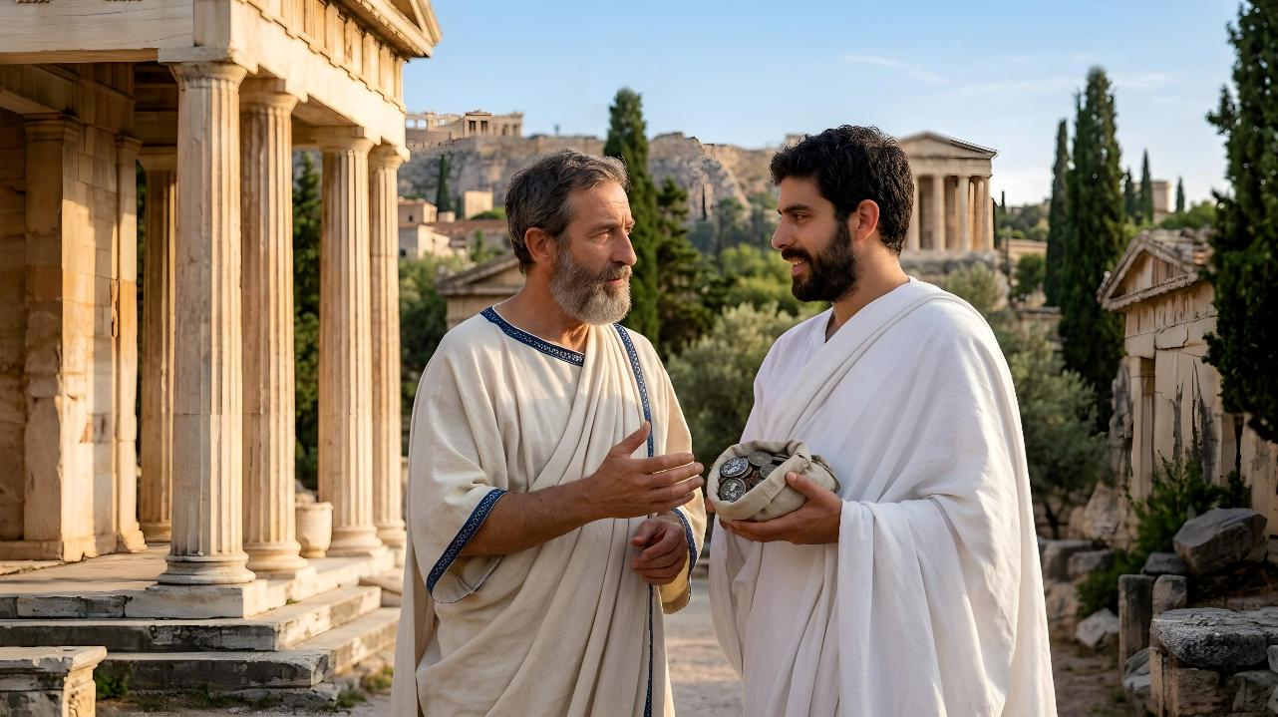
GOUCHIN LE
PATHIEN NATOH
Simmun 11: September 12, 2026

Slide 2
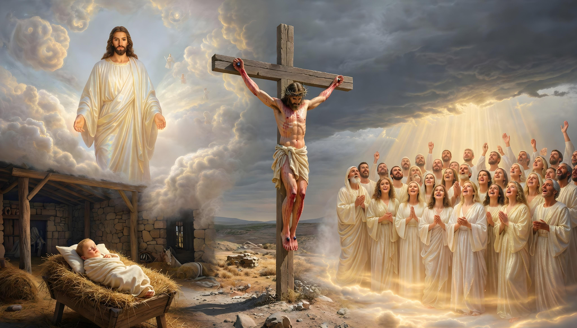
“Ajieh chu ama vaichat vang a nangho nahaodoh theina ding uva, ahao nasa a nangho jal a vaicha jieng a, hiche Pakai Jesu Christa lungsiet chu nanghon nahe uve.” (2 Corinth 8:9)

Slide 3

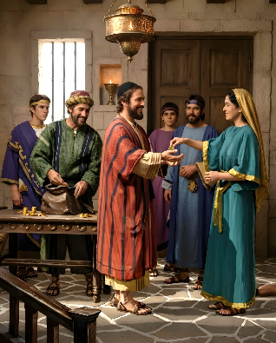
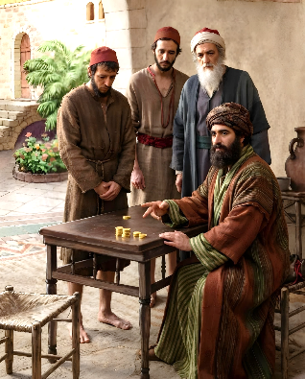



Khat vetkol ding a kiselhah pih le mopuohna kipe chu ama dia gouchin kiti ahi.
Corinth mite heng a Paul lekhathot nina a chun gouchin kiti hi solchahpu natoh kichieh tah kipe chu ahi tin atahlang e: hiche phaat lai chun hahsatna tampi thuoh Jerusalem houbung chu Gentile houbung mite’n nei adonpih un, akithopi uve.
Corinth mite chu midang kithopi ding kimansa ahi jing uvin, amaho dia anatoh a vetsahna ding phaat kilem tah chu ahi. Macedonia houbung in jong pan ahin la pan tan ahi. Aneidon u tam le lhom Paul in thupi asapon, thanop akipieh uva kiphal tah a ahin choikhom uva, lungsiet achan u apiehson je ahet u chu thupi asa’i.
Gouchin kipatna:
  Jesu a kuon kihilna
  Lungsietna chang ho kipiehdohna
Gouchin je dan:
  Tohguon phatah siem ding
  Lungput dih nei ding
Gouchin gapha:
  Houbung kipumkhatna

Slide 4

GOUCHIN KIPATNA

Slide 5


JESU A KUON KIHILNA
Hao tah ahin, eiho ding jal in vaicha tah ahung hi tai (2 Corinth 8:9)
Vanmun adalha’n, eiho chenkhompi din leisiet ahung tai
Van le lei thilsiem jouse vaihompa ahina achuomkoi in, leisiet a thingthiembol mi hi ding ahin kilhen jo tai
Bitna mun hin dalha’n, melma gam a cheng din ahung tai
Leng lallukhuh sang in ling lukhuh ahin kilhen jo tai
“I-Pakai u Jesu Christa lungsietna chu nahe uve; haotah ahin, avaichatna chu nangho’n nahaolona diuvin nangho jal in ama tah vaicha’n ahung um doh tai.”
(2 Corinth 8:9)
Pathien lungsietna le hongphalna iti kikhe’m? (2 Cor. 8:1-2)
Pathien in Macedonia houbung alungsietna ape’n, hichu amahon “ahaolopi” ta uve (2 Corinth 8:2). Amaho le eiho din jong Jesu lungsietna ichan u haona’n apang tai.
Hichu aman ngailutna jal bouva abol ahi! (John 15:13; Ephesia 5:2; Galatia 2:20; 1 John 3:16).
Jesu lungsietna iti ilethuh thei ding u ham? “Manbei a nachan u ahin, manbei in homjal un” (Mt. 10:8).

Slide 6

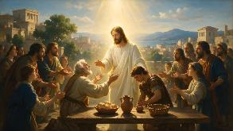
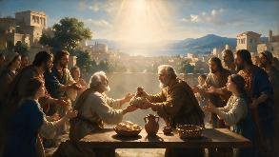
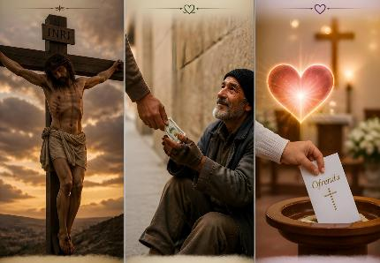
LUNGSIETNA CHANG HO KIPIEHDOHNA
“Hiche hi ka ginchat kalval u ahitan, amasan amaho tah Pakai ah akiphaldoh uvin, chu in Pathien dei bang in keiho hieng ah akipedoh jieng ui.” (2 Corinth 8:5)
Macedonia mite kipiehdohna vetiem ute:
Jesu lungsietna akisan un ahi (2 Cor. 8:9)
Jesu hieng a akipedoh jieng un ahi (2 Cor. 8:5)
Thilpha boljouna phatthei achan diu angeh ui (2 Cor. 8:4)
Vaicha tah ahivang un ajo chan in thilpha abol uve (2 Cor. 8:2-3)
Jildoh thei ipi inei um?
Pathien lungsietna ichan kipa ding (2 Cor. 9:15)
Jesu’n eiho din aneisun ape tai; ama a kipah chun abon a alepieh nuom ding ahi.
Pathien phattheina midang jong chansah ding (2 Cor. 9:11a)
Pathien a kuon amu midang piehson ding thanopna anei ding ahi.
Ngailutna dihtah
(2 Corinth 8:24)
Hongphalna chun lungsung a ngailutna vei aphochien e.

Slide 7

GOUCHIN JE DAN

Slide 8

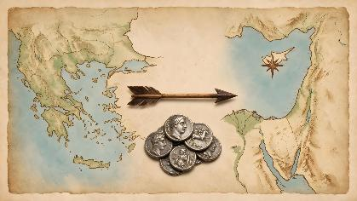
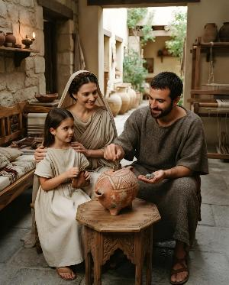
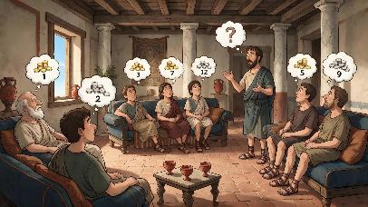
TOHGUON PHATAH SIEM DING
“Kisih pum le piehlou khoh man hilouvin, mitin in alungdei bang chieh a apieh ding ahi; ijieh in em itile lunglhai sel a pe a chu Pathien in angailu’i.” (2 Corinth 9:7)
Paul chun Corinth gamkai kibahpi a um Macedonia le Achaia houbung mite’n Jerusalem houbung kithopina a nei adonkhom u hin lahpa ding ati anahi (Rom. 15:26).
MACEDONIA
Corinth
ACHAIA
Jerusalem
Hiche thu chu kum khat masang chun Colossa khopi a thanuom tah in ana seilha uve (2 Cor. 9:1-2). Khat chieh in lungsung a bidoi kisiem in, apieh ding jat akigellha ta uve (2 Cor. 9:7a).
Nei donkhom ding chu amimal insung in agelkhom uva, ajo kham kham kiphal tah a ahin choikhom ding u ahi.
Hiche thudol a hin Paul in khat vei se a selhing ding ati pon; hapta sieh leh themcha cha a akoitup uva, abidoi alhin kah a abol diuvin ahil e (1 Cor. 16:2). Hiti chun Paul hung vailhun tieng neidonkhom jat baitah le kipah tah a alah thei ding ati ahi (2 Cor. 9:3-5).

Slide 9

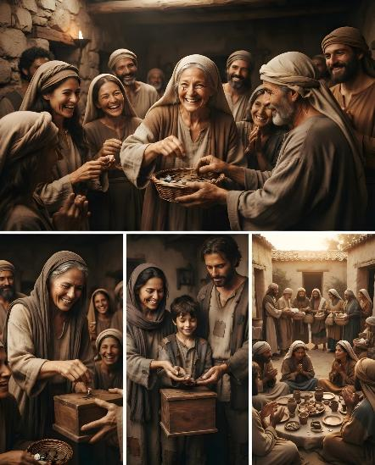
LUNGPUT DIH NEI DING
“Hetuoh a kasei ahi, atha uvin ajo chan, akalval gei in jong, ape uvin, acham tah uvin ape uve” (2 Corinth 8:3)
Colossa houbung mite kiphal dan pachatna’n Paul in Macedonia houbung vetjui thei tah ahina u asei e. Hiche houbung a sopite hi lungput dih tah a akiphal ahi uvin; hiti hin akipedoh ji uve…
Kipah tah in
(2 Cor. 8:2a)
Pe thei a aum u akipah uve
Kiphal tah in (2 Cor. 8:2b)
Achagat u apaomepi po uve
Thanuom tah in
(2 Cor. 8:3)
Mimal kiphalna
Chanvou pha chang a kingaituo’n (2 Cor. 8:4)
Hichun Pathien le ahoubung angailut u atahlah e
Thienna hinkho a ngaituo’n
(2 Cor. 8:5)
Pathien angailut un mite ngailutna aneisah e

Slide 10

GOUCHIN GAPHA

Slide 11

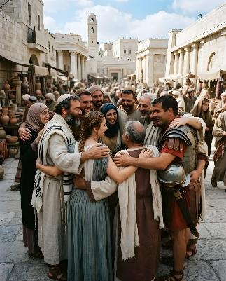
HOUBUNG KIPUMKHATNA
“Ipi jieh in em itile hiche lhacha kinbolna hin mithiengte ngaichat atuo keo jong ahipon, mi tamtah a kuon a Pathien thangvahna avumval a umdoh lo ahitai.” (2 Corinth 9:12)
Jerusalem houbung nei adonkhompih jal un gapha tah tah asuobe’i (2 Cor. 9:12).
Juda mi houbungte
Gospel thupa atheljalle uve
Gentile mi houbungte
Anei jouse uvin thilpha abol ui
Juda le Gentile houbung mite kah a kithokhom le kiguolchatna lungthim apung cheh cheh jieng tai (Rom. 15:26-27). Hiti chun solchahpu lungtup- houbung kipumkhatna- bulhit in aumthei tai.
Nei adonkhom dan un tukhang eiho din jildoh thei tah khat aumsah kit e: thil kibol jouse abih abih a bol ding, chop letlut a bollou ding ahi.
Houbung khat
General Conference
Conference/Mission/
Union
Division
Paul in hiche nei kidongkhom ho vesui din Titus anganse’n, mimal houbung in alah uva khat Titus kihoumatpi din anganse kit e (2 Cor. 8:16-24). Jerusalem houbung thotdoh theina dia panlah dan hiche kallhah um ta ponte.

Slide 12

“Pathien natoh hi hopsom, kipa thilpieh chuleh kiphalna dang dang ho jal a tohdoh a um thei ahi. Pathien in phattheina mite achan a, gou achinsah ho chun tun ama kin a amanchah diuvin angeh e. […]
Aman anungjuite abolpih kalval amite’n abol diuvin angeh poi. Pathien lam kat jal a chang ding gellouva, kipiehdohna nei jing te chu Pathien khonung a che te ahi uve. Aleng sangkhol le alallukhuh achuomkoi in, thuneina mun ahin kikhenpi tai. Eihon tuonsot gou iluotheina diuvin vaichat akisaan in, vaicha tah in ahung tai. Chang ding kigellouvin, kiphalthiengna dihtah anei jal in ahaona jouse apampai in, ahinna gei in akikhenpi tai; hijieh chun Pathien lenggam lut nuom jouse din alamting bei a vangam lut theina kot ahong tai.
[…] Pakai Jesu’n ama toh tongkhom din ei tiem uve. Inei jouse’u chung a anei dihtah le thanei dihtah ama bou ahi. Anatoh kithopi dia nopna inei thei u chu ama ingailut u ivetsahna u ahung hi tai.
EGW (The Upward Look, April 9)

