Slide 1
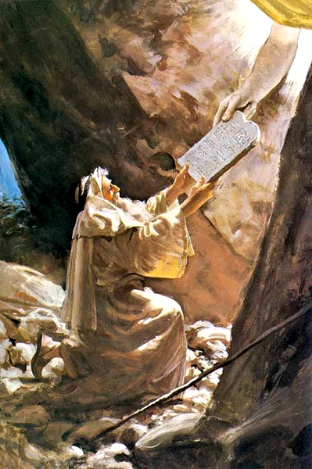
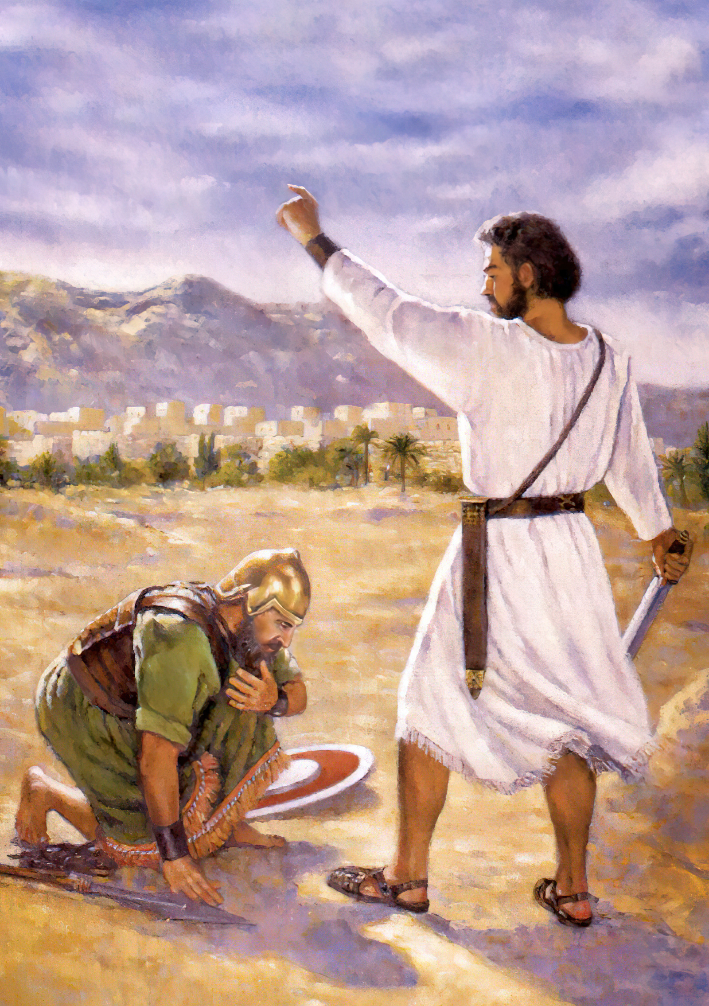
Mose
Leh
Joshua

Slide 2
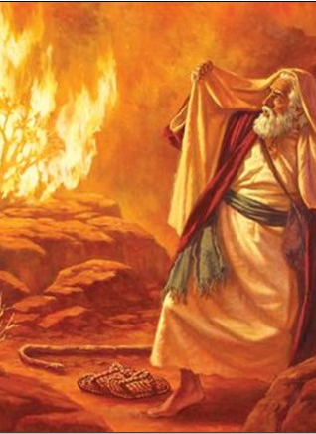
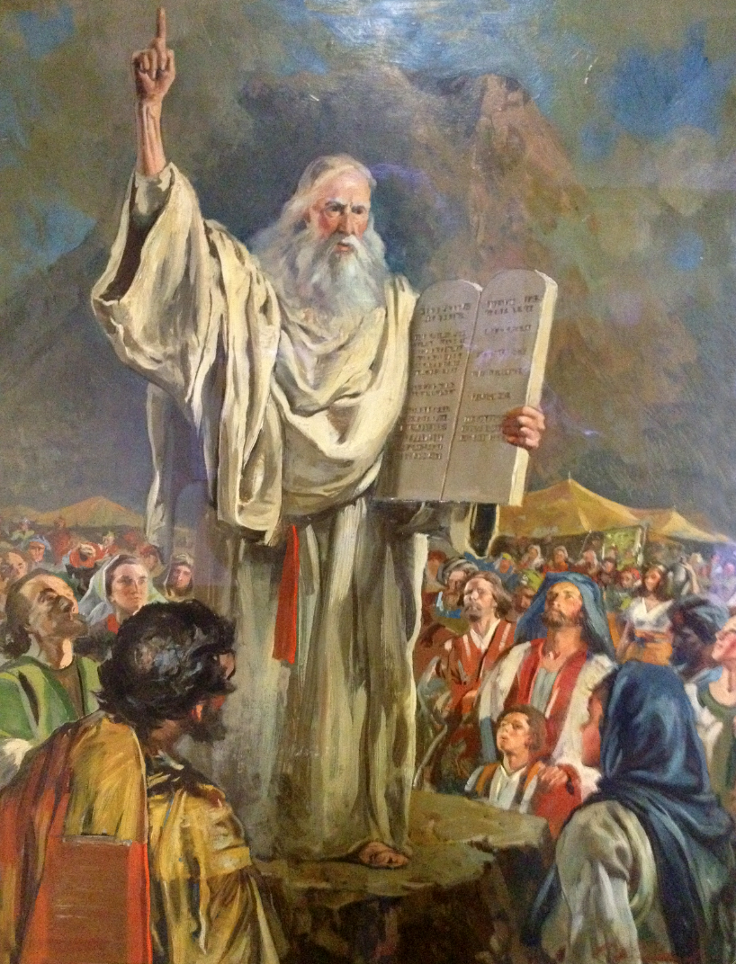
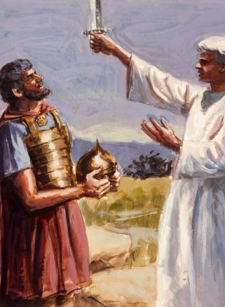
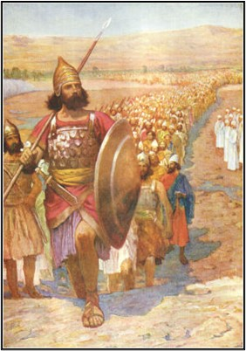
Pathien in amite puihuoi din Mose leh Joshua khang kijom leh phaat hahsa lai tah chun analheng doh gel lhon e.
Pathien in amanchah lhon dan kibahna tampi akimu thei e. Hiche kibahnaho a chun eiho hinkho a Pathien natoh je jong muthei ahí.

Slide 3

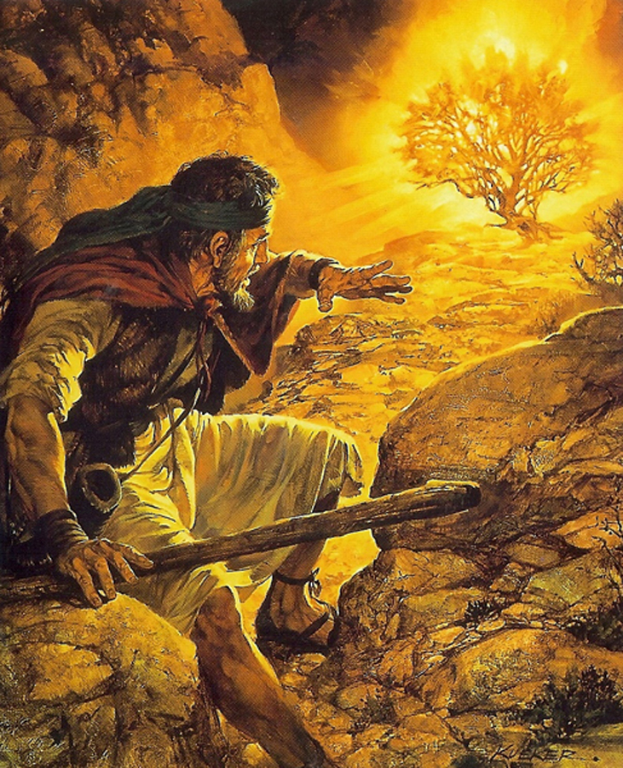

Akom Lhon ah Pathien Akilah Gel E.
Joshua heng ah chemjam dodohsa gal lamkai mel in ahung kilah e.
Joshua 5:13-14
Pakai hamboh lah a meikouvin ahung kilah in Mose akou e. (Exo 3:2)

Slide 4
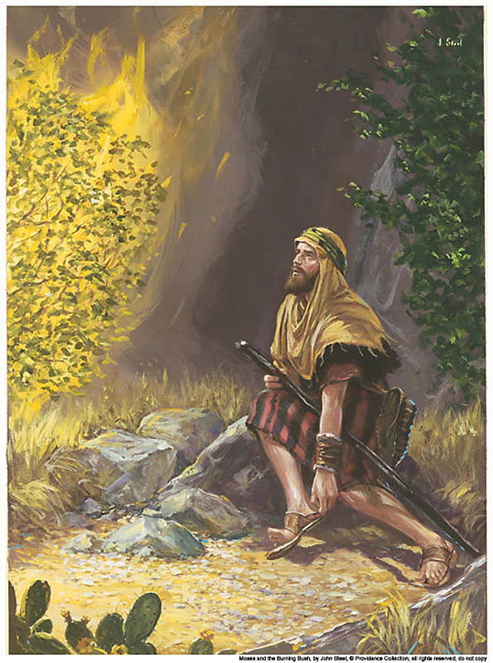
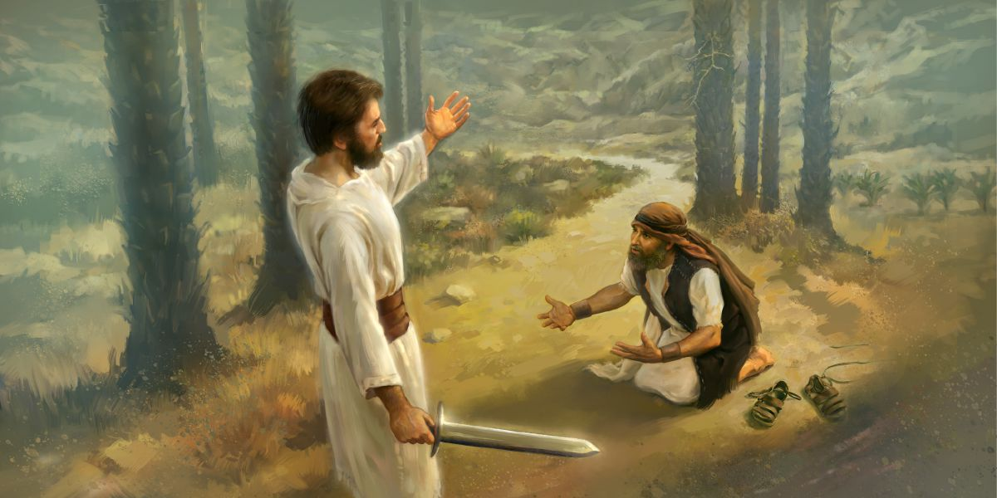
Mose'n anailut Pakai in amu phat in, hamboh lah a kuon chun "Mose! Mose!" tin ahin kouve. Mose'n, "Hoi, ka um nai" ati. Pathien in, "Hin nailutbe tahih in. Nakengchot kisut in, munthieng a ding nahi tai. (Exo 3:4-5)
Hichun Pakai sepaite lamkaipu’n, "Kengchot sutlha’n, nadinna chu munthieng ahi" ati. Aseipih bang in Joshua’n abol tai.
(Joshua 5:15)
Ani gel lhon in kengchot sutlha din athupieh e, ajieh chu adinna lhon mun chu munthieng ahi.

Slide 5
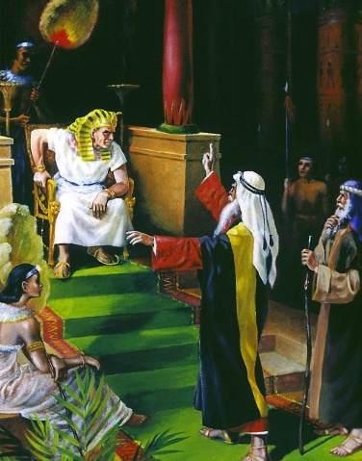
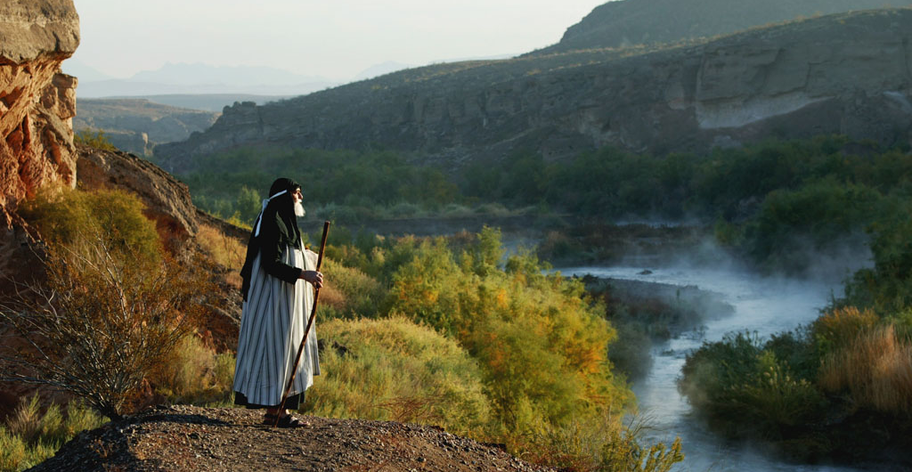
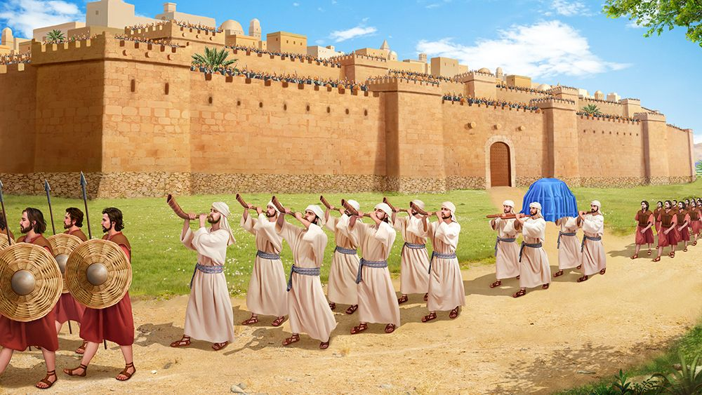
Joshua jong Natoh ape’n ahi:
Pakai in Joshua kom a, "Jericho khopi le alengpa chule asepai galhang tah tah jouse nakhut ah kape tai. Nigup sung a nang le nasepaite, nisieh le khatvei vei khopi kimvel a nakijot diu ahi. Sumkon choi cheh, Thiempu sagi Kitepna thingkong masang a che diu ahi. Ni sagi lhin ni le nangle sepaite khopi kimvel a vel sagi vei nakijot uva, Thiempu hon sumkon amut chieh diu ahi. (Joshua 6:2-4)
Sumkon ging lhum jen jen a amut teng u, pasal jouse’n na-ao chieh diu, chutah le khopi pal jouse chimsuoh ding ahitai. Chutah le sepai jouse khopi sung a nakitol lut jeng diu ahi" ati. (Joshua 6:5)
Amuolsuo Lhon Ding Natoh Akipe Gel Lhon E.
Mose Natoh Ape’n ahi:
“Agamsunga kona kamite puidoh dia Egypt lengpa koma kasol nahi" ati. (Exo 3:10)

Slide 6

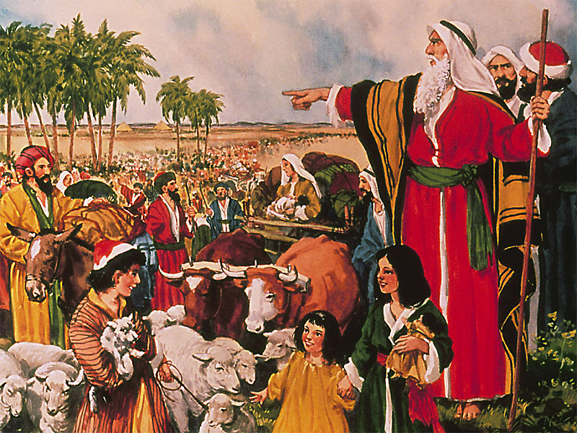
Pathien in Alhonpi Ding Ateppih Gel Lhon E.
Vo Joshua, nahinkho lhumkei a koiman najotho lou hiel ding ahi. Mose kalhonpi bang a kalhonpi jing ding nahi. Umpi jing ing ting, dalha po’ng e. (Jos 1:5)
Pathien in, "Ken nalhonpi na’ng e, Egypt a kuon a Israelte nahin puidoh teng hiche muolsang chung a hi nei hou diu…” ati.
(Exo 3:12)

Slide 7
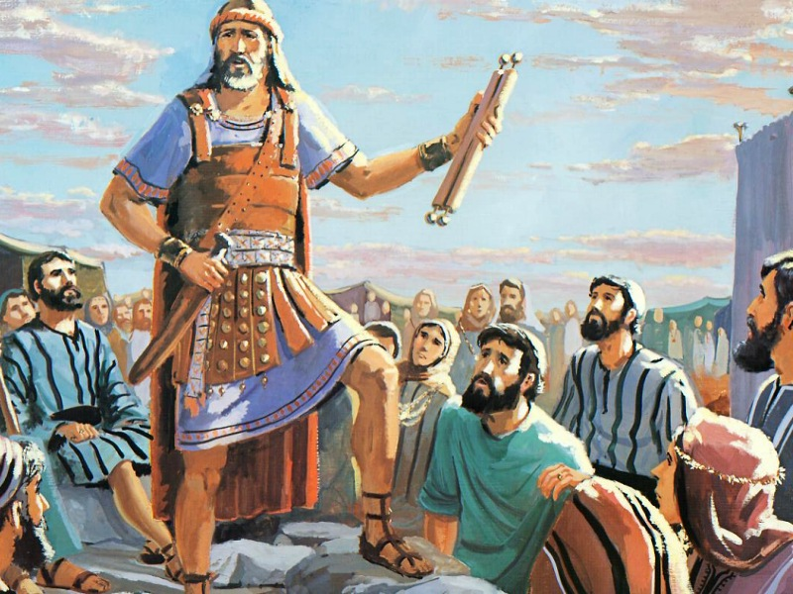
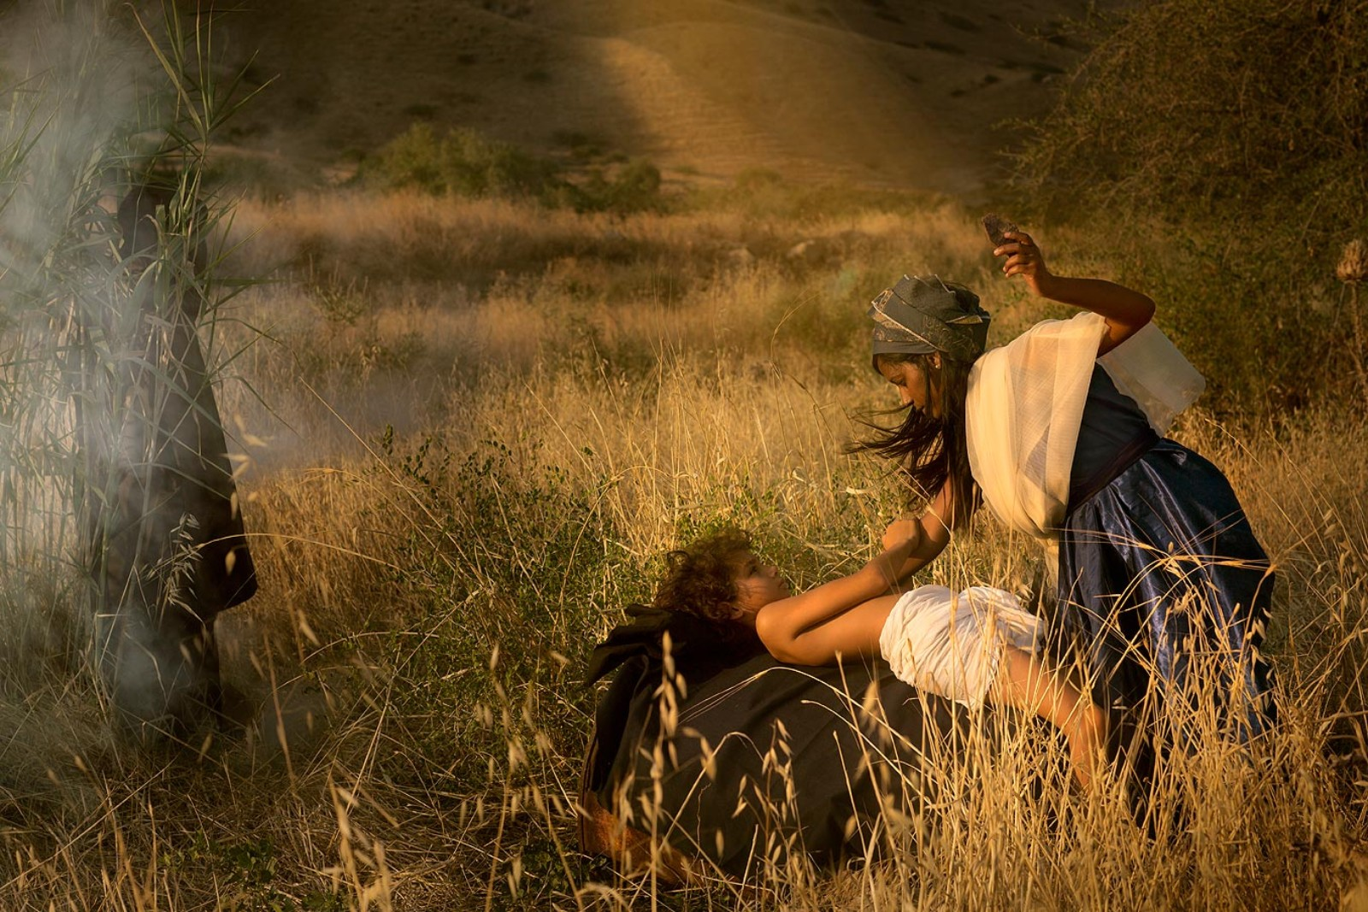
Pathien toh Kitepna Anei Melchihna din Cheptan Ding Athupieh Gel Lhon E.
Lampi a gebuh khat a Pakai in Mose akimupi’n tha din ago tai. Mose jinu Zipporah chun suonghiem khat in achapa chep atan in, Mose kengphang a aloi in, "Cheptan chonchan dungjui a ji a kanei nahi" ati. (Exo 4:24-25)
Pakai in Joshua jah a, "Meituh suonghiem la’n, Israelte chep tanpih in" ati. Pakai thupieh bang in Joshua’n abol in, cheptanna lhang kiti lai a chun Israelte chep atanpih e. (Jos 5:2-3)

Slide 8
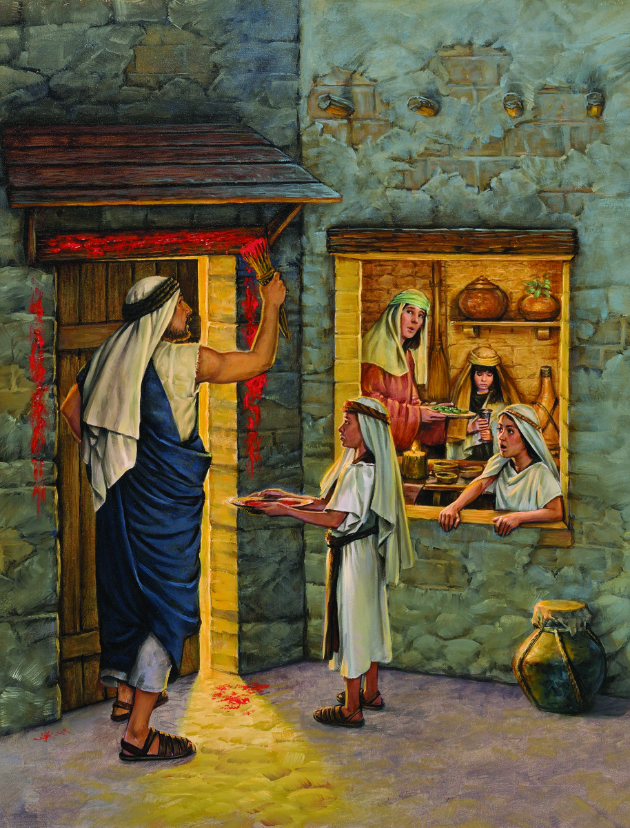
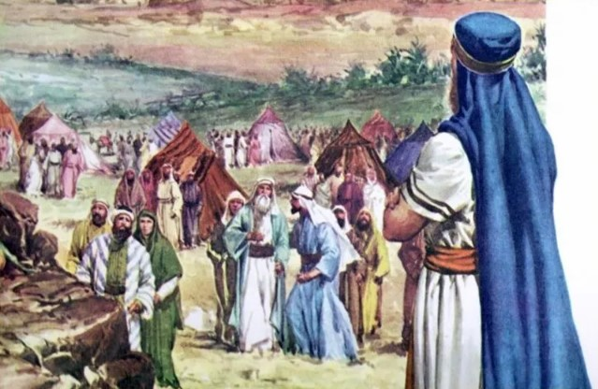
Kalchuh Kut Anit Gel Lhon E.
Jericho kom phaicham, Gilgal mun a, Israelte ki-ngah pet chun, chuche lha nisom le ni li ni’n, nilhah lam in, kalchuh kut amang uve.
(Jos 5:10)
Mose'n Israel lamkaite akou suohkei in ajah-uva, "Kalchuh Kut bolna dia na inkoko uva kelngoi ham, kelguol ham nakitha chieh diu ahi. Nagantha u thisan chu hyssop puon in de uvin lang, kotpi khom le inkam jol ah loisan suohkei un. Jingkah masang a koiman insung nakhokal theilou diu ahi. Egyptte sugam dia Pakai in Egypt gamsung achot teng, kot khom dung le inkam dung a thisan kiloi mu’ntin, mi sugam Vantil na insung uva alutsah da a, nahinghoi diu ahi. (Exo 12:21-23)

Slide 9
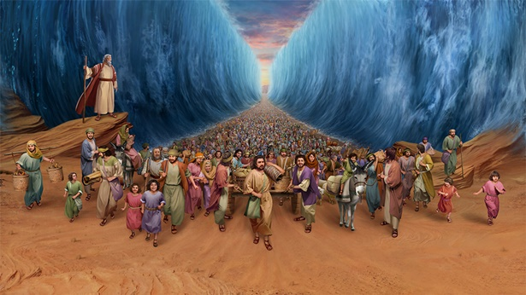
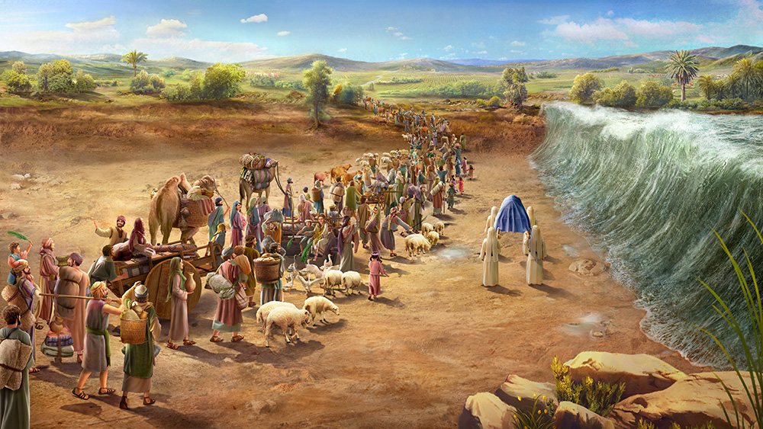
Tuipi leh Vadung Tolgo Pal in Apal Galkai Gel Lhon E
Mose'n Twikhanglien chung a akhut ajah le, Pakai in Twikhanglien chu niso lam khohui asemkhensah in akiting kih tai. Hui anung khovah hiel in, Twikhanglien lailung tolgo asuoh tai. Twipi akihom khen in, Israelten ajet avei…tolgo’n ajotdoh ta uve. (Exo 14:21-22)
Thiempu hon vadung lai achot lut lut uvin, twiluon ban atang in, vadung nahlam, Zarethan khopi kom, Adam mun a chun akidil den tai. Twimang lam a luongsuh twi jouse jong akangtai, mipi Jericho khopi kom cha chun agalkai theita uve. Mipi tolgo lah a akitol uva, agalkaisuoh hiel kahse uvin Pakai kitepna thingkong pu a Thiempuho Jordan lailung, tolgo lah a ading ding jeng ui. (Jos 3:15-17)

Slide 10
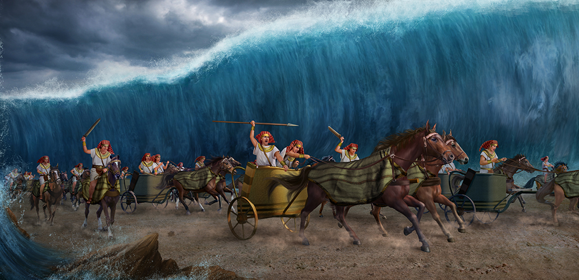
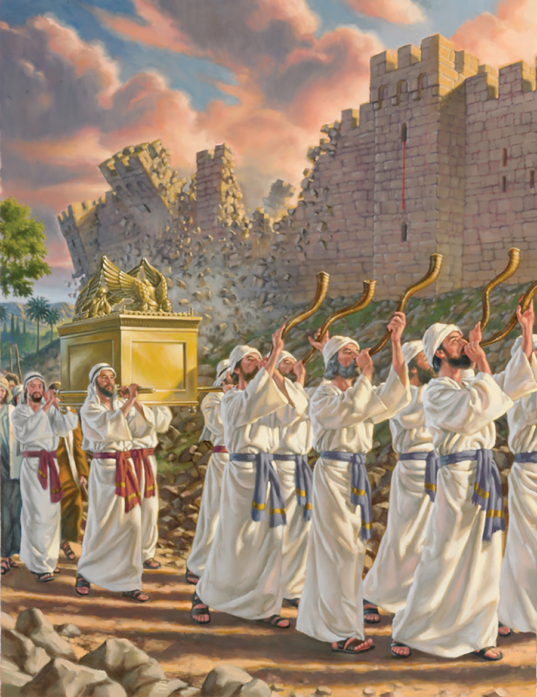
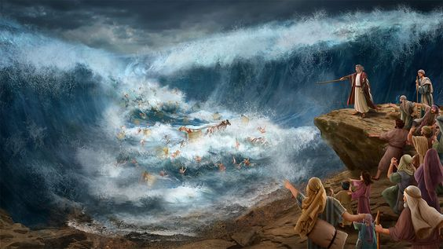
Bolmo Kidang Bol Pathien
Athilbol loupi tah tah ihekhen po uvin, Thil kidang abol simjou ahita poi. (Job 5:9)
Mose'n, "Kicha hih un, pangdet un, nahuhhingna diuva Pakai in ipi abol tuni a namu diu ahi. Hiche Egypt mite hi namu kitlou hiel diu ahí” ati
(Exo 14:13)
Joshua’n mipi jah a, "Jing teng nalah uva Pakai in thil kidang abol ding ahi, kisuthieng uvin," ati.
(Joshua 3:5)

Slide 11
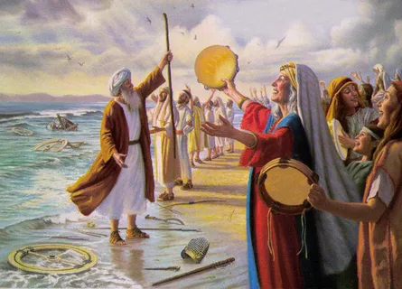
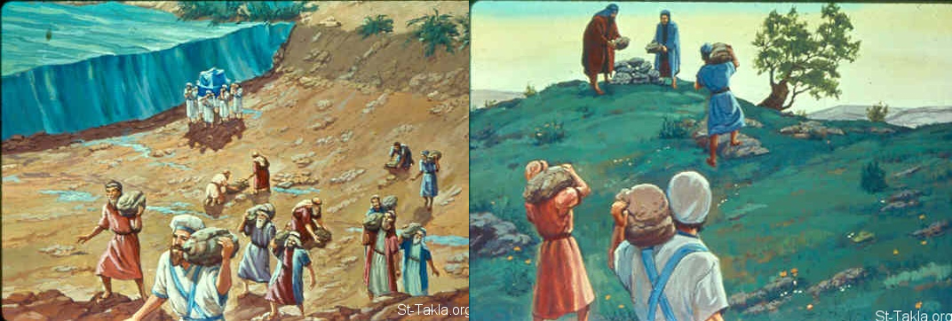
Hetjingna Din La Sah leh Suongphuna Abol Gel Un Ahi.
Mose le Israelten Pakai vahchoina’n hiche la hi asa uve: "Pakai vahchoi la sa’ng e, Aman gal ajou tai! Sakolte le achung a toute Twikhanglien lailung ah alehlut tai. Kakulpi det pen Pakai ahin, Eihuhhing a Ama ahi. Ka Pathen ahi vahchoi ing e, Kapa Pathen loupi je sachoi le’ng e! (Exo 15:1-2)
Hiche suong ho hin Pakai thilbol chu mipi ageldohsah jing ding ahi. Khonung teng hiche suong ho ipi dia kitung ahi nachate uvin adoh teng, Pakai kitepna thingkong Jordan galkai pet a luidung twiluon akan jeng chu naseipih diu ahi. (Jos 4:6)
Hikom a thilsuoh jouse chu hiche suong ho hin Israelte ageldohsah jing ding ahi," ati. (Joshua 4:7)

Slide 12
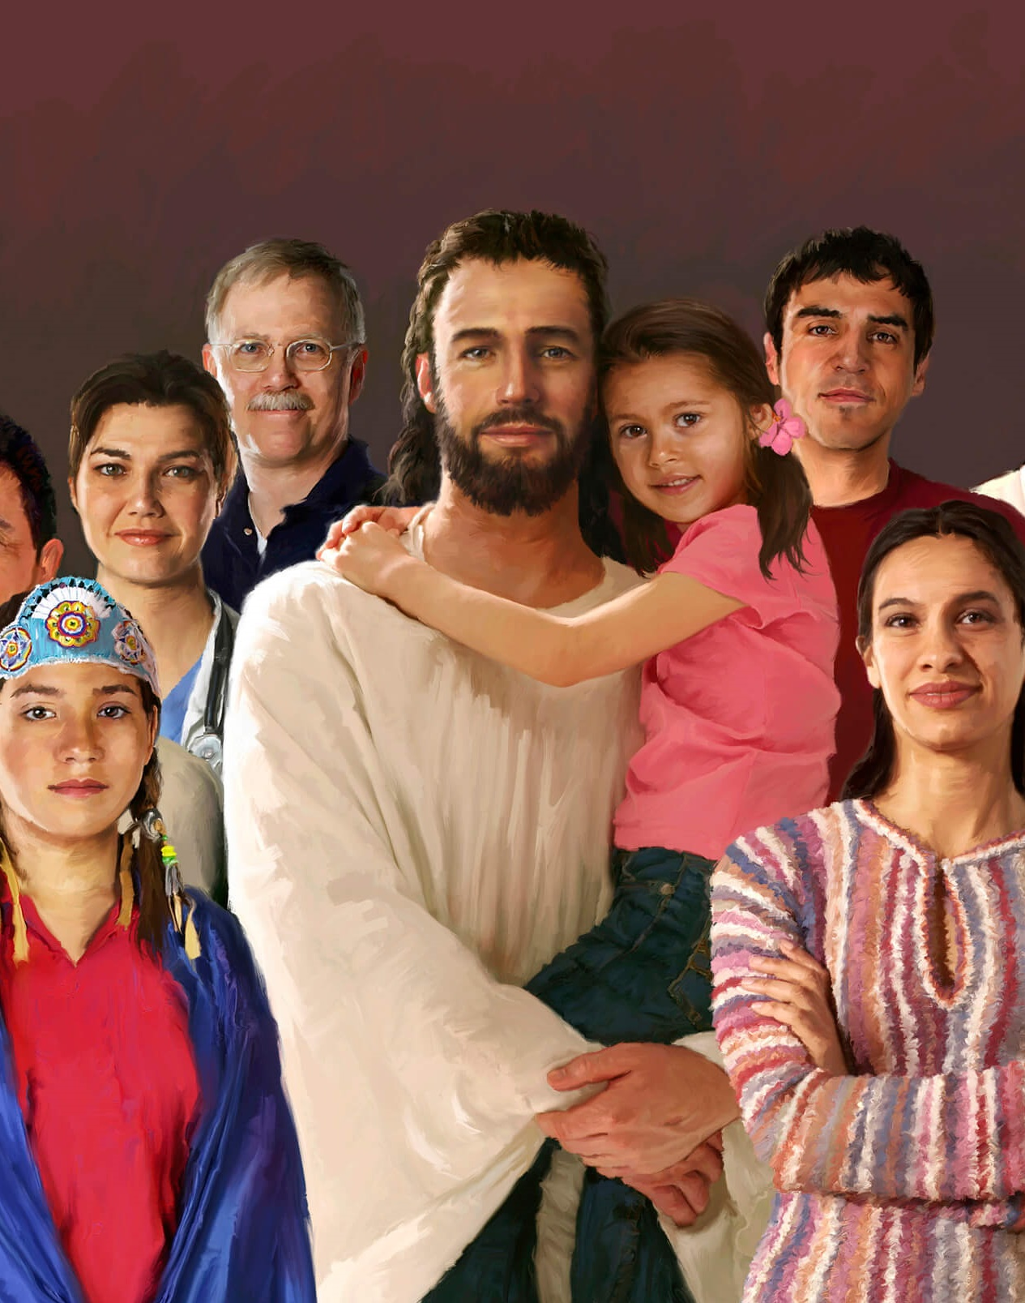









PATHIEN IN EIHO ITI EI TOHSAH JI UM?
Mimal ngaichat bang tah in Pathien ahung kilah ji e (Vetsahna’n, Joshua galsat ache kuon chun gallamkai mel in Jesu ahung kilah e)
Athien je, Ahina ei tahlangpih ji uve
Toh muolsuo ding khat eipe ji uve
Alhonpi jing ding ei teppih ji uve
Lungthim chep itan diu ei thupieh uve
Jesu eiho dia akipiehdoh ikisan thei uve
Tahsanna’n malam ino thei uve
Pathien in bolmo kidang eibolpih ji uve
Ama vahchoina’n idim ji ta uve

Slide 13
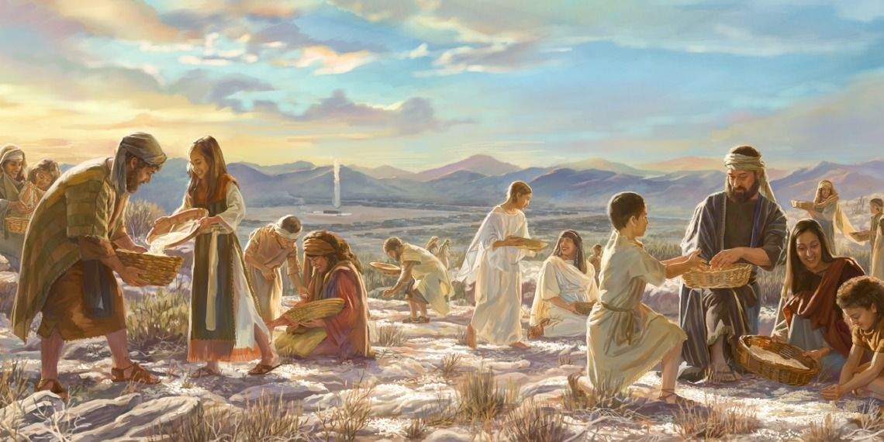
Pakai in Mose jah a, "Naboncha uva dia van a kuon a neh le chah goju kabahsah ding ahi. Nisieh le nehkhop bep ding agakilo khol diu ahi. Kahil ajui ajui louvu photchetna hiti a hi kabol ding ahi. Nigup lhin ni le nidang a akilokhom jat u ajat ni akilo diu ahi" ati.
(Exo 16:4-5)
Aneh u chu Israelten Manna asah ui. Muchi kang tobang ahin, khoiju to kisiemtha changlhah tui in atui e. (Exo 16:31)
Ajing nikho’n Canaan gamsuoh an ane masapen ui: chang kanpoh le cholsolou changlhah ahi. Hiche nikho a pat Manna ahung lha tapoi, Israelten Manna aneitapo uve. Hiche a pat hin Canaan gamsuoh an bou aneta uve. (Jos 5:11-12)
Van An Manna Akipe Gel Un Ahi

Slide 14
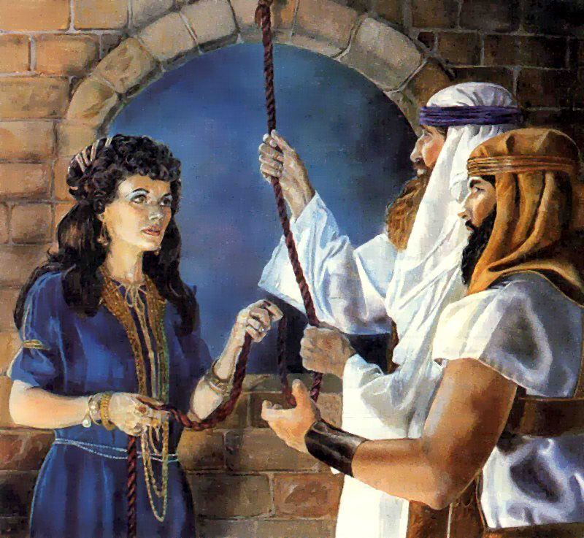

Pakai in Mose jah a, "Israelte kapieh got Canaan gam velhi din phung som le ni a lamkai khat chieh sol in" ati. Pakai thupieh bang in Paran gamthip nuoi a pat, Mose'n Israelte lamkai som le ni asol tai. (Number 13:1-3)
Thinggi ngahmun a kuon in Joshua’n Canaan gam khuol ding le Jericho khopi velhi din mini asol e. Jericho khopi a ahung lhon phat in numei noti Rahab inn a ajan geh lhon e. (Jos 2:1)
Gamvelhi Kisol Masa Gel

Slide 15
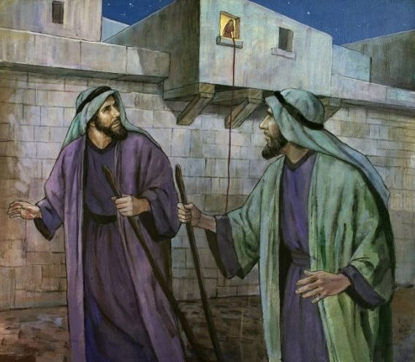
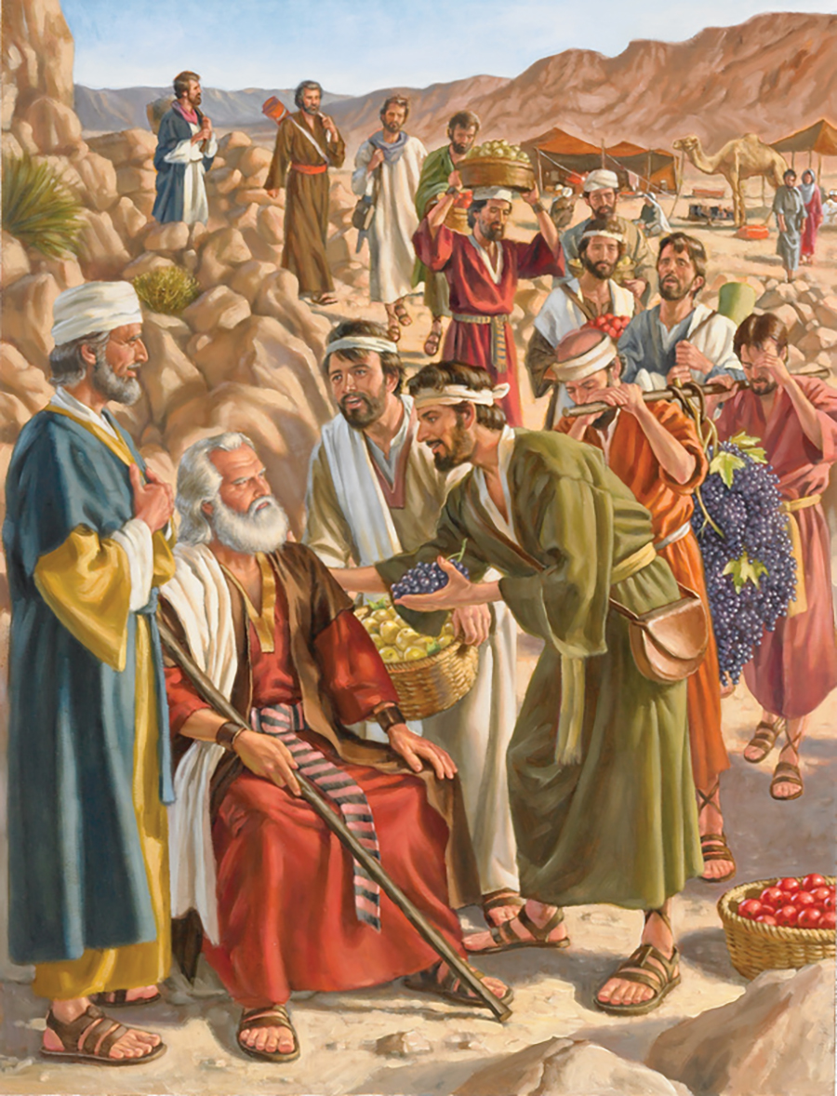
Gamve hon Mose jah a, "Gamsung kagakhuol un, gampha le leipha tah ahi; agamga jong hiche hohi ahi. Gamsung miho vang ahat thei un, khopi lien tah tah anei un, phatah a kulpi kaikhumsa jeng ah acheng uve. Tijat um cheh in, gamsung a chun milen, gin umtah tah Anak chilhahte kamudoh ui. Gamsung lhang lam se se ah Amalekte acheng un, thinglhang gamsung a Hit miho le Jebus mite, chule Amor mite achengui; Canaan mite vang Mediterranea twikhanglien pang dung le Jordan vadung pang a acheng uve," atiuvin ahi. (Num 13:27-29)
Mose henga kiphinho chu Caleb in aphoh thip in, "Tutah a gamsung chu delkhum a lah jeng ding ahi; jona khamset tha inei na uve," ati. Ahivang in Caleb to lhon hon, "Khuche gamsung mite sat jou dan ihi naisai po uve; eiho sang a gamcheng a hatjo ahibouvui," ati uve. Hiti hin agamvet u chu dih lou tah in Israelte kom a thu athethaang suoh ta uve. Amahon "Agamsung a chengte neh khop jong aput poi. Mihem kamu chan u asaan a saang thei, milien tah tah, Anak suon ho jong kamu uve. Akom uva keiho khaokhopi te cheng bep bouvin eigel tei unte” ati uve. (Num 13:30-33)
Gamvelhi ho Thulhut
Thinglhang a kuon in gamvelhi teni ahung kumsuh in, Jordan galkai in, Joshua kom ah ahung lhung lhon tai. Thilsuoh jouse aseipih lhon in, "Agam pumpi khu Pakai in eipieh mong mong u ahi kahe lhon tai. Agamsung miten eigiing thei lheh jeng uve," tin asei lhon e. (Jos 2:23-24)

Slide 16
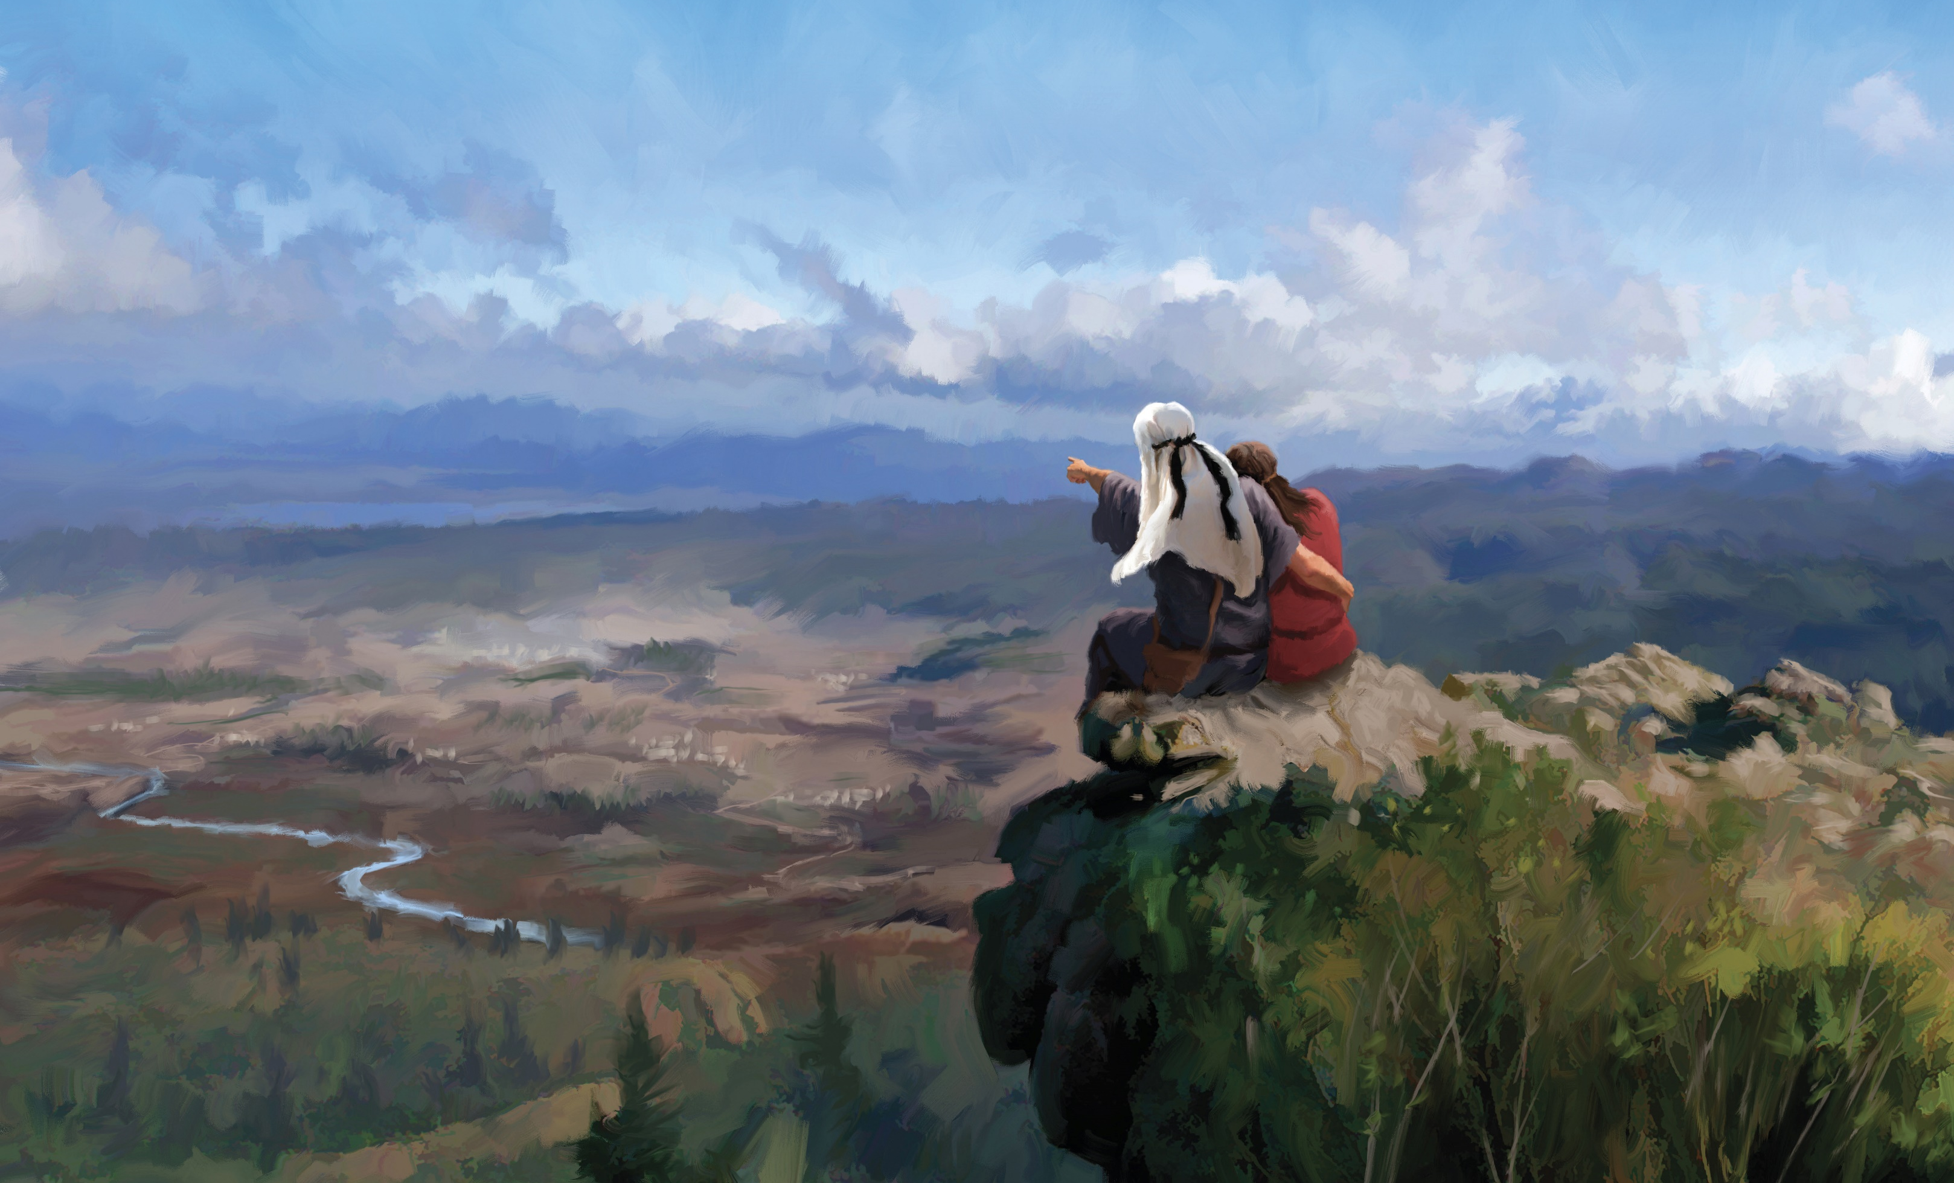
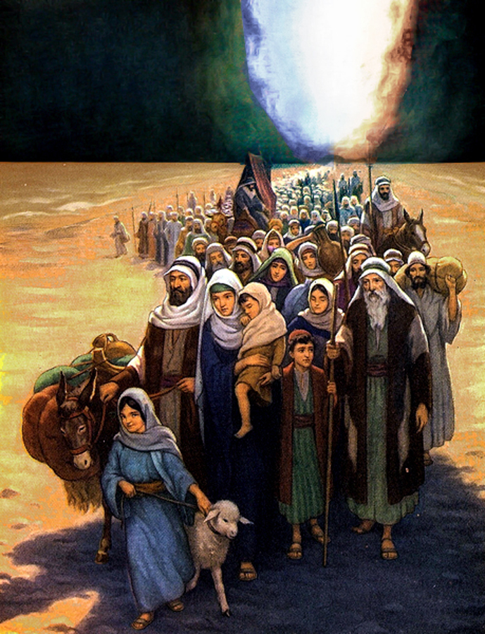
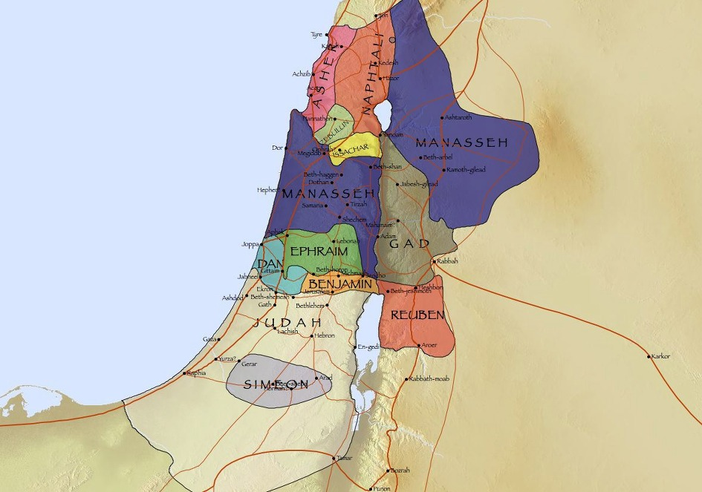
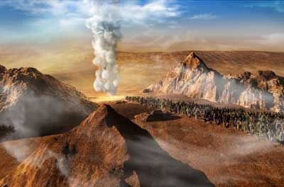
Thulhuhna Kibol Gaho
Gam Luo Joulou, Thina Lhung:
Hitin seipih in, 'Hing jing Pakai kitep kahi, nataopih bang in bol na’ng e. Kei Pakai in kaseidoh ahitai. Nathi uva hiche gamthip nuoi naluong u kithethaang suoh ding ahi. Kakom a nakiphin jeh uva kum somni a lhah chunglam koimacha khuche gamsung nalut lou hiel diu ahi. Hiche gam a khu cheng dia katepsa nahi uvin, hijongle nangho vang, Caleb le Joshua tilou, khatcha lut po uvin nate.
(Num 14:28-30)
Nachateu gal in amat din nasei un, amaho chu nadeimosa u gamsung a kapuilut ding inmun a anei diu ahi. Nang ho vang hiche gamthip lai a thigam ding nahi uve.
(Num 14:31-32)
Gam Luo U:
Hiti hin Thempuhon sumkon amut ta uve. Sumkon gin ajah tah-un pasal jousen a-ao jeng u le, khopi kulpi achim tai. Chutah chun sepai jouse khopi sung a akitol lut un, atoupha ta uve. Khosung mite chemjam in asatlih suoh hiel un, numei pasal, teh le khang dat louvin athat gam ta uve. Bong le kelngoi chule sa-ngan jouse jong athat uve. Gam ve-lhite ni jah a Joshuan, "Nakitepna lhon bangin, Rahab notinu in lut'in, amale a-insung mite gapuidoh lhontan," ati.
(Jos 6:20-22)

Slide 17

Pathien chu janhi, tuni leh jiing nikho a jong angei ngei, abang bang hi jing jieng ahi. Khang jouse hieng a ahina akilahsah akibang jing e: hepina, thuohhat, khongaisot, thutan dih ahi atahlah jing e; bolmo kidang abol jing in, ama akijumso ngei poi.
Israel te bang a Ama tahsan le tahsan lou ding, hoi joh ikilhen diu ham?
Ama tahsanna inei uva, athupieh sung a ium u leh khoiju le bongnoi luonna Gamtep Gam ilhun tei diu ahi.
Van Canaan gam, lei thah, mit in amukhah lou, na in ajahkhah lou, lung a kilangkhalou gam chu ilut tei diu ahi.

