Slide 1
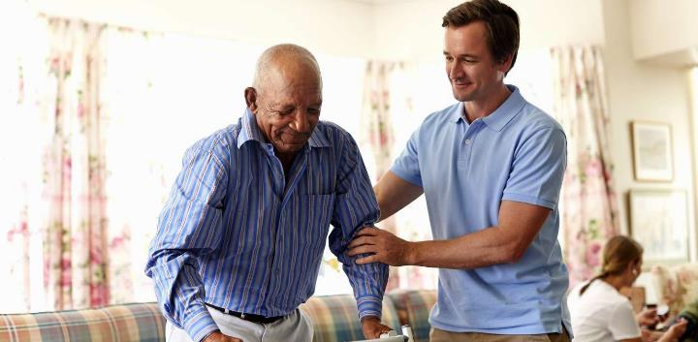
ika gpur;rid:
md;gh my;yJ Raeykh?
ghlk; 2 Vg;uy; 13, 2024

Slide 2
“eP gag;glhNj> ehd; cd;DlNd ,Uf;fpNwd;@ jpifahNj> ehd; cd; Njtd;@ ehd; cd;idg; gyg;gLj;jp cdf;Fr; rfhak;gz;ZNtd;@ vd; ePjpapd; tyJfuj;jpdhy; cd;idj; jhq;FNtd;.” (Vrhah 41:10)

Slide 3
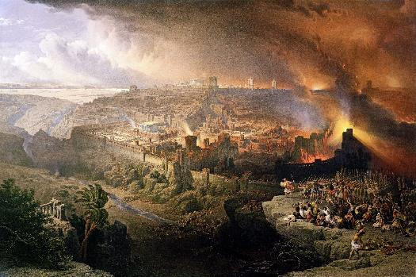
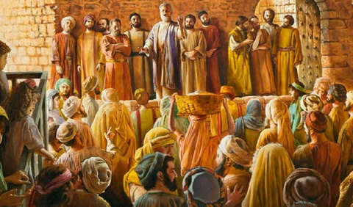
,];Nuy; xU Njrkhf fpgp 70y; KbT ngw;wJ. vUrNyikAk; Njthyaj;ijAk; mopj;jJ Nuhk; jhd; vd;whYk;> kw;w rf;jpfs; me;j Nghhpy; <Lgl;ld.
kWGwk;, Nkrpahit epuhfhpf;f rhj;jhd; ,];uNtiy J}z;bdhd;, gpd;dh; Njrj;ij mopf;f mtDila chpikia Nfhhpdhhd;.
kWGwk;, mtiu epuhfhpg;gjhy; Vw;gLk; tpisTfis gw;wp Njtd; kPz;Lk; kPz;Lk; vr;rhpj;jhh;; jz;lidia jhkjg;gLj;jpdhh;; rj;jpa N[hjpia vLj;J> NjtDila md;gpd; nra;jpahy; cyif xspu nra;a xU $l;l kf;fis> rigia Njtd; Maj;jg;gLj;jpdhh;.
vUrNykpd; moptpypUe;J gbg;gpidfs;:
NjtDila md;ig epuhfhpj;jy;.
jd; kf;fspd; Nky; NjtDila mf;fiw.
Kjy; fpwp];jth;fsplkpUe;J ghlq;fs;:
ehl;lj;jpy; tpRthrk;.
NjitapypUg;NghUf;F cjTjy;.
md;G, ek; milahs rpd;dk;.

Slide 4
vUrNykpd; moptpypUe;J gbg;gpidfs;

Slide 5
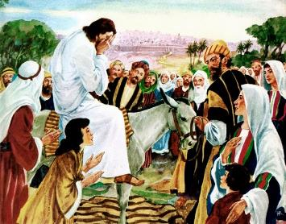
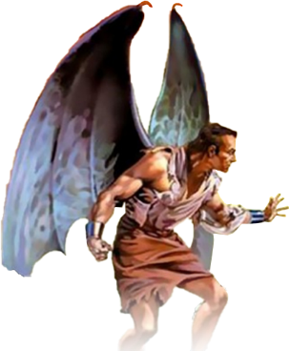
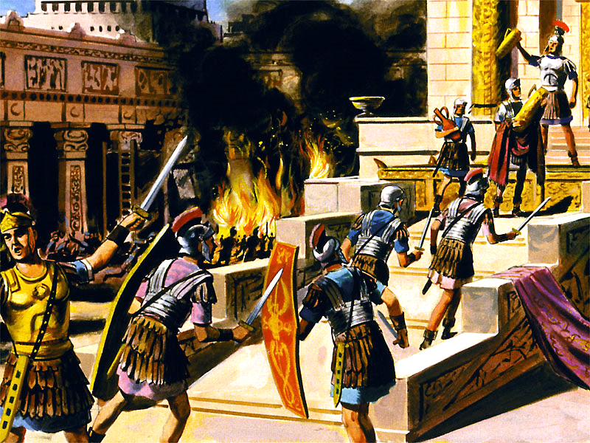
NjtDila md;ig epuhfhpj;jy;
“vUrNyNk> vUrNyNk> jPh;f;fjhprpfisf; nfhiynra;J> cd;dplj;jpy; mDg;gg;gl;lth;fisf; fy;nywpfpwtNs! Nfhop jd; FQ;Rfisj; jd; rpwFfspd;fPNo $l;br; Nrh;j;Jf; nfhs;Sk;tz;zkhf ehd; vj;jid juNkh cd; gps;isfisf; $l;br; Nrh;j;Jf;nfhs;s kdjhapUe;Njd;@ cq;fSf;Nfh kdjpy;yhkw;Nghapw;W.” (kj;NjA 23:37)
,NaR vUrNyik neUq;Fifapy; fz;zPh; tpl;lhh; (Y}f;fh 19:41-44). NjtDila md;ghd miog;Gfis mth;fs; gpbthjkhf epuhfhpj;jjd; jFjpahd tpisTfis mth;fs; mDgtpg;ghh;fs; vd;gij mth; mwpe;jpUe;jhh; (kj;. 23:37).
tuf;$ba Nrhfj;ij mth;fs; jtph;j;jpUf;fyhk; vd mth; mOjhh;. Vndd;why;> Njtd; ek;ik Nerpf;fpwhh;> mth; ahUk; ,wf;f tpUk;gtpy;iy> Mdhy; xt;nthUtUk; epj;jpa [Ptid ngw tpUk;Gfpwhh; (Nah. 5:39-40; vNr. 18:31-32).
Nuhkhdpah;fspd; mj;JkPwy;fSf;F vjpuhf A+jh;fs; fpgp 66Mk; Mz;L fyfk; nra;jjhf tuyhW $WfpwJ. gy;NtW A+j gphpTfs; jq;fSf;Fs; rz;ilapl;ld> mNj Neuj;jpy; Nuhkhdpah;fs; efuj;ij Kw;Wifapl;ldh;. fpgp 70y; vy;yhk; KbTw;wJ. ill;l]; vUrNyikAk; Myaj;ijAk; mopj;jhh;. xU kpy;ypad; A+jh;fs; mope;jdh;.
Mdhy; rhj;jhd; vg;gb A+jh;fis fpsh;r;rpf;F J}z;bdhd;> Nuhkhdpah;fis gopthq;f vg;gb J}z;bdhd; vd;W rhpj;jpuk; nrhy;ytpy;iy. vUrNykpd; mopT gprhrpd; Neub Ntiy. tho;f;ifapd; %yj;jpypUe;J tpyfpajd; %yk;, mopitAk; kuzj;ijAk; kl;LNk NjLk; xU vjphpapd; jatpy; ,];Nuy; ,Ue;jJ.

Slide 6
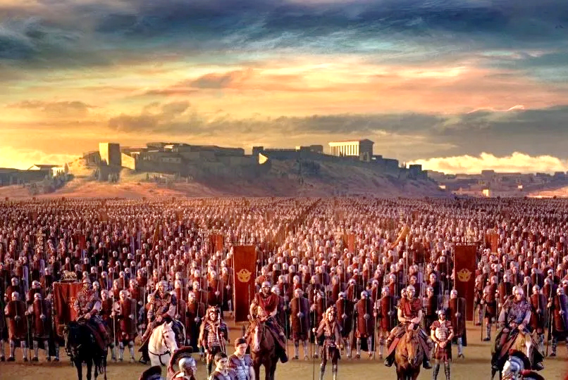
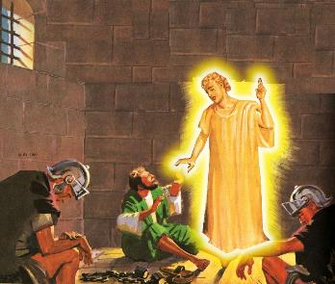
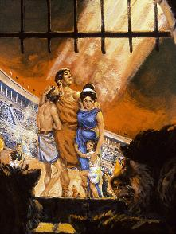
jd; kf;fspd; Nky; NjtDila mf;fiw
“eP gag;glhNj> ehd; cd;DlNd ,Uf;fpNwd;@ jpifahNj> ehd; cd; Njtd;@ ehd; cd;idg; gyg;gLj;jp cdf;Fr; rfhak;gz;ZNtd;@ vd; ePjpapd; tyJfuj;jpdhy; cd;idj; jhq;FNtd;.” (Vrhah 41:10)
mtUila md;gpy;, moptpypUe;J jg;gpf;f tpUk;gpa midtUf;Fk; Njtd; xU tha;g;igf; nfhLj;jhh;. mth; xU milahsj;ijAk; nfhLj;jhh;: vUrNyk; Nridfshy; R+og;gl;lJ (Y}f;fh 21:20).
fa]; nr];ba]; fhy]; me;j milahsj;ij fpgp 66Mk; Mz;by; epiwNtw;wpdhh;. Kw;Wif ePf;fg;gl;lJ, [Pyl; jiyth; vypahrh; ngd; irkd; Nuhkhdpah;fis gpd;njhlh;e;J mth;fis Njhw;fbj;jhh;.
,NaRtpd; thh;j;ijfis ek;gpa midtUk; vUrNykpy; ,Ue;J jg;gpNahl> ghJfhg;gpd;wp tplg;gl;l me;j jUzj;ij gad;gLj;jpf; nfhz;ldh;.
rpy khjq;fs; fopj;J, fpsh;r;rpia mlf;f ePNuh nt];ghrpaid mDg;gpdhh;. fpgp 67 Kjy; fpgp 70 tiu, Kw;Wif epue;jukhdJ.
Njtd; jdJ gps;isfis kpfTk; fbdkhd fhyq;fspy; $l ghJfhf;f tpUk;Gfpwhh;> mtuhy; ghJfhf;fTk; KbAk; (rq;. 46:1; Vrh. 41:10). vd;whYk;, NjtDf;F cz;ikaha; ,Ue;jjhy; gyh; jq;fs; capiu ,oe;Js;sdh;(vgp. 11:35-38).
rpyh; Vd; ghJfhf;fg;gLfpwhh;fs;> kw;wth;fs;> ntspg;gilahf> Njtdhy; iftplg;gLfpwhh;fs;?

Slide 7
Kjy; fpwp];jth;fsplkpUe;J ghlq;fs;

Slide 8
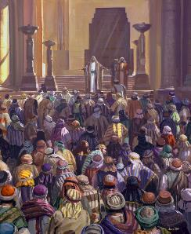
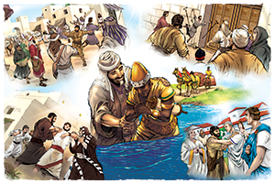
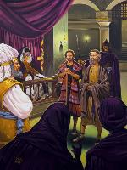
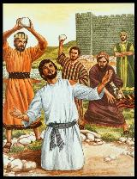
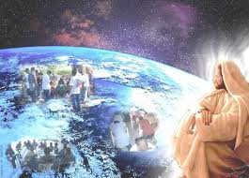
Jd;GWj;jypy; tpRthrk;
“rTy; tPLfs;NjhWk; Eioe;J> GU\iuAk; ];jphPfisAk; ,Oj;Jf;nfhz;LNgha;> fhtypy; NghLtpj;J> rigiag; ghohf;fpf;nfhz;bUe;jhd;.” (mg; 8:3)
njhlf;fq;fs; cz;ikapNyNa ek;gpf;ifAld; ,Ue;jd: kdkhw;wq;fs; Mapufzf;fpy; ,Ue;jd(mg; 2:41; 4:4); tpRthrpfs; ty;yikAld; gpurq;fpj;jhh;fs; (mg; 4:31; 5:42).
Mdhy; vjphp mikjpapd;wp ,Ue;jhd;. Kjy; mr;RWj;jy;fs; (mg; 4:17-18); gpd;G, jz;lidfs; (mg; 5:40); ,Wjpapy;, kuzk; (mg; 7:59).
rTy; vOg;gpa Jd;GWj;jypd; fhuzkhf> rPlh;fs; rpjwpNghdhh;fs; (mg; 8:1). Mdhy;, ntspr;rk; mize;Jnghftpy;iy> tpRthrpfspd; tpRthrj;jpw;F ed;wp. mwpag;gl;l cyfk; KOtJk; mJ kpfTk; gpufhrj;Jld; gpufhrpj;jJ (mg; 8:4; 11:19-21; Nuh. 15:19; nfhNyh. 1:23).
,NaR jdJ jpUr;rigf;F xU MiziaAk; mij Kd;ndLj;Jr; nry;Yk; Mw;wiyAk; nfhLj;jpUe;jhh; (mg; 1:8). ve;jnthU ty;yikNah> rhPu my;yJ Md;kPf Kaw;rpNah ew;nra;jpapd; Kd;Ndw;wj;ij jLf;f KbahJ (kj;. 16:18). “Njtd; ek;Kila gl;rj;jpypUe;jhy; ekf;F tpNuhjkhapUg;gtd; ahh;?” (Nuhkh;. 8:31)

Slide 9
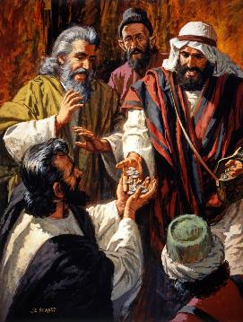
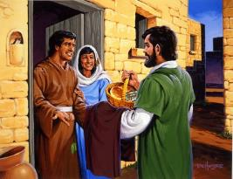
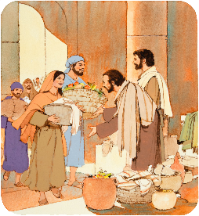
NjitapypUg;NghUf;F cjTjy;
“fhzpahl;rpfisAk; M];jpfisAk; tpw;W> xt;nthUtDf;Fk; Njitahdjw;Fj;jf;fjhf mitfspy; vy;yhUf;Fk; gfph;e;JnfhLj;jhh;fs;.” (mg; 2:45)
Muk;gfhy fpwp];jth;fs; kPJ ew;nra;jp vd;d jhf;fj;ij Vw;gLj;jpaJ (mg; 2:42-47)?
mth;fs; ,NaRtpd; Nfhl;ghLfis ek;gpdhh;fs;.
tuk; ngw;wth;fs; NehAw;wth;fis Fzg;gLj;jpdh;.
mth;fSf;F vy;yh tp\aq;fSk; nghJthdit.
mth;fs; jq;fsplk; cs;sij NjitgLgth;fSld; gfph;eJnfhz;ldh;.
nghJ$l;lq;fs; elj;jpdhh;fs;
mth;fs; tPLfspy; $l;lq;fis elj;jpdhh;fs;, mq;Nf mth;fs; fh;j;jUila ,uhNgh[dj;ij nfhz;lhbdhh;fs;
mth;fs; kfpo;r;rpAlDk; vspikAlDk; tho;e;jdh;
mth;fs; Njtid Nghw;wpdh;
fpwp];Jtpd; J}jh;fshf, mth;fs; ,NaRit gpd;gw;wpdhh;fs;. jq;fis Rw;wpAs;sth;fspd; Njitfisf; ftdpj;J> mth;fs; KO efuj;jpd; ed;kjpg;igg; ngw;wdh;.
mJNghyNt, fpwp];jth;fs; xUtUf;nfhUth; md;G nrYj;JtJk;> mth;fspd; r%fj;jpd; kPjhd mf;fiwAk; jpUr;rigapd; rpwg;gpay;Gfshf ,Uf;f Ntz;Lk;.

Slide 10
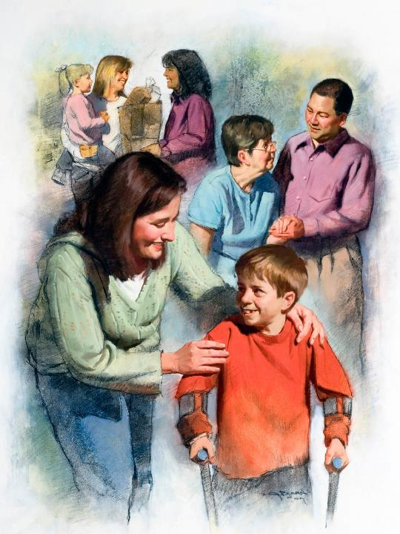
md;G, ek; milahs rpd;dk;
“ePq;fs; xUthpnyhUth; md;Gs;sth;fshapUe;jhy;> mjpdhy; ePq;fs; vd;Dila rP\h;fnsd;W vy;yhUk; mwpe;Jnfhs;thh;fs; vd;whh;.” (Nahthd; 13:35)
gpugQ;r Nkhjypy; <Lg;gl;Ls;s xt;nthU jug;gpdUk; mjd; nrhe;j Fzhjpraq;fisf; nfhz;Ls;sdh;: rhj;jhd; ntWj;J mopf;fpwhd;; Njtd; Nerpj;J kPl;nlLf;fpwhh;.
xU fl;rp my;yJ kw;nwhU fl;rpiag; gpd;gw;Wgth;fs; ,e;j Kiwfspd;gb nray;gLfpwhh;fs;. Njtid gpd;gw;WNthkhdhy;, gpwhplk; fhl;Lk; md;gpd; %yk; mij fhl;LNthk; (1Nah. 4:20-21)
2 kw;Wk; 3Mk; E}w;whz;Lfspd; fpwp];jth;fs; jd;dykw;w md;ig eilKiwg;gLj;jpdh;. ,uz;L nghpa njhw;WNeha;fspd; NghJ (160 kw;Wk; 265 tUlq;fspd; NghJ), mth;fs; jq;fs; nrhe;j ghJfhg;ig fUj;jpy; nfhs;shky;> ghjpf;fg;gl;lth;fis ftdpg;gjpy; jq;fis mw;gzpj;Jf; nfhz;ldh;.
mth;fs; md;gpdhy; jq;fisNa nfhLj;jhh;fs;> mth;fs; kpy;ypad; fzf;fhd kf;fSf;F gadspj;jdh;. Mdhy; mth;fs; jq;fs; ftdj;ij jq;fis Nehf;fp <h;f;ftpy;iy, Mdhy; ahUf;fhf mth;fs; jq;fs; capiu nfhLf;f jahuhf ,Ue;jhh;fs; vd;why;, jq;fs; ,ul;rfuhfpa ,NaRTf;Nf.

