Slide 1
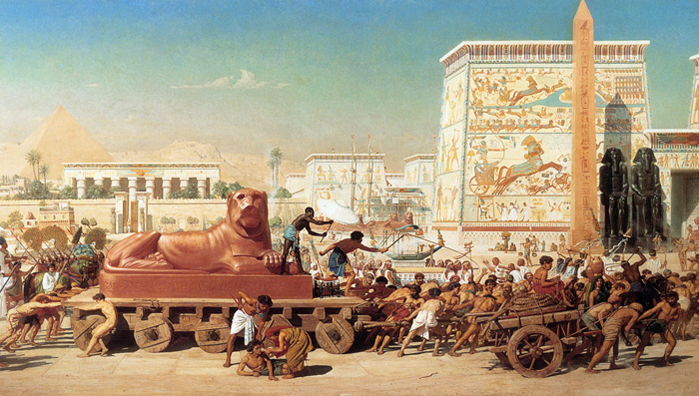
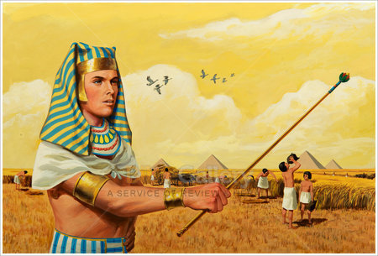
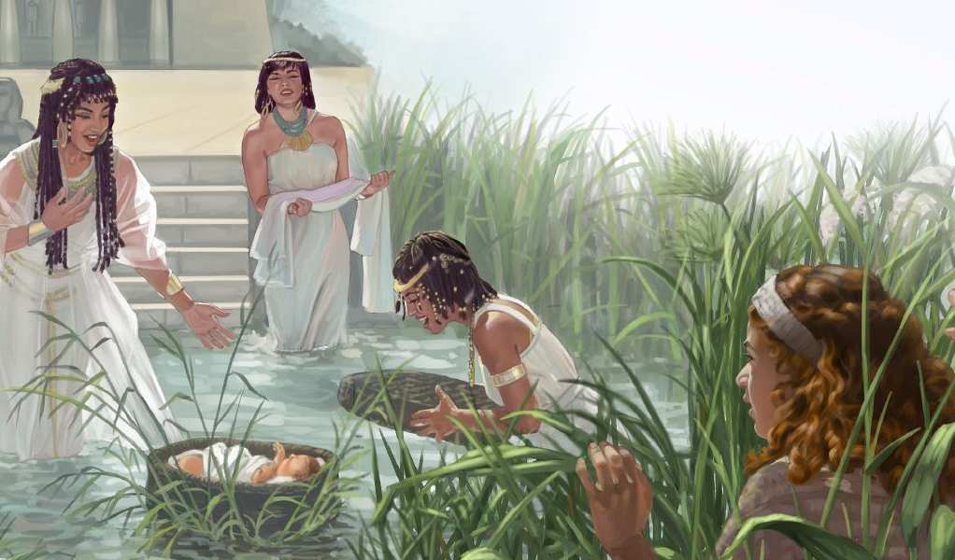
ghlk; 1 [_iy 5, 2025
xLf;Fjy;: NkhNrapd; gpz;zzpAk; gpwg;Gk;

Slide 2
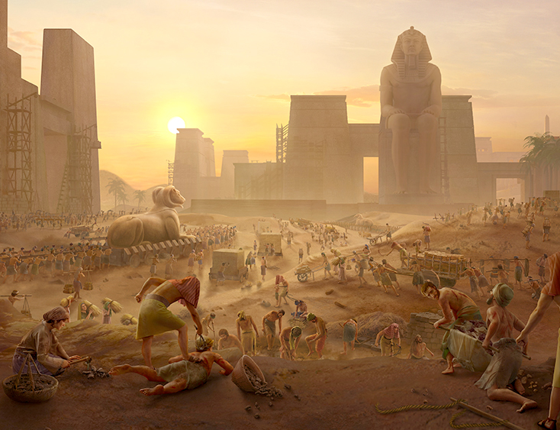
“,];uNty; Gj;jpuh; mbikj;jdj;jpdhy; jtpj;J> Kiwapl;Lf; nfhz;bUe;jhh;fs;@ mth;fs; mbikj;jdj;jpypUe;J KiwapLk; rj;jk; Njtre;epjpapy; vl;bdJ. Njtd; mth;fs; ngU%r;irf;Nfl;L> jhk; MgpufhNkhLk; <rhf;NfhLk; ahf;NfhNghLk; nra;j cld;gbf;ifia epidT$h;e;jhh;. Njtd; ,];uNty; Gj;jpuiuf; fz;Nzhf;fpdhh;@ Njtd; mth;fis epidj;jUspdhh;.”
ahj;jpuhfkk; 2:23–25

Slide 3

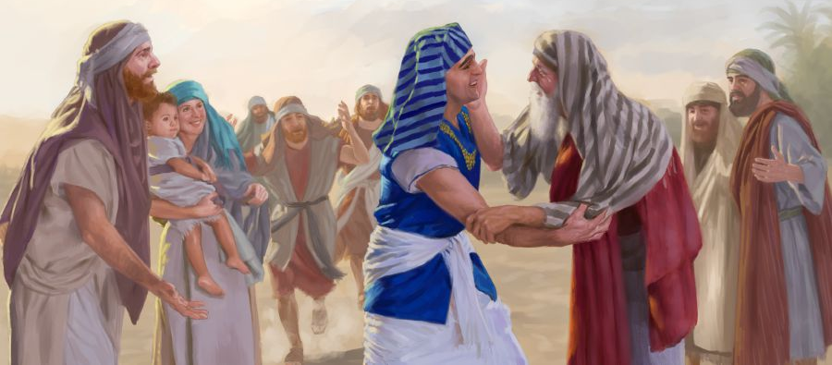
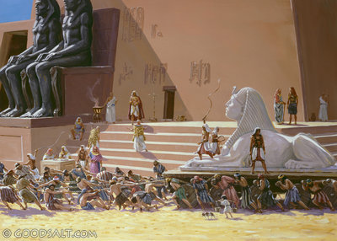
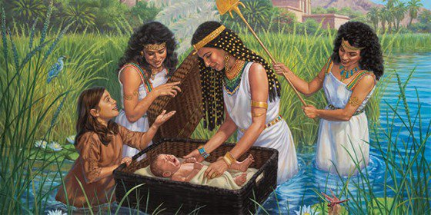





ahj;jpuhfkj;jpd; fij> ghu;Nthdpd; xg;GjYld; vfpg;jpy; FbNaWk; xU rpwpa FLk;gj;Jld; njhlq;FfpwJ.
jpbnud;W, epiyik khwp, mbikfshfp> jq;fs; vfpg;jpa “v[khdu;fSf;F” Ntiy nra;a Ntz;ba fl;lhak; Vw;gLfpwJ
epiyik NkYk; NkYk; Nkhrkhfp tUfpwJ. Jd;gq;fSf;F kj;jpapy;> rpg;Nghuhs; kw;Wk; G+ths; vd;w ,uz;L ngz;fspd; tpRthrk; gpufhrpfpwJ> mNj Nghy; Njtd; jkJ kf;fis tuNtw;Fk; ek;gpf;ifapd; fjpu;: iey; ejpapypUe;J kPl;fg;gl;l mofhd Foe;ij, NkhNr.
vfpg;jpy; NjtDila [dq;fs; (ahj;jpuhfkk; 1:1-14)
Mgpufhk; Kjy; NkhNr tiu (Mjp 15:13; ahj; 1:8)
tpRthrj;jpd; ntw;wp (ahj; 1:15-22)
iey; ejpapd; Foe;ij (ahj; 2:1-10)
Njhy;tpAw;w tpLtpg;ghsu; (ahj; 2:11-25)

Slide 4

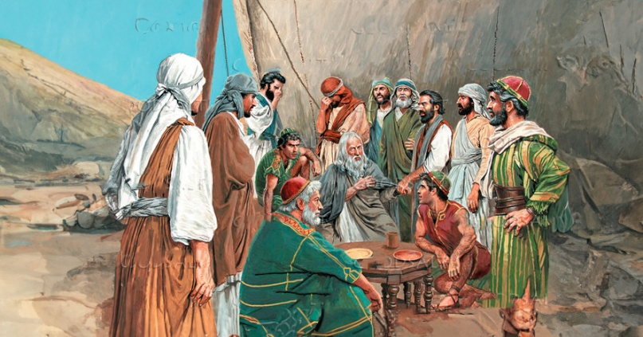
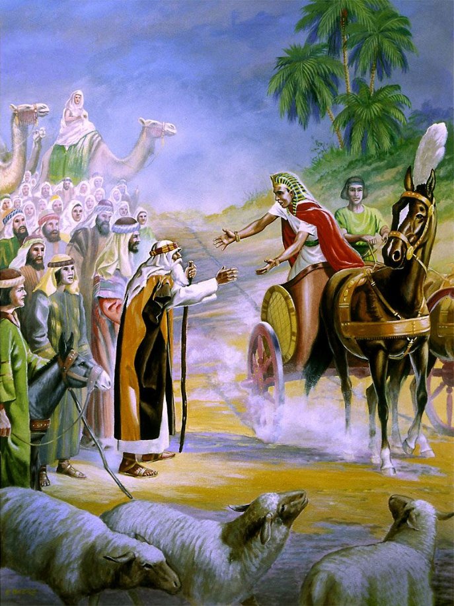
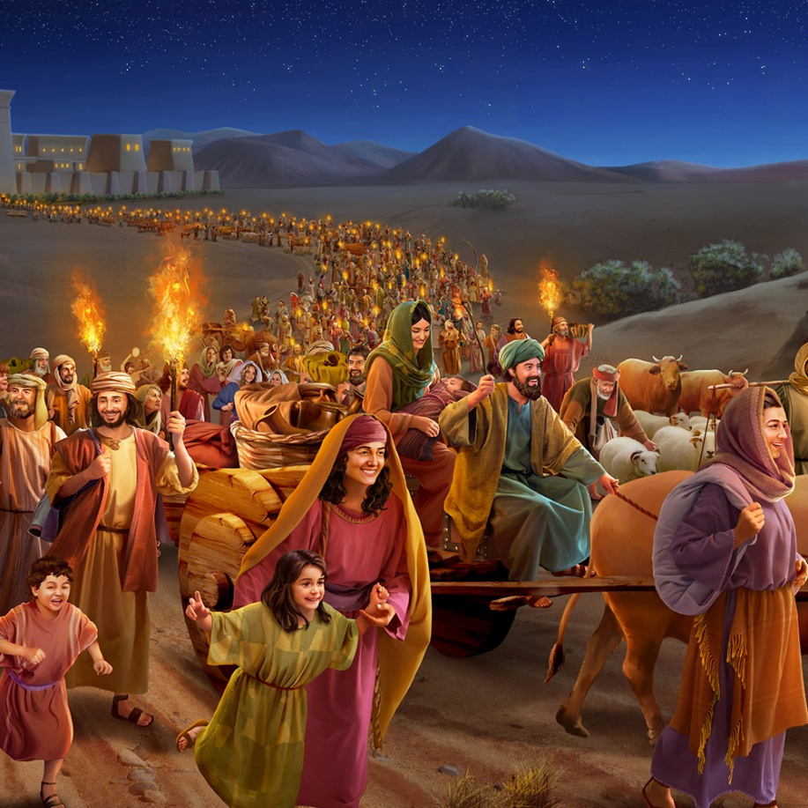
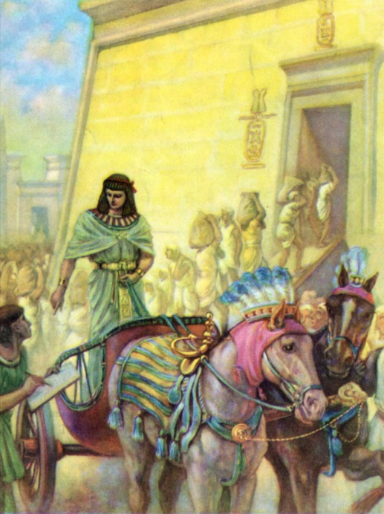
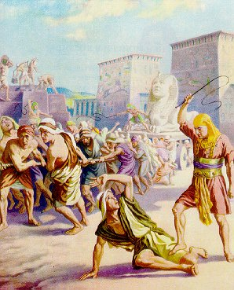
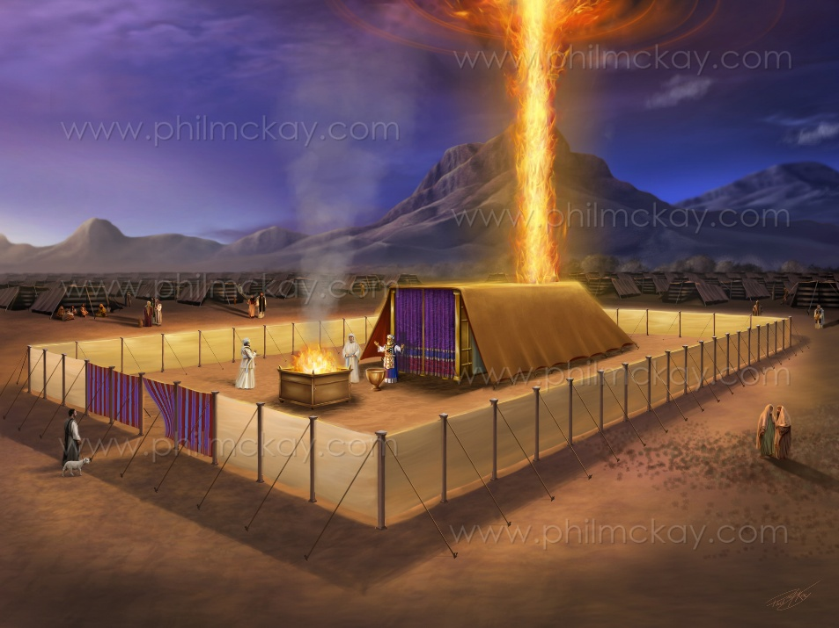
vfpg;jpy; NjtDila [dq;fs;
“vfpg;Jf;Fg; Nghd ,];uNtYila Fkhuhpd; ehkq;fshtd:” (ahj; 1:1)
NkhNrapd; ,uz;lhtJ Gj;jfk; mjd; fUg;nghUs; fhuzkhf yj;jPd; nkhopapy; “ahj;jpuhkk;” vd;W miof;fg;gl;lJ. Mdhy; vgpNua nkhopapy; ,J “n\Nkhl;” (ngau;fs;) vd;W miof;fg;gLfpwJ> fhuzk; mjd; njhlf;f thu;j;ijfs; (ahj; 1:1).
,e;j “ngau;fs;” ahf;NfhG kw;Wk; mtUila kfd;fspd; ngau;fs;.70 Ngu;fis nfhz;L xU rpW FO (Mjp. 46:26-27;ahj;. 1:5). fhyg;Nghf;fpy;, mtu;fs; Rkhu; 6>00>000 Nghu;tPuu;fis nfhz;l xU Nridahf tsu;e;jdu; (ahj;. 12:37).
ahf;Nfhgpd; kfd;, NahNrg;G, vfpg;jpa tk;rhtspia Nru;e;j i`f;Nrh]pd; 17tJ tk;r ghu;NthDf;F mikr;ruhf ,Ue;jhu;, Mdhy; mtu; vfpg;jpa tk;rj;ij rhu;e;jtu; my;yu;. i`f;Nrhf;fs; Njhw;fbf;fg;gl;lNghJ, vfpg;jpy; Gjpa tk;rk; njhlq;fpaJ, mJ “NahNrg;ig mwpahj tk;rk;” (ahj;. 1:7-8).
,J ,];uNtiy xU fbdkhd R+o;epiyf;F nfhz;L te;jJ (ahj; 1:9-14). ,Ug;gpDk;, ahj;jpuhfk Gj;jfj;jpd; Kbtpy;, epiyik Kw;wpYk; khWfpwJ: ,];uNty; NjtDila gpurd;dj;jpw;F Kd;ghf Rje;jpukhf njhOif nra;fpwJ (ahj; 40:38). ,e;j Gj;jfj;jpd; Nghjid njspthf cs;sJ: Njtd; ek; tho;f;ifia fl;Lg;gLj;Jfpwhu;; R+o;epiyfs; rhj;jpakw;wjhf Njhd;wpdhYk;> mtu; ek;ik fhg;ghw;Wthu;.

Slide 5

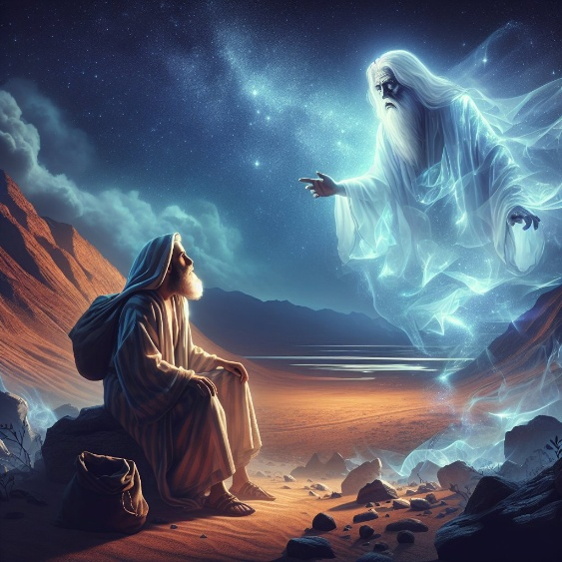
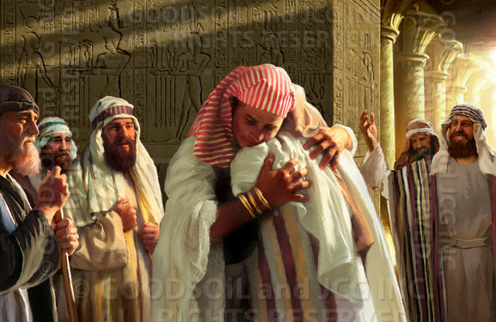
Mgpufhk; Kjy; NkhNr tiu
“mg;nghOJ mth; Mgpuhik Nehf;fp: cd; re;jjpahh; jq;fSilajy;yhj me;epa Njrj;jpNy guNjrpfshapUe;J> mj;Njrj;jhiur; Nrtpg;ghh;fs; vd;Wk;> mth;fshy; ehD}W tU\k; cgj;jputg;gLthh;fs; vd;Wk;> eP epr;rakha; mwpaf;fltha;.” (Mjp 15:13)
Njtd; MgpufhKf;F fhdhd; Njrj;ij nfhLg;gjhf thf;FWjp mspj;jpUe;jhu;> Mdhy; ,e;j jpl;lj;ij epiwNtw;Wtjpy; 400 tUl jhkjk; Vw;gLk; vd;W vr;rupj;jhu; (Mjp. 15:13-16).
NkhNrAk; gTYk; ,e;j fhyfl;lj;Jld; 30 Mz;Lfis $l;b> mij Muhdpy; cs;s miog;Gf;F nfhz;L nry;fpd;wdu; (ahj;. 12:40; fyh. 3:17):
Muhdpy; Mgpuhkpd; miog;G Kjy; ahf;NfhG vfpg;Jf;F tUk; tiu: 215 tUlq;fs;
ahf;NfhG vfpg;Jf;F te;jjpypUe;J vfpg;jpypUe;J ntspNaWjy; tiu: 215 tUlq;fs;
ahf;NfhG vfpg;Jf;F vg;gb te;jhu;? Kw;wpYk; mw;Gjkhd Kiwapy;. NahNrg;ig nfhy;y rNfhjuj;Jt Kaw;rpfs; ele;j NghjpYk;> mtu; vfpg;jpd; gpujkuhdhu;. mtuJ gjtpf;F ed;wp> mtu; jdJ KO FLk;gj;ijAk; nfhz;L te;jhu;.
,njy;yhk; vg;NghJ ele;jJ? ekf;F rupahd Njjpfs; njupahJ> Mdhy; njupe;j tuyhw;wpy; nghUj;j NghJkhd msT ekf;F njupAk; (mjpYk; Jy;ypakw;w Njjpfs; cs;sd).

Slide 6

Mgpufhk; Kjy; NkhNr tiu
“,];uNty; Gj;jpuh; vfpg;J Njrj;jpypUe;J Gwg;gl;l ehD}w;W vz;gjhk; tU\j;jpYk;> rhnyhNkhd; ,];uNtypd;Nky; uh[hthd ehyhk; tU\k; rPg;khjkhfpa ,uz;lhk; khjj;jpYk;> mtd; fh;j;jhpd; Myaj;ijf; fl;lj;njhlq;fpdhd;.” (1 ,uh[hf;fs; 6:1)
1 ,uh[hf;fs; 6:1 rhyNkhdpd; ,uz;lhk; Mz;Lf;F 480 Mz;LfSf;F Kd;G ahj;jpuhfkk; epfo;e;jjhf $WfpwJ. ,e;j Njjp Jy;ypakhfTk; cs;slf;fpajhfTk; ,Ue;jhy;, ,J fpK 1445y; ek;ik nfhz;L nry;fpwJ. ,ij xU “Rw;W vz;” vd;W fUjp> ghu;Nthudpd; kuzj;ij fzf;fpy; vLj;Jf;nfhz;lhy;> ahj;jpuhfkk; fpK 1450y; ele;jJ. ,e;j juitf; nfhz;L ehk; gy jUzq;fis jPu;khdpf;f KbAk;.
mfNkh]; I (1575/1550). i`f;Nrhi] Njhw;fbj;jhu;. ,tu; “NahNrg;ig mwpahky;” ,];uNtiy mbikgLj;jpa ghu;Nthd;(ahj; . 1:8-12)
mk;kpNdhgp]; I (1550/1530). ,tu; ,];uNtiy njhlu;e;J xLf;fpdhu; (ahj;. 1:13-14)
Jl;Nkh]; I (1530/1517). ,tu; vgpNua Foe;ijfis nfhy;y cj;jutpl;lhu;(ahj;. 1:15-22)
NkhNr (1530/1410). Jl;Nkh]; I, `l;N\g;Gl; vd;gtupd; kfshy; jj;njLj;J tsu;f;fgl;lhu;
Jl;Nkh]; II (1517/?). ,tuJ Ml;rp fhyj;jpy; jhd; NkhNr vfpg;ij tpl;L xbg;Nghdhu; (1490)
`l;N\g;Gl; (?/1479). ,tuJ kfd; vfpg;Jf;F jpUk;Gtjw;F Kd;Ng ,tu; ,we;Jtpl;lhu;
Jl;Nkh]; III (1479/1450). ahj;jpuhfkj;jpd; ghu;Nthd;. ,tUila %j;j kfd; “fhy;eilfis guhkupf;Fk; nghWg;gpy;” ,Ue;jhu;”> Mdhy; mtu; 10tJ thijapd; NghJ ,we;jjhy; xUNghJk; Ml;rp nra;atpy;iy
mk;k;Ndhkp]; II (1450/1424). Jl;Nkh]; IIId; kfd;, Mdhy; mtupd; Kjy; kfd; my;y

Slide 7

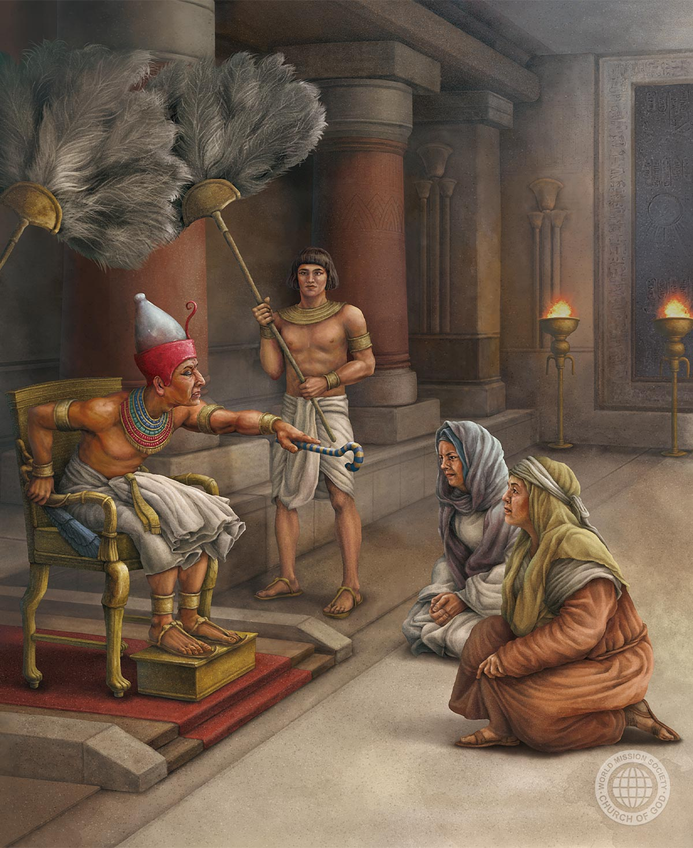
tpRthrj;jpd; ntw;wp
“kUj;Jtr;rpfs; NjtDf;Fg; gae;jjpdhy;> mth;fSila FLk;gq;fs; jiof;Fk;gb nra;jhh;.” (ahj; 1:21)
18tJ vfpg;jpa tk;rk; me;epau;fis ntWj;jJ. NkYk;, ,];uNtyu;fs; fpsu;r;rp nra;Ak; msTf;F Vuhskhf ,Ue;jdu; (ahj;. 1:9-10). vdNt mtu;fs; gbg;gbahf mtu;fis fPo;gLj;jpdu;:
1
fl;blq;fis fl;Lk;gb fl;lhag;gLj;j mtu;fs; Mizau;fis epakpj;jdu; (ahj;. 1:11)
mtu;fs; jq;fs; Nfhupf;iffis ,Wf;fp> mtu;fis njhopyhsu;fs; kw;Wk; mbikfshf khw;wpdu; (ahj;. 1:13-14)
mtu;fs; kUj;Jtr;rpfis gad;gLj;jp Mz;Foe;ijfspd; kuzj;ij Mizapl;ldu; (ahj;. 1:15-16)
,Wjpahf, mtu;fs; Mz; Foe;ijfis tYf;fl;lhakhf nfhd;wdu; (ahj;. 1:22)
2
3
4
,e;j Ntjidapd; kj;jpapy;> rpg;Nghuhs; kw;Wk; G+thspd; tpRthrk; jdpj;J epw;fpwJ (ahj;. 1:15-19). NkhNr ghu;Nthdpd; ngaiu jtpu;j;Jtpl;L mtu;fspd; ngau;fis ekf;F nfhLf;fpwhu;.
NkYk; ek;Kila fw;wYf;fhf> mtu;fspd; cz;ikjd;ikf;fhf Njtd; mtu;fis vt;thW mrPu;tjpj;jhu; vd;gijAk; ,J gjpT nra;fpwJ(ahj;. 1:20-21).

Slide 8

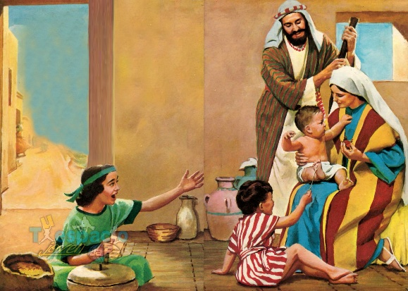
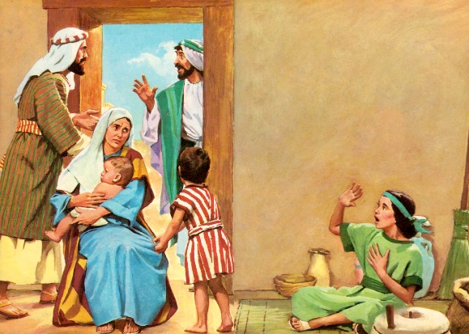
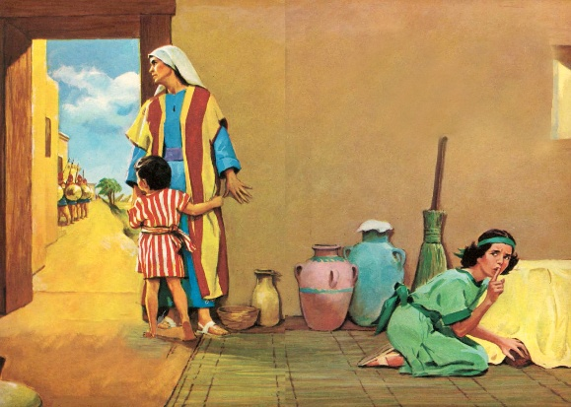
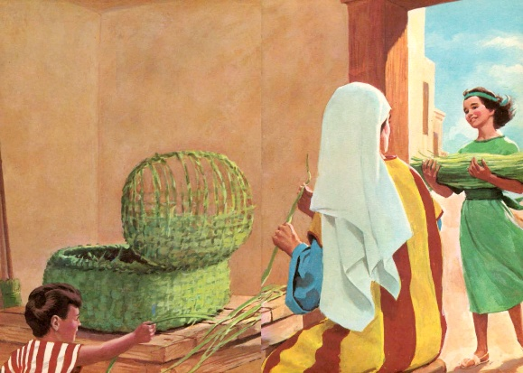
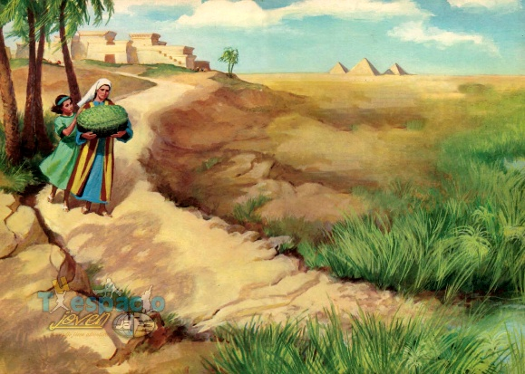
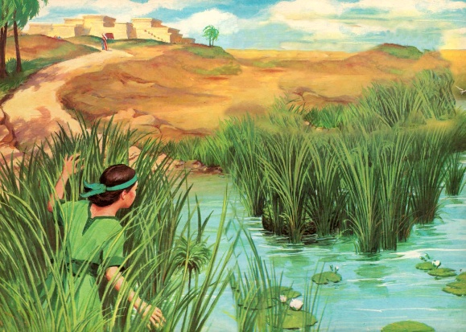
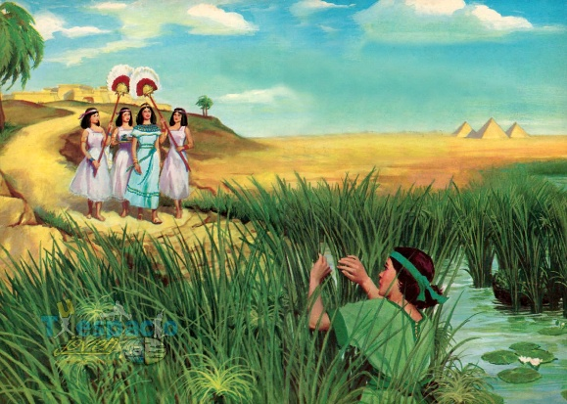
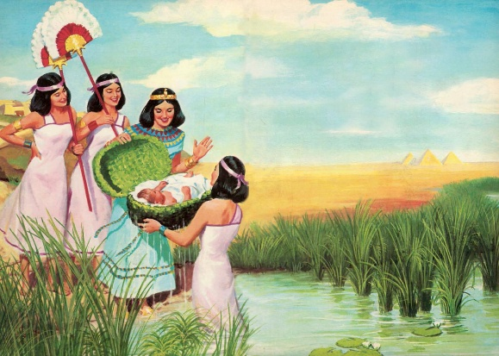
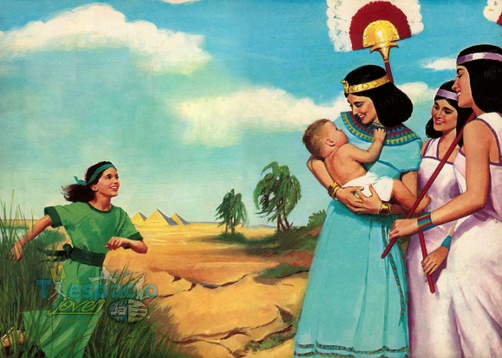
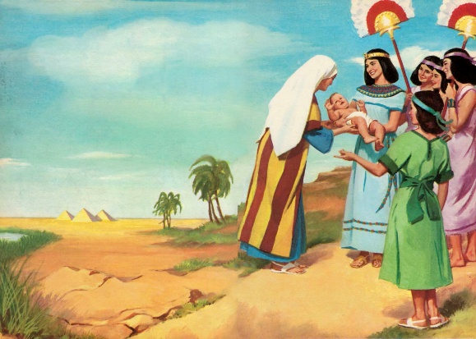
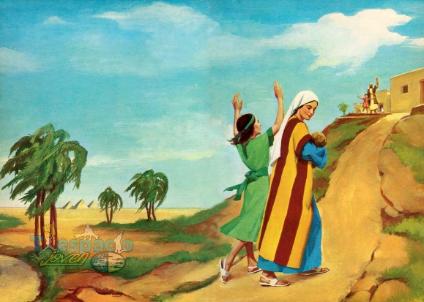
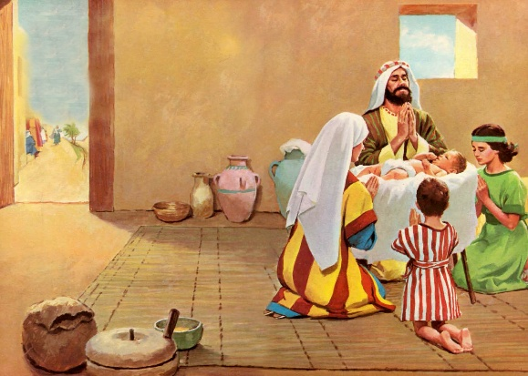
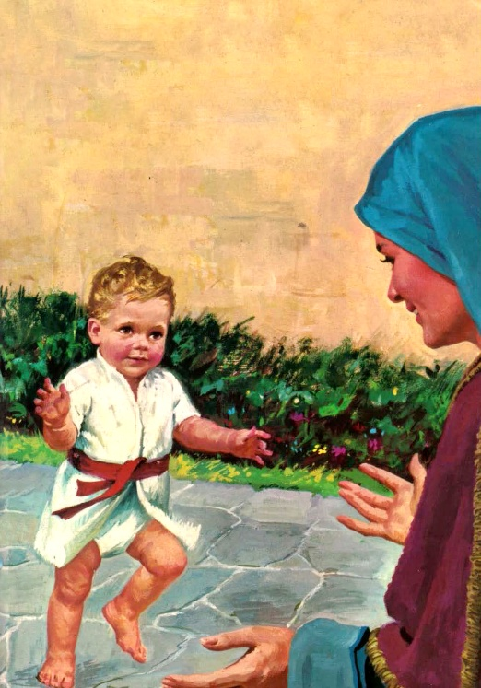
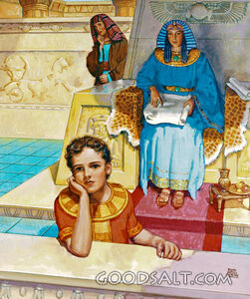
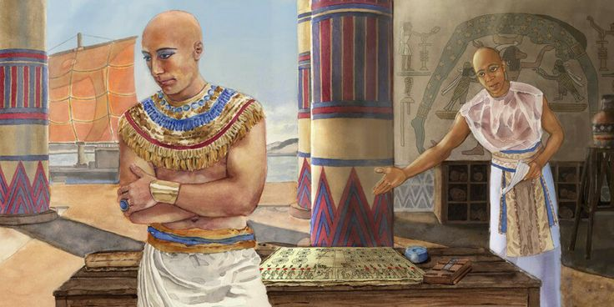
iey; ejpapd; kfd;
“me;j ];jphP fh;g;gtjpahfp> xU Mz;gps;isiag; ngw;W> mJ moFs;sJ vd;W fz;L> mij %d;Wkhjk; xspj;Jitj;jhd;.” (ahj;jpuhfkk; 2:2)
“moF” vd;gJ NahNfngj; kfid tptupf;f jtwptpl;lJ (ahj;. 2:2). “Nlhg;” (ey;yJ, mofhdJ, rupahdJ) vd;w vgpNua thu;j;ijiaNa Njtd; jdJ gilg;gpd; KOikia tptupf;f gad;gLj;Jfpwhu; (Mjp. 1:31).
Njtd; mtUf;fhf rpwg;Gj; jpl;lq;fis itj;jpUe;jhu;. xU jha; xU Mgj;ij vLj;jhu;; xU ,sk;ngz; czu;r;rp trg;gl;lhu;; xU Foe;ij Qhdj;Jld; NgrpaJ… vjpu;fhy kPl;gu; kuzj;jpypUe;J fhg;ghw;wg;gl;lhu; (ahj;. 2:3-7).
mtUila ngw;Nwhu; mtUf;F itj;j ngau; ekf;F njupahJ, Mdhy; mtuJ tsu;g;G jhahu;, ghu;Nthdpd; kfs; mtUf;F toq;fpa ngau;: `hgpNkhrp]; (iey; flTspd; kfd;) vd;gJ ekf;F njupAk;. Mdhy; mtu; jd;id “kfd;,” “Nkhrp]; ,” Nkhr]; vd;W kl;LNk mioj;jhu;(ahj;. 2:10).
mtd; jd; guhkupg;gpy; ,Ue;j rpy tUlq;fis mtd; jha; ed;whf gad;gLj;jpf; nfhz;lhs; (ahj;. 2:8-9). NjtDila cz;ikahd Foe;ijahf ,Uf;f mts; mtDf;F fw;Wf; nfhLj;jhs;. jha;khu;fs; jq;fs; Foe;ijfis NjtDf;F gae;J tsu;g;gjpy; vt;tsT Kf;fpakhd gzpia nra;fpwhu;fs;!

Slide 9


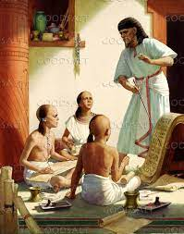
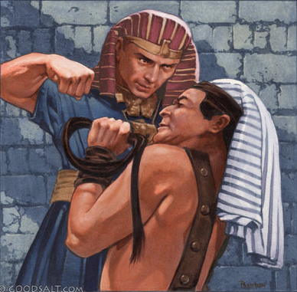
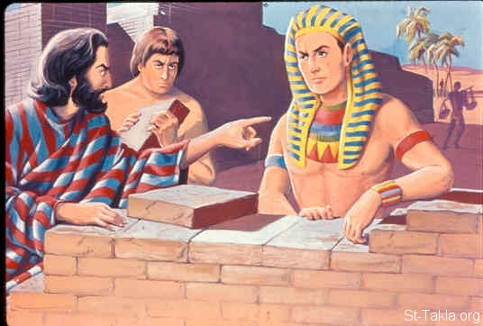
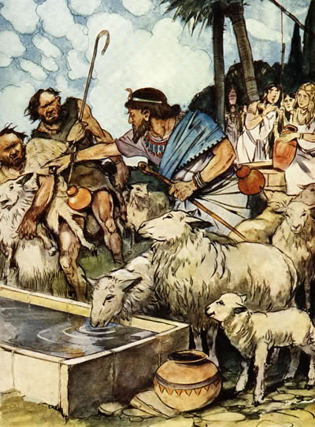
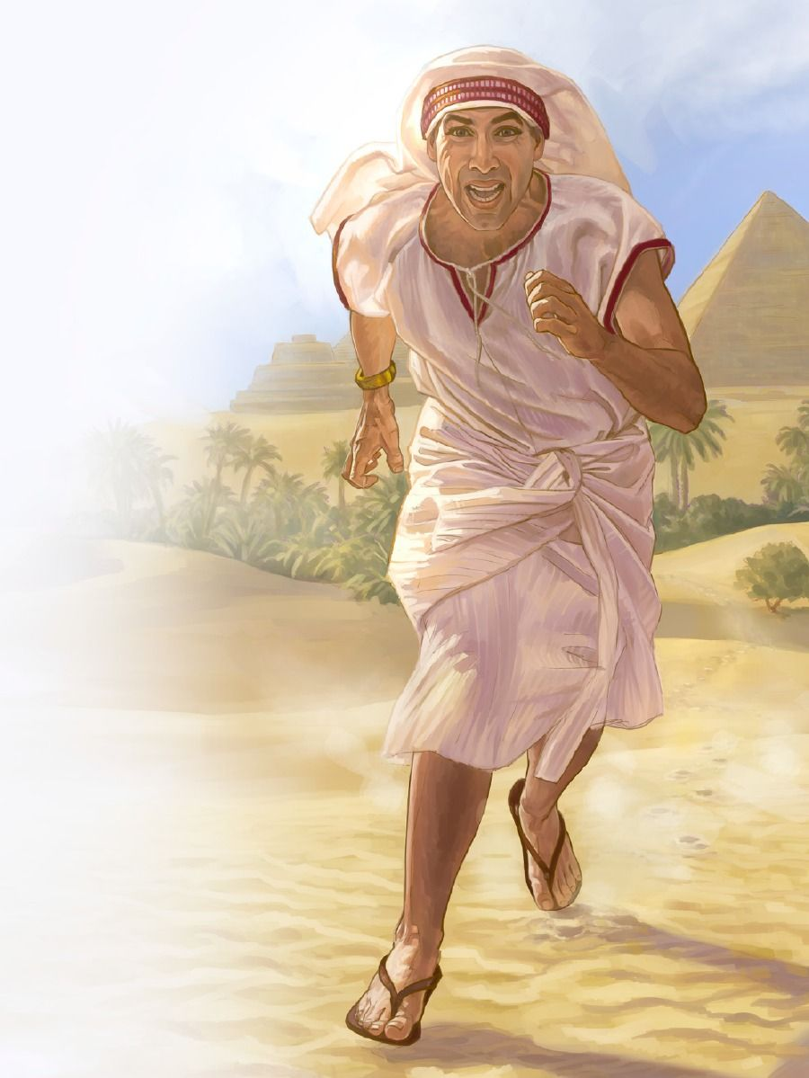
Njhy;tpAw;w tpLtpg;ghsu;
“ghh;Nthd; me;jf; fhhpaj;ijf; Nfs;tpg;gl;lNghJ> NkhNriaf; nfhiynra;a tifNjbdhd;. NkhNr ghh;Nthdplj;jpdpd;W jg;gpNahb> kPjpahd; Njrj;jpy; Ngha;j; jq;fp> xU Jutz;ilapNy cl;fhh;e;jpUe;jhd;.” (ahj;jpuhfkk; 2:15)
NkhNrapd; ,sik gUtj;ijf; Fwpj;J ekf;F mjpfk; njupahJ. Mupaizapd; thuprhf ,Uf;ff;$batuhf, mtu; mjw;fhd fy;tpia ngw;wpUg;ghu;, mjpy; ,uhZtk; kw;Wk; murpay; epGzj;JtKk; mlq;Fk; (vyd; [p citl; , “Kw;gpjhf;fSk; jPu;f;fjuprpfSk;,” gf;. 245) .
NkhNr 40 taij miltjw;F rw;W Kd;G, murpay; R+o;r;rp fhuzkhf ,uz;lhk; Jl;Nkh]; ghu;Nthdhf mwptpf;fg;gl;lhu; vd;gJ ekf;F njupAk;. NkhNr mg;NghJ jdJ kf;fshd ,];uNtiy tpLtpf;Fk; Neuk; te;Jtpl;ljhf ek;gpdhu;. Mdhy; mtu; xU vfpg;jpaid nfhd;wjd; %yk; jdJ tpLjiyia njhlq;fpdhu;. ,J xU ngupa jtW (ahj;. 2:11-12 ). mtuJ kf;fs; $l mtiu jq;fs; tpLjiyahsuhf fUjtpy;iy (ahj;. 2:13-14 ;mg; 7:25 ).
xU rpy ehl;fspy;, mtu; ghu;Nthdpd; muz;kidapy; kupahijf;Fupa cWg;gpduhf ,Ue;J jg;gpNahba Nka;g;guhf khwpdhu; (ahj;. 2:15-22). ,Ug;gpDk;, Njtd; NkhNria epuhfupf;ftpy;iy; NkhNr jtWfs; nra;j NghjpYk;> Njtd; njhlu;e;J mtiu ek;gpdhu;.

Slide 10

“ghu;Nthdpd; mw;Gjkhd muz;kidAk;> kd;dupd; rpk;khrdKk; NkhNrf;F xU J}z;Ljyhf fhl;lg;gl;ld; Mdhy; kdpju;fs; Njtid kwf;f nra;Ak; ght ,d;gq;fs; mjd; gpuGj;Jt ePjpkd;wq;fspy; ,Ug;gij mtu; mwpe;jpUe;jhu;. mofpa muz;kidf;F mg;ghy;, xU kd;dupd; fpuPlj;jpw;F mg;ghy;, ghtj;jhy; fiwglhj xU ,uh[;aj;jpy; cd;djkhdtupd; gupRj;jthd;fSf;F toq;fg;gLk; cau;e;j kupahijfis mtu; ghu;j;jhu;. tpRthrj;jpdhNyNa> guNyhf ,uh[h n[aq;nfhs;gtupd; new;wpapy; itf;fg;NghFk; xU mopahj fpuPlj;ijf; fz;lhu;. ,e;j tpRthrk; mtiu G+kpapd; gpuGf;fsplkpUe;J tpyfp> ghtj;jpw;F Nrit nra;tjw;F gjpyhf NjtDf;F fPo;gbaj; Nju;e;njLj;j jho;ikahd> Vio> ntWf;fg;gl;l Njrj;Jld; Nru toptFj;jJ.”
vyd; [p citl; (Kw;gpjhf;fSk; jPu;f;fjuprpfSk;, gf;. 246)

