Slide 1
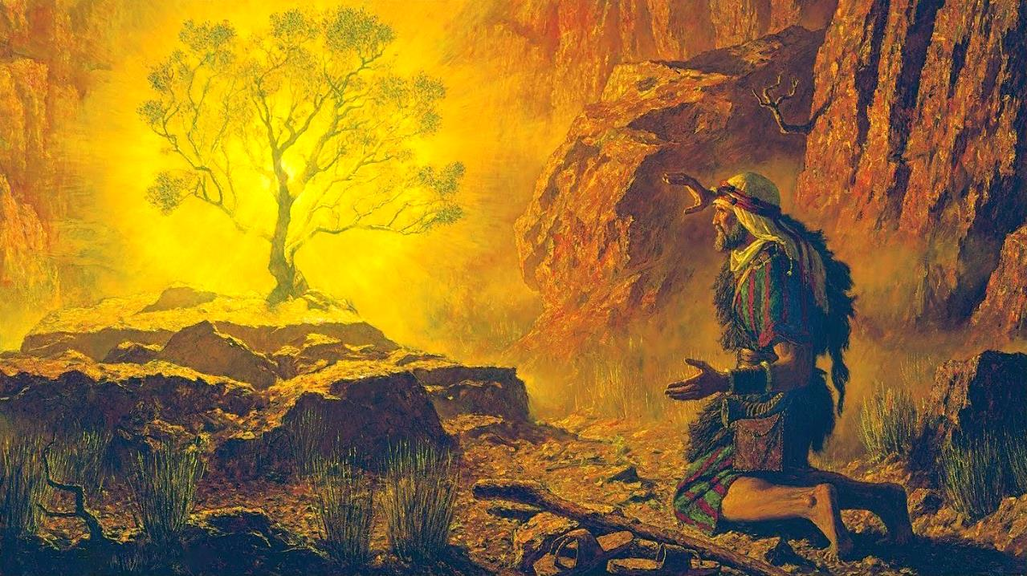
vupfpw Kl;nrb
ghlk; 2 [_iy 12, 2025

Slide 2
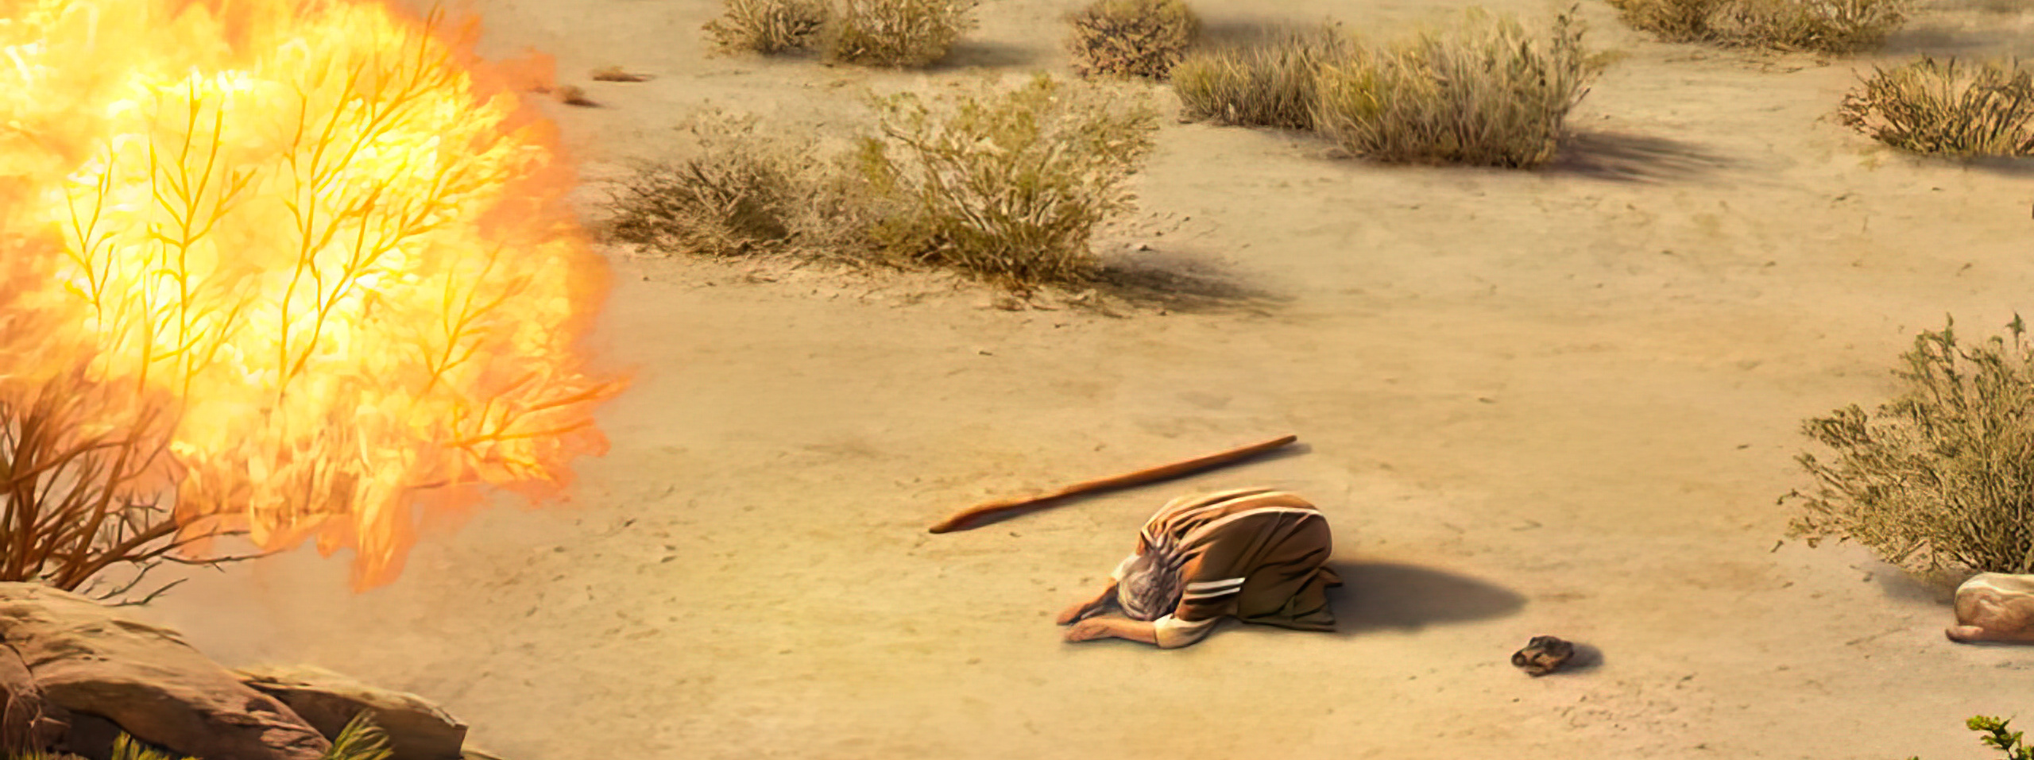
“mg;nghOJ fh;j;jh;: vfpg;jpypUf;fpw vd; [dj;jpd; cgj;jputj;ij ehd; ghh;f;fNt ghh;j;J> MNshl;bfspdpkpj;jk; mth;fs; ,Lfpw $f;Fuiyf; Nfl;Nld;> mth;fs; gLfpw NtjidfisAk; mwpe;jpUf;fpNwd;. mth;fis vfpg;jpahpd; iff;F tpLjiyahf;fTk;> mth;fis me;jj; Njrj;jpypUe;J ePf;fp> fhdhdpaUk; Vj;jpaUk; vNkhhpaUk; nghprpaUk; VtpaUk; vG+rpaUk; ,Uf;fpw ,lkhfpa ghYk; NjDk; XLfpw eyKk; tprhyKkhd Njrj;jpy; nfhz;LNgha;r; Nrh;f;fTk; ,wq;fpNdd;.” ahj;jpuhfkk; 3:7, 8

Slide 3

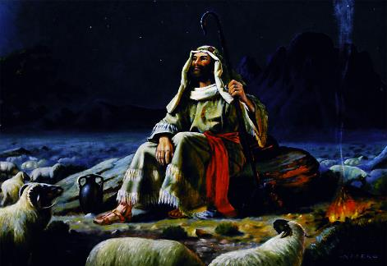
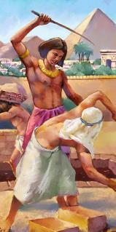
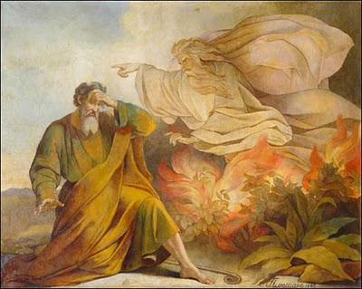







,];uNty; kf;fis tpLtpf;Fk; Kaw;rpapy; Njhy;tpaile;j gpwF, NkhNr kPjpahd; ghiytdj;jpy; 40 tUlq;fs; Nka;g;guhf fopj;jhu;. me;j fhyfl;lj;jpy;, NjtDldhd neUq;fpa cwit njhlu;e;jhYk;, ,];uNtypd; tpLjiyahsu; vd;w vz;zj;ij mtu; iftpl;lhu;.
Mdhy; Njtd; me;j Nahridia iftpltpy;iy. NjtDf;F NkhNr Nju;e;njLf;fg;gl;l tpLjiyahsuhfNt ,Ue;jhu;. Vndd;why; mtu; jk;Kila kf;fspd; Jd;gj;ij kwf;ftpy;iy. ,g;NghJ, ,];uNtiy mtu;fspd; fLikahd mbikj;jdj;jpypUe;J kPl;Lnfhs;s Ntz;ba Neuk; te;Jtpl;lJ.
miog;G (ahj;jpuhfkk; 3):
  vupfpw Kl;nrb (ahj;jpuhfkk; 3:1-6)
  NjtDila cj;juTfs; (ahj; 3:7-12)
  NjtDila ehkk; (ahj; 3:13-22)
Copag;gzpia epiwNtw;Wjy; (ahj; 4):
  rhf;FNghf;Ffs; NkYk; $Ljyhd rhf;FNghf;Ffs; (ahj; 4:1-17)
  vfpg;Jf;F jpUk;Gjy; (ahj; 4:18-31)

Slide 4

miog;G

Slide 5

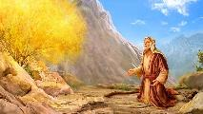
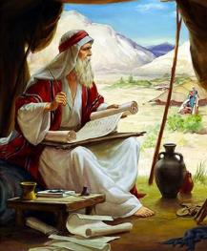
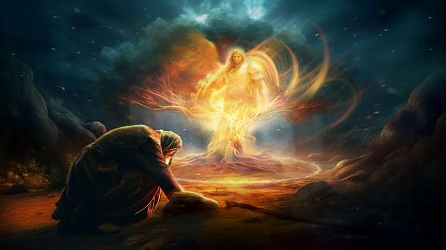
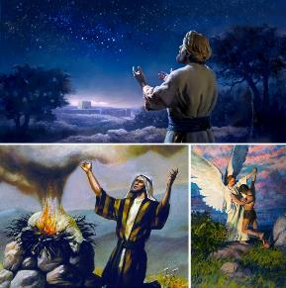
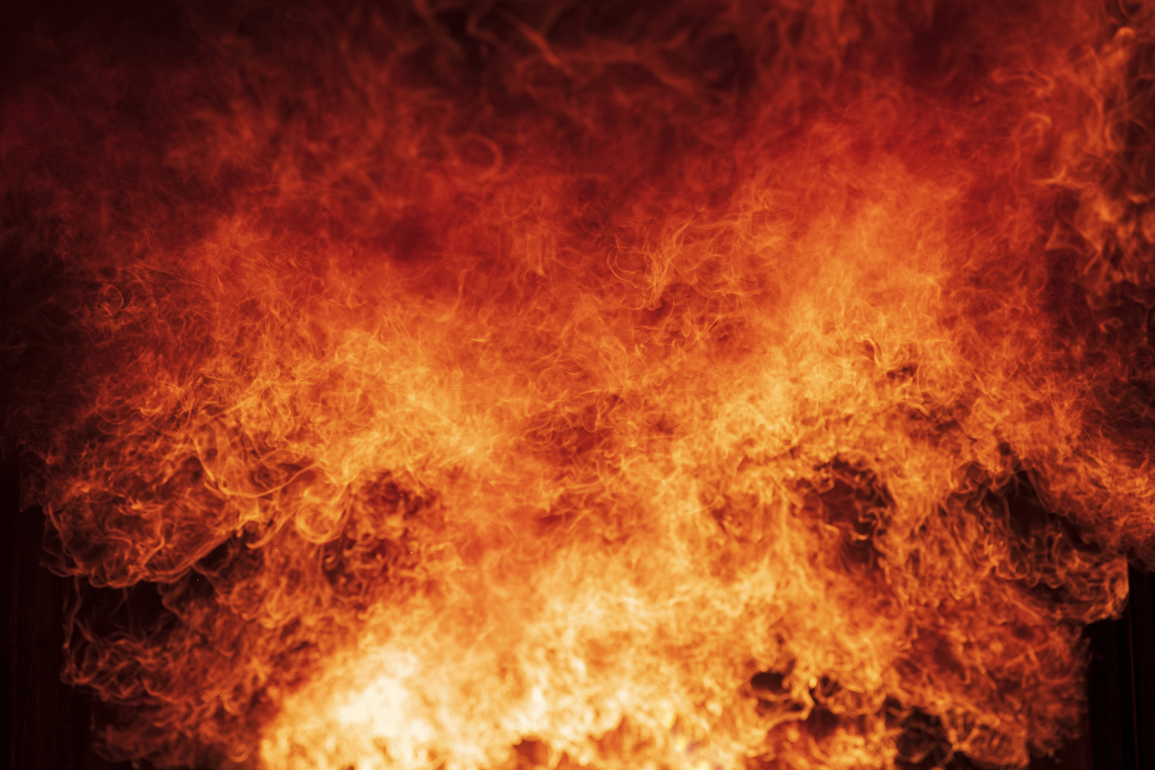
vupfpw Kl;nrb
“mq;Nf fh;j;jUila J}jdhdth; xU Kl;nrbapd; eLtpypUe;J cz;lhd mf;fpdp[{thiyapNy epd;W mtDf;Fj; jhprdkhdhh;. mg;nghOJ mtd; cw;Wg;ghh;j;jhd;@ Kl;nrb mf;fpdpahy; [{thypj;J vhpe;Jk;> mJ nte;JNghfhky; ,Ue;jJ.” (ahj; 3:2)
NkhNr kPjpahd; Njrj;jpy; tho;e;j 40 Mz;Lfis gpd;tUkhW RUf;fkhf $wyhk;: mtu; jpUkzk; nra;J nfhz;lhu;> ,uz;L kfd;fisg; ngw;whu;. NkYk; jdJ khkdhUf;F Nka;g;guhfg; gzpahw;wpdhu;. mtu; me;j Neuj;ij ,uz;L Gj;jfq;fis vOJtjw;Fk; mw;gzpj;jhu;: ,ul;rpg;gpd; Kf;fpakhd fUg;nghUs;fis Gupe;Jnfhs;tjw;F mtrpakhd NahGTk; MjpahfkKk;. Mdhy; vy;yhk; xU fzj;jpy; khwpaJ.
xNugpNy (rPdha; kiy), Njt J}jdhdtu; NkhNrf;F vupfpw Kl;nrbapd; thapyhf juprdkhdhu;(ahj;. 3:1-3). ahu; ,e;j J}jd;? Njtd; jhNk (ahj;. 3:4). kdpj mtjhuk; vLg;gjw;F Kd;ghf> ,NaR gy re;ju;g;gq;fspy; “NahNfhthtpd; J}juhf” Njhd;wpdhu; (Mjp. 22:11-17; epaha 6:11, 16; 13:17-22; rfup. 3:1-2).
NkhNraplk; NgRk;NghJ, Njtd; jd;id Mgpufhk;> <rhf;F kw;Wk; ahf;Nfhgpd; Njtdhf fhl;bdhu;. ,e;j Nfhj;jpu je;ijau;fSf;Ff; nfhLf;fg;gl;l thf;FWjpia epiwNtw;wTk;> ,];uNtYf;F fhdhd; Njrj;ijf; nfhLf;fTk; ,wq;fp te;jhu; vd;gJ njspthf njupe;jJ(Mjp. 12:7; 26:3; 48:3-4).

Slide 6

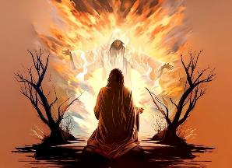
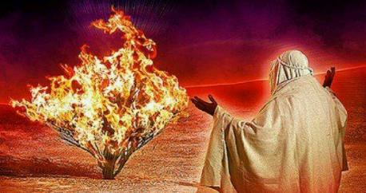
NjtDila cj;juTfs;
“eP ,];uNty; Gj;jpuuhfpa vd; [dj;ij vfpg;jpypUe;J mioj;J tUk;gb cd;idg; ghh;Nthdplj;Jf;F mDg;GNtd; th vd;whh;.” (ahj; 3:10)
Njtd; jd;id xU Mw;wy;kpf;f eguhf ntspg;gLj;Jfpwhu;, nray;tpid nrhw;fis gad;gLj;Jfpwhu;: ghu;f;fpwhu;, ,wq;Ffpwhu;, kw;Wk; ntspNa vLf;fpwhu; (ahj;. 3:7-8).
ghu;f;fpwhu;: Njtd; Jd;gj;ij ghu;j;J myl;rpakhf ,y;iy. mtu; vy;yhtw;iwAk; ghu;f;fpwhu;. Fwpg;ghf jk; kf;fSf;F vjpuhf ,iof;fg;gLk; typiaAk; mePjpiaAk; mtu; fhz;fpwhu; (2 ,uh[h 9:26).
,wq;Ffpwhu;: Njtd; mirahky; ,Ug;gjpy;iy. mtu; ek;kpilNa ,wq;fp tUfpwhu;. mtu; kdpju;fspilNa trpf;fpwhu;
(ahj;. 29:45; Nah. 14:16-17)
ntspNa vLf;fpwhu;: Njtd;, jk;Kila Neuj;jpy;, ek;ik Jd;gj;jpy; ,Ue;J tpLtpj;J> jk;Kila thf;FWjpfis epiwNtw;w nray;gLfpwhu; (vNu. 29:11)
NkhNraplkpUe;Jk; Njtd; jpl;ltl;lkhd nray;fis Nfhupdhu;: vfpg;Jf;F Ngha; vd; [dq;fis mq;fpUe;J mioj;J th (ahj;. 3:10, 12). NkhNr me;j gzpapy; KOikahf Ko;fp Nghdhu;. mtu; ,dp jdJ gyj;ij gad;gLj;j tpUk;gtpy;iy; gzpia epiwNtw;Wk; jpwd; mtUf;F ,y;iy vd;W mtu; ,dp czutpy;iy; “ehd; ahu;?” vd;W kl;LNk mtu; $r;rypl Kbe;jJ, (ahj;. 3:11). mtUila ngUik kdj;jho;ikahf khw;wg;gl;lJ. cz;ikapy;, ,e;j Neuj;jpy; jhd; mtu; me;j gzpf;F jahuhf ,Ue;jhu;.

Slide 7


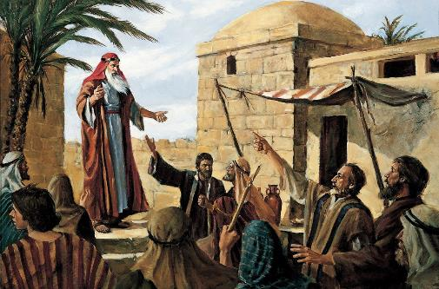
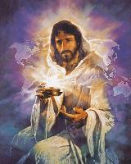
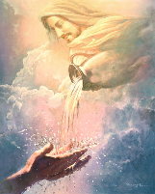
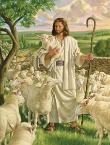
NjtDila ehkk;
“mjw;Fj; Njtd;: ,Uf;fpwtuhf ,Uf;fpNwd; vd;W NkhNrAlNd nrhy;yp> ,Uf;fpNwd; vd;gth; vd;id cq;fsplj;Jf;F mDg;gpdhh; vd;W ,];uNty; Gj;jpuNuhNl nrhy;thahf vd;whh;.” (ahj; 3:14)
Xt;nthU vfpg;jpa flTSf;Fk; ngau; ,Ue;jJ> Mdhy; ,];uNtyu; “ru;t ty;yikAs;s Njtid” tzq;fpdu; (ahj;. 6:3). gy E}w;whz;Lfshf vfpg;jpa khRghl;bw;F gpwF> ,];uNtyu; jq;fs; kPl;gupd; ehkj;ij mwpa tpUk;gpdu; (ahj;. 3:13).
me;j fhyj;jpy; xU ngau; me;j egupd; Fzj;Jld; ,izf;fg;gl;bUe;jjhy;> Njtd; jdJ Kf;fpa gz;Gfspy; xd;iwf; nfhz;L jd;id mwpKfg;gLj;jpf; nfhs;fpwhu;: ‘ahNt(,Uf;fpNwd;). Njtd; epj;jpakhdtu;, vg;NghJk; ,Ue;jpUf;fpwhu;, ,Uf;fpwhu;, vg;NghJk; ,Ug;ghu;. mtu; jhd; “,Uf;fpNwd;” (ahj;. 3:14).
fhyg; Nghf;fpy;, ,e;j ngaupd; cr;rupg;G kiwe;Jtpl;lJ. Njtd; ,ij mDkjpj;jhu;> Vndd;why; Kf;fpakhdJ ngau; my;y mjd; Fzk;. mtu; ek; NjitfSf;Nfw;g khWfpwhu;. mtiu ehk; “Nka;g;gu;,” “kUj;Jtu;,” “Njitfis re;jpg;gtu;,” “mg;gh,” …, “md;G” vd;Wk; miof;fyhk;.
Kf;fpakhd tp\ak; vd;dntd;why;> ehk; neUf;fkhfTk;> mZff;$batuhfTk;> mtrpakhdtuhfTk;> neUq;fpa ez;guhfTk; czug;gl Ntz;Lk; vd;W Njtd; tpUk;Gfpwhu;.

Slide 8
Copag;gzpia epiwNtw;Wjy;

Slide 9

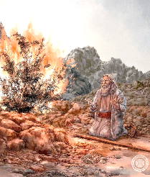
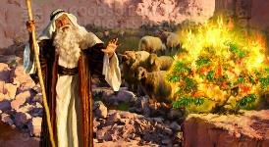
rhf;FNghf;Ffs; NkYk; $Ljyhd rhf;FNghf;Ffs;
«mjw;F mtd;: Mz;ltNu> ePh; mDg;gr; rpj;jkhapUf;fpw ahiuahfpYk; mDg;Gk; vd;whd;.”»
(ahj; 4:13)
Njtd; jd;dplk; xg;gilj;j gzpia epiwNtw;w tpUk;gtpy;iy vdgij ntspg;gilahf xg;Gf;nfhs;tjw;F Kd;> NkhNr mij epuhfupg;gjw;fhd ehd;F “rupahd” rhf;Fg;Nghf;Ffis Kd;itj;jhu;. Xt;nthU rhf;Fg;Nghf;fpw;Fk; Njtd; xU thf;FWjpld; gjpyspj;jhu;
“ehd; vk;khj;jpuk;?” (ahj;. 3:11)
“ehd; cd;NdhNl ,Ug;Ngd;” (ahj;. 3:12)
NjtDila fl;lisia epiwNtw;Wk; ty;yik ek;kplk; ,y;iy> khwhf Njtd; ekf;F mjpfhuk; mspf;fpwhu; vd;gjpy; jhd; cs;sJ. mtu; NkhNrAld; ,Ue;jJ Nghy; ek;KlDk; ,Ug;ghu;
“mtUila ehkk; vd;d?” (ahj;. 3:13)
“,Uf;fpwtuhf ,Uf;fpNwd;” (ahj;. 3:14)
Njtd; cz;ikahdtu;, epj;jpakhdtu;, jdpg;gl;ltu;; mtu; thf;FWjp mspf;fpwhu;> vg;NghJk; jdJ thf;FWjpfis fhg;ghw;Wfpwhu;; mtu; fhyj;jhy; mopahjtu;; vg;NghJk; ek;gfkhdtu;.
“mth;fs; vd;id ek;ghh;fs;@ vd; thf;Ff;Fr; nrtpnfhlhh;fs;@” (ahj;. 4:1)
“…milahsj;ijf; fz;L ek;Gthh;fs;.” (ahj;. 4:8)
NkhNrf;F mw;Gjq;fis nra;a Njtd; ty;yikiaf; nfhLj;jhu;, NkYk; me;j mw;Gjq;fis ek;Gk;gb kf;fspd; ,jaq;fspy; mtu; nray;gl;lhu;. ,NaRTk; ekf;F mijNa nra;tjhf thf;FWjp mspj;jhu; (khw;F 16:17-18).
“ehd; jpf;FthAk; ke;j ehTk; cs;std;” (ahj;. 4:10)
“ehd; cd; thNahNl ,Ue;J> eP NgrNtz;baij cdf;Fg; Nghjpg;Ngd;”
(ahj;. 4:12)
ehitg; gilj;jtu; ekf;F Njitahd thu;j;ijfis Njitahd Neuj;jpy; jUthu; (ahj;. 4:11; Y}f;fh 12:11-12)
,Wjpahf, Njtd; NkhNraplk;, “NghJk; cdJ rhf;Fg;Nghf;Ffs;; cd;dhy; KbAk;, eP nra;tha;” vd;W $wpdhu;(ahj;. 4:14-17).

Slide 10


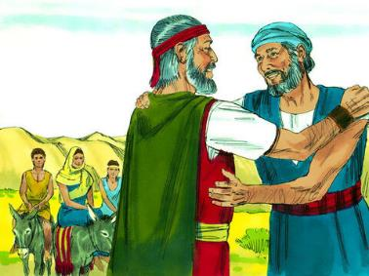
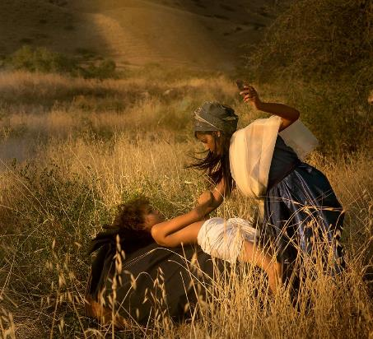
vfpg;Jf;F jpUk;Gjy;
“topapNy jq;Fk; ,lj;jpy; fh;j;jh; mtDf;F vjph;g;gl;L> mtidf; nfhy;yg;ghh;j;jhh;.” (ahj; 4:24)
vfpg;jpw;F jpUk;Gtjw;F NkhNr vLj;j Kjy; gb> jdJ khkdhuplk; mDkjp Nfl;gJjhd;(ahj;. 4:18 ). jdJ FLk;gj;jpdiu mioj;Jf;nfhz;L gazj;ij njhlu;e;jhu;(ahj;. 4:20). Mdhy; Mr;rupakhd xd;W ele;jJ. topapy;, Njtd; mtiu nfhy;yg; ghu;j;jhu; (ahj;. 4:24 ).
vd;d elf;fpwJ vd;gij rpg;Nghuhs; Gupe;Jnfhz;lhs;, NkYk; kuzj;ij jtpu;f;f Njitahd eltbf;iffis vLj;jhs;: mts; jd; kfDf;F tpUj;jNrjdk; nra;jhs; (ahj;. 4:25).
NkhNr (jd; kidtpahy; ghjpf;fg;gl;ltu;) jd; kfDf;F tpUj;jNrjdk; nra;atpy;iy. vdNt, Njtd; MgpufhKld; Vw;gLj;jpa cld;gbf;ifapd; epge;jidfis mtd; kPwpdhd; (Mjp. 17:10).
njspthd nja;tPf fl;lisf;F fPo;gba NkhNr kdg;G+u;tkhf kWj;jjhy;> mtu; kf;fis topelj;Jk; jFjpia ,oe;jhu;. jdJ gzpia epiwNtw;Wtjw;F Kd;G ,e;j epiyik rupnra;ag;gl Ntz;bapUe;jJ.

