Slide 1

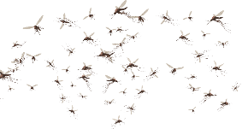
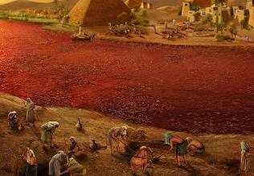
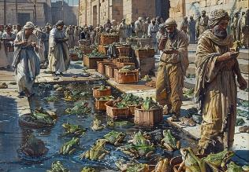
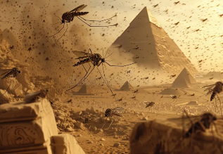
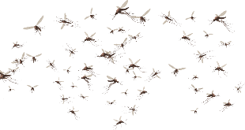
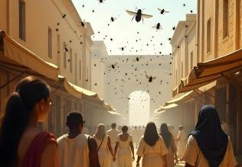
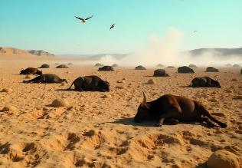
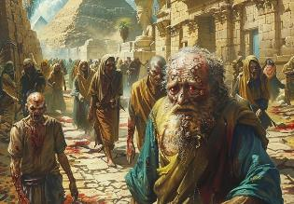
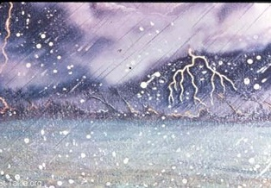
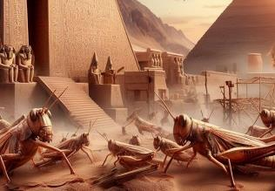
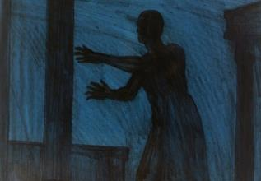
Thijfs;
ghlk; 4 [_iy 26, 2025

Slide 2
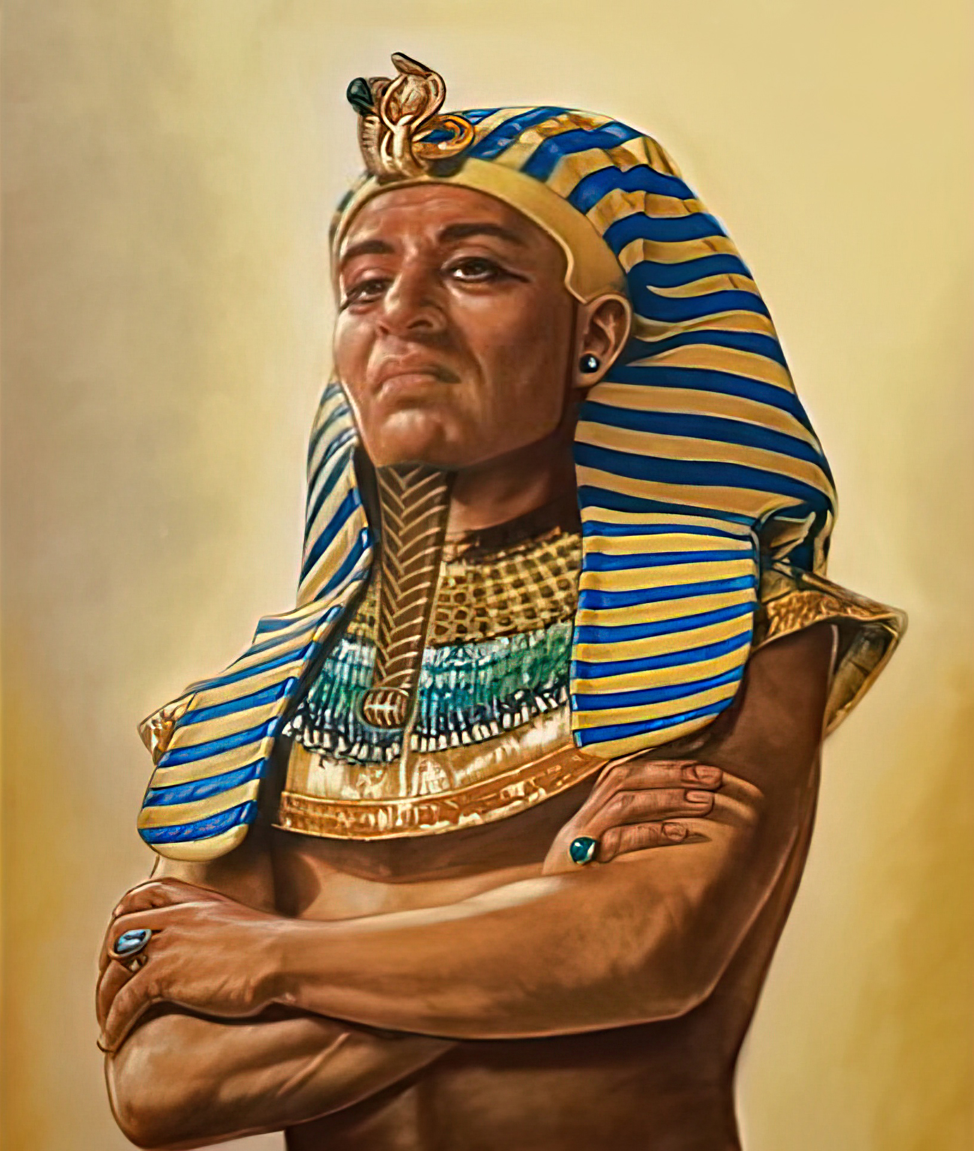
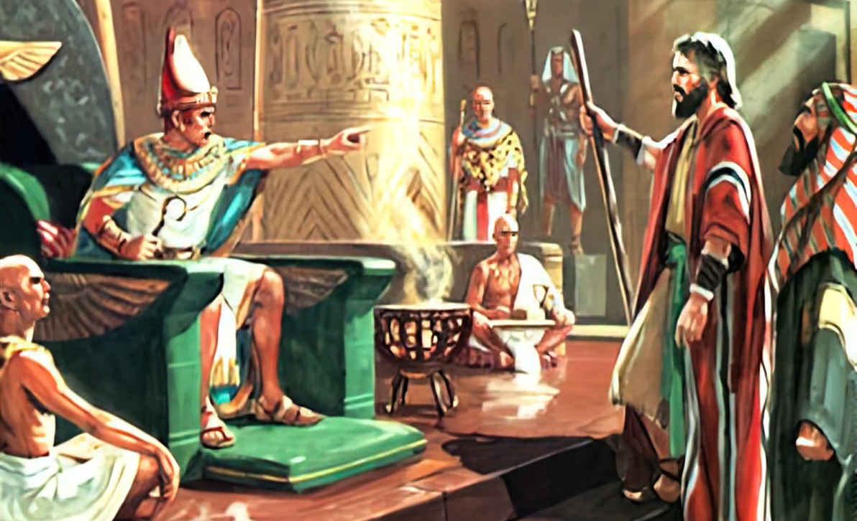
“fh;j;jh; NkhNriaf;nfhz;L nrhy;ypapUe;jgbNa> ghh;Nthdpd; ,Ujak; fbdg;gl;lJ@ mtd; ,];uNty; Gj;jpuiug; Nghftpltpy;iy.” ahj; 9:35

Slide 3

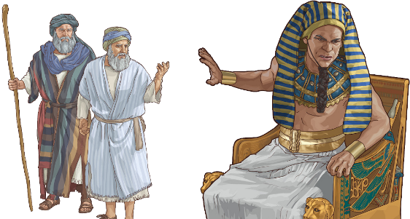
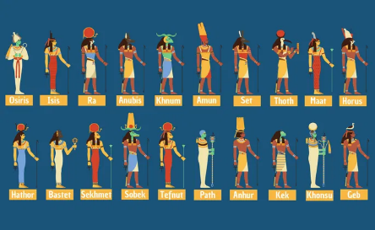
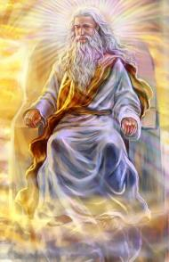




Njt [dq;fs; Nghiu vjpu;nfhz;l NghJ, Kjypy; rkhjhd Ngr;Rthu;j;ij elj;Jk;gb Njtd; mtu;fSf;F fl;lisapl;lhu;. xU cld;gbf;if vl;lKbahtpl;lhy;, eltbf;if vLf;fg;glNtz;Lk; (cgh. 20:10-12).
Njtd; vfpg;ij ,g;gbj;jhd; ifahz;lhu;. xU mikjpahd jPu;Tf;F Kaw;rpf;fg;gl;lJ, Mdhy; Jl;Nkh]; mij Vw;f kWj;Jtpl;lhu;. eltbf;if vLf;f Ntz;ba Neuk; te;Jtpl;lJ.
thijfs; te;J tpOe;j NghJ, gue;j vfpg;jpa nja;t FOtpy; ,Ue;j ve;j flTshYk; xNu cz;ikahd NjtDila ty;yikapypUe;J vfpg;ij ghJfhf;f Kbatpy;iy.
Kd;Diu:
  ghk;G rz;il (ahj; 7:8-12)
  fbdg;gLj;jg;gl;l ,Ujak; (ahj; 7:13)
thijfs;:
  %d;W Nyrhd thijfs; (ahj; 7:14-8:19)
  %d;W fLikahd nfhs;isNeha;fs; (ahj; 8:20-9:12)
  %d;W NguopT jUk; thijfs; (ahj; 9:13-10:29)

Slide 4

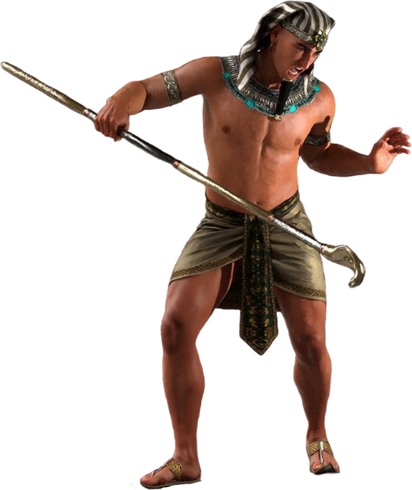
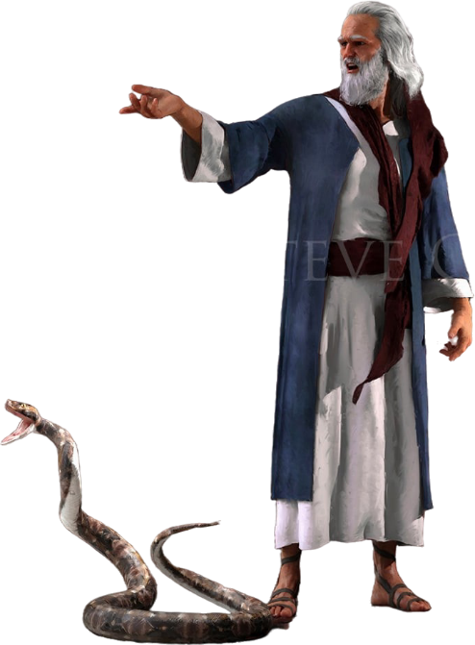
Kd;Diu

Slide 5

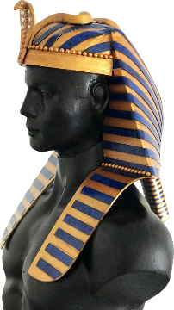
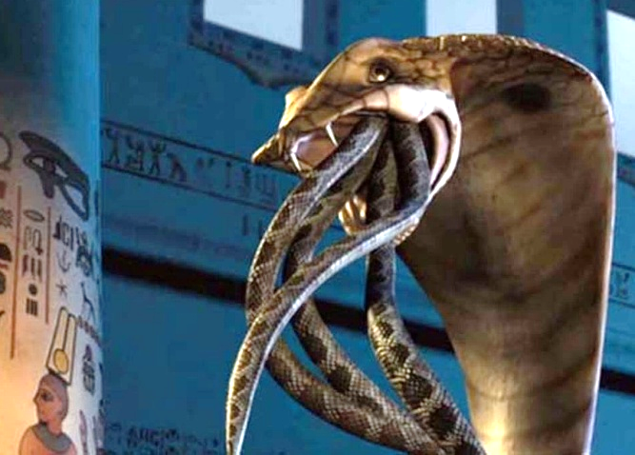
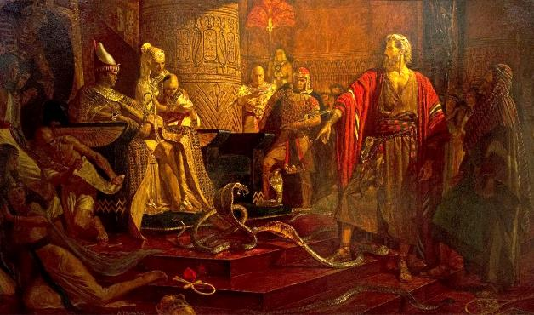
ghk;G rz;il
“mth;fs; xt;nthUtdhfj; jd; jd; Nfhiyg; Nghl;lNghJ> mitfs; rh;g;gq;fshapd@ MNuhDila NfhNyh mth;fSila Nfhy;fis tpOq;fpw;W..” (ahj; 7:12)
,];uNtiy tpLjiy nra;tJ> vfpg;jpa flTs;fSf;F vjpuhfj; jhk; jdpg;gl;l Kiwapy; elj;jpa Nghu; vd;W Njtd; ntspg;gLj;jpdhu;(ahj;. 12:12; vz;. 33:4).
jdJ ty;yikapd; milahskhf> jdJ fpuPlj;jpy;, ghu;Nthd; cj;Naj; nja;tj;ijf; Fwpf;Fk; xU mofhd ehf ghk;ig mzpe;jpUe;jhd;.
me;j Nfhiy ghk;ghf khw;wpajd; %yk;, Njtd; me;j nja;tj;jpw;F Neubahf rthy; tpLj;jhu; (ahj;. 7:10). mtshy; ghu;Nthid ghJfhf;f KbAkh?
rhj;jhd; ke;jputhjpfs; %yk; mw;Gjj;ij elg;gpj;jhd;
(ahj;. 7:11). Mdhy; mtdhy; capiu gilf;f ,ayhJ; mtDila ghk;Gfs; ghk;Gfs; NghyNt ,Ue;jd. ,Ug;gpDk;, Njtd; capUs;s capudq;fis tpOq;Fk; jpwd; nfhz;l xU capUs;s ghk;ig gilj;jpUe;jhu; (ahj;. 7:12).
,t;thW Njtd; vfpg;jpa flTs;fs; my;y> jhNk ,iwahz;ikiaAk; mjpfhuj;ijAk; nfhz;ltu; vd;gij fhl;bdhu;.

Slide 6

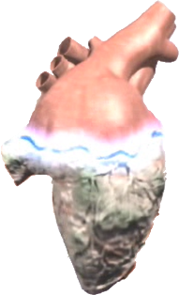
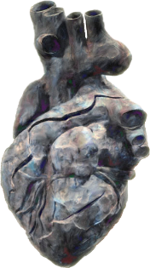


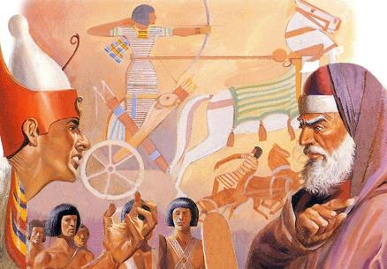

fbdg;gLj;jg;gl;l ,Ujak;
“fh;j;jh; nrhy;ypapUe;jgb ghh;Nthdpd; ,Ujak; fbdg;gl;lJ> mth;fSf;Fr; nrtpnfhlhkw;Nghdhd;.” (ahj; 7:13)
ahj;jpuhfk Gj;jfj;jpy;, Njtd; ghu;Nthdpd; ,Ujaj;ij fbdg;gLj;jpdhu; vd;W 9 Kiw $wg;gl;Ls;sJ (ahj;. 4:21; 7:3; 9:12; 10:1; 10:20; 10:27; 11:10; 14:4; 14:8), NkYk; 9 Kiw ghu;Nthd; jd; ,jaj;ijf; fbdg;gLj;jpf; nfhz;ljhff; $wg;gLfpwJ(ahj;. 7:13; 7:14; 7:22; 8:15; 8:19; 8:32; 9:7; 9:34; 9:35). rup rkk;! ghu;Nthdpd; ,jaj;ij fbdg;gLj;jpaJ ahu;?
Kjy; Ie;J thijfSf;F gpwF, ghu;Nthd; jd; ,jaj;ij fbdg;gLj;jpdhd; vd;W ntspg;gilahff; $wpdhd;. mjhtJ, ,];uNtiy tpLjiy nra;a gupRj;j Mtpapd; miog;Gf;F mtd; Neu;kiwahf gjpyspf;f kWj;Jtpl;lhd;.
MwhtJ thijf;F gpd;, Njtd; mtd; ,jaj;ij fbdg;gLj;jpdhu; (ahj;. 9:12). ghu;Nthd; kde;jpUk;Gjypd; vy;iyia jhz;btpl;lhd; vd;gJ njspthfj; njupfpwJ. ,Ug;gpDk;, VohtJ thijapy;, mtDf;F ,d;ndhU tha;g;G toq;fg;gLfpwJ, Mdhy; mtd; kPz;Lk; jd; ,jaj;ij fbdg;gLj;Jfpwhd; (ahj;. 9:34-35 ).
mg;NghjpUe;J, mtDila tpjp epr;rapf;fg;gl;lJ. ghu;Nthd; kde;jpUk;Gtjpy;iy vd;W cWjpahf KbT nra;jjhy;> Njtd; mtDila ,jaj;ij fbdg;gLj;jpdhu;.

Slide 7

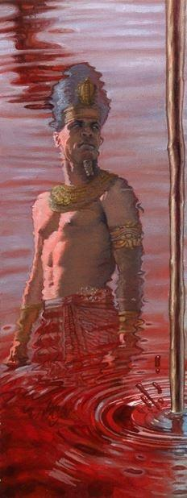
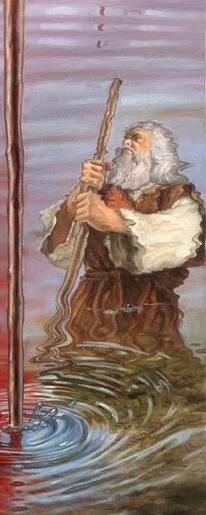
thijfs;

Slide 8

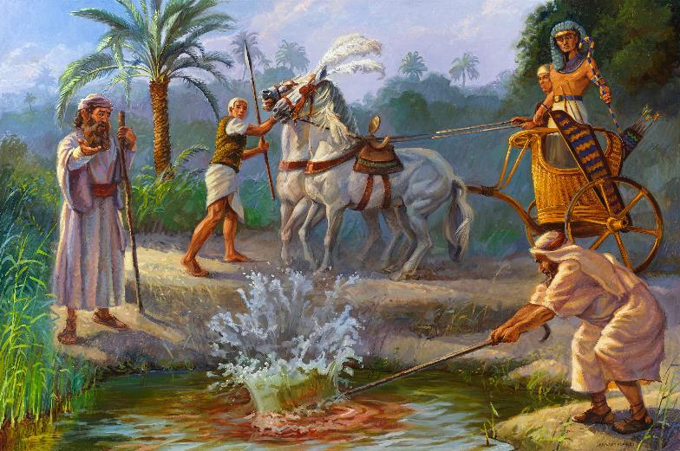
Kjy; thij (Nyrhd): ,uj;jk;
“,Njh> vd; ifapy; ,Uf;fpw Nfhypdhy; ejpapy; ,Uf;fpw jz;zPh;Nky; mbg;Ngd;@ mg;nghOJ mJ ,uj;jkha; khwp>” (ahj; 7:17)
`g;gp, iey; ejpapd; flTs;
ahj;jpuhfkk; 7:14-25
iey; ejp, mjd; nts;sj;jhy;, vfpg;Jf;F capu; nfhLj;jJ. Mdhy; ePu; Mjhuq;fis cUthf;fpatu; ahu;? ke;jputhjpfs; jz;zPu; khw;wj;ij cUtfg;gLj;jpdu;> Mdhy; mtu;fshy; mij jiyfPohf khw;w Kbatpy;iy.

Slide 9

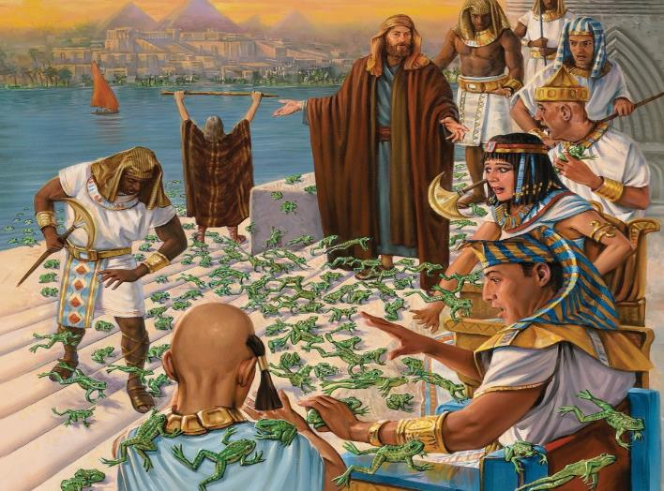
,uz;lhk; thij (Nyrhd): jtisfs;
“NkYk; fh;j;jh; NkhNrapdplj;jpy; eP MNuhid Nehf;fp: eP cd; ifapy; ,Uf;fpw Nfhiy ejpfs;NkYk; tha;f;fhy;fs;NkYk; Fsq;fs;NkYk; ePl;b> vfpg;J Njrj;jpd;Nky; jtisfis tUk;gb nra; vd;W nrhy; vd;whh;.” (ahj; 8:5)
`f;fl;, jtisfspd; flTs;
ahj;jpuhfkk; 8:1-15
kPz;Lk; ke;jputhjpfs; thijia gpujpgypf;f ghu;j;jdu;> Mdhy; mtu;fshy; mij jLf;f Kbatpy;iy.

Slide 10

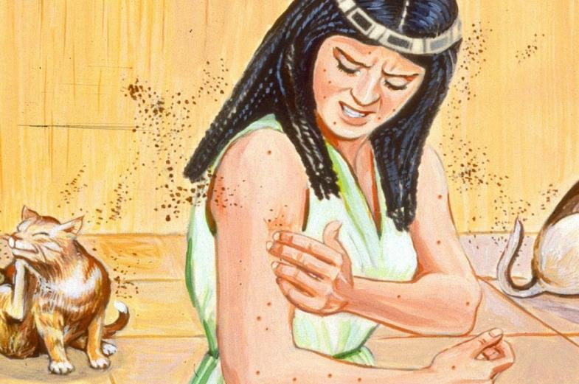
%d;whk; thij (Nyrhd): Ngd;fs;
“mg;nghOJ fh;j;jh; NkhNrapdplj;jpy;: eP MNuhid Nehf;fp: cd; Nfhiy ePl;b> G+kpapd; GOjpapd;Nky; mb@ mg;nghOJ mJ vfpg;J Njrk; vq;Fk; Ngd;fsha;g; Nghk; vd;W nrhy; vdwhh;.” (ahj; 8:16)
nfg;, G+kpf;fhd flTs;
ahj;jpuhfkk; 8:16-19
G+kpapd; J}spypUe;J capiug; gilj;jhuh (Mjp. 1:24)? thijfspd; Njhw;wk; Fwpj;J ,dp ve;j re;NjfKk; ,y;iy: “,J NjtDila tpuy;” (ahj; . 8:19). ke;jputhjpfs; ,Wjpahf mikjpahfptpl;ldu;.

Slide 11

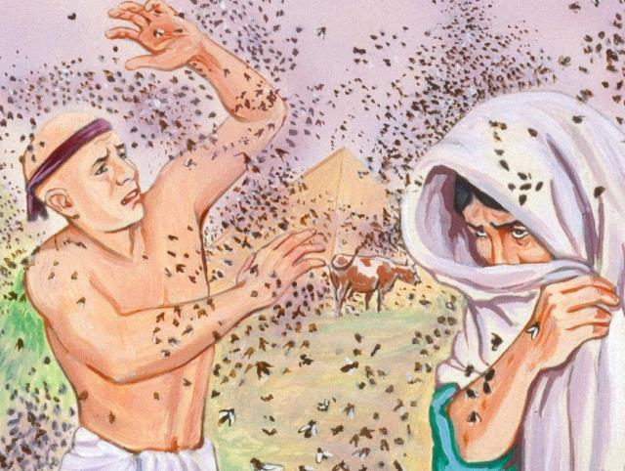
ehd;fhtJ thij (fbdkhd): tz;Lfs;
“mg;gbNa fh;j;jh; nra;jhh;@ kfh jpushd tz;L [hjpfs; ghh;Nthd; tPl;bYk;> mtd; Copaf;fhuh; tPLfspYk;> vfpg;J Njrk; KOtjpYk; te;jJ@ tz;LfspdhNy Njrk; nfl;Lg;Nghapw;W.” (ahj; 8:24)
Cl;rpl;, rJg;G epyq;fspd; nja;tk;
ahj;jpuhfkk; 8:20-32.
Kjy;Kiwahf, ,];uNtyu;fs; thijapypUe;J ghJfhf;fg;gl;ldu;. ,J ghu;Nthid Ngr;R thu;j;ijf;F ,l;Lr; nrd;wJ, Mdhy; mtu; ,Wjpapy; Nguj;jpd; Kbit jtwptpl;lhu;.

Slide 12

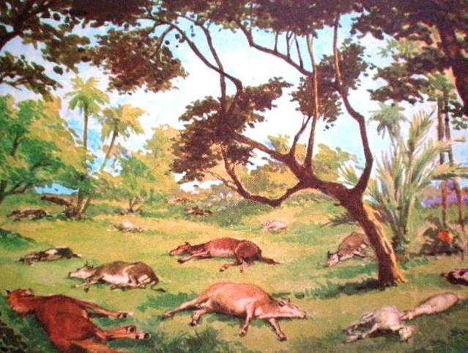
Ie;jhtJ thij (fLikahd): kpUf[Ptd;fspd; nfhs;isNeha;
“fh;j;jUila fuk; ntspapypUf;fpw cd; kpUf[Ptd;fshfpa Fjpiufspd;NkYk; fOijfspd;NkYk; xl;lfq;fspd;NkYk; MLkhLfspd;NkYk; ,Uf;Fk;@ kfh nfhbjhd nfhs;isNeha; cz;lhFk;.” (ahj; 9:3)
f;Dk;, cUthf;Fk; flTs;
ahj;jpuhfkk; 9:1-7.
gy flTs;fSf;F tpyq;Ffspd; jiyfs; ,Ue;jd, vdNt ,e;j nfhs;is Neha; mtu;fspy; ngUk;ghNyhiu mtkhdg;gLj;jpaJ.

Slide 13

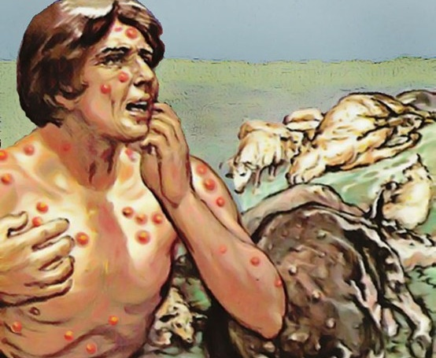
MwhtJ thij (fLikahd): vupge;jkhd nfhg;Gsq;fs;
“mg;gbNa mth;fs; #isapd; rhk;giy ms;spf;nfhz;L> ghh;NthDf;F Kd;ghf te;J epd;whh;fs;. NkhNr mij thdj;Jf;F Neuhf ,iwj;jhd;@ mg;nghOJ kdpjh;NkYk; kpUf[Ptd;fs;NkYk; vhpge;jkhd nfhg;Gsq;fs; vOk;gpw;W.” (ahj; 9:10)
Nrf;nkl;, Rfk; nfhLf;fpw flTs;
ahj;jpuhfkk; 9: 8-12 .
ke;jputhjpfshy; $l jq;fis jhq;fNs Fzkhf;fpf; nfhs;s Kbatpy;iy(ahj;. 9:11). thijfspd; %yj;ij gw;wp ghu;NthDf;F ve;j re;NjfKk; ,y;iy. Mdhy; mtd; NjtDf;F Kd;ghf tzq;f kWj;Jtpl;lhd;, mtDila fyfj;jpd; gyid mtd; mWtil nra;a Njtd; mDkjpj;jhu; (ahj;. 9:12).

Slide 14

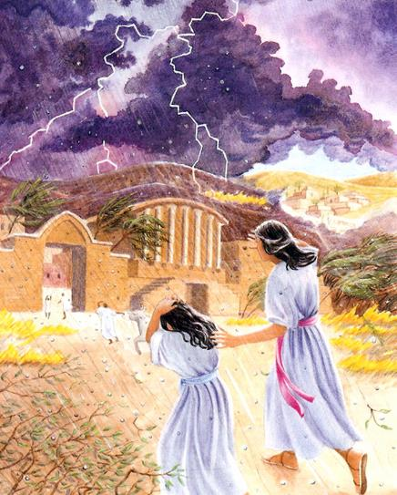
VohtJ thij (NguopT): fy;kio
“vfpg;J Njhd;wpa ehs;Kjy; ,Jtiuf;Fk; mjpy; nga;ahj kpfTk; nfhba fy;kioia ehis ,e;Neuk; nga;ag;gz;ZNtd;.” (ahj; 9:18)
el;, Mfhaj;jpd; flTs;
ahj;jpuhfkk; 9:13-35.
vfpg;jpau;fspd; tpRthrk; Nrhjpf;fg;gl;lJ. tpRthrpj;jtu;fs; jq;fs; Ntiyf;fhuu;fspd; capiuAk; fhyeilfisAk; ghJfhj;jhu;fs; (ahj;. 9:20). ghu;Nthd; tpRthrpf;ftpy;iy, mtd; jd; ghtj;ij xg;Gf;nfhz;lhYk;, mtDila ghtmwpf;if cz;ikahf ,y;iy (ahj;. 9:27-30).
Nrj;, Gay;fSf;fhd flTs;

Slide 15

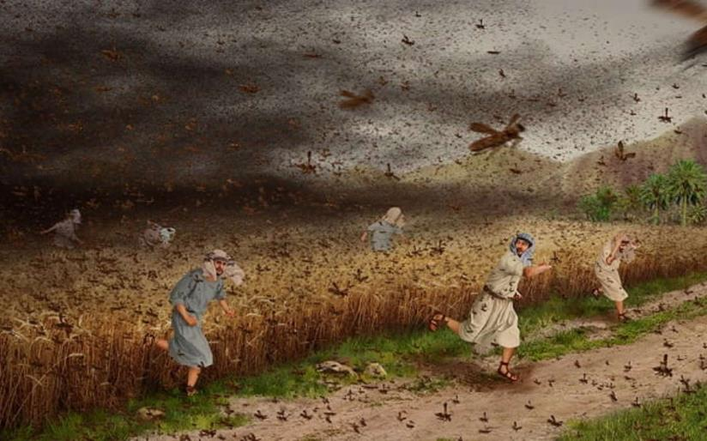
vl;lhtJ thij (NguopT): ntl;Lf;fpsp
“eP vd; [dq;fisg; Nghftplkhl;Nld; vd;ghahfpy;> ehd; ehisf;F cd; vy;iyfSf;Fs;Ns ntl;Lf;fpspfis tug;gz;ZNtd;.” (ahj; 10:4)
Neg;ghu;, jhdpaq;fSf;fhd flTs;
ahj;jpuhfkk; 10:1-20.
vfpg;J NguopTf;Fs;shdjhy;, vfpg;jpau;fs; jhq;fshfNt ,];uNtiy tpLtpf;Fk;gb ghu;Nthdplk; nfQ;rpdu; (ahj;. 10:7).

Slide 16

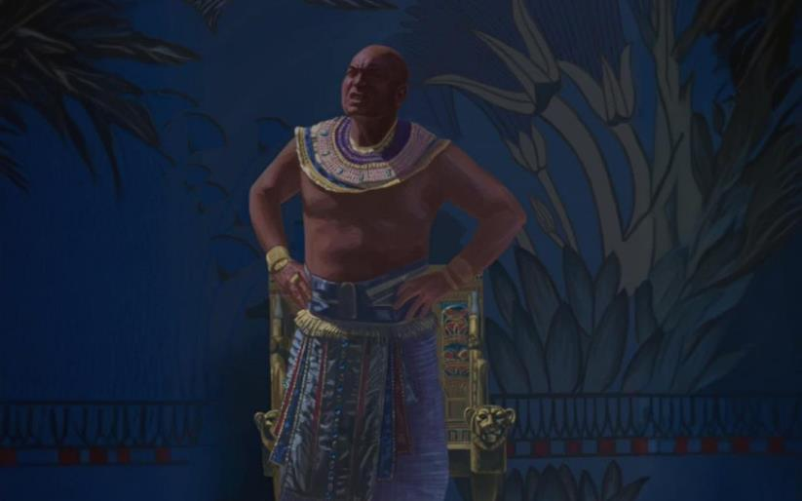
Xd;gjhtJ thij (NguopT): ,Us;
“mg;nghOJ fh;j;jh; NkhNria Nehf;fp: jltpf;nfhz;bUf;fj;jf;fjhd ,Us; vfpg;J Njrj;jpd;Nky; cz;lhFk;gbf;F> cd; ifia thdj;jpw;F Neuhf ePl;L vd;whh;.” (ahj; 10:21)
uh, R+upaf; flTs;
ahj;jpuhfkk; 10:21-29.
%d;W ehl;fSf;F vfpg;jpd; tho;f;if ];jk;gpj;jJ (NfhNrid jtpu). Njtd; rpe;jpf;f xU Neuj;ij toq;fpdhu;, Mdhy; ghu;Nthd; mij KOikahf gad;gLj;jpf; nfhs;stpy;iy.

