Slide 1
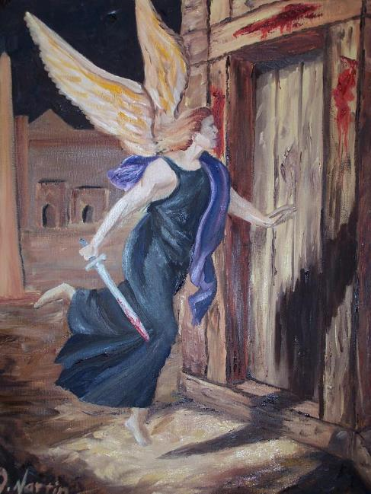
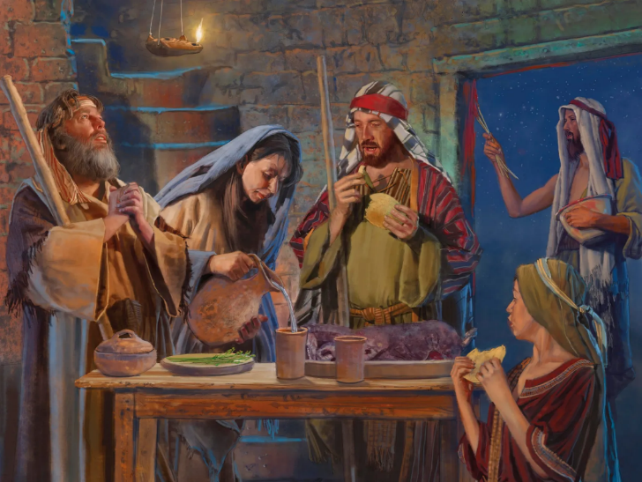
g];fh
ghlk; 5 Mf];l; 2, 2025

Slide 2
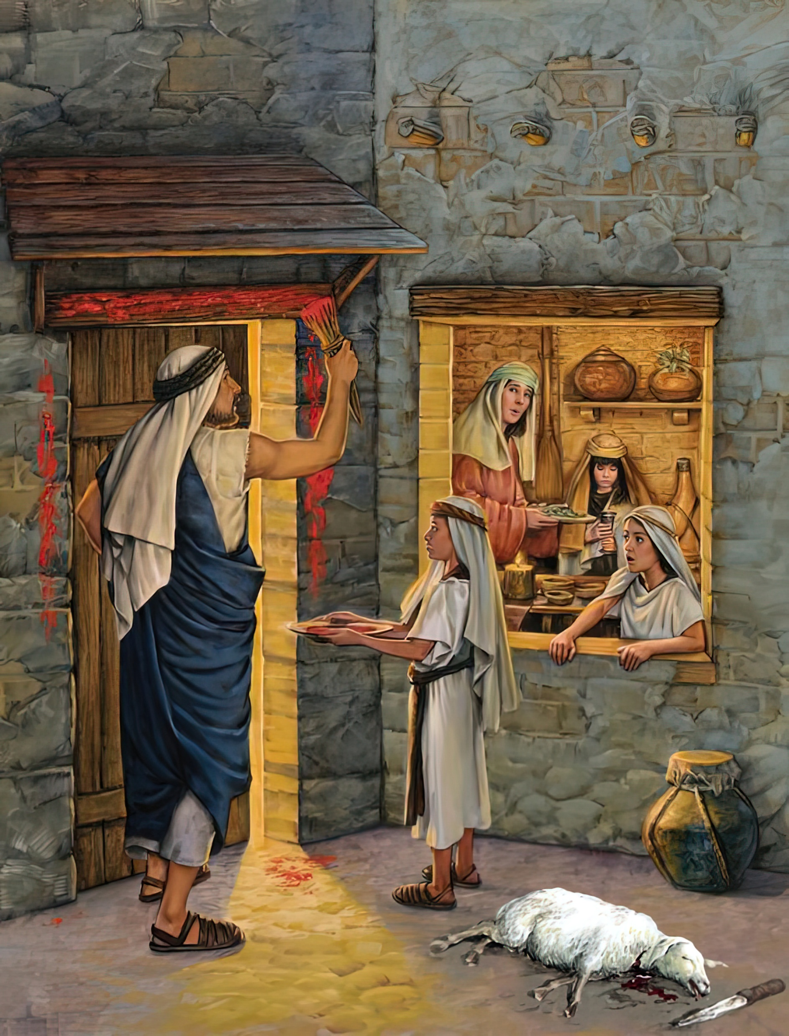
“mg;nghOJ cq;fs; gps;isfs;: ,e;j Muhjidapd; fUj;J vd;d vd;W cq;fisf; Nfl;lhy;> ,J fh;j;jUila g];fhthfpa gyp@ mth; vfpg;jpaiu mjk;gz;zp> ek;Kila tPLfisj; jg;gg;gz;zpdNghJ> vfpg;jpypUe;j ,];uNty; Gj;jpuUila tPLfisf; fle;JNghdhh; vd;W ePq;fs; nrhy;yNtz;Lk; vd;whd;. mg;nghOJ [dq;fs; jiytzq;fpg; gzpe;Jnfhz;lhh;fs;. ”
ahj;jpuhfkk; 12:26, 27

Slide 3

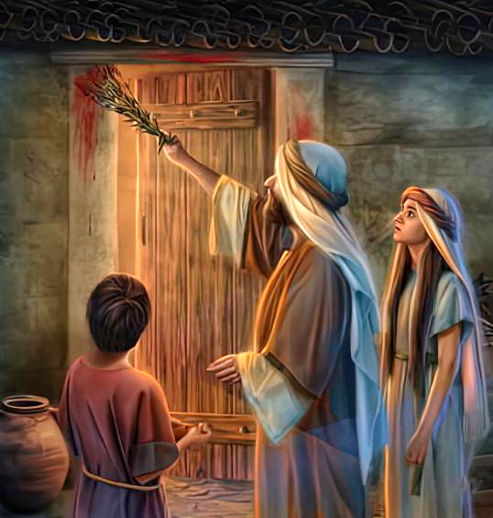
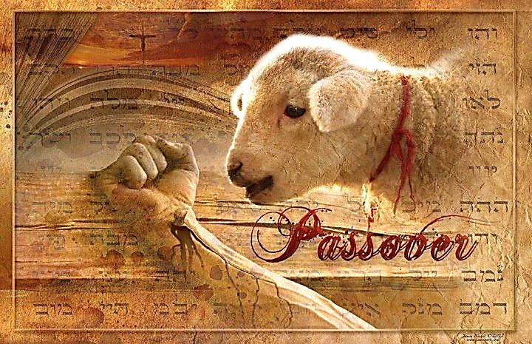
NjtDila fl;lisfis gpd;gw;w kWj;j vfpg;jpy; cs;s xt;nthU FLk;gj;ijAk; gj;jhtJ thij jhf;fpaJ. mJ jpBnud;W tutpy;iy, Mdhy; gy ehl;fSf;F Kd;Ng mwptpf;fg;gl;lJ.
cz;ikapy; mJ tpRthrj;jpd; xU Nrhjid. me;j ,utpy; ahUk; ,wf;f Ntz;ba mtrpakpy;iy. Xt;nthUtUf;Fk; jq;fs; Kjy; Foe;ijapd; capiu fhg;ghw;w tha;g;G fpilj;jJ.
Ml;Lf;Fl;bahdtu; khj;jpuNk fz;ldk; nra;ag;gl;lhu;. mtu; kl;LNk kupf;f Ntz;Lk;. mtuJ ,uj;jk; kl;LNk rq;fhu J}jid fle;J nry;y nra;Ak;. Vd;? Vndd;why; fpwp];J kl;LNk ,ul;rpf;fpwhu;. NkYk; ,J jiyKiw jiyKiwahf epidT$ug;gl Ntz;Lk;… mtu; tUk; tiu.
vr;rupf;if (ahj;jpuhfkk; 11)
Maj;jk; (ahj;jpuhfkk; 12:1-16)
,uj;jKk; kJtKk; (ahj;jpuhfkk; 12:17-23)
epidT$u;e;J Nghjpf;f Ntz;Lk; (ahj; 12:24-28)
gj;jhtJ thij (ahj; 12:29-30)

Slide 4


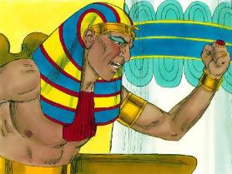
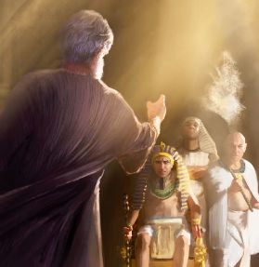
vr;rupf;if
“mg;nghOJ fh;j;jh; NkhNria Nehf;fp: ,d;Dk; xU thijiag; ghh;Nthd;NkYk; vfpg;jpd;NkYk; tug;gz;ZNtd;@ mjw;Fg;gpd; mtd; cq;fis ,t;tplj;jpypUe;J NghftpLthd;@ r%ykha; cq;fisg; NghftpLtJk; my;yhky;> cq;fis ,t;tplj;jpypUe;J Juj;jpAk; tpLthd;.” (ahj;jpuhfkk; 11:1)
nja;tPf epahaj;jPu;g;G Neuk; te;Jtpl;lJ (ahj;. 12:12):
%d;W ehl;fs; ,Ul;bw;F gpwF, ghu;Nthd; NkhNr kPJ Nfhgkile;J> muz;kidf;F tUtij jLj;jhd;(ahj;. 10:28).
ngUik, jpkPu; gpbj;jtu; kw;Wk; Ruz;ly; nra;gtu;fSf;F: jz;lid, kw;Wk; kpul;b gzk; gwpf;fg;gLtij jpUg;gp juNtz;ba flik
(ahj;. 11:4-5, 2)
NjtDila fl;lisfSf;F fPo;gbe;jtu;fshf: jz;lidia fle;J tUk;gbAk;, tpLjiyailAk; gbahfTk; (ahj; . 11:7-8)
Mdhy; NkhNr ,e;j fl;lisf;F fPo;gba Kbatpy;iy, Vndd;why; ghu;Nthdpd; Kjy; kfdpd; capu; Mgj;jpy; ,Ue;jJ. ghu;Nthdpd; “flTshf” (ahj;. 7:1) NkhNr, ghu;Nthd; vd;d nra;a Ntz;Lk; vd;gij vr;rupf;f Ntz;bapUe;jJ (MNkh]; 3:7).
,g;NghJ NkhNrjhd; Nfhgj;Jld; ghu;Nthdpd; gpurd;dj;ij tpl;L ntspNawpdhu;. ghu;Nthdpd; gpbthjj;ijAk; mtuJ Kbtpd; tpisTfisAk; fz;L Nfhgkile;jhu;. NkhNria kjpj;j NghjpYk;, gy vfpg;jpau;fs; vr;rupf;ifia ftdpf;f kwe;Jtpl;ldu; (ahj;. 11:3).

Slide 5


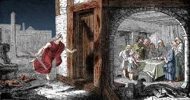
Maj;jk;
“ePq;fs; ,];uNty; rigahh; ahtiuAk; Nehf;fp: ,e;j khjk; gj;jhk; Njjpapy; tPl;Lj;jiyth;fs;> tPl;Lf;F xU Ml;Lf;Fl;bahf> xt;nthUtUk; xt;nthU Ml;Lf;Fl;biaj; njhpe;J nfhs;sf;flth;fs;.” (ahj; 12:3)
rq;fhu Jhjd; “fle;J nry;yTk;” (ngrhf;> g];fh);> Kjw;Ngwhdtu;fs; ,wf;fhky; ,Uf;f mtu;fs; vd;d nra;a Ntz;Lk; vd;gijAk; vd;gijAk; Njtd; tpupthf tpsf;fpdhu;:
10Mk; Njjp xt;nthU FLk;gj;jpw;Fk; my;yJ gy FLk;gq;fSf;Fk; Fiwghlw;w xU Ml;Lf;Fl;bia xJf;fp itf;fNtz;Lk; (ahj;. 12:3-5).
14Mk; Njjp, me;jp Ntisapy;, mtu;fs; mij gypapl Ntz;Lk; (ahj;. 12:6)
mtu;fs; jq;fs; fjT epiyfisAk; fjT epiyfspd; Nkw;rl;lj;ijAk;> mjpd; ,uj;jj;jhy; mgpN\fk; nra;a Ntz;Lk; (ahj;. 12:7)
mtu;fs; ,iwr;r;pia KOtJkhf tWj;J, Gspg;gpy;yhj mg;gk; kw;Wk; frg;ghd %ypiffSld; Grpf;f Ntz;Lk;
(ahj;. 12:8-10)
mtu;fs; mij mtrukhf rhg;gpLk;NghJ, mtu;fs; cil mzpe;J nry;y jahuhf ,Uf;f Ntz;Lk; (ahj;. 12:11)
mtu;fs; vfpg;ij tpl;L ntspNawpa NghJ, VO ehl;fs; Gspg;gpy;yhj mg;gj;ij njhlu;e;J rhg;gplNtz;bapUe;jJ (ahj;. 12:15)
jk;Kila kf;fs; jk;ik tzq;fTk;> jk;Kila fpUigia mtu;fs; Gupe;Jnfhs;sTk; Njtd; mtu;fis Maj;jg;gLj;jpdhu; (ahj;. 12:27gp).

Slide 6


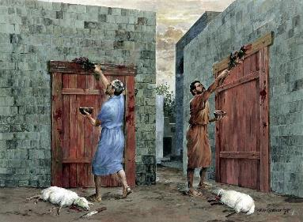
,uj;jKk; kJtKk;
“mg;nghOJ NkhNr ,];uNty; %g;gh; ahtiuAk; miog;gpj;J: ePq;fs; cq;fs; FLk;gq;fSf;Fj; jf;fjhf cq;fSf;F Ml;Lf;Fl;biaj; njhpe;njLj;Jf;nfhz;L> g];fhit mbj;J> (ahj; 12:21)
14Mk; Njjp, tpohtpy; ,uz;L $Wfs; Kf;fpa gq;F tfpj;jd: ,uj;jk; kw;Wk; kJtk;.
mtu;fs; jq;fs; tPLfspypUe;J kJtj;ij mfw;wp> mJ ,y;yhky; nuhl;bia Rl Ntz;Lk; (Gspg;gpy;yhj mg;gk;). mtu;fs; cldbahf Gwg;gl Ntz;bajpUe;jjhy;, me;j Muk;g fhyq;fspy; mtu;fsplj;jpy; kJtk; ,Ue;jpUf;fhJ(ahj;. 12:17–20). ,e;j kJtk; ghtj;jpd; rpd;dk;, Gspg;gpy;yhj mg;gk; fpwp];J ,NaRtpy; Gjpa tho;f;ifia Fwpf;fpwJ (1 nfhup. 5:6–8; 2 nfhup. 5:17).
,uj;jk; vd;gJ ,ul;rpg;Gf;Fwpa %yg;nghUshf ,Ue;jJ. mJ ,NaRtpd; ,uj;jj;ij Fwpf;fpwJ—mij mtu; rpYitapy; rpe;jpdhu;—,jdhy;, epahaj;jPu;g;gpy;, Njtd; ek; fz;ldj;ij fle;J nry;thu;(1 Nahthd; 1:7 ; 2:1-2).
,uj;jk; njspf;fg;gl Ntz;ba <Nrhg;G
(ahj;. 12:22) ghtk; Rj;jpfupf;fg;gLtjw;f;fhd milahskhFk; (rq;. 51:7).

Slide 7

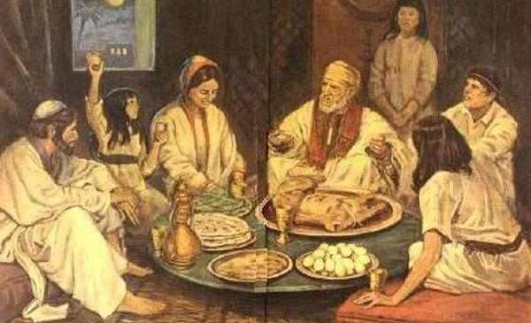
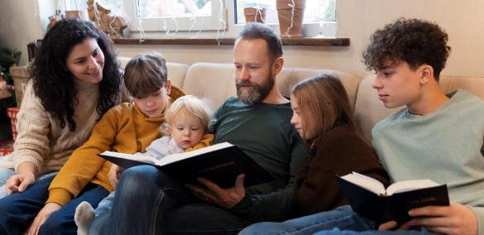
epidT$u;e;J Nghjpf;f Ntz;Lk;
“,e;jf; fhhpaj;ij cq;fSf;Fk; cq;fs; gps;isfSf;Fk; epj;jpa epakkhff; iff;nfhs;sf;fltPh;fs;.” (ahj;jpuhfkk; 12:24)
vfpg;jpypUe;J mtu;fis ntspNa nfhz;L tUtjw;F Kd;Ng, Njtd; vgpNua FLk;gq;fSf;F xt;nthU Mz;Lk; jq;fs; Foe;ijfSf;F nrhy;yp nfhLg;gjd; %yk; jq;fs; tuyhw;iw ghJfhf;f fw;W nfhLj;jhu; (ahj;. 12:24-27).
mg;NghjpypUe;J, g];fh gz;bif xU FLk;g nfhz;lhl;lkhf ,Uf;Fk;. ngw;Nwhu;fs; jq;fs; gps;isfSf;F Njtidg; gw;wpa mwptpy; elj;Jtjw;fhd tha;g;ghf ,Uf;Fk;.
tpLjiyapd; fijia tpupthfTk;> Kjy; eguhfTk; tpsf;f Ntz;bapUe;jJ (cgh . 26:5-9).
,J ekf;F kpfTk; rpwg;ghd ghlj;ij nfhz;Ls;sJ. ek; ek;gpf;ifia ek; Foe;ijfSf;Fk; nfhLf;f Ntz;Lk;. tuyhw;wpy; kl;Lky;y, ek; nrhe;j tho;f;ifapYk; Njtd; vd;d nra;jpUf;fpwhu; vd;gijg; gw;wp ehk; mtu;fSf;F nrhy;y Ntz;Lk;. ehk; mtu;fSf;F Kd;ghf Njtid tzq;fp topgl Ntz;Lk; (ahj;. 12:27).

Slide 8


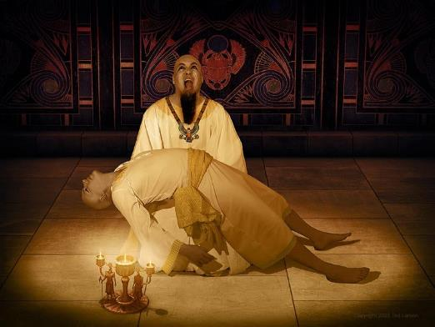
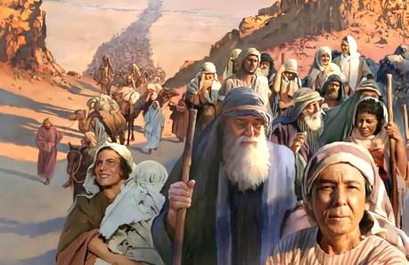
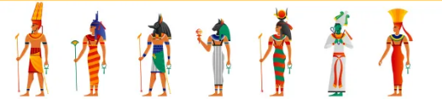
gj;jhtJ thij
“eLuhj;jphpapNy rpq;fhrdj;jpd; Nky; tPw;wpUf;Fk; ghh;NthDila jiyg;gps;isKjy; fhty; fplq;fpypUf;Fk; rpiwg;gl;ltdpd; jiyg;gps;is tiuf;Fk;> vfpg;J Njrj;jpy; ,Ue;j Kjw;Ngwidj;ijAk; kpUf[Ptd;fspd; jiyaPw;widj;ijAk; fh;j;jh; mopj;jhh;.” (ahj;jpuhfkk; 12:29)
ghu;Nthd; tpjptpyf;F ,y;yhky; vy;yh vgpNua rpWtu;fisAk; nfhy;y cj;jutpl;lhd;(ahj;. 1:22). Njtd; Kjy; Foe;ijfSf;F kl;LNk epge;jidf;Fl;gl;l kuzj;ij jPu;khdpj;jhu; (ahj;. 12:29). Ml;Lf;Fl;bapd; ,uj;jk; mgpN\fk; nra;ag;glhj xt;nthU tPl;Yk; Fiwe;jJ xU eguhtJ ,we;jhu; (ahj;. 12:30).
ghu;Nthdpd; gpujpepjpahf ,Ue;j vfpg;jpa flTs;fs; kPJ NjtDila jPu;g;Gfs; KO tPr;rpy; ,Ue;jd (ahj;. 12:12).
ve;j vfpg;jpa flTSk; cjtp nra;a jd; ifia cau;j;jtpy;iy> Nguopit jLf;f ghu;NthDk; vJTk; nra;a Kbatpy;iy.
ghu;Nthidg; NghyNt, ek;Kila ghtKk; kw;wtu;fis vjpu;kiwahf ghjpf;fyhk;. Mdhy;, NkhNriag; NghyNt, ek;Kila cz;ikj;jd;ikAk; cWjpAk; gyiuf; fhg;ghw;Wk;.

