Slide 1
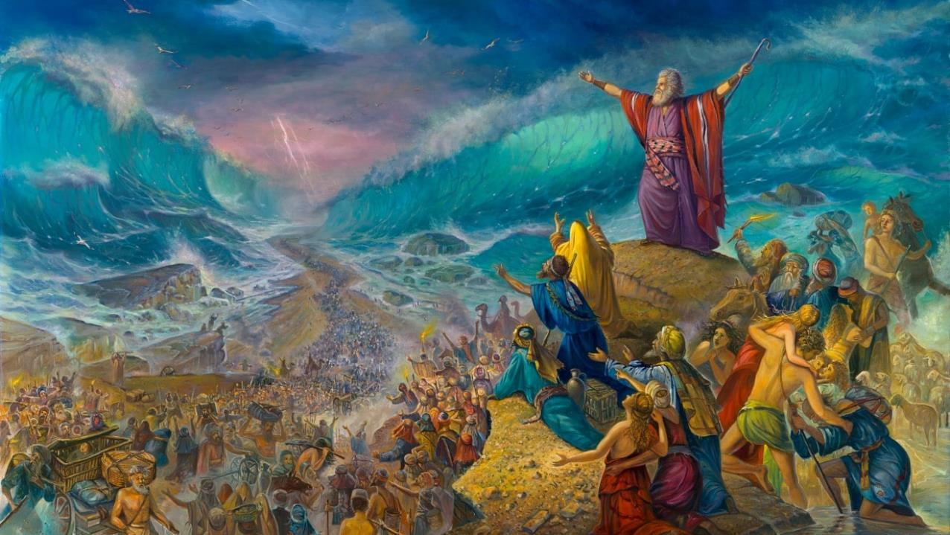
rpte;j rKj;jpuj;jpd; topaha;
ghlk; 6 Mf];l; 9, 2025

Slide 2
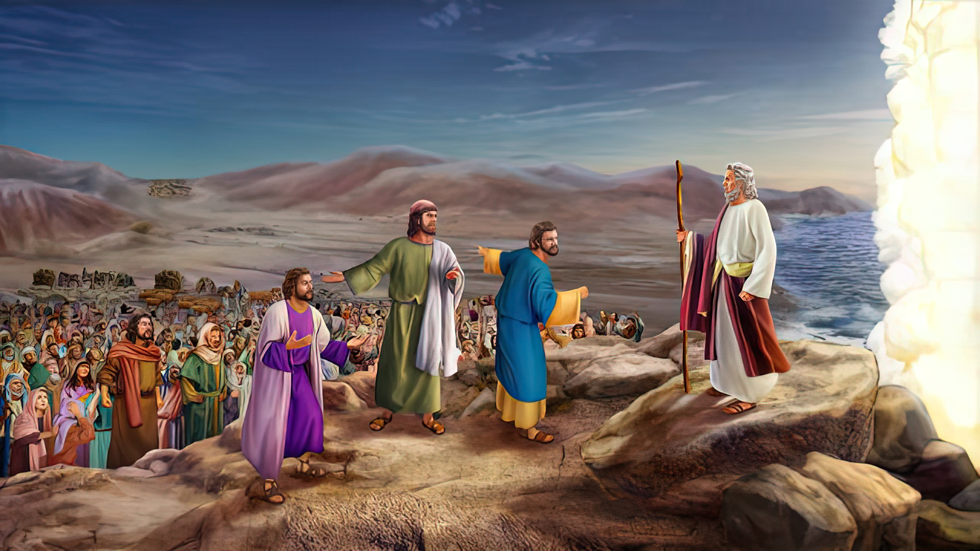
“mg;nghOJ NkhNr [dq;fis Nehf;fp: gag;glhjpUq;fs;@ ePq;fs; epd;Wnfhz;L ,d;iwf;Ff; fh;j;jh; cq;fSf;Fr; nra;Ak; ,ul;rpg;igg; ghUq;fs;@ ,d;iwf;F ePq;fs; fhz;fpw vfpg;jpaiu ,dp vd;iwf;Fk; fhzkhl;Bh;fs;. fh;j;jh; cq;fSf;fhf Aj;jk;gz;Zthh;@ ePq;fs; Rk;khapUg;gPh;fs; vd;whd;.” ahj;jpuhfkk; 14:13, 14

Slide 3

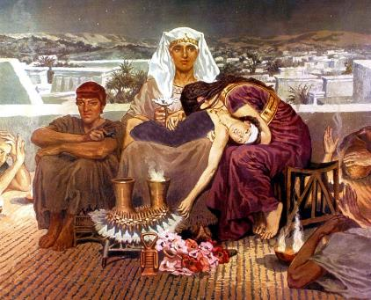
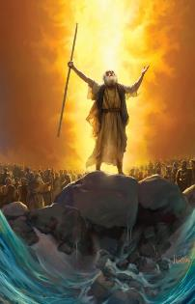
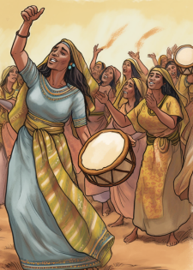



vfpg;jpypUe;J ntspNaWtJ ghu;Nthdpd; Kjy; kfdpd; kuzj;ijNah my;yJ Fiwe;jgl;rk; kuz mr;RWj;jiyNah cs;slf;Fk; vd;W Njtd; Muk;gj;jpypUe;Nj vr;rupe;jpUe;jhu; (ahj; 4:22-23).
Kjw;Ngwhdtu;fspd; kuzj;ij jtpu;f;fTk;> mtu;fis vfpg;jpypUe;J ntspNa mioj;J nry;yTk;> Njtd; mtu;fsplk; xU tpRthr nraiy Nfl;lhu;: g];fh gz;bif. ,g;NghJ, mtu; mtu;fis NtWtop ,y;yhj ghijf;F mioj;J nrd;W nfhz;bUe;jNghJ, tpRthrj;jpd; ,uz;lhtJ gbia vLf;fNtz;ba Neuk; ,J: Kd;Ndhf;fp nry;tJ.
nrq;fliy fle;j gpd;G, ,Wjpahf vfpg;jpd; mbikj;jdj;jpypUe;J tpLtpf;fg;gl;l ,];uNtyu;, jq;fs; tpLjiyahsiug; Gfo;e;J ghbdu;.
vfpg;jpypUe;J ahj;jpiu:
  jaTnra;J fpsk;Gq;fs;! (ahj; 12:31-36)
  Kjw;Ngwhdtu;fspd; gpujp\;il (ahj; 13:1-16)
nrq;fliy fle;Jnry;Yjy;:
  tdhe;juj;jpy; rpf;fpf;nfhz;lhu;fs; (ahj; 13:17-14:12)
  flypy; xU ghij (ahj; 14:13-31)
nfhz;lhl;lk;:
  NkhNrapd; ghl;L (ahj; 15:1-21)

Slide 4
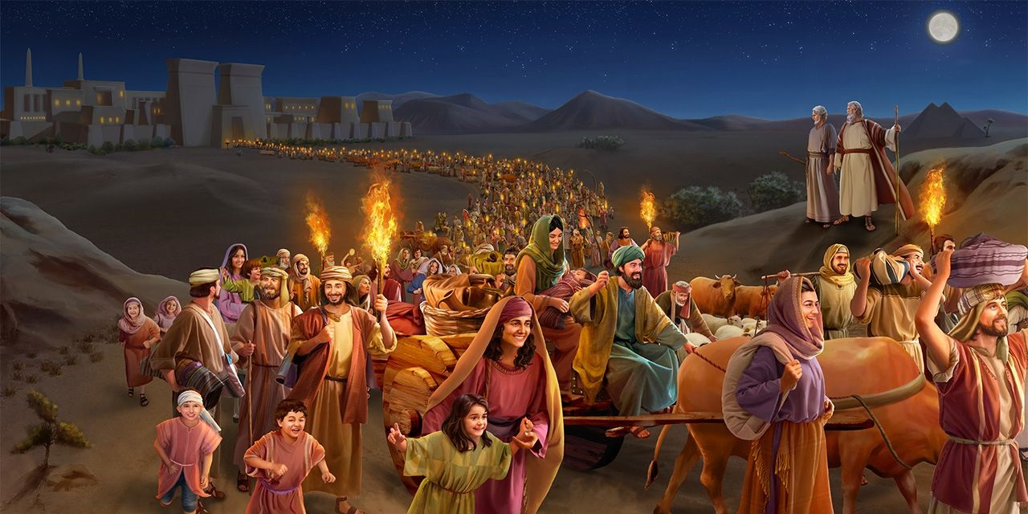
vfpg;jpy; ,Ue;J ahj;jpiu

Slide 5


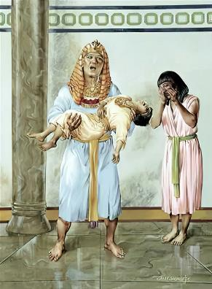
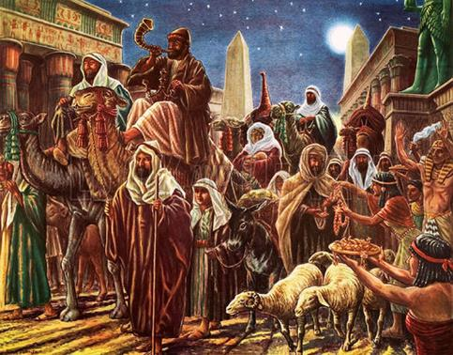
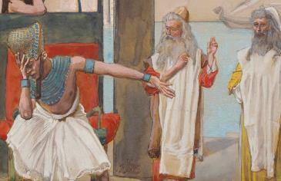
jaTnra;J fpsk;Gq;fs;!
“vfpg;jpah;: ehq;fs; vy;yhUk; rhfpNwhNk vd;W nrhy;ypj;> jPtpukha; [dq;fisj; Njrj;jpypUe;J mDg;gptpl mth;fis kpfTk; Jhpjg;gLj;jpdhh;fs;.” (ahj; 12:33)
vfpg;J KOtJk; ghoile;jJ, “rhtpy;yhj xU tPLk; ,Ue;jjpy;iy.” (ahj;. 12:30). ,];uNtyu; ntspNaw ghu;Nthdpd; mDkjp kpfTk; jhkjkhf te;jJ.
“vd;idAk; MrPh;tjpAq;fs;” (ahj;. 12:32) vd;w nrhw;nwhUld;, ghu;Nthd; jdJ kf;fs; midtupd; czu;TfisAk; ntspg;gLj;jpdhu;: jaTnra;J vq;fSf;F NtW vJTk; elf;fhky; ghu;j;Jf; nfhs;Sq;fs;!
mJ jdJ jtWf;fhd cz;ikahd tUj;jj;jpd; ntspg;ghly;y> khwhf Nguopit epWj;j Ntz;Lk; vd;w tpUg;gkhFk;.
,];uNtyu;fs; jq;fs; gy tUl Nritf;fhd $ypia Nfl;lNghJ, vfpg;jpau;fs; “Nfl;lij mth;fSf;Ff; nfhLj;jhh;fs;” (ahj;. 12:36). ,e;j topapy;, Njtd; jk;Kila Kjw;Ngwhdtu;fs; vfpg;jpypUe;J ntspNaWtij cWjp nra;jhu; - NkYk; mtu; iffis epug;gpdhu;.

Slide 6

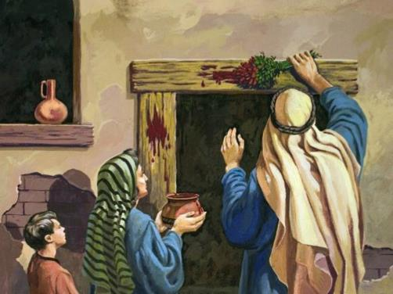
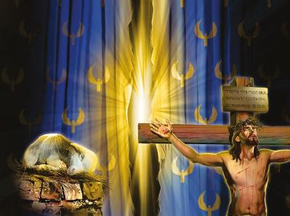

Kjw;Ngwhdtu;fspd; gpujp\;il
“,];uNty; Gj;jpuUf;Fs; kdpjhpYk; kpUf[Ptd;fspYk; fh;g;ge;jpwe;J gpwf;fpw Kjw;Ngwidj;ijAk; vdf;Fg; ghpRj;jg;gLj;J@ mJ vd;DilaJ vd;whh;.” (ahj; 13:2)
Kjw;Ngwhdtu;fs; vt;thW gpujp\;il nra;ag;gl;lhu;fs;?
mtu;fs; kuzj;jhy; Gdpjg;gLj;jg;gl;ldu;. Xt;nthU Kjw;Ngwhd kfDk; ,wf;f Ntz;Lk;. Mdhy; Kjw;Ngwhd kfDf;F gjpyhf NtnwhUtu; ,wf;Fk; tifapy; Vw;ghL nra;ag;gl;lJ.
cwit ftdpAq;fs;: ,];uNty; NjtDila Kjw;NgwhdJ (ahj;. 4:22); ,d;iwa jpUr;rig Md;kPf ,];uNty; (fyh. 6:16); vdNt, ehk; midtUk; NjtDf;F mw;g;gzpf;fg;gLtjw;F ,wf;f Ntz;Lk;; Mdhy; ek; ,lj;jpy; ,we;j xUtu; ,Uf;fpwhu;.
,NaR, “Njthl;Lf;Fl;b” (Nah. 1:29), jk;Kila ,uj;jj;ij jq;fs; ,Uja thrypy; G+Rfpw vtUk; kupf;fhky; epj;jpa [Ptidg; ngWk;gb kupj;jhu;.
Njtd; Vw;fdNt jk;Kila gq;if nra;Jtpl;lhu;. mtUila kPl;gpd; ,uj;jj;jhy; ek;ik %bf;nfhs;s mDkjpg;gJ ek; nghWg;G.

Slide 7
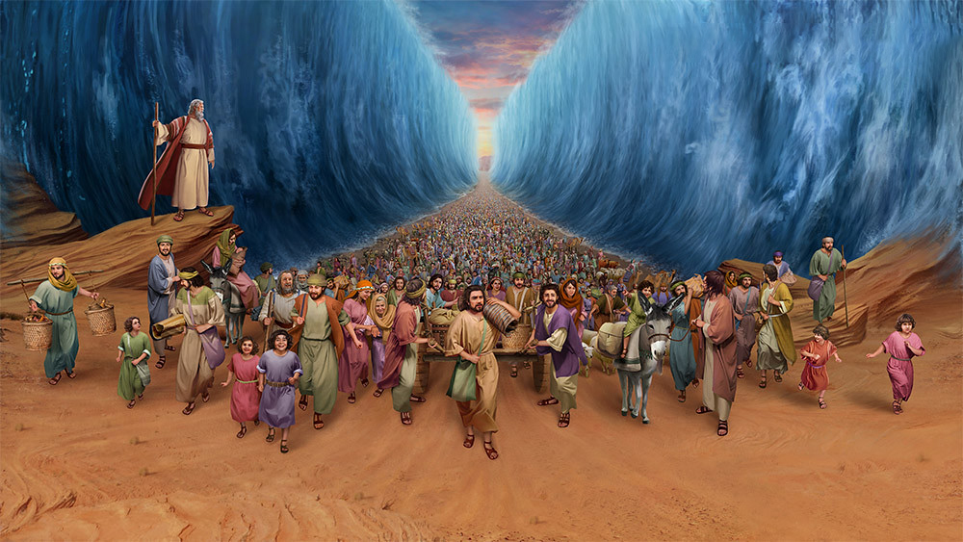
nrq;fliy fle;Jnry;Yjy;

Slide 8


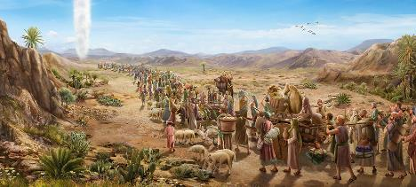
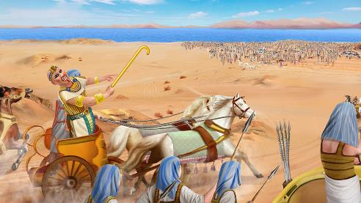
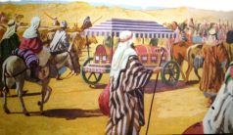
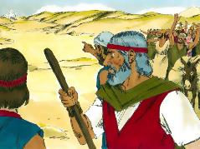
tdhe;juj;jpy; rpf;fpnfhz;lhu;fs;
“mg;nghOJ ghh;Nthd; ,];uNty; Gj;jpuiuf;Fwpj;J: mth;fs; Njrj;jpNy jpifj;Jj; jphpfpwhh;fs;@ tdhe;juk; mth;fis milj;Jg;Nghl;lJ vd;W nrhy;Ythd;.” (ahj; 14:3)
ghu;Nthdpd; mDkjpAld;, ,];uNtyu;fs; “mzpazpaha;g; Gwg;gl;Lg;Nghdhh;fs;” (ahj;. 13:18). Mdhy; mtu;fs; Nghiu vjpu;nfhs;s Njtd; tpUk;gtpy;iy> mjdhy; mtu; mtu;fis Rw;wp topelj;jpdhu; (ahj;. 13:17).
,jw;fpilapy;, ghu;Nthd; kde;jpUk;gp ,];uNtiy Juj;jp tpl;ljw;fhf tUj;jg;gl;lhd; (ahj;. 14:5). ,];uNty; ,g;NghJ tdhe;juj;jpy; rpf;fp nfhz;lJ> jg;gpf;f top ,y;yhky; ,Ue;jJ (ahj;. 14:2-3, 9).
tpRthrj;jpd; nrayhf, mtu;fs; NahNrg;gpd; rtg;ngl;bia mtu;fSld; vLj;J nrd;wdu; (ahj;. 13:19). NkYk;, Njtd; mtu;fis mw;Gjkhf topelj;jpf; nfhz;bUe;jhu; (ahj;. 13:21).
,Ug;gpDk;, ghu;Nthdpd; gilia ghu;j;jJk;> mtu;fspd; ek;gpf;if Kw;wpYkhf rupe;jJ. (ahj;. 14:10-12). jhq;fs; mDgtpj;j mw;Gjq;fis vt;tsT tpiuthf kwe;Jtpl;lhu;fs;! ,J ekf;Fk; elf;Fkh?
“mth; nra;j mjpraq;fis … epidT$Uq;fs;” (1 ehsh. 16:12)

Slide 9

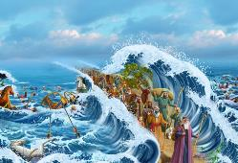
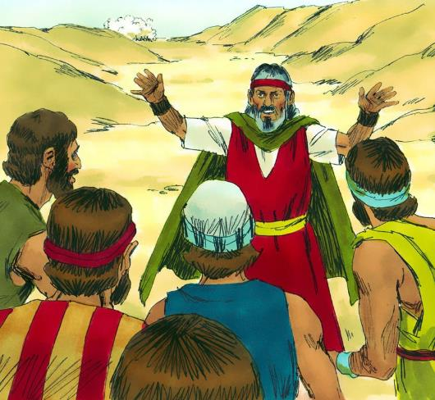
flypy; xU ghij
“mg;nghOJ NkhNr [dq;fis Nehf;fp: gag;glhjpUq;fs;@ ePq;fs; epd;Wnfhz;L ,d;iwf;Ff; fh;j;jh; cq;fSf;Fr; nra;Ak; ,ul;rpg;igg; ghUq;fs;@ ,d;iwf;F ePq;fs; fhz;fpw vfpg;jpaiu ,dp vd;iwf;Fk; fhzkhl;Bh;fs;. fh;j;jh; cq;fSf;fhf Aj;jk;gz;Zthh;@ ePq;fs; Rk;khapUg;gPh;fs; vd;whd;.” (ahj; 14:13-14)
kf;fspd; tpRthr Fiwghl;il vjpu;nfhz;L, NkhNr mtu;fis Njtd; kPJ ek;gpf;if itf;f Cf;Ftpj;jhu; (ahj;. 14:13-14):
“gag;glhjpUq;fs;”
ntw;wp miltjw;fhd Kjy; gb Njtd; kPJ ek;gpf;if itg;gJ jhd;
“epd;W nfhz;L”
ehk; KZKZf;fhky;> nghWikNahL ekJ ,lj;jpy; ,Uf;f Ntz;Lk;.
“,ul;rpg;ig ghUq;fs;”
Njtd; ek;ik topelj;j mDkjpj;jhy; ntw;wp epr;rak;.
“NaNfhth cq;fSf;fhf Aj;jk; gz;Zthu;”
Njtd; ekf;fhf rhj;jhDf;Fk; ghtj;jpw;Fk; vjpuhf NghuhLfpwhu;. fy;thup ,jw;F kpfg; ngupa rhd;whFk;.

Slide 10

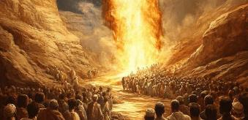
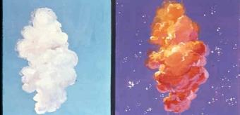
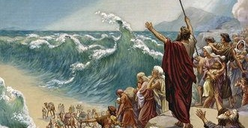
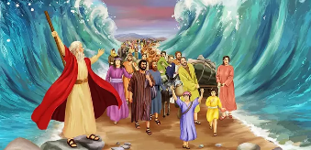
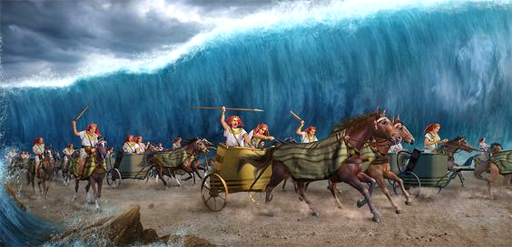
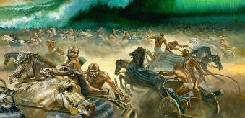
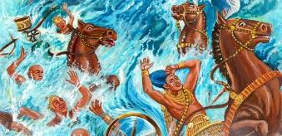
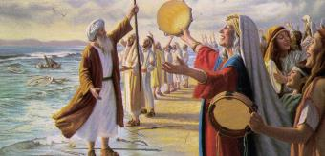
flypy; xU ghij
Njtd; xNunahU fl;lisia [dq;fSf;F nfhLj;jhu;: “Gwg;gl;Lg; Nghq;fs;” (ahj;jpuhfkk; 14:15). mj;jUzj;jpypUe;J, vju;ghuhjitfs; ele;jd (ahj;jpuhfkk; 14:19-31):
,];uNty; [dq;fspd; Kfhkpw;Fk; vfpg;jpau;fspd; Kfhkpw;Fk; ,ilapy; NjtDila J}jDk; Nkf];jk;gKk; epd;wJ
,utpy;, me;j J}z; vfpg;jpau;fSf;F ,UshfTk; ,];uNtyu;fSf;F ntspr;rkhfTk; ,Ue;jJ
NkhNr jd; Nfhiy cau;j;jpdhd;> fly; ,uz;lhf gpse;jJ> mjdhy; ,];uNtyu; twz;l epyj;jpy; ele;J nrd;whu;fs;.
,];uNtyu; flYf;Fs; Eioe;jhu;fs;, jz;zPu;fs; mtu;fs; tyJ kw;Wk; ,lJ gf;fq;fspy; Rtu;fshf epd;wJ
vfpg;jpau;fSk; flYf;Fs; Eioe;jhu;fs;
tpbaw;fhiyapy;, vfpg;jpau;fis Njtd; fyq;fbj;jhu;
mtu;fs; gpd;thq;f Kad;wNghJ> fly; mjd; ghijf;F jpUk;gp> KO ,uhZtj;ijAk; mopj;jJ.
flw;fiuapype;J, ,];uNtyu; ntw;wpia fz;lhu;fs;, mtu;fs; NjtidAk; NkhNriaAk; ek;gpdhu;fs;

Slide 11
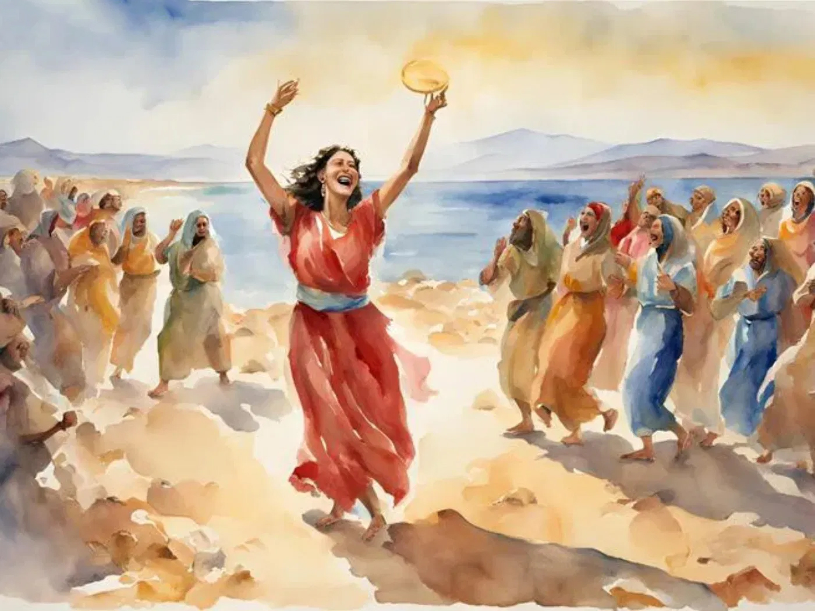
nfhz;lhl;lk;

Slide 12


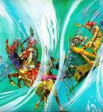
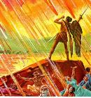
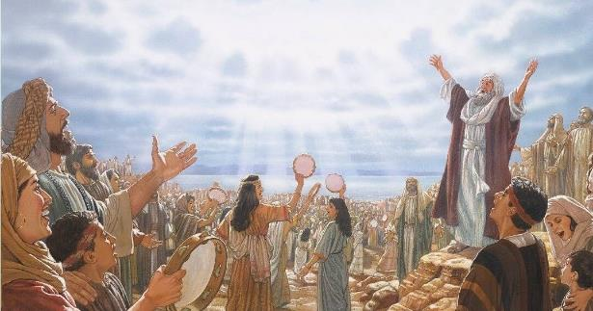
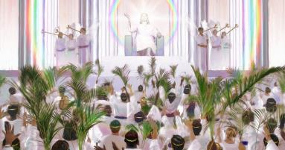
NkhNrapd; ghl;L
“mth;fs; NjtDila Copaf;fhudhfpa NkhNrapd; ghl;ilAk; Ml;Lf;Fl;bahdtUila ghl;ilAk; ghb: rh;tty;yikAs;s Njtdhfpa fh;j;jhNt> NjthPUila fphpiafs; kfj;JtKk; Mr;rhpaKkhditfs;@ ghpRj;jthd;fspd; uh[hNt> NjthPUila topfs; ePjpAk; rj;jpaKkhditfs;.” (ntspg;gLj;jy; 15:3)
ele;jijf; fz;L, NkhNr ,];uNtyNuhL Njtid Gfo;e;J ghLfpwhu;, kpupahKk; ngz;fNshL Nru;e;J xU ghlfu; FOTld; gjpyspf;fpwhu; (ahj;. 15:1, 20-21).
,e;j ghlypy;, ,];uNty; vd;d nra;jJ vd;gJ gw;wp vJTk; Fwpg;gplgltpy;iy. ,e;j ghly; vjpupia mopj;jjw;fhf Njtid Gfo;tNjhL kl;Lky;yhky; (ahj;. 15:6), mtUila fpupiafSf;fhfTk; ghlg;gl;lJ (ahj;. 15:11). vd;d ele;jJ vd;W Nfl;gtu;fspd; vjpu;tpid mwptpf;fg;gLfpwJ (ahj;. 15:14).
NkYk;, Njtd; ,d;Dk; vd;d nra;ag; Nghfpwhu; vd;gJk; mwptpf;fg;gl;lJ: “ePh; mth;fisf; nfhz;LNgha;> fh;j;juhfpa NjthPh; thrk;gz;Zfpwjw;F epakpj;j ];jhdkhfpa ck;Kila Rje;juj;jpd; gh;tjj;jpYk;> ..mth;fis ehl;LtPh;.” (ahj;. 15:17).
NjtDila epahaj;jPu;g;Gfs; ntspg;gl;L, jPikAk; xLf;FjYk; xopf;fg;gl;bUf;Fk; NghJ, Njrq;fspypUe;J kPl;fg;gl;ltu;fs; me;j ePjpahd epahaj;jPu;g;GfSf;fhf mtiu Gfo;e;J, NkhNrapd; ghliyAk; Ml;Lf;Fl;bahdtupd; ghliyAk; ghLthu;fs; (ntsp. 15:3).

