Slide 1
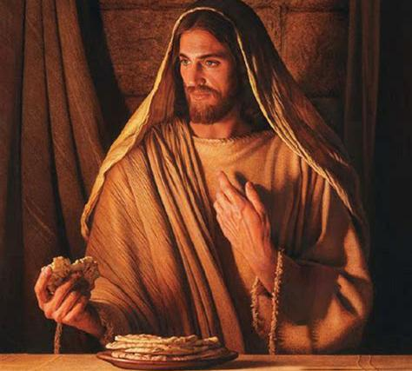
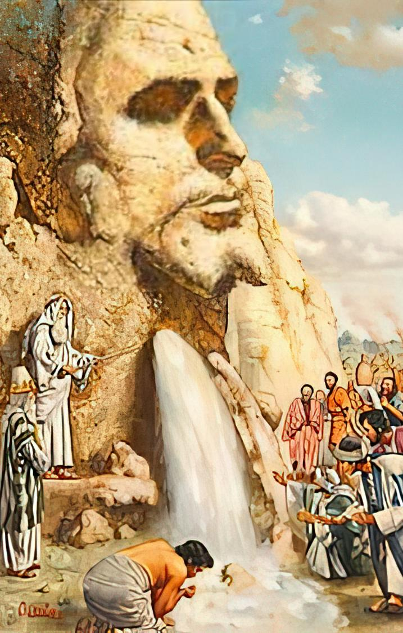
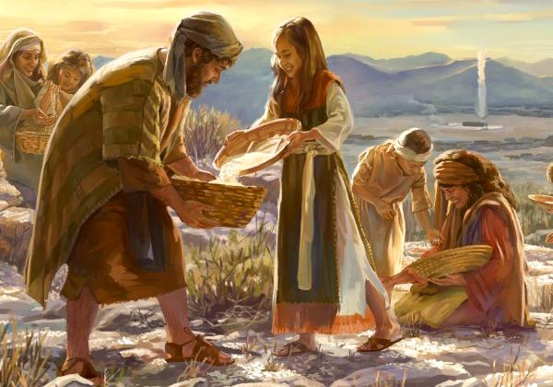
[Pt mg;gKk; [Pt jz;zPUk;
ghlk; 7 Mf];l; 16, 2025

Slide 2
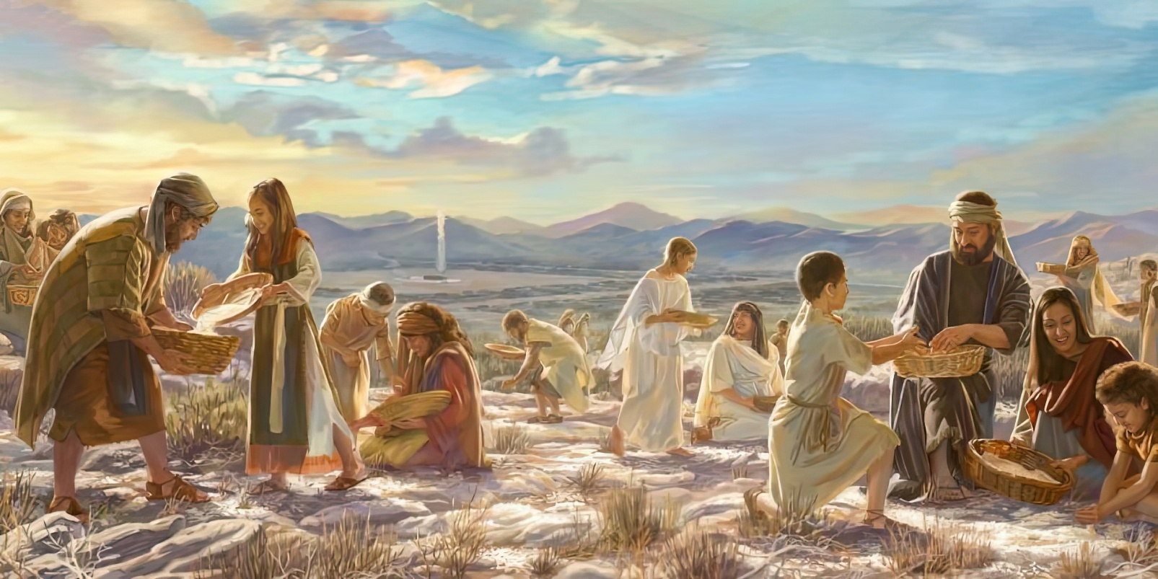

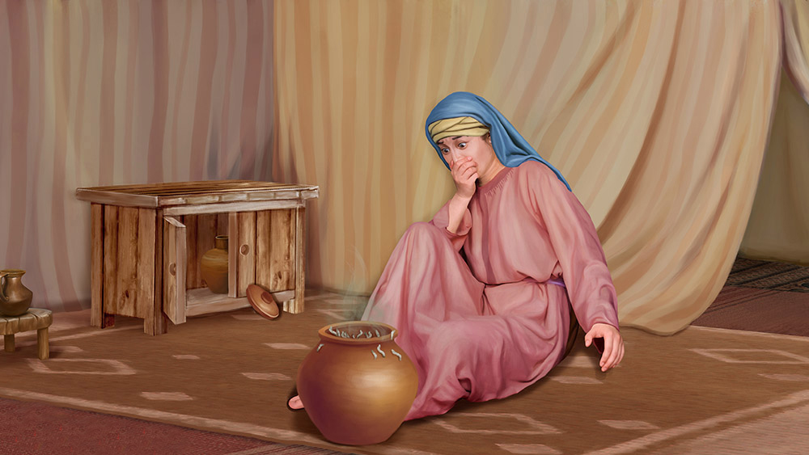
“mg;nghOJ fh;j;jh; NkhNria Nehf;fp: vd; fl;lisfisAk; vd; gpukhzq;fisAk; iff;nfhs;s ve;j kl;Lk; kdjpy;yhjpUg;gPh;fs;? ghUq;fs;> fh;j;jh; cq;fSf;F Xa;Tehis mUspdgbahy;> mth; cq;fSf;F Mwhk; ehspy; ,uz;L ehSf;F Ntz;ba Mfhuj;ijf; nfhLf;fpwhh;@ Vohk;ehspy; cq;fspy; xUtDk; jd; jd; ];jhdj;jpypUe;J Gwg;glhky;> mtdtd; jd; jd; ];jhdj;jpNy ,Uf;fNtz;Lk; vd;whh;. mg;gbNa [dq;fs; Vohk;ehspy; Xa;e;jpUe;jhh;fs;.”
ahj;jpuhfkk; 16:28–30

Slide 3

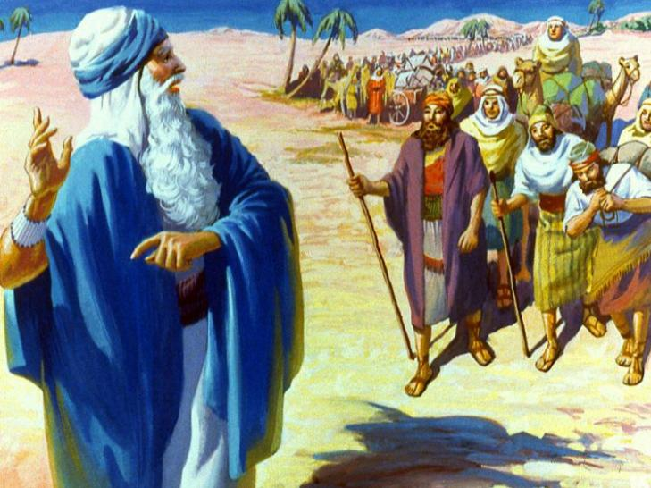
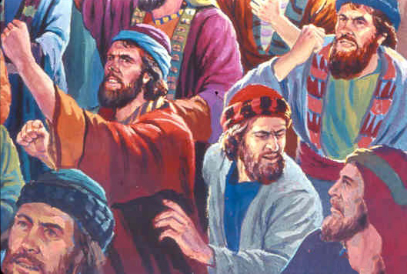
mtu;fs; ,Wjpahf vfpg;jpd; vy;iyia fle;Jtpl;lhu;fs;. ghYk; NjDk; xLfpw Njrj;jpw;F nry;Yk; ghijapy; ,tu;fs; ,Wjpahf ,Ue;jhu;fs;.
%d;W ehl;fSf;F, vy;yhk; G+uzkhf ,Ue;jJ. Mdhy; mtu;fsplk; ,Ue;j vy;yh nghUl;fSk; jPu;e;J Nghapd. ghiytdj;jpy; 20 kpy;ypad; kf;fSf;F mtu;fshy; vg;gb cztspf;f KbAk;?
gpur;ridapd; Kjy; mwpFwpapNyNa, [dq;fs; KWKWf;f njhlq;fpdhu;fs;. mtu;fs; vfpg;jpy; ,we;jpUf;f tpUk;Gthu;fs;! njspthf, mtu;fspd; ek;gpf;if tsu;e;J gyg;gLj;jg;gl Ntz;Lk;. vdNt Njtd; mtu;fSf;F jz;zPiuAk; mg;gj;ijAk; toq;fpdhu;; mtu;fspd; vjpupfsplkpUe;J mtu;fis ghJfhj;jhu;; NkYk; mtu;fs; xOq;fikf;f cjtpdhu;.
Rj;jkhd jz;zPu; (ahj; 15:22-27)
guNyhfj;jpypUe;J mg;gk; (ahj; 16:1-36)
xNugpd; fd;kiy (ahj; 17:1-7)
cau;j;jg;gl;l iffs; (ahj; 17:8-16)
ey;y mwpTiu (ahj; 18:1-27)
[Pt mg;gKk; [Pt jz;zPUk;: ,NaR

Slide 4

“vgpNuau;fspd; khWgl;l mDgtq;fs;> fhdhdpy; mtu;fSf;F thf;FWjpaspf;fg;gl;l tPl;bw;F jahuhFk; gs;spahf ,Ue;jd. ,e;j ehl;fspy; Njtd; jk;Kila [dq;fs; gz;ila ,];uNtyu; fle;J te;j Nrhjidfis kdj;jho;ikAld;> fw;Wf;nfhs;sf;$ba kWguprPyid nra;a Ntz;Lk; vd;W tpUk;gpdhu;. ,jdhy; mtu;fs; guk fhdhDf;F jauhFk;NghJ mwpTWj;jgLthu;fs;.”
vyd; [p citl; (Kw;gpjhf;fSk; jPu;f;fjuprpfSk;, gf;. 293)

Slide 5


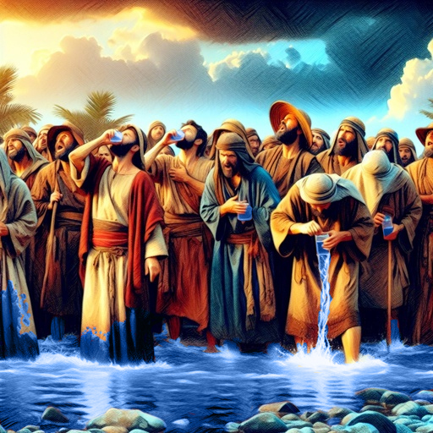
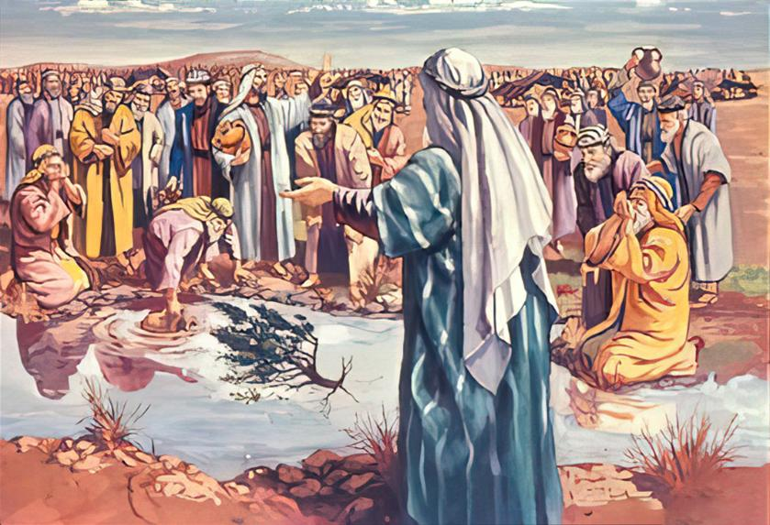
Rj;jpfupf;fg;gl;l jz;zPu;
“mth;fs; khuhtpNy te;jNghJ> khuhtpd; jz;zPh; frg;ghapUe;jjpdhy; mijf; Fbf;f mth;fSf;Ff; $lhjpUe;jJ@ mjpdhy; mt;tplj;Jf;F khuh vd;W Nghplg;gl;lJ” (ahj; 15:23)
Njtd; ek;NkhbUe;jhy;, Vd; ekf;F nfl;l fhupaq;fs; elf;fpwJ? nrq;fliy fle;J gpd;G> ,];uNty; [dq;fspd; kdepiy ,Jthf jhd; ,Ue;jJ.
Fbg;gjw;F ghJfhg;gw;w jz;zPiu fz;lwpe;J, mtu;fs; Gfhu; nra;jhu;fs;, “vd;dj;ijf; Fbg;Nghk;?” (ahj;. 15:24). mtu;fs; tUtjw;F Kd;Ng Njtd; me;j jz;zPiu Rj;jpfupj;jpUf;fyhk;, Mdhy; mtu; rupahd jUzj;jpw;fhf fhj;jpUe;jhu;.
NkYk; mw;Gjj;ij nra;tjw;F NkhNraplk; xU cjtp Nfl;lhu;, jz;zPiu Rj;jpfupf;f xU kuj;ij vwpa nrhd;dhu; (ahj;. 15:25).
Njtd; jk;Kila gpurd;dj;ij ehk; mwpe;jpUf;fTk;, jk;Kila fl;lisfSf;fhf fhj;jpUf;fTk;, mtNuhL xj;Jiof;fTk; tpUk;Gfpwhu;.
,];uNtyu; NjtDila Njitfis G+u;j;jp nra;J, Njtd; jq;fSf;F nfhLj;j rl;lq;fSf;F fPo;gbe;jhy;, mtu;fs; jPikapypUe;J ghJfhf;fgLthu;fs; vd;gjpy; cWjpahf ,Uf;fyhk; (ahj;. 15:26).

Slide 6


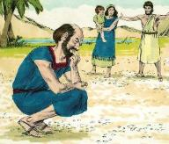
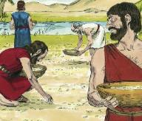
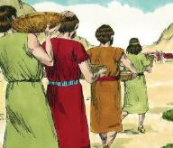
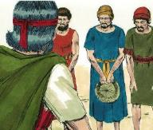
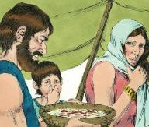
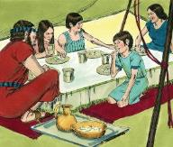
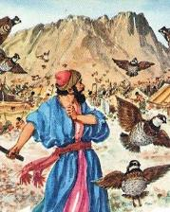
guNyhfj;jpypUe;J te;j mg;gk;
“,];uNty; Gj;jpuh; mijf; fz;L> mJ ,d;dJ vd;W mwpahjpUe;J> xUtiu xUth; ghh;j;J> ,J vd;d vd;whh;fs;@ mg;nghOJ NkhNr mth;fis Nehf;fp: ,J fh;j;jh; cq;fSf;Fg; Grpf;ff;nfhLj;j mg;gk;.” (ahj; 16:15)
,iwr;rp rhg;gpl Ntz;Lk; vd;w Mir ,];uNtyiu NkhNrf;Fk; MNuhDf;Fk; vjpuhf KWKWf;f itj;jJ(ahj;. 16:2-3). Mdhy; mtu;fSila KWKWg;G cz;ikapy; NjtDf;F vjpuhf ,Ue;jJ (ahj;. 16:8). mtu;fSila gpur;rid jhd; vd;d?
guNyhfj;jpypUe;J te;j ,e;j mg;gk; cz;ikapNyNa mw;Gjkhf ,Ue;jjJ:
mtu;fs; fle;j ehl;fis kwe;JNghdhu;fs;
mtu;fs; epfo;fhyj;jpd; gpur;ridfspy; ftdk; nrYj;jpdu;
thf;FWjpaspf;fg;gl;l vjpu;fhyj;ij mtu;fs; kwe;Jtpl;lhu;fs;
R+upad; cjpj;jJk; mJ cUfpaJ
(ahj; . 16:21)
Ie;J ehl;fSk; mNj msT tpOe;jJ (ahj;. 16:16)
MwhtJ ehspy; mJ ,uz;L klq;F mjpfkhf tpOe;jJ
(ahj;. 16:22)
mtu;fs; cz;gjw;F fhilfis nfhLj;jgpwF, Njtd; mtu;fSf;F xt;nthU ehSk; cztspf;f NghJkhd kd;dhit nfhLj;jhu;… 40 tUlq;fshf! (ahj;. 16:35)
Xa;Tehsd;W mJ tpoNt ,y;iy
(ahj;. 16:26)
kw;w ehl;fspy; mij kW ehisf;F kPjk; itj;jhy;> mJ G+r;rp gpbj;jJ (ahj;. 16:20)
Mdhy; MwhtJ ehs; Kjy; xa;Tehs; tiu mJ nfl;L Nghftpy;iy (ahj;. 16:23-24)

Slide 7


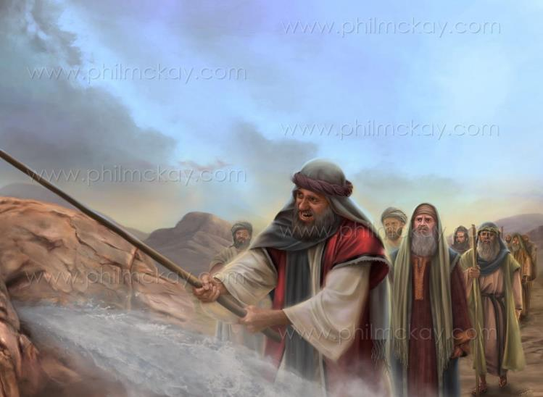
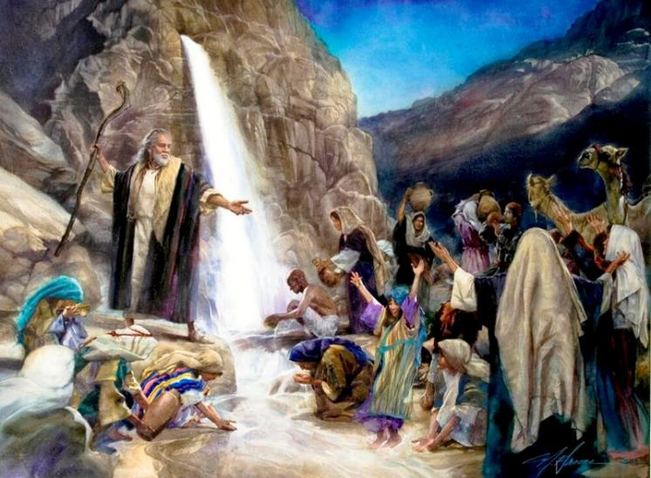
xNugpd; fd;kiy
“mq;Nf XNugpNy ehd; cdf;F Kd;ghff; fd;kiyapd;Nky; epw;Ngd;@ eP me;jf; fd;kiyia mb@ mg;nghOJ [dq;fs; Fbf;f mjpypUe;J jz;zPh; Gwg;gLk; vd;whh;@ mg;gbNa NkhNr ,];uNty; %g;ghpd; fz;fSf;F Kd;ghfr; nra;jhd;.” (ahj; 17:6)
“fh;j;jh; vq;fs; eLtpy; ,Uf;fpwhuh ,y;iyah?”(ahj;. 17:7). Njtd; mtu;fSf;F xt;nthU ehSk; thdj;jpypUe;J mg;gj;ij mDg;gtpy;iyah? mtu;fshy; mij Nkfj;jpy; ghu;f;f Kbatpy;iyah?
,];uNtyu; fhl;ba mtek;gpf;if Mr;rupakspf;fpwJ. Mdhy; mtek;gpf;ifapd; cjhuzj;jpy; tpohjgb gTy; ek;ik vr;rupf;fpwhu;(vgp. 3:12).
mtu;fSf;F ek;gpf;ifapd;ik ,Ue;jNghjpYk;, ,NaR jhNk ghiwia gpse;J> mtu;fSila gazk; KOtJk; mtu;fSf;F jz;zPu; toq;fp nfhz;bUe;jhu;. “mth;fNshNl$lr; nrd;w Qhdf;fd;kiy” fpwp];JNt(1 nfhup. 10:4).
mtu;fSf;Fk;, ekf;Fk;, fpwp];JNt [Ptdpd; Cw;whfTk;> epj;jpa [Ptid nfhLg;gtuhfTk; ,Uf;fpwhu;.

Slide 8

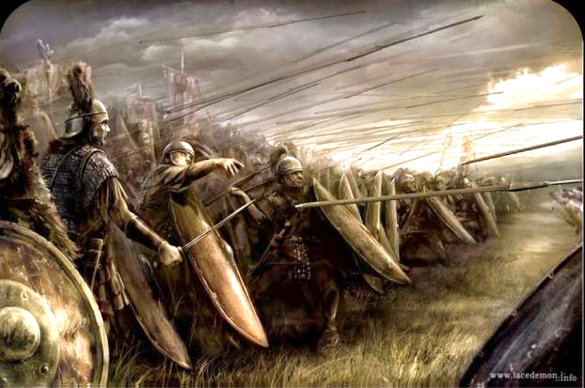
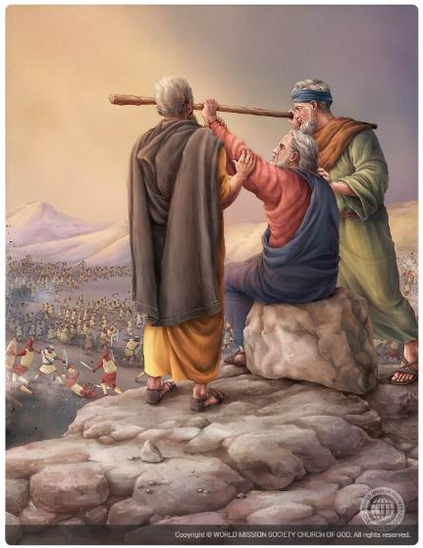
cau;j;jg;gl;l iffs;
“mkNyf;fpah; te;J nutpjPkpNy ,];uNtyNuhNl Aj;jk;gz;zpdhh;fs;.” (ahj; 17:8)
mtu;fs; tdhe;juj;jpd; topaha; Kd;Ndwp nry;Yk;NghJ, mkNyf;fpau; ,];uNtyiu jhf;fpdu;, NkhNr NahRthtplk; mtu;fis ghJfhf;Fk;gb Nfl;lhu;, mNj Neuj;jpy; mtu;> MNuhd;> Cu; kw;Wk; “NjtDila NfhYld;” kiyf;F Vwp nrd;whu; (ahj;. 17:8-10).
Vd; mkNyf;fpau;fs; te;J jhf;fpdhu;fs;?
vfpg;jpy; Njtd; nra;jij mtu;fs; Nfs;tpg;gl;bUe;jhu;fs;. Mdhy;, kw;w fhdhdpau;fis Nghy, mtu;fs; gag;gltpy;iy. mtu;fs; Njtid Vsdk; nra;J> mtUila kf;fis jhf;fp> mtiu tpl typikahdtu;fs; vd;gij ep&gpf;f mtu;fs; Kad;wdu; (ahj;. 17:16).
NkhNr NjtDila Nfhiy cau;j;jpa tiu, ,];uNty; ntd;wJ. Mdhy; mtuJ iffs; Nrhu;tile;jNghJ> ,];uNty; Njhw;fbf;fg;gl;lJ (ahj;. 17:11).
kw;w jiytu;fSk; gzpRikia gfpu;e;J nfhs;s Ntz;ba Neuk; mJ. MNuhDk; CUk; NkhNria Mjupj;J> NjtDila Ntiyia ntw;wpfukhf nra;a mtUf;F cjtpdhu;fs;> ,jdhy; vjpupia Njhw;fbj;jhu;fs; (ahj;. 17:12).

Slide 9


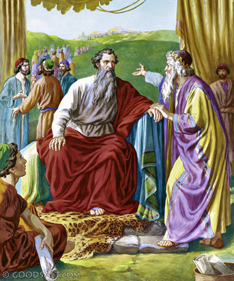
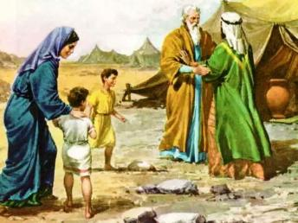
ey;y mwpTiu
“[dq;fs; vy;yhUf;Fs;Sk; NjtDf;Fg; gae;jth;fSk; cz;ikAs;sth;fSk; nghUshiria ntWf;fpwth;fSkhd jpwikAs;s kdpjiuj; njhpe;Jnfhz;L> mth;fis Mapuk;NgUf;F mjpgjpfshfTk;> E}WNgUf;F mjpgjpfshfTk;> Ik;gJNgUf;F mjpgjpfshfTk;> gj;Jg;NgUf;F mjpgjpfshfTk; Vw;gLj;Jk;.” (ahj; 18:21)
NkhNrf;F Njtd; mwptpj;j milahsj;ijg; ghu;j;j vj;jpNuh, rpg;NghuhSlDk; mtSila gps;isfSlDk; xNugpy; NkhNria ghu;f;f nrd;whu; (ahj;. 3:12; 18:1-5).
vj;jpNuh, ,];uNtydhf ,y;yhtpl;lhYk;, Njtid tzq;fpdhu;. vdNt, vfpg;jpy; ele;jitfis gw;wpa NkhNrapd; mwpf;ifia ngw;wg; gpwF, Njtid Gfo;e;J mtUf;F gypfis nrYj;jpdhu; (ahj;. 18:8-12).
kW ehs;, NkhNr vy;yh kf;fisAk; jdpahf epahae;jPu;g;gij ghu;j;jg; gpd;, mtu; mtUf;F rpy Qhdkhd MNyhridfis toq;fpdhu;: nghWg;Gfis gfpu;e;Jnfhs;Sq;fs;.(ahj;. 18:17-23).
,e;j mwpTiuapy; NjtDila thu;j;ijfis NkhNr jho;ikAld; Vw;Wf;nfhz;lhu;. vdNt, mtu; jdJ khkdhupd; MNyhridia Nfl;L> nghWg;Gfis Rkf;f jFjpahdtu;fis Nju;e;njLj;jhu;.
mjd; gz;Gfs; (ahj;. 18:21):
Njtid kjpj;jy;
ek;gpf;iff;Fupatu;fsha; ,Uj;jy;
gupjhdj;ij ntWj;jy;

Slide 10


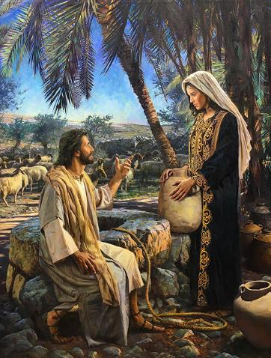
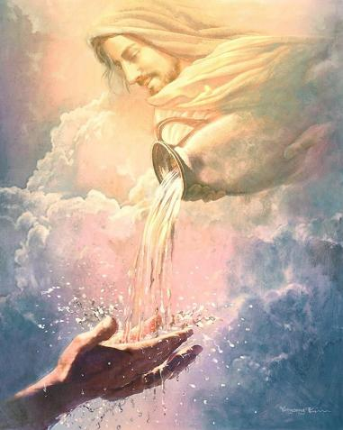
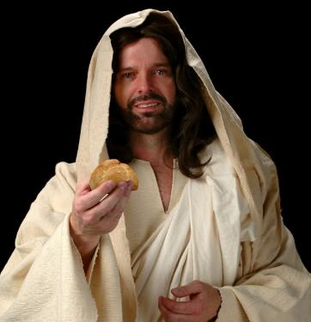
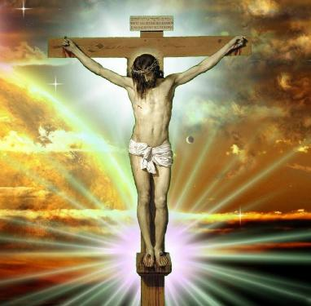
[Pt mg;gKk; [Pt jz;zPUk;: ,NaR
“ehNd thdj;jpypUe;jpwq;fpd [Pt mg;gk;@ ,e;j mg;gj;ijg; Grpf;fpwtd; vd;nwd;iwf;Fk; gpiog;ghd;@ ehd; nfhLf;Fk; mg;gk; cyfj;jpd; [PtDf;fhf ehd; nfhLf;Fk; vd; khk;rNk vd;whh;.” (Nahthd; 6:51)
ahj;jpuhfkf; fijfs; ekf;F mwpTWj;Jtjw;fhf vOjg;gl;lit vd;W gTy; ekf;F nrhy;fpwhu;, mjhtJ, mit ek; tho;f;iff;F Md;kPfg; gad;ghl;il nfhz;Ls;sd (1 nfhup. 10:1-11).
,e;j fijfs; Nguhir> tpf;fpuf Muhjid> Ntrpj;jdk;> Njtid Nrhjpj;jy; kw;Wk; tPz;Ngr;R Mfpatw;wpw;F vjpuhf ek;ik vr;rupf;fpd;wd
NkYk;, ghiwapypUe;J jz;zPu; kw;Wk; thdj;jpypUe;J te;j mg;gk; gw;wpa fijfis ,NaR Fwpg;ghf jkf;F nghUj;jpf; nfhz;lhu;.
gupRj;j Mtpahdtiu milahsg;gLj;Jk; [Pt jz;zPiu toq;Fgtu; mtNu(Nah. 4:14; 7:37-39). rkhjhdk;> re;Njh\k; kw;Wk; kfpo;r;rpf;fhd ekJ cs;jhfj;ij jPu;j;J itf;ff;$ba xNu egu; mtu;jhd;.
,NaR> jhd; jhd; guNyhfj;jpypUe;J ,wq;fp te;j nka;ahd mg;gk; vd;whu;. me;j mg;gk; mtUila nrhe;j khk;rNk (Nahthd; 6:51). mJ mtUila ruPuk;, mJ rpYitapy; cilf;fg;gl;L> mij “cl;nfhs;Sk;” midtUf;Fk; ,ul;rpg;ig nfhz;LtUfpwJ—mjhtJ, mtiu ,ul;rfuhf Vw;Wf;nfhz;L mtUld; jpdKk; cwT nfhz;bUq;fs;. ekJ Md;kPf jhfj;ijAk; grpiaAk; fpwp];Jthy; kl;LNk G+u;j;jp nra;a KbAk;.

