Slide 1

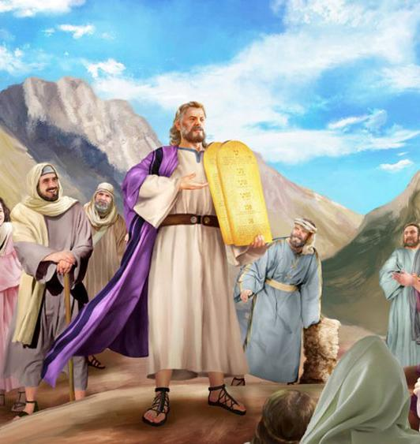
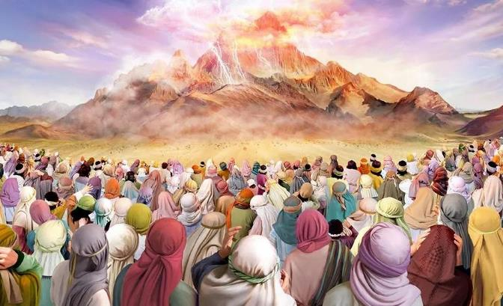
rPdhapy; cld;gbf;if
ghlk; 8 Mf];l; 23, 2025

Slide 2
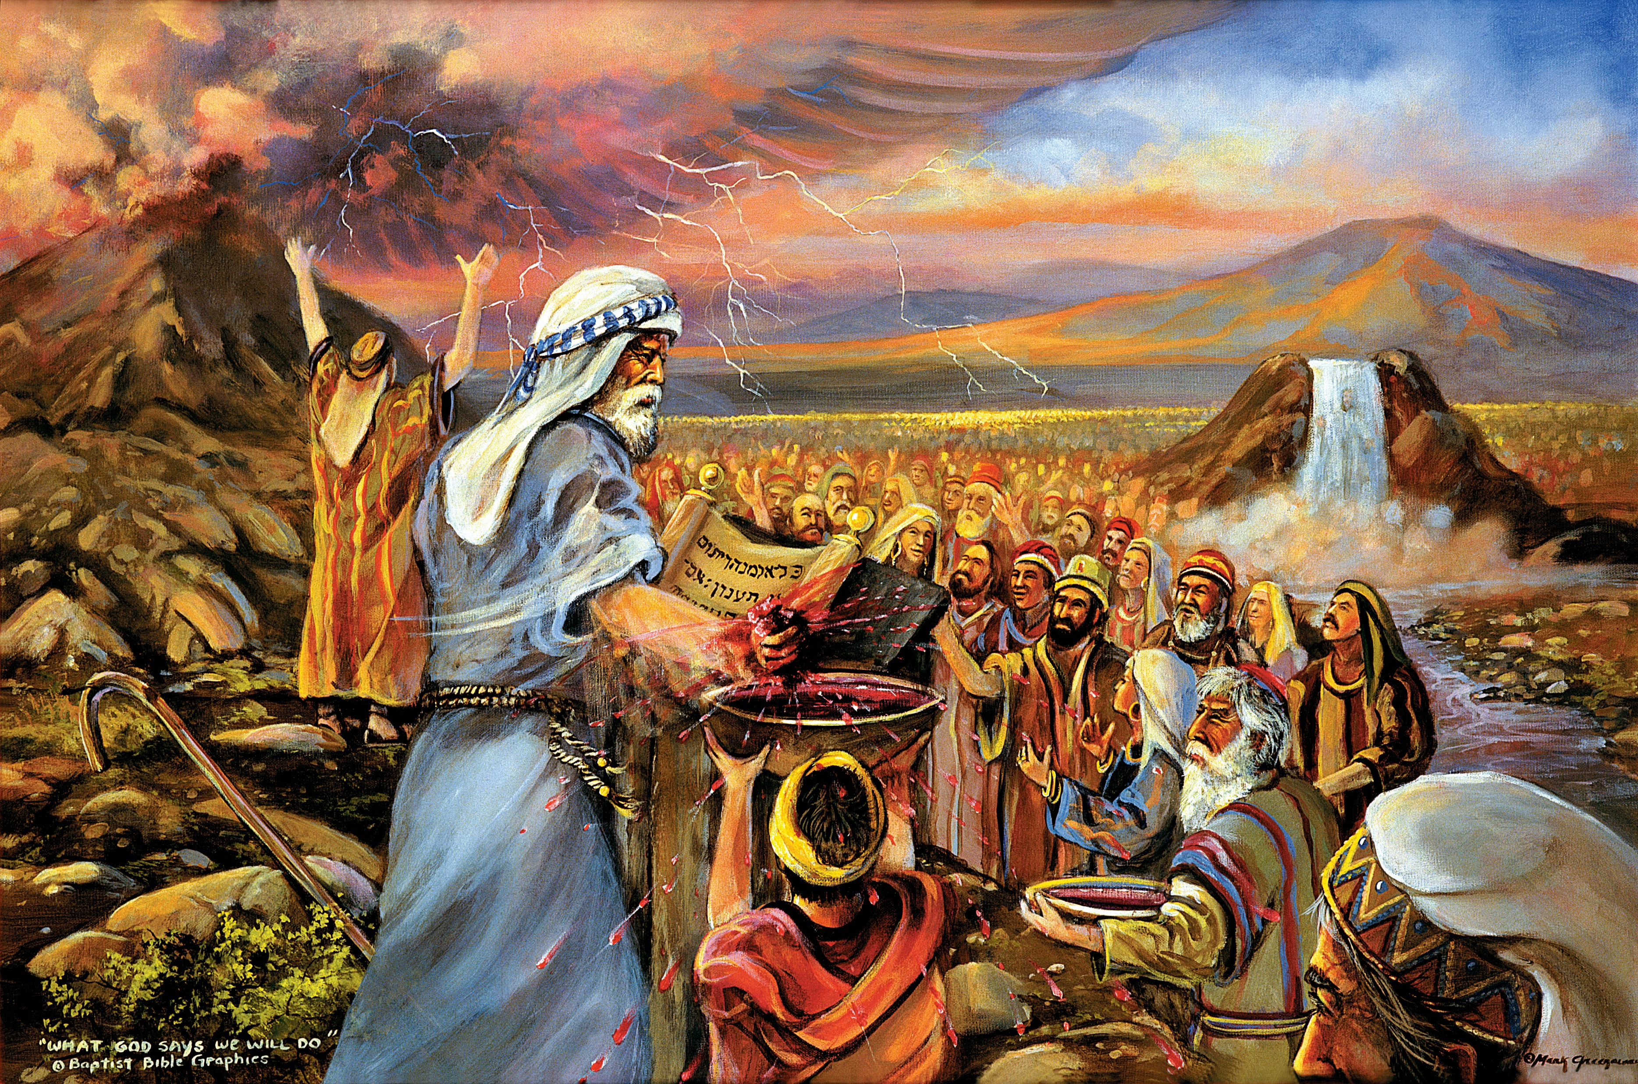
“ehd; vfpg;jpaUf;Fr; nra;jijAk;> ehd; cq;fisf; fOFfSila nrl;ilfspd;Nky; Rke;J> cq;fis vd;dz;ilapNy Nrh;j;Jf;nfhz;lijAk;> ePq;fs; fz;bUf;fpwPh;fs;. ,g;nghOJ ePq;fs; vd; thf;if cs;sgb Nfl;L> vd; cld;gbf;ifiaf; iff;nfhs;tPh;fshdhy;> rfy [dq;fspYk; ePq;fNs vdf;Fr; nrhe;j rk;gj;jhapUg;gPh;fs;@ G+kpnay;yhk; vd;DilaJ. ePq;fs; vdf;F Mrhhpa uh[;aKk; ghpRj;j [hjpAkha; ,Ug;gPh;fs; vd;W eP ,];uNty; Gj;jpuNuhNl nrhy;yNtz;ba thh;j;ijfs; vd;whh;.” ahj;jpuhfkk; 19:4–6

Slide 3

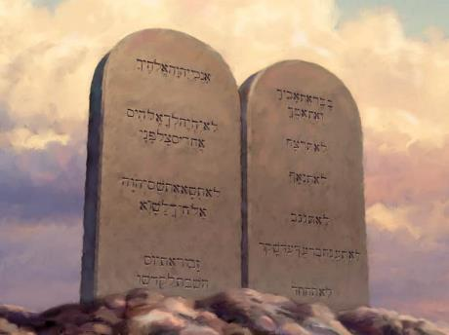
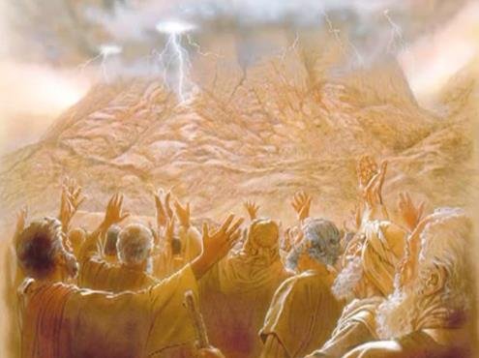








nrq;fliy fle;jJ ,];uNtYf;F iky;fy;yhf ,Ue;jJ. ,uz;lhtJ iky;fy; NjtDila thahy; epahag;gpukhzj;ij gpufldg;gLj;JtjhFk;.
mj;jUzj;jpy;, ,];uNty; gupRj;j Njrkhf gpwe;jpUe;jJ. mjd; ,Ug;ig epu;tfpf;Fk; tpjpfisg; ngw;wJ.
Mdhy; mit ntWk; kj> r%f my;yJ Rfhjhu rl;lq;fis tpl mjpfkhf ,Ue;jd. gj;J fl;lisfs;, vy;yh rl;lq;fSf;Fk; mbg;gilahdJ, mJ NjtDila Fzhjpraq;fspd; ntspg;ghlhf ,Ue;jJ, vdNt, mJ ,];uNtYf;F kl;Lky;y, NjtDila xt;nthU gps;isf;Fk; nghUe;Jk;.
epahag;gpukhzj;ijf; nfhLj;jy;:
  fl;lisfis ngWgtu;fs; (ahj; 19:1-8)
  fl;lisfis nfhLg;gtu; (ahj; 19:9-25)
  gj;J fl;lisfs; (ahj; 20:1-17)
epahag;gpuhzj;jpd; mu;j;jk;:
  epahag;gpukhzj;jpd; mu;j;jk;.
  thf;Fj;jj;jkhd epahag;gpukhzk;.
  epahag;gpukhzk; xU Kbthf.

Slide 4

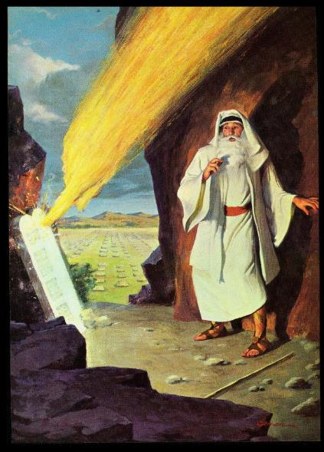
epahag; gpukhzj;ijf; nfhLj;jy;

Slide 5

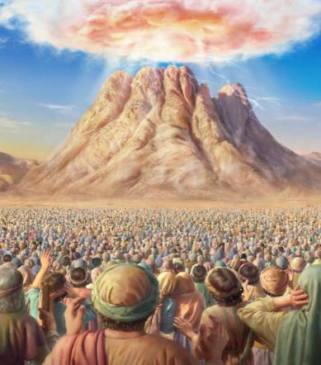
fl;lisfis ngWgtu;fs;
“ehd; vfpg;jpaUf;Fr; nra;jijAk;> ehd; cq;fisf; fOFfSila nrl;ilfspd;Nky; Rke;J> cq;fis vd;dz;ilapNy Nrh;j;Jf;nfhz;lijAk;> ePq;fs; fz;bUf;fpwPh;fs;..” (ahj; 19:4)
Njtd; Vd; ,];uNtyiu vfpg;jpypUe;J mioj;J te;jhu;?
mtiu Nrtpf;f (ahj;. 5:1; 7:16; 8:1, 20; 9:1, 13; 10:3). mtiu Nrtpg;gjhy;, mtu;fs; kpfg;ngupa gad;fis ngw;Wf;nfhs;thu;fs; (mtw;Ws; fhdhd; NjrKk; xd;W).
vfpg;jpypUe;J mtu;fs; Gwg;gl;l %d;whk; khjj;jpy; mtu;fs; rPdha; kiyapd; mUNf Kfhkpl;ldu;. mq;F jhd; ,];uNty; Njrk; cUthf;fj;jpw;fhd mbj;jsk; mikf;fg;gl;lJ. Njtd; mtu;fSld; xU cld;gbf;ifia Kd;nkhope;jhu;> mtu;fs; mij Vw;Wf;nfhz;ldu; (ahj;. 19:1-8).
cld;gbf;ifia Vw;Wf;nfhs;tjd; %yk;> ,];uNty; vd;dthFk; (ahj;. 19:5-6)?
gupRj;j [dq;fs;
mtu;fs; jq;fis NjtDf;F mw;gzpj;J> mtUila Fzj;ij ntspg;gLj;Jthu;fs;.
Mrhupau;fspd; ,uh[;ak;
mtu;fs; kw;wtu;fis NjtDila ,izj;J> mtUila epahag;gpukhzj;ij mtu;fSf;F fw;Wf; nfhLg;ghu;fs;
NjtdplkpUe;J xU tpN\r nghf;fp\k;
Njtd; ,];uNtiyf; nfhz;L cyfpw;F jk;ik gw;wpa mwpit nfhz;L xspu nra;Ak; xU xspaiy tupir ahf khw;Wthu;

Slide 6

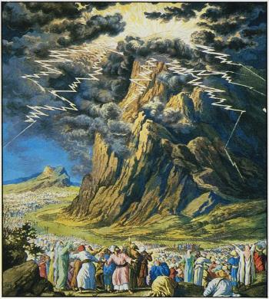
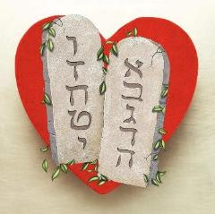
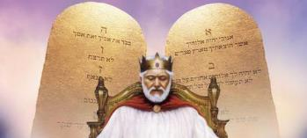
epahag;gpukhzj;ij nfhLg;gtu;
“fh;j;jh; rPdha;kiyapd;Nky; mf;fpdpapy; ,wq;fpdgbahy;> mJ KOtJk; Giff;fhlha; ,Ue;jJ@ me;jg; Gif#isapd; Gifiag;Nghy vOk;gpw;W@ kiy KOtJk; kpfTk; mjph;e;jJ.” (ahj; 19:18)
rPdhapy; NjtDila epahag;gpukhzj;jpd; tpsf;ff;fhl;rp kpfr; rpwe;jjhfTk; jpfpY}l;Lk; tpjkhfTk; ,Ue;jJ(vgp. 12:18-21). ahUk; mg;gbg;gl;l tp\aj;jpw;F jahuhf ,y;iy. vdNt, nja;tPf kfpikahy; tpOq;fg;glhky; ,Uf;f> kf;fs; Kd;$l;bNa jq;fis J}a;ikg;gLj;jpf; nfhz;L> nghUj;jkhd J}uj;ij guhkupf;f Ntz;bapUe;jJ (ahj;. 19:10-12).
Vd; ,g;gb xU epiyg;ghL Njitg;gl;lJ?
Njtd; mtu;fsplk; NgrtpUe;j thu;j;ijfs; mtUila nrhe;j Fzj;jpd; ntspg;ghlhFk;. mtu;fSf;F fPo;gbtJ tho;f;if; mtu;fSf;F fPo;gbahky; NghtJ kuzk;. “gj;Jf; fw;gidfshfpa cld;gbf;ifapd; thh;j;ijfspd;” jPtpuj;ijAk; mjd; Kf;fpaj;Jtj;ijAk; ,];Nuy; Koikahf mwpe;jpUf;f Ntz;Lk; (ahj;. 34:28).
epahag;gpukhzj;jpd; ,uz;L gjpg;Gfs; gjpT nra;ag;gl;Ls;sd: xd;W ahj;jpuhfkj;jpd; njhlf;fj;jpy;> kw;nwhd;W fhdhDf;Fs; Eiotjw;F Kd;G NkhNrapd; ,Wjp ciufspd; xU gFjpahf.
mjd; tpsf;ff;fhl;rpapy; mJ gaKWj;Jtjhf Njhd;wpdhYk;> epahag;gpukhzk; NjtDila rpwe;j Fzj;ij gpujpgypf;fpwJ: md;G (Nuh. 13:10).

Slide 7
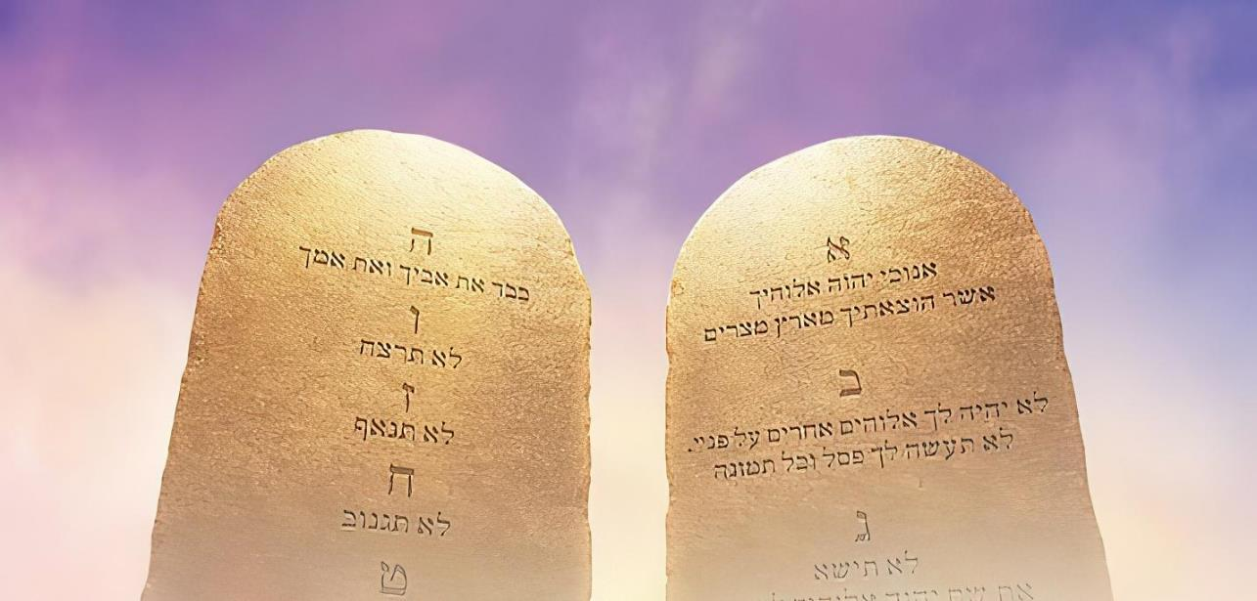

gj;J fl;lisfs;
“cd;id mbikj;jd tPlhfpa vfpg;J Njrj;jpypUe;J Gwg;glg;gz;zpd cd; Njtdhfpa fh;j;jh; ehNd.” (ahj; 20:2)
Njtd; mjd; Kjd;ikahd nray;ghl;il njspTg;gLj;Jtjd; %yk; rl;lj;ij mwpKfg;gLj;Jfpwhu;: “cd;id mbikj;jd tPlhfpa vfpg;J Njrj;jpypUe;J Gwg;glg;gz;zpd cd; Njtdhfpa fh;j;jh; ehNd.” (ahj;. 20:2). fl;lisfis ftdpg;gJ, ekf;F, kPl;gpw;fhd gjpy;. ,J ngwg;gl;l md;gpw;fhd md;gpd; gjpy;.
“md;G epahag;gpukhzj;jpd; epiwNtWjyhapUf;fpwJ” (Nuh. 13:10)
Njtid Nerpg;gJ (cgh. 6:5; ahj;. 20:3-11)
mayhid Nerpg;gJ (Nytp. 19:18; ahj;. 20:12-17)
ve;j Raey MirfSk; ek; Fzj;ij fiwg;gLj;jhjgbf;F ek;ik kjpf;f Ntz;Lk;.
mtUila xa;T kw;Wk; Muhjid ehshd xa;T ehis fdk; gz;Zq;fs;
ek; tho;tpy; NjtDf;F Kjyplk; nfhLj;J mtiu kjpf;fTk;> tzq;fTk; Ntz;Lk;.
Njtid ve;j tpf;fpufj;jhYk; khw;whky; mtiu tzq;f Ntz;Lk;
NjtDila ngau;> ew;ngau; kw;Wk; Fzj;ij tzq;Fq;fs;
ngw;Nwhiu kjpf;fNtz;Lk;
[Ptid kjpf;fNtz;Lk;
jpUkzj;ij kjpf;f Ntz;Lk;
[dq;fSila nrhj;Jf;fis kjpf;f Ntz;Lk;
kw;wtu;fspd; ew;ngaiu kjpf;f Ntz;Lk;

Slide 8

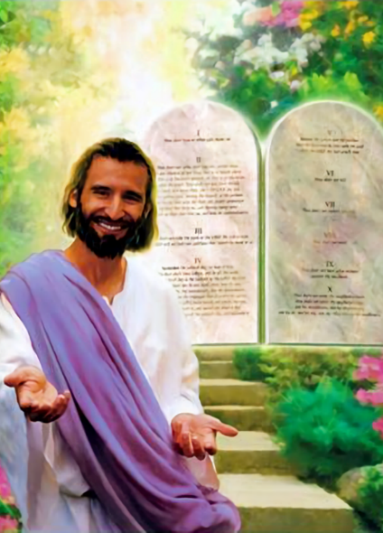

epahag; gpukhzj;jpd; mu;j;jk;

Slide 9


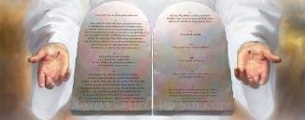
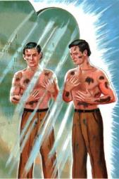
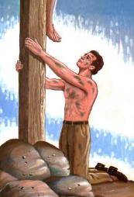
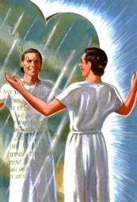
epahag;gpukhzj;jpd; nray;ghL
“,t;tpjkhf> ehk; tpRthrj;jpdhNy ePjpkhd;fshf;fg;gLtjw;F epahag;gpukhzk; ek;ikf; fpwp];Jtpdplj;jpy; topelj;Jfpw cghj;jpaha; ,Ue;jJ.” (fyh 3:24)
epahag;gpukhzj;jpd; rpy nra;y;ghLfs; vd;d?
,ul;rpg;G mjd; nray;ghLfspy; ,y;iy(fyh. 2:16). fl;lisfs; vd;gJ ekJ ghtq;fis gpujpgypf;Fk; xU fz;zhb Nghd;wJ (ahf; 1 :23-25).
mJ jPikia tpl;L ek;ik tpyf;fp itf;fpwJ(rq;. 119:104)
mJ ekf;F Qhdj;ij jUfpwJ(cgh. 4:6)
mJ Rje;juj;ij nfhLf;fpwJ (ahf; 2:12)
mJ ekf;F rkhjhdj;ij jUfpwJ(rq;. 119:165)
mJ ekf;F nropg;ig jUfpwJ (NahR. 1:8)
mJ ek; ghtj;ij Rl;bf;fhl;LfpwJ (Nuh. 7:7)
ek;ik fpwp];JTf;F Neuhf elj;JfpwJ
(fyh. 3:24)
fz;zhbia cilg;gjhy; fiwfs; ePq;fhJ; mij Gwfzpg;gjhy; fiwfs; ePq;fhJ. Mdhy; “fz;zhb” (fl;lisfs;) ,y;yhky; ehk; (ghtj;jhy;) fiwg;gl;Ls;Nshk; vd;gijAk;> ek;ik Rj;jfupf;f “iff;Fl;il” “fpwp];J” ekf;F Njit vd;gijAk; ehk; mwpakhl;Nlhk;.
Ntjk; njspthf $WfpwJ: fw;gid ed;ikaha; ,Uf;fpwJ (Nuh. 7:12); mijg; gw;wp jpahdpg;gJ xU kfpo;r;rp (rq;. 1:2). “ckJ Ntjj;jpy; ehd; vt;tsT gphpakhapUf;fpNwd;! ehs;KOJk; mJ vd; jpahdk;.” (rq;. 119:97).

Slide 10


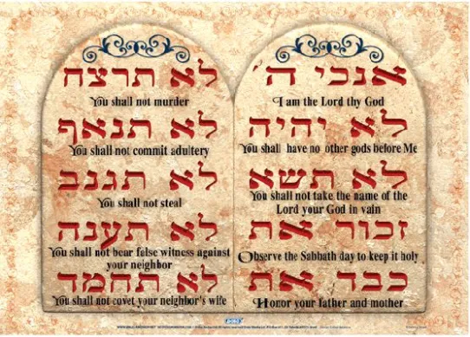

thf;Fj;jj;jkhd epahag;gpukhzk;
“,td; cq;fSf;fhfTk;> yhNthjpf;NfaUf;fhfTk;> vuhg;NghypaUf;fhfTk;> kpFe;j [hf;fpuijAs;stdhapUf;fpwhndd;gjw;F ehd; rhl;rpahapUf;fpNwd;.” (cghfkk; 4:13)
vgpNuaj;jpy;, gj;J fl;lisfs; %d;W Kiw Fwpg;gpl;lhy;> mit “gj;J thu;j;ijfs;” vd;W miof;fg;gLfpd;wd (ahj;. 34:28; cgh. 4:13; cgh. 10:4).
,ijg; gw;wp ehk; Nahrpg;Nghk;. ehk; xUtuplk;> “ehd; cq;fSf;F vd; thu;j;ijia nfhLf;fpNwd;” vd;W nrhy;Yk;NghJ vd;d mu;j;jk;?
cz;ikapy;, ehd; cq;fSf;F vijAk; nfhLf;ftpy;iy; ehq;fs; cq;fSf;F xU thf;FWjp mspf;fpNwhk;. ehq;fs; cWjpahd xd;iw nra;ag; NghfpNwhk; vd;W cq;fSf;F cWjpaspf;fpNwhk;.
vdNt, vgpNua %y thu;j;ijahd “jhgu;”, “thu;j;ij” my;yJ “thf;FWjp” vd;W nkhop ngau;f;fg;glyhk;
cjhuzk;: “mth; jk;Kila jhrdhfpa NkhNriaf;nfhz;L nrhd;d mtUila ey;thh;j;ijfspy; (jhgu;) vy;yhk; xU thh;j;ijahdhYk; (jhgu;) jtwpg;Nghftpy;iy.” (1 ,uh[hf;fs; 8:56).
gj;J fw;gidfs; vd;gJ Njtd; ekf;F nfhLf;Fk; gj;J thf;FWjpfs;> mit ek;ik rupahd ghijapy; topelj;Jk; Nehf;fk; nfhz;lit.

Slide 11

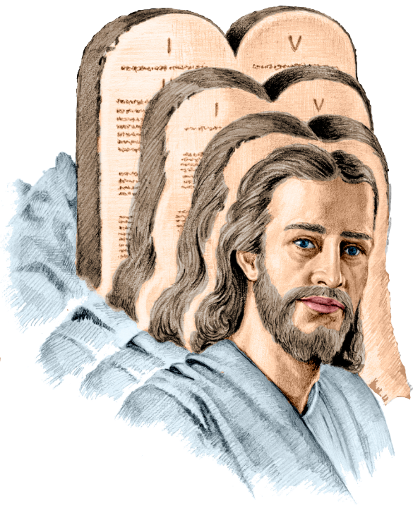
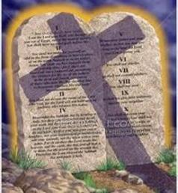
epahag;gpukhzNk xU Kbthf
“vg;gbnad;why;> mth;fs; NjtePjpia mwpahky;> jq;fs; RaePjpia epiyepWj;jj; NjLfpwgbahy; NjtePjpf;Ff; fPo;g;gbahjpUf;fpwhh;fs;.” (Nuhku; 10:4)
Nuhku; 10:4y; gTy; fl;lisfSf;F gad;gLj;jpa “KbT” vd;w thu;j;ij “nlNyh];” MFk;. ,e;j thu;j;ijapd; mu;j;jk; vd;d?
Kjd;ik nghUs;: xU tuk;G my;yJ Nehf;fkhf Fwpf;fgl;l Gs;sp. cl;f;Fwpg;G (,uz;lhk; epiy mu;j;jq;fs;): KbT, Kw;W, tpisT, Nehf;fk;. mjd; Fwpg;gpl;l nghUs; mJ gad;gLj;jg;gLk; thf;fpaj;jhy; jPu;khdpf;fg;gl Ntz;Lk;.
,ij fpwp];J epahag;gpukhzj;jpd; KbT” vd;W nkhopngau;j;jhy; ,NaRtpd; kuzj;jpw;F gpwF ,dp ve;j fl;lisfSk; ,y;iy. vdNt, ghtk; ,y;iy. gTy; jd;dpy; jhNd Kuz;gLfpwhu; (Nuh. 7:7).
“fpwp];J jhd; epahag;gpukhzj;ij Rl;bfhl;Lk; Gs;sp”
vd;W ehk; nkhopngau;j;jhy;> gTy; xU epiyahf ,Uf;fpwhu;, Vndd;why; epahag;gpukhzk; ,d;Dk; eilKiwapy; cs;sJ> NkYk; mJ ek;ik fpwp];Jtplk; mioj;J nry;fpwJ (Nuh. 3:31; fyh. 3:24).

