Slide 1

epahag;
gpukhzj;jpd; gb thOjy;
ghlk; 9 Mf];l; 30, 2025

Slide 2
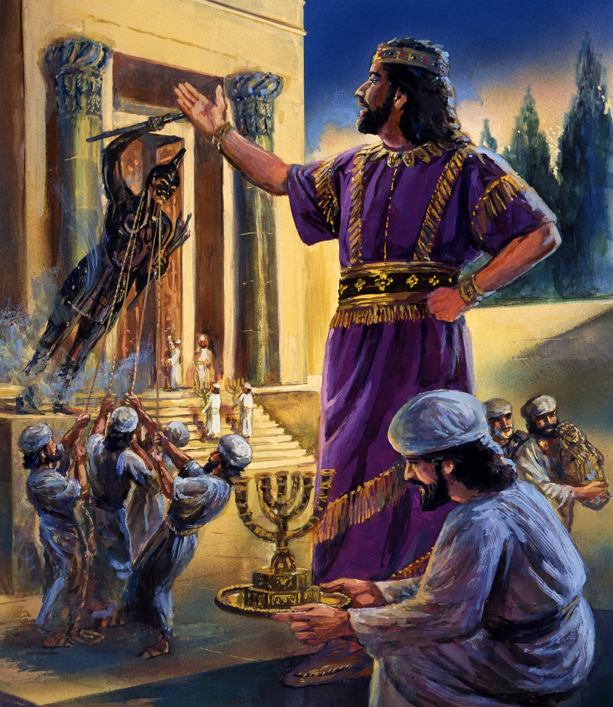
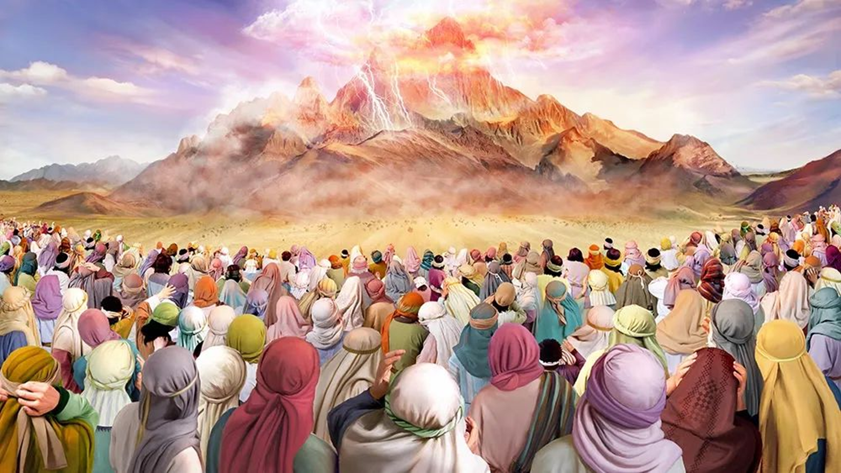
“mg;nghOJ fh;j;jh; NkhNria Nehf;fp: eP ,];uNty; Gj;jpuNuhNl nrhy;yNtz;baJ vd;dntd;why;> ehd; thdj;jpypUe;J cq;fNshNl NgrpNdd; vd;W fz;Bh;fs;. ePq;fs; vdf;F xg;ghf nts;spapdhNy nja;tq;fisAk; nghd;dpdhNy nja;tq;fisAk; cq;fSf;F cz;lhf;fNt Ntz;lhk;. ” ahj; 20:22, 23

Slide 3

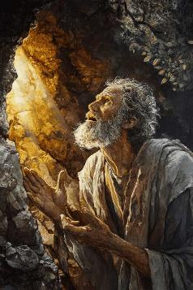
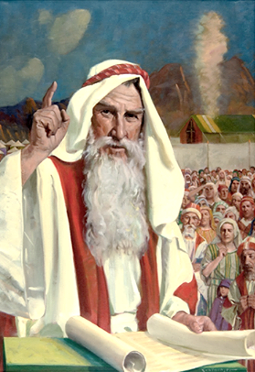
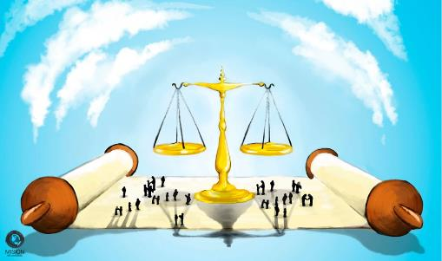


gj;Jf; fl;lisfis mwptpj;j gpd;G, [dq;fs; NjtDf;Fk; jq;fSf;Fk; ,ilapy; ,ilf; fu;j;juhf ,Uf;Fk;gb NkhNria Nfl;Lf;nfhz;lhu;fs; (ahj; 20:19). mj;jUzj;jpypUe;J, Njtd; NkhNrf;F rpy rl;lj;jpl;lq;fis nfhLj;jhu;> NkhNr mij [dq;fSf;F nfhLj;jhu;.
“cld;gbf;if FwpaPL” vd;W miof;fg;gLk; ,e;j rl;lj;jpl;lq;fs;, ,];uNty; kf;fspd; tho;f;ifia xOq;Fg;gLj;Jk; Nehf;fk; nfhz;lit> vdNt mJ ek;KilaJkhFk; (ekJ jw;Nghija ajhu;j;jj;jpw;F Njitahd jOty;fSld;).
RUf;fkhf nrhd;dhy;, mit, gj;J fl;lisfis md;whl tho;f;ifapd; Fwpg;gpl;l epfo;TfSf;F eilKiw gad;ghlhf nfhz;Ls;sd.
fw;gidapd;gb vg;gb tho;tJ?:
  td;Kiwia vt;thW epu;tfpg;gJ (ahj; 21:1-32)
  rKjhaj;jpy; vg;gb tho;tJ (ahj; 21:33-23:19)
  vg;gb ntw;wp ngWtJ (ahj; 23:20-33)
fw;gidia vg;gb Gupe;Jnfhs;tJ?:
  gopthq;Fk; rl;lq;fs;.
  ntFkjp kw;Wk; jz;lid.

Slide 4

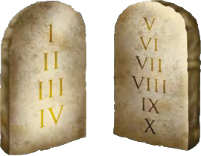

fw;gidapd;gb vg;gb tho;tJ?

Slide 5

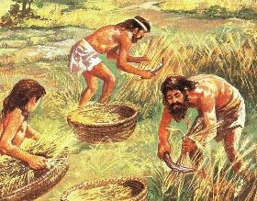
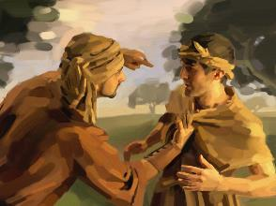
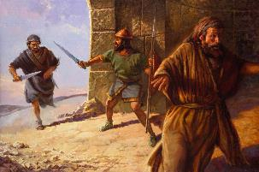
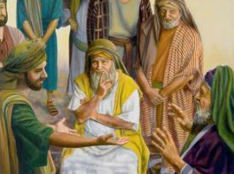
td;Kiwia vg;gb epu;tfpg;gJ?
“xU kdpjidr; rhFk;gb mbj;jtd;> epr;rakha;f; nfhiynra;ag;glf;fltd;.” (ahj; 21:12)
cld;gbf;if FwpaPL vgpNua rKjhaj;jpd; %d;W Kf;fpa mk;rq;fis xOq;Fg;gLj;Jtjd; %yk; njhlq;FfpwJ:
mbikj;jdk; (ahj;. 21:2-11)
  Vohk; Mz;Lf;F gpwF Mz;fs; tpLtpf;fg;gl;ldu;.
  ngz;fs;, jpUkzk; nra;aahkypUe;jhy;, mtu;fSk; tpLtpf;fg;gLthu;fs;.
  xU kdpjd; tpUk;gpdhy; mtd; mbikahfNt ,Uf;fyhk;.
kuz jz;lid (ahj;. 21:12-17)
  jpl;lkpl;L nfhiy nra;gtDf;F
  ngw;Nwhiu rgpg;gtUf;F my;yJ fhag;gLj;Jgtu;f;F
  flj;jy;fhuDf;F
fhaq;fs; (ahj;. 21:18-32)
  epjp ,og;gPL nrYj;jNtz;ba flik
  fUf;fiyg;G ele;jhy;, ePjpgjpAk; ngz;Zk;(mtsJ fztUld;) mguhjk; tpjpf;fyhk;.
,e;j rl;lq;fs; vy;yhk; kf;fspilNa J\;gpuNahfk; kw;Wk; td;Kiwiaj; jLf;f Kaw;rpf;fpd;wd.

Slide 6

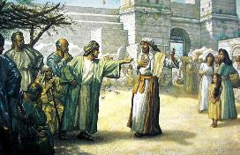
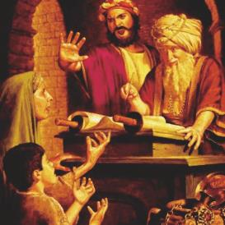
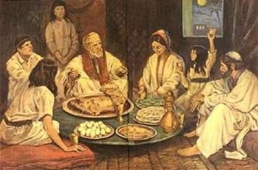
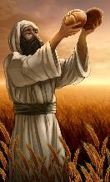
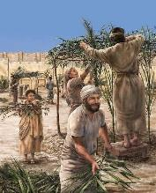
rKjhaj;jpy; vg;gb tho;tJ?
“epakpf;fg;glhj xU fd;dpifia xUtd; Nkhrk;Nghf;fp mtNshNl radpj;jhy;> mtd; mtSf;fhfg; ghprk;nfhLj;J> mtis tpthfk;gz;zf;fltd;.(ahj; 22:16)
Njtd; ekf;F “mbg;gil” rl;lq;fis tpl;Ltpl;L> ekf;F Njitahdgb mtw;iw gad;gLj;j mDkjpg;gjpy; jpUg;jp milatpy;iy. mtw;iw ehk; rupahf gad;gLj;Jtjw;fhf mtu; cWjpahd cjhuzq;fis toq;Ftjpy; ftdkhf ,Ue;jhu;.
,e;j cjhuzq;fspy; tpyq;Ffs; kPJ tpyq;F jhf;Fjy;fs; mlq;Fk; (ahj;. 21:35-36 ); fld; nfhLj;jy; kw;Wk; thliff;F tpLjy; (ahj;. 22:14-15 ); jpUkzj;jpw;F Ke;ija cwTfs; (ahj;. 22:16 ), Kjypad.
gytPdkhdtu;fisAk; xuq;fl;lg;gl;ltu;fisAk; ghJfhg;gjpy; rpwg;G ftdk; nrYj;jg;gLfpwJ, Mdhy; mtu;fSf;F epahakw;w rYiffis toq;fhky; —mjhtJ, mtu;fSf;F ed;ik gaf;Fk; my;yJ jPq;F tpistpf;Fk; tifapy; ePjpia jpirjpUg;ghky; ,Uf;f Ntz;Lk;(ahj;. 22:21-23; 23:2-3, 6).
,J NjtDf;Fk; mtUila [dq;fSf;Fk; ,ilapyhd cld;gbf;ifahf ,Ug;gjhy;, ,e;j fl;lisfs; ehk; mtUld; vt;thW njhlu;G nfhs;s Ntz;Lk; vd;gijAk; cs;slf;fpaJ. Xa;Tehl;fspd; xa;it jtpu, ghtj;jpypUe;J ekJ tpLjiy> nja;tPf ghJfhg;G kw;Wk; ekf;fhf fhj;jpUf;Fk; kfpikahd vjpu;fhyj;ij epidT+l;Lk; gz;biffis filgpbf;f Ntz;ba flik ,Ue;jJ.

Slide 7

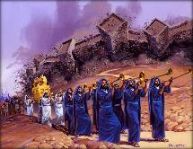
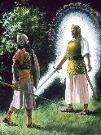
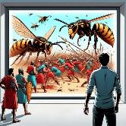
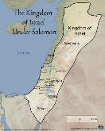
ntw;wp ngWtJ vg;gb?
“topapy; cd;idf; fhf;fpwjw;Fk;> ehd; Maj;jk;gz;zpd ];jhdj;Jf;F cd;idf; nfhz;LNgha;r; Nrh;f;fpwjw;Fk;> ,Njh> ehd; xU J}jid cdf;F Kd;Nd mDg;GfpNwd;.” (ahj; 23:20)
,];uNtyu;fs; vd;d nra;a Ntz;Lnkd;W Njtd; $Wfpwhu;?
NjtDila rj;jj;ij NfSq;fs;, cq;fSila rj;JUf;fSf;F mtu; rj;JUthapUg;ghu;
(23:21-22)
NjtDf;F kl;LNk Nrit nra;Aq;fs;> mg;NghJ mtu; vy;yh Neha;fisAk; ePf;Fthu;(23:24-26)
fhdhdpau;fSld; ve;j cld;gbf;ifiaAk; nra;ahky;> mtu;fSila nja;tq;fis tzq;fhky; ,Uf;f Ntz;Lk;(23:32-33)
Njtd; jhk; vd;d nra;ag; Nghfpwhu; vd;W ,];uNtyu;fSf;F $Wfpwhu;?
mtu;fis ghJf;fhf;fTk;> mtu;fis ghJfhg;Gf;Fs; nfhz;L tuTk; mtu; jk;Kila J}jid mDg;Gthu;(23:20)
NjtJ}jd; mtu;fSf;F Kd;ghf nrd;W mtu;fis fhdhDf;F mioj;J nry;thu; (23:23)
mtu; me;j Fbkf;fSf;F gaq;fuj;ij mDg;Gthu; (23:27)
mtu;fis tpul;l mtu; Fstpfis mDg;Gthu;(23:28)
mtu; mtu;fis gbg;gbahf tpul;Lthu;(23:29-30)
kj;jpa jiuf;fly; Kjy; Igpuhj;J ejptiu mtu;fs; Mjpf;fk; nrYj;Jk;tiu mtu; mtu;fis ,];uNtyuplk; xg;gilg;ghu; (23:31)
fhdhdpau;fspd; ,uh[;aj;ij Vd; Njtd; MgpuhfhKf;F nfhLf;ftpy;iy? “Vndd;why; vNkhhpaUila mf;fpukk; ,d;Dk; epiwthftpy;iy.” (Mjp. 15:16).
ehd;F E}w;whz;Lfs; fUizf;F gpwFk;, fhdhdpau;fs; jq;fs; topfis khw;wpf; nfhs;stpy;iy. ,];uNtyuplk; epyj;ij xg;gilf;f Ntz;ba Neuk; ,J… mikjpahf! (ahj;. 13:17)
Njtd; mtu;fis vfpg;jpypUe;J Nghu; nra;ahkNyNa ntspNa nfhz;L te;jpUe;jhy;> fliy ,uz;lhf gpupe;jpUe;jhy;> mw;Gjkhf mtu;fSf;F cztspj;jpUe;jhy;> jk;Kila NjtJ}ju;fis nfhz;L mtu;fis topelj;jpapUe;jhy;… mtu;fs; mjw;fhfg; Nghu; nra;ahkNyNa fhdhid nfhLf;f mtuhy; Kbahjh?

Slide 8

fw;gidia Gupe;J nfhs;tJ vg;gb?

Slide 9

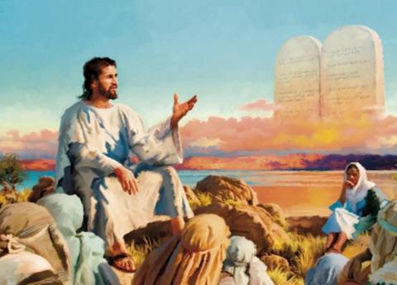


gopthq;Fk; rl;lq;fs;
“fz;Zf;Ff; fz;> gy;Yf;Fg; gy;> iff;Ff; if> fhYf;Ff; fhy;>” (ahj; 21:24)
,NaR kiyg;gpurq;fj;ij toq;fpa NghJ> gopthq;Fk; rl;lj;ij xopj;jhu;(kj;. 5:38-42) … ,y;iyah?
“nrhy;yg;gl;lij ePq;fs; Nfs;tpg;gl;bUf;fpwPu;fs;… Mdhy; ehd; cq;fSf;F nrhy;fpNwd;” vd;w thf;fpak; epahag;gpukhzj;ij xopf;ftpy;iy (“nfhiy nra;ahNj” my;yJ “tpgr;rhuk; nra;ahNj” vd;gjw;Fk; mNj nrhw;nwhliu ,NaR gad;gLj;jpdhu;. Mdhy; mtu; mtw;iw xUNghJk; xopf;f tpUk;gtpy;iy). cz;ikapy;, ,NaR vg;NghJk; epahag;gpukhzj;ij tpupTg;gLj;jpdhu;> Nkk;gLj;jpdhu;> mjw;F mjd; cz;ikahd mu;j;jj;ij nfhLj;jhu;.
xU egu; kw;nwhUtUf;F jPq;F tpistpj;jjw;fhf jdJ fz;izNah my;yJ ifiaNah ,of;fNtz;Lk; vd;gJ topthq;Fk; rl;lj;jpd; cz;ikahd Nehf;fkhf xUNghJk; ,Uf;ftpy;iy.
gopthq;Fjiy jLg;gJ> ,uj;jfsup rz;ilfSf;F Kw;Wg;Gs;sp itg;gJ kw;Wk; Kd; tprhuiz ,y;yhky; gopthq;Ftij jLf;Fk; Nehf;fj;Jld; ,e;j rl;lk; cUthf;fg;gl;lJ. Nrjq;fis ePjpgjpfs; kjpg;gpl Ntz;Lk;> gpd;du; nghUj;jkhd gz ,og;gPL epWtg;gl;L toq;fg;gLk;. kf;fs; jq;fs; iffspy; ePjpia vLj;Jf;nfhs;tij jLf;f ,e;j eilKiw vOe;jJ. ePjp toq;fg;gl Ntz;Lk;> Mdhy; NjtDila rl;lj;jpw;Fk; ,zq;f Ntz;Lk;.

Slide 10




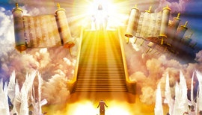
ntFkjp kw;Wk; jz;lid
“xUtd; gjptpUe;J nfhy;yhky;> Njtr;nrayha;j; jd; iff;F Nehpl;ltidf; nfhd;why;> mtd; Xbg;Ngha;r; NruNtz;ba ];jyj;ij cdf;F epakpg;Ngd;.” (ahj; 21:13)
gopthq;Fk; vz;zk; ek;kpy; Mokhf Nt&d;wpAs;sJ. mJ ehk; ngw;w jtWf;F vg;NghJk; tpfpjhrhukw;wJ: “mtd; vdf;F ,ij nra;jhy;> ehd; mtDf;F ,ijtpl mjpfkhf nra;Ntd;.”
ehk; tpUk;Gtjw;F Neu;khwhf jPikf;F ed;ik nra;Ak;gb ,NaR ek;ik miof;fpwhu;: (kj;. 5:44). mg;gbahdhy; ePjp vq;Nf? Fw;wthspf;F ahu; jFjpahdij nrYj;Jthu;fs;?
Mf;fpkpg;ghsu; jz;bf;fglkhl;lhu; vd;Nwh> ve;jnthU nraYf;Fk; gopthqfg;gLthu; vd;Nwh Njtd; ekf;F nrhy;ytpy;iy. Mdhy; mtu; gopthq;Fgtu; vd;W njspthf nrhy;fpwhu;(Nuh. 12:19-21).
cld;gbf;if Fwpapl;by; jdpg;gl;l gopthq;fy; nghWj;J nfhs;sg;gl;lhYk;> J\;gpuNahfj;ij jLf;f xU ePjpj;Jiw mikg;ig cUthf;Ftjd; %yk; mJ fl;Lg;gLj;jg;gl;lJ (ahj;. 21:12-13, 22; 22:8-9).
ePjpgjp> eLtu; kd;wk; kw;Wk; kuz jz;lid epiwNtw;Wgtu; Mfpa gjtpfis ahUk; xNu Neuj;jpy; Vw;f KbahJ. jz;lid tpjpf;fg;glNtz;Lkhdhy;> mJ xU epahakhd ePjpj;Jiw nray;Kiw %yk; nra;ag;gl Ntz;Lk;. NkYk; fpwp];JNt cr;r kw;Wk; ,Wjp ePjpgjpahf ,Ug;ghu;.

