Slide 1
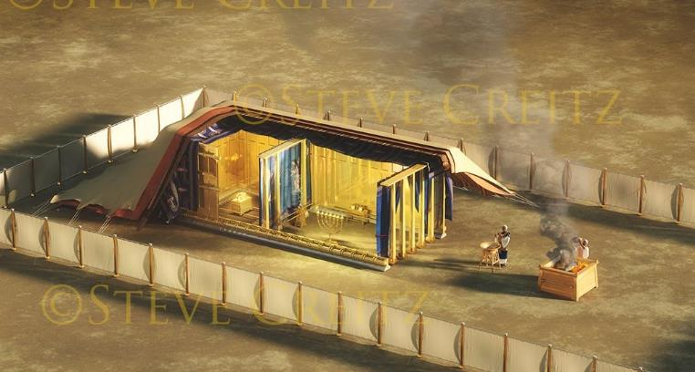
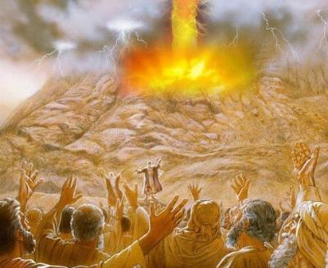
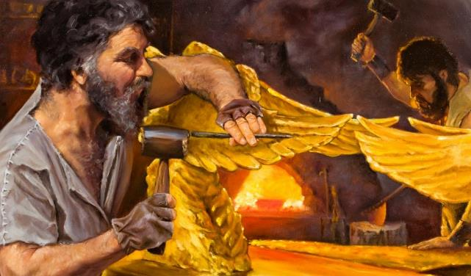
ghlk; 10 nrg;lk;gu; 6, 2025
cld;gbf;ifAk; mjd; tiuglKk;

Slide 2
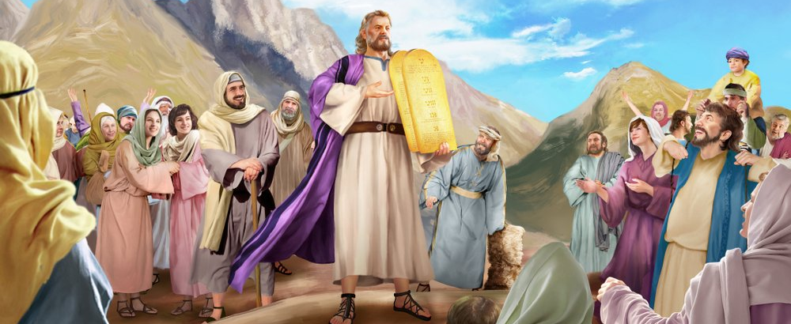
“NkhNr te;J> fh;j;jUila thh;j;ijfs; ahitAk; epahaq;fs; ahitAk; [dq;fSf;F mwptpj;jhd;@ mg;nghOJ [dq;fs; vy;yhUk; Vfrj;jkha;: fh;j;jh; mUspd vy;yh thh;j;ijfspd;gbAk; nra;Nthk; vd;W gpujpAj;juk; nrhd;dhh;fs;.” ahj;jpuhfkk; 24:3

Slide 3

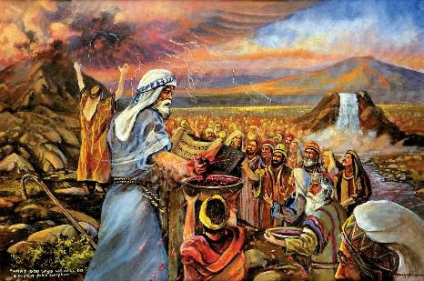
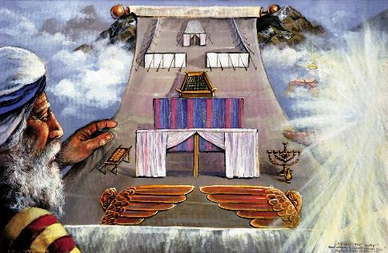


gj;J fl;lisfis rj;jkhf mwptpj;J> NkhNrf;F mbg;gil rl;lq;fis nfhLj;j gpwF, Njtd; ,];uNtYld; cld;gbf;if nra;a tpUk;gpdhu;.
me;j cld;gbf;if vspikahdJ: ehd; cq;fs; Njtdhf ,Ug;Ngd;, ehd; cq;fis ghJfhj;J> cq;fis MrPu;tjpg;Ngd;; ePq;fs; vd; fl;lisfSf;F fPo;gbAq;fs;.
cld;gbf;ifia xU RUspy; vOjpa gpwF, ,U jug;gpdUk; mij cWjpg;gLj;j Ntz;bapUe;jJ. [dq;fs; mijf; filg;gpbg;gjhf cWjpg;gLj;jpdu;. Njtd; vt;thW cWjpg;gLj;jpdhu;? ,uj;jj;jhy;; xU tpUe;J %yk;; kw;Wk; cld;gbf;ifia Gupe;Jnfhs;s cjTk; xU khjpupAld;.
cld;gbf;if:
  cld;gbf;ifapd; ,uj;jk; (ahj; 24:1-6, 8)
  cld;gbf;ifapd; epiwNtWjy; (ahj; 24:7)
  cld;gbf;ifapd; tpUe;J (ahj; 24:9-18)
khjpup:
  khjpupapd; Nehf;fk; (ahj; 25:1-9)
  khjpupapd; Maj;jk; (ahj; 31:1-18)

Slide 4
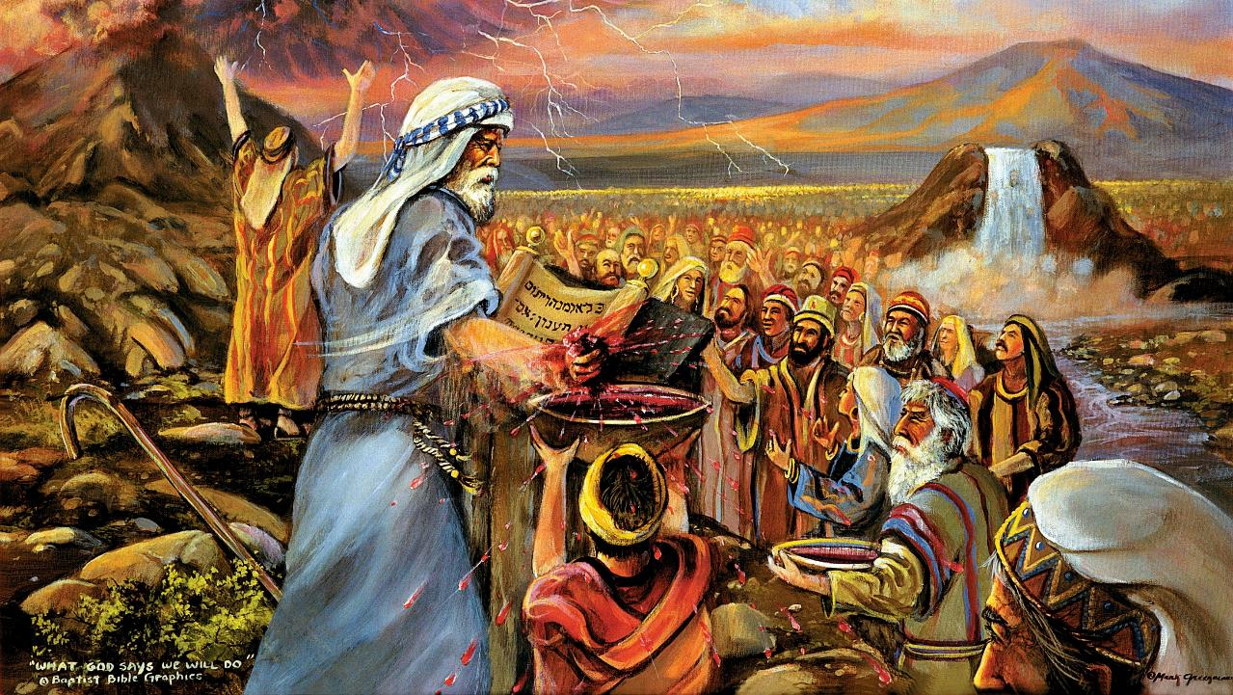
cld;gbf;if

Slide 5

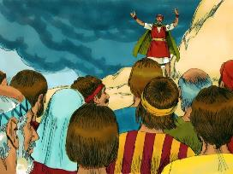
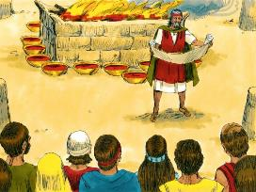
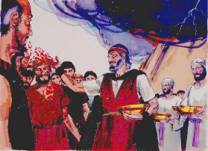
cld;gbf;ifapd; ,uj;jk;
“mg;nghOJ NkhNr ,uj;jj;ij vLj;J> [dq;fspd;Nky; njspj;J> ,e;j thh;j;ijfs; ahitAq;Fwpj;J fh;j;jh; cq;fNshNl gz;zpd cld;gbf;ifapd; ,uj;jk; ,JNt vd;whd;.” (ahj;jpuhfkk; 24:8)
,e;j cld;gbf;if vt;thW Vw;gLj;jg;gl;lJ?
cld;gbf;if thrpf;fg;gl;lJ (ahj;. 24:3K)
[dq;fs; rhjfkhf gjpyspj;jdu; (ahj;. 24:3gp)
mJ RUspy; vOjg;gllJ (ahj;. 24:4K)
gypgPlk; fl;lg;gl;lJ (ahj;. 24:4gp)
12 J}z;fs; mikf;fg;gl;ld (ahj;. 24:4e)
jfd gypfs; gypaplg;gl;lJ (ahj;. 24:5)
,uj;jj;jpy; ghjp gypgPlj;jpy; njspf;fg;gl;lJ (ahj;. 24:6)
cld;gbf;if kPz;Lk; thrpf;fg;gl;lJ (ahj;. 24:7K)
[dq;fs; kPz;Lk; rhjfkhf gjpyspj;jdu; (ahj;. 24:7gp)
kw;nwhU ghjp ,uj;jk; [dq;fs; kPJ njspf;fg;gl;lJ (ahj;. 24:8K)
mij NkhNr “cld;gbf;ifapd; ,uj;jkhf” mwptpj;jhu; (ahj;. 24:8gp; kj;. 26:28)
cld;gbf;ifia cWjpg;gLj;j xU tpUe;J eilngw;wJ (ahj;. 24:9-11)
Njtd; ,];uNtiy jk;Kila [dkhf mq;fpfupj;jhu;(12 neLtupirfs;): mtu; Fwpg;ghf ,isQu;fis kjpg;gpl;lhu;: NkYk; mtu; xt;nthU egUf;Fk; jdpj;jdpahf jd;id xg;Gf;nfhLj;jhu;(mtu;fs; kPJ jk;Kila ,uj;jj;ij njspj;jhu;.
Njtd; ek;Kld; jdpg;gl;l tpjj;jpYk;, tpRthrpfspd; r%fkhfTk; xU cwit itj;Jf;nfhs;s tpUk;Gfpwhu;.

Slide 6

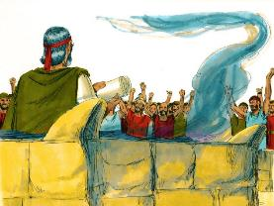


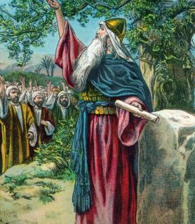
cld;gbf;ifapd; epiwNtWjy;
“cld;gbf;ifapd; G];jfj;ij vLj;J> [dq;fspd; fhJ Nfl;f thrpj;jhd;@ mth;fs; fh;j;jh; nrhd;dgbnay;yhk; nra;J> fPo;g;gbe;J elg;Nghk; vd;whh;fs;.” (ahj;jpuhfkk; 24:7)
KO Neu;ikAld;, [dq;fs; cld;gbf;ifia filgpbf;f jq;fis mu;g;gzpj;J nfhz;ldu;. ,e;j cWjpnkhop Fwfpa fhyNk ePbj;jJ (ahj; . 32:8).
mLj;j jiyKiwAk; cld;gbf;ifia filgpbf;f cWjpG+z;lJ (NahR. 24:18gp). Mdhy; NahRth njspthf vr;rupj;jhu;: “ePq;fs; fh;j;jiur; Nrtpf;fkhl;Bh;fs;@” (NahR. 24:19).
ekf;F ey;y Nehf;fq;fs; ,Ue;jNghjpYk;, NjtDf;F fPo;gbtij jLg;gJ vJ?
,aw;ifahfNt, ehk; fPo;gbahik cs;stu;fs;
(Nuh. 7:18), NkYk; ekJ Nghf;if khw;wpf; nfhs;s ehk; vJTk; nra;a KbahJ (Nuh. 7:24).
Mdhy; mtiu ehk; mDkjpg;Nghkhdhy;, Njtdhy; jhd; ek; ,aw;jd;ikia khw;w KbAk; (vNr. 36:26-27). ehk; mtUf;F fPo;gbAk;gb, mtu; Rj;jpfupf;fpwhu;, vLj;Jf;nfhs;fpwhu;, mikj;J nfhLf;fpwhu;. mtu; kl;LNk ek;ik gyg;gLj;Jfpwhu; (2 nfhup. 12:10).

Slide 7

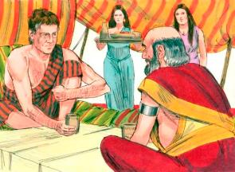
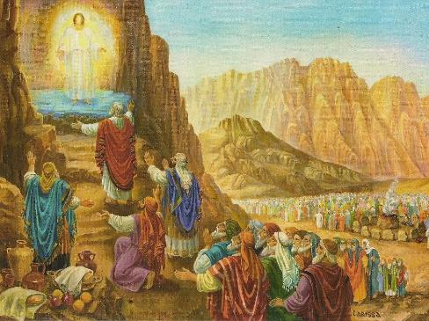
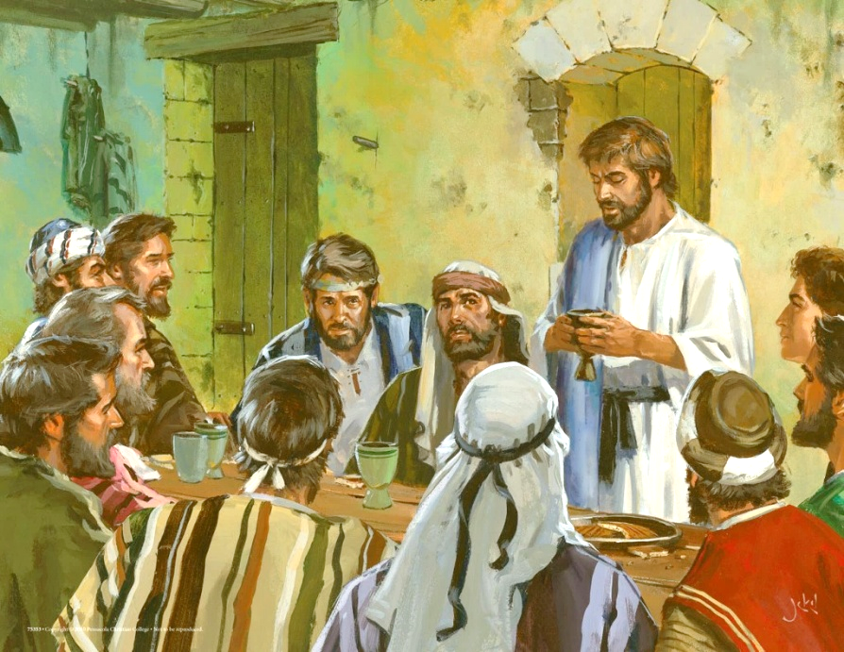
cld;gbf;ifapd; tpUe;J
“gpd;G NkhNrAk; MNuhDk; ehjhGk; mgpa+Tk;> ,];uNtyUila %g;ghpy; vOgJNgUk; Vwpg;Ngha;>; […] mth;fs; Njtidj; jhprpj;J> gpd;G Grpj;Jf; Fbj;jhh;fs;.” (ahj;jpuhfkk; 24:9, 11gp)
ahf;NfhG kw;Wk; yhghd; cjhuzj;jpy; ehk; fhzf;$baJ Nghy, gz;ila fpof;fpy; xU cld;gbf;ifapd; cWjpnkhopapy; ,U jug;gpdUk; gfpu;e;J nfhs;Sk; czTk; mlq;Fk; (Mjp. 31:44-54).
rPdhapy;, 74 NgUf;F Njtd; cld;gbf;ifapd; tpUe;J mspj;jhu;: NkhNr, MNuhd;, ehjhg;, mgpA, kw;Wk; 70 %g;gu;fs;, vy;yh [dq;fisAk; ,tu;fs; gpujpgypj;jhu;fs; (ahj;. 24:9-11).
,NaR Gjpa cld;gbf;ifia ];jhgpj;j NghJ, 12 mg;Ngh];jyu;fSld; jk;Kila czit gfpu;e;J nfhs;tjd; %yKk; mij nra;jhu; (kj;. 26:26-28).
ehk; fu;j;jUila ,uhNgh[dj;jpy; gq;Fnfhs;Sk; xt;nthU KiwAk;> NjtDldhd ekJ cld;gbf;ifia GJg;gpf;fpNwhk;. mg;gj;ijAk; jpuhl;rurj;ijAk; cl;nfhs;tjd; %yk;, ,NaRtpy; ekf;F fpilj;j kd;dpg;igAk; ,ul;rpg;igAk; nfhz;lhLfpNwhk; (1 nfhhup. 11:26).
,ul;rpg;ig mtu;fs; ,Wjpahf epuhfupj;j NghjpYk;> ehjhg;> mgpA+> A+jh]; ,tu;fs; ,e;j “cld;gbf;if tpUe;jpy;” ,Ue;J tpyf;fg;gltpy;iy.

Slide 8
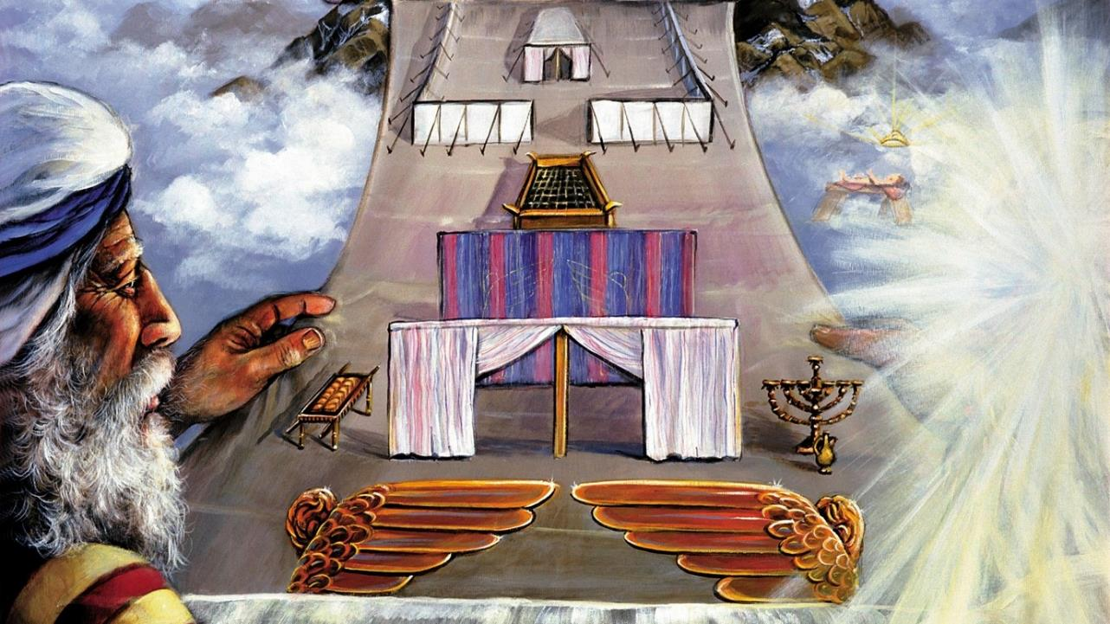
khjpup

Slide 9

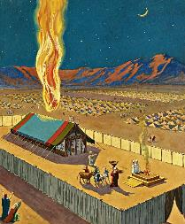
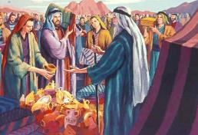
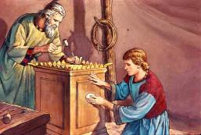
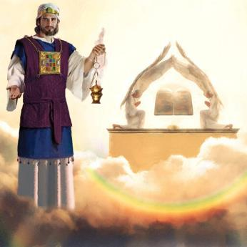
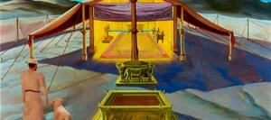
khjpupapd; Nehf;fk;
“mth;fs; eLtpNy ehd; thrk;gz;z> vdf;F xU ghpRj;j ];jyj;ij cz;lhf;Fthh;fshf.” (ahj;jpuhfkk; 25:8)
cld;gbf;ifapd; jdJ gq;if mtu; epiwNtw;Wthu; vd;gjw;fhd cj;juthjkhf> Njtd; kf;fspilNa nrd;W tho KbT nra;jhu;.
Mdhy; NjtDila ruPu gpurd;dk; mtu;fs; midtUf;Fk; cldb kuzj;ij Fwpf;Fk; (ahj;. 33:20). Mifahy;, mtu; jk;Kila gpurd;dj;ij ntspg;gLj;jf;$ba xU thr];jyj;ij fl;Lk;gb mtu;fSf;F fl;lisapl;lhu;. ,e;j gpurd;dk; rpd;dq;fspy; ntspg;gl;lJ. Vndd;why; Njtd; ve;j G+kpf;Fupa NfhtpypYk; cly; uPjpahf trpg;gjpy;iy (mg; 17:24 ).
NkhNrf;F khjpup fhl;lg;gl;L> mjd; fl;Lkhdj;jpw;fhd Fwpg;gpl;l topKiwfs; toq;fg;gl;ld. Njitdahd nghUl;fis gq;fspf;FkhW kf;fsplk; Nfl;Lf;nfhs;sg;gl;lJ(ahj;. 25:2-7).
,e;j Mrupg;Gf; $lhuKk;> rhyNkhd; fl;ba MyaKk; guNyhfj;jpy; fl;lg;gl;l Myaj;jpd; khjpupahf ,Ue;jd (vgp. 8:1-2; 1,uh. 8:27, 30).
,NaR kupj;j NghJ jpiur;rPiy fpopf;fg;gl;l ehs; tiuapYk;> xU ,];uNtyu; gupRj;j ];jyj;jpw;Fs; Eioe;j NghJ, mtu;—milahsg;G+u;tkhf—NjtDila gpurd;dj;jpw;Fs; Eiofpwhu;….

Slide 10

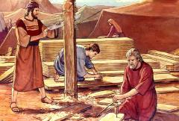
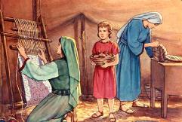
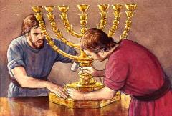
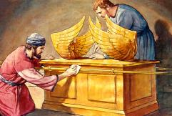
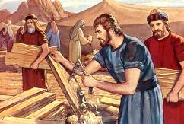
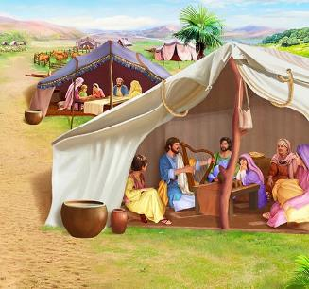
khjpupapd; Maj;jk;
“ehd; A+jhtpd; Nfhj;jpuj;jpy; CUila kfdhd Chpapd; Fkhud; ngrnyNaiyg; Ngh;nrhy;yp mioj;J> tpNehjkhd Ntiyfis mtd; Nahrpj;Jr; nra;fpwjw;Fk;> nghd;dpYk; nts;spapYk; ntz;fyj;jpYk; Ntiynra;fpwjw;Fk;>” (ahj;jpuhfkk; 31:2-3)
Njtd; fl;Lkhdk; Fwpj;J NkhNrf;F kpf tpupthd topKiwfis nfhLj;j NghjpYk;, mtu; vy;yh tptuq;fisAk; nrhy;ytpy;iy. ntz;fy njhl;b> NfUgPd;fs;> Mrhupau;fspd; ghiffs; Nghd;wit vg;gb ,Uf;f Ntz;Lk;? ,J gupRj;j MtpahdUf;F fl;bl fiyQu;fspd; gupRfSld; Ntiy nra;a tha;g;gspj;jJ.
,e;j tptuq;fSf;F, gupRj;j Mtpahdtu; rpwg;G tuq;fis toq;fpdhu;:
ngrnyNay;, KO jpl;lj;ijAk; ,af;fpatu; (ahj;. 31:2)
mNfhypahg;, mtUila jiyik cjtpahsu; (ahj;. 31:6K)
Ntiyapy; cjtpa kw;wtu;fs; (ahj;. 31:6gp)
thr];jyj;ij fl;Ltjw;fhd topKiwfSf;F kj;jpapy;> xa;Tehis gw;wpa rpwg;G Fwpg;G cs;sJ (ahj;. 31:12-17). ,jw;Fk; xa;TehSf;Fk; vd;d rk;ke;jk;?
gupRj;jNk Kf;fpak;. gupRj;j Njtid mZf, ehKk; mtiug; NghyNt gupRj;jkhf ,Uf;f Ntz;Lk;. Xa;Tehs; vd;gJ gupRj;jj;jpd; milahsk; (ahj;. 31:13; vNr. 20:12, 20).
Notes:
Exodus 31:2
See, I have called by name Bezalel the son of Uri, the son of Hur, of the tribe of Judah;
Exodus 31:6a
And behold, I have set with him Aholiab the son of Ahisamach , of the tribe of Dan;
Exodus 31:6b
and I have put wisdom in the minds of every wise-hearted person, so that they may do all that I have commanded you;
Exodus 31:12-17 And the LORD spake unto Moses, saying, (13) Thou shalt speak unto the children of Israel, saying, Ye shall surely keep my sabbaths: for it is a sign between me and you throughout your generations, that ye may know that I am the LORD that sanctifies you. (14) Therefore ye shall keep the sabbath day, for it is holy unto you: whoso profaneth it shall surely be put to death: for whosoever doeth any work in it, that soul shall be cut off from among his people. (15) Six days shall work be done: but the seventh day is a sabbath of rest holy to the LORD: whosoever doeth any work on the sabbath day shall surely be put to death. (16) Therefore shall the children of Israel keep the sabbath, to observe the sabbath throughout their generations for a perpetual covenant. (17) It is a sign between me and the children of Israel for ever: for in six days the LORD made heaven and earth, and on the seventh day he rested, and was refreshed.

