Slide 1
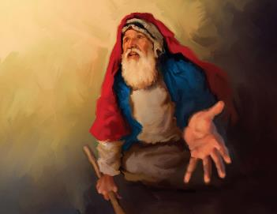
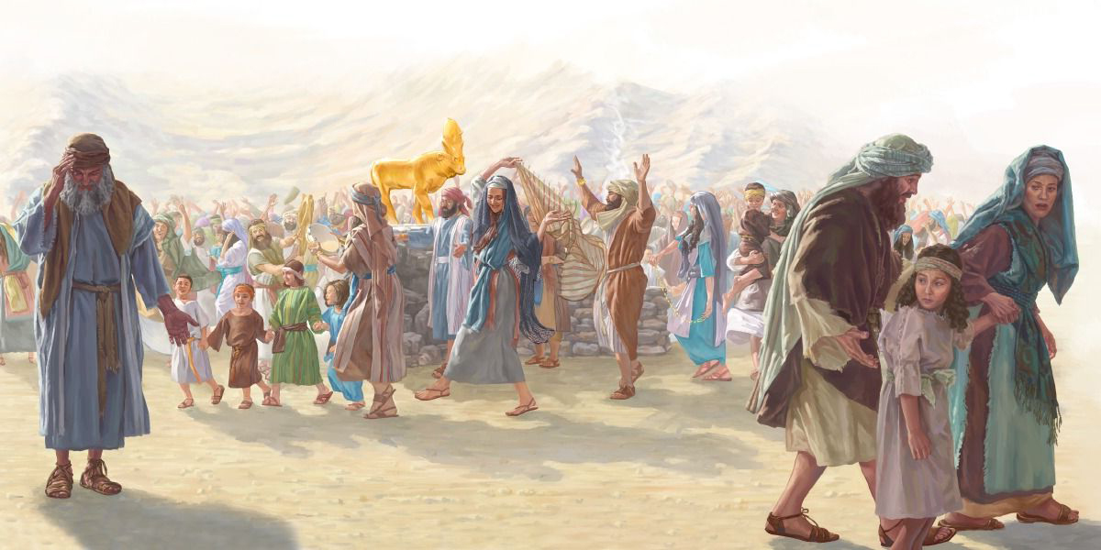
tpRthr JNuhfk; kw;Wk; gupe;JNgRjy;
ghlk; 11 nrg;lk;gu; 13, 2025

Slide 2
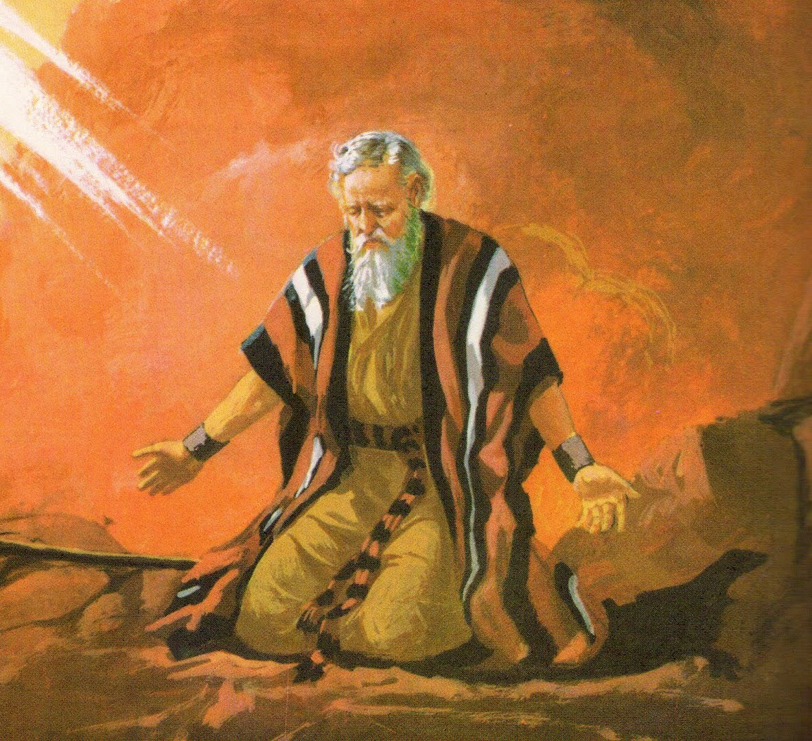
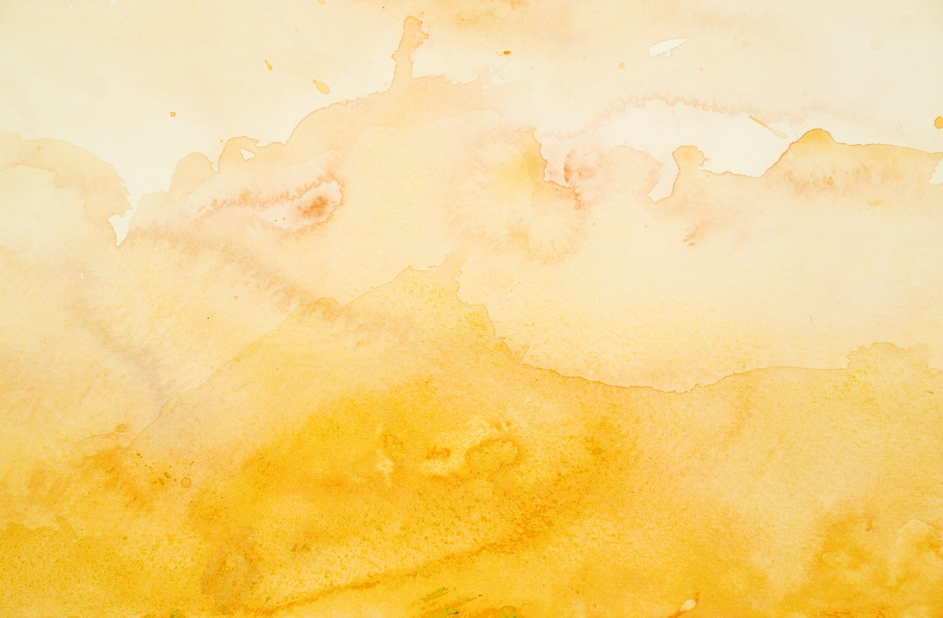
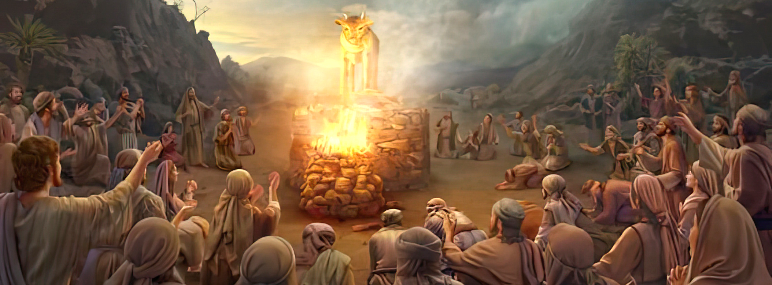
“mg;gbNa NkhNr fh;j;jhplj;jpw;Fj; jpUk;gpg;Ngha;: INah> ,e;j [dq;fs; nghd;dpdhy; jq;fSf;Fj; nja;tq;fis cz;lhf;fp> kfh nghpa ghtk; nra;jpUf;fpwhh;fs;. MfpYk;> NjthPh; mth;fs; ghtj;ij kd;dpj;jUStPuhdhy; kd;dpj;jUSk;@ ,y;yhtpl;lhy; ePh; vOjpd ck;Kila G];jfj;jpypUe;J vd; Ngiuf; fpWf;fpg;NghLk; vd;whd;.”
ahj;jpuhfkk; 32:31, 32

Slide 3

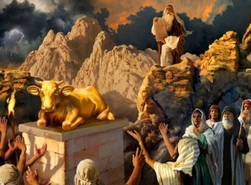
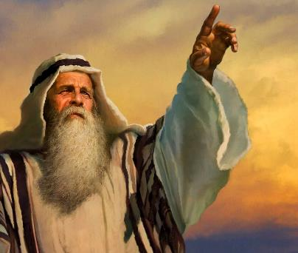


“mth;fSf;F ehd; tpjpj;j topia mth;fs; rPf;fpukha; tpl;L tpyfpdhh;fs;@” (ahj;. 32:8).
gj;J fl;lisfisg; ngw;w rpwpJ Neuj;jpNyNa, rpiyfis cUthf;ff;$lhJ vd;W kPz;Lk; nrhy;ypAk; (ahj;. 20:23), ,];uNtyu; tzq;Ftjw;fhf xU jq;f fd;Wf;Fl;bia nra;jhu;fs;.
,e;j tpRthr JNuhfj;ij vjpu;nfhz;ljhy;, ,];uNtiy mopj;J NkhNria Gjpa Njrkhf;f NkhNraplk; Njtd; mDkjp Nfl;lhu; (ahj;. 32:10). kf;fs; tpRthr JNuhfk; nra;j NghjpYk;, NkhNr ,uz;L Kiw Njtdplk; Ngrp> jFjpaw;w mtu;fSf;fhf kd;dpg;G Nfhupdhu;.
tpRthr JNuhfk;:
  MNuhdpd; gytPdk; (ahj; 32:1-5)
  fd;Wf;Fl;bapd; tpUe;J (ahj; 32:6)
  cUt topghl;bd; Coy; (ahj; 32:7-8)
gupe;JNgRjy;:
  “ck;Kila Nfhgj;jpd; cf;fpuj;ij tpl;Lj; jpUk;gp>” (ahj; 32:9-29)
  “ePh; vOjpd ck;Kila G];jfj;jpypUe;J vd; Ngiuf; fpWf;fpg;NghLk;!” (ahj; 32:30-32)

Slide 4

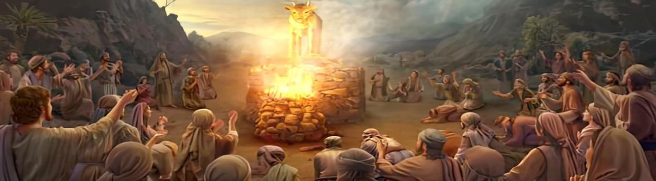
tpRthr JNuhfk;

Slide 5

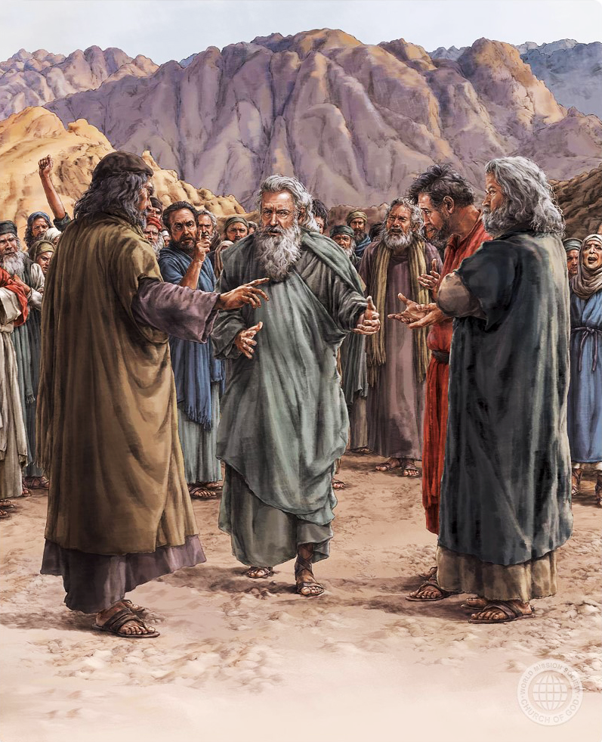
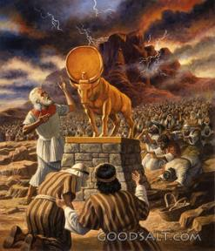
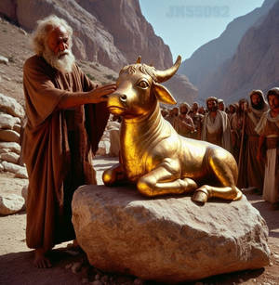
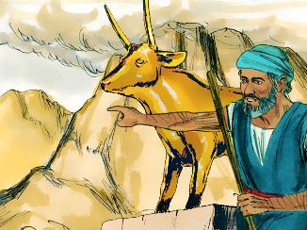
MNuhdpd; gytPdk;
“MNuhd; mijg; ghh;j;J> mjw;F Kd;ghf xU gypgPlj;ijf; fl;b> ehisf;Ff; fh;j;jUf;Fg; gz;bif vd;W $wpdhd;.” (ahj;jpuhfkk; 32:5)
VNyhfPk; vd;w vgpNua thu;j;ij “Njtd;” vd;gjd; gd;ikahf ,Ue;jhYk;> mJ nghJthf xNu Njtid Fwpg;gjw;F gad;gLj;jg;gLfwJ: “vfpg;J Njrj;jpypUe;J Gwg;glg;gz;zpd cd; Njtdhfpa[VNyhfPk;] fh;j;jh; ehNd” (ahj;. 20:2).
NkhNr ,y;yhj Neuj;jpy;, kf;fs; MNuhdplk;> jhq;fs; tzq;ff;$ba xU fhzf;$ba VNyhfPik cUthf;Fk;gb Nfl;lhu;fs;. (ahj;. 32:1). mtu;fs; ngw;w fl;lisfisAk;> mtw;iw filg;gpbg;gjw;fhd cWjpg;ghl;ilAk; mtu;fs; tpiutpy; kwe;Jtpl;lhu;fs; (ahj;. 24:7).
kf;fSld; Ngr;Rthu;j;ij elj;j Kaw;rpg;gjpy; MNuhdpd; jaf;fk; (ahj;. 32:2) tpRthr JNuhfj;ij xopg;gjw;F gjpyhf mjw;F topelj;j toptFj;jJ.
rpiyfis cUthf;Ftjw;F vjpuhd jilfis mtu;fSf;F epidT+l;Ltjw;F gjpyhf> MNuhd;, mtu;fSf;F xU jq;f fd;Wf;Fl;bia nra;J> “cq;fis vfpg;JNjrj;jpypUe;J mioj;Jf; nfhz;Lte;j cq;fs; nja;tq;fs; [VNyhfPk;] ,itfNs!” (ahj;. 32:4).

Slide 6

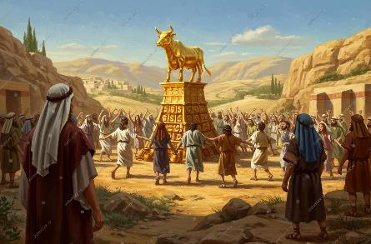
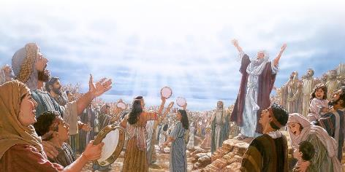

fd;Wf;Fl;bapd; tpUe;J
“kWehs; mth;fs; mjpfhiyapy; vOe;J> rh;thq;f jfdgypfisapl;L> rkhjhdgypfisr; nrYj;jpdhh;fs;@ gpd;G> [dq;fs; Grpf;fTk; Fbf;fTk; cl;fhh;e;J> tpisahl vOe;jhh;fs;.” (ahj;jpuhfkk; 32:6)
xU fd;Wf;Fl;bapd; tbtj;jpy; xU rpiyia cUthf;Ftjd; %yk;> ,];uNtyu; ru;t ty;yikAs;s Njtid xU tpyq;fpd; cUtkhf Fiwj;J> gilg;ghsUf;F gjpyhf capupdj;ij tzq;fpdu;(Nuh. 1:23).
xU nrJf;fg;gl;l rpiy jq;fis topelj;Jk; vd;W mtu;fs; gFj;jwptw;w Kiwapy; epidj;jhu;fs;. VNyhfPk; jhNd xU fd;Wf;Fl;bahf khwptpl;lhu; vd;W $l mtu;fs; epidj;jpUf;fyhk;(ahj;. 32:24)
cz;ikapy;, mtu;fs; Njtid tzq;Ftij tpl;Ltpl;L Nga;fis tzq;fpdhu;fs; (cgh. 32:17). mtu;fs; Njtid tzq;fp nfhz;bUe;j NghJ> mtu;fs; xOf;fuPjpahf tsu;e;jhu;fs;. Vndd;why; mtu;fs; Njtid Nghy; Mdhu;fs;.
Nga;fis tzq;Ftjd; %yk;, mtu;fs; jq;fis jho;j;jpf; nfhs;s njhlq;fpdu;, Vndd;why; mtu;fs; tzq;Fk; Nga;fis NghyNt ,Ue;jhu;fs;.
ehk; ek; ,jaq;fis gilg;ghsUf;F nfhLf;fhky;, NtW rpy rpiyfSf;F (gy cs;sd) Nrit nra;Ak;NghJ, tpiutpy; my;yJ gpd;du; mJ ek;ik xOf;f rPuopTf;F ,l;L nry;Yk;.

Slide 7

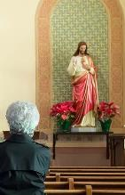



cUt topghl;bd; Coy;
“mg;nghOJ fh;j;jh; NkhNria Nehf;fp: eP ,wq;fpg;Ngh@ vfpg;JNjrj;jpypUe;J eP elj;jpf;nfhz;Lte;j cd; [dq;fs; jq;fisf; nfLj;Jf;nfhz;lhh;fs;.” (ahj;jpuhfkk; 32:7)
xU rpiy Kd;ghf (mJ NjtidNah> fpwp];JitNah my;yJ mtUila gupRj;jthd;fisNah gpujpepjpj;Jtg;gLj;jpdhYk;) gzptJ NjtDila epahag;gpukhzj;ij kPWtjhFk; (ahj;. 20:3-6) vdNt mJ ghtj;jpYk; rPu;Nfl;bYk; EiotjhFk;.
21tJ E}w;whz;bd; cUt topghL vd;d? NjtDf;F gjpyhf xd;iw tzq;FtNj rpiy topghL. Njtid tpl ek; fw;gid> ghrk;> Neuk; kw;Wk; kdij mjpfkhf gpbj;J> ek; rpe;jidia mbikg;gLj;Jk; vJTk; rpiy MFk;.
ehk; ve;j rpiyfis tzq;FfpNwhk;? ePq;fNs xU gl;baiy cUthf;fyhk;. rpy gupe;Jiufs;: ngUik, gzk;, mjpfhuk;, ghYzu;T, czT, Ntiy, r%f Clfq;fs;…
,e;j rpiyfis tzq;FtJ vij cs;slf;fpaJ? ekJ MSik, rpe;jid Kiw, czu;r;rpfs;, Vd; ekJ r%f tho;f;if $l khw;wkilfpwJ. ek;ik fhg;ghw;w Kbahj ntw;W kw;Wk; mu;j;jkw;w njhlu;GfSf;fhf NjtDldhd cz;ikahd cwTfis gupkhwpf; nfhs;fpNwhk;.

Slide 8


gupe;JNgRjy;

Slide 9

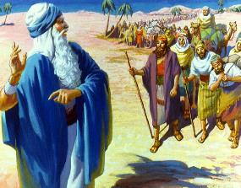
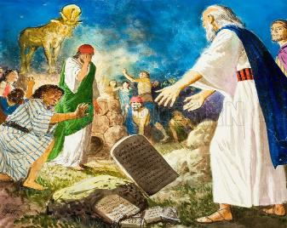
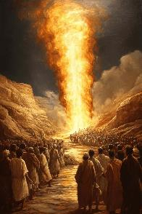
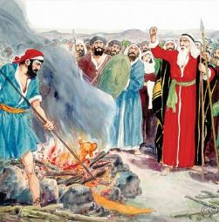
“ck;Kila Nfhgj;jpd; cf;fpuj;ij tpl;Lj; jpUk;gp>”
“kiyfspy; mth;fisf; nfhd;W NghlTk;> G+kpapd;Nky; ,uhjgbf;F mth;fis eph;%ykhf;fTk;> mth;fSf;Fj; jPq;Fnra;Ak;nghUl;Nl mth;fisg; Gwg;glg;gz;zpdhh; vd;W vfpg;jpah; nrhy;YthNdd;? ck;Kila Nfhgj;jpd; cf;fpuj;ij tpl;Lj; jpUk;gp> ckJ [dq;fSf;Fj; jPq;Fnra;ahjgbf;F> mth;fs;Nky; ghpjhgq;nfhs;Sk;. ” (ahj; 32:12)
Njtd; NkhNraplk;“eP ,wq;fpg;Ngh@ vfpg;J Njrj;jpypUe;J eP elj;jpf;nfhz;Lte;j cd; [dq;fs; jq;fisf; nfLj;Jf;nfhz;lhh;fs;.” (ahj;. 32:7).
NkhNr rupahf gjpyspj;jhu;: “mtu;fs; vd;Dila [dq;fs; my;y, Mdhy; ck;Kilatu;fs;; ehd; mtu;fis nfhz;L tutpy;iy, Mdhy; ePu; jhd;” (ahj;. 32:11). ,];uNtiy mopf;f jd;id tpl;LtpLkhW Njtd; $wpdhu; (ahj;. 32:10), Mdhy; NkhNr mjw;F mDkjp jutpy;iy.
NjtDila Nfhgk; ePjpahdJ> Mdhy; NkhNrf;F njupAk; “epahaj;jPh;g;Gf;F Kd;ghf ,uf;fk; Nkd;ikghuhl;Lk;.” (ahf;NfhG 2:13). ,];uNtYf;fhf gupe;J Ngrpag;gpd;, Njtd; jdJ Nfhgj;ij jdpj;J tpl;lhu; vd;w ek;gpf;ifAld;, NkhNr(Nfhgj;Jld;) kiyapy; ,Ue;J ,wq;fpdhu; (ahj;. 32:12-15). tpRthr JNuhfj;ij ghu;j;jg;gpd;, mtu; cld;gbf;ifapd; rpd;dj;ij cilj;jhu;: fw;gyiffs; (ahj;. 32:19).
jdJ rNfhjudpd; gytPdkhd rhf;FNghf;Ffis Nfl;lg; gpwF> NkhNr me;j td;Kiwia jLf;f jPu;f;fkhf nray;gl;lhu;(ahj;. 32:20-28).

Slide 10

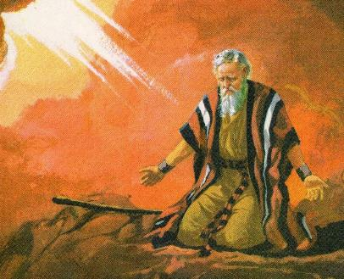
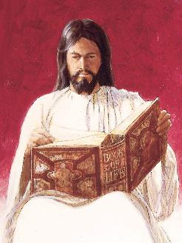

“ePh; vOjpd ck;Kila G];jfj;jpypUe;J vd; Ngiuf; fpWf;fpg;NghLk;”
“MfpYk;> NjthPh; mth;fs; ghtj;ij kd;dpj;jUStPuhdhy; kd;dpj;jUSk;@ ,y;yhtpl;lhy; ePh; vOjpd ck;Kila G];jfj;jpypUe;J vd; Ngiuf; fpWf;fpg;NghLk; vd;whd;.(ahj;jpuhfkk; 32:32)
NkhNr jdJ Kjy; gupe;Jiuapd; %yk;, kf;fspd; mopit jLj;jhu;. Mdhy; ,e;j ghtj;jpw;F gpwF Njtd; mtu;fis ,dp MrPu;tjpf;fNt KbahJ vd;gJ njspthf njupe;jJ. MfNt, mtu; ,uz;lhtJ gupe;Jiuia nra;a KbT nra;jhu; (ahj;. 32:30).
kf;fs; kd;dpf;fglhtpl;lhy; NkhNr jdJ nrhe;j ,ul;rpg;ig ,of;f jahuhf ,Ue;jhu; (ahj;. 32:31-32). ,Ug;gpDk;> NkhNr Nfl;lJ rhjhuz xopg;G my;y> Vnddpy; mtu; “kd;dpf;fTk;“ vd;gjw;fhd tof;fkhd thu;j;ijia gad;gLj;jtpy;iy. kf;fspd; ghtj;ij Njtd; “Rkf;f” Ntz;Lk; vd;W Nfl;lhu;.
,J Njtd; ghtj;ij jhNd Vw;Wf;nfhz;L> mjd; tpiyia – kuzj;ij - nrYj;Jthu;(Vrh. 53:6;
Nuh. 6:23). ,ij jhd; ,NaR rpYitapy; nra;jhu;> ehk; mila Ntz;ba kuzj;ij mtu; ,wq;Fk;gb> mtu; ek;Kila ghtq;fis jk;Nky; Vw;Wnfhz;lhu; (1 NgJ. 2:24).

