Slide 1
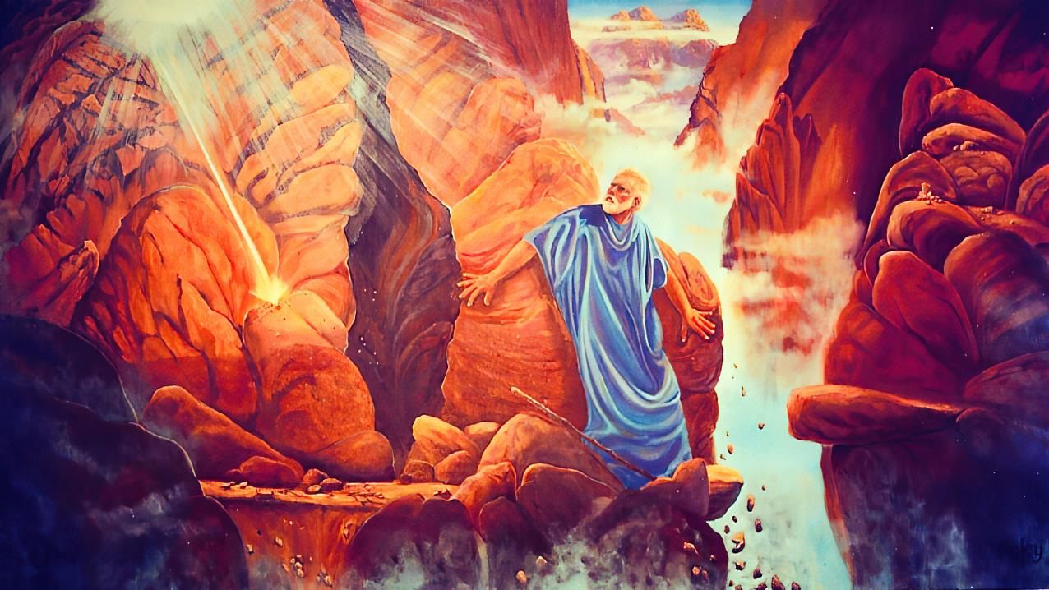
“ck;Kila kfpikia vdf;Ff; fhz;gpj;jUSk;”
ghlk; 12 nrg;lk;gu; 20, 2025

Slide 2
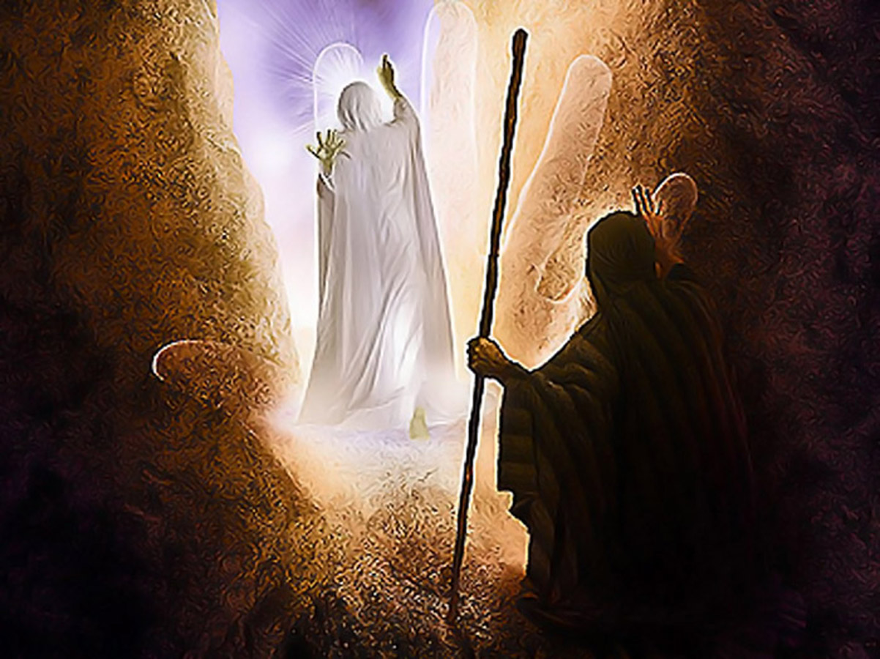
“fh;j;jh; mtDf;F Kd;ghff; fle;JNghfpwNghJ> mth;: fh;j;jh;> fh;j;jh;@ ,uf;fKk;> fpUigAk;> ePba rhe;jKk;> kfh jiaAk;> rj;jpaKKs;s Njtd;. Mapuk; jiyKiwfSf;F ,uf;fj;ijf; fhf;fpwth;@ mf;fpukj;ijAk; kPWjiyAk; ghtj;ijAk; kd;dpf;fpwth;@ Fw;wthspiaf; Fw;wkw;wtdhf tplhky;> gpjhf;fs; nra;j mf;fpukj;ijg; gps;isfsplj;jpYk;> gps;isfSila gps;isfsplj;jpYk; %d;whk; ehd;fhk; jiyKiwkl;Lk; tprhhpf;fpwth; vd;W $wpdhh;. ”
ahj;jpuhfkk; 34:6, 7

Slide 3

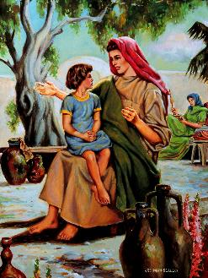
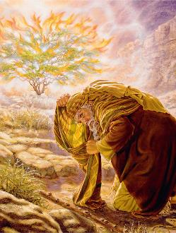

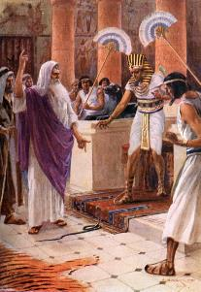
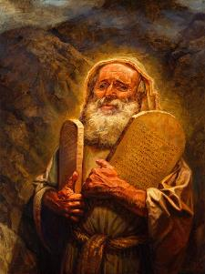

NkhNrAk; NjtDk; neUq;fpa ez;gu;fshdhu;fs;> mjpy; ve;jtpj re;NjfKk; ,y;iy.
,J xNu ,utpy; ele;jjy;y. ,J xU nka;ahd nray;Kiw. ,J mtUila Muk;g fhyq;fspy; njhlq;fpaJ> mtUila jhahu; mtu;fs; Nrtpj;j Njtidg; gw;wp Ngrpa NghJ njhlq;fpaJ.
rPdha; kiyapy; mtu;fs; re;jpj;j gy;NtW re;jpg;Gfspd; NghJ mtu;fspd; el;G gyg;gLj;jg;gl;lJ. NkYk; Njtd; NkhNria xa;ntLf;f mioj;j ehs; tiu njhlu;e;J tsu;e;jJ.
,e;j jPtpu cwtpy; xU rpwg;G jUzj;ij ahj;jpuhfkk; 33 kw;Wk; 34 mjpfhuq;fs; gjpT nra;fpd;wd: NjtDila kfpikia fhz;gjw;fhd NkhNrapd; Ntz;LNfhs;.
NjtDk; NkhNrAk;:
  NjtDld; xU re;jpg;G (ahj;jpuhfkk; 33:7-11)
  Njtidg; gw;wp ed;F mwpe;Jnfhs;Sjy; (ahj; 33:12-17)
NjtDila kfpik:
  NjtDila kfpikia mwptjw;fhd thQ;ir (ahj; 33:18-23)
  NjtDila kfpikapd; juprdk; (ahj; 34:1-28)
  NjtDila kfpikia fz;ljd; tpisT (ahj; 34:29-35)

Slide 4

NjtDk; NkhNrAk;

Slide 5

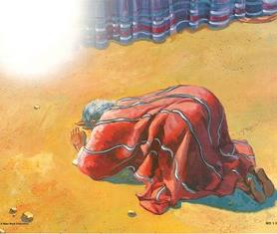
Njtid re;jpj;jy;
NjtDf;Fk; NkhNrf;Fk; ,ilapyhd cwT gbg;gbahf tYtile;jJ
vupAk; GjupypUe;J Njtd; mtid mioj;jhu;
Njtd; vfpg;jpa nja;tq;fis vt;thW Njhw;fbj;jhu; vd;gij NkhNr fz;lhu;
,];uNtiy tpLtpg;gjw;fhf nrq;fly; gpuptij mtu; Neupy; fz;lhu;
Njtd; ,];uNtiy rPdha;f;F mioj;J nrd;wij mtu; ghu;j;jhu;
mtu; kiyapy; 40 KO ehl;fisAk; xd;whf fopj;jhu;
mtu;fspd; cwT xt;nthU ehSk; NkYk; NkYk; tsu;e;jJ
NahGitAk; Mjpahfkj;ijAk; vOj Njtd; Vtpdhu;
“NkhNr $lhuj;Jf;Fs; gpuNtrpf;ifapy;> Nkf];jk;gk; ,wq;fp> $lhuthrypy; epd;wJ@ fh;j;jh; NkhNrNahNl Ngrpdhh;.” (ahj;jpuhfkk; 33:9)
NkhNr Mrupg;Gf;$lhuj;jpy; Njtid re;jpj;jhu;> mq;F mtu; mtUld; NeUf;F Neu; Ngrpdhu;(ahj;. 33:7-11).
njspTg;gLj;jpdhu;: “KfKfkha;” vd;w $w;W mtu;fs; xUtiunahUtu; cly; uPjpahf ghu;j;jhu;fs; vd;W mu;j;jky;y> khwhf mtu;fs; xU jput cilahliy nfhz;bUe;jhu;fs; (NkhNr NjtDila Kfj;ij xUNghJk; ghu;j;jjpy;iy).
NkhNr NjtDila cz;ikAs;s Copauhdhu; (vgp. 3:5), ,Uspy; mizahj fyq;fiu tpsf;fhfTk;, Kd;khjpupahd jPu;f;fjuprpahfTk; Mdhu;.

Slide 6


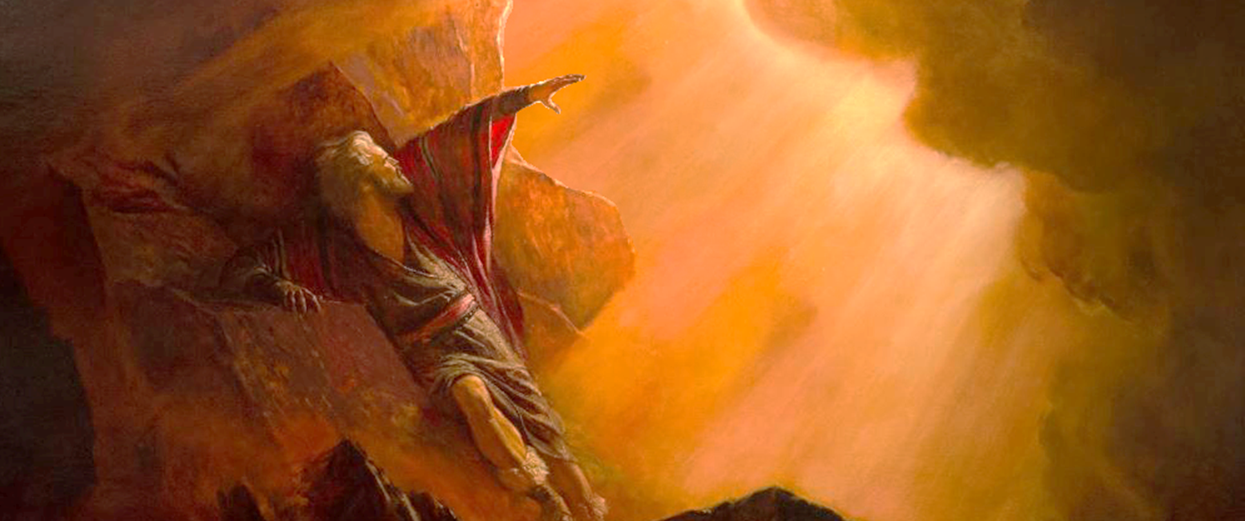
Njtid ed;F mwpe;Jnfhs;Sjy;
“ck;Kila fz;fspy; ,g;nghOJ vdf;Ff; fpUig fpilj;jjhdhy; ehd; ck;ik mwptjw;Fk;> ck;Kila fz;fspy; vdf;Ff; fpUig fpilg;gjw;Fk;> ck;Kila topia vdf;F mwptpAk;@ ,e;j [hjp ck;Kila [dnkd;W epidj;jUSk; vd;whd;.” (ahj; 33:13)
Njtd; NkhNraplk; kf;fSld; fhdhDf;F nfhz;L nry;ykhl;Nld; vd;W nrhd;d NghJ (ahj;. 33:1-3), xU Rthu];akhd ciuahly; ele;jJ (ahj;. 33:12-17):
Njtd;
NkhNr
Njtd;
NkhNr
NkhNr
Njtd;
eP vd; ez;gd;> cdf;F vd; mUs; cz;L
mJ cz;ikapNyNa mg;gbahdhy;> ehd; ck;ik mwpAk;gb ckJ topia vdf;F fw;gpj;jUSk;
vd; rKfk; cdf;F Kd;ghfr; nry;Yk;> ehd; cdf;F ,isg;ghWjy; jUNtd;
ck;Kila rKfk; vd;NdhNl $lr; nry;yhkw;Nghdhy;> vq;fis ,t;tplj;jpypUe;J nfhz;LNghfhjpUk;.
vdf;Fk; ckJ [dq;fSf;Fk; ck;Kila fz;fspNy fpUig fpilj;jnjd;gJ vjpdhy; mwpag;gLk;@ ePh; vq;fNshNl tUtjpdhy; my;yth?
eP nrhd;d ,e;j thh;j;ijapd;gbNa nra;Ntd;@ vd; fz;fspy; cdf;Ff; fpUig fpilj;jJ@ cd;idg; Ngh;nrhy;yp mioj;J mwpe;jpUf;fpNwd; vd;whh;.
NkhNr NjtDld; 40 ehl;fs; nrytpl;lhu;, gj;J fl;lisfisAk; gupRj;j ];jyj;ij fl;Ltjw;fhd topKiwfisAk; ngw;whu;. ,g;NghJ mtu; kPz;Lk; NjtDf;F Kd;ghf epd;whu;> kf;fSf;fhf gupe;J NgRtjw;fhf. mtu; Njtid ed;F mwpe;jpUg;gjhf Njhd;wpaJ> Vndd;why; mtu; mtUld; kpfTk; gupr;rakhf Ngrpdhu;. mg;gbahdhy;, gpd;G, ve;j mu;j;jj;jpy; mtiu mwpa Ntz;bapUe;jJ (ahj;. 33:13)? ve;j mu;j;jj;jpy; ePq;fs; mtiu mwpa Ntz;Lk;?

Slide 7

NjtDila kfpik

Slide 8


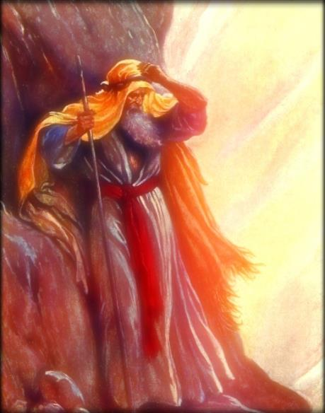
NjtDila kfpikia mwptjw;fhd thQ;ir
“mg;nghOJ mtd;: ck;Kila kfpikia vdf;Ff; fhz;gpj;jUSk; vd;whd;.” (ahj;jpuhfkk; 33:18)
mg;nghOJ mtd;: ck;Kila kfpikia vdf;Ff; fhz;gpj;jUSk; vd;whd;. (ahj;. 33:18)
mjw;F mth;: vd;Dila jiaia vy;yhk; ehd; cdf;F Kd;ghff; fle;JNghfg;gz;zp> (ahj;. 33:19)
NjtDila kfpik mtUila ew;Fzk;> mjhtJ mtUila Fzk;.
Njtd; jd; Fzj;ij ntspg;gLj;jpdhu; (ahj;. 34:6-7)
NjtDila kfpik mtUila gps;isfSf;F mjpfhuk; mspg;gjpYk;> kde;jpUk;gpa ghtpfis mutizg;gjpYk;> mtu;fspd; khw;wj;jpw;F Njitahd midj;ijAk; toq;FtjpYk; cs;sJ vd;W vyd; [p citl; NkYk; $Wfpwhu;
,t;thW, ekJ “kfpik” vd;gJ ekJ tho;tpy; NjtDila jd;ikia gpujpgypg;gjhFk;(2 nfhup. 1:12; 3:18).
ehk; rpYitia ghu;f;Fk;NghJ, NjtDila kfpik> mtuJ ed;ik kw;Wk; mtuJ Fzhjpraq;fspd; kpfg;ngupa ntspg;ghl;il fhz;fpNwhk;.

Slide 9

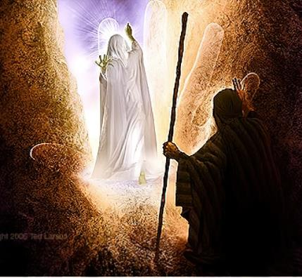
NjtDila kfpikapd; juprdk;
“fh;j;jh; mtDf;F Kd;ghff; fle;JNghfpwNghJ> mth;: fh;j;jh;> fh;j;jh;@ ,uf;fKk;> fpUigAk;> ePba rhe;jKk;> kfh jiaAk;> rj;jpaKKs;s Njtd;.” (ahj;jpuhfkk; 34:6)
NkhNr rPdha; kiyapy; Vwpa VohtJ re;ju;g;gj;jpy; Njtd; jk;Kila kfpikia mtUf;F fhl;bdhu;. NkhNr ve;j Neuq;fspy;> ve;j Nehf;fj;jpw;fhf NjtDf;F Kd; epd;whu;?
1
2
3
4
5
6
7
cld;gbf;ifapd; mbg;gilfis ngWtjw;F (ahj;. 19:3-7)
rPdhapy; cs;s nja;tPff;fhl;rp Fwpj;j topKiwfis ngWtjw;Fk; kf;fspd; gjpiy toq;Ftjw;Fk;(ahj;. 19:8-14)
Gjpa topKiwfis ngw (ahj;. 19:20-25)
NjtDila epiwthd gpukhzq;fis ngWtjw;F (ahj;. 20:21; 24:3)
NjtDila tpuyhy; vOjg;gl;l gj;Jf;fl;lisfisAk;> gupRj;j ];jyj;jpd; khjpupiaAk; ngWtjw;F (ahj;. 24:12, 18; 32:15)
kf;fspd; nghd;fd;Wf;Fl;bapd; ghtj;jpw;F gupe;J NgRtjw;F (ahj;. 32:30)
Njtd; mtUf;F jk;Kila kfpikia fhl;lTk;> gj;J fl;lisfis nfhz;l Gjpa fw;gyiffis ngWtjw;Fk; (ahj;. 34:1-5)
NjtDila kfpikapd; juprdk; NjtDila Fzhjpraj;jpd; Ra gpufldkhf ep&gpf;fg;gl;lJ (ahj;. 34:6-7). NjtDila md;gpd; ghu;itapy;, NkhNr Njtid njhOJ nfhz;lhu; (ahj;jpuhfkk; 34:8; 1 Nahthd; 4:19). ,Wjpapy;, Njtd; ,];uNtYldhd jdJ cld;gbf;ifia kPz;Lk; cWjpg;gLj;jpdhu;> fd;Wf;Fl;b rk;gtj;ij kd;dpj;jhu;.

Slide 10

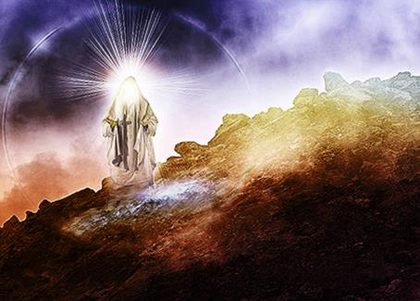
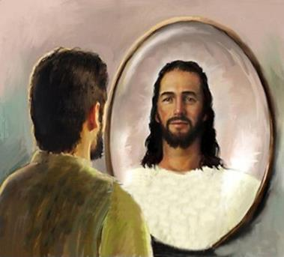
NjtDila kfpikia fz;ljd; tpisT
“NkhNr rhl;rpg; gyiffs; ,uz;ilAk; jd; ifapy; vLj;Jf;nfhz;L> rPdha;kiyapypUe;J ,wq;FfpwNghJ> jd;NdhNl mth; NgrpdjpdhNy jd; Kfk; gpufhrpj;jpUg;gij mtd; mwpahjpUe;jhd;.(ahj;jpuhfkk; 34:29)
NkhNr ,jw;F Kd;G gy Kiw NjtDld; “NeUf;F Neu;” NgrpapUe;jhu;, mJtiu, mtUila Kfk; xU NghJk; gpufhrpj;jjpy;iy. ,e;j Kiw vd;d khwptpl;lJ? NkYk;, me;j khw;wk;, ePz;l fhykhf ePbj;jJ vd;gij ftdpAq;fs; (ahj; . 34:34-35).
,g;NghJ NkhNr Njtid ed;whf mwpe;jpUe;jhu;. mtUila el;Gk; Kjpu;r;rpaile;jpUe;jJ. mtu; me;j kfpikia rpe;jpj;J> me;j kfpikahy; khw;wkile;jpUe;jhu;.
,e;j mj;jpahaj;ij vjpnuhypf;Fk; tifapy;, gTy; ek;ik NkhNria gpd;gw;wp> NjtDila kfpikia rpe;jpj;J> mtu; vg;gb kW&gkhf;fg;gl;lhNuh mg;gbNa ehKk; khw;wg;gl miof;fpwhu; (2 nfhup. 3:12-18).
NkhNr xU Kd;khjpup> Njtd; ek; Fzj;ij khw;wTk;> ek;ik mtUila nja;tPf rhayhf tbtikf;fTk; ehk; mDkjpf;Fk;NghJ mtu; ekf;F vd;d nra;a KbAk; vd;gij ep&gpf;fpwhu;.

