Slide 1

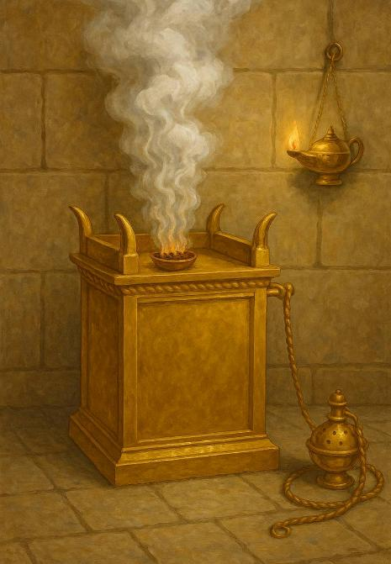
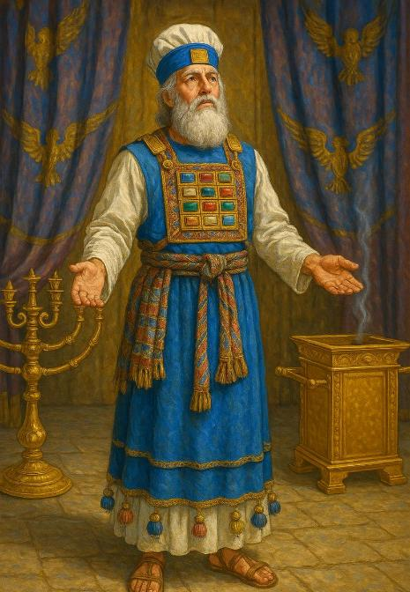
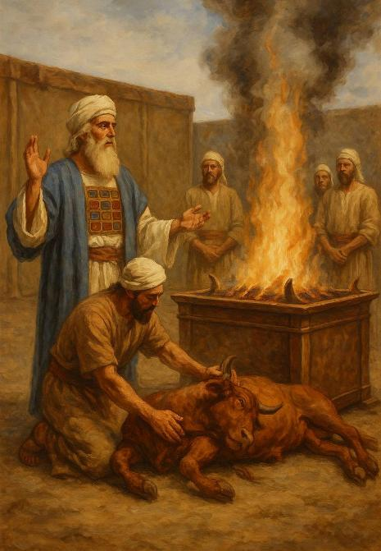
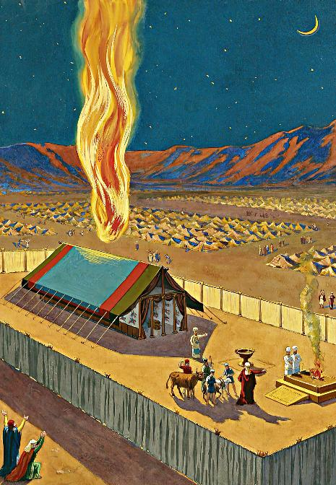
Mrupg;Gf;$lhuk;
ghlk; 13 nrg;lk;gu; 27, 2025

Slide 2
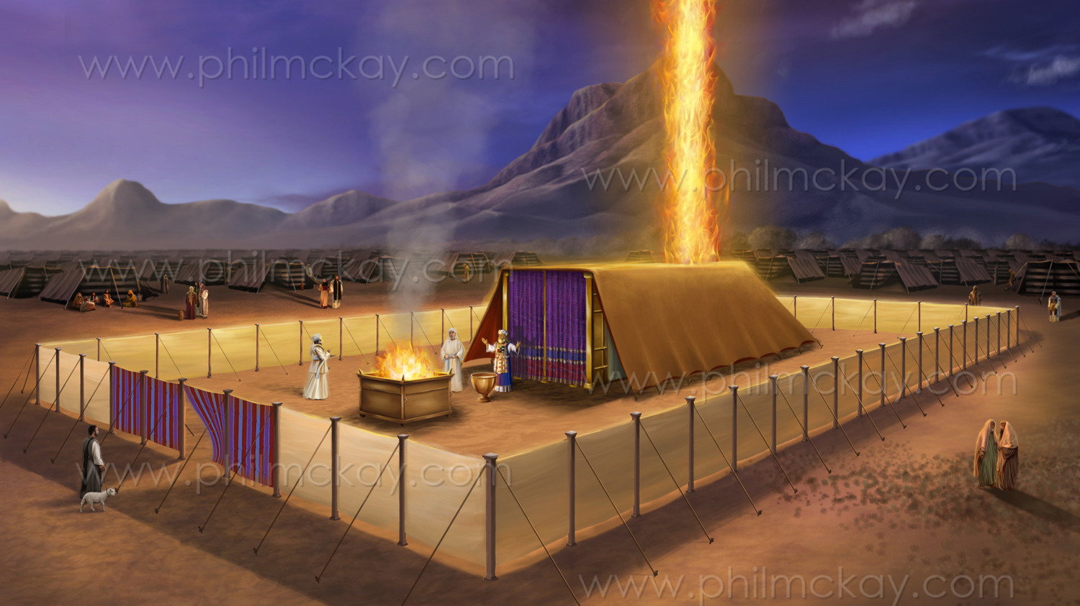
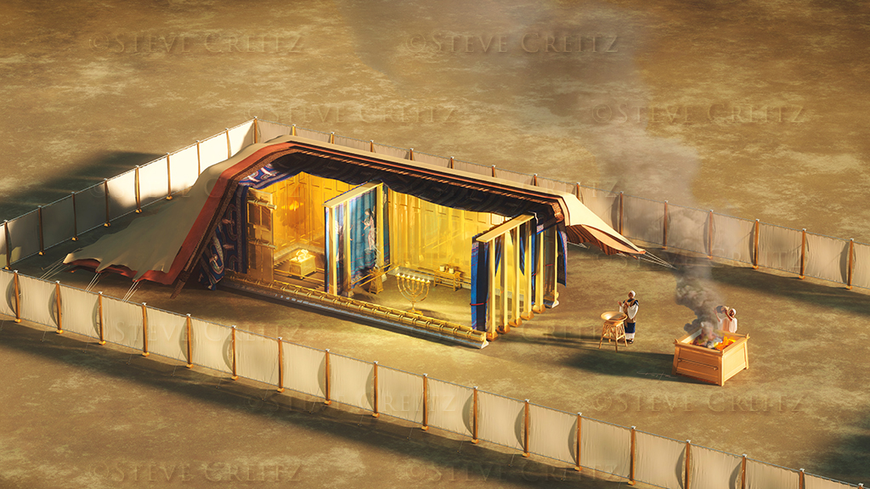
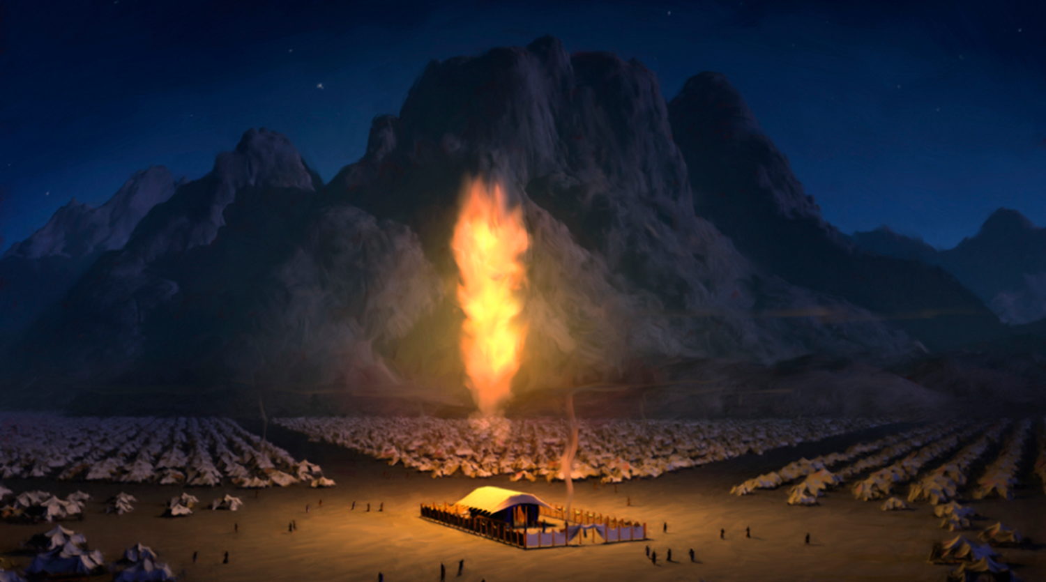
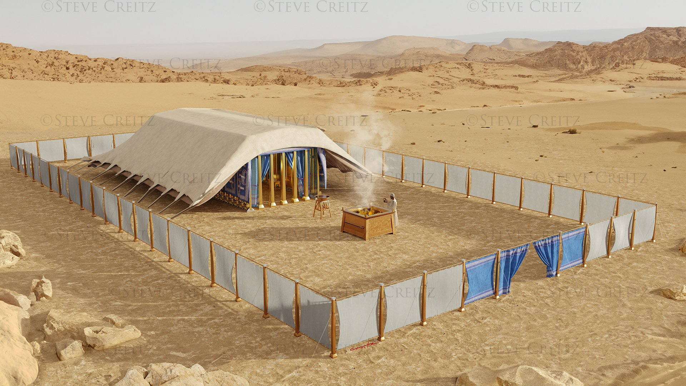
“mg;nghOJ xU Nkfk; Mrhpg;Gf;$lhuj;ij %bdJ@ fh;j;jUila kfpik thr];jyj;ij epug;gpw;W. … ,];uNty; tk;rj;jhh; gz;Zk; vy;yhk; gpuahzq;fspYk; mth;fnsy;yhUila fz;fSf;Fk; gpuj;jpal;rkhfg; gfypy; fh;j;jUila NkfKk;> ,utpy; mf;fpdpAk;> thr];jyj;jpd;Nky; jq;fpapUe;jJ.”
ahj;jpuhfkk; 40:34, 38

Slide 3

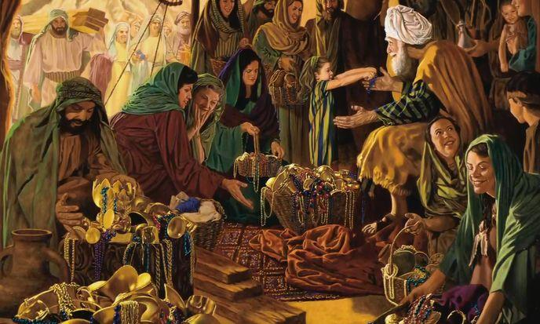

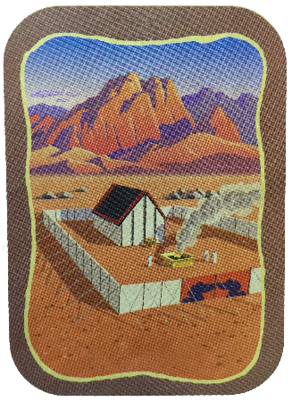
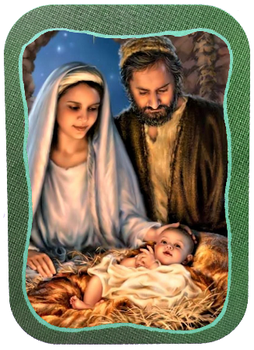
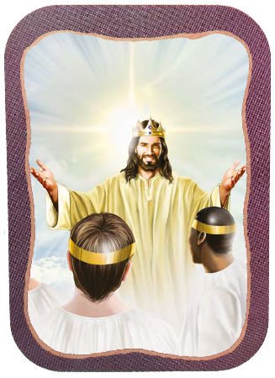







ahj;jpuhfkj;jpd; filrp mj;jpahaq;fs; $lhuj;jpd; fl;Lkhdk; kw;Wk; gpujp\;il gw;wpa tphpthd tpsf;fj;jpw;F mu;g;gzpf;fg;gl;Ls;sd.
,it rpwg;G jUzq;fs;, kf;fs; kfpo;r;rpAld; gq;Nfw;W, NjtDf;fhd ,e;j kfj;jhd Ntiyf;F—jq;fshy; ,ad;wtiu—gq;fspj;jdu;.
,e;j vLj;J nry;yf;$ba Myaj;ij fl;Ltjw;F Njtd; nfhLf;Fk; Kjd;ikahd fhuzk;> jk;Kila kf;fspilNa trpf;f NtzLk; vd;w mtuJ tpUg;gkhFk;
(ahj;. 25:8). ,e;j Mir ,NaRtpy; epiwNtwpaJ> NkYk; ehk; midtUk; mtUld; Gjpa G+kpapy; ,Uf;Fk; NghJ mJ KOikahf epiwNtWk;.
Maj;jk;:
  Xa;Tehs; (ahj; 35:1-3)
  kdKte;J mspf;Fk; fhzpf;if (ahj; 35:4-36:7)
Mrupg;G $lhuk;:
  fl;Lkhdk; (ahj; 36:8-39:43)
  gpujp\;il (ahj; 40:1-38)
kw;w Mrupg;G $lhuk;:
  ,NaR kw;Wk; Gjpa vUrNyk;

Slide 4
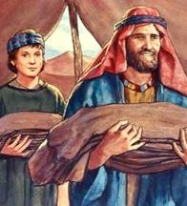
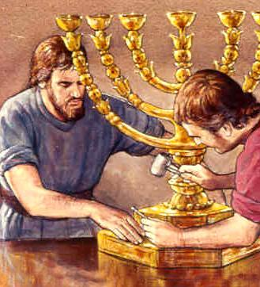
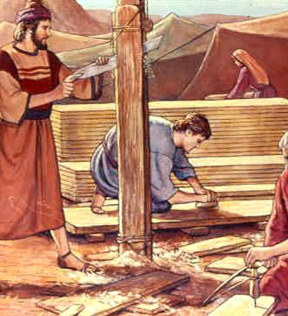
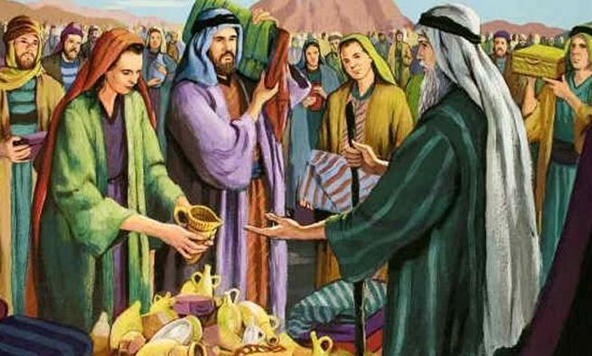
Maj;jk;

Slide 5

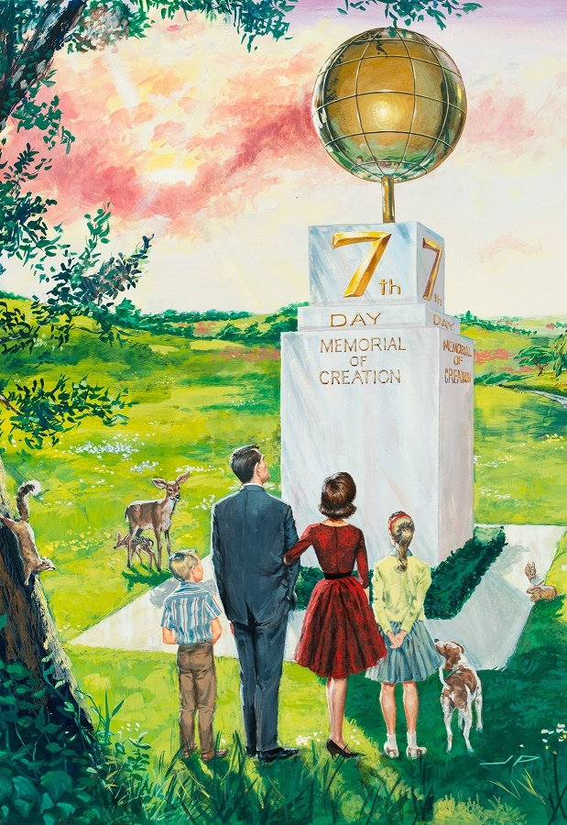
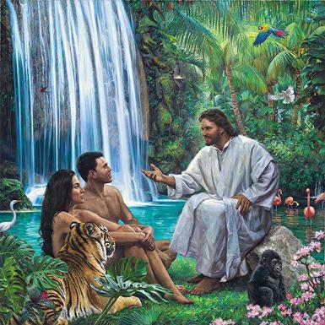

Xa;Tehs;
“ePq;fs; MWehs; Ntiynra;aNtz;Lk;> Vohk; ehNsh cq;fSf;Fg; ghpRj;j ehsha; ,Ug;gjhf@ mJ fh;j;jUf;nfd;W Xa;e;jpUf;Fk; Xa;Tehs;@ mjpNy Ntiynra;fpwtd; vtDk; nfhiynra;ag;glf;fltd;.” (ahj;jpuhfk; 35:2)
  NjtDila kfpikia xU ghu;it ghu;j;j gpwF> NkhNr kf;fSf;F “fu;j;ju; fl;lisapl;lij” njuptpj;jhu; (ahj;. 35:1, 4). ,e;j mwpTWj;jy;fs; fhyj;jpYk; (xa;Tehs;)> $lhuj;jpYk; (Mrupg;G $lhuj;jpYk;) NjtDldhd mtu;fspd; cwit cs;slf;fpaJ.
gilg;gpNyNa jk;Kila $l;Lwit mDgtpg;gjw;fhf> xa;Tehis xU rpwg;G Neukhf Njtd; xJf;fp itj;jhu; (Mjp. 2:1-3; ahj;. 20:11), gj;J fl;lisfis mwptpg;gjw;F rw;W Kd;G mtu; ,];uNtYf;F ,ij epidT+l;bdhu; (ahj;. 16:22-29).
Njtd; ek; gilg;ghsu; kw;Wk; kPl;gu; vd;gij xa;Tehs; ekf;F epidT+l;LfpwJ (cgh. 5:15), NkYk; ehk; epj;jpaj;jpw;Fk; mtUila Jizia mDgtpf;ff;$ba vjpu;fhy fhyj;jpw;Fk; ek;ik mioj;J nry;fpwJ (Vrh. 66:22-23).

Slide 6

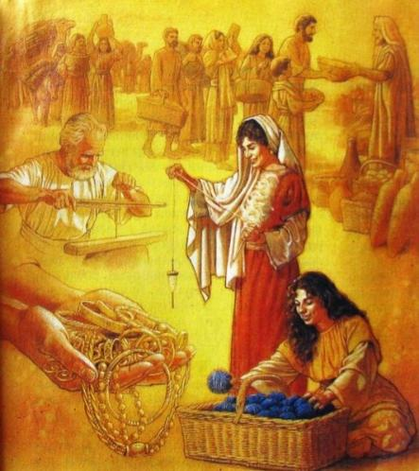
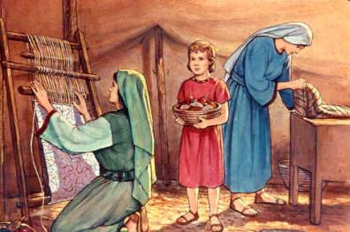
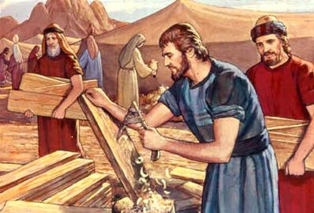
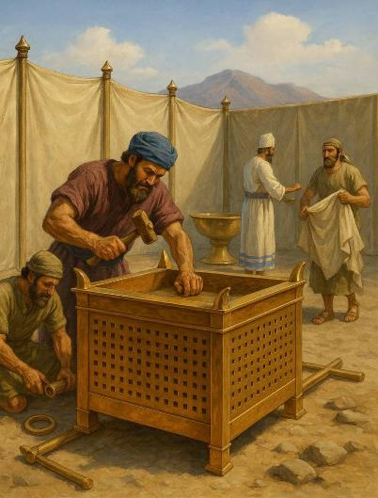
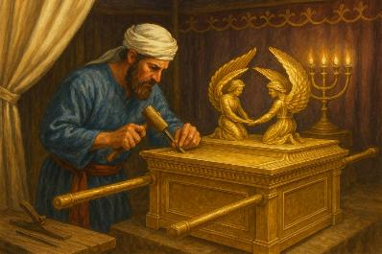
kdKte;J mspf;Fk; fhzpf;if
“cq;fSf;F cz;lhdjpNy fh;j;jUf;F xU fhzpf;ifiaf; nfhz;Lte;J nrYj;Jq;fs;@ kdKs;std; vtNdh> mtd; mijf; nfhz;Ltul;Lk;@ fh;j;jUf;Fr; nrYj;Jk; fhzpf;if vd;dntd;why;> nghd;Dk;> nts;spAk;> ntz;fyKk;> [ …] cq;fspy; Qhd ,UjaKs;s mittUk; te;J> fh;j;jh; fl;lisapl;litfisnay;yhk; nra;thh;fshf.” (ahj; 35:5,10)
$lhug; gzpf;F gq;fspf;f ,uz;L topfs; ,Ue;jd: nghUl;fis ed;nfhilahf toq;Fjy; kw;Wk; ciog;ig nra;jy;.
xU ld;Df;Fk; mjpfkhd jq;fk;> Rkhu; 3.75 ld; nts;sp kw;Wk; Rkhu; 2.5 ld; ntz;fyk;> kuk; kw;Wk; gy;NtW Jzpfs; gad;gLj;jgl;ld (ahj;. 38:21-31).
,njy;yhk; vq;fpUe;J te;jJ? ,];uNtyu; vfpg;jpau;fis tpl;L ntspNawpa NghJ mtu;fsplkpUe;J vLj;J nfhz;ltw;wpypUe;J ,J ngUk;ghYk; te;jJ (ahj;. 11:2).
$Ljyhf, E}w;ghsu;fs;> ijay; kle;ijfs; kw;Wk; ijay;fhuu;fs;> jr;ru;fs;> nrJf;Fgtu;fs;> eiff;filf;fhuu;fs; Nghd;wtu;fspd; Ntiy Njitg;gl;lJ.
vy;yhUk; cjt kpfTk; tpUg;gKs;stu;fshapUe;jjhy;> ngrNyNay;> mNfhypahg; kw;Wk; gpw Ntiyahl;fs; NkhNraplk; kf;fs; fhzpf;iffisf; nfhz;L tUtij epWj;j nrhd;dhu;fs; (ahj;. 36:3-7).
,e;j Ntiyia epiwNtw;w, rk;ge;jg;gl;l midj;J njhopyhsu;fSf;Fk; jhye;Jfis toq;fpdhu; (ahj;. 35:30–36:2). mJNghy, NjtDila gzpapy; xj;Jiof;Fk; midtUf;Fk; Njitahd jhye;Jfis mtu; njhlu;e;J toq;Ffpwhu;.

Slide 7

“Njtd; Mz;fSf;Fk; ngz;fSf;Fk; tpiykjpg;gw;w jhye;Jfis cilikahf nfhLj;Js;shu;. ntt;NtW NgUf;F mtu; ntt;NtW jhye;Jfis nfhLj;jpUf;fpwhu;. midtUf;Fk; xNu khjpupahd Fz typikNah my;yJ xNu khjpupahd mwptpd; MoNkh ,Ug;gjpy;iy. ,e;j gupR vt;tsT rpwpajhf Njhd;wpdhYk;> xt;nthUtUk; jq;fs; jhye;Jfis v[khdupd; Nritf;fhf gad;gLj;j Ntz;Lk;. cz;ikAs;s tprhuizf;fhud; jd;dplk; xg;gilf;fg;gl;l nghUl;fis Qhdkhf tpahghuk; nra;fpwhd;.”
vyd; [p citl; (jp mg;tu;l; Yf;, brk;gu; 31)

Slide 8
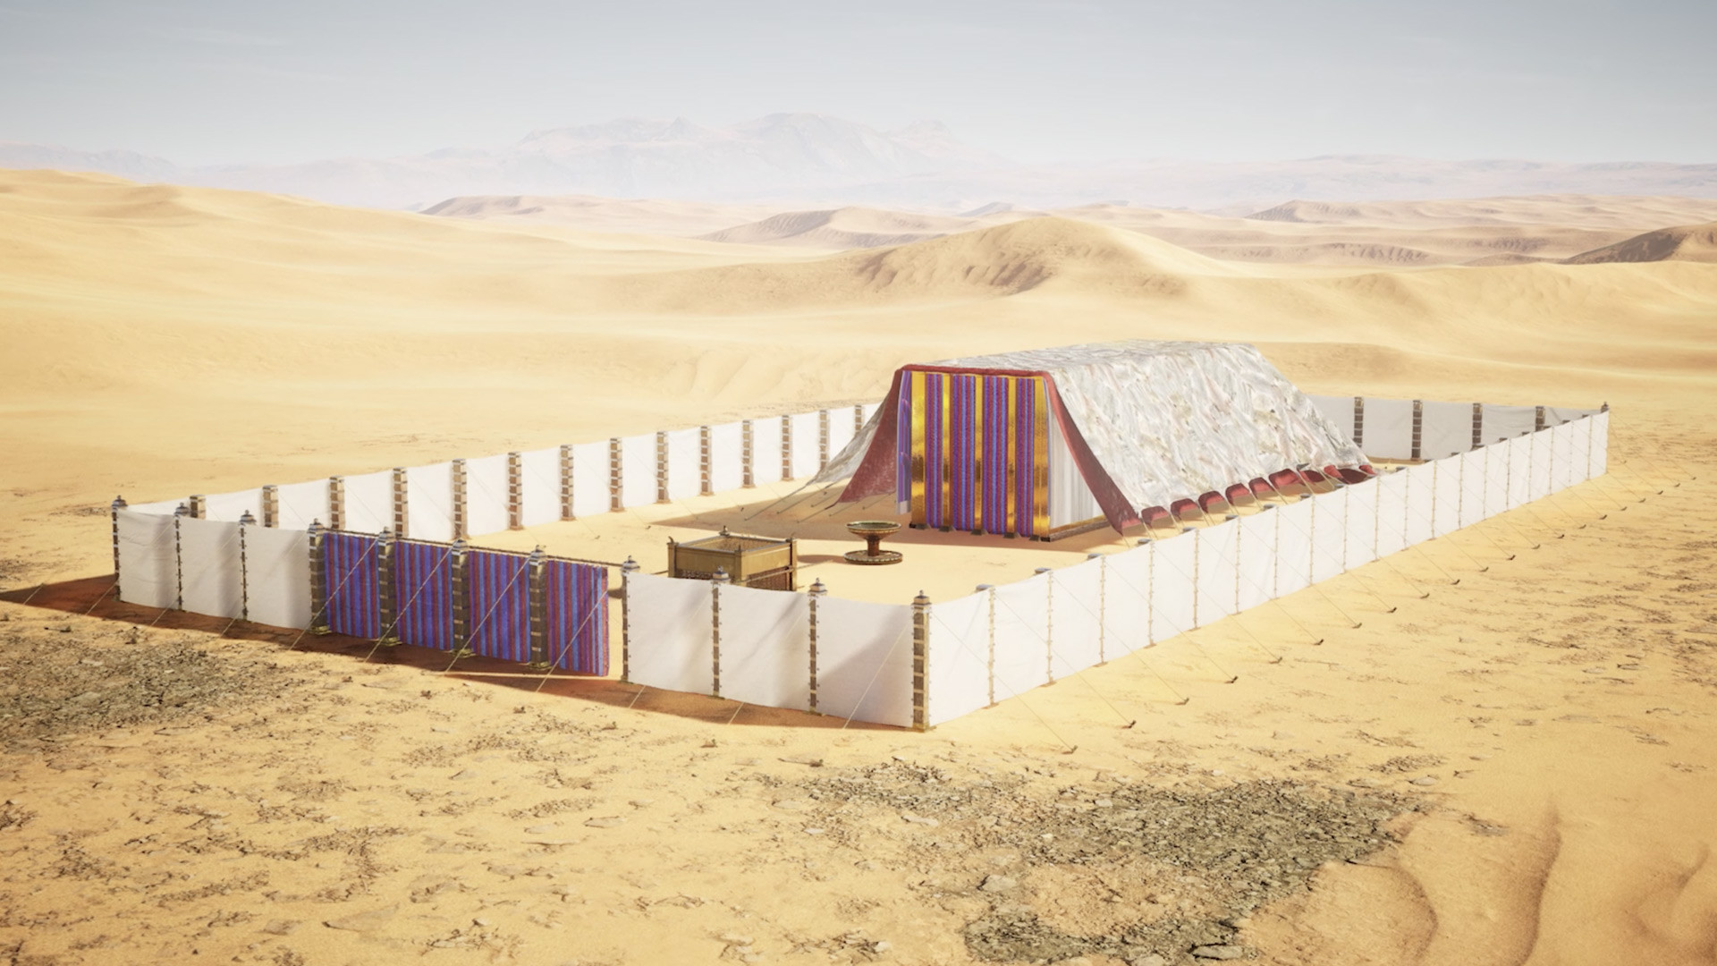
Mrupg;Gf;$lhuk;

Slide 9

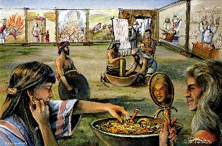
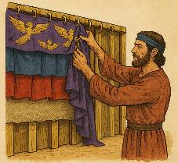
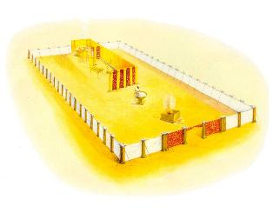
fl;Lkhdk;
“NkhNr me;j Ntiyfisnay;yhk; ghh;j;jhd;@ fh;j;jh; fw;gpj;jgbNa mijr; nra;jpUe;jhh;fs;. NkhNr mth;fis MrPh;tjpj;jhd;.” (ahj; 39:43)
Mrupg;Gf;$lhuk; mjd; nray;ghLfis epiwNtw;w vd;d $Wfs; mtrpakhf ,Ue;jd?
Mrupg;Gf; $lhuk; (gupRj;j ];jyk; kw;Wk; kfh gupRj;j ];jyk;)
fpUghrdg; ngl;b
rKfj;jg;g Nki[
Fj;Jtpsf;F
J}ggPlk;
jfd gypgPlk;
ntz;fy njhl;b
gpufhuk;
VNghj;J
khu;gjf;fk;
kw;w Milfs;

Slide 10

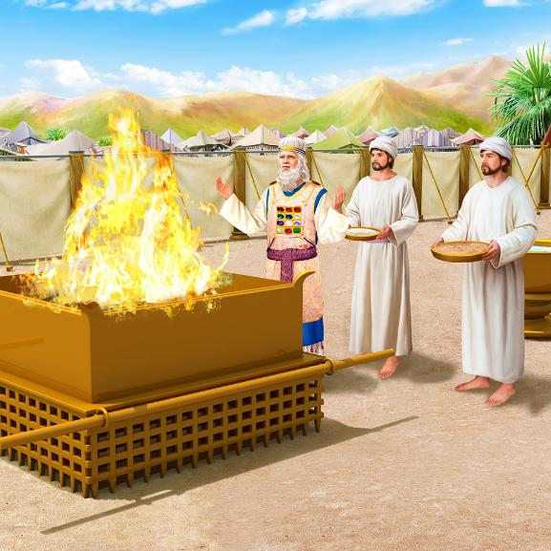
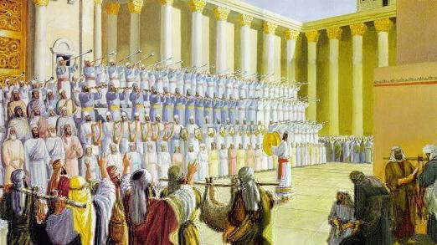
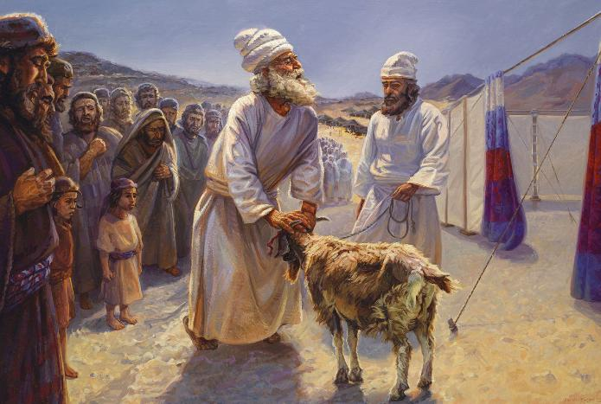
fl;Lkhdk;
fl;lg;gl;lJk;, Mrupg;Gf;$lhuk; (Mrupg;Gf; $lhuk; kw;Wk; gpufhuk;) ,uz;L jdpj;Jtkhd MuhjidfSf;F jhafkhf ,Ue;jJ: jpdrup kw;Wk; tUlhe;jpu Muhjid. mtu;fspd; gy;NtW rlq;Ffs;> xd;whf vLj;Jf;nfhs;sg;gl;lhy;> ekf;F fw;gpf;Fk; tp\ak; vd;dntd;why;:
Njtd; ghtj;ij ntWf;fpwhu;
Njtd; ghtpia ,ul;rpf;fpwhu;
Jd;khu;f;fiu Njtd; mopg;ghu;
Njtd; ekf;F kfpikahd vjpu;fhyj;ij cWjpaspf;fpwhu;
jpdrup Muhjidfs; %yk;, xd;Wkwpah tpyq;fpd; kuzj;jpdhy;, fpUigahy; ghtpia kd;dpf;Fk; topia Njtd; fhl;bdhu;: “,Njh> cyfj;jpd; ghtj;ijr; Rke;JjPh;f;fpw Njt Ml;Lf;Fl;b.”. (Nah. 1:29).
tUlhe;jpu Muhjidapd; %yk;(ght epthuz ehs;), Njtd; vt;thW gpugQ;rj;jpypUe;J ghtj;ij xopg;ghu; vd;gijf; fhl;bdhu;> jPikapd; gpur;ridf;F ,Wjp jPu;it fhl;bdhu; (rq;. 73:17).
Njtid tzq;Ftjw;Fk;> mtiu Gfo;tjw;Fk;> mtUf;F ed;wp njuptpg;gjw;Fk; ,e;j Myak; xU ,lkhfTk; ,Ue;jJ.

Slide 11

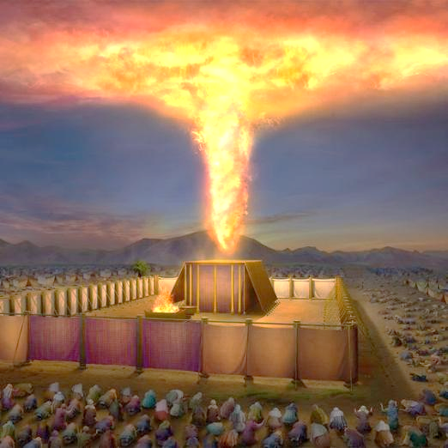
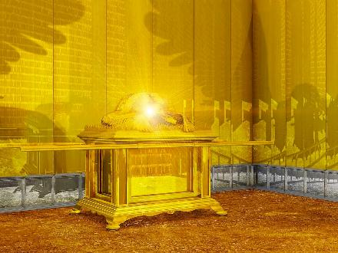
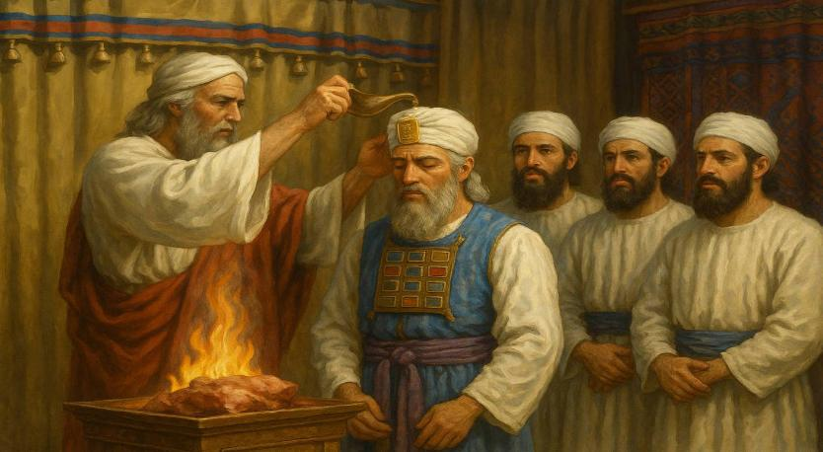
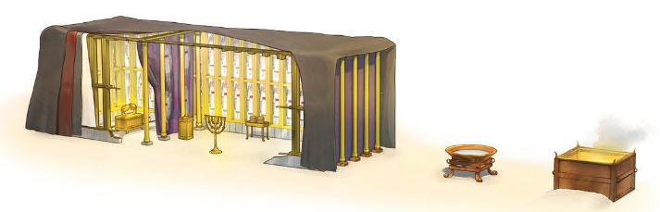
gpujp\;il
“mg;nghOJ xU Nkfk; Mrhpg;Gf;$lhuj;ij %bdJ@ fh;j;jUila kfpik thr];jyj;ij epug;gpw;W.” (ahj; 40:34)
ahj;jpuhfkk; Gj;jfk; gupRj;j ];jyj;ijAk; mjd; Mrhupau;fisAk; gpujp\;il nra;tNjhL KbfpwJ. ,e;j mj;jpahaj;jpd; fjhehafd; re;Njfj;jpw;F ,lkpd;wp Njtd; jhk;> mtu; vy;yhtw;iwAk; jdJ kfpikahd gpurd;dj;jhy; epug;Gfpwhu; (ahj;. 40:34). ,e;j gpurd;dk; Nkfj;jpYk; n\f;fpdhtpYk; (ngl;bapd; Nky; NfUgPd;fSf;F ,ilNa nja;tPf kfpikapd; ntspg;ghL) $lhuj;Jld; njhlu;e;J nrd;wJ.
gy khj Ntiyf;F gpwF, mtu;fs; vfpg;jpypUe;J Gwg;gl;l ,uz;lhk; Mz;bd; Kjy; khjj;jpd; Kjy; ehspy; Mrupg;Gf; $lhuk; mikf;fg;gl;lJ (ahj;. 40:2, 17). vy;yhk; xOq;fhf mikf;fg;gl;bUe;jd (cld;gbf;if ngl;b, jpiurPiy, Nki[, Fj;Jtpsf;F, nghd; gypgPlk;, J}ggPlk;, ntz;fy njhl;b), kw;Wk; gpujp\;il nra;ag;gl;ld (ahj;. 40:9).
,Wjpahf, MNuhDk; mtUila kfd;fSk; Mrhupa cilfs; mzpe;J> Copaj;jpw;fhf mgpN\fk; gz;zg;gl;ldu; (ahj;. 40:12-15).

Slide 12

vyd; [p citl; (Kw;gpjhf;fSk; jPu;f;fjuprpfSk;, gf;. 349)
“gupRj;j ];jyj;jpw;Fs; fhl;lg;gLk; fhl;rpapd; kfpikia ve;j nkhopahYk; tptupf;f KbahJ—nghd; Fj;Jtpsf;fpd; xspia gpujpgypf;Fk; jq;f Kyhk; G+rg;gl;l Rtu;fs;, gpufhrpf;Fk; NjtJ}ju;fSld; $ba nrOikahd rpj;jpu Ntiyg;ghL nra;ag;gl;l jpiurPiyfspd; gpufhrkhd tz;zq;fs;> Nki[ kw;Wk; jq;fj;jhy; kpd;Dk; J}ggPlk;; ,uz;lhtJ jpiuf;F mg;ghy; cld;gbf;if ngl;b> mjd; kPJ Nf&gpd;fs;> mjw;F NkNy NaNfhthtpd; gpurd;dj;jpy; fhzf;$ba ntspg;ghlhd gupRj;j n\f;fpdh; kdpjdpd; kPl;gpw;fhd Ntiyapd; ngupa ikakhd guNyhfj;jpy; cs;s NjtDila Myaj;jpd; kfpikfspd; kq;fyhd gpujpgypg;G kl;LNk ,it.”

Slide 13
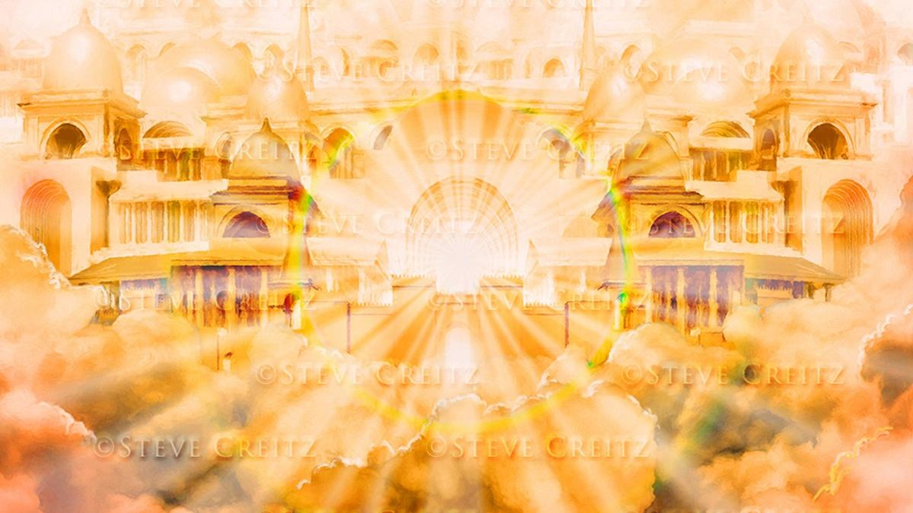
kw;w Mrupg;Gf;$lhuq;fs;

Slide 14

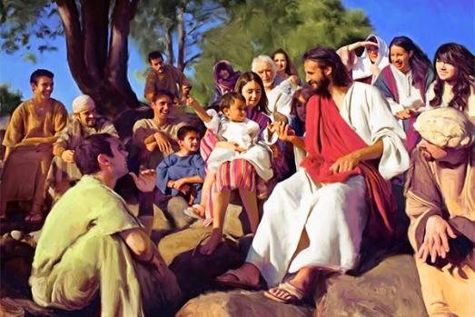

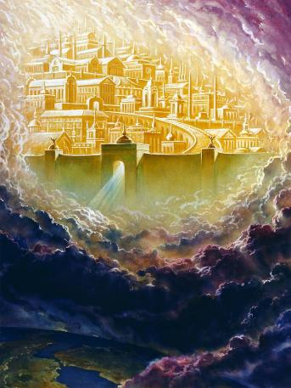
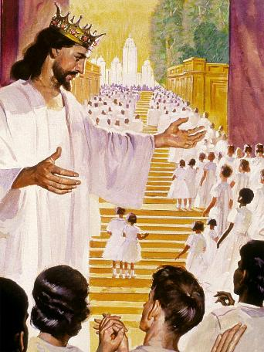
,NaR kw;Wk; Gjpa vUrNyk;
“me;j thh;j;ij khk;rkhfp>@... ekf;Fs;Ns thrk;gz;zpdhh;@” (Nahthd; 1:14K)
“NkYk;> guNyhfj;jpypUe;J cz;lhd xU ngUQ;rj;jj;ijf; Nfl;Nld;@ mJ: ,Njh> kD\h;fsplj;jpNy NjtDila thr];jykpUf;fpwJ> mth;fsplj;jpNy mth; thrkhapUg;ghh;@ mth;fSk; mtUila [dq;fshapUg;ghh;fs;> Njtd;jhNk mth;fNshNl$l ,Ue;J mth;fSila NjtdhapUg;ghh;.” (ntsp 21:3)
Nahthd; 1:14 ,NaR khk;rkhfp ek;kpilNa “$lhukhf” ,Ue;jhu; (thrk;gz;zpdhu;” vd;W nrhy;yg;gLfpwJ. epj;jpa Njtdhfpa ,NaR, jk;Kila mtjhuj;jpd; %yk;, ek;kpilNa ruPugpufhukhf trpf;f Ntz;Lk; vd;w jdJ tpUg;gj;ij epiwNtw;wpdhu;. mtu; ,k;khDNty;> Njtdhf ek;NkhL thrk;gz;zpdhu; (kj;. 1:23).
gupRj;j Mtpahdtupd; %yk; Njtd; ,d;Wk; ek;Kld; njhlu;e;J trpf;fpwhu;(kj;. 18:20; 1nfhup. 3:16).
Mdhy; ek; Njtid NeUf;F Neu; re;jpj;J, mtNu ekf;fhf Maj;jk; nra;jpUf;Fk; Gjpa vUrNyk; vd;w ,uh[uPf $lhuj;jpy; mtNuhL thof;$ba ehs; tpiutpy; tUk; (ntsp. 21:3).
,ul;rpg;gpd; jpl;lk; epiwtile;J> jPik Kw;wpYkhf mopf;fg;gLk; NghJ ,J epfOk;.

Slide 15

vyd; [p citl; (Afq;fspd; thQ;ir, gf;. 23)
“mth;fs; eLtpNy ehd; thrk;gz;z> vdf;F xU ghpRj;j ];jyj;ij cz;lhf;Fthh;fshf.” (ahj;jpuhfkk; 25:8) vd;W Njtd; NkhNr %ykhf ,];uNtyUf;F fl;lisapl;lhu;, NkYk; mtu; jk; [dq;fspd; eLNt gupRj;j ];jyj;jpy; thrk; gz;zpdhu;. tdhe;juj;jpy; mtu;fs; fisg;Gld; miye;J jpupe;j NghJ> mtUila gpurd;dj;jpd; rpd;dk; mtu;fSld; ,Ue;jJ. vdNt fpwp];J ekJ kdpju;fspd; ghisaj;jpd; eLtpy; jk;Kila $lhuj;ij mikj;jhu;. mtu; ek;kpilNa thrk; nra;J, jk; nja;tPf Fzj;ijAk; tho;f;ifiaAk; ekf;F mwpKfg;gLj;Jtjw;fhf, mtu; jk;Kila $lhuj;ij kD\Uila $lhuq;fSf;F gf;fj;jpy; mikj;jhu;.”

