Slide 1
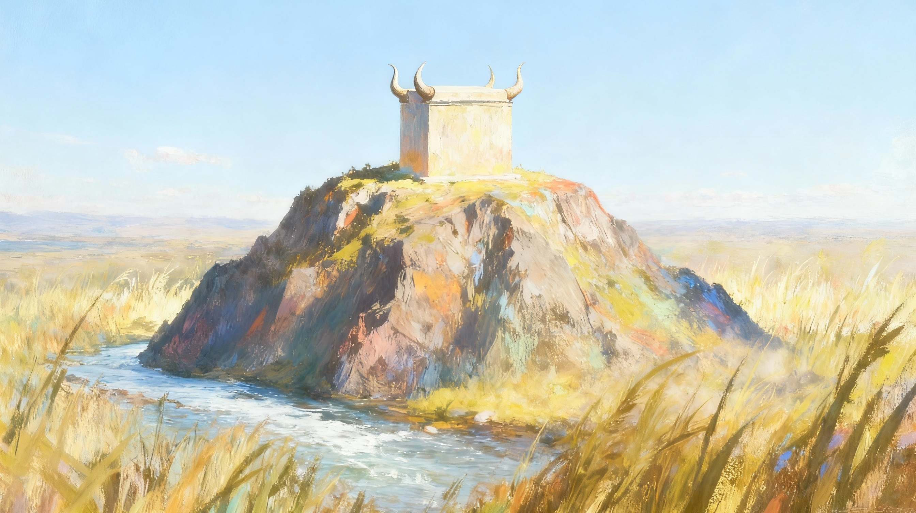
Njrj;jpy; thOjy;
ghlk; 11 brk;gu; 13, 2025

Slide 2
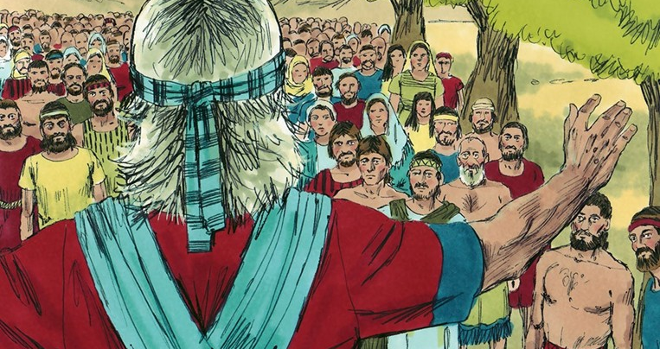

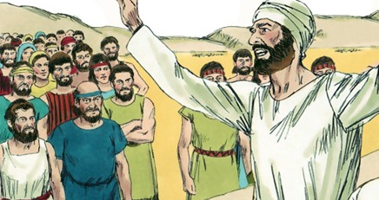
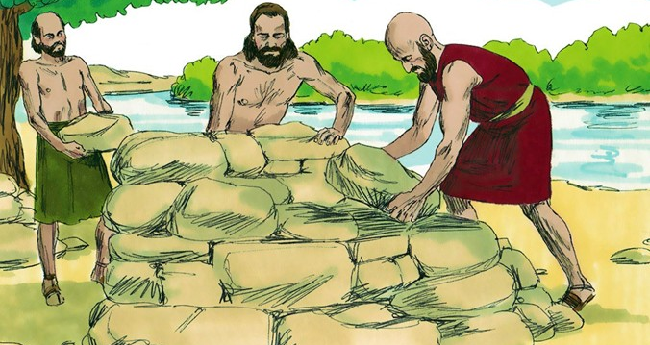
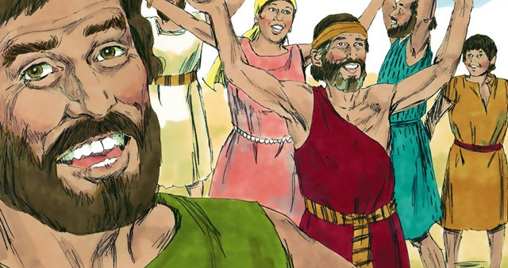
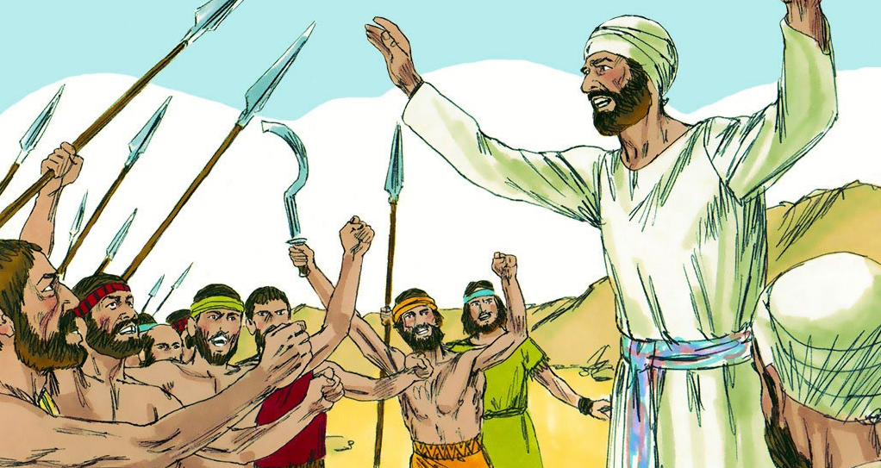
“nkJthd gpujpAj;juk; cf;fpuj;ij khw;Wk;@ fLQ;nrhw;fNsh Nfhgj;ij vOg;Gk;.” (ePjpnkhopfs; 15:1)

Slide 3

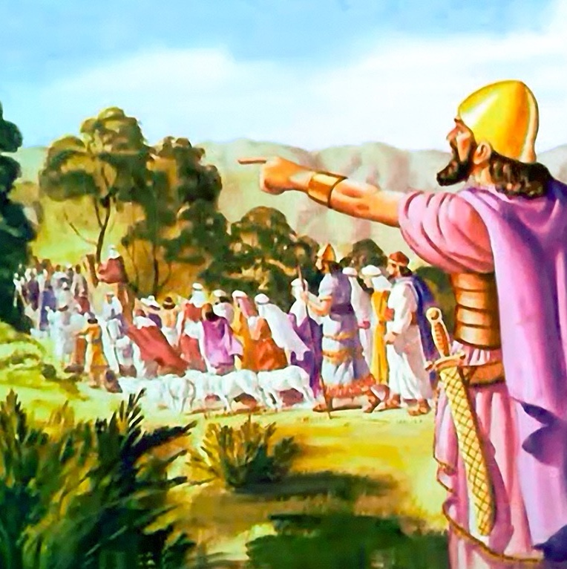
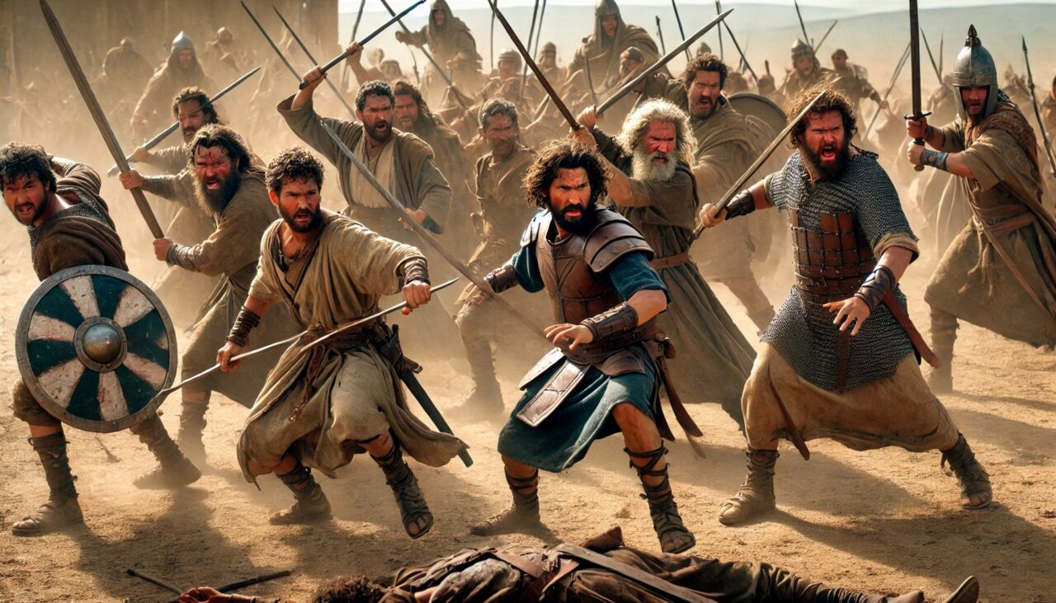





gy tUl NghUf;F gpwF, ,];uNty; fhdhid ifg;gw;wpaJ, ,Ug;gpDk; mjd; midj;J kf;fSk; ,d;Dk; ntspNaw;wg;gltpy;iy.
fpof;F gFjpia (&gd;, fhj;> kdhNrapd; ghjp Nfhj;jpuk;), ntw;wpf;F cjt Nahu;jhidf; fle;J nrd;w ,uz;liu Nfhj;jpuj;jpdu; jq;fs; thf;FWjpia cz;ikahf epiwNtw;wpdu;.
,Wjpahf, gpuptjw;fhd Neuk; te;Jtpl;lJ. mtu;fis MrPu;tjpj;J> fu;j;jUila ghijapy; njhlu mwpTWj;jpa gpwF, NahRth mtu;fis mDg;gptpl;lhu;. Mdhy;> ,];uNty; kf;fspd; xw;Wikia vspjpy; mopf;ff;$ba xU fLikahd jtwhd Gupjyhy; ,e;j tpilngWjy; kiwf;fg;gl;lJ.
gpupahtpil ciu (NahRth 22:1-8)
Kuz;ghl;bw;fhd fhuzk; (NahRth 22:10-12)
Fw;wr;rhl;Lfs; (NahRth 22:13-20)
fdpthd gjpy; (NahRth 22:21-29)
Xg;GuthFjy; (NahRth 22:30-34)

Slide 4


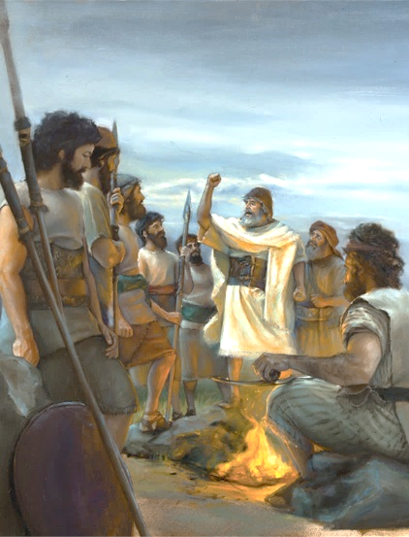
gpupahtpil ciu
“MdhYk; ePq;fs; cq;fs; Njtdhfpa fh;j;jhpy; md;G$h;e;J> mtUila topfnsy;yhk; ele;J> mth; fw;gidfisf; iff;nfhz;L> mtiug; gw;wpf;nfhz;bUe;J> mtiu cq;fs; KO,Ujaj;NjhLk; cq;fs; KO Mj;JkhNthL Nrtpf;fpwjw;fhf> fh;j;jhpd; jhrdhfpa NkhNr cq;fSf;Ff; fw;gpj;j fw;gidapd;gbNaAk; epahag;gpukhzj;jpd;gbNaAk; nra;Ak;gbkhj;jpuk; ntF rhtjhdkhapUq;fs; vd;whh;.”(NahRth 22:5)
Nahu;jhd; ejp Nfhj;jpuq;fSf;fpilapy; gpuptpidia Vw;g;gLj;jg; Nghtjhy;> ,uz;liu Nfhj;jpuq;fs; cz;ikahf ,Uf;Fk;gb NahRth Qhdkhd MNyhridia toq;fpdhu; (NahRth 22:5):
cq;fs; Njtdhfpa fu;j;jiu Nerpf;f
mtUf;F fPo;gbe;J elf;f
mtUila fl;lisfis filgpbf;f
mtiu ,Wfg; gw;wpf;nfhs;s
cq;fs; KO ,Ujaj;NjhLk; KO Mj;JkhNthLk; mtUf;F Nrit nra;a
md;Gjhd; ek;ik Njtdplk; mioj;J nry;y Ntz;ba nfhs;if. mtu; Kjypy; ek;ik Nerpj;jjhy; ehk; mtiu Nerpf;fpNwhk;. (1 Nahthd; 4:19)
NjtNdhL elf;f Nju;e;njLg;gtu;fsplkpUe;J vjpu;ghu;f;fg;gLk; elj;ijia NahRth ,t;thW Rl;bf;fhl;Lfpwhu;
Njtd; nra;jij Gupe;Jnfhs;Sk; ed;wpAs;s ,jaj;jpd; ,ay;ghd tpisTjhd; fPo;gbjy;
me;j gpizg;ig ve;j ftdrpjwYk; cilf;ftplhky; ehk; Njtid gw;wpf;nfhs;s Ntz;Lk;
ehk; ek; gilg;ghsUf;F md;Gld; kdKte;J Nrit nra;Ak;NghJ> ekJ cz;ikahd Nehf;fk;> jpUg;jp kw;Wk; Vuhskhd tho;f;ifia fhz;fpNwhk;

Slide 5


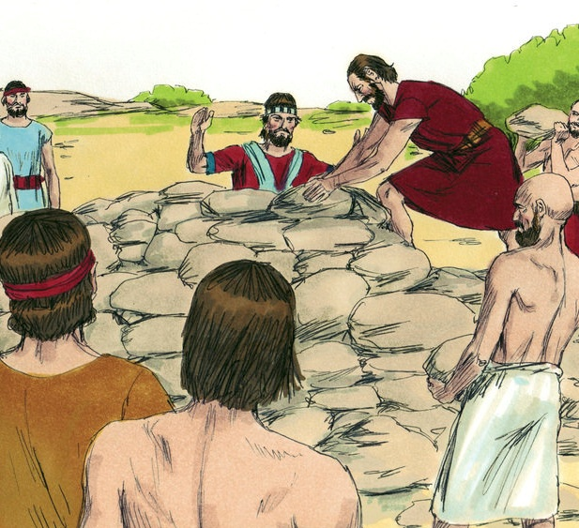
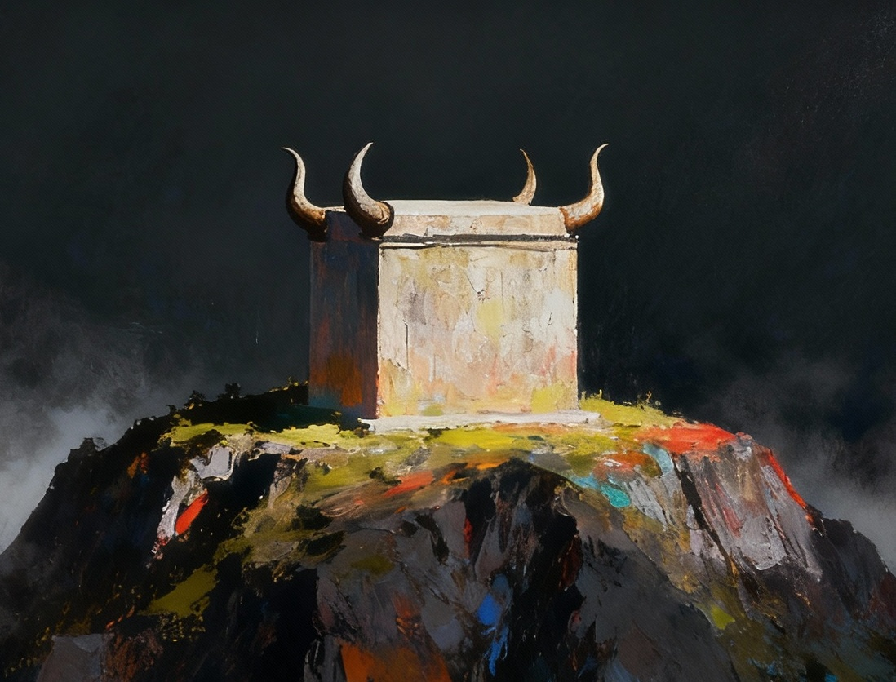
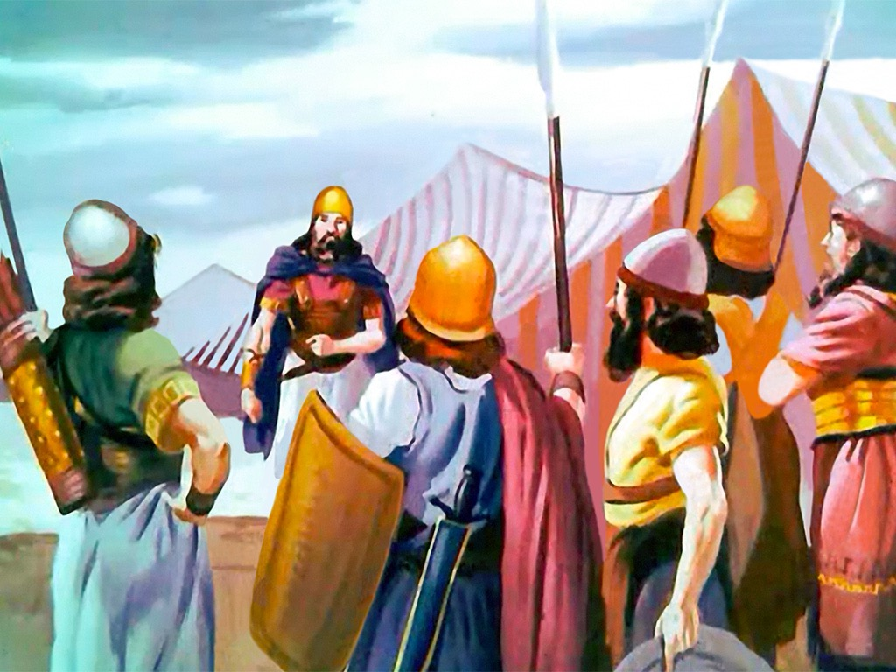
Kuz;ghl;bw;fhd fhuzk;
“fhdhd;Njrj;jpy; ,Uf;fpw Nahh;jhdpd; vy;iyfSf;F te;jNghJ> &gd; Gj;jpuUk; fhj; Gj;jpuUk; kdhNrapd; ghjpf; Nfhj;jpuj;jhUk;> mq;Nf Nahh;jhdpd; Xuj;jpNy ghh;itf;Fg; nghpjhd xU gPlj;ijf; fl;bdhh;fs;.” (NahRth 22:10)
Nahu;jhd; ejpia mw;Gjkhf fle;jjw;fhd epidTrpd;dj;ij NahRth mikj;j ,lj;jpw;F mUfpy;, ,uz;liu Nfhj;jpuj;jpw;F gupRj;j ];jyj;jpd; gypgPlj;ij Nghd;w xU gypgPlj;ij fl;bdhu;fs; (NahR. 22:10, 28).
,e;j nray;> Mrupg;Gf;$lhuj;jpy; cs;s jfd gypgPlj;ij jtpu NtW ,lj;jpy; gypfis nrYj;Jtij jilnra;Ak; rl;lj;jpd; kPwyhf tpsf;fg;gl;lJ (Nytp. 17:8-9).
kPjKs;s ,];uNtyu;fs; jq;fs; rNfhjuu;fis jhf;Ftjd; %yk; ,e;j ghtj;ij xopf;f KbT nra;jdu;(NahR. 22:12). Mdhy; Njtd; jiyapl;L xU ,uj;jk; rpe;jf;$ba cs;ehl;L Nghiu jLj;jhu;. vy;yh Mjhuq;fSk; ,y;yhky; jPu;g;gspf;f tpUk;ghj kf;fis mtu; vOg;gpdhu;; mtu;fs; re;Njfj;jpd; gyid mspj;jdu;; NkYk; jq;fs; rNfhjuu;fs; jq;fis tpsf;fpf; nfhs;s xU tha;g;gspf;f KbT nra;jdu; (NahR. 22:13-14).
mjd; tpisthf, mtu;fs; nra;j xNu jtW jdJ rNfhjuu;fSf;F jdJ Nehf;fq;fis njuptpf;fhky; NghdJ jhd;… Mdhy; mJ ghtky;y.

Slide 6

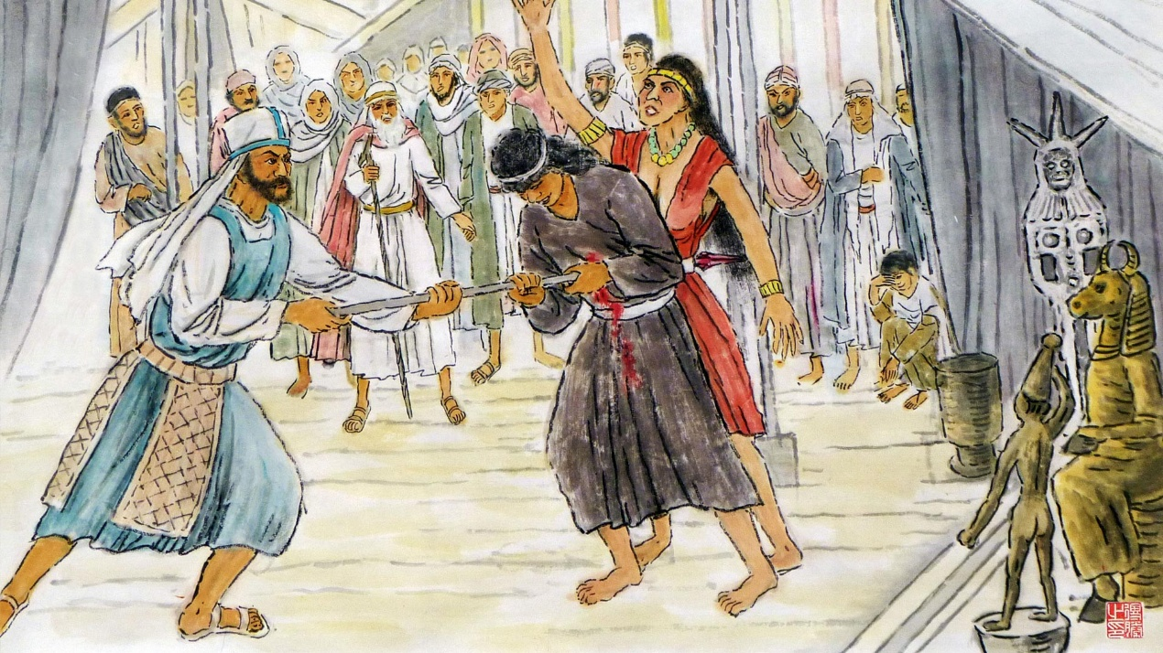
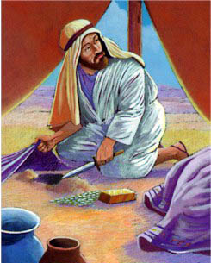
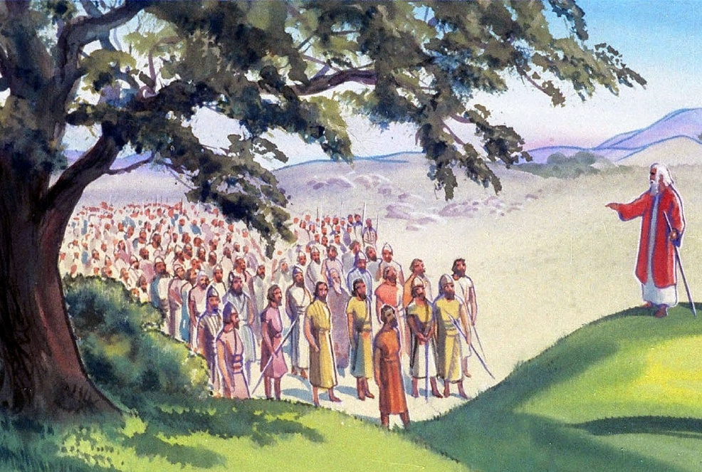
Fw;wr;rhl;Lfs;
“ePq;fs; ,e;ehspNy fh;j;jiug; gpd;gw;whjgbf;Fg; Guz;L> ,e;ehspNy fh;j;jUf;F tpNuhjkha;f; fyfk; gz;Zk;gbahf cq;fSf;F xU gPlj;ijf; fl;b> ,];uNtypd; NjtDf;F tpNuhjkhfg; gz;zpd ,e;jj; JNuhfk; vd;d?” (NahRth 22:16)
tprhuizf;FOtpd; jiytuhf gpndfh]; Vd; Nju;e;njLf;fg;gl;lhu; (NahR. 22:13-14)?
gpujhd Mrhupaupd; kfdhd gpndfh];> ghfhy; NgNahupy; ele;j ghtj;ijj; jLg;gjpy; tplhKaw;rpAld; ,Ue;jhu; (vz;. 25:7-8). mtu; jdJ ciuapy;, ,e;j ghtj;ij Mfhdpd; ghtj;Jld; ,izj;J> ,uz;liu Nfhj;jpuj;jpdu; nra;jjhf $wg;gLk; ghtj;Jld; mij rkd; nra;jhu; (NahR. 22:16-20).
gpndfh]; Ngr;R rupahd mu;j;jKs;sjhf ,Ue;jJ. Gjpjhf vOg;gg;gl;l gypgPlj;jpd; gypfs; nrYj;jg;gl;lhy;> mjw;fhf Njtd; ,];uNty; KOtijAk; jz;bg;ghu; (NahR. 22:18gp).
,Ug;gpDk;, mtu;fs; ghtk; nra;tjw;F Kd;G, ,e;j jtiw rupnra;a mtu; mtu;fSf;F tha;g;gspj;jhu;: gupRj;j ];jyk; ,Ue;j Nahu;jhd; gf;fk; jpUk;Gtjw;fhd tha;g;ig mtu; mtu;fSf;F toq;fpdhu;(NahR. 22:19).

Slide 7


fdpthd gjpy;
“xU fhhpaj;ijf;Fwpj;J ehq;fs; vq;fSf;F me;jg; gPlj;ijf; fl;bdNj my;yhky;> fh;j;jiug; gpd;gw;whjgbf;F tpyFtjw;fhtJ> mjpd;Nky; rh;thq;f jfdgypiaahfpYk; Ngh[dgypiaahfpYk; rkhjhdgypfisahfpYk; nrYj;Jfpwjw;fhtJ mijr; nra;jJz;lhdhy;> fh;j;jh; mij tprhhpg;ghuhf.” (NahRth 22:23)
Fw;wk; rhl;lg;gl;lNghJ> &gd; kw;Wk; fhj; Nfhj;jpuj;jhUk;> kdhNrapd; ghjp Nfhj;jpuj;jhUk; Kd;khjpupahf ele;Jnfhz;ldu;:
mtu;fs; Fw;wr;rhl;Lfis mikjpahf Nfl;ldu;
mtu;fs; Njtid rhl;rpahf mioj;jhu;fs;
mtu;fs; ghtk; nra;jpUe;jhy; jz;bf;fg;gLtij Vw;Wf;nfhz;ldu;
mtu;fs; jq;fs; cz;ikahd ce;Jjy;fis ntspg;gLj;jpdu;
gypgPlj;ij fl;Ltjw;F jq;fs; rNfhjuu;fspd; Nehf;fq;fis ,];uNtyu; mwpahjNghJ> mtu;fs; fUjpaJ: fyfk;, gpuptpidf;fhd Mir, nja;tPf jz;lid.
ajhu;j;jk; vd;dntd;why;: jq;fs; rNfhjuu;fSld; xw;Wikahf ,Uf;fTk; ,];uNtyu;fspd; jug;gpy; vjpu;fhyj;jpy; gpuptpid Vw;gLtij jtpu;f;fTk; xU Mir(NahR. 22:24-26).
Fw;wk;rhl;lg;gl;l Nfhj;jpuj;jhu; Fw;wr;rhl;Lfshy; Gz;gLj;jg;gl;L> jq;fis ghJfhj;Jf;nfhs;s td;Kiwapy; <Lg;gl;bUf;fyhk; vd;whYk;, mtu;fspd; el;G uPjpahd gjpYf;F ed;wp, Nghu; jtpu;f;fg;gl;lJ.

Slide 8

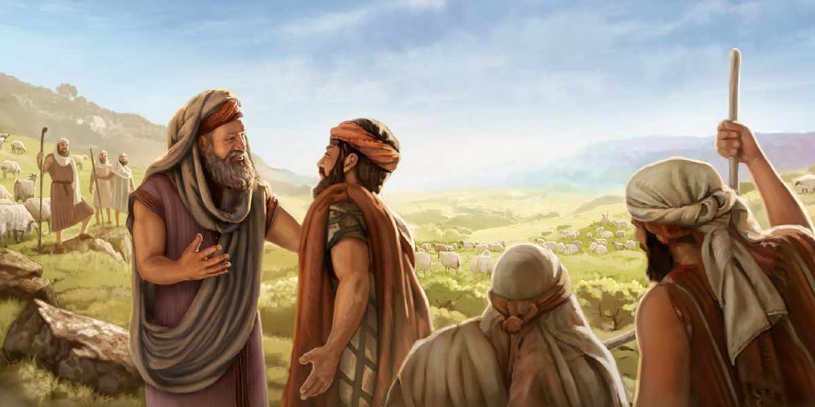
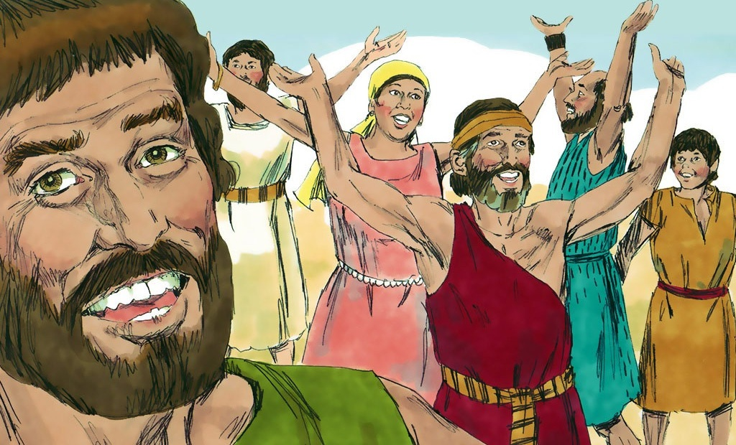
Xg;GuthFjy;
“me;jr; nra;jp ,];uNty; Gj;jpuhpd; ghh;itf;F ed;whapUe;jJ@ Mifahy; &gd; Gj;jpuUk; fhj; Gj;jpuUk; FbapUf;fpw Njrj;ij mopj;Jtpl> mth;fs;Nky; Aj;jj;jpw;Fg; Gwg;gLNthk; vd;fpw Ngr;ir tpl;L> ,];uNty; Gj;jpuh; Njtid ];Njhj;jphpj;jhh;fs;.” (NahRth 22:33)
Fw;wr;rhl;L Mjhukw;wJ vd;gijf; fz;lJk;> gpndfh]_k; ,];uNty; gpujpepjpfSk; epk;kjpaile;jdu; (NahR. 22:30-31). ,];uNtyu; cz;ikia fw;Wf;nfhz;l NghJ, mtu;fs; jq;fs; gq;fpw;F kfpo;aile;J Njtid Gfo;e;jhu;fs; (NahR. 22:32-33).
FLk;gk;> Njthyak; kw;Wk; r%fk; njhlu;ghd xj;j R+o;epiyfspy; mikjpia kPl;nlLg;gjw;fhd Njitahd eltbf;iffis mtu;fspd; cjhuzj;jpd; %yk; ehk; fhzyhk;:
mtrug;gl;L KbTfis vLf;fhjPu;fs;
nray;gLtjw;F Kd; gpur;ridfisg; gw;wp NgRq;fs;
Xw;Wikia mila jpahfq;fis nra;a jahuhf ,Uq;fs;
Fw;wr;rhl;LfSf;F fz;zpakhd gjpiy nfhLq;fs;
mikjp kPl;nlLf;fg;gLk;NghJ kfpo;r;rpaile;J Njtid ];Njhj;jupAq;fs;
ekJ vz;zq;fis njhlu;Gnfhs;tJ

