Slide 1

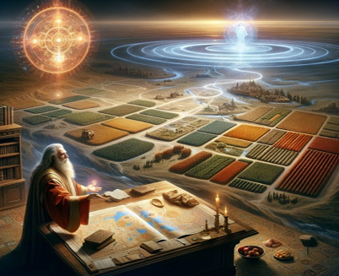
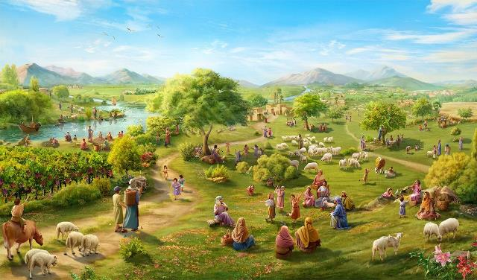
Njtd; ek;gj;jFe;jtu;!
ghlk; 12 brk;gu; 20, 2025

Slide 2

“fh;j;jh; ,];uNty; FLk;gj;jhUf;Fr; nrhy;ypapUe;j ey;thh;j;ijfspnyy;yhk; xU thh;j;ijAk; jtwpg;Nghftpy;iy@ vy;yhk; epiwNtwpw;W.” (NahRth 21:45)

Slide 3

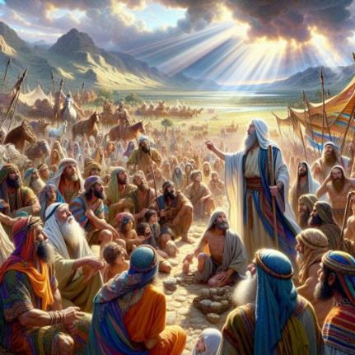
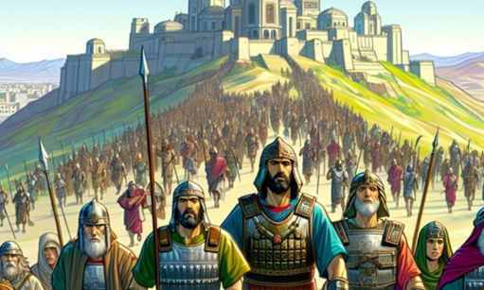
NahRth Vw;fdNt taJ Kjpe;jtuhf ,Ue;jhu;. ,d;Dk; ifg;gw;wgl Ntz;ba Njrq;fs; ,Ue;jd. mtw;iw njhlu;eJ ifg;gw;Wtjw;fhf Gjpa jiytu;fis xd;W $l;b Cf;Ftpj;jhu;
mNj Neuj;jpy;> mjpy; cs;s mghaq;fisAk; mtu; vLj;Jiuj;jhu;. cz;ikapy; xNu xU mghak; jhd; ,Ue;jJ - ,d;W ehKk; me;j mghaj;ij vjpu;nfhs;fpNwhk;:
NjtDf;F cz;ikahf ,Ug;gij tpl;LtpLjy;: NjtDila cz;ikf;F gjpyhf ek;kplkpUe;J mtek;gpf;ifia mspj;jy;. ntw;wpia milAk; ty;yik mtu;fsplj;jpy; my;y> mJ Njtdplj;jpy; ,Ue;jJ. Mifahy; Njtd; mtu;fSf;F Vw;fdNt ntspg;gLj;jpd cz;ikia mtu; mtu;fSf;F epidg;G+l;bdhu;;NkYk; Njtd; njhlu;e;J cz;ikahf ,Ug;gjhf cWjp mspj;jhu;.
NjtDila cz;ikj;jd;ik (NahRth 21:43-45)
Njtd; vd;d nra;jpUf;fpwhu;> Njtd; vd;d nra;thu; (NahRth 23:1-5)
cz;ikf;fhd gupR (NahRth 23:6-10)
ehk; vd;d nra;a Ntz;Lk; (NahRth 23:11-14)
cz;ikapy;yhjjw;fhd jz;lid (NahRth 23:15-16)

Slide 4


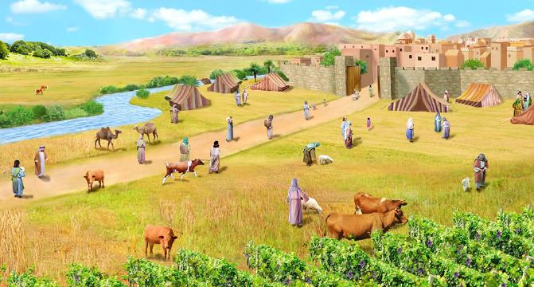
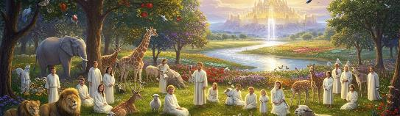
NjtDila cz;ikj;jd;ik
“fh;j;jh; ,];uNty; FLk;gj;jhUf;Fr; nrhy;ypapUe;j ey;thh;j;ijfspnyy;yhk; xU thh;j;ijAk; jtwpg;Nghftpy;iy@ vy;yhk; epiwNtwpw;W.” (NahRth 21:45)
Njtd; ,];uNtYf;F “KO Njrj;ijAk;” nfhLj;jhu; (NahR. 21:43) kw;Wk; mtu;fSila “vy;yh rj;JUf;fisAk;” mtu;fs; iffspy; xg;gilj;jhu; (NahR. 21:44), Mifahy; “xU thu;j;ijAk; jtwhky; vy;yhk; epiwNtwpaJ” (NahR. 21:45).
“vy;yhk;” vd;w nrhy;ypd; kPz;Lk; kPz;Lk; gad;ghL> Njtd; jkJ thf;Fj;jj;jq;fis epiwNtw;Wtjpy; vt;tsT cz;ikAs;stu; vd;gij typAWj;JfpwJ. mtu;fSila rj;JUf;fs; Njtdhy; Njhw;fbf;fg;gl;lhu;fs;. Njtd; Vw;fdNt me;j Njrj;ij mtu;fSf;fhf ifg;gw;wpapUe;jjhy;> mtu;fs; me;j Njrj;jpy; FbapUf;f Kbe;jJ. ,Jtiu Njtd; jkJ thf;Fj;jj;jq;fis fhj;Jf; nfhz;bUe;jjhy;> vjpu;fhyj;jpYk; mtu; mtw;iw njhlu;e;J fhj;J nfhs;thu; vd;w cWjpAk; mtu;fSf;F ,Ue;jJ.
,it vy;yhk;; ek;Kila ed;ikf;fhfNt nray;gLfpd;wd. mtu; vg;NghJk; cz;ikahfNt ,Uf;fpwhu;.(cgh. 7:9; rq;. 117:2; Gyk;. 3:22-23). mtu; ek;ik ,ul;rpg;gjhfTk;> G+kpia Rje;jukhf mspg;gjhfTk; thf;Fj;jj;jk; nra;Js;shu;: me;j thf;Fj;jj;ij mtu; epr;rakhf epiwNtw;Wthu; (gpypg;. 1:6; 1 NgJ. 1:5; rq;. 37:29).

Slide 5

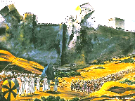
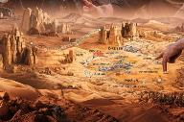
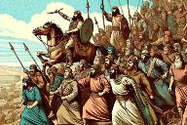
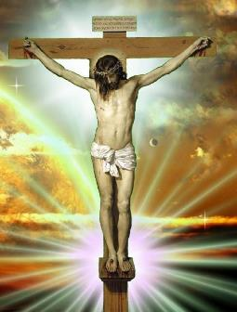
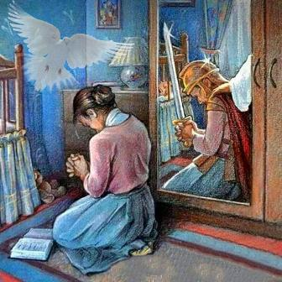
Njtd; vd;d nra;jpUf;fpwhu;? vd;d nra;a Nghfpwhu;
“cq;fs; Njtdhfpa fh;j;jh; cq;fSf;F Kd;ghf ,e;jr; rfy [hjpfSf;Fk; nra;j ahitAk; ePq;fs; fz;Bh;fs;@ cq;fs; Njtdhfpa fh;j;jh;jhNk cq;fSf;fhf Aj;jk;gz;zpdhh;.” (NahRh 23:3)
%g;gu;fSf;F nrhd;d jdJ ciuapy;> NahRth Kjypy; Njtd; Vw;fdNt nra;j fhupaq;fisAk;> mtu; ,d;Dk; nra;atpUf;Fk; fhupaq;fisAk; epidT+l;Lfpwhu;:
mtu; kw;w [hjp;fSf;F vjpuhf Aj;jk; gz;zpdhu; (NahR. 23:3)
Njrj;ij Nfhj;jpuq;fSf;F ,ilNa gq;fpl;L mspj;jhu;(NahR. 23:4)
,d;Dk; kPjKs;s [hjpfisAk; mtu; mfw;wg;gNghfpwhu; (NahR. 23:5)
,it midj;Jk; (,Jtiu nra;ag;gl;lijAk;> ,dp nra;ag;gl ,Ug;gijAk;) ,];uNtYf;F xNu xU epge;jidia rhu;e;Nj ,Ue;jJ: fPo;gbjy; (NahR. 23:6).
,];uNtypd; tuyhW ,d;W ekf;F xU ghlkhf ,Uf;fpwJ. Njtd; Vw;fdNt ghtj;jpd; Nky; ntw;wp ngw;Ws;shu;. ,NaRtpd; gypapdhy; ekf;F ,ul;rpg;gpd; epr;raj;ij mspj;Js;shu; (nfhNyh. 2:15).
Nghuhl;lj;ij njhlu;e;J elj;JtJ ek;Kila nghWg;G. ntw;wpAs;s [Ptpaj;ij tho> gupRj;j Mtpapd; Nky; ek;gpf;if itj;J elf;f Ntz;Lk; (2 nfhup. 10:3-5; vNg. 6:11-18).

Slide 6

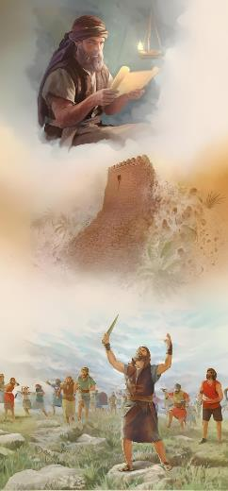
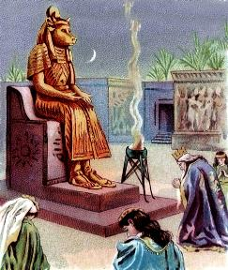

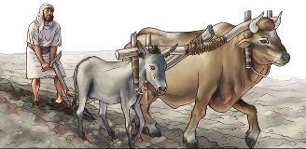
cz;ikf;fhdg; gupR
“cq;fspy; xUtd; Mapuk;Ngiuj; Juj;Jthd;. cq;fs; Njtdhfpa fh;j;jh; cq;fSf;Fr; nrhd;dgb> mth;jhNk cq;fSf;fhf Aj;jk;gz;Zfpwhh;.” (NahRth 23:10)
,];uNty; NjtDf;F cz;ikahf ,Ue;jpUe;jhy;> mtu;fSila vy;yh rj;JUf;fspd; NkYk; KOikahd kw;Wk; jPu;khdkhd ntw;wpia ngWthu;fs; (NahR. 23:6, 10).
fhdhd; Njrj;ij ifg;gw;wpa R+o;epiyapy;, NjtDf;fhd cz;ik %d;W Fwpg;gpl;l topfspy; ntspg;gl Ntz;bajhf ,Ue;jJ:
,j;Njrj;jpd; Fbfis jpUkzk; nra;a Ntz;lhk;(NahR. 23:7K)
gpw nja;tq;fspd; ngau;fis cr;rupf;f Ntz;lhk;(NahR. 23:7e)
gpw nja;tq;fis tzq;f Ntz;lhk; (NahR. 23:7gp)
mtu;fs; Mtpf;Fupa J}a;ikia ghJfhf;f Ntz;baJ mtrpakhf ,Ue;jJ. mj;Njrj;J Fbfis jpUkzk; nra;jpUe;jhy;, ,Wjpapy; mtu;fisNa Muhjpf;f njhlq;fpapUg;ghu;fs;. ,t;tpjkhfj;jhd; rhyNkhdpd; tpRthr tPo;r;rp Muk;gkhdJ (1 ,uh[hf;fs; 11:4).
mJNghy, tpRthrkpy;yhjtu;fSld; jpUkzk; nra;a Ntz;lhk; vd;W fpwp];jtu;fs; ehKk; mwpTWj;jg;gLfpNwhk; (2 nfhup. 6:14-16).

Slide 7


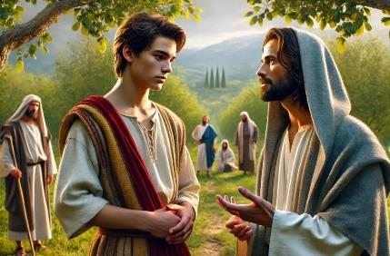
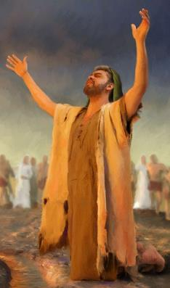
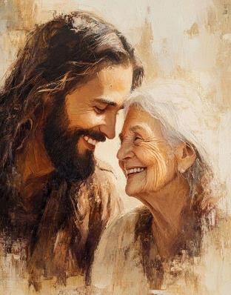

ehk; vd;d nra;a Ntz;Lk;?
“Mifahy; cq;fs; Njtdhfpa fh;j;jhpy; md;G$Uk;gb> cq;fs; Mj;Jkhf;fisf;Fwpj;J kpfTk; vr;rhpf;ifahapUq;fs;.” (NahRth 23:11)
NahRthtpd; ciuapd; ikaf; fUj;J trdk; 11y; njspthff; fhzg;gLfpwJ: Njtid Nerpg;gJ.
,];uNty; NtW Njtu;fis Nerpf;fhky; ,Ug;gjd; %yk;> Njtdplj;jpYs;s jq;fSila md;ig ntspg;gLj;j Ntz;baJ mtrpakhf ,Ue;jJ> ,y;iynadpy; mJ mtu;fSf;F fLk; ghjpg;ig cz;lhf;fpapUf;Fk; (NahR. 23:12-13).
$Ljyhf, me;j Nerj;ij tsu;f;Fk; xU Cf;fj;ijAk; NahRth Kd; itf;fpwhu;: NjtDila cz;ikj;jd;ik (NahR. 23:14).
,d;iwf;F ekf;F ,d;Dk; ngupa Cf;fk; cs;sJ: ,NaRtpd; vLj;Jf;fhl;L (Nah. 13:34).
jkJ md;gpw;F gjpyspf;Fk; xt;nthUtUlDk;> Njtd; neUf;fkhdJk; jdpg;gl;lJkhd cwit Vw;gLj;j tpUk;Gfpwhu;.
Mifahy;> vy;yhuplj;jpYk; mtu; itj;Js;s gu];gu md;Ng> ek;Kila tpUg;gj;JlDk; gu];gu md;GlDk; ntspg;gLk; md;Gf;fhd mbj;jskhf ,Uf;fpwJ.

Slide 8

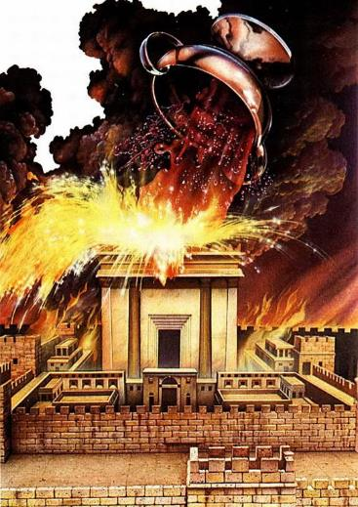
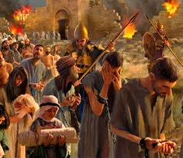
cz;ikapy;yhjw;fhd jz;lid
“,g;nghOJk; cq;fs; Njtdhfpa fh;j;jh; cq;fNshNl nrhd;d ey;y fhhpanky;yhk; cq;fsplj;jpNy vg;gb epiwNtwpw;Nwh> mg;gbNa> cq;fs; Njtdhfpa fh;j;jh; cq;fSf;Ff; fl;lisapl;l mtUila cld;gbf;ifia ePq;fs; kPwp> me;epa Njth;fisr; Nrtpj;J> mitfisg; gzpe;J nfhs;Sq;fhyj;jpy;>” (NahRth 23:15)
NahRth jdJ ciuia> fPo;gbypd;ikapd; tpisTfis gw;wpa fLikahd vr;rupf;ifAld; Kbf;fpwhu;: NjtDila Nfhgj;ij mDgtpj;jy; (NahR. 23:15-16).
cld;gbf;ifia ntspg;gilahf kPWtjhy;> NaNfhthtpd; Nfhgj;ij J}z;Ltjd; tpisTfis ,];uNty; ed;F mwpe;jpUe;jJ.
ekf;fhf jkJ Fkhuid nfhLf;f J}z;ba mNj md;Ng> ghtj;ij gpbthjkhfg; gpbj;Jf; nfhs;Sfpwtu;fs; Nky; Nfhgkhf ntspg;gLfpwJ (Nahthd; 3:16; Nuhku; 2:5).
,];uNty; Njhy;tpaile;J jz;lidia mDgtpj;jhu;fs;. ,d;iwf;F ehk; NtnwhU tuyhw;iw vOJk; tha;g;ig ngw;Ws;Nshk;: mtUila md;gpy; epiyj;jpUe;J> mtUf;F cz;ikahf ,Uf;f Ntz;Lk; (Nahthd; 15:9).

