Slide 1
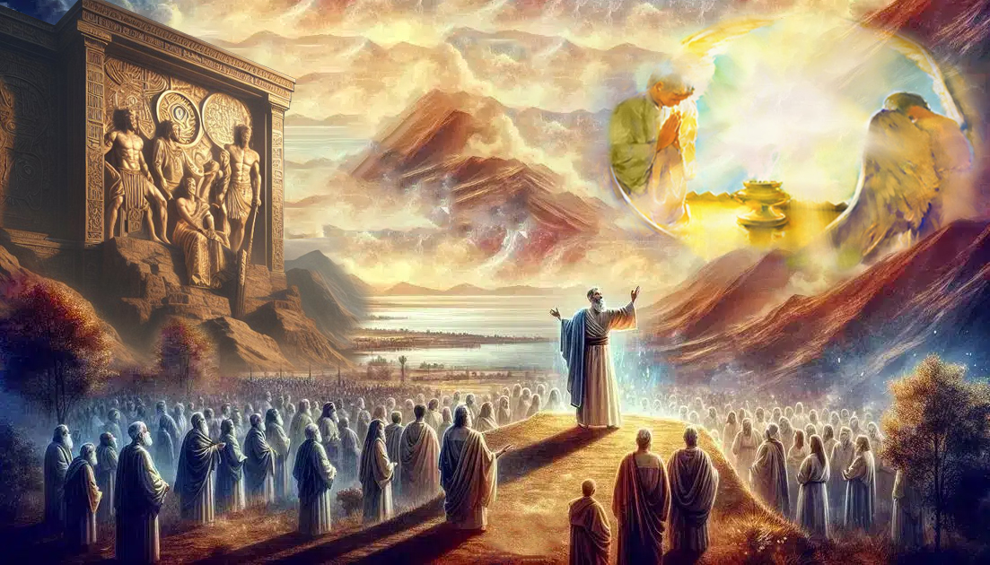
,d;W njhpe;Jnfhs;Sq;fs;!
ghlk; 13 brk;gu; 27, 2025

Slide 2
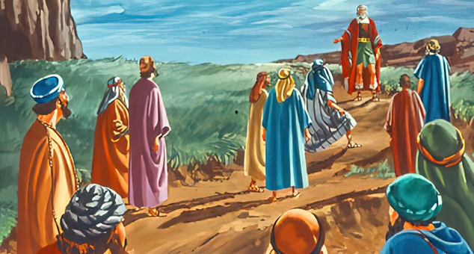
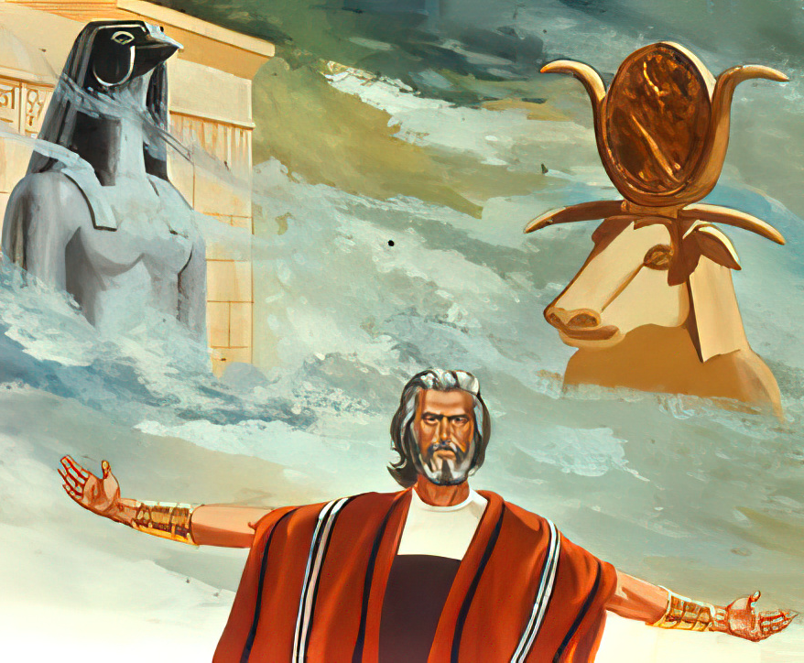
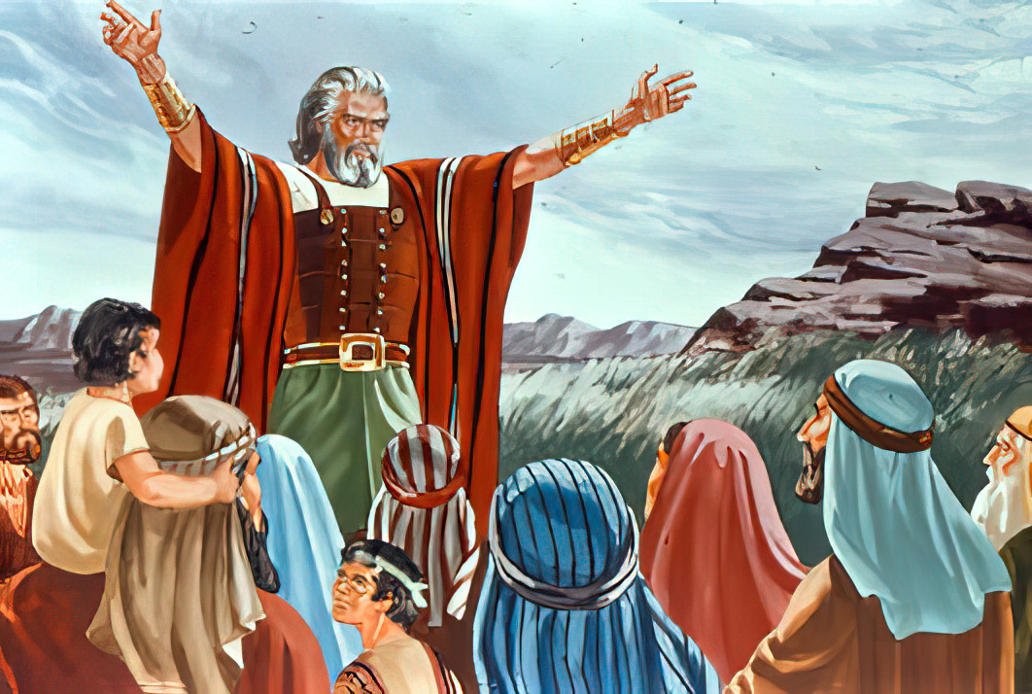
“fh;j;jiur; Nrtpf;fpwJ cq;fs; ghh;itf;F Mfhjjha;f; fz;lhy;> gpd;id ahiur; Nrtpg;gPh;fs; vd;W ,d;W njhpe;Jnfhs;Sq;fs;@. . . . ehDk; vd; tPl;lhUNkhntd;why;> fh;j;jiuNa Nrtpg;Nghk;”
(NahRth 24:15)

Slide 3

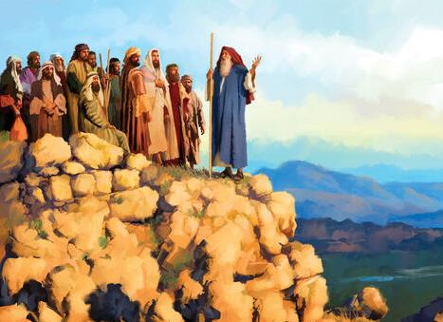
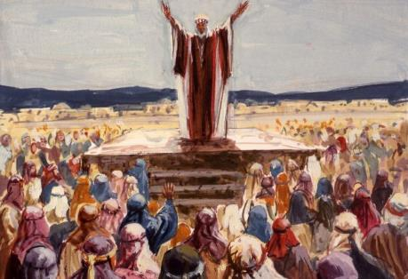
NahRth jd; KbT neUq;fptpl;ljhf czu;e;jhu;. mtu; e;y Nghuhl;lj;ij Nghuhbdhu;. mtu; xl;lj;ij Kbj;Jtpl;lhu;. mtu; tpRthrj;ijf; fhj;Jf;nfhz;lhu;. gTiyg; NghyNt> mtUk; ePjpapd; fpuPlj;ij ek;gpf;ifAld; vjpu;g;ghu;j;jpUf;fyhk; (2 jPNkh. 4:7-8).
Mdhy;, fhNyig NghyNt, kw;wtu;fs; me;j nghWg;ig Vw;Wf;nfhz;L> NjtDila kf;fis rupahd ghijapy; topelj;Jthu;fs; vd;gij mtu; cWjpg;gLj;j Ntz;bapUe;jJ.
me;j fhuzj;jpw;fhf, mtu; tpRthr cld;gbf;ifia GJg;gpg;gjw;fhfTk;, NjtDf;F Nrit nra;Ak; tho;f;ifia Nju;e;njLf;Fk;gb mtu;fis cw;rhfg;gLj;Jtjw;fhfTk;> kf;fis rPNfkpy; xd;W $l;bdhu;.
Njtd; vOjpa fij (NahRth 24:1-13)
xUikg;ghl;bw;fhd miog;G (NahRth 24:14-15)
[dq;fspd; njupe;Jnfhs;Sjy; (NahR 24:16-21)
cld;gbf;ifia GJg;gpj;jy; (NahRth 24:22-28)
fijapd; njhlu;r;rp (NahRth 24:29-33)

Slide 4


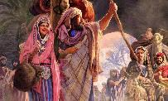
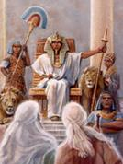
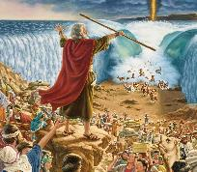
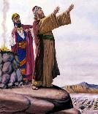
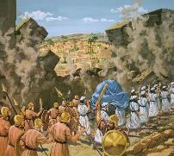

Njtd; vOjpa fij
“mg;gbNa ePq;fs; gz;gLj;jhj Njrj;ijAk;> ePq;fs; fl;lhj gl;lzq;fisAk; cq;fSf;Ff; nfhLj;Njd;> mitfspy; FbapUf;fpwPh;fs;@ ePq;fs; elhj jpuhl;rj; Njhl;lq;fspd; gyidAk; xyptj;Njhg;Gf;fspd; gyidAk; Grpf;fpwPh;fs; vd;whh;.” (NahR 24:13)
jdJ filrp ciuf;fhf NahRth Nju;e;njLj;j ,lk; xU tuyhw;W rpwg;Gkpf;f ,lk;: rPNfk; (NahR. 24:1).
1. fhdhdpy; Mgpufhk; $lhuk; Nghl;l Kjy; ,lk; (Mjp. 12:6)
2. fhdhdpy; ahf;NfhG $lhuk; Nghl;l Kjy; ,lk; (Mjp. 33:18)
3. ahf;NfhG thq;fpa xNu nrhj;J (Mjp. 33:19)
4. mq;Nf ahf;NfhG jdJ FLk;gj;jpdu; irj;jpUe;j me;epa nja;tq;fis Gijj;jhd; (Mjp. 35:4)
NahRth jq;fs; %jhijau; NjuhF topg;gl;l “me;epa nja;tq;fis” gw;wp nrhy;tjd; %yk; jdJ ciuia njhlq;fpdhu; (NahR. 24:2). mq;fpUe;J Njtd; nra;j midj;ijAk; mtu; jd; nrhe;j thu;j;ijfspy; mtu;fSf;F epidT+l;bdhu;: ehd; vLj;Njd;; ehd; nfhz;L te;Njd;; ehd; gYf nra;Njd;; ehd; mDg;gpNdd;; ehd; mbj;Njd;; ehd; ntspNa nfhz;L te;Njd;; ehd; cd;id cs;Ns nfhz;L te;Njd;; ehd; mtu;fis tpLtpj;Njd;; ehd; mtu;fis mopj;Njd;; ehd; gpNyahKf;F nrtprha;f;ftpy;iy; ehd; cd;id tpLtpj;Njd;; ehd; mtu;fis iftpl;Nld;; ehd; Fstpfis mDg;gpNdd;; ehd; cq;fSf;F Njrj;ij nfhLj;Njd; (NahR. 24:3-13).
,e;j tuyhw;wpy;, jiyKiwfs; xd;wd;g;gpd; xd;whf ve;j NtWghLk; ,y;yhky; fle;J nry;fpd;wd. midtUk; ,jpy; mlq;Ftu;. NahRthtpd; Ngr;ir Nfl;ltu;fs;> “ejpf;F mg;Gwj;jpypUe;J te;jtu;fs;” mtu;fs; vfpg;jpw;F nrd;whu;fs;; kpFe;j ty;yikAld; mq;fpUe;J Gwg;gl;lhu;fs;; mtu;fs; nrq;fliy fle;jhu;fs;; Nahu;jhDf;F fpof;NfAs;s Njrj;ij ifg;gw;wpdhu;fs;; fhdhid Rje;jupj;Jf;nfhz;lhu;fs;. mtu;fSila %jhijau;fSld; Njtd; vd;d nra;jhNuh> mijNa mtu;fSlDk; nra;fpwhu;> ,d;W ek;NkhLk; nra;fpwhu;.

Slide 5

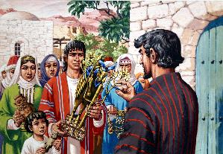
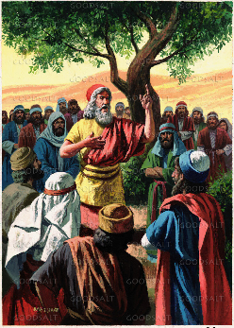
xUikg;ghl;bw;fhd miog;G
“fh;j;jiur; Nrtpf;fpwJ cq;fs; ghh;itf;F Mfhjjha;f; fz;lhy;> gpd;id ahiur; Nrtpg;gPh;fs; vd;W ,d;W njhpe;Jnfhs;Sq;fs;@ ejpf;F mg;Gwj;jpy; cq;fs; gpjhf;fs; Nrtpj;j Njth;fisr; Nrtpg;gPh;fNsh? ePq;fs; thrk;gz;Zfpw Njrj;Jf; Fbfshfpa vNkhhpahpd; Njth;fisr; Nrtpg;gPh;fNsh? ehDk; vd; tPl;lhUNkhntd;why;> fh;j;jiuNa Nrtpg;Nghk; vd;whd;.” (NahRth 24:15)
ahf;NfhG ngj;Njypy; NjtDld; jq;fs; cld;gbf;ifiag; GJg;gpg;gjw;F Kd;G> jd; FLk;gj;jpdiu jq;fs; nja;tq;fis mlf;fk; nra;Ak;gb mioj;jJ NghyNt> NahRthTk; NjtDld; jq;fs; cld;gbf;ifia GJg;gpg;gjw;F Kd;G> kf;fs; jq;fs; nja;tq;fis iftpLkhW miof;fpwhu; (NahR. 24:14gp).
mtu;fs; NjtDf;F gae;J> mtiu cj;jKk; cz;ikAkha; Nrtpf;f Ntz;Lk;(NahR. 24:14K). ,J vijf; Fwpf;fpwJ?
NjtDf;F gae;J
vd;idtpl vy;iyaw;w Kiwapy; Nkyhdtuhfpa mtUf;F Mo;e;j kupahijia fhl;Ltjw;Fk;> mtiu vd; ,uh[hthfTk; Mz;ltuhfTk; Vw;Wf;nfhs;tjw;Fk;
cz;ikahd kdJld; NjtDf;F Nrit nra;a [xUikghL]
Fiwfsw;w Nrit (“Fiwghlw;wjhf” [KOikahf] ,Ue;jhy;jhd; ,iwr;rpf;fhf ntl;Ltjw;F jFjpahdJ vd;W tiuaWf;fg;gl;l tpyq;F ,JNghyNt ,Ue;jJ)
cz;ikAld; NjtDf;F Nrit nra;a
tpRthrkhfKs;stuhfTk;> ek;gfkhdtuhfTk;> cz;ikAs;stuhfTk;> khwhjtuhfTk;> epiyj;jd;ik cilatuhfTk; ,Ug;gJ. Njtd; vd; tho;tpy; nra;jitfSf;fhf mtUf;F ehd; nrYj;Jk; ed;wpia vd; tho;tpd; %yk; ntspg;gLj;JtJ.

Slide 6

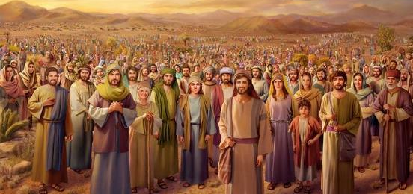
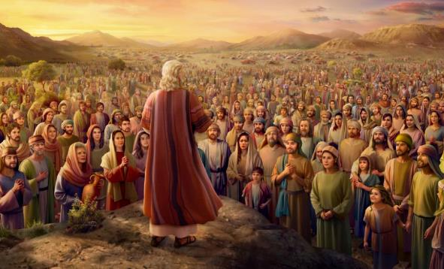
[dq;fspd; njupe;Jnfhs;Sjy;
“mg;nghOJ [dq;fs; gpujpAj;jukhf: NtNw Njth;fisr; Nrtpf;Fk;gb> fh;j;jiu tpl;L tpyFfpw fhhpak; vq;fSf;Fj; J}ukhapUg;gjhf!’” (NahRth 24:16)
NahRthtpd; mioggpw;F vd;d gjpy; fpilj;jJ (NahR. 24:16)? me;j kf;fs; midtUk; jq;fs; nja;tq;fSf;F ,y;iy vdf; $wp> jq;fSf;F xNu xU Njtd; kl;LNk cz;L vd;gij Vw;Wf;nfhz;ldu;: “ek;Kila Njtd;,” mtNu jhd; mtu;fSila %jhijau;fisAk; mtu;fisAk; me;j epkplk; tiu topelj;jp te;jtu; (NahR. 24:17-18).
kf;fspd; KbTf;F tho;j;J nrhy;tjw;F gjpyhf> NahRth xU vjpu;ghuhj gjpiy mspj;jhu;: “ePq;fs; fh;j;jiur; Nrtpf;fkhl;Bh;fs;@” (NahR. 24:19). vd;d xU Vkhw;wk;!
NahRth jdJ ngw;nwhu; ,Nj thf;FWjpia nfhLg;gij Nfl;bUe;jhu; (ahj;. 19:8), NkYk;> fle;j 40 Mz;Lfshf mtu;fs; mij kPz;Lk; kPz;Lk; kPwpaij mtu; ghu;j;jpUe;jhu;.
,e;j fLikahd gjpy; mjd; Nehf;fj;ij epiwNtw;wpaJ. Gjpa jiyKiwapdu; mNj jtWfis kPz;Lk; nra;af;$lhJ vd;gjpy; cWjpahf ,Ue;jdu; (NahR. 24:21).

Slide 7


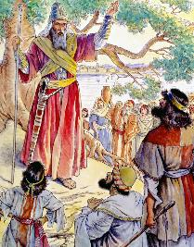
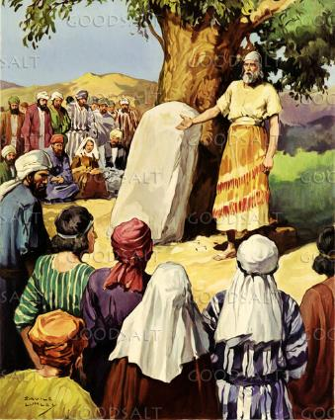
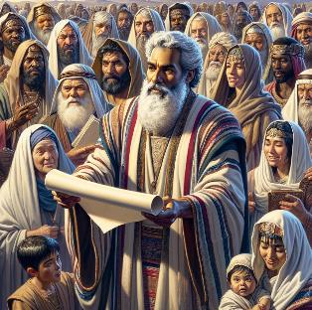
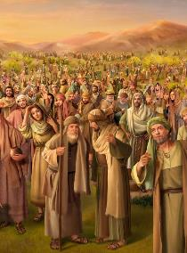
cld;gbf;ifia GJg;gpj;jy;
“me;jg;gb NahRth me;ehspy; rPNfkpNy [dq;fNshNl cld;gbf;ifgz;zp> mth;fSf;F mijg; gpukhzKk; epahaKkhf Vw;gLj;jpdhd;.” (NahRth 24:25)
jdJ ciuia Kbf;Fk; tpjkhf> NahRth mtu;fsplk;> “cq;fSf;Fs; ,Uf;Fk;” nja;tq;fis mfw;wptpl;L> jq;fs; ,Ujaq;fis kPz;Lk; Njtdplk; jpUg;GkhW Nfl;Lf;nfhz;lhu; (NahR. 24:23).
%d;whtJ Kiwahf, [dq;fs; Njtid Nrtpg;gjhf cWjpaspj;jdu; (NahR. 24:24). me;j cld;gbf;if cWjpg;gLj;jg;gl;lJ, NkYk; NkhNria NghyNt> NahRthTk; mtu;fSf;F fl;lisfisAk; rl;lq;fisAk; nfhLj;jhu;” (NahR. 24:25).
NjtDldhd cld;gbf;ifahdJ mtUldhd xU capUs;s cwit mbg;gilahf nfhz;lJ vd;gjhYk;, mij ntWk; tpjpKiwfs; %yk; KOikahf ntspg;gLj;j KbahJ vd;gjhYk;> me;j cld;gbf;ifapy; epiyj;jpUf;f mtu;fSf;F cjTk; njspthd epidT+l;ly;fis tpl;L nry;tJ mtrpak; vd;gij NahRth Gupe;Jnfhz;lhu;.
mtu; me;j cld;gbf;ifia vOj;JG+u;tkhf gjpT nra;J> xU epidT rpd;dj;ij epWtpdhu;: mtu;fs; nra;j cWjpnkhopf;F rhl;rpahf ,Uf;Fk; xU fy; (NahR. 24:26-27).

Slide 8

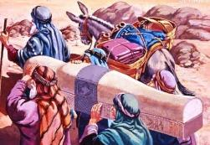
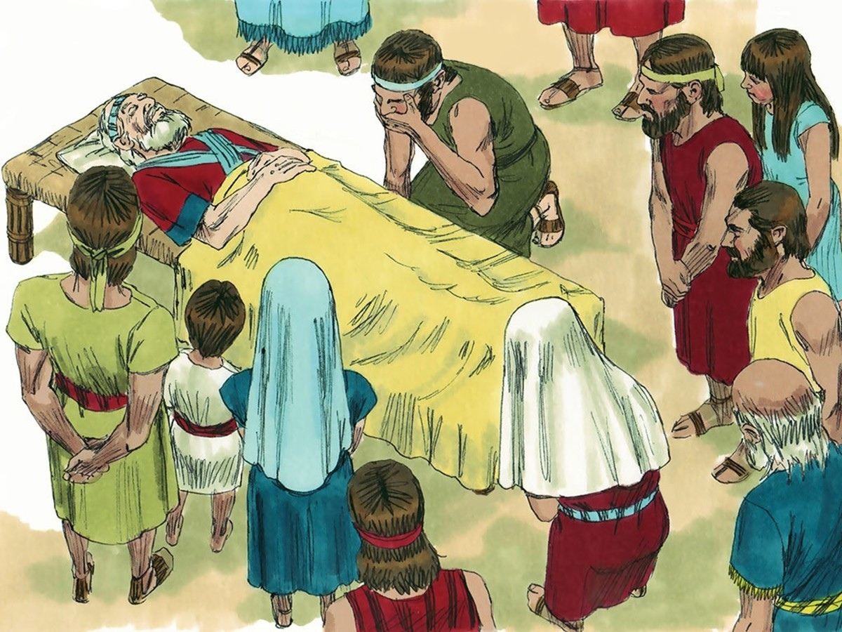
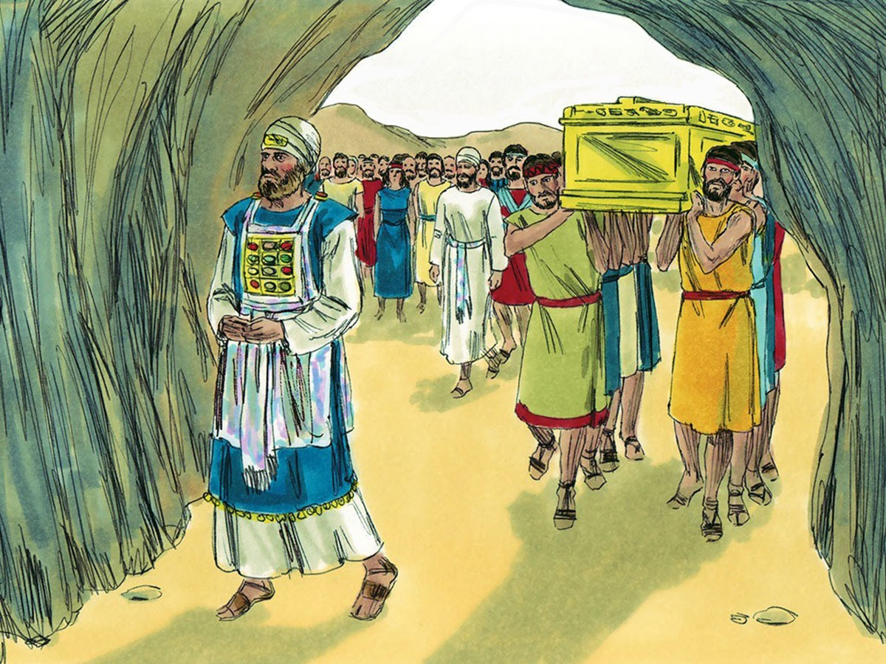
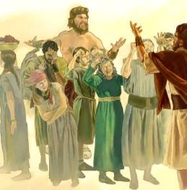
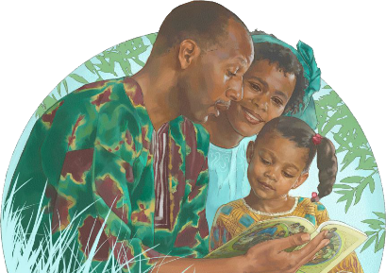
fijapd; njhlu;r;rp
“NahRth capNuhbUe;j rfy ehl;fspYk;> fh;j;jh; ,];uNtYf;Fr; nra;j mtUila fphpiafs; ahitAk; mwpe;J NahRthTf;Fg;gpd;G ntFehs; capNuhbUe;j %g;gUila rfy ehl;fspYk;> ,];uNtyh; fh;j;jiur; Nrtpj;jhh;fs;.” (NahRth 24:31)
NahRth Gj;jfk; 3 mlf;f MuhjidfSld; KbailfpwJ. mtw;wpy; xd;W, E}w;Wf;fzf;fhd Mz;LfSf;F Kd;Ng Kd;dwptpf;fg;gl;lgb, ahf;Nfhgpd; Rje;ju G+kpapy; NahNrg;gpd; mlf;fk; MFk; (Mjp. 50:24-26; NahR. 24:32).
vfpg;jpypUe;J ntspte;j me;j fyff;fhu jiyKiw tdhe;juj;jpy; Gijf;fgl;lJ. Mdhy; Gjpa jiyKiwNah> tpRthrkw;w jiyKiwapy; tpRthrj;Jld; ,Ue;j NahRth kw;Wk; vnyahrhu; MfpNahUld; Nru;e;J> jq;fs; Rje;ju Njrj;jpy; Gijf;fg;gltpUe;jJ (NahR. 24:29-30, 33).
,e;j Gjpa jiyKiw tpRthrkhf ,Ue;jJ (NahR. 24:31). Mdhy; mLj;j jiyKiwapd; epiy vd;d (NahR. 2:10-11)?
Xt;nthU jiyKiwAk; NjtNdhL jdf;nfd xU cld;gbf;ifia Vw;gLj;jpf; nfhs;s KbAk;. mtu;fspd; ngw;Nwhu; tpRthrk; rupahd Kbit vLf;f mtu;fSf;F cjtf; $Lk;. Mdhy; me;j KbT mtu;fSilaJ. ,d;W ehKk; ekJ Kbit vLg;Nghk;: “ehDk; vd; tPl;lhUNkhntd;why;> fh;j;jiuNa Nrtpg;Nghk; vd;whd;.” (NahR. 24:15).

Slide 9

“xU NghupYk; Njhw;fhj ekJ jsgjp, jk;Kila nfhbapd; fPo; mzpjpuz;l xt;nthuplkpUe;Jk; kdg;G+u;tkhd> cz;ikAs;s Nritia vjpu;ghu;f;fpwhu;. ed;ikf;fhd rf;jpfSf;Fk; jPikapd; gilfSf;Fk; ,ilNa ,g;NghJ ele;Jnfhz;bUf;Fk; ,Wjp Nghuhl;lj;jpy;> Mrhupau;fs; cl;gl midtUk; gq;Nfw;f Ntz;Lk; vd;W mtu; vjpu;ghu;f;fpwhu;. mtUila tPuu;fshfg; gjpT nra;Jnfhz;l midtUk;> jq;fs; xt;nthUtu; kPJk; Rkj;jg;gl;Ls;s nghWg;G Fwpj;j Mo;e;j czu;Tld;> ve;j Neuj;jpYk; Nritf;Fj; jahuhf ,Uf;Fk; tPuu;fis Nghy cz;ikAs;s Nritia nra;a Ntz;Lk;.”
vyd; [p citl; (nl];bnkhdp]; /ghu; j ru;r;, mjp. 9, gf;. 116)

