Slide 1
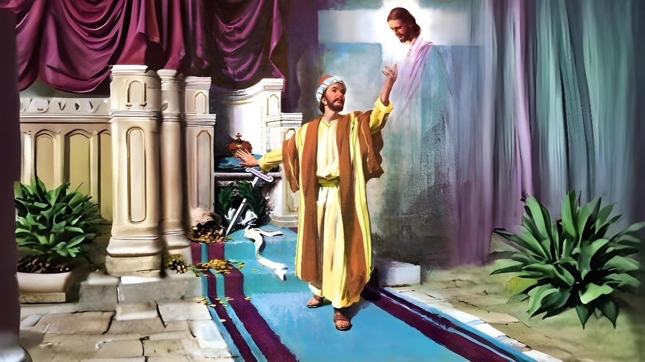
ghlk; 6 gpg;utup 7, 2026
fpwp];Jtpy; kl;LNk ek;gpf;if

Slide 2


“,g;gb ehd; mtiuAk; mtUila caph;j;njOjypd; ty;yikiaAk;> mtUila ghLfspd; If;fpaj;ijAk; mwpfpwjw;Fk;> mtUila kuzj;jpw;nfhg;ghd kuzj;jpw;Fs;shfp> vg;gbahapDk; ehd; khpj;NjhhpypUe;J capNuhnlOe;jpUg;gjw;Fj; jFjpahFk;gbf;Fk;> mtUf;fhf vy;yhtw;iwAk; e\;lnkd;W tpl;Nld;@ Fg;igAkhf vz;ZfpNwd;.”
gpypg;gpau; 3:10, 11

Slide 3










gTYk; rPyhTk; me;j efuj;jpy; Kjd;Kjypy; kjk; khwpatu;fspy; xUtUf;F(rpiwr;rhiyf;fhud;) njspthf nrhd;dJ Nghy(mg; 16:30-31), gpypg;gpau; ,ul;rpg;Gf;fhd topia mwpe;jpUe;jhu;fs; .
,g;nghOJ jpUr;rig cWjpahf epiyepWj;jg;gl;ljhy;> mtu;fs; ,ul;rpg;gpd; ghijapypUe;J topjtwp nry;Yk; mghaj;jpy; ,Ue;jdu;.
,e;j fhuzj;jpw;fhf, tpRthrj;jpdhy; ,ul;rpg;G ngWtjw;fhd mbg;gil J}z;fisg; gw;wp gTy; mtu;fSf;F epidT+l;Lfpwhu;.
cq;fs; ,ul;rpg;ig ,og;gij jtpu;g;gjw;fhd Fwpg;Gfs;:
vij jtpu;f;f Ntz;Lk; (gpypg;gpau; 3:1-3)
vJ kPjkhf cs;sJ (gpypg;gpau; 3:4-6)
Kf;fpakhd tp\ak; (gpypg;gpau; 3:7-8)
,ul;rpg;gpy; epiyj;jpUg;gjw;fhd Fwpg;Gfs;:
fpwp];Jitg; gw;Wk; tpRthrk; (gpypg;gpau; 3:9)
fpwp];Jit mwpfpw mwpT (gpypg;gpau; 3:10-16)

Slide 4

cq;fs; ,ul;rpg;ig ,og;gij jtpu;g;gjw;fhd Fwpg;Gfs;

Slide 5

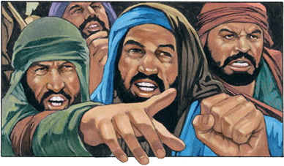

vij jtpu;g;gJ
“eha;fSf;F vr;rhpf;ifahapUq;fs;> nghy;yhj Ntiyahl;fSf;F vr;rhpf;ifahapUq;fs;> Rd;dj;Jf;fhuUf;F vr;rhpf;ifahapUq;fs;.” (gpypg;gpau; 3:2)
tpRthrj;jpw;F mr;RWj;jyhf ,Uf;Fk; Mgj;Jf;fis gw;wp tpthjpg;gjw;F Kd;> gTy; ekf;F rpy mwpTiufis toq;Ffpwhu;: “fh;j;jUf;Fs; re;Njh\g;gLq;fs;” (gpypg;. 3:1K). ,jw;F mtu; Kf;fpakhd xd;iw Nru;f;fpwhu;: ehk; Vw;fdNt ed;F mwpe;jpUe;jhYk;> ek;kplk; cs;s cz;ikia kPz;Lk; nrhy;tJ ey;yJ (gpypg;. 3:1gp).
NjtDila fpUigia ngWjy; (rq; 31:7)
mtu; kPJ ek; ek;gpf;if itg;gJ (rq; 5:11)
,ul;rpg;gpd; MrPu;thjq;fis ngWjy; (rq; 9:14)
NjtDila fw;gidfis ifnfhs;Sjy; (rq; 119:14; Vrh 58:13, 14)
mtUila thu;j;ijfis ek;Gjy; (rq; 119:162)
gps;isfis NjtDf;Fs;shf tsu;j;jy; (ePjp. 23:24, 25)
ehk; vt;thW fu;j;jUf;Fs; re;Njh\khapUf;f KbAk;?
mf;fhyj;jpy; jpUr;rigia mr;RWj;jpa kpfg;ngupa Mgj;ij gTy; Rl;bf;fhl;Lfpwhu;: rlq;fhr;rhu gpukhzj;ij fz;bg;ghf filg;gpbg;gij fw;gpj;j jtwhd Mrpupau;fs; (gpypg;. 3:2). mtu; ,tu;fis %d;W jdpj;Jtkhd topfspy; Fwpg;gpLfpwhu;: eha;fs; (rq;. 22:16; 2 NgJ. 2:21-22); nghy;yhj Ntiyahl;fs;; Rd;dj;Jf;fhuu; (tpUj;jNrjdf;fhuu;).

Slide 6

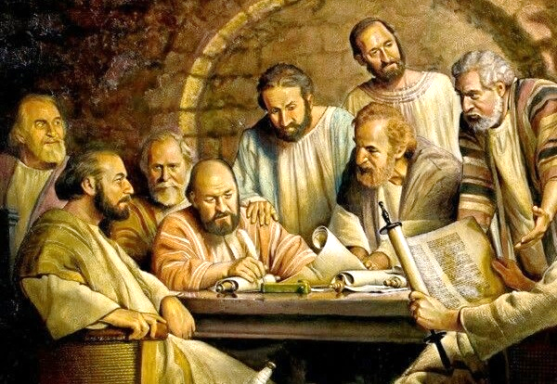
vJ kPjkhf cs;sJ
“ehd; vl;lhk; ehspNy tpUj;jNrjdkile;jtd;> ,];uNty; tk;rj;jhd;> ngd;akPd; Nfhj;jpuj;jhd;> vgpnuahpy; gpwe;j vgpnuad;> epahag;gpukhzj;jpd;gb ghpNrad;@” (gpypg;gpau; 3:5)
vUrNyk; rq;fj;jpy;, A+j rlq;fhr;rhu tp\aq;fspy; Gw[hjpapdu; njhe;juT nra;af;$lhJ vd;W fl;lisaplg;gl;bUe;jJ (mg; 15:19-21). vd;whYk;, rpy Nghjfu;fs; gpypg;gpapy; tpUj;jNrjdj;jpd; mtrpaj;ij Nghjpf;f te;jhu;fs; (gpypg;. 3:2-3).
fhyj;jpw;F gpd;Ndhf;fp nrd;W, gTy; me;j Mrpupau;fisg; Nghy ,Ue;jNghJ vt;tsT gupG+uzkhf ,Ue;jhu; vd;gij mtu;fSf;F epidT+l;Lfpwhu; (gpypg;. 3:4-6):
vl;lhk; ehspy; tpUj;j Nrjdk; gz;zg;gl;lhu;; mw;gzpg;Gs;s ngw;Nwhupd; kfd;
vgpNuau;fSf;F vgpNuad;; ngd;akPd Nfhj;jpuj;jhd;
epahag;gpukhzj;jpd;gb ghpNrad;@
gf;jpituhf;fpaj;jpd;gb rigiaj; Jd;gg;gLj;jpdtd;>
epahag;gpukhzj;jpw;Fhpa ePjpapd;gb Fw;wQ;rhl;lg;glhjtd;.
Mdhy; mtu; ,NaRit mwptjw;F Kd;Ng mtu; ,ijnay;yhk; gw;wp ngUikahf Ngrpdhu;. ,g;NghJ mtUf;F rl;lk; Gupatpy;iy vd;gJ njspthf njupfpwJ (kj;. 5:21-22). ,g;NghJ fpwp];J kl;LNk ,ul;rpg;G vd;gij mtu; mwpe;jpUe;jhu; (gpypg;. 3:7).

Slide 7

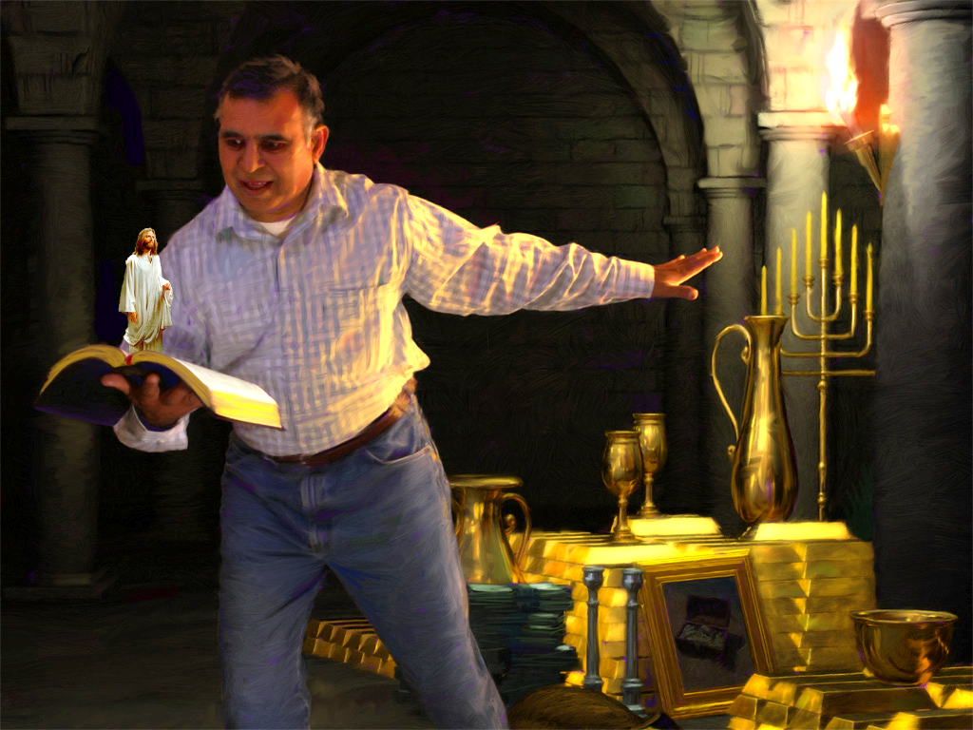



Kf;fpakhd tp\ak;
“MfpYk;> vdf;F yhgkhapUe;jitfnsitfNsh mitfisf; fpwp];JTf;fhf e\;lnkd;W vz;zpNdd;.” (gpypg;gpau; 3:7)
gTy; jdJ Ke;ija tho;f;ifia jw;Nghija tho;f;ifAld; xg;gpLfpwhu;. xUGwk;, mtu; jdJ vy;yh mwpitAk;; fkhypNaypd; el;rj;jpu khztuhf jdJ kfpikahd vjpu;fhyj;ijAk;; mtuJ mw;Gjkhd gupNra gupRfisAk; itf;fpwhu;. midj;Jk; Mjhak;.
,g;NghJ, fpwp];Jit re;jpj;jjpypUe;J mtuJ tho;f;ifia juhrpd; kWgf;fj;jpy; itf;fpwhu;. midj;J Mjhaq;fSk; Fg;igahfptpLfpwJ> Vndd;why; fpwp];Jtpd; md;NghL vijAk; xg;gpl KbahJ (gpypg;. 3:7-8).
guNyhfj;jpYk; Gjpa G+kpapYk; epj;jpa [Ptid tpl kjpg;Gkpf;fJ vJthf ,Uf;f KbAk;? ,Ug;gpDk;, cyf tpOkpaq;fs; ,e;j ajhu;j;jjpw;F gyiu FUlhf;Ffpd;wd. ,q;F Kf;fpakhdjhf fUjg;gLk; tp\aq;fSf;Fk; guNyhfk; cz;ikapNyNa kjpf;Fk; tp\aq;Sf;Fk; ,ilNa xU ,ay;ghd Nghl;b cs;sJ: fpwp];Jit Nghd;w Fzk; kw;Wk; Md;khtpd; ,ul;rpg;G.

Slide 8

,ul;rpg;gpy; epiyj;;jpUg;gjw;fhd Fwpg;Gfs;

Slide 9



fpwp];Jitg; gw;Wk; tpRthrk;
“ehd; fpwp];Jit Mjhag;gLj;jpf;nfhs;Sk;gbf;Fk;> epahag;gpukhzj;jpdhy; tUfpw RaePjpia cilatdhapuhky;> fpwp];Jitg; gw;Wk; tpRthrj;jpdhy; tUfpwJk; tpRthr%ykha;j; Njtdhy; cz;lhapUf;fpwJkhd ePjpia cilatdhapUe;J> fpwp];JTf;Fs; ,Uf;fpwtndd;W fhzg;gLk;gbf;Fk;>” (gpypg;gpau; 3:9)
gTy;, jdJ nrhe;j ePjpapy; ek;gpf;if nfhz;L, “top” gpuptpd; kjntwpau;fis ,ul;rpg;gpd; ghijf;F kPz;Lk; nfhz;L tu jk];FTf;F nrd;whu; (mg; 9:1-2). Mdhy; mtu; kw;nwhU ePjpahy;> mjhtJ NjtDila ePjpahy; Njhw;fbf;ff;fl;L jk];FTf;Fs; Eioe;jhu;: “fpwp];Jitg; gw;Wk; tpRthrj;jpdhy; tUfpwJ” (gpypg;gpau; 3:9).
me;j jUzj;jpypUe;J, mtu; kPz;Lk; xUNghJk; jdJ nrhe;j ePjpia ek;gtpy;iy. Vndd;why;> ,ul;rpg;ig mila ek; nray;fis ek;GtJ gadw;wJ (fyh. 2:16).
mtu; “fpwp];Jtpy;” fhzg;gl “tpUk;gpdhu;” (gpypg;. 3:9). ,J vijf; Fwpf;fpwJ?
1 nfhupe;jpau; 1:30d; gb, “fpwp];Jtpy;” ,Ug;gJ ekJ Md;kPf Ez;zwptpd;(Qhdj;jpd;) tpbaypy; ,Ue;J, tpRthrj;jhy; ePjpkhdhf;fg;gLjy; (ePjp), kw;Wk; guNyhfj;jpw;F Maj;jkhFjy; (gupRj;jg;gLjJjy;) %yk;, ,Wjpahf, ,uz;lhk; tUifapy; kfpikg;gLj;jg;gLjy; (kPl;G) tiu ,ul;rpg;gpd; jpl;lj;jpd; midj;ijAk; cs;slf;fpaJ.

Slide 10

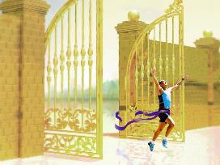





fpw];Jit mwpfpw mwpT
“,g;gb ehd; mtiuAk; mtUila caph;j;njOjypd; ty;yikiaAk;> mtUila ghLfspd; If;fpaj;ijAk; mwpfpwjw;Fk;> mtUila kuzj;jpw;nfhg;ghd kuzj;jpw;Fs;shfp> vg;gbahapDk; ehd; khpj;NjhhpypUe;J capNuhnlOe;jpUg;gjw;Fj; jFjpahFk;gbf;Fk;>” (gpypg;gpau; 3:10)
fpwp];Jit ehk; vg;gb mwpe;Jnfhs;tJ(gpypg;. 3:10-16)?
mtu; thu;j;ijia ehk; gbf;Fk;NghJ
gupRj;j Mtpahy; ehk; elj;jg;gLk;NghJ
mtUila ghLfspy; ehk; gq;F nfhs;Sk;NghJ
ehk; ,yf;if Nehf;fp nry;Yk;NghJ
fpwp];jt tho;f;if xU xl;l ge;jak; Nghd;wJ. ek; ,yf;if ehk; njspthf kdjpy; nfhs;s Ntz;Lk;. ehk; ,q;NfNa jq;fp ,e;j tho;f;ifia mDgtpg;gjw;fhf kl;Lk; thotpy;iy. ,we;jtu;fspd; capu;njOjiy milthu;fs; vd;W ehk; ek;GfpNwhk; (gpypg;. 3:11).
me;j jUzk; tUk;tiu, ehk; “fpwp];J ,NaRtpdhy; ehd; vjw;fhfg; gpbf;fg;gl;NlNdh mij ehk; gpbj;Jf;nfhs;Sk;gb”(gpypg;. 3:12) NghuhLfpNwhk;. ,NaR vdf;F xU efuj;ij; xU gupir; mtUld; tho xU Kbtw;w tho;f;ifia nfhLf;f vd;id mile;jhu; (vgp. 11:10; gpypg;. 3:14; 1njr. 4:17).

