Slide 1
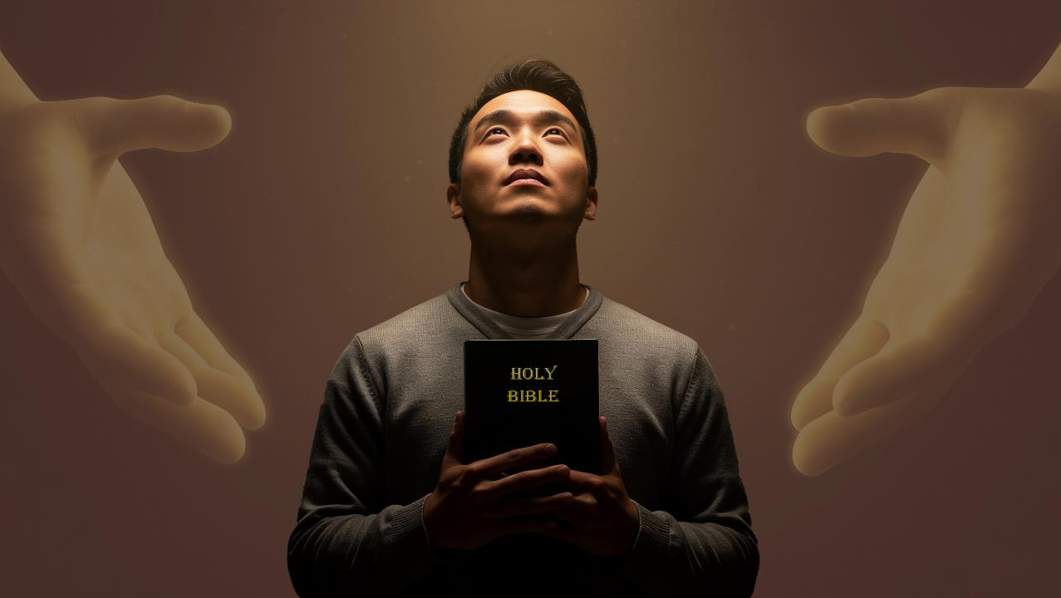
Xg;GuthFjYk; ek;gpf;ifAk;
ghlk; 9 gpg;utup 28, 2026

Slide 2


2 nfhupe;jpau; 5:21
“ehk; mtUf;Fs; NjtDila ePjpahFk;gbf;F> ghtk; mwpahj mtiu ekf;fhfg; ghtkhf;fpdhh;.”

Slide 3



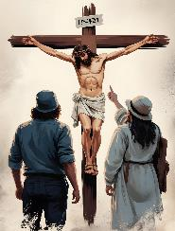
fpwp];Jtpd; rpYit thdj;ijAk; G+kpiaAk; xg;Guthf;fpaJ vd;W $wpag;gpd; (nfhNyh. 1:20), ,e;j xg;Guthf;Fjypd; eilKiw tpsf;fq;fis gTy; njhlu;e;J tpsf;Ffpwhu;.
,J vt;thW ek;ik khw;wpAs;sJ? Njtd; ,ijnay;yhk; vt;thW Kd;dwptpj;jhu;? kw;wtu;fs; ,e;j xg;Guthf;Fjypy; gq;F nfhs;sTk; ek;gpf;ifiag; ngwTk; ehk; vd;d nra;a KbAk;?
RtpNr\j;jpd; %ykhf xg;GuthFjYk; ek;gpf;ifAk;
Xg;Guthf;Fjypd; tpisTfs;
ghtpfspypUe;J gupRj;ju;fSf;F(nfhNyh. 1:21-22)
Nt&d;wp epiyj;jpUj;jy; (nfhNyh. 1:23)
ek;gpf;if
ek;gpf;ifia nfhz;L tUjy; (nfhNyh.1:24-25)
NjtDila ,ufrpak; (nfhNyh. 1:26-27)
RtpNr\j;jpd; ty;yik
RtpNr\j;ij mwptpj;jy; (nfhNyh. 1:28-29)

Slide 4

Xg;Guthf;Fjypd; tpisTfs;

Slide 5

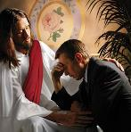
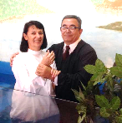
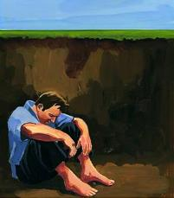
ghtpfspypUe;J gupRj;ju;fSf;F
“Kd;Nd me;epauhAk; Jh;f;fphpiafspdhy; kdjpNy rj;JUf;fshAk; ,Ue;j cq;fisAk; ghpRj;juhfTk; Fw;wkw;wth;fshfTk; fz;bf;fg;glhjth;fshfTk; jkf;F Kd; epWj;Jk;gbahf mtUila khk;r rhPuj;jpy; mile;j kuzj;jpdhNy ,g;nghOJ xg;Guthf;fpdhh;. ePq;fs; Nfl;l RtpNr\j;jpdhy; cz;lhFk; ek;gpf;ifiatpl;L mirahky;> ];jpukhAk; cWjpahAk; tpRthrj;jpNy epiyj;jpUg;gPh;fshdhy; mg;gbahFk;.” (nfhNyhnrau; 1:21-22)
gpur;rid vspJ. ehk; jPik nra;J tho;e;Njhk;, vdNt, ehk; epj;jpa kuzj;jpw;F MshNdhk;(Nuh. 6:23; ntsp. 21:8).
ek;Kila ghtj;jpw;fhd tpiyia nrYj;j mtu; rpYitapy; kupj;jhu; (Nuh. 5:8)
tpRthrk;> kde;jpUk;Gjy; kw;Wk; Qhd];ehdk; %yk;> ehk; ekJ ghtj;jpypUe;J tpLtpf;fg;gl;L> NjtDf;F Kd;ghf fiwaw;wtu;fshfTk;> Fw;wkw;wtu;fshfTk; ,Uf;fpNwhk; [ePjpkhdhf;fg;gLjy;] (Nuh. 5:10; nfhNyh. 1:22)
gupRj;j Mtpahdtupd; fpupiaapd; %yk; ekJ tho;f;if gbg;gbahf khw;wkile;J> ehk; NjtDf;F Kd;ghf gupRj;jkhfpNwhk; [gupRj;jkhf;fg;gLjy;] (Nuh. 8:1; 2 nfhup. 5:17)
,e;j R+o;epiyia khw;wNth ekJ ,ul;rpg;Gf;F gzk; nrYj;jNth ek;khy; ,ayhJ (rq;fPjk; 49:7-8).
Mdhy; Njtd; ekf;fhf xU ngupa jpl;lj;ij jahupj;jpUe;jhu;:

Slide 6


Nt&d;wp epiyj;jpUj;jy;
“ePq;fs; Nfl;l RtpNr\j;jpdhy; cz;lhFk; ek;gpf;ifiatpl;L mirahky;> ];jpukhAk; cWjpahAk; tpRthrj;jpNy epiyj;jpUg;gPh;fshdhy; mg;gbahFk;.” (nfhNyhnrau; 1:22)
ehk; Vw;fdNt ePjpkhd;fshf;fg;gl;Ltpl;Nlhk;, gupRj;jkhf;fg;gl;L tUfpNwhk;, Mdhy; me;j gazk; ,d;Dk; Kbtilatpy;iy. ehk; topjtwp ,yf;if milahky; NghFk; mghak; cs;sJ. mjdhy;jhd; gTy; %d;W tp\aq;fis ekf;F mwpTWj;Jfpwhu; (nfhNyh. 1:23K):
tpRthrj;jpy; njhlUq;fs;
rpiwapypUe;J tpLjiyahd gpwF> fjT jpwf;Fk;tiu jl;ba NgJUitg; Nghy> tplhKaw;rpAld; ,Uq;fs; (mg; 12:11-16)
Nt&d;Wjy;
Ntjj;jpy; ehk; fw;Wf;nfhz;l rj;jpaq;fis mbg;gilahff; nfhz;L> ek; tpRthrk; cWjpahf ,Uf;f Ntz;Lk;
epiyj;jpUj;jy;
ehk; mirf;f Kbahjtu;fshfTk;> “RtpNr\j;jpd; ek;gpf;ifapy;” ek;gpf;if itg;gij epWj;jhjtu;fshfTk; ,Uf;f Ntz;Lk;.

Slide 7

ek;gpf;if

Slide 8

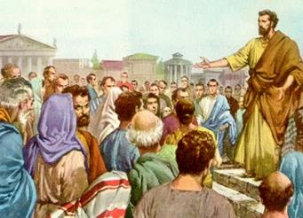
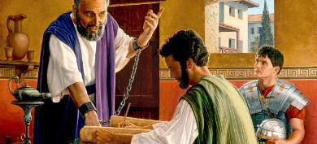
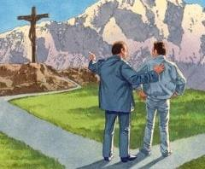
ek;gpf;ifia nfhz;L tUjy;
“cq;fs;nghUl;Lj; Njtdhy; vdf;F mspf;fg;gl;l cj;jpNahfj;jpd;gbNa ehd; me;jr; rigf;F Copaf;fhudhNdd;.” (nfhNyhnrau; 1:26)
ehk; ghu;j;jg;gb, ekJ ,ul;rpg;Gfhd NjtDila jpl;lk; ,NaRtpd; kuzj;ij mbg;gilahf nfhz;lJ> NkYk; mJ ePjpkhdhf;fg;gLjy; kw;Wk; gupRj;jkhf;fg;gLjiy cs;slf;fpaJ. Mdhy; Kf;fpakhd xd;W fhzhky; NghdJ: vg;gbahtJ, ,e;j jpl;lj;ij Vw;Wf;nfhs;s ehk; mij mwpe;J nfhs;s Ntz;Lk;. mij gad;gLj;j ahuhtJ mij ntspg;gLj;j Ntz;Lk;.
,q;F jhd; “NjtDila epu;thfk;” [R+o;epiyfs;> vz;zq;fs;, kf;fs; Nghd;wtw;iw xOq;Fg;gLj;Jk; NjtDila top] tUfpwJ> mjpy; gTy; xU Copauhf ,Ue;jhu; (nfhNyh. 1:25).
,e;j jpl;lj;jpy; Jd;gq;fs; ,Ue;jNghjpYk;, gTy; mjpy; xU gFjpahf ,Ug;gjpy; kfpo;r;rp mile;jhu;(nfhNyh. 1:24). Nuhkpy; ifJ nra;ag;gl;ljpypUe;J kupf;Fk;tiu, Gjpa Vw;ghl;by; ghJfhf;fg;gl;Ls;s gjpdhd;F epUgq;fspy; Fiwe;jJ VO epUgq;fis mtu; vOjpdhu;.
NjtDila jpl;lj;jpd; xU Kf;fpa gFjpahf gTy; ,Ue;jhu;> gTy;; mjpy; kfpo;r;rpaile;jhu;. fpwp];JT mwpTf;F kw;wtu;fis topelj;Jtjd; %yk; ehKk; ,e;j jpl;lj;jpd; xU gFjpahf ,Uf;f KbAk;. mJjhd; vq;fs; kfpo;r;rp!

Slide 9

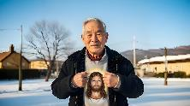
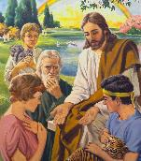

NjtDila ,ufrpak;
“Mjpfhyq;fSf;Fk; jiyKiw jiyKiwfSf;Fk; kiwthapUe;J> ,g;nghOJ mtUila ghpRj;jthd;fSf;F ntspahf;fg;gl;l ,ufrpakhfpa Njttrdj;ijg; g+uzkha;j; njhpag;gLj;Jfpwjw;F>” (nfhNyhnrau; 1:25)
fpwp];Jtpd; capu;j;njOjYf;Fg;gpd; jpUr;rigf;F ntspg;gLj;jg;gl;l xU ,ufrpaj;ijg; gw;wp gTy; NgRfpwhu;(nfhNyh. 1:26). mJtiu, mjd; rpy Jspfs; kl;LNk ,Ue;jd. Mdhy; me;j ,ufrpak; jhd; vd;d? “fpwp];Jthdth; kfpikapd; ek;gpf;ifahf cq;fSf;Fs; ,Ug;gNj me;j ,ufrpak;.” (nfhNyh. 1:27).
,J cyfk; Njhd;Wtjw;F Kd;Ng cUthf;fg;gl;lJ(1 NgJU 1:20)
,J NjtJ}ju;fSf;F xusTf;F njuptpf;fg;gl;lJ (1 Peter 1:12)
Mjhk; kw;Wk; Vths; gw;wpa Kjy; ghu;it toq;fg;gl;lJ(Mjp. 3:15)
,J jPu;f;fjuprpfSf;Fk; ntspg;gLj;jg;gl;lJ (1 NgJU 1:10-11)
,NaR Kjypy; A+ju;fSf;F ntspg;gLj;jpdhu;(kj;. 15:24)
gpd;du;> ,J vy;yh kdpju;fSf;Fk; Koikahf ntspg;gLj;jg;gl;lJ(nfhNyh. 1:27)
,e;j ,ufrpaj;jpy; ,d;Dk; gy fl;lq;fs; ntspg;gl cs;sd. ,g;NghJ ehk; kfpikg;gLj;jg;gLNthk; vd;w ek;gpf;ifapy; tho;fpNwhk;. vd;d xU khw;wk;! vd;d xU ,ufrpak;! ghtKs;s kf;fs; ,NaRtpd; kPl;gpd; ,uj;jj;jhy; ePjpkhd;fshf;fg;gl;L> gupRj;jkhf;fg;gl;L> kfpikg;gLj;jg;gLfpwhu;fs;. ,e;j ,ufrpak; epj;jpaj;jpw;Fk; xU Ma;Tg;nghUshfj; njhlUk;.

Slide 10

RtpNr\j;jpd; ty;yik

Slide 11

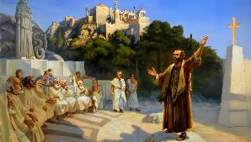
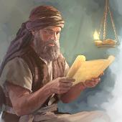
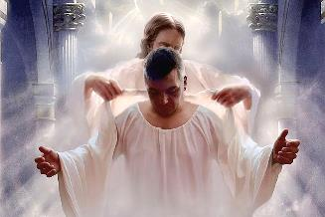
RtpNr\j;jpd; ty;yik
“ve;j kD\idAk; fpwp];J ,NaRTf;Fs; Njwpdtdhf epwj;Jk;gbf;F> mtiuNa ehq;fs; mwptpj;J> ve;j kD\Df;Fk; Gj;jpnrhy;yp> ve;j kD\Df;Fk; vy;yh Qhdj;NjhLk; cgNjrk;gz;ZfpNwhk;.” (nfhNyhnrau; 1:28)
gTy; vg;gb RtpNr\j;ij gpurq;fpj;jhu;? mtUila gpurq;fj;jpd; ikag;gFjp rpYitapy; miwag;gl;l fpwp];JthFk; (1 nfhupe;jpau; 1:23). kf;fs; ,NaRit Vw;Wf;nfhz;lg; gpd;, mtu;fs; gupG+uzkhFk; tiu mtu; mtu;fSf;F mwpTiu $wp fw;gpj;jhu; (nfhNyhnrau; 1:28-29). ,ij mtu; vg;gb nra;jhu;?
mtu; mtu;fSf;F fpwp];jt Nfhl;ghL kw;Wk; eilKiwia tpsf;fpdhu; (2 njr 2:15)
RtpNr\j;ij epuhfupg;gjhy; Vw;gLk; tpisTfis Fwpj;J mtu; mtu;fis vr;rupj;Js;shu; (vgp. 10:25-29)
fs;sg;Nghjfu;fspd; Mgj;Jf;fisf; gw;wp mtu; mtu;fis vr;rupj;jhu; (mg; 20:29-30)
xU epkp\k;… mtu;fis rupahdtu;fshf;fth? xU rpyiu kl;Lk; ,y;y… “xt;nthU kdpjidAk;”!(nfhNyh. 1:28gp).
“Kjpu;r;rpaile;j” (nlypNah];) vd;w fpNuf;f thu;j;ijapd; mu;j;jk; gupG+uzkhdJ kw;Wk; FiwghL ,y;yhjJ. fpwp];jt tsu;r;rpapd; nray;Kiw %yk;, NjtDila epahag;gpukhzj;jpd; Moj;ijAk; mjd; NjitfisAk; ehk; $u;ikahf mwpe;Jnfhs;fpNwhk;. Mifahy;, ekJ ,yf;F, fpwp];J ,NaRtpy; gupG+uzkhf ,Ug;gNjahFk;.

Slide 12

“rpYitapy; miwag;gl;l kPl;giu ghu;f;Fk;NghJ, guNyhf khl;rpikahy; nra;ag;gl;l jpahfj;jpd; msitAk; mu;j;jj;ijAk; ehk; KOikahf Gupe;Jnfhs;fpNwhk;. ,ul;rpg;gpd; jpl;lk; ekf;F Kd;ghf kfpikg;gLj;jg;gLfpwJ, NkYk; fy;thup gw;wpa rpe;jid ek; ,Ujaq;fspy; capUs;s kw;Wk; gupRj;jkhd czu;r;rpfis vOg;GfpwJ. NjtDf;Fk; Ml;Lf;Fl;bahdtUf;Fkhd Jjp ek; ,jaq;fspYk; cjLfspYk; ,Uf;Fk;; Vndd;why; fy;thupf; fhl;rpfis epidtpy; itj;jpUf;Fk; Md;khtpy; ngUikAk; Ra topghLk; nropf;f KbahJ.”
vyd; [p citl; (Afq;fspd; thQ;ir, gf;. 661)

