Slide 1

Njtid mwpe;Jnfhs;tjw;F
ghlk; 2 Vg;uy; 11, 2026

Slide 2
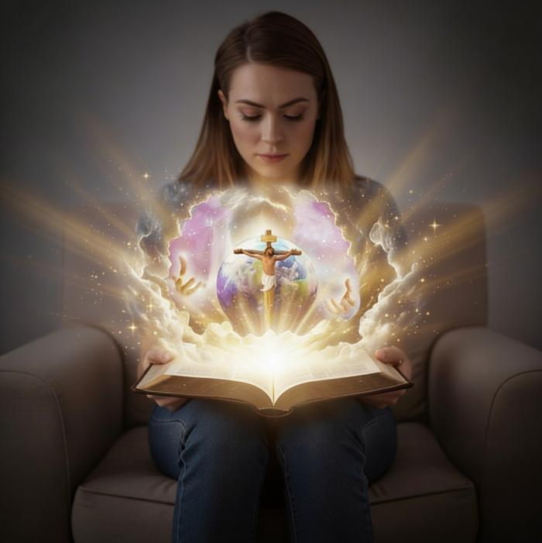
“xd;;whd nka;j;Njtdhfpa ck;ikAk; ePh; mDg;gpdtuhfpa ,NaR fpwp];JitAk; mwptNj epj;jpa[Ptd;.”
(Nahthd; 17:3)

Slide 3

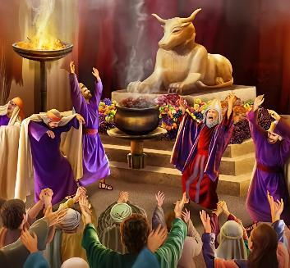

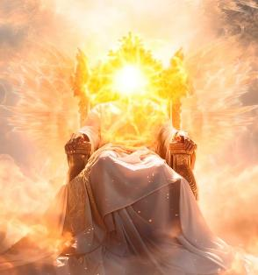

Njtidg; gw;wpa ekJ Gupjy; ghtj;jhy; rpijf;fg;gl;Ls;sJ. tpyq;Ffs; my;yJ kdpju;fs; Nghd;w cUtq;fspy; mtiu rpj;jupf;f ehk; Kad;wpUf;fpNwhk;. mtu; kdk; Nghd Nghf;fpy; nray;gLgtuhfNth my;yJ nfhLq;NfhyuhfNth rpj;jupf;fg;gl;Ls;shu;. ,Wjpapy;, kdpjFyk; NjtDila xU gpk;gj;ij jd; rhaypy; cUthf;fpAs;sJ.
Mdhy; Njtd; cz;ikapy; vg;gbg;gl;ltu;? mtiu Gupe;Jnfhs;tJ ek;Kila mwpTf;F vl;lhj msTf;F mtu; mt;tsT ngupatuh? epr;rakhf, ehk; vt;tsT Kad;whYk;, ek; kdjhy; Njtid Gupe;J nfhs;s KbahJ. ekf;F cjtp Njit.
Mdhy; cjtp te;Jtpl;lJ. mtu; vg;gbgl;ltu; vd;W ePq;fs; mwpa tpUk;GfpwPu;fsh? Ntjhfkj;jpy;, NjtDila ,ay;ig gw;wpa cz;ikahd ntspg;ghL ekf;F fpilf;fpwJ.
NjtDila gz;Gfs;
NjtDila Fzk;:
Njtd; gupRj;ju;
Njtd; md;ghdtu;
Njtid mwpjy;:
rpU\;bg;gpy; ntspg;gl;l Njtd;
Njtd; ,NaRtpy; ntspg;gl;lhu; (,k;khDNty;)

Slide 4


NjtDila gz;Gfs;

Slide 5


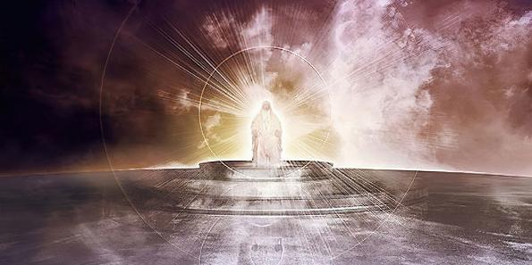

“Nridfspd; Njtdhfpa fh;j;jhNt> ck;ikg;Nghy; ty;yikAs;s fh;j;jh; ahh;? ck;Kila cz;ik ck;ikr; #o;e;jpUf;fpwJ.” (rq;fPjk; 89:8)
NjtDila gz;Gfs;
Ntjhfkk; Njtidg; gw;wpa kpfTk; cz;ikahd> njspthd kw;Wk; rPuhd rpj;jpuj;ij mspf;fpwJ. mtUila gz;Gfspd; %ykhfNt ehk; mtiu mwpe;J nfhs;s mJ mDkjpf;fpwJ.
NjtDila rpy gz;Gfs;
ePjpAs;stu; (rq;fPjk; 11:7)
,uf;fKs;stu; (cghfkk; 4:31)
nghWikAs;stu; kw;Wk; MWjypd; Njtd; (Nuhku; 15:6)
fpUig mspg;gtu; (Nuhku; 3:24)
kd;dpf;fpwtu; (rq;fPjk; 86:5)
,uh[h (rq;fPjk; 47:7)
epj;jpakhdtu; (Mjpahfkk; 21:33)
rh;tty;yikAs;s Njtd; (Mjp 17:1)
rfyj;ijAk; mwpe;jtu; (1 Nahthd; 3:20)
vjpu;fhyk; mwpe;jtu; (Vrhah 46:10)
jd; gq;fpw;F, rhj;jhDk; Muk;gj;jpypUe;Nj NjtDila jd;ikia jpupj;J, mtu; jd; nrhe;j eyid kl;LNk ehLk;, xU RaeyKs;stu; vd;W fhl;l Kad;W tUfpwhd; (Mjp. 3:4-5).

Slide 6

NjtDila Fzk;

Slide 7

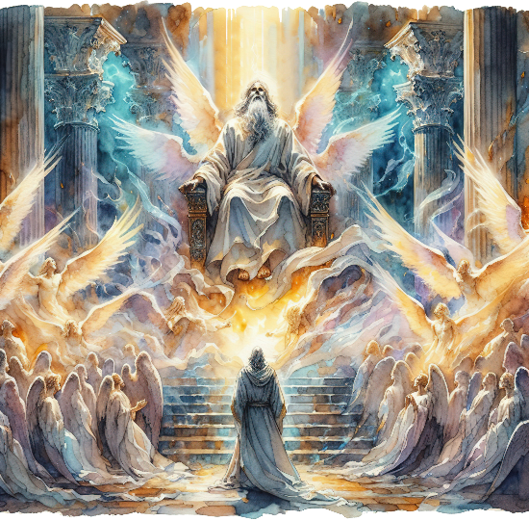
“xUtiunahUth; Nehf;fp: Nridfspd; fh;j;jh; ghpRj;jh;> ghpRj;jh;> ghpRj;jh;> g+kpaidj;Jk; mtUila kfpikahy; epiwe;jpUf;fpwJ vd;W $g;gpl;Lr; nrhd;dhh;fs;.” (Vrhah 6:3)
Njtd; gupRj;ju;
NjtDf;F mUfpy; epw;ff;$ba NjtJ}ju;fs; mtiu> “ghpRj;jh;> ghpRj;jh;> ghpRj;jh;” (Vrh. 6:3; ntsp. 4:8) vd;W Jjpj;jhu;fs;. ,e;j gz;G mtUila Fzhjpraj;Jld; kpfTk; cs;shu;e;j Kiwapy; ,izf;fg;gl;Ls;sJ. Vrhah mij NjtDila ehkkhf gad;gLj;Jfpwhu;: “vd;W ghpRj;jh; nrhy;Yfpwhh;”. (Vrh. 40:25; 57:15).
gupRj;jkhf ,Ug;gjd; mu;j;jk; vd;d? ,J GdpjgLj;jg;gl;l> xJf;fgl;l> J}a;ikg;gLj;jgl;l vd;W nghUs;. jPikapypUe;J tpyfp> Njtd; ekf;F xg;gilj;j Ntiyia nra;Ak; NghJ ehk; gupRj;jkhf ,Uf;fpNwhk;. (vz;. 15:40; Nytp. 11:44; 1 NgJ. 2:9).
Mdhy; ,J NjtDf;F vt;thW nghUe;Jk;? mtu; jPikapypUe;J Kw;wpYk; NtWg;gl;ltu; kw;Wk; ghtj;Jld; vt;tpj njhlu;Gk; ,y;iy.
,jd; nghUs;, mtu; gupRj;juhf ,Ug;gjhy;> mtUila md;G gupRj;jkhdJ> J}a;ikahdJ kw;Wk; Raeyk; ,y;yhjJ. mtu; gupRj;juhf ,Ug;gjhy;> mtUila ru;t ty;yik gupRj;jkhdJ> J}a;ikahdJ> Raeyk; ,y;yhjJ. mtUila midj;J gz;GfSk; gupRj;jk; kw;Wk; J}a;ikahy; epug;gl;Ls;sd.

Slide 8


Njtd; md;ghdtu;
“Njtd; ek;Nky; itj;jpUf;fpw md;ig ehk; mwpe;J tpRthrpj;jpUf;fpNwhk;. Njtd; md;ghfNt ,Uf;fpwhh;@ md;gpy; epiyj;jpUf;fpwtd; Njtdpy; epiyj;jpUf;fpwhd;> NjtDk; mtdpy; epiyj;jpUf;fpwhh;.” (1 Nahthd; 4:16)
Njtd; md;ig nfhz;bUg;gJ klLkpy;yhky;> md;ig mUs;gtUk; Mthu; (mtu; ,t;tpuz;ilAk; nra;fpwhu;), Mdhy; NjtNd md;ghf ,Uf;fpwhu;” (1 Nahthd; 4:8, 16). gupRj;jj;ij Nghy, md;Gk; ,iwj;jd;ikapd; xU cs;shu;e;j gFjpahFk;.
md;gpdpkpj;jk;, mtu; kDf;Fyj;ij MZk; ngz;Zkhf rpU\;bj;jhu;: NkYk;> xUtiunahUtu; Nerpf;FkhW mtu;fSf;F “fl;lisapl;lhu;” (Mjp. 2:24)
md;gpdpkpj;jk;, MjhKk; VthSk; ghtk; nra;j NghJ, mtu; mtu;fis Njbr; nrd;W mtu;fSf;F ek;gpf;if mspj;jhu; (Mjp. 3:9, 15)
md;gpdpkpj;jk;, mtu; MgpufhNkhL cld;gbf;if nra;J> kdpj Fyj;ijNa MrPu;tjpg;ghjhf thf;fUspdhu;(Mjp. 26:4)
md;gpdpkpj;jk;, mtu; jd; xNu Ngwhd Fkhudhfpa –,NaR fpwp];Jit– ek;Kila ghtq;fspdpkpj;jk; kupg;gjw;F xg;Gf;nfhLj;jhu;(Nahthd; 3:16)
mtUila md;gpw;F ehd; vt;thW gjpy; nra;tJ?
“mth; Ke;jp ek;kplj;jpy; md;G $h;e;jgbahy; ehKk; mthplj;jpy; md;G$UfpNwhk;.” (1 Nahthd; 4:19).
Notes:
SmartArt with large images (the four “for love”)

Slide 9

Njtid mwpjy;

Slide 10



rpU\;bg;gpy; ntspg;gLj;jg;gl;l Njtd;
“thdq;fs; NjtDila kfpikia ntspg;gLj;JfpwJ> MfhatphpT mtUila fuq;fspd; fphpiaia mwptpf;fpwJ.” (rq;fpjk; 19:1)
Ntjhfkk; Njtid אֱלֹהִ֑ים (VNyhfPk;) vd;W Fwpg;gpLtjd; %yk; njhlq;FfpwJ. ,e;j thu;j;ijapd; Neub nkhopngau;g;G “Njtu;fs;” vd;wpUe;jhYk;> ,J xU xUik nrhy;yhfNt gad;gLj;jg;gLfpwJ. ,J Nghd;w xd;W “MjpapNy Njtd; thdj;ijAk; g+kpiaAk; rpU\;bj;jhh;.” (Mjp. 1:1).
,J thu;j;ijapd; [,NaR fpwp];Jtpd;] %ykhfTk;> Mtpapd; jiyaPl;LlDk;, jw;NghJ ,Ug;git midj;ijAk; Njhw;Wtpf;Fk; ty;yik nfhz;l gilg;ghsiu ekf;F Kd; epWj;JfpwJ (Mjp.1:1-3; Nah. 1:1-3).
Mjpahfkk; 2Mk; mjpfhuj;jpy;, NjtDf;fhd xU jdpg;gl;l ngau; Nru;f;fg;gLfpwJ: יְהוָ֥ה (NaNfhth). ,g;NghJ mtu; ntWkNd, “mJ cz;lhf fltJ” vd;W $Wtjpy;iy. mtu; kdpjid vLj;J> jk; fuq;fshNyNa mtid tbtikf;fpwhu;. ty;yikAs;s me;j ,iwtd;> jd;id xU jdpg;gl;l mZff;$ba Njtdhf ntspg;gLj;Jfpwhu;.
mtu; ek;ik njhLfpwhu;, ek;kplk; NgRfpwhu;, ekf;F fw;Wf; nfhLf;fpwhu;, ekf;F ek; gzpia xg;gilf;fpwhu;… mtu; ek;ik Nerpf;fpwhu;.

Slide 11


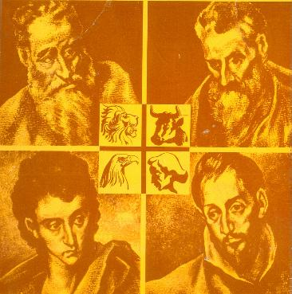
Njtd; ,NaRtpy; ntspg;gLj;jg;gl;lhu; (,k;khDNty;)
“Njtid xUtDk; xUf;fhYk; fz;ljpy;iy> gpjhtpd; kbapypUf;fpw xNuNgwhd FkhuNd mtiu ntspg;gLj;jpdhh;.” (Nahthd; 1:18)
Njtd; vj;jifatu; vd;gij ehk; mwpa tpUk;gpdhy;> ,NaRit mwpe;Jnfhs;Nthk;. mtNu kdpj mtjhuk; vLj;j Njtd; Mthu; (Nahthd; 1:14), ehk; mtiu fhzTk; mtu; NgRtij Nfl;fTk; ,aYk; nghUl;L> mtu; kdpj ,ay;ig Vw;Wf;nfhz;L jk;ik ntspg;gLj;jpdhu; (Nahthd; 1:18; 14:9; 1 Nahthd; 5:20).
mtUila tho;tpd; Nehf;fj;ij Rl;bf;fhl;Lk; xU jPu;f;fjuprd ngaupd; fPo; mtu; mwptpf;fg;gl;lhu;: ,k;khDNty;, Njtd; ek;NkhL ,Uf;fpwhu; (Vrhah 7:14; kj;NjA 1:23). ehd;F ew;nra;jpahsu;fs; mtiu ekf;F Kd; ntt;NtW Nfhzq;fspy; Kd; itf;fpd;wdu;.
kj;NjA
xU A+juplkpUe;J A+ju;fSf;F
khw;F
xU A+juplkpUe;J Gw[hjpahUf;F
Y}f;fh
xU Gw[hjpapduplkpUe;J Gw[hjpapdUf;F
Nahthd;
xU A+juplkpUe;J A+ju;fSf;Fk; Gw[hjpapdUf;Fk;
mtu; jhk; thf;fspj;jij epiwNtw;Wk; Nkrpah Mthu;
gpwUf;F Nrit nra;tjpy; vg;NghJk; ftdj;Jld; ,Ug;gtu;
kdpjNeakpf;f kw;Wk; ,uf;fKs;s
ruPu kw;Wk; Mtpf;Fupa tho;it mspg;gtu;

Slide 12

“Mapuf;fzf;fhNdhu; NjtidAk; mtUila gz;GfisAk; Fwpj;J jtwhd fUj;ij nfhz;Ls;sdu;… Njtd; rj;jpaj;jpd; Njtd;. ePjpAk; ,uf;fKk; mtUila rpq;fhrdj;jpd; gz;GfshFk;. mtu; md;Gf;Fk;> ,uf;fj;jpw;Fk;> fdpthd gupTf;Fk; cupa Njtd;. ,t;thWjhd;> mtUila Fkhudhd ek; kPl;gupd; %yk; mtu; ntspgLj;jg;gLfpwhu;. mtu; nghWikf;Fk;> ePba-nghWikf;Fk; cupa Njtd;. ehk; tzq;Fk; me;j nja;tk; mj;jifajha; ,Ue;J> mjd; Fzhjpraq;fSld; ehk; xd;wpiza Kay;fpNwhkhdhy;, cz;ikahd nja;tj;ijj;jhd; ehk; tzq;FfpNwhk;.”
vyd; [p citl; (fhl; Nfu;]; /ghu; m];, Mf];l; 8)

